Slide 1
TTIC 31190: Natural Language Processing
Kevin Gimpel
Spring 2018
Lecture 6:
Learning for Classification;
Language Modeling

Slide 2
assignment 1 due today
questions?
if you want to use late day(s), state that on your report

Slide 3
assignment 2 will be posted tomorrow
start thinking about your project, who you might want to work with, etc.

Slide 4
short quiz at start of class Wed., April 18th
covering material up to and including Mon., April 9th
don’t stress about it
grading will be check-minus/check/check-plus

Slide 5
Roadmap
words, morphology, lexical semantics
text classification
simple neural methods for NLP
language modeling and word embeddings
recurrent/recursive/convolutional networks in NLP
sequence labeling, HMMs, dynamic programming
syntax and syntactic parsing
semantics, compositionality, semantic parsing
machine translation and other NLP tasks

Slide 6
Text Classification
datasets
classification
modeling
inference
learning

Slide 7
Classifiers
one simple type:
for any input x, assign a score to each label y
classify by choosing highest-scoring label:

Slide 8
Linear Models
parameters are arranged in a vector
score function is linear in :
: vector of feature functions
Notes:
\renewcommand{\vec}[1]{\boldsymbol{\mathbf{#1}}}
\mathrm{score}(\vect{x},y,\vec{w}) = \vec{w}^\top \vec{f}(\vect{x},y) = \sum_i \theta_i f_i(\vect{x},y)
\nonumber

Slide 9
Modeling, Inference, Learning
inference: solve _
modeling: define score function
learning: choose _
Learning: How do we choose the weights w?

Slide 10
Regularized Empirical Risk Minimization
surrogate loss
regularization strength
regularization term

Slide 11
Regularized Empirical Risk Minimization
encourages model to fit the training data well
encourages model to be “simpler” in the hope that this will help it to generalize to new data

Slide 12
Visualization
for a single input x
score
five possible outputs

Slide 13

Visualization
for a single input x
cost
gold standard

Slide 14
perceptron loss:
score
gold standard

Slide 15
perceptron loss:
score
effect of learning?
gold standard

Slide 16
perceptron loss:
score
effect of learning:
gold standard will have highest score
gold standard

Slide 17
Visualization for a single x: each point is a possible y
-cost
score
Notes:
Each circle is one translation, all are for a single input sentence in our training data.
Horizontal bands correspond to different derivations of the same translation; same BLEU score, different model scores.
Our MT system outputs the translation that is farthest to the right. By changing the weights of our model, we move translations left or right. We can’t move them up or down.
The goal of training is to change the parameters so that, on average, our system’s predictions for all input sentences are translations with high BLEU scores.

Slide 18
Visualization for a single x: each point is a possible y
-cost
prediction
(output of classify)
score
Notes:
Each circle is one translation, all are for a single input sentence in our training data.
Horizontal bands correspond to different derivations of the same translation; same BLEU score, different model scores.
Our MT system outputs the translation that is farthest to the right. By changing the weights of our model, we move translations left or right. We can’t move them up or down.
The goal of training is to change the parameters so that, on average, our system’s predictions for all input sentences are translations with high BLEU scores.

Slide 19
Visualization for a single x: each point is a possible y
gold standard
-cost
prediction
(output of classify)
score
Notes:
This causes problems when applying standard learning algorithms to MT.

Slide 20
learning moves points in this plot
-cost
score
Notes:
Each circle is one translation, all are for a single input sentence in our training data.
Horizontal bands correspond to different derivations of the same translation; same BLEU score, different model scores.
Our MT system outputs the translation that is farthest to the right. By changing the weights of our model, we move translations left or right. We can’t move them up or down.
The goal of training is to change the parameters so that, on average, our system’s predictions for all input sentences are translations with high BLEU scores.

Slide 21
learning moves points left or right in this plot
-cost
score
Notes:
Each circle is one translation, all are for a single input sentence in our training data.
Horizontal bands correspond to different derivations of the same translation; same BLEU score, different model scores.
Our MT system outputs the translation that is farthest to the right. By changing the weights of our model, we move translations left or right. We can’t move them up or down.
The goal of training is to change the parameters so that, on average, our system’s predictions for all input sentences are translations with high BLEU scores.

Slide 22
-cost
“ideal” model?
score
Notes:
Each circle is one translation, all are for a single input sentence in our training data.
Horizontal bands correspond to different derivations of the same translation; same BLEU score, different model scores.
Our MT system outputs the translation that is farthest to the right. By changing the weights of our model, we move translations left or right. We can’t move them up or down.
The goal of training is to change the parameters so that, on average, our system’s predictions for all input sentences are translations with high BLEU scores.

Slide 23
-cost
“ideal” model?
score
Notes:
Each circle is one translation, all are for a single input sentence in our training data.
Horizontal bands correspond to different derivations of the same translation; same BLEU score, different model scores.
Our MT system outputs the translation that is farthest to the right. By changing the weights of our model, we move translations left or right. We can’t move them up or down.
The goal of training is to change the parameters so that, on average, our system’s predictions for all input sentences are translations with high BLEU scores.

Slide 24
Perceptron Loss?
-cost
score
Notes:
This causes problems when applying standard learning algorithms to MT.

Slide 25
Perceptron Loss
gold standard
-cost
prediction
(output of classify)
score
Notes:
This causes problems when applying standard learning algorithms to MT.

Slide 26
Losses for Linear Models

Slide 27
Losses for Linear Models

Slide 28
Loss Subgradients for Linear Models
some of our loss functions are not differentiable:
but they are subdifferentiable:

Slide 29
Loss Subgradients for Linear Models
some of our loss functions are not differentiable:
but they are subdifferentiable:

Slide 30
Loss Subgradients for Linear Models
some of our loss functions are not differentiable:
but they are subdifferentiable:

Slide 31
Loss Subgradients for Linear Models
some of our loss functions are not differentiable:
but they are subdifferentiable:
find subgradient of the function that achieves the max

Slide 32
Loss Subgradients for Linear Models
some of our loss functions are not differentiable:
but they are subdifferentiable:
find subgradient of the function that achieves the max

Slide 33
Loss Subgradients for Linear Models
some of our loss functions are not differentiable:
but they are subdifferentiable:
find subgradient of the function that achieves the max

Slide 34
Loss Subgradients for Linear Models
perceptron loss:
subderivative for a single parameter:

Slide 35
Loss Subgradients for Linear Models
perceptron loss and subgradient:
parameter update:

Slide 36
Loss Subgradients for Linear Models
perceptron loss and subgradient:
parameter update:
step size / learning rate for stochastic subgradient descent

Slide 37
Perceptron Loss with Regularization
update rule from before:
with L2 regularization:

Slide 38
Perceptron Loss with Regularization
update rule from before:
with L2 regularization:

Slide 39
Perceptron Loss with Regularization
update rule from before:
with L2 regularization:
pushes weights closer to zero (“weight decay”)

Slide 40
hinge loss:
score + cost
gold standard

Slide 41
hinge loss:
score + cost
gold standard

Slide 42
hinge loss:
effect of learning?
score + cost
gold standard

Slide 43
hinge loss:
effect of learning:
score of gold standard will be higher than score+cost of all others
score + cost
gold standard

Slide 44
Perceptron Loss
gold standard
-cost
prediction
(output of classify)
score
Notes:
This causes problems when applying standard learning algorithms to MT.

Slide 45
Hinge Loss?
-cost
score
Notes:
This causes problems when applying standard learning algorithms to MT.

Slide 46
Hinge Loss
gold standard
-cost
cost-augmented prediction
score
Notes:
This causes problems when applying standard learning algorithms to MT.

Slide 47
Perception → Hinge

Slide 48
Loss Subgradients for Linear Models
hinge loss:
subderivative for a single parameter:

Slide 49
Loss Subgradients for Linear Models
hinge loss:
subderivative for a single parameter:

Slide 50
Loss Subgradients for Linear Models
hinge loss:
subderivative for a single parameter:
“cost-augmented inference” or “cost-augmented decoding”

Slide 51
Feature count cut-off of zero?
perceptron loss update rule:
what do you expect to happen to weights of features with count 0 in the training data? (if they are initialized to 0)

Slide 52
Feature count cut-off of zero?
perceptron loss update rule:
what do you expect to happen to weights of features with count 0 in the training data? (if they are initialized to 0)
they will stay at zero or become negative

Slide 53
Roadmap
words, morphology, lexical semantics
text classification
simple neural methods for NLP
language modeling and word embeddings
recurrent/recursive/convolutional networks in NLP
sequence labeling, HMMs, dynamic programming
syntax and syntactic parsing
semantics, compositionality, semantic parsing
machine translation and other NLP tasks

Slide 54
Probabilistic Language Models
language modeling: assign probabilities to sentences
Why?
machine translation:
P(high winds tonite) > P(large winds tonite)
spelling correction:
The office is about fifteen minuets from my house
P(about fifteen minutes from) > P(about fifteen minuets from)
speech recognition:
P(I saw a van) >> P(eyes awe of an)
summarization, question answering, etc.!
J&M/SLP3

Slide 55
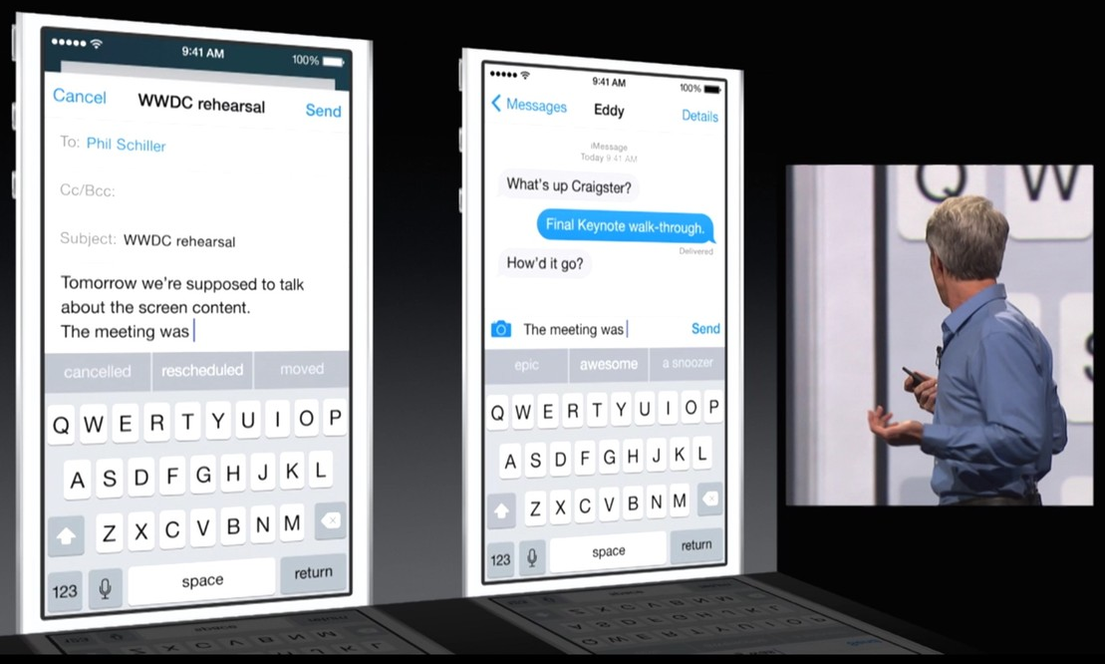
Automatic Completion

Slide 56
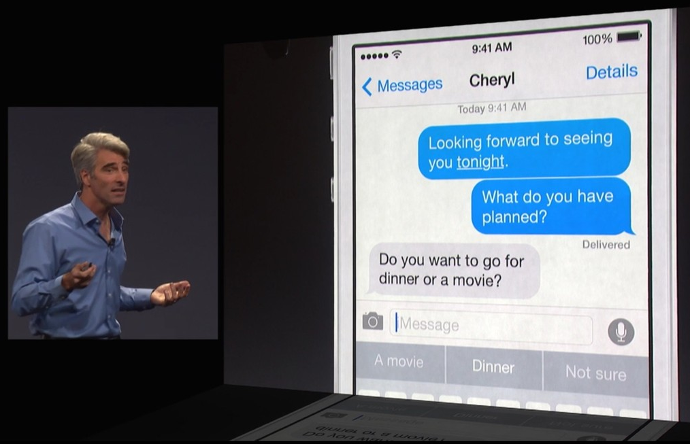
Automatic Completion

Slide 57


Slide 58
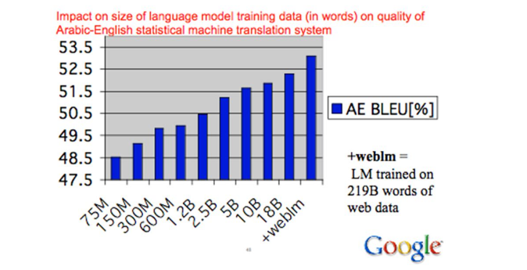
Language Modeling for Machine Translation

Slide 59
Probabilistic Language Modeling
goal: compute the probability of a sequence of words:
related task: probability of next word:
a model that computes either of these:
or
is called a language model (LM)
J&M/SLP3

Slide 60
How to compute a
How to compute this joint probability:
P(its, water, is, so, transparent, that)
Intuition: let’s rely on the Chain Rule of Probability
J&M/SLP3

Slide 61
Reminder: Chain Rule
factor joint probability into product of conditional probabilities:
we have not yet made any independence assumptions

Slide 62
Chain Rule for computing joint probability of words in sentence
P(“its water is so transparent”) =
P(its) × P(water | its) × P(is | its water)
× P(so | its water is) × P(transparent | its water is so)
J&M/SLP3

Slide 63
How to estimate these probabilities
could we just count and divide?
no! too many possible sentences!
we’ll never see enough data for estimating these
J&M/SLP3

Slide 64
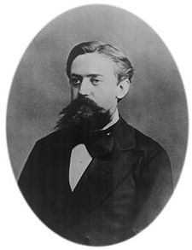
Markov Assumption
simplifying assumption:
or maybe:
Andrei Markov
J&M/SLP3

Slide 65
Markov Assumption
i.e., we approximate each component in the product:
J&M/SLP3

Slide 66
Simplest case: Unigram model
automatically generated sentences from a unigram model:
fifth an of futures the an incorporated a a the inflation most dollars quarter in is mass
thrift did eighty said hard ’m july bullish
that or limited the
J&M/SLP3

Slide 67
Bigram model
condition on the previous word:
automatically generated sentences from a bigram model:
texaco rose one in this issue is pursuing growth in a boiler house said mr. gurria mexico ’s motion control proposal without permission from five hundred fifty five yen
outside new car parking lot of the agreement reached
this would be a record november
J&M/SLP3

Slide 68
n-gram models
we can extend to trigrams, 4-grams, 5-grams
in general this is an insufficient model of language
because language has long-distance dependencies:
“The computer which I had just put into the machine room on the fifth floor crashed.”
but we can often get away with n-gram models
J&M/SLP3

