Slide 1
TTIC 31210: Advanced Natural Language Processing
Kevin Gimpel
Spring 2019
Lecture 10:
Inference & Learning in Structured Prediction

Slide 2
Roadmap
intro (1 lecture)
deep learning for NLP (5 lectures)
structured prediction (4 lectures)
introducing/formalizing structured prediction, categories of structures
inference: dynamic programming, greedy algorithms, beam search
inference with non-local features
learning in structured prediction
generative models, latent variables, unsupervised learning, variational autoencoders (2 lectures)
Bayesian methods in NLP (2 lectures)
Bayesian nonparametrics in NLP (2 lectures)
review & other topics (1 lecture)

Slide 3
Assignments
Assignment 2 due today. Questions?
Assignment 3 has been posted, due two weeks from tomorrow

Slide 4
Inference with Structured Predictors
inference: solve _
Notes:
\mathrm{classify}(\vect{x},\vect{\theta}) = \argmax_{\vect{y}}\; \mathrm{score}(\vect{x}, \vect{y}, \vect{\theta})

Slide 5
Greedy Inference
Lower the lights
<s>
J
D
N
</s>
V D N
Lower the lights
Notes:
\newcommand{\sos}{\mbox{\texttt{<s>}}}
\newcommand{\eos}{\mbox{\texttt{</s>}}}
\hat{y}_1 = \argmax_{y\in\mathcal{L}} \,\,\,p_{\boldsymbol{\eta}}(\mbox{``Lower''} \mid y)\,p_{\boldsymbol{\tau}}(y \mid \sos)
\hat{y}_2 = \argmax_{y\in\mathcal{L}} \,\,\,p_{\boldsymbol{\eta}}(\mbox{``the''} \mid y)\,p_{\boldsymbol{\tau}}(y \mid \mbox{\texttt{J}})
\hat{y}_3 = \argmax_{y\in\mathcal{L}} \,\,\,p_{\boldsymbol{\eta}}(\mbox{``lights''} \mid y)\,p_{\boldsymbol{\tau}}(y \mid \mbox{\texttt{D}})\,p_{\boldsymbol{\tau}}(\eos\mid y)

Slide 6
Beam Search (beam size b = 2)
Lower the lights
<s>
score of hypothesis
starting hypothesis
low score
high score
Notes:
\newcommand{\topb}{\mathop{\mbox{$\max$-$b$}}}
\newcommand{\sos}{\mbox{\texttt{<s>}}}
\newcommand{\eos}{\mbox{\texttt{</s>}}}
%\hat{y}_1 = \argmax_{y\in\mathcal{L}} \,\,\,p_{\boldsymbol{\eta}}(\mbox{``Lower''} \mid y)\,p_{\boldsymbol{\tau}}(y \mid \sos)
%\hat{y}_2 = \argmax_{y\in\mathcal{L}} \,\,\,p_{\boldsymbol{\eta}}(\mbox{``the''} \mid y)\,p_{\boldsymbol{\tau}}(y \mid \mbox{\texttt{J}})
%\hat{y}_3 = \argmax_{y\in\mathcal{L}} \,\,\,p_{\boldsymbol{\eta}}(\mbox{``lights''} \mid y)\,p_{\boldsymbol{\tau}}(y \mid \mbox{\texttt{D}})\,p_{\boldsymbol{\tau}}(\eos\mid y)
B(1) = \topb_{y\in\mathcal{L}} \,\,\,p_{\boldsymbol{\eta}}(\mbox{``Lower''} \mid y)\,p_{\boldsymbol{\tau}}(y \mid \sos)

Slide 7
Extend Hypotheses
Lower the lights
scores of extended hypotheses:
<s>
N
V
D
J
low score
high score
Notes:
\newcommand{\topb}{\mathop{\mbox{$\max$-$b$}}}
\newcommand{\sos}{\mbox{\texttt{<s>}}}
\newcommand{\eos}{\mbox{\texttt{</s>}}}
p_{\boldsymbol{\eta}}(\mbox{``Lower''} \mid y)\,p_{\boldsymbol{\tau}}(y \mid \sos)\,\mathrm{score}(\mathrm{hyp}_{\mathrm{prev}})
B(1) = \topb_{y\in\mathcal{L}} \,\,\,p_{\boldsymbol{\eta}}(\mbox{``Lower''} \mid y)\,p_{\boldsymbol{\tau}}(y \mid \sos)

Slide 8
Prune Hypotheses (b = 2)
Lower the lights
keep top b hypotheses
<s>
N
V
D
J
low score
high score
Notes:
\newcommand{\topb}{\mathop{\mbox{$\max$-$b$}}}
\newcommand{\sos}{\mbox{\texttt{<s>}}}
\newcommand{\eos}{\mbox{\texttt{</s>}}}
%\hat{y}_1 = \argmax_{y\in\mathcal{L}} \,\,\,p_{\boldsymbol{\eta}}(\mbox{``Lower''} \mid y)\,p_{\boldsymbol{\tau}}(y \mid \sos)
%\hat{y}_2 = \argmax_{y\in\mathcal{L}} \,\,\,p_{\boldsymbol{\eta}}(\mbox{``the''} \mid y)\,p_{\boldsymbol{\tau}}(y \mid \mbox{\texttt{J}})
%\hat{y}_3 = \argmax_{y\in\mathcal{L}} \,\,\,p_{\boldsymbol{\eta}}(\mbox{``lights''} \mid y)\,p_{\boldsymbol{\tau}}(y \mid \mbox{\texttt{D}})\,p_{\boldsymbol{\tau}}(\eos\mid y)
B(1) = \topb_{y\in\mathcal{L}} \,\,\,p_{\boldsymbol{\eta}}(\mbox{``Lower''} \mid y)\,p_{\boldsymbol{\tau}}(y \mid \sos)

Slide 9
Prune Hypotheses (b = 2)
Lower the lights
<s>
V
J
low score
high score
Notes:
\newcommand{\topb}{\mathop{\mbox{$\max$-$b$}}}
\newcommand{\sos}{\mbox{\texttt{<s>}}}
\newcommand{\eos}{\mbox{\texttt{</s>}}}
%\hat{y}_1 = \argmax_{y\in\mathcal{L}} \,\,\,p_{\boldsymbol{\eta}}(\mbox{``Lower''} \mid y)\,p_{\boldsymbol{\tau}}(y \mid \sos)
%\hat{y}_2 = \argmax_{y\in\mathcal{L}} \,\,\,p_{\boldsymbol{\eta}}(\mbox{``the''} \mid y)\,p_{\boldsymbol{\tau}}(y \mid \mbox{\texttt{J}})
%\hat{y}_3 = \argmax_{y\in\mathcal{L}} \,\,\,p_{\boldsymbol{\eta}}(\mbox{``lights''} \mid y)\,p_{\boldsymbol{\tau}}(y \mid \mbox{\texttt{D}})\,p_{\boldsymbol{\tau}}(\eos\mid y)
B(1) = \topb_{y\in\mathcal{L}} \,\,\,p_{\boldsymbol{\eta}}(\mbox{``Lower''} \mid y)\,p_{\boldsymbol{\tau}}(y \mid \sos)

Slide 10
Extend Hypotheses
Lower the lights
scores of extended hypotheses:
<s>
V
N
J
V
b hypotheses to extend
D
J
consider all possible ways of extending them
…
N
V
Notes:
\newcommand{\topb}{\mathop{\mbox{$\max$-$b$}}}
\newcommand{\sos}{\mbox{\texttt{<s>}}}
\newcommand{\eos}{\mbox{\texttt{</s>}}}
&p_{\boldsymbol{\eta}}(\mbox{``the''} \mid y)\\
&\times p_{\boldsymbol{\tau}}(y \mid y_{\mathrm{prev}})\\
&\times \mathrm{score}(\mathrm{hyp}_{\mathrm{prev}})
p_{\boldsymbol{\eta}}(\mbox{``the''} \mid y)\,p_{\boldsymbol{\tau}}(y \mid y_{\mathrm{prev}})\,\mathrm{score}(\mathrm{hyp}_{\mathrm{prev}})
%\hat{y}_1 = \argmax_{y\in\mathcal{L}} \,\,\,p_{\boldsymbol{\eta}}(\mbox{``Lower''} \mid y)\,p_{\boldsymbol{\tau}}(y \mid \sos)
%\hat{y}_2 = \argmax_{y\in\mathcal{L}} \,\,\,p_{\boldsymbol{\eta}}(\mbox{``the''} \mid y)\,p_{\boldsymbol{\tau}}(y \mid \mbox{\texttt{J}})
%\hat{y}_3 = \argmax_{y\in\mathcal{L}} \,\,\,p_{\boldsymbol{\eta}}(\mbox{``lights''} \mid y)\,p_{\boldsymbol{\tau}}(y \mid \mbox{\texttt{D}})\,p_{\boldsymbol{\tau}}(\eos\mid y)
B(1) = \topb_{y\in\mathcal{L}} \,\,\,p_{\boldsymbol{\eta}}(\mbox{``Lower''} \mid y)\,p_{\boldsymbol{\tau}}(y \mid \sos)

Slide 11
Prune Hypotheses (b = 2)
Lower the lights
<s>
V
D
J
D
note: due to the small size of HMM parts, these two hypotheses will look identical going forward
we don’t need to keep both of them! (unless we’re trying to return an n-best list)
Notes:
\newcommand{\topb}{\mathop{\mbox{$\max$-$b$}}}
\newcommand{\sos}{\mbox{\texttt{<s>}}}
\newcommand{\eos}{\mbox{\texttt{</s>}}}
%\hat{y}_1 = \argmax_{y\in\mathcal{L}} \,\,\,p_{\boldsymbol{\eta}}(\mbox{``Lower''} \mid y)\,p_{\boldsymbol{\tau}}(y \mid \sos)
%\hat{y}_2 = \argmax_{y\in\mathcal{L}} \,\,\,p_{\boldsymbol{\eta}}(\mbox{``the''} \mid y)\,p_{\boldsymbol{\tau}}(y \mid \mbox{\texttt{J}})
%\hat{y}_3 = \argmax_{y\in\mathcal{L}} \,\,\,p_{\boldsymbol{\eta}}(\mbox{``lights''} \mid y)\,p_{\boldsymbol{\tau}}(y \mid \mbox{\texttt{D}})\,p_{\boldsymbol{\tau}}(\eos\mid y)
B(1) = \topb_{y\in\mathcal{L}} \,\,\,p_{\boldsymbol{\eta}}(\mbox{``Lower''} \mid y)\,p_{\boldsymbol{\tau}}(y \mid \sos)

Slide 12
Prune Hypotheses (b = 2)
Lower the lights
<s>
V
D
J
D
note: due to the small size of HMM parts, these two hypotheses will look identical going forward
we don’t need to keep both of them! (unless we’re trying to return an n-best list)
we can use recombination
Notes:
\newcommand{\topb}{\mathop{\mbox{$\max$-$b$}}}
\newcommand{\sos}{\mbox{\texttt{<s>}}}
\newcommand{\eos}{\mbox{\texttt{</s>}}}
%\hat{y}_1 = \argmax_{y\in\mathcal{L}} \,\,\,p_{\boldsymbol{\eta}}(\mbox{``Lower''} \mid y)\,p_{\boldsymbol{\tau}}(y \mid \sos)
%\hat{y}_2 = \argmax_{y\in\mathcal{L}} \,\,\,p_{\boldsymbol{\eta}}(\mbox{``the''} \mid y)\,p_{\boldsymbol{\tau}}(y \mid \mbox{\texttt{J}})
%\hat{y}_3 = \argmax_{y\in\mathcal{L}} \,\,\,p_{\boldsymbol{\eta}}(\mbox{``lights''} \mid y)\,p_{\boldsymbol{\tau}}(y \mid \mbox{\texttt{D}})\,p_{\boldsymbol{\tau}}(\eos\mid y)
B(1) = \topb_{y\in\mathcal{L}} \,\,\,p_{\boldsymbol{\eta}}(\mbox{``Lower''} \mid y)\,p_{\boldsymbol{\tau}}(y \mid \sos)

Slide 13
Recombination
Lower the lights
<s>
V
D
J
D
recombination: combine hypotheses with identical final labels, keep backpointer for higher-scoring hypothesis
Notes:
\newcommand{\topb}{\mathop{\mbox{$\max$-$b$}}}
\newcommand{\sos}{\mbox{\texttt{<s>}}}
\newcommand{\eos}{\mbox{\texttt{</s>}}}
%\hat{y}_1 = \argmax_{y\in\mathcal{L}} \,\,\,p_{\boldsymbol{\eta}}(\mbox{``Lower''} \mid y)\,p_{\boldsymbol{\tau}}(y \mid \sos)
%\hat{y}_2 = \argmax_{y\in\mathcal{L}} \,\,\,p_{\boldsymbol{\eta}}(\mbox{``the''} \mid y)\,p_{\boldsymbol{\tau}}(y \mid \mbox{\texttt{J}})
%\hat{y}_3 = \argmax_{y\in\mathcal{L}} \,\,\,p_{\boldsymbol{\eta}}(\mbox{``lights''} \mid y)\,p_{\boldsymbol{\tau}}(y \mid \mbox{\texttt{D}})\,p_{\boldsymbol{\tau}}(\eos\mid y)
B(1) = \topb_{y\in\mathcal{L}} \,\,\,p_{\boldsymbol{\eta}}(\mbox{``Lower''} \mid y)\,p_{\boldsymbol{\tau}}(y \mid \sos)

Slide 14
Recombination
Lower the lights
<s>
V
D
J
J
recombination can make better use of hypothesis set
above, we now have space to add another hypothesis and increase label diversity at this position
Notes:
\newcommand{\topb}{\mathop{\mbox{$\max$-$b$}}}
\newcommand{\sos}{\mbox{\texttt{<s>}}}
\newcommand{\eos}{\mbox{\texttt{</s>}}}
%\hat{y}_1 = \argmax_{y\in\mathcal{L}} \,\,\,p_{\boldsymbol{\eta}}(\mbox{``Lower''} \mid y)\,p_{\boldsymbol{\tau}}(y \mid \sos)
%\hat{y}_2 = \argmax_{y\in\mathcal{L}} \,\,\,p_{\boldsymbol{\eta}}(\mbox{``the''} \mid y)\,p_{\boldsymbol{\tau}}(y \mid \mbox{\texttt{J}})
%\hat{y}_3 = \argmax_{y\in\mathcal{L}} \,\,\,p_{\boldsymbol{\eta}}(\mbox{``lights''} \mid y)\,p_{\boldsymbol{\tau}}(y \mid \mbox{\texttt{D}})\,p_{\boldsymbol{\tau}}(\eos\mid y)
B(1) = \topb_{y\in\mathcal{L}} \,\,\,p_{\boldsymbol{\eta}}(\mbox{``Lower''} \mid y)\,p_{\boldsymbol{\tau}}(y \mid \sos)

Slide 15
Recombination with Ranked Backpointers
Lower the lights
<s>
V
1
D
1
J
2
J
we could keep both backpointers, distinguishing them according to score rank
this adds overhead, but could help us later in beam search
commonly done if we want (approximate) n-best lists
Notes:
\newcommand{\topb}{\mathop{\mbox{$\max$-$b$}}}
\newcommand{\sos}{\mbox{\texttt{<s>}}}
\newcommand{\eos}{\mbox{\texttt{</s>}}}
%\hat{y}_1 = \argmax_{y\in\mathcal{L}} \,\,\,p_{\boldsymbol{\eta}}(\mbox{``Lower''} \mid y)\,p_{\boldsymbol{\tau}}(y \mid \sos)
%\hat{y}_2 = \argmax_{y\in\mathcal{L}} \,\,\,p_{\boldsymbol{\eta}}(\mbox{``the''} \mid y)\,p_{\boldsymbol{\tau}}(y \mid \mbox{\texttt{J}})
%\hat{y}_3 = \argmax_{y\in\mathcal{L}} \,\,\,p_{\boldsymbol{\eta}}(\mbox{``lights''} \mid y)\,p_{\boldsymbol{\tau}}(y \mid \mbox{\texttt{D}})\,p_{\boldsymbol{\tau}}(\eos\mid y)
B(1) = \topb_{y\in\mathcal{L}} \,\,\,p_{\boldsymbol{\eta}}(\mbox{``Lower''} \mid y)\,p_{\boldsymbol{\tau}}(y \mid \sos)

Slide 16
Recombination in Beam Search
recombination has been successfully used in beam search for phrase-based machine translation
incurs additional overhead, but improves hypothesis diversity
exact (lossless) recombination only feasible with small parts
as with other beam search components (extend hypotheses / prune hypothesis set), recombination must be defined by modeler for particular problem / score function in use

Slide 17
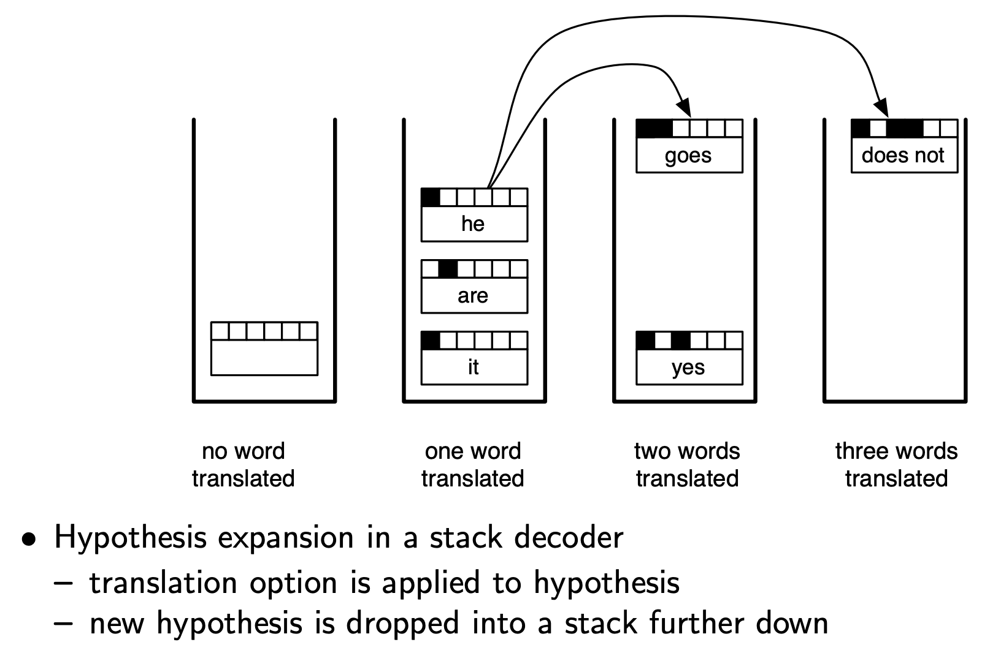
Beam Search for Phrase-Based Machine Translation
hypothesis sets are separated based on how many source words have been translated
Koehn: Statistical Machine Translation

Slide 18
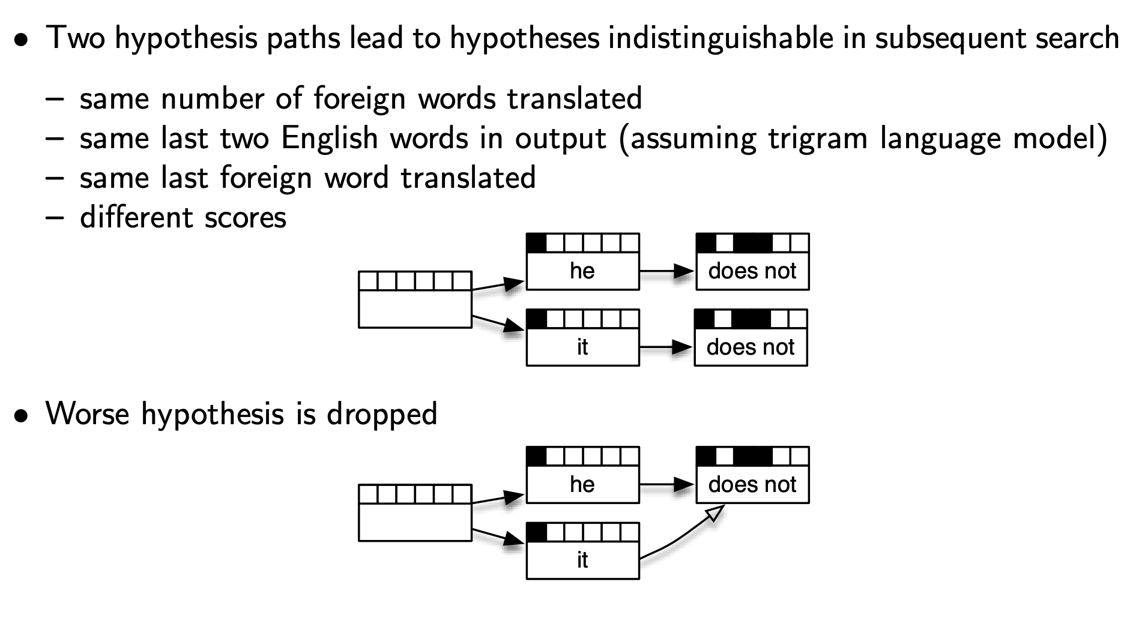
Recombination for Phrase-Based Machine Translation
Koehn: Statistical Machine Translation

Slide 19
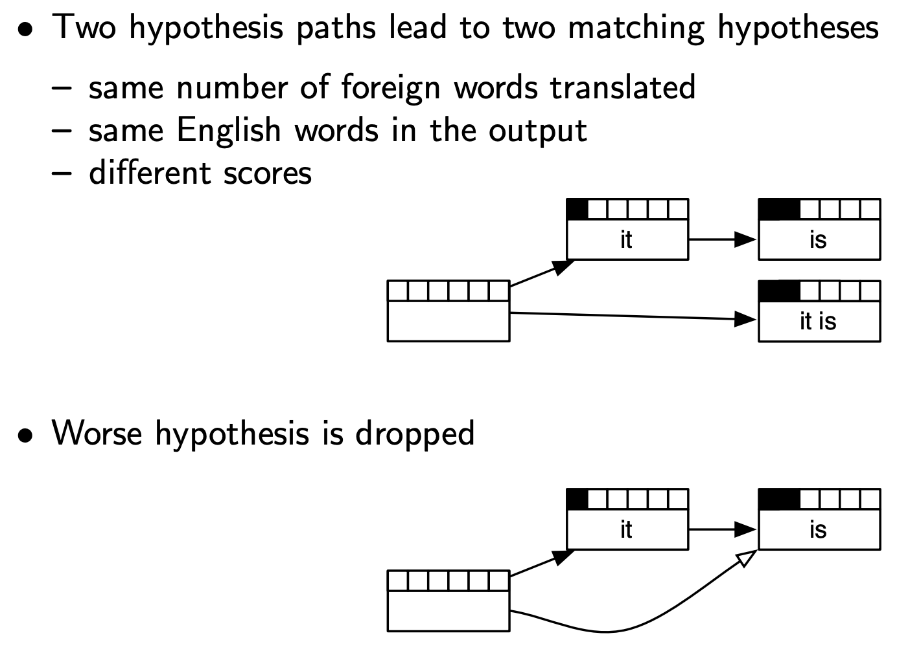
Recombination for Phrase-Based Machine Translation
this situation (“spurious ambiguity”) sometimes arises in structured prediction tasks
Koehn: Statistical Machine Translation

Slide 20
Gradient Descent for Inference
note: we’re talking about using gradient descent for inference, not learning
in solving this argmax, we are doing optimization (over a discrete, structured space)
we can relax the output space from a discrete space to a continuous one, then apply any optimization method we want (e.g., gradient descent)
we just need ways to relax the discrete space and then ways to convert the “continuous structured output” to a discrete one after optimization

Slide 21
Relaxing Discrete Output Space for POS Tagging
<s>
V
D
N
</s>
Lower the lights
N
V
D
J
<s>
</s>
first, represent discrete, structured output using one-hot vectors
Notes:
\newcommand{\sos}{\mbox{\texttt{<s>}}}
\newcommand{\eos}{\mbox{\texttt{</s>}}}
\hat{y}_1 = \argmax_{y\in\mathcal{L}} \,\,\,p_{\boldsymbol{\eta}}(\mbox{``Lower''} \mid y)\,p_{\boldsymbol{\tau}}(y \mid \sos)
\hat{y}_2 = \argmax_{y\in\mathcal{L}} \,\,\,p_{\boldsymbol{\eta}}(\mbox{``the''} \mid y)\,p_{\boldsymbol{\tau}}(y \mid \mbox{\texttt{J}})
\hat{y}_3 = \argmax_{y\in\mathcal{L}} \,\,\,p_{\boldsymbol{\eta}}(\mbox{``lights''} \mid y)\,p_{\boldsymbol{\tau}}(y \mid \mbox{\texttt{D}})\,p_{\boldsymbol{\tau}}(\eos\mid y)

Slide 22
Relaxing Discrete Output Space for POS Tagging
<s>
V
D
N
</s>
Lower the lights
N
V
D
J
<s>
</s>
then, relax to vectors where sum of entries is 1 (treat them as distributions over tags)
Notes:
\newcommand{\sos}{\mbox{\texttt{<s>}}}
\newcommand{\eos}{\mbox{\texttt{</s>}}}
\hat{y}_1 = \argmax_{y\in\mathcal{L}} \,\,\,p_{\boldsymbol{\eta}}(\mbox{``Lower''} \mid y)\,p_{\boldsymbol{\tau}}(y \mid \sos)
\hat{y}_2 = \argmax_{y\in\mathcal{L}} \,\,\,p_{\boldsymbol{\eta}}(\mbox{``the''} \mid y)\,p_{\boldsymbol{\tau}}(y \mid \mbox{\texttt{J}})
\hat{y}_3 = \argmax_{y\in\mathcal{L}} \,\,\,p_{\boldsymbol{\eta}}(\mbox{``lights''} \mid y)\,p_{\boldsymbol{\tau}}(y \mid \mbox{\texttt{D}})\,p_{\boldsymbol{\tau}}(\eos\mid y)

Slide 23
Relaxing Discrete Output Space for POS Tagging
<s>
V
D
N
</s>
Lower the lights
N
V
D
J
<s>
</s>
use gradient descent to optimize the pretrained score function with respect to these vector entries
Notes:
\newcommand{\sos}{\mbox{\texttt{<s>}}}
\newcommand{\eos}{\mbox{\texttt{</s>}}}
\hat{y}_1 = \argmax_{y\in\mathcal{L}} \,\,\,p_{\boldsymbol{\eta}}(\mbox{``Lower''} \mid y)\,p_{\boldsymbol{\tau}}(y \mid \sos)
\hat{y}_2 = \argmax_{y\in\mathcal{L}} \,\,\,p_{\boldsymbol{\eta}}(\mbox{``the''} \mid y)\,p_{\boldsymbol{\tau}}(y \mid \mbox{\texttt{J}})
\hat{y}_3 = \argmax_{y\in\mathcal{L}} \,\,\,p_{\boldsymbol{\eta}}(\mbox{``lights''} \mid y)\,p_{\boldsymbol{\tau}}(y \mid \mbox{\texttt{D}})\,p_{\boldsymbol{\tau}}(\eos\mid y)

Slide 24
Relaxing Discrete Output Space for POS Tagging
<s>
V
D
N
</s>
Lower the lights
N
V
D
J
<s>
</s>
at convergence, find largest value in each vector and return it as the predicted POS tag at that position
Notes:
\newcommand{\sos}{\mbox{\texttt{<s>}}}
\newcommand{\eos}{\mbox{\texttt{</s>}}}
\hat{y}_1 = \argmax_{y\in\mathcal{L}} \,\,\,p_{\boldsymbol{\eta}}(\mbox{``Lower''} \mid y)\,p_{\boldsymbol{\tau}}(y \mid \sos)
\hat{y}_2 = \argmax_{y\in\mathcal{L}} \,\,\,p_{\boldsymbol{\eta}}(\mbox{``the''} \mid y)\,p_{\boldsymbol{\tau}}(y \mid \mbox{\texttt{J}})
\hat{y}_3 = \argmax_{y\in\mathcal{L}} \,\,\,p_{\boldsymbol{\eta}}(\mbox{``lights''} \mid y)\,p_{\boldsymbol{\tau}}(y \mid \mbox{\texttt{D}})\,p_{\boldsymbol{\tau}}(\eos\mid y)

Slide 25
Gradient Descent for Inference
simple and general
easy to implement thanks to toolkits with automatic differentiation
it does require a way to relax the output space to be continuous
how well does it work?

Slide 26
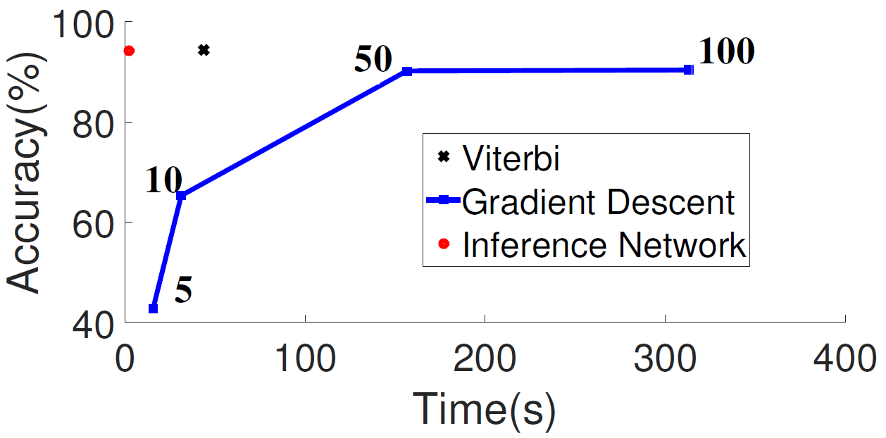
Empirical Comparison
# of gradient descent iterations
sequence labeling task with 400 labels (CCG supertagging)
model is a BLSTM-CRF
gradient descent is much worse than Viterbi!
Tu & Gimpel (2019): Benchmarking Approximate Inference Methods for Neural Structured Prediction

Slide 27
Inference Networks for Structured Prediction
working in the relaxed continuous output space, we can design a neural network architecture to map from inputs to (relaxed) outputs
train the network to output a structure with high score (similar to teacher-student networks / knowledge distillation)
Tu & Gimpel (2018): Learning Approximate Inference Networks for Structured Prediction

Slide 28
Inference Networks for POS Tagging
<s>
V
D
N
</s>
Lower the lights
N
V
D
J
<s>
</s>
use an LSTM (for example) to go from the sentence to the POS tag distribution at each position
Notes:
\newcommand{\sos}{\mbox{\texttt{<s>}}}
\newcommand{\eos}{\mbox{\texttt{</s>}}}
\hat{y}_1 = \argmax_{y\in\mathcal{L}} \,\,\,p_{\boldsymbol{\eta}}(\mbox{``Lower''} \mid y)\,p_{\boldsymbol{\tau}}(y \mid \sos)
\hat{y}_2 = \argmax_{y\in\mathcal{L}} \,\,\,p_{\boldsymbol{\eta}}(\mbox{``the''} \mid y)\,p_{\boldsymbol{\tau}}(y \mid \mbox{\texttt{J}})
\hat{y}_3 = \argmax_{y\in\mathcal{L}} \,\,\,p_{\boldsymbol{\eta}}(\mbox{``lights''} \mid y)\,p_{\boldsymbol{\tau}}(y \mid \mbox{\texttt{D}})\,p_{\boldsymbol{\tau}}(\eos\mid y)

Slide 29
N
V
D
J
<s>
</s>
<s> Lower the lights </s>
Notes:
\newcommand{\sos}{\mbox{\texttt{<s>}}}
\newcommand{\eos}{\mbox{\texttt{</s>}}}
\hat{y}_1 = \argmax_{y\in\mathcal{L}} \,\,\,p_{\boldsymbol{\eta}}(\mbox{``Lower''} \mid y)\,p_{\boldsymbol{\tau}}(y \mid \sos)
\hat{y}_2 = \argmax_{y\in\mathcal{L}} \,\,\,p_{\boldsymbol{\eta}}(\mbox{``the''} \mid y)\,p_{\boldsymbol{\tau}}(y \mid \mbox{\texttt{J}})
\hat{y}_3 = \argmax_{y\in\mathcal{L}} \,\,\,p_{\boldsymbol{\eta}}(\mbox{``lights''} \mid y)\,p_{\boldsymbol{\tau}}(y \mid \mbox{\texttt{D}})\,p_{\boldsymbol{\tau}}(\eos\mid y)

Slide 30
N
V
D
J
<s>
</s>
train these LSTM parameters to produce continuous structured outputs with high score under pretrained structured score function
<s> Lower the lights </s>
Notes:
\newcommand{\sos}{\mbox{\texttt{<s>}}}
\newcommand{\eos}{\mbox{\texttt{</s>}}}
\hat{y}_1 = \argmax_{y\in\mathcal{L}} \,\,\,p_{\boldsymbol{\eta}}(\mbox{``Lower''} \mid y)\,p_{\boldsymbol{\tau}}(y \mid \sos)
\hat{y}_2 = \argmax_{y\in\mathcal{L}} \,\,\,p_{\boldsymbol{\eta}}(\mbox{``the''} \mid y)\,p_{\boldsymbol{\tau}}(y \mid \mbox{\texttt{J}})
\hat{y}_3 = \argmax_{y\in\mathcal{L}} \,\,\,p_{\boldsymbol{\eta}}(\mbox{``lights''} \mid y)\,p_{\boldsymbol{\tau}}(y \mid \mbox{\texttt{D}})\,p_{\boldsymbol{\tau}}(\eos\mid y)

Slide 31
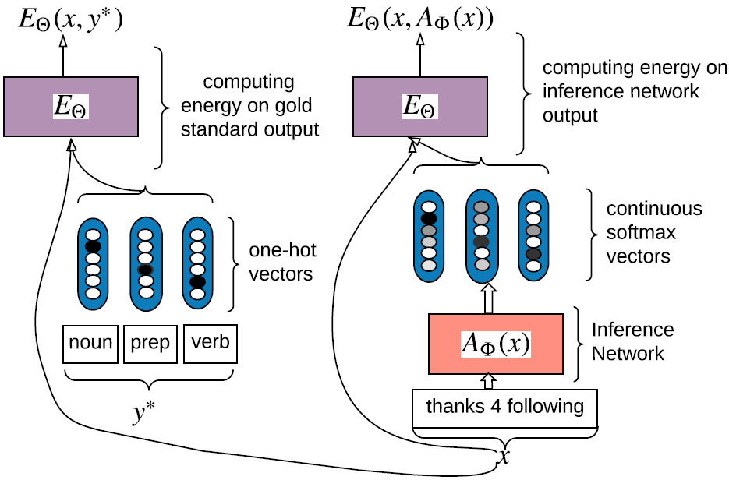
Inference Networks
Tu & Gimpel (2018): Learning Approximate Inference Networks for Structured Prediction

Slide 32
Empirical Comparison
# of gradient descent iterations
sequence labeling task with 400 labels (CCG supertagging)
model is a BLSTM-CRF
inference network shows a much better speed/accuracy trade-off
Tu & Gimpel (2019): Benchmarking Approximate Inference Methods for Neural Structured Prediction

Slide 33
Integer Linear Programming
we can often formulate inference as optimizing an integer linear program
we can then use off-the-shelf ILP solvers
sometimes we can relax the ILP to an LP (remove integer constraints), then solve the LP which can be done efficiently, then convert the relaxed structure to a discrete one

Slide 34
Inference: Summary
exact DP algorithms if parts are small
beam search
can improve with heuristics (“heuristic search”)
can handle non-local features / large parts
recombination can help, though not with large parts
coarse-to-fine
gradient descent for inference
inference networks
linear programming / ILP

Slide 35
Learning in Structured Prediction
learning: choose _
most loss functions used in structured prediction have the same form as those used in multi-class classification
part that changes: now structured inference is required for computing gradients
we can use any inference strategy we discussed in the context of learning
there are also new inference problems that arise for certain loss functions
Notes:
\mathrm{classify}(\vect{x},\vect{\theta}) = \argmax_{\vect{y}}\; \mathrm{score}(\vect{x}, \vect{y}, \vect{\theta})

Slide 36
Cost Functions
cost function: how different are these two structures?
typically used to compare predicted structure to gold standard
should reflect evaluation metric for task
usual conventions:
for classification, what cost should we use?

Slide 37
Cost Functions
typical cost for multi-class classification:
how about for sequences?
“Hamming cost”:
“0-1 cost”:

Slide 38
Empirical Risk Minimization
this is intractable so we typically minimize a surrogate loss function instead

Slide 39
Loss Functions for Structured Prediction
name | loss | where used
cost (“0-1”) |  | MERT (Och, 2003)

Slide 40
Loss Functions for Structured Prediction
name | loss | where used
cost (“0-1”) |  | MERT (Och, 2003)
percep-tron |  | structured perceptron (Collins, 2002)

Slide 41
Loss Functions for Structured Prediction
name | loss | where used
cost (“0-1”) |  | MERT (Och, 2003)
percep-tron |  | structured perceptron (Collins, 2002)
hinge |  | structured SVMs (Taskar et al., inter alia)

Slide 42
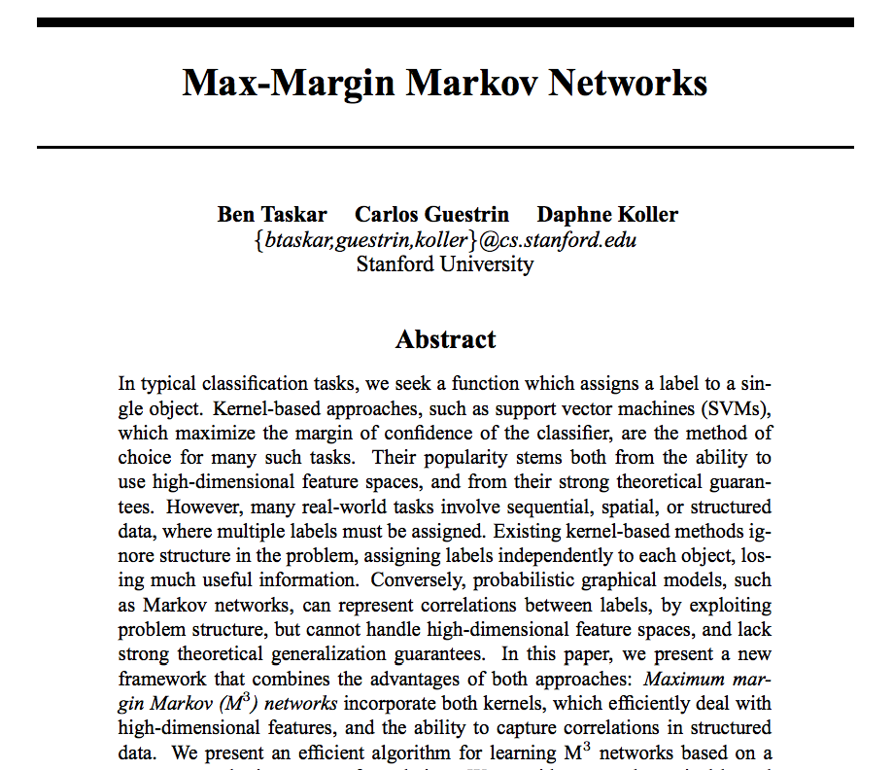
Max-Margin Markov Networks

Slide 43
Maximum-Margin Markov Networks
parts function contains parts on consecutive labels (“bigram parts”)
arbitrary features of input are permitted
test-time inference uses Viterbi Algorithm
learning done by minimizing hinge loss (inference algorithms used to compute subgradients)

Slide 44
A New Structured Inference Problem
test-time inference:
“cost-augmented” inference includes cost function:
only used during training
we can use all the same argmax inference algorithms as for the test-time inference problem as long as the cost function parts are not too big
Notes:
change max to argmax, costClassify?

Slide 45
Loss Functions for Structured Prediction
name | loss | where used
cost (“0-1”) |  | MERT (Och, 2003)
percep-tron |  | structured perceptron (Collins, 2002)
hinge |  | structured SVMs (Taskar et al., inter alia)

Slide 46
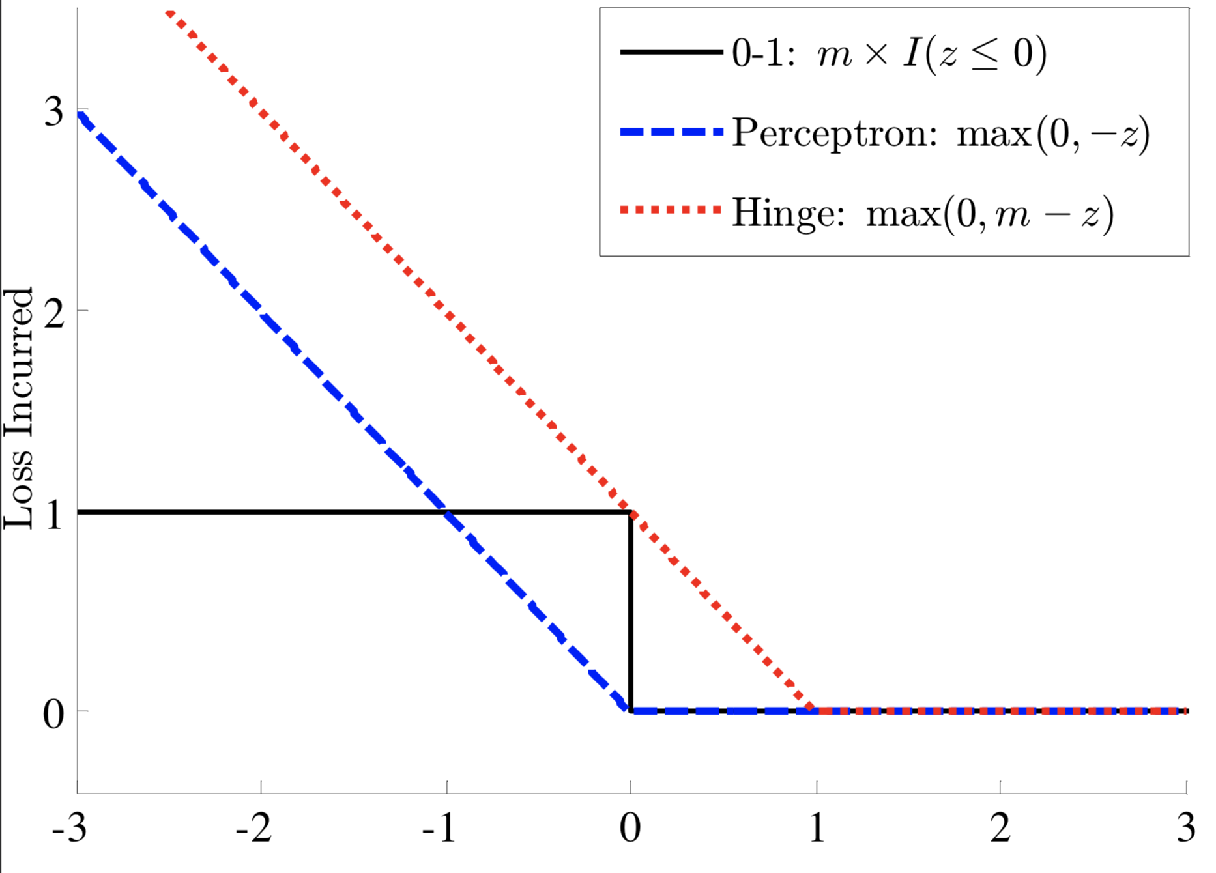
Visualizing Losses for Binary Classification
this is for binary classification, so y is either -1 or 1
m = cost multiplier
z = classifier score (the larger it is, the more confident the classifier is)

Slide 47
Loss Functions for Structured Prediction
name | loss | where used
cost (“0-1”) |  | MERT (Och, 2003)
percep-tron |  | structured perceptron (Collins, 2002)
hinge |  | structured SVMs (Taskar et al., inter alia)
log |  | CRFs (Lafferty et al., 2001)

Slide 48
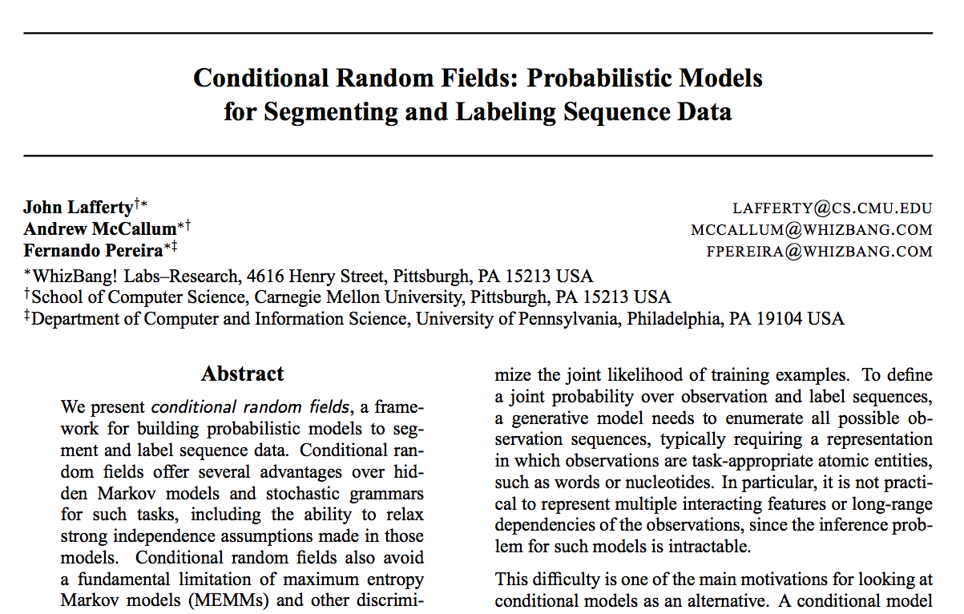
(Chain) Conditional Random Fields

Slide 49
(Chain) Conditional Random Fields
parts function contains parts on consecutive labels (“bigram parts”)
arbitrary features of input are permitted
test-time inference uses Viterbi Algorithm
learning done by minimizing log loss (DP algorithms used to compute gradients)

Slide 50
Loss Functions for Structured Prediction
name | loss | where used
cost (“0-1”) |  | MERT (Och, 2003)
percep-tron |  | structured perceptron (Collins, 2002)
hinge |  | structured SVMs (Taskar et al., inter alia)
log |  | CRFs (Lafferty et al., 2001)

Slide 51
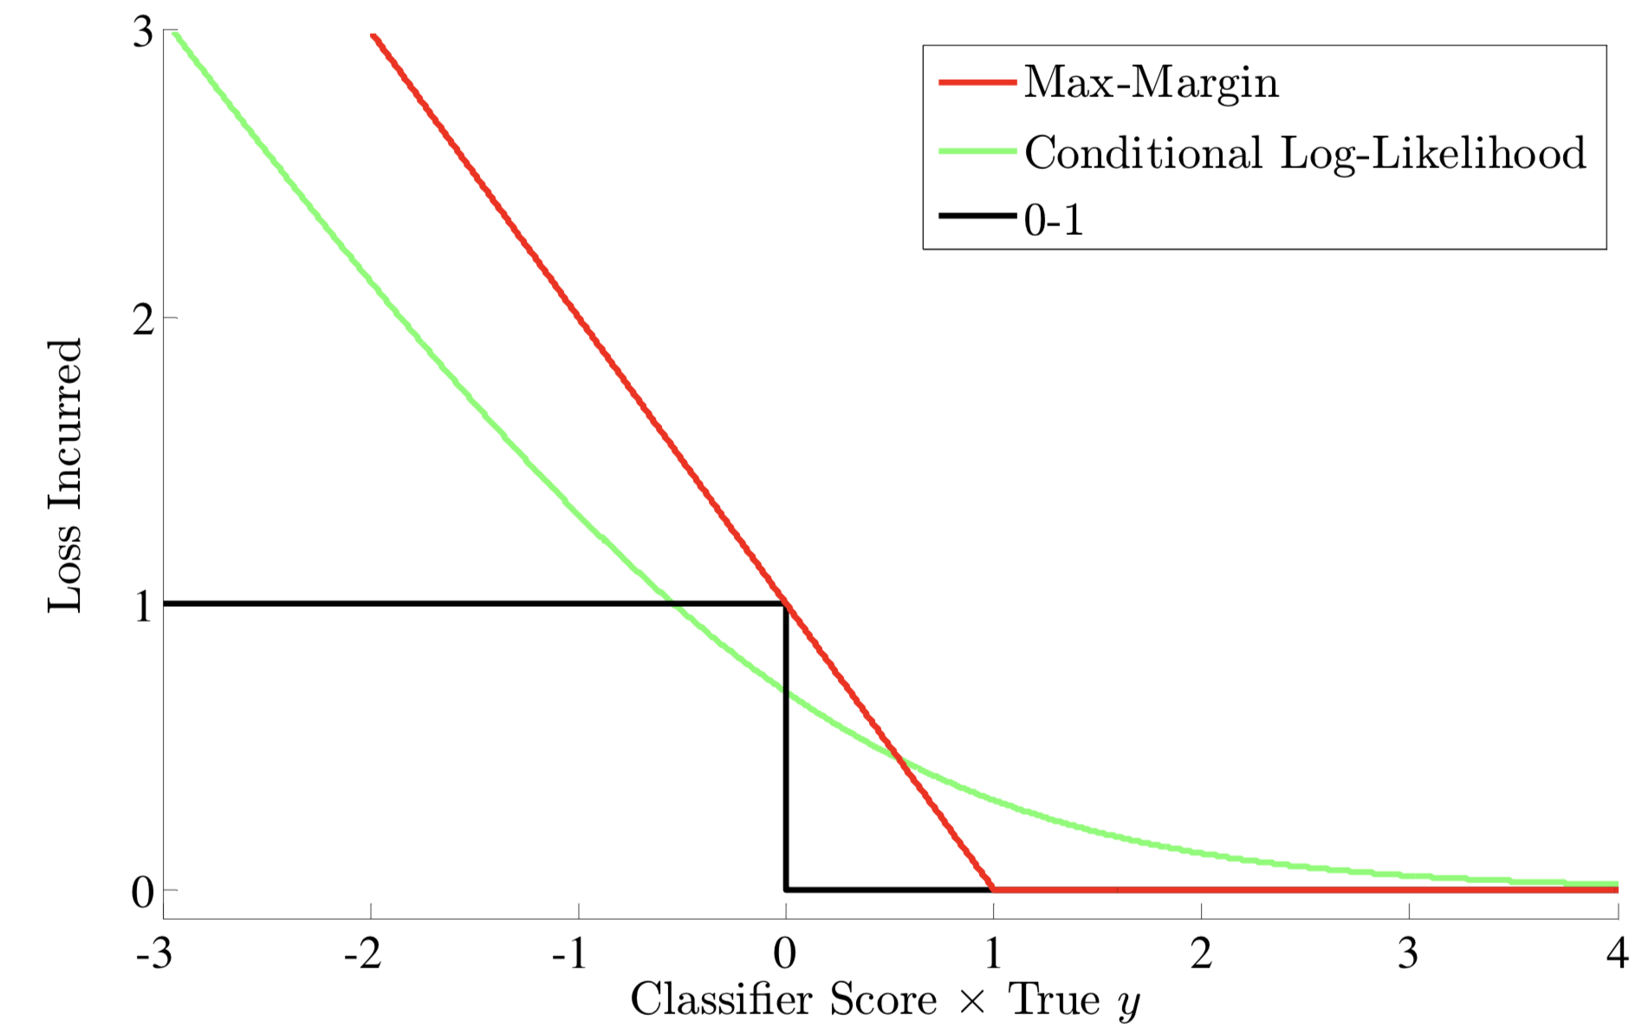


Visualizing Losses for Binary Classification
this is for binary classification, so y is either -1 or 1
m = cost multiplier
z = classifier score (the larger it is, the more confident the classifier is)

Slide 52
Loss Functions for Structured Prediction
name | loss | where used
cost (“0-1”) |  | MERT (Och, 2003)
percep-tron |  | structured perceptron (Collins, 2002)
hinge |  | structured SVMs (Taskar et al., inter alia)
log |  | CRFs (Lafferty et al., 2001)
softmax margin |  | Povey et al. (2008), Gimpel & Smith (2010)

Slide 53
Relationships Among Losses
perceptron loss
max to softmax
log loss
add cost function
add cost function
max-margin
max to softmax
softmax-margin

