Slide 1
TTIC 31210: Advanced Natural Language Processing
Kevin Gimpel
Spring 2019
Lecture 13:
Introduction to Bayesian NLP
Notes:
Copyright notice for the slide containing the LDA figure:
Permission to make digital or hard copies of part or all of this work for personal or classroom use is granted without fee provided that copies are not made or distributed for profit or commercial advantage and that copies bear this notice and full citation on the first page. Copyright for components of this work owned by others than ACM must be honored. Abstracting with credit is permitted. To copy otherwise, to republish, to post on servers, or to redistribute to lists, requires prior specific permission and/or fee. Request permission to publish from permissions@acm.org or fax (212) 869-0481.
The Digital Library is published by the Association for Computing Machinery. Copyright © 2012 ACM, Inc.

Slide 2
Roadmap
intro (1 lecture)
deep learning for NLP (5 lectures)
structured prediction (4.5 lectures)
generative models, latent variables, unsupervised learning, variational autoencoders (1.5 lectures)
Bayesian methods in NLP (2 lectures)
Bayesian nonparametrics in NLP (2 lectures)
review & other topics (1 lecture)

Slide 3
Assignments
any questions about Assignment 3?

Slide 4
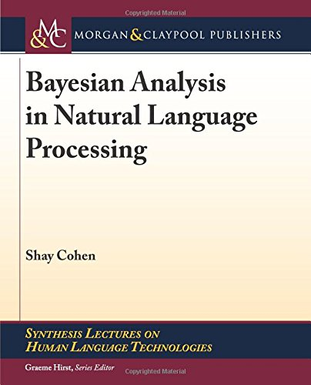
Additional Reading
for this segment of the course, the optional text is Cohen (2016, 2019)
there is a copy of the second edition (2019) in the TTIC library
readings will be drawn from this book for the next few lectures

Slide 5
Motivation
in most neural NLP, we assume parameters and architectures are fixed
consider a one-hidden-layer MLP:
Notes:
% anlp: deepbayes
&p(Y = y \mid \boldsymbol{x}) = \frac{\exp\{\mathbf{w}_y^\top \tanh\left(\mathbf{W} g(\boldsymbol{x})\right)\}}{Z}\\
&p(Y = y \mid \boldsymbol{x}, \Theta = \{\mathbf{w},\mathbf{W}\}) = \frac{\exp\{\mathbf{w}_y^\top \tanh\left(\mathbf{W} g(\boldsymbol{x})\right)\}}{Z}\\
&p(Y = y \mid \boldsymbol{x}) = \int_{\Theta} p(Y = y, \Theta = \{\mathbf{w},\mathbf{W}\} \mid \boldsymbol{x}) d\Theta \\
&p(Y = y \mid \boldsymbol{x}, \Lambda = \mathrm{MLP}(\mathbf{w},\mathbf{W})) = \frac{\exp\{\mathbf{w}_y^\top \tanh\left(\mathbf{W} g(\boldsymbol{x})\right)\}}{Z}\\
&p(Y = y \mid \boldsymbol{x}) = \int_{\Lambda} p(Y = y, \Lambda = \mathrm{MLP}(\mathbf{w},\mathbf{W}) \mid \boldsymbol{x}) d\Lambda \\

Slide 6
Motivation
in most neural NLP, we assume parameters and architectures are fixed
consider a one-hidden-layer MLP:
now let’s be more explicit about what we’re conditioning on:
Notes:
% anlp: deepbayes
&p(Y = y \mid \boldsymbol{x}) = \frac{\exp\{\mathbf{w}_y^\top \tanh\left(\mathbf{W} g(\boldsymbol{x})\right)\}}{Z}\\
&p(Y = y \mid \boldsymbol{x}, \Theta = \{\mathbf{w},\mathbf{W}\}) = \frac{\exp\{\mathbf{w}_y^\top \tanh\left(\mathbf{W} g(\boldsymbol{x})\right)\}}{Z}\\
&p(Y = y \mid \boldsymbol{x}) = \int_{\Theta} p(Y = y, \Theta = \{\mathbf{w},\mathbf{W}\} \mid \boldsymbol{x}) d\Theta \\
&p(Y = y \mid \boldsymbol{x}, \Lambda = \mathrm{MLP}(\mathbf{w},\mathbf{W})) = \frac{\exp\{\mathbf{w}_y^\top \tanh\left(\mathbf{W} g(\boldsymbol{x})\right)\}}{Z}\\
&p(Y = y \mid \boldsymbol{x}) = \int_{\Lambda} p(Y = y, \Lambda = \mathrm{MLP}(\mathbf{w},\mathbf{W}) \mid \boldsymbol{x}) d\Lambda \\

Slide 7
Motivation
in most neural NLP, we assume parameters and architectures are fixed
consider a one-hidden-layer MLP:
now let’s be more explicit about what we’re conditioning on:
note: the notation above suggests that we can think of parameters
as random variables; this is not uncontroversial.
Notes:
% anlp: deepbayes
&p(Y = y \mid \boldsymbol{x}) = \frac{\exp\{\mathbf{w}_y^\top \tanh\left(\mathbf{W} g(\boldsymbol{x})\right)\}}{Z}\\
&p(Y = y \mid \boldsymbol{x}, \Theta = \{\mathbf{w},\mathbf{W}\}) = \frac{\exp\{\mathbf{w}_y^\top \tanh\left(\mathbf{W} g(\boldsymbol{x})\right)\}}{Z}\\
&p(Y = y \mid \boldsymbol{x}) = \int_{\Theta} p(Y = y, \Theta = \{\mathbf{w},\mathbf{W}\} \mid \boldsymbol{x}) d\Theta \\
&p(Y = y \mid \boldsymbol{x}, \Lambda = \mathrm{MLP}(\mathbf{w},\mathbf{W})) = \frac{\exp\{\mathbf{w}_y^\top \tanh\left(\mathbf{W} g(\boldsymbol{x})\right)\}}{Z}\\
&p(Y = y \mid \boldsymbol{x}) = \int_{\Lambda} p(Y = y, \Lambda = \mathrm{MLP}(\mathbf{w},\mathbf{W}) \mid \boldsymbol{x}) d\Lambda \\

Slide 8
Motivation
how do we get back to ?

Slide 9
Motivation
how do we get back to ?
marginalize over new random variables:

Slide 10
Motivation
how do we get back to ?
marginalize over new random variables:

Slide 11
Motivation
how do we get back to ?
marginalize over new random variables:
intuitively: don’t commit to a single set of parameter values; use them all (with a suitable prior distribution)

Slide 12
Going Further…
marginalize over architectures & parameters:

Slide 13
Going Further…
marginalize over architectures & parameters:
the Bayesian framework gives us a vocabulary to discuss this kind of thing and methods for approximating these computations
Notes:
% anlp: deepbayes
&p(Y = y \mid \boldsymbol{x}) = \frac{\exp\{\mathbf{w}_y^\top \tanh\left(\mathbf{W} g(\boldsymbol{x})\right)\}}{Z}\\
&p(Y = y \mid \boldsymbol{x}, \Theta = \{\mathbf{w},\mathbf{W}\}) = \frac{\exp\{\mathbf{w}_y^\top \tanh\left(\mathbf{W} g(\boldsymbol{x})\right)\}}{Z}\\
&p(Y = y \mid \boldsymbol{x}) = \int_{\Theta} p(Y = y, \Theta = \{\mathbf{w},\mathbf{W}\} \mid \boldsymbol{x}) d\Theta \\
&p(Y = y \mid \boldsymbol{x}, \Lambda = \mathrm{MLP}(\mathbf{w},\mathbf{W})) = \frac{\exp\{\mathbf{w}_y^\top \tanh\left(\mathbf{W} g(\boldsymbol{x})\right)\}}{Z}\\
&p(Y = y \mid \boldsymbol{x}) = \int_{\Lambda} p(Y = y, \Lambda = \mathrm{MLP}(\mathbf{w},\mathbf{W}) \mid \boldsymbol{x}) d\Lambda \\

Slide 14
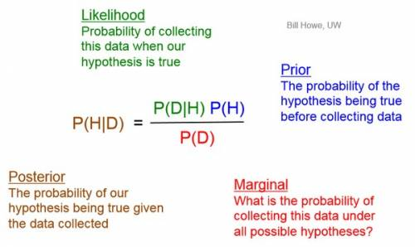
Why “Bayesian”?

Slide 15
Bayesian NLP
typically used with unsupervised learning:
we have data
we hypothesize some latent variables through which the data are generated
we define the “generative story” that describes how latent variables are generated, then how data is generated using latent variables
new: we parameterize the distributions & add the parameters themselves to the generative story

Slide 16
Generative Story Template
the above generative story implies the following factorization of the joint distribution:
Notes:
% anlp: genstory
&\mbox{1: } \mbox{Draw a set of parameters } \theta \mbox{ from } p(\theta)\\
&\mbox{2: } \mbox{Draw a latent structure } z \mbox{ from } p(z\mid\theta)\\
&\mbox{3: } \mbox{Draw the observed data } x \mbox{ from } p(x\mid z, \theta)
p(x,z,\theta) = p(\theta)p(z\mid\theta)p(x\mid z, \theta)

Slide 17
Categorical Distribution
parameterized by a vector of probabilities, one for drawing each outcome
i.e., prob. of drawing outcome i for variable X:
when we want to draw from this distribution, we will write:
Notes:
% anlp: multinomial
&p(A = a_i \mid \theta) = \theta_i
&a \sim \mbox{Multinomial}(\theta)
p(X = x_i \mid \theta) = \theta_i
x \sim \mbox{Multinomial}(\theta)
x \sim \mbox{Categorical}(\theta)

Slide 18
Categorical vs. Multinomial
“multinomial” is used frequently to mean categorical in this literature, so we’ll use them interchangeably
a multinomial is actually more general (permits more than 1 instance of an event)

Slide 19
Vector Form of Categorical Distribution
form we saw earlier:
we can also write the categorical distribution as a (one-hot) vector random variable Y:
?
Notes:
p(X = x_i \mid \theta) = \theta_i
i\in \{1,\ldots,K\}
Y_i = \mathbb{I}[X = i]
Y\in \{0,1\}^K
p(Y = y \mid \theta) = \prod_{i=1}^K \theta_i^{y_i}

Slide 20
Vector Form of Categorical Distribution
form we saw earlier:
we can also write the categorical distribution as a (one-hot) vector random variable Y:
Notes:
p(X = x_i \mid \theta) = \theta_i
i\in \{1,\ldots,K\}
Y_i = \mathbb{I}[X = i]
Y\in \{0,1\}^K
p(Y = y \mid \theta) = \prod_{i=1}^K \theta_i^{y_i}

Slide 21
The 2-Simplex
consider a categorical distribution with 3 outcomes
e.g., a distribution over words using a vocabulary of size 3:
cat
dog
UNK

Slide 22
The 2-Simplex
a point on this simplex represents a categorical distribution over the 3 outcomes
a uniform distribution:
cat
dog
UNK

Slide 23
The 2-Simplex
a distribution that puts most probability on UNK:
cat
dog
UNK

Slide 24
The 2-Simplex
a categorical distribution with K outcomes has K-1 parameters
cat
dog
UNK

Slide 25
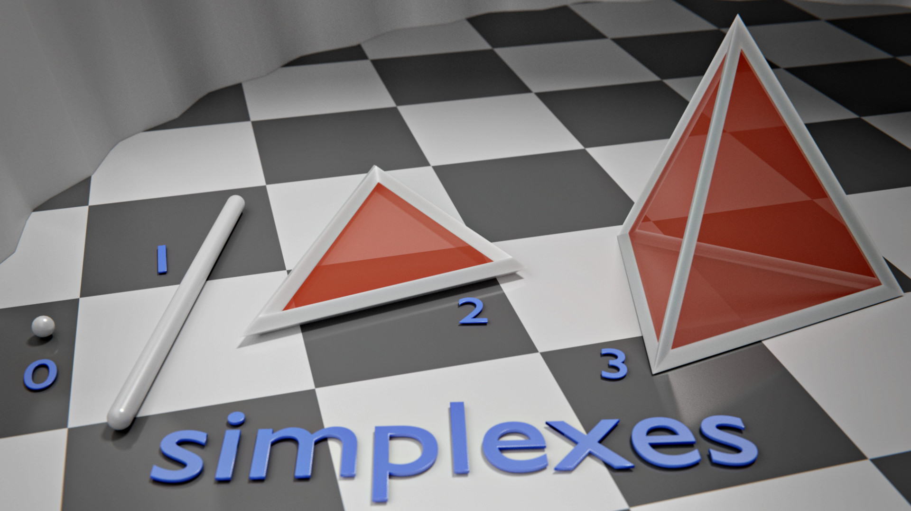
Categorical Parameters lie in (K-1)-Simplex
source: https://en.wikipedia.org/wiki/Simplex#/media/File:Simplexes.jpg

Slide 26
generative model for document collections using latent variables that can be interpreted as “topics”
learns a multinomial distribution over words for each topic

Slide 27
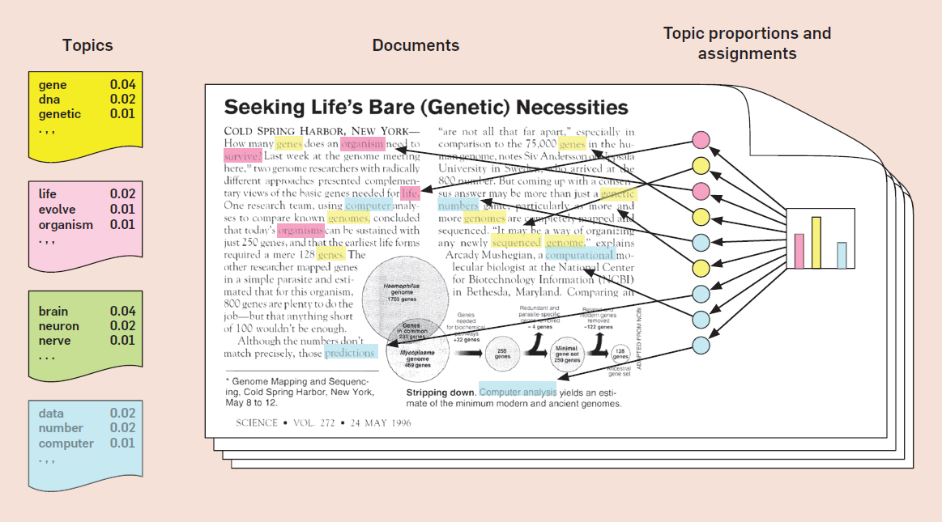
Blei (2012): Probabilistic Topic Models
Permission to make digital or hard copies of part or all of this work for personal or classroom use is granted without fee provided that copies are not made or distributed for profit or commercial advantage and that copies bear this notice and full citation on the first page. Copyright for components of this work owned by others than ACM must be honored. Abstracting with credit is permitted. To copy otherwise, to republish, to post on servers, or to redistribute to lists, requires prior specific permission and/or fee. Request permission to publish from permissions@acm.org or fax (212) 869-0481.
The Digital Library is published by the Association for Computing Machinery. Copyright © 2012 ACM, Inc.
Notes:
Permission to make digital or hard copies of part or all of this work for personal or classroom use is granted without fee provided that copies are not made or distributed for profit or commercial advantage and that copies bear this notice and full citation on the first page. Copyright for components of this work owned by others than ACM must be honored. Abstracting with credit is permitted. To copy otherwise, to republish, to post on servers, or to redistribute to lists, requires prior specific permission and/or fee. Request permission to publish from permissions@acm.org or fax (212) 869-0481.
The Digital Library is published by the Association for Computing Machinery. Copyright © 2012 ACM, Inc.

Slide 28
Latent Dirichlet Allocation (Blei et al., 2003)
categorical distributions over words for four topics:

Slide 29
Generative Story for Simple LDA
simplified LDA, and only showing generative story for 1 document:
Notes:
% anlp: LDA1
&\mbox{1: } \mbox{Draw a multinomial topic distribution } \theta \mbox{ from some distribution } p(\Theta)\\
&\mbox{2: For each position $i$ in document:}\\
&\mbox{ a: } \mbox{Draw a topic } z_i \sim \mbox{Multinomial}(\theta)\\
&\mbox{ b: } \mbox{Draw a word } w_i \sim \mbox{Multinomial}(\beta_{z_i})

Slide 30
Generative Story for Simple LDA
simplified LDA, and only showing generative story for 1 document:
multinomial distribution over words for topic

Slide 31
Generative Story for Simple LDA
simplified LDA, and only showing generative story for 1 document:
what should we keep in mind
when choosing this distribution?

Slide 32
Dirichlet Distribution
distribution over vectors with entries that are all positive and sum to 1
so it’s kind of like a “distribution over (categorical) distributions”
normalization term that depends on
Notes:
% anlp: dirichlet
&p(\Theta = \theta \mid \alpha) = \frac{1}{B(\alpha)}\prod_i \theta_i^{\alpha_i - 1}\\
%&\theta \sim \mbox{Dirichlet}(\alpha)

Slide 33
Dirichlet Distribution
parameterized by a positive vector
Notes:
% anlp: dirichlet
&p(\Theta = \theta \mid \alpha) = \frac{1}{B(\alpha)}\prod_i \theta_i^{\alpha_i - 1}\\
%&\theta \sim \mbox{Dirichlet}(\alpha)

Slide 34
categorical = point on the simplex
Dirichlet = distribution over the simplex
cat
dog
UNK
cat
dog
UNK

Slide 35
[see Jupyter Notebook]

Slide 36
Generative Story for Simple LDA
simplified LDA, and only showing generative story for 1 document:
Notes:
% anlp: LDA1
&\mbox{1: } \mbox{Draw a multinomial topic distribution } \theta \mbox{ from some distribution } p(\Theta)\\
&\mbox{2: For each position $i$ in document:}\\
&\mbox{ a: } \mbox{Draw a topic } z_i \sim \mbox{Multinomial}(\theta)\\
&\mbox{ b: } \mbox{Draw a word } w_i \sim \mbox{Multinomial}(\beta_{z_i})

Slide 37
Generative Story for Simple LDA
simplified LDA, and only showing generative story for 1 document:
Notes:
% anlp: LDA2
&\mbox{1: } \mbox{Draw a multinomial topic distribution } \theta \sim \mbox{Dirichlet}(\alpha)\\
&\mbox{2: For each position $i$ in document:}\\
&\mbox{ a: } \mbox{Draw a topic } z_i \sim \mbox{Multinomial}(\theta)\\
&\mbox{ b: } \mbox{Draw a word } w_i \sim \mbox{Multinomial}(\beta_{z_i})

Slide 38
Generative Story for LDA
now we show explicitly the generation of the word multinomials (once for the document collection)
where should the hyperparameters (alpha and psi) come from?
Notes:
% anlp: LDA3
&\mbox{1: For each topic, draw a multinomial word distribution } \beta_i \sim \mbox{Dirichlet}(\psi)\\
&\mbox{2: For each document $d$:}\\
&\:\:\mbox{ a: } \mbox{Draw a multinomial topic distribution } \theta \sim \mbox{Dirichlet}(\alpha)\\
&\:\:\mbox{ b: For each position $i$ in document $d$:}\\
&\:\:\:\:\mbox{ i: } \mbox{Draw a topic } z_i \sim \mbox{Multinomial}(\theta)\\
&\:\:\:\:\mbox{ ii: } \mbox{Draw a word } w_i \sim \mbox{Multinomial}(\beta_{z_i})

Slide 39
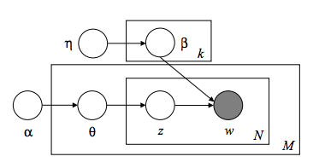
Graphical Model for LDA

