Slide 1
TTIC 31210: Advanced Natural Language Processing
Kevin Gimpel
Spring 2019
Lecture 14:
Inference in Bayesian NLP
Notes:
Copyright notice for the slide containing the LDA figure:
Permission to make digital or hard copies of part or all of this work for personal or classroom use is granted without fee provided that copies are not made or distributed for profit or commercial advantage and that copies bear this notice and full citation on the first page. Copyright for components of this work owned by others than ACM must be honored. Abstracting with credit is permitted. To copy otherwise, to republish, to post on servers, or to redistribute to lists, requires prior specific permission and/or fee. Request permission to publish from permissions@acm.org or fax (212) 869-0481.
The Digital Library is published by the Association for Computing Machinery. Copyright © 2012 ACM, Inc.

Slide 2
Roadmap
intro (1 lecture)
deep learning for NLP (5 lectures)
structured prediction (4.5 lectures)
generative models, latent variables, unsupervised learning, variational autoencoders (1.5 lectures)
Bayesian methods in NLP (2 lectures)
Bayesian nonparametrics in NLP (1.5 lectures)
research tips & other topics (0.5 lectures)

Slide 3
Assignments
we’ll go over Assignment 3 today
Assignment 4 has been posted; due in 2 weeks

Slide 4
Motivation
in neural NLP, we typically assume parameters and architectures are fixed
1-layer MLP:
now, include parameters as random variables and condition on them:
Notes:
% anlp: deepbayes
&p(Y = y \mid \boldsymbol{x}) = \frac{\exp\{\mathbf{w}_y^\top \tanh\left(\mathbf{W} g(\boldsymbol{x})\right)\}}{Z}\\
&p(Y = y \mid \boldsymbol{x}, \Theta = \{\mathbf{w},\mathbf{W}\}) = \frac{\exp\{\mathbf{w}_y^\top \tanh\left(\mathbf{W} g(\boldsymbol{x})\right)\}}{Z}\\
&p(Y = y \mid \boldsymbol{x}) = \int_{\Theta} p(Y = y, \Theta = \{\mathbf{w},\mathbf{W}\} \mid \boldsymbol{x}) d\Theta \\
&p(Y = y \mid \boldsymbol{x}, \Lambda = \mathrm{MLP}(\mathbf{w},\mathbf{W})) = \frac{\exp\{\mathbf{w}_y^\top \tanh\left(\mathbf{W} g(\boldsymbol{x})\right)\}}{Z}\\
&p(Y = y \mid \boldsymbol{x}) = \int_{\Lambda} p(Y = y, \Lambda = \mathrm{MLP}(\mathbf{w},\mathbf{W}) \mid \boldsymbol{x}) d\Lambda \\

Slide 5
Motivation
how do we get back to ?
marginalize over new random variables:
intuitively: don’t commit to a single set of parameter values; use them all (with a suitable prior distribution)

Slide 6
Going Further…
marginalize over architectures & parameters?
Notes:
% anlp: deepbayes
&p(Y = y \mid \boldsymbol{x}) = \frac{\exp\{\mathbf{w}_y^\top \tanh\left(\mathbf{W} g(\boldsymbol{x})\right)\}}{Z}\\
&p(Y = y \mid \boldsymbol{x}, \Theta = \{\mathbf{w},\mathbf{W}\}) = \frac{\exp\{\mathbf{w}_y^\top \tanh\left(\mathbf{W} g(\boldsymbol{x})\right)\}}{Z}\\
&p(Y = y \mid \boldsymbol{x}) = \int_{\Theta} p(Y = y, \Theta = \{\mathbf{w},\mathbf{W}\} \mid \boldsymbol{x}) d\Theta \\
&p(Y = y \mid \boldsymbol{x}, \Lambda = \mathrm{MLP}(\mathbf{w},\mathbf{W})) = \frac{\exp\{\mathbf{w}_y^\top \tanh\left(\mathbf{W} g(\boldsymbol{x})\right)\}}{Z}\\
&p(Y = y \mid \boldsymbol{x}) = \int_{\Lambda} p(Y = y, \Lambda = \mathrm{MLP}(\mathbf{w},\mathbf{W}) \mid \boldsymbol{x}) d\Lambda \\

Slide 7
Generative Story Template
the above generative story implies the following factorization of the joint distribution:
Notes:
% anlp: genstory
&\mbox{1: } \mbox{Draw a set of parameters } \theta \mbox{ from } p(\theta)\\
&\mbox{2: } \mbox{Draw a latent structure } z \mbox{ from } p(z\mid\theta)\\
&\mbox{3: } \mbox{Draw the observed data } x \mbox{ from } p(x\mid z, \theta)
p(x,z,\theta) = p(\theta)p(z\mid\theta)p(x\mid z, \theta)

Slide 8
generative model for document collections using latent variables that can be interpreted as “topics”
learns a multinomial distribution over words for each topic

Slide 9
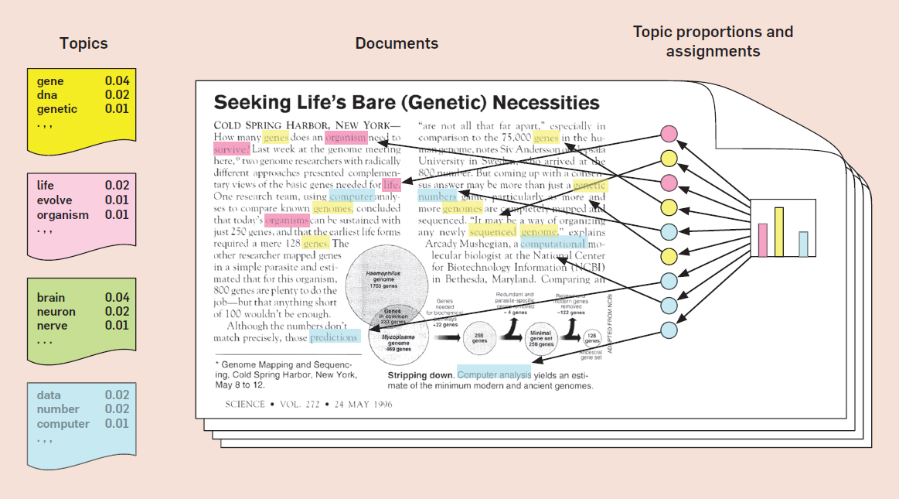
Blei (2012): Probabilistic Topic Models
Permission to make digital or hard copies of part or all of this work for personal or classroom use is granted without fee provided that copies are not made or distributed for profit or commercial advantage and that copies bear this notice and full citation on the first page. Copyright for components of this work owned by others than ACM must be honored. Abstracting with credit is permitted. To copy otherwise, to republish, to post on servers, or to redistribute to lists, requires prior specific permission and/or fee. Request permission to publish from permissions@acm.org or fax (212) 869-0481.
The Digital Library is published by the Association for Computing Machinery. Copyright © 2012 ACM, Inc.
Notes:
Permission to make digital or hard copies of part or all of this work for personal or classroom use is granted without fee provided that copies are not made or distributed for profit or commercial advantage and that copies bear this notice and full citation on the first page. Copyright for components of this work owned by others than ACM must be honored. Abstracting with credit is permitted. To copy otherwise, to republish, to post on servers, or to redistribute to lists, requires prior specific permission and/or fee. Request permission to publish from permissions@acm.org or fax (212) 869-0481.
The Digital Library is published by the Association for Computing Machinery. Copyright © 2012 ACM, Inc.

Slide 10
Dirichlet Distribution
parameterized by a positive vector
Notes:
% anlp: dirichlet
&p(\Theta = \theta \mid \alpha) = \frac{1}{B(\alpha)}\prod_i \theta_i^{\alpha_i - 1}\\
%&\theta \sim \mbox{Dirichlet}(\alpha)

Slide 11
categorical = point on the simplex
Dirichlet = distribution over the simplex
cat
dog
UNK
cat
dog
UNK

Slide 12
Compare Categorical and Dirichlet
categorical:
vector form of categorical:
Dirichlet:
Notes:
p(\Theta = \theta \mid \alpha) = \frac{1}{B(\alpha)}\prod_{i=1}^K \theta_i^{\alpha_i - 1}

Slide 13
Posterior over Categorical Parameters?
posterior (given a single observation y):
Notes:
p(\Theta = \theta \mid \alpha) = \frac{1}{B(\alpha)}\prod_{i=1}^K \theta_i^{\alpha_i - 1}
p(\theta\mid y, \alpha)\propto p(\theta\mid \alpha)p(y\mid \theta) &\propto \left(\prod_{i=1}^K \theta_i^{\alpha_i - 1}\right)\times\left(\prod_{i=1}^K \theta_i^{y_i}\right)\\
&=\prod_{i=1}^K \theta_i^{\alpha_i + y_i - 1}

Slide 14
Posterior over Categorical Parameters?
posterior:
Notes:
p(\Theta = \theta \mid \alpha) = \frac{1}{B(\alpha)}\prod_{i=1}^K \theta_i^{\alpha_i - 1}
p(\theta\mid y, \alpha)\propto p(\theta\mid \alpha)p(y\mid \theta) &\propto \left(\prod_{i=1}^K \theta_i^{\alpha_i - 1}\right)\times\left(\prod_{i=1}^K \theta_i^{y_i}\right)\\
&=\prod_{i=1}^K \theta_i^{\alpha_i + y_i - 1}

Slide 15
Posterior over Categorical Parameters?
posterior:
Notes:
p(\Theta = \theta \mid \alpha) = \frac{1}{B(\alpha)}\prod_{i=1}^K \theta_i^{\alpha_i - 1}
p(\theta\mid y, \alpha)\propto p(\theta\mid \alpha)p(y\mid \theta) &\propto \left(\prod_{i=1}^K \theta_i^{\alpha_i - 1}\right)\times\left(\prod_{i=1}^K \theta_i^{y_i}\right)\\
&=\prod_{i=1}^K \theta_i^{\alpha_i + y_i - 1}

Slide 16
Posterior over Categorical Parameters?
posterior:
Notes:
p(\Theta = \theta \mid \alpha) = \frac{1}{B(\alpha)}\prod_{i=1}^K \theta_i^{\alpha_i - 1}
p(\theta\mid y, \alpha)\propto p(\theta\mid \alpha)p(y\mid \theta) &\propto \left(\prod_{i=1}^K \theta_i^{\alpha_i - 1}\right)\times\left(\prod_{i=1}^K \theta_i^{y_i}\right)\\
&=\prod_{i=1}^K \theta_i^{\alpha_i + y_i - 1}

Slide 17
Posterior over Categorical Parameters?
prior:
posterior:
posterior has form of another Dirichlet distribution!
posterior parameters:
Notes:
p(\Theta = \theta \mid \alpha) = \frac{1}{B(\alpha)}\prod_{i=1}^K \theta_i^{\alpha_i - 1}
p(\theta\mid y, \alpha)\propto \prod_{i=1}^K \theta_i^{\alpha_i + y_i - 1}
\alpha' = \alpha + y
p(\theta\mid y, \alpha)\propto p(\theta\mid \alpha)p(y\mid \theta) &\propto \left(\prod_{i=1}^K \theta_i^{\alpha_i - 1}\right)\times\left(\prod_{i=1}^K \theta_i^{y_i}\right)\\
&=\prod_{i=1}^K \theta_i^{\alpha_i + y_i - 1}

Slide 18
Conjugate Priors
Dirichlet is (simplest) conjugate prior to multinomial
Dirichlet parameters are like “pseudo-observations”
definition: “posterior obtained from a given prior in the prior family and a given likelihood function belongs to the same prior family”
result of “algebraic similarity” between prior family and likelihood
often leads to tractability & closed-form analytic solutions for posterior

Slide 19
Generative Story Template
the above generative story implies the following factorization of the joint distribution:
Notes:
% anlp: genstory
&\mbox{1: } \mbox{Draw a set of parameters } \theta \mbox{ from } p(\theta)\\
&\mbox{2: } \mbox{Draw a latent structure } z \mbox{ from } p(z\mid\theta)\\
&\mbox{3: } \mbox{Draw the observed data } x \mbox{ from } p(x\mid z, \theta)
p(x,z,\theta) = p(\theta)p(z\mid\theta)p(x\mid z, \theta)

Slide 20
using a prior distribution over parameters (not even really Bayesian)
less
Bayesian
more
Bayesian

Slide 21
using a prior distribution over parameters (not even really Bayesian)
computing posterior over parameters instead of using a point estimate
less
Bayesian
more
Bayesian
Notes:
p(z^{(1)},..., z^{(n)} \mid x^{(1)},..., x^{(n)}, \hat{\theta}, \alpha)

Slide 22
computing posterior over parameters instead of using a point estimate
data is a set of samples:
Notes:
&\mbox{posterior with}\\
&\mbox{point estimate:}
\mbox{posterior with}
\mbox{point estimate:}
p(z^{(1)},..., z^{(n)} \mid x^{(1)},..., x^{(n)}, \hat{\theta}, \alpha)

Slide 23
using a prior distribution over parameters (not even really Bayesian)
computing posterior over parameters instead of using a point estimate
integrating out parameters (with fixed parameters for prior)
less
Bayesian
more
Bayesian

Slide 24
integrating out parameters (with fixed parameters for prior)
data is a set of samples:

Slide 25
using a prior distribution over parameters (not even really Bayesian)
computing posterior over parameters instead of using a point estimate
integrating out parameters (with fixed parameters for prior)
integrating out parameters while estimating parameters of prior (“Empirical Bayes”)
integrating out parameters and prior parameters (using a “hyperprior”)
…
less
Bayesian
more
Bayesian

Slide 26
Inference
inference roughly means “calculate statistical quantities of interest”
examples:
compute the mode of some random variables when conditioning on some and marginalizing out others
compute marginals of some random variables (variable posteriors when marginalizing out everything else)
compute posterior distribution over some subset of random variables

Slide 27
Learning?
in Bayesian NLP, there’s often no “learning”
there is only “inference”
just define model and do inference to calculate what we want to calculate
no parameters are being estimated from data*
we are not optimizing any loss function*
there is no gradient descent*
but sometimes we do learn some latent variables (certain parameters or hyperparameters), and infer or marginalize over others
* typically

Slide 28
Markov Chain Monte Carlo (MCMC)
MCMC algorithms are widely used in Bayesian modeling but also useful more generally
can be used to generate samples from distributions that are hard to sample from
samples can be used to estimate quantities of interest
these estimates are unbiased

Slide 29
Gibbs Sampling
Gibbs sampling is the simplest and most widely-used MCMC algorithm (at least in NLP)

Slide 30
Gibbs Sampling Template
Notes:
% anlp: gibbs1
%&U_1,...,U_p = \mbox{latent variables}\\
%&U_{-i} = \mbox{all latent variables other than $U_i$}\\
%&\boldsymbol{X} = \mbox{all observed data and hyperparameters}\\
&\mbox{Gibbs sampling: }\\
&\mbox{\;\;\;\;initialize all $U_i$ to values $u_i$}\\
&\mbox{\;\;\;\;repeat until convergence:}\\
&\mbox{\;\;\;\;\;\;\;\;sample } u \mbox{ from } p(U_i \mid u_{-i}, \boldsymbol{X})\\
&\mbox{\;\;\;\;\;\;\;\;set $U_i\leftarrow u$}

Slide 31
Gibbs Sampling Template
At convergence, each time we update any value of any random
variable in , we have another sample from the posterior
these samples can be used to estimate any quantity of interest
while offering some nice theoretical properties

Slide 32
Disadvantages of Gibbs Sampling?
nearby samples are not necessarily uncorrelated, so it can take many samples for good estimates, especially of rare events
guarantees are at convergence
“burn-in” time can be hard to estimate & depends on initialization

Slide 33
Gibbs sampling is simple and has nice guarantees, but it can be tricky to derive for NLP models
why? we just need to sample each random variable conditioned on all the others
in certain kinds of NLP models, hard to define the random variables!
even when we can do this, the sampler might be very slow to converge (“mix slowly”)

Slide 34
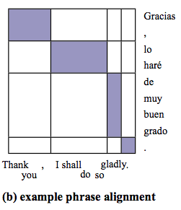
Example: Phrase Alignments in Machine Translation
DeNero et al. (2008): Sampling Alignment Structure under a Bayesian Translation Model

Slide 35
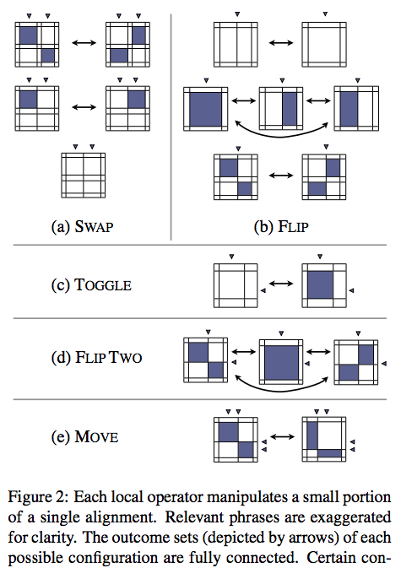
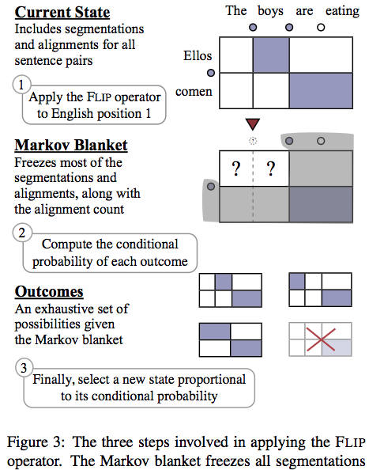
Example: Phrase Alignments in Machine Translation

Slide 36
Graphical Models in NLP?
Gibbs sampling is easy to apply to graphical models, but graphical models are not a good fit for certain tasks/models in NLP:
segmentation
context-free grammars (see case-factor diagrams; McAllester et al., 2007)
finite-state automata
models over paths in graphs
models over hyperpaths in hypergraphs

Slide 37
Example: Lattice for Phrase-Based Machine Translation
start
state
final
state
German input:
English reference:
this is a finite-state transducer: a directed graph where each edge consumes part of the input and outputs a string
each edge has a score (not shown)
a translation is a path from the start state to a final state

Slide 38
Phrase Lattice → Graphical Model
each edge in the phrase lattice is a binary random variable in the graphical model
Notes:
There actually aren’t enough edges here to account for all of the hard constraints present in the original lattice.

Slide 39
consider what happens when we set a variable to 1 (green)
Notes:
For example, if this edge here is “ON”, that is, its value is 1, then this implies that the values of many other random variables must be zero.

Slide 40
just by setting one variable to 1, many other variables are forced to be 0 or 1 to obey path legality constraints
Notes:
Just by setting that one variable to green, all of these other variables are set to 0 or 1 to obey the path legality constraints.
So we have lots of long-distance, structural constraints. These are known to cause problems for Gibbs samplers and for belief propagation, often making them take a very long time to do inference or making the results worse.

Slide 41
long-distance, deterministic dependencies among variables
known to be problematic for certain inference algorithms (Gibbs sampling and belief propagation)
Notes:
Just by setting that one variable to green, all of these other variables are set to 0 or 1 to obey the path legality constraints.
So we have lots of long-distance, structural constraints. These are known to cause problems for Gibbs samplers and for belief propagation, often making them take a very long time to do inference or making the results worse.

Slide 42
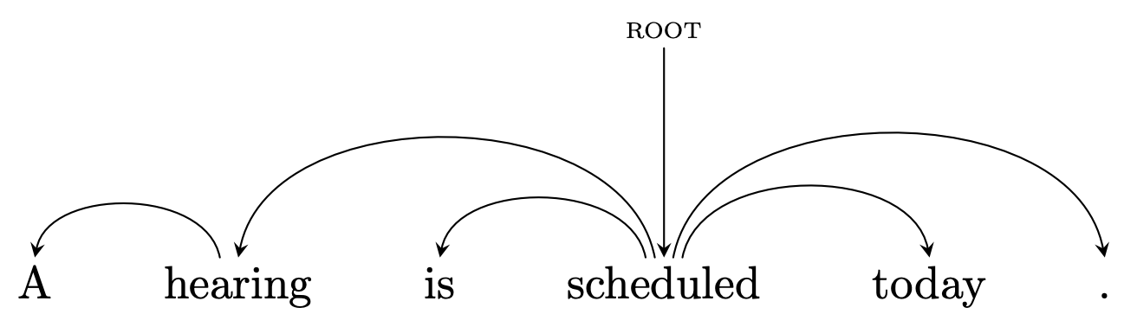
Graphical Models for Dependency Parsing
define a binary random variable for each pair of words in the sentence
global tree constraint among all random variables (special handling for this constraint)
Smith & Eisner (2008): Dependency Parsing by Belief Propagation

Slide 43
Summary: Graphical Models in NLP
we can often come up with a way to define random variables for structured NLP tasks
downside: every variable may have an edge to all others! (global constraints)
global, deterministic potentials can cause issues with certain general-purpose inference algorithms in graphical models
it’s better to use specialized algorithms designed for the global constraints

Slide 44
LDA Generative Story
Notes:
% anlp: LDA3
%
&\mbox{1: For each topic $k=1...K$, draw multinomial word distribution } \beta_k \sim \mbox{Dirichlet}(\psi)\\
&\mbox{2: For each document $i$:}\\
&\:\:\mbox{ a: } \mbox{Draw a multinomial topic distribution } \theta^{(i)} \sim \mbox{Dirichlet}(\alpha)\\
&\:\:\mbox{ b: For each position $j$ in document $i$:}\\
&\:\:\:\:\mbox{ i: } \mbox{Draw a topic } z^{(i,j)} \sim \mbox{Multinomial}(\theta^{(i)})\\
&\:\:\:\:\mbox{ ii: } \mbox{Draw a word } w^{(i,j)} \sim \mbox{Multinomial}(\beta_{z^{(i,j)}})

Slide 45
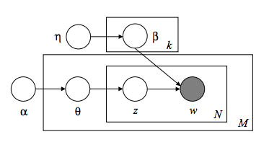
Graphical Model for LDA

Slide 46
Gibbs Sampling for LDA
Notes:
% anlp: gibbs lda
%&U_1,...,U_p = \mbox{latent variables}\\
%&U_{-i} = \mbox{all latent variables other than $U_i$}\\
%&\boldsymbol{X} = \mbox{all observed data and hyperparameters}\\
%&\mbox{1: } \mbox{Draw a set of parameters } \theta \mbox{ from } p(\theta\mid \alpha)\\
%&\mbox{2: } \mbox{Draw a latent structure } z \mbox{ from } p(z\mid\theta)\\
%&\mbox{3: } \mbox{Draw the observed data } x \mbox{ from } p(x\mid z, \theta)
%\mbox{joint: } \;\;p(x^{(1)},..., x^{(n)}, z^{(1)},..., z^{(n)},\theta\mid \alpha)
%&\theta^{(i)}\in\mathbb{R}^K\\
%&\beta \in \mathbb{R}^{K\times V}
%Z^{(i,j)} \mid Z^{-(i,j)}, \Theta, \beta, \boldsymbol{w}, \alpha, \psi \sim \mbox{Multinomial}(\theta^{(i)} \odot \beta_{\cdot,w^{(i,j)}})
Z^{(i,j)} \mid &\mbox{ everything else} \sim \mbox{Multinomial}(\theta^{(i)} \odot \beta_{\cdot,w^{(i,j)}})\\
%
%&\theta^{(i)} \mid \theta^{-(i)}, \beta, Z, \boldsymbol{w}, \alpha, \psi \sim \mbox{Dirichlet}([\alpha_1 + m^{(i)}_{1}, \alpha_2 + m^{(i)}_{2},...,\alpha_k + m^{(i)}_{K}])\\
%&m^{(i)}_{k} = \mbox{\# words in doc $i$ from topic $k$}
%
%&\theta^{(i)} \mid \theta^{-(i)}, \beta, Z, \boldsymbol{w}, \alpha, \psi \sim \mbox{Dirichlet}(\alpha + m^{(i)})\\
\theta^{(i)} \mid &\mbox{ everything else} \sim \mbox{Dirichlet}(\alpha + m^{(i)})\\
%
%&\beta_k \mid \beta_{-k}, \theta, Z, \boldsymbol{w}, \alpha, \psi \sim \mbox{Dirichlet}(\psi + n_k)\\
\beta_k \mid &\mbox{ everything else} \sim \mbox{Dirichlet}(\psi + n_k)\\
\\
&\theta^{(i)}\in\mathbb{R}^K\\
&\beta \in \mathbb{R}^{K\times V}\\
&m^{(i)}_{k} = \mbox{\# words in doc $i$ from topic $k$}\\
&n_{k,v} = \mbox{\# of times word $v$ appears with topic $k$ in any document}
%

Slide 47
Gibbs Sampling for LDA
Notes:
% anlp: gibbs lda
%&U_1,...,U_p = \mbox{latent variables}\\
%&U_{-i} = \mbox{all latent variables other than $U_i$}\\
%&\boldsymbol{X} = \mbox{all observed data and hyperparameters}\\
%&\mbox{1: } \mbox{Draw a set of parameters } \theta \mbox{ from } p(\theta\mid \alpha)\\
%&\mbox{2: } \mbox{Draw a latent structure } z \mbox{ from } p(z\mid\theta)\\
%&\mbox{3: } \mbox{Draw the observed data } x \mbox{ from } p(x\mid z, \theta)
%\mbox{joint: } \;\;p(x^{(1)},..., x^{(n)}, z^{(1)},..., z^{(n)},\theta\mid \alpha)
%&\theta^{(i)}\in\mathbb{R}^K\\
%&\beta \in \mathbb{R}^{K\times V}
%Z^{(i,j)} \mid Z^{-(i,j)}, \Theta, \beta, \boldsymbol{w}, \alpha, \psi \sim \mbox{Multinomial}(\theta^{(i)} \odot \beta_{\cdot,w^{(i,j)}})
Z^{(i,j)} \mid &\mbox{ everything else} \sim \mbox{Multinomial}(\theta^{(i)} \odot \beta_{\cdot,w^{(i,j)}})\\
%
%&\theta^{(i)} \mid \theta^{-(i)}, \beta, Z, \boldsymbol{w}, \alpha, \psi \sim \mbox{Dirichlet}([\alpha_1 + m^{(i)}_{1}, \alpha_2 + m^{(i)}_{2},...,\alpha_k + m^{(i)}_{K}])\\
%&m^{(i)}_{k} = \mbox{\# words in doc $i$ from topic $k$}
%
%&\theta^{(i)} \mid \theta^{-(i)}, \beta, Z, \boldsymbol{w}, \alpha, \psi \sim \mbox{Dirichlet}(\alpha + m^{(i)})\\
\theta^{(i)} \mid &\mbox{ everything else} \sim \mbox{Dirichlet}(\alpha + m^{(i)})\\
%
%&\beta_k \mid \beta_{-k}, \theta, Z, \boldsymbol{w}, \alpha, \psi \sim \mbox{Dirichlet}(\psi + n_k)\\
\beta_k \mid &\mbox{ everything else} \sim \mbox{Dirichlet}(\psi + n_k)\\
\\
&\theta^{(i)}\in\mathbb{R}^K\\
&\beta \in \mathbb{R}^{K\times V}\\
&m^{(i)}_{k} = \mbox{\# words in doc $i$ from topic $k$}\\
&n_{k,v} = \mbox{\# of times word $v$ appears with topic $k$ in any document}
%

Slide 48
we now have a way to generate samples from the posterior for the LDA model
how should we do the following?
get topic assignments for each word in the document collection?
get topic distribution for a document?
get estimates of topic-word distributions for each topic?

