Slide 1
TTIC 31210: Advanced Natural Language Processing
Kevin Gimpel
Spring 2019
Lecture 15:
Finish Inference in Bayesian NLP,
Start Bayesian Nonparametrics

Slide 2
Roadmap
intro (1 lecture)
deep learning for NLP (5 lectures)
structured prediction (4.5 lectures)
generative models, latent variables, unsupervised learning, variational autoencoders (1.5 lectures)
Bayesian methods in NLP (2 lectures)
Bayesian nonparametrics in NLP (1.5 lectures)
research tips & other topics (0.5 lectures)

Slide 3
Assignments
questions about Assignment 4?

Slide 4
Generative Story Template
the above generative story implies the following factorization of the joint distribution:
Notes:
% anlp: genstory
&\mbox{1: } \mbox{Draw a set of parameters } \theta \mbox{ from } p(\theta)\\
&\mbox{2: } \mbox{Draw a latent structure } z \mbox{ from } p(z\mid\theta)\\
&\mbox{3: } \mbox{Draw the observed data } x \mbox{ from } p(x\mid z, \theta)
p(x,z,\theta) = p(\theta)p(z\mid\theta)p(x\mid z, \theta)

Slide 5
categorical = point on the simplex
Dirichlet = distribution over the simplex
cat
dog
UNK
cat
dog
UNK

Slide 6
Posterior over Categorical Parameters?
posterior (given a single observation y):
Notes:
p(\Theta = \theta \mid \alpha) = \frac{1}{B(\alpha)}\prod_{i=1}^K \theta_i^{\alpha_i - 1}
p(\theta\mid y, \alpha)\propto p(\theta\mid \alpha)p(y\mid \theta) &\propto \left(\prod_{i=1}^K \theta_i^{\alpha_i - 1}\right)\times\left(\prod_{i=1}^K \theta_i^{y_i}\right)\\
&=\prod_{i=1}^K \theta_i^{\alpha_i + y_i - 1}

Slide 7
Posterior over Categorical Parameters?
prior:
posterior:
posterior has form of another Dirichlet distribution!
posterior parameters:
Notes:
p(\Theta = \theta \mid \alpha) = \frac{1}{B(\alpha)}\prod_{i=1}^K \theta_i^{\alpha_i - 1}
p(\theta\mid y, \alpha)\propto \prod_{i=1}^K \theta_i^{\alpha_i + y_i - 1}
\alpha' = \alpha + y
p(\theta\mid y, \alpha)\propto p(\theta\mid \alpha)p(y\mid \theta) &\propto \left(\prod_{i=1}^K \theta_i^{\alpha_i - 1}\right)\times\left(\prod_{i=1}^K \theta_i^{y_i}\right)\\
&=\prod_{i=1}^K \theta_i^{\alpha_i + y_i - 1}

Slide 8
Gibbs Sampling Template
Notes:
% anlp: gibbs1
%&U_1,...,U_p = \mbox{latent variables}\\
%&U_{-i} = \mbox{all latent variables other than $U_i$}\\
%&\boldsymbol{X} = \mbox{all observed data and hyperparameters}\\
&\mbox{Gibbs sampling: }\\
&\mbox{\;\;\;\;initialize all $U_i$ to values $u_i$}\\
&\mbox{\;\;\;\;repeat until convergence:}\\
&\mbox{\;\;\;\;\;\;\;\;sample } u \mbox{ from } p(U_i \mid u_{-i}, \boldsymbol{X})\\
&\mbox{\;\;\;\;\;\;\;\;set $U_i\leftarrow u$}

Slide 9
LDA Generative Story
Notes:
% anlp: LDA3
%
&\mbox{1: For each topic $k=1...K$, draw multinomial word distribution } \beta_k \sim \mbox{Dirichlet}(\psi)\\
&\mbox{2: For each document $i$:}\\
&\:\:\mbox{ a: } \mbox{Draw a multinomial topic distribution } \theta^{(i)} \sim \mbox{Dirichlet}(\alpha)\\
&\:\:\mbox{ b: For each position $j$ in document $i$:}\\
&\:\:\:\:\mbox{ i: } \mbox{Draw a topic } z^{(i,j)} \sim \mbox{Multinomial}(\theta^{(i)})\\
&\:\:\:\:\mbox{ ii: } \mbox{Draw a word } w^{(i,j)} \sim \mbox{Multinomial}(\beta_{z^{(i,j)}})

Slide 10
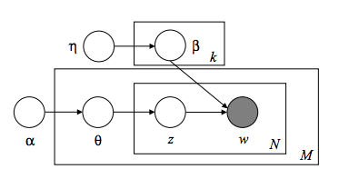
Graphical Model for LDA

Slide 11
Gibbs Sampling for LDA
Notes:
% anlp: gibbs lda
%&U_1,...,U_p = \mbox{latent variables}\\
%&U_{-i} = \mbox{all latent variables other than $U_i$}\\
%&\boldsymbol{X} = \mbox{all observed data and hyperparameters}\\
%&\mbox{1: } \mbox{Draw a set of parameters } \theta \mbox{ from } p(\theta\mid \alpha)\\
%&\mbox{2: } \mbox{Draw a latent structure } z \mbox{ from } p(z\mid\theta)\\
%&\mbox{3: } \mbox{Draw the observed data } x \mbox{ from } p(x\mid z, \theta)
%\mbox{joint: } \;\;p(x^{(1)},..., x^{(n)}, z^{(1)},..., z^{(n)},\theta\mid \alpha)
%&\theta^{(i)}\in\mathbb{R}^K\\
%&\beta \in \mathbb{R}^{K\times V}
%Z^{(i,j)} \mid Z^{-(i,j)}, \Theta, \beta, \boldsymbol{w}, \alpha, \psi \sim \mbox{Multinomial}(\theta^{(i)} \odot \beta_{\cdot,w^{(i,j)}})
Z^{(i,j)} \mid &\mbox{ everything else} \sim \mbox{Multinomial}(\theta^{(i)} \odot \beta_{\cdot,w^{(i,j)}})\\
%
%&\theta^{(i)} \mid \theta^{-(i)}, \beta, Z, \boldsymbol{w}, \alpha, \psi \sim \mbox{Dirichlet}([\alpha_1 + m^{(i)}_{1}, \alpha_2 + m^{(i)}_{2},...,\alpha_k + m^{(i)}_{K}])\\
%&m^{(i)}_{k} = \mbox{\# words in doc $i$ from topic $k$}
%
%&\theta^{(i)} \mid \theta^{-(i)}, \beta, Z, \boldsymbol{w}, \alpha, \psi \sim \mbox{Dirichlet}(\alpha + m^{(i)})\\
\theta^{(i)} \mid &\mbox{ everything else} \sim \mbox{Dirichlet}(\alpha + m^{(i)})\\
%
%&\beta_k \mid \beta_{-k}, \theta, Z, \boldsymbol{w}, \alpha, \psi \sim \mbox{Dirichlet}(\psi + n_k)\\
\beta_k \mid &\mbox{ everything else} \sim \mbox{Dirichlet}(\psi + n_k)\\
\\
&\theta^{(i)}\in\mathbb{R}^K\\
&\beta \in \mathbb{R}^{K\times V}\\
&m^{(i)}_{k} = \mbox{\# words in doc $i$ from topic $k$}\\
&n_{k,v} = \mbox{\# of times word $v$ appears with topic $k$ in any document}
%

Slide 12
Gibbs Sampling for LDA
Notes:
% anlp: gibbs lda
%&U_1,...,U_p = \mbox{latent variables}\\
%&U_{-i} = \mbox{all latent variables other than $U_i$}\\
%&\boldsymbol{X} = \mbox{all observed data and hyperparameters}\\
%&\mbox{1: } \mbox{Draw a set of parameters } \theta \mbox{ from } p(\theta\mid \alpha)\\
%&\mbox{2: } \mbox{Draw a latent structure } z \mbox{ from } p(z\mid\theta)\\
%&\mbox{3: } \mbox{Draw the observed data } x \mbox{ from } p(x\mid z, \theta)
%\mbox{joint: } \;\;p(x^{(1)},..., x^{(n)}, z^{(1)},..., z^{(n)},\theta\mid \alpha)
%&\theta^{(i)}\in\mathbb{R}^K\\
%&\beta \in \mathbb{R}^{K\times V}
%Z^{(i,j)} \mid Z^{-(i,j)}, \Theta, \beta, \boldsymbol{w}, \alpha, \psi \sim \mbox{Multinomial}(\theta^{(i)} \odot \beta_{\cdot,w^{(i,j)}})
Z^{(i,j)} \mid &\mbox{ everything else} \sim \mbox{Multinomial}(\theta^{(i)} \odot \beta_{\cdot,w^{(i,j)}})\\
%
%&\theta^{(i)} \mid \theta^{-(i)}, \beta, Z, \boldsymbol{w}, \alpha, \psi \sim \mbox{Dirichlet}([\alpha_1 + m^{(i)}_{1}, \alpha_2 + m^{(i)}_{2},...,\alpha_k + m^{(i)}_{K}])\\
%&m^{(i)}_{k} = \mbox{\# words in doc $i$ from topic $k$}
%
%&\theta^{(i)} \mid \theta^{-(i)}, \beta, Z, \boldsymbol{w}, \alpha, \psi \sim \mbox{Dirichlet}(\alpha + m^{(i)})\\
\theta^{(i)} \mid &\mbox{ everything else} \sim \mbox{Dirichlet}(\alpha + m^{(i)})\\
%
%&\beta_k \mid \beta_{-k}, \theta, Z, \boldsymbol{w}, \alpha, \psi \sim \mbox{Dirichlet}(\psi + n_k)\\
\beta_k \mid &\mbox{ everything else} \sim \mbox{Dirichlet}(\psi + n_k)\\
\\
&\theta^{(i)}\in\mathbb{R}^K\\
&\beta \in \mathbb{R}^{K\times V}\\
&m^{(i)}_{k} = \mbox{\# words in doc $i$ from topic $k$}\\
&n_{k,v} = \mbox{\# of times word $v$ appears with topic $k$ in any document}
%

Slide 13
LDA
Notes:
% anlp: LDA vs Posterior Gibbs
%
&\mbox{Generative Story:}\\
&\beta_k \sim \mbox{Dirichlet}(\psi)\\
&\theta^{(i)} \sim \mbox{Dirichlet}(\alpha)\\
&Z^{(i,j)} \sim \mbox{Multinomial}(\theta^{(i)})\\
\\

Slide 14
we now have a way to generate samples from the posterior for the LDA model
how should we do the following?
get topic assignments for each word in the document collection?
get topic distribution for a document?
get estimates of topic-word distributions for each topic?

Slide 15
Key Quantities
Our data is a set of samples:

Slide 16
Collapsed Gibbs Sampling for LDA
the collapsed posterior is tricky to work with because all latent variables become coupled
i.e., we now have fewer independence assumptions to help us simplify things
[on board]

Slide 17
Collapsed Gibbs Sampling for LDA
Notes:
% anlp: collapsed gibbs lda
%&U_1,...,U_p = \mbox{latent variables}\\
%&U_{-i} = \mbox{all latent variables other than $U_i$}\\
%&\boldsymbol{X} = \mbox{all observed data and hyperparameters}\\
%&\mbox{1: } \mbox{Draw a set of parameters } \theta \mbox{ from } p(\theta\mid \alpha)\\
%&\mbox{2: } \mbox{Draw a latent structure } z \mbox{ from } p(z\mid\theta)\\
%&\mbox{3: } \mbox{Draw the observed data } x \mbox{ from } p(x\mid z, \theta)
%\mbox{joint: } \;\;p(x^{(1)},..., x^{(n)}, z^{(1)},..., z^{(n)},\theta\mid \alpha)
%&\theta^{(i)}\in\mathbb{R}^K\\
%&\beta \in \mathbb{R}^{K\times V}
%Z^{(i,j)} \mid Z^{-(i,j)}, \Theta, \beta, \boldsymbol{w}, \alpha, \psi \sim \mbox{Multinomial}(\theta^{(i)} \odot \beta_{\cdot,w^{(i,j)}})
\mbox{Posterior: } &Z^{(i,j)} \mid Z^{-(i,j)}, \theta, \beta, \boldsymbol{w}, \alpha, \psi \sim \mbox{Multinomial}(\theta^{(i)} \odot \beta_{\cdot,w^{(i,j)}})\\
%\mbox{Collapsed: } &Z^{(i,j)} \mid Z^{-(i,j)}, \boldsymbol{w}, \alpha, \psi \sim \mbox{?}\\
\mbox{Collapsed: } &p(Z^{(i,j)} \mid Z^{-(i,j)}, \boldsymbol{w}, \alpha, \psi) = \frac{\psi + [n_{-(i,j),k}]_{w^{(i,j)}}}{V\psi + \sum_v [n_{-(i,j),k}]_{v}}\times\frac{\alpha + [m_{-(i,j)}]_k}{K\alpha + \sum_{k'}[m_{-(i,j)}]_{k'}}\\
%
%%
%&\theta^{(i)} \mid \theta^{-(i)}, \beta, Z, \boldsymbol{w}, \alpha, \psi \sim \mbox{Dirichlet}([\alpha_1 + m^{(i)}_{1}, \alpha_2 + m^{(i)}_{2},...,\alpha_k + m^{(i)}_{K}])\\
%&m^{(i)}_{k} = \mbox{\# words in doc $i$ from topic $k$}
%
%&\theta^{(i)} \mid \theta^{-(i)}, \beta, Z, \boldsymbol{w}, \alpha, \psi \sim \mbox{Dirichlet}(\alpha + m^{(i)})\\
%\theta^{(i)} \mid &\mbox{ everything else} \sim \mbox{Dirichlet}(\alpha + m^{(i)})\\
%
%&\beta_k \mid \beta_{-k}, \theta, Z, \boldsymbol{w}, \alpha, \psi \sim \mbox{Dirichlet}(\psi + n_k)\\
%\beta_k \mid &\mbox{ everything else} \sim \mbox{Dirichlet}(\psi + n_k)\\

Slide 18
Roadmap
intro (1 lecture)
deep learning for NLP (5 lectures)
structured prediction (4.5 lectures)
generative models, latent variables, unsupervised learning, variational autoencoders (1.5 lectures)
Bayesian methods in NLP (2 lectures)
Bayesian nonparametrics in NLP (1.5 lectures)
research tips & other topics (0.5 lectures)

Slide 19
“Nonparametric”?
nonparametric does not mean “no parameters”
it means that “the number of parameters grows as the data grows”
for our purposes, think of it as “some component of the model permits an unbounded set of something”

Slide 20
Parametric or Nonparametric?
Model | Parametric or Nonparametric?
Gaussian Mixture Model (GMM) | parametric
Hidden Markov Model (with GMM emissions) | parametric
Hidden Markov Model (for part-of-speech tagging, with multinomial emissions) | nonparametric*
n-gram language models | nonparametric
LDA | nonparametric*
LSTM language model | nonparametric*
character-level LSTM language model | parametric (assuming fixed set of characters)
*parametric if vocab fixed

Slide 21
Parametric or Nonparametric?
Model | Parametric or Nonparametric?
Gaussian Mixture Model (GMM) | parametric
Hidden Markov Model (with GMM emissions) | parametric
Hidden Markov Model (for part-of-speech tagging, with multinomial emissions) | nonparametric*
n-gram language models | nonparametric*
LDA | nonparametric*
LSTM language model | nonparametric*
character-level LSTM language model | parametric (assuming fixed set of characters)
*parametric if vocab fixed

Slide 22
“nonparametric modeling” in terms of vocab has a lot of simple engineering solutions:
use UNK for unknown words, do smoothing of high-order n-grams, etc.
in this case, unbounded part of model is mostly determined by observed data, heuristics are useful
modeling gets more interesting when unbounded part of model relates to latent variables

Slide 23
when might you want to permit an unbounded set of latent items in a model?

Slide 24
Infinite Mixture Model
number of mixture components is unbounded (grows depending on the data)
e.g., LDA with an unbounded set of topics

Slide 25
“Infinite” HMM
HMMs permit infinite sequences already
what’s new here?
infinite number of hidden states:
Beal et al. (2002), Teh et al. (2005)

Slide 26
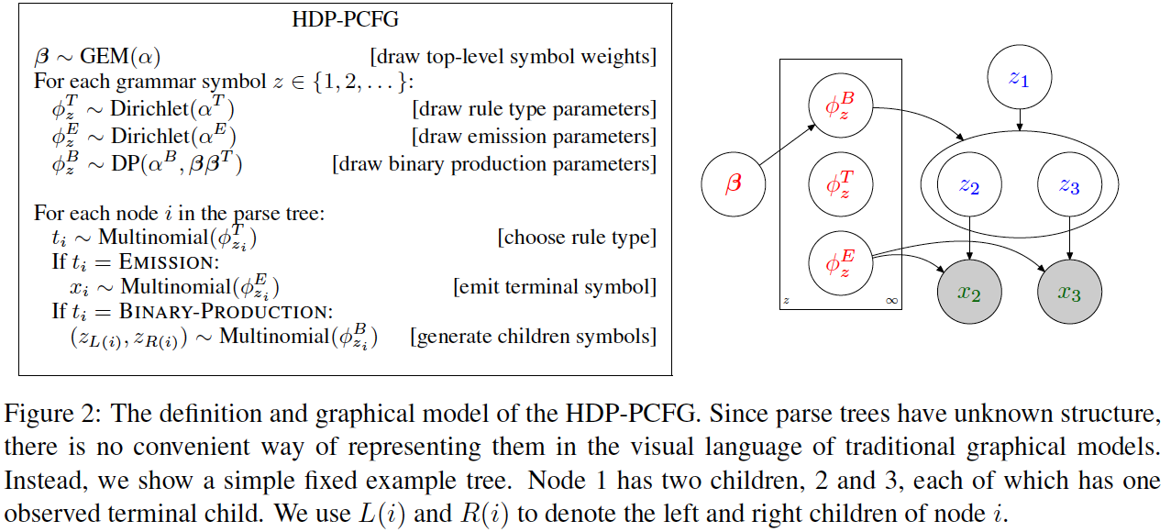
“Infinite” PCFG
PCFGs can already handle infinite-length derivations
“infinite” here means an infinite number of nonterminals:
Liang et al. (2007), Finkel et al. (2007)

Slide 27
when might you want to permit an unbounded set of latent items in a model?
# topics in LDA
# Gaussians in a Gaussian Mixture Model
# hidden states in an HMM
# nonterminals in a PCFG
morph lexicon for morphological segmentation
lexicon for Chinese word segmentation
# coreference chains in coreference resolution
# senses for a word when learning sense-specific word embeddings
# dimensions in an embedding (?!)

Slide 28
we need priors over distributions that permit an unbounded set of items

Slide 29
LDA Generative Story
dimensionality of alpha
must be K (the number of topics)

Slide 30
Dirichlet Process (DP)
“distribution over distributions”
unlike Dirichlet distribution, DP does not require pre-specifying number of components
we’ll now describe how a DP generates a distribution over an unbounded set of items

Slide 31
Running Example
let’s say we’re trying to segment words into morphological units without any supervision:
walking → walk + ing
restarted → re + start + ed
what is the unbounded set of latent items here?
lexicon of possible morphological units

Slide 32
Dirichlet Process (DP)
contains a “base distribution”
simple example base distribution for our morph lexicon:
e.g., probability of “ing”:

Slide 33
Dirichlet Processes
our unbounded distribution over items will choose its items by sampling from the base distribution
base distribution typically has an infinite set of items with nonzero probability, as in our example:

Slide 34
Items and Probabilities
base distribution provides the items (“atoms”), as many as we want
where do their probabilities come from?
we need an infinite set of probabilities that sum to 1
DPs have another parameter: concentration (strength) parameter s

Slide 35
Stick-Breaking Process
full stick
…
the betas form an infinite sequence that sums to 1
they provide probabilities for an infinite set of items!

Slide 36
Stick-Breaking Process
full stick
the betas form an infinite sequence that sums to 1
they provide probabilities for an infinite set of items!

Slide 37
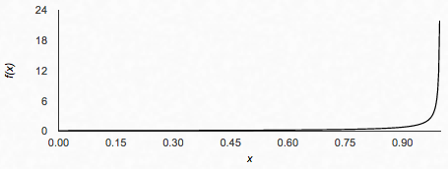
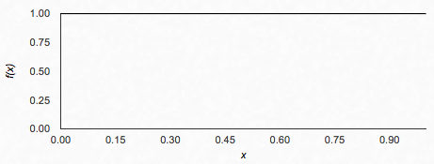
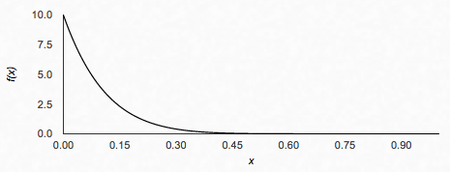
Beta Distribution

Slide 38
Stick-Breaking with High Concentration (s = 10)
full stick

Slide 39
Stick-Breaking with High Concentration (s = 10)
full stick
high concentration = more of probability mass preserved for other pieces in the stick

Slide 40
Stick-Breaking with Low Concentration (s = 0.1)
full stick

Slide 41
Stick-Breaking with Low Concentration (s = 0.1)
full stick
low concentration = stronger power law effects in resulting probabilities

Slide 42
A Draw G from a DP
draw infinite probabilities from
stick-breaking process with parameter s
draw atoms from base distribution
atoms can be repeated!

Slide 43
A Draw G from a DP
draw infinite probabilities from
stick-breaking process with parameter s
draw atoms from base distribution
atoms can be repeated!

Slide 44
the stick-breaking construction of the DP is useful for specifying models and defining inference algorithms

Slide 45
Dirichlet Process Mixture Model
generative story for dataset :
each x is generated from a single mixture component
the number of mixture components is unbounded
what should the base distribution be?

