Slide 1
TTIC 31210: Advanced Natural Language Processing
Kevin Gimpel
Spring 2019
Lecture 16:
Finish Bayesian Nonparametrics;
Research Advice

Slide 2
Roadmap
intro (1 lecture)
deep learning for NLP (5 lectures)
structured prediction (4.5 lectures)
generative models, latent variables, unsupervised learning, variational autoencoders (1.5 lectures)
Bayesian methods in NLP (2 lectures)
Bayesian nonparametrics in NLP (1.5 lectures)
research advice (0.5 lectures)

Slide 3
Assignments
questions about Assignment 4?

Slide 4
Grading
let me know before your grading deadline if you want to take this class pass/fail

Slide 5
Dirichlet Process (DP)
“distribution over distributions”
unlike Dirichlet distribution, DP does not require pre-specifying number of components (“nonparametric”)

Slide 6
Views of the Dirichlet Process (DP)
last week: the “stick-breaking” view
today we’ll discuss the “Chinese Restaurant Process” view
with both, we have the same DP hyperparameters
(base distribution & concentration parameter s)

Slide 7
Base Distribution for DP
our unbounded distribution over items will choose them from base distribution
base distribution usually has infinite support
simple example base distribution for our morph lexicon:

Slide 8
Concentration Parameter
in stick-breaking process, concentration parameter determines how much of the stick we break off each time
high concentration == small parts of stick
full stick

Slide 9
stick-breaking construction is useful for specifying models and defining inference algorithms
another useful way of representing a draw from a DP is with the Chinese Restaurant Process (CRP)
CRP provides a distribution over partitions with an unbounded number of parts

Slide 10
imagine a Chinese restaurant with an infinite number of tables…
…
1
2
3
4

Slide 11
first customer sits at first table:
…
1
2
3
4

Slide 12
second customer enters, chooses a table:
…
1
2
3
4

Slide 13
second customer enters,
chooses table 1:
…
1
2
3
4

Slide 14
second customer enters,
chooses table 1:
chooses new table:
…
1
2
3
4

Slide 15
second customer enters,
chooses table 1
…
1
2
3
4

Slide 16
third customer enters,
…
1
2
3
4

Slide 17
third customer enters,
chooses table 1:
chooses new table:
…
1
2
3
4

Slide 18
third customer enters,
chooses new table
…
1
2
3
4

Slide 19
fourth customer enters,
p(choose table 1): p(choose table 2):
p(choose new table):
…
1
2
3
4

Slide 20
…
1
2
3
4

Slide 21
large value of concentration parameter s:
…
1
2
3
4
full stick

Slide 22
small value of concentration parameter s:
…
1
2
3
4

Slide 23
CRP gives us an unbounded set of probabilities
atoms (drawn from base distribution) are the “dish” eaten by all customers at the table:
walk
talk
ed
ing
…
1
2
3
4

Slide 24
A Draw G from a DP (Stick-Breaking Representation)
draw infinite probabilities from
stick-breaking process with parameter s
draw atoms from base distribution
atoms can be repeated!

Slide 25
A Representation of G Drawn from a DP (Chinese Restaurant Process Representation)
draw table assignments for n customers
with parameter s
for each occupied table, draw atom
from base distribution
each draw from G is an atom, where its
probability comes from the number of
customers at its table
number of
tables occupied
this avoids directly drawing G itself
Notes:
% anlp: CRP priors
%p(Y^{(2)} = 1 \mid Y^{(1)}, s) = \frac{1}{1+s}
%p(Y^{(2)} = 2 \mid Y^{(1)}, s) = \frac{s}{1+s}
%p(Y^{(3)} = 1 \mid Y^{(1)}, Y^{(2)}, s) = \frac{2}{2+s}
%p(Y^{(3)} = 2 \mid Y^{(1)}, Y^{(2)}, s) = \frac{s}{2+s}
%\frac{2}{3+s}
%\frac{1}{3+s}
%\frac{s}{3+s}
%&\mbox{1: } y^{(1)},...,y^{(n)}\sim\mbox{CRP}(s)\\
%&\mbox{2: } \phi_1,...,\phi_{y_{\mathrm{max}}} \sim G_0\\
%&\mbox{3: set each $\theta^{(i)}$ to $\phi_{y^{(i)}}$ for $i\in\{1,...,n\}$}\\
%the distribution $G$ is defined as:}\\
%G(\theta) = \sum_{k=1}^{\infty} \beta_k \mathbb{I}[\theta = \theta_k]
%G(\textrm{``ing''}) = \sum_{k=1}^{\infty} \beta_k \mathbb{I}[\textrm{``ing''} = \theta_k]
%y_{\mathrm{max}} = \max_i\, y^{(i)}

Slide 26
CRP can be used to define predictive distribution of values from a DP without representing G explicitly:
given that we saw values of some data points, what’s the probability of seeing some value next?
e.g., if using a DP prior for modeling words, this is the probability of the next word conditioned on all previous words
Notes:
p(\theta_i \mid \boldsymbol{\theta}_{-i}, G_0, s) = \int p(\theta_i\mid G) \,p(G\mid \boldsymbol{\theta}_{-i}, G_0, s) \,dG

Slide 27
predictive distribution of values:
integrate out G:
under certain conditions (models typically used in NLP), this yields the CRP representation:
Notes:
p(\theta_i \mid \boldsymbol{\theta}_{-i}, G_0, s) = \int p(\theta_i\mid G) \,p(G\mid \boldsymbol{\theta}_{-i}, G_0, s) \,dG
p(\theta_i = \theta \mid \boldsymbol{\theta}_{-i}, G_0, s) = \frac{1}{i-1 + s}\sum_{j=1}^{i-1} \mathbb{I}[\theta_j = \theta] + \frac{s}{i-1+s}G_0(\theta)

Slide 28
probability of choosing some
existing table with dish
probability of choosing
a new table and drawing dish
= number of times was observed in cases other than i
Notes:
p(\theta_i \mid \boldsymbol{\theta}_{-i}, G_0, s) = \int p(\theta_i\mid G) \,p(G\mid \boldsymbol{\theta}_{-i}, G_0, s) \,dG
p(\theta_i = \theta \mid \boldsymbol{\theta}_{-i}, G_0, s) = \frac{1}{i-1 + s}\sum_{j=1}^{i-1} \mathbb{I}[\theta_j = \theta] + \frac{s}{i-1+s}G_0(\theta)
p(\theta_i = \theta \mid \boldsymbol{\theta}_{-i}, G_0, s) = \frac{n_{\theta}^{(\boldsymbol{\theta}_{-i})} + sG_0(\theta)}{i-1 + s}

Slide 29
Inference
CRP representation of DP very useful for MCMC algorithms!
another important detail: DP models are exchangeable:
probability of a sequence of words doesn’t depend on their ordering in the sequence

Slide 30
Important Extensions
hierarchical Dirichlet processes:
Dirichlet process where base distribution is another Dirichlet process!
Pitman-Yor processes
generalization of Dirichlet Process that supports power law effects
hierarchical Pitman-Yor processes

Slide 31
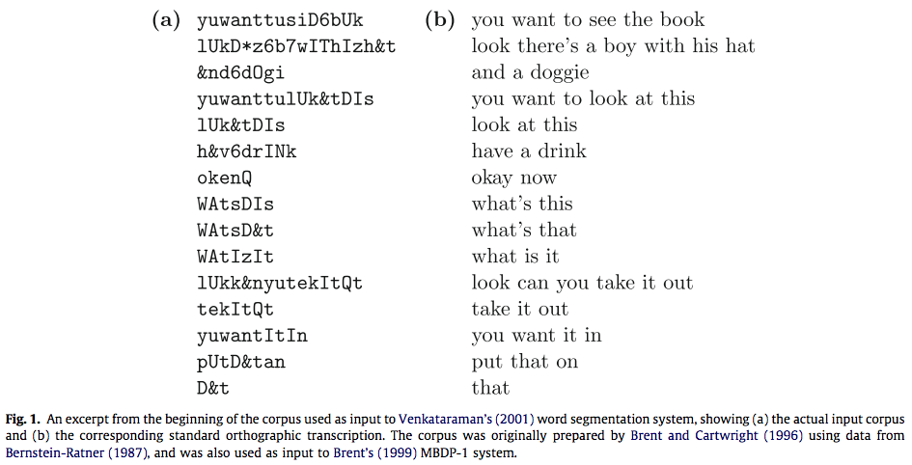
Segmentation
Goldwater et al. (2009): A Bayesian framework for word segmentation: Exploring the effects of context

Slide 32
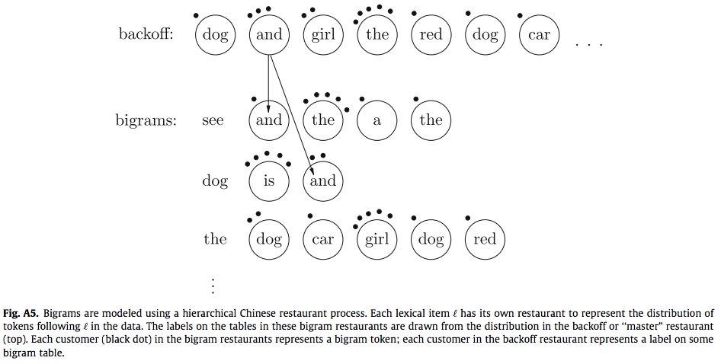
Segmentation
Goldwater et al. (2009): A Bayesian framework for word segmentation: Exploring the effects of context

Slide 33
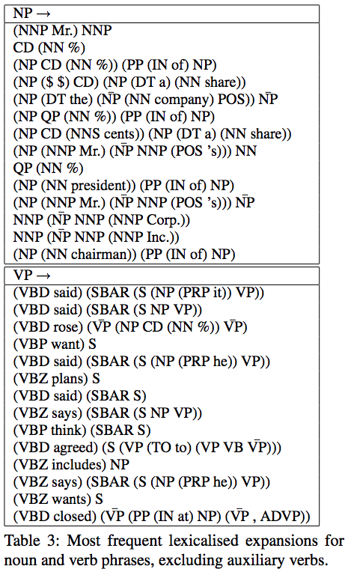
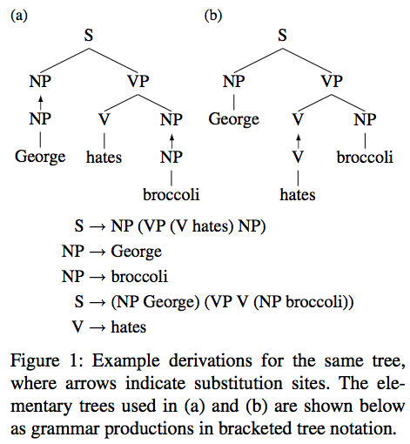
Grammar Rules for Parsing
Cohn et al. (2009): Inducing Compact but Accurate Tree-Substitution Grammars
Post & Gildea (2009): Bayesian Learning of a Tree Substitution Grammar

Slide 34
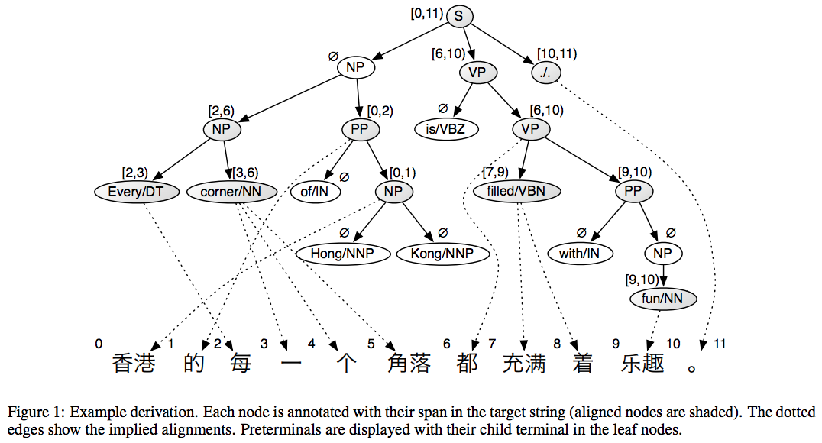
Synchronous Grammar Rules for Machine Translation
Cohn & Blunsom (2009): A Bayesian Model of Syntax-Directed Tree to String Grammar Induction

Slide 35
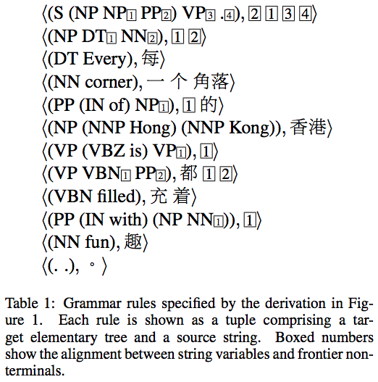
Synchronous Grammar Rules for Machine Translation
Cohn & Blunsom (2009): A Bayesian Model of Syntax-Directed Tree to String Grammar Induction

Slide 36
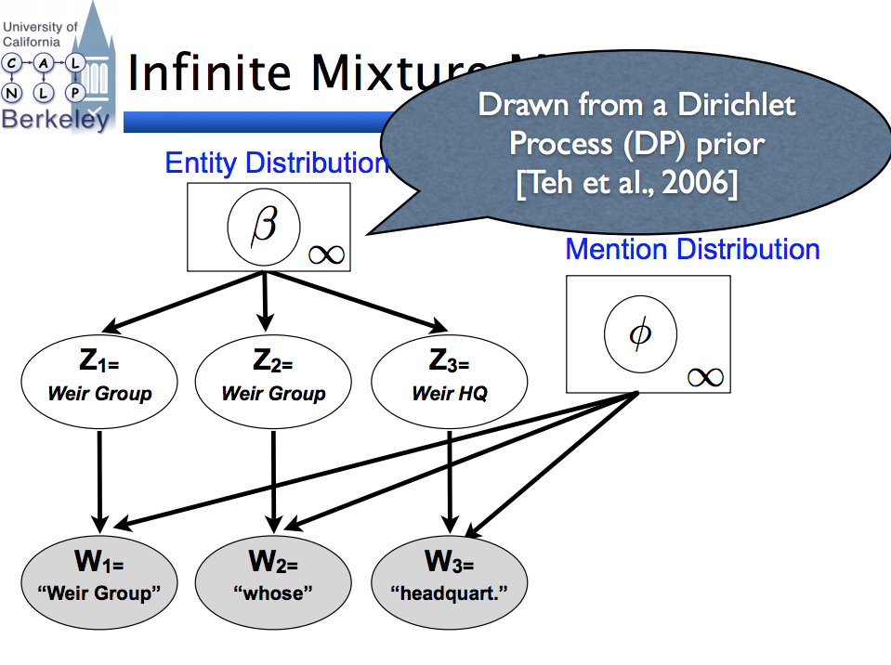
Unsupervised Coreference Resolution
Haghighi & Klein (2007): Unsupervised Coreference Resolution in a Nonparametric Bayesian Model

Slide 37
nato must either say " yes " or " no " to the baltic states .
Generative story:
Generate number of word positions
Generate number of colors
Assign word positions to colors
Generate a lexical pattern for each color
Gimpel & Smith (2011): Generative Models of Monolingual and Bilingual Gappy Patterns

Slide 38
nato must either say " yes " or " no " to the baltic states .
Generative story:
Generate number of word positions (n = 16)
Generate number of colors
Assign word positions to colors
Generate a lexical pattern for each color

Slide 39
nato must either say " yes " or " no " to the baltic states .
Generative story:
Generate number of word positions (n = 16)
Generate number of colors (m = 10)
Assign word positions to colors
Generate a lexical pattern for each color

Slide 40
nato must either say " yes " or " no " to the baltic states .
Generative story:
Generate number of word positions (n = 16)
Generate number of colors (m = 10)
Assign word positions to colors
Generate a lexical pattern for each color
Notes:
For each word position, we sample a color uniformly.
If we don’t use all m colors, we redo this step until we do.

Slide 41
nato must either say " yes " or " no " to the baltic states .
Generative story:
Generate number of word positions (n = 16)
Generate number of colors (m = 10)
Assign word positions to colors
Generate a lexical pattern for each color
nato must either say " yes " or " no " to the baltic states .
Notes:
Go through each color and generate a pattern.

Slide 42
nato must either say " yes " or " no " to the baltic states .
Generative story:
Generate number of word positions (n = 16)
Generate number of colors (m = 10)
Assign word positions to colors
Generate a lexical pattern for each color
nato must either say " yes " or " no " to the baltic states .
Notes:
Go through each color and generate a pattern.

Slide 43
nato must either say " yes " or " no " to the baltic states .
Generative story:
Generate number of word positions (n = 16)
Generate number of colors (m = 10)
Assign word positions to colors
Generate a lexical pattern for each color
nato must either say " yes " or " no " to the baltic states .
Notes:
Go through each color and generate a pattern.

Slide 44
nato must either say " yes " or " no " to the baltic states .
Generative story:
Generate number of word positions (n = 16)
Generate number of colors (m = 10)
Assign word positions to colors
Generate a lexical pattern for each color
nato must either say " yes " or " no " to the baltic states .
Notes:
If the pattern doesn’t fit the format of the color, throw it out and sample a new pattern for that color.

Slide 45
What is a pattern?
nato must either say " yes " or " no " to the baltic states .
A sequence of symbols, possibly including the special symbol “__” which is used to indicate a gap of nonzero length
Examples:
Generative story:
Generate n word positions (n = 16)
Generate m colors (m = 10)
Assign word positions to colors
Generate a lexical pattern for each color
nato
must
either __ or
the united states
according to the __ ,
countries __ their __ the united states
nato must either say " yes " or " no " to the baltic states .

Slide 46
nato must either say " yes " or " no " to the baltic states .
Generative story:
Generate number of word positions (n = 16)
Generate number of colors (m = 10)
Assign word positions to colors
Generate a lexical pattern for each color
nato must either say " yes " or " no " to the baltic states .

Slide 47
nato must either say " yes " or " no " to the baltic states .
Generative story:
Generate number of word positions (n = 16)
Generate number of colors (m = 10)
Assign word positions to colors
Generate a lexical pattern for each color
nato must either say " yes " or " no " to the baltic states .

Slide 48
nato must either say " yes " or " no " to the baltic states .
Generative story:
Generate number of word positions (n = 16)
Generate number of colors (m = 10)
Assign word positions to colors
Generate a lexical pattern for each color
nato must either say " yes " or " no " to the baltic states .

Slide 49
Highest-Ranked Patterns
-- __ -- ( __ ) - __ - both __ and not only __ but " __ " more __ than either __ or why __ ? neither __ nor what __ ? rule __ law whether __ or around __ world has __ been | how __ ? the __ ( __ ) on __ basis less __ than on __ other hand at __ level it is __ that not __ , but play __ role france __ germany he __ his allow __ to for __ first time china __ india what __ do | we __ our over __ past prevent __ from in __ way one __ another political __ economic for __ reasons at __ time more __ more the rest __ world more __ less in __ region rich __ poor as __ whole on __ scale | his __ his some __ others may __ be as __ as oil __ gas at __ moment such as __ and question __ whether if __ then war __ iraq ; __ ; have __ been in __ cases war __ terror at __ cost
Gimpel & Smith (2011): Generative Models of Monolingual and Bilingual Gappy Patterns
Notes:
Only gappy patterns are shown here

Slide 50
When to be Bayesian?
if you’re doing unsupervised learning or learning with latent variables
if you want to marginalize out some model parameters
if you want to learn the structure/architecture of your model
if you want to learn a potentially-unbounded lexicon or set of latent items (Bayesian nonparametrics)

Slide 51
Being Bayesian in Practice
you can forgo theory to solve a problem, but you should know what you are doing!
e.g., some researchers would start by deriving a Gibbs sampler without thinking about the model
as a result, the Gibbs sampler was not a Gibbs sampler (just some code that did something)
if you only care about solving a problem, this may be fine, but you should make sure you understand and communicate to readers that it’s not a Gibbs sampler!

Slide 52
Roadmap
intro (1 lecture)
deep learning for NLP (5 lectures)
structured prediction (4.5 lectures)
generative models, latent variables, unsupervised learning, variational autoencoders (1.5 lectures)
Bayesian methods in NLP (2 lectures)
Bayesian nonparametrics in NLP (1.5 lectures)
research advice (0.5 lectures)

Slide 53
getting started
researching
communication

Slide 54
Getting Started on a New Project
what are the inputs and outputs?
when I talk to people who “want to use AI”:
they want AI to tell them what to do with their data
they have never thought about inputs and outputs

Slide 55
If you are the AI consultant…
ask for examples of inputs and outputs
if they don’t have these, then tell them to study the data until they figure this out
most important thing they can do: think long and hard about this part, keeping in mind privacy, fairness, and ethics

Slide 56
Once you have input/output pairs…
look at the data
use UNIX command-line tools: awk, grep, sort, uniq, cut, join, comm, etc.
do what you can without writing code
your code is slow and buggy

Slide 57
Once you have input/output pairs…
“If you’re going to ask the computer to do the task, try to do it yourself first.” –Kevin Knight
sample some data, hide the outputs from yourself, and try to predict them
if you find yourself using tricks and shallow heuristics, that’s what the computer will do too!

Slide 58
Preprocessing
be aware of the preprocessing you’re doing!
I preprocessed the data for the assignments
some of you did extra preprocessing. why?
no single preprocessing pipeline is optimal
everything can be tuned, including preprocessing

Slide 59
Most Important Preprocessing Rule
if using embeddings or linguistic analyzers, match your preprocessing to what they expect
this may be non-trivial – you might need to reverse-engineer their decisions

Slide 60
getting started
researching
communication

Slide 61
Keep Your Goals in Mind
higher numbers are neither necessary nor sufficient for making a contribution
junior researchers want to get higher numbers
senior researchers want to know why the numbers are higher

Slide 62
“I always tell students not to get too pleased when they get state of the art performance on some standard task: someone else will beat them next year.
If the only thing that I learn from their papers is that they win on task X, then next year there's nothing to learn from that paper.
The paper has to teach me something else to have any sort of lasting effect: what is the generalizable knowledge.”
– Hal Daume, The myth of a strong baseline, Nov 15, 2014

Slide 63
Working on a Research Project
throughout, be both quantitative and qualitative
if quantitative eval is not working out, it can be hard to figure out why (it’s just numbers…)
but whether or not you’re beating the baseline, qualitative eval should look reasonable
if qualitative eval looks bad, maybe there’s a bug

Slide 64
Working on a Research Project
even worse, quantitative eval may look good but there could be a beneficial bug
e.g., bug in evaluation code
your brain is good at sanity checks in qualitative evaluation
computers are not (yet) good at sanity checks

Slide 65
The Role of Your Brain in Your Research
use your brain to help you
this is non-trivial; see “The Bitter Lesson” by Rich Sutton
for some things, your brain is better than a computer
for other things, a computer is better than your brain
figure out which is which
e.g., look at data, form hypotheses, write code to check those hypotheses on more data that you can’t look at systematically, repeat

Slide 66
you can’t be systematic about everything
do a greedy search (or beam search) through the space of ideas, experiments, methods
brains are pretty good at this sort of open-ended, heuristic search

Slide 67
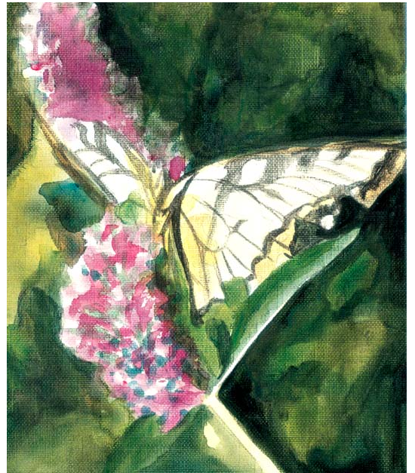
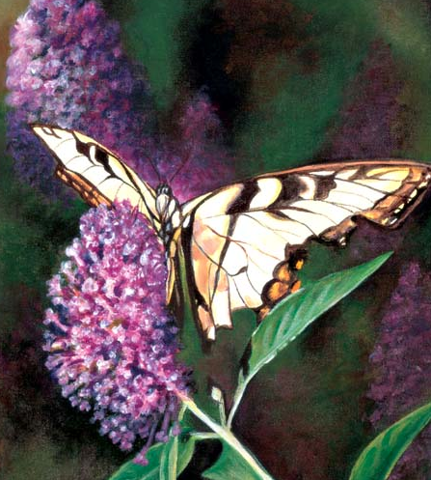
The Awkward Stage
The Final Painting
Credit: Lee Hammond

Slide 68
The Awkward Stage
beginning painters often give up when they reach the awkward stage
experienced painters know how to finish
Credit: Lee Hammond

Slide 69
Research Projects have Awkward Stages
you are bogged down in hyperparameter tuning
you have tried so many random things that you don’t know how to distill them into a coherent story
the results are inconsistent, helping on some tasks/datasets but not others (this is very common!)
you’ve been trying stuff forever and nothing seems to predictably affect the results

Slide 70
Escaping the Awkward Stage
embrace the notion that a long search over the space of ideas is necessary for understanding!
figure out what matters and what doesn’t
talk to other researchers and see what parts of your work they are most excited about
focus on those parts, streamlining the rest

Slide 71
When Things Don’t Work Out
sometimes you can keep working and publish a paper about your experiences
but you might be better off just leaving things behind and starting something new
publishing has costs: time and attention

Slide 72
getting started
researching
communication

Slide 73
“Your writing is not about you. It’s about the Reader…
There is one thing all Readers want:
clear,
concise,
comprehensible sentences
that mean something to them.”
June Casagrande
It Was the Best of Sentences, It was the Worst of Sentences

Slide 74
Technical Writing
writing should be in service of the research
good writing does not draw attention to itself
mathematical notation?
goal is to make things clearer, not impress anyone!
with good notation, complex ideas can be clear & concise

Slide 75
I hope they think I’m smart
how does this fit into my grand unified theory?
I didn’t catch that technical part and now I’m lost
how does this relate to my research?
Speaker
Audience

Slide 76
I hope they think I’m smart
how does this fit into my grand unified theory?
I didn’t catch that technical part and now I’m lost
how does this relate to my research?
I’m not following. Is everyone else smarter than me?
I’m bored
Speaker
Audience

Slide 77
I hope they think I’m smart
how does this fit into my grand unified theory?
I didn’t catch that technical part and now I’m lost
how does this relate to my research?
most people think about themselves most of the time
I’m not following. Is everyone else smarter than me?
I’m bored
Speaker
Audience

Slide 78
Speaker
Audience

Slide 79
every talk is about bridging a gap
Speaker
Audience

Slide 80
every talk is about bridging a gap
you have something in your head,
you want to get it into their heads
Speaker
Audience

Slide 81
a good talk:
Speaker
Audience

Slide 82
a bad talk:
Speaker
Audience

Slide 83
a bad talk:
Speaker
Audience

Slide 84
build bridges to your audience
organization, content, and delivery should be oriented to the audience
if you start building, they will help!
a good talk feels like a collaboration
Speaker
Audience

Slide 85
Other Advice for Oral Presentations
watch videos by Jean-luc Doumont
it’s mostly common sense, yet we all forget!
to prepare an N-minute talk, you need 20N minutes
practice by yourself (out loud!) and with others
this will help you to build bridges to everyone in the audience
for a conference talk, practice at least 10 times

Slide 86
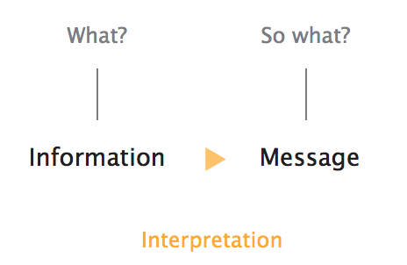
Doumont

Slide 87
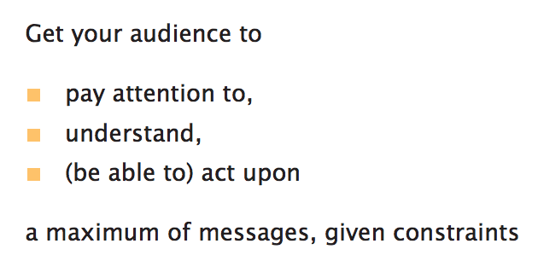
Doumont

Slide 88
Thanks!

