Slide 1
TTIC 31210: Advanced Natural Language Processing
Kevin Gimpel
Spring 2019
Lecture 4:
Subword Modeling and Contextualized Word Embeddings

Slide 2
Roadmap
intro (1 lecture)
deep learning for NLP (5 lectures)
structured prediction: sequence labeling, syntactic and semantic parsing, dynamic programming (4 lectures)
generative models, latent variables, unsupervised learning, variational autoencoders (2 lectures)
Bayesian methods in NLP (2 lectures)
Bayesian nonparametrics in NLP (2 lectures)
review & other topics (1 lecture)

Slide 3
Today
modeling subword structure in words
contextualized word embeddings

Slide 4
Recap
on Monday we briefly reviewed some models and loss functions for word embeddings

Slide 5
Other Work on Word Embeddings
using subword information (e.g., characters) in word embeddings
multiple embeddings for a single word type corresponding to different word senses
tailoring embeddings using particular resources or for particular NLP tasks
Notes:
Ling LSTM, ballest
Yoon Kim CNN
DSSM/Charagram

Slide 6
Other Work on Word Embeddings
using subword information (e.g., characters) in word embeddings
multiple embeddings for a single word type corresponding to different word senses
tailoring embeddings using particular resources or for particular NLP tasks
Notes:
Ling LSTM, ballest
Yoon Kim CNN
DSSM/Charagram

Slide 7
Subword Modeling for Word Embeddings
Using word embeddings has limitations:
closed vocabulary (100k-300k words is typical)
large number of parameters! (100k * 300)
for morphologically-rich languages, using a separate vector for each word type is “obviously” wrong
Solution: character-level modeling
open vocabulary, fewer parameters, often similar or better performance

Slide 8
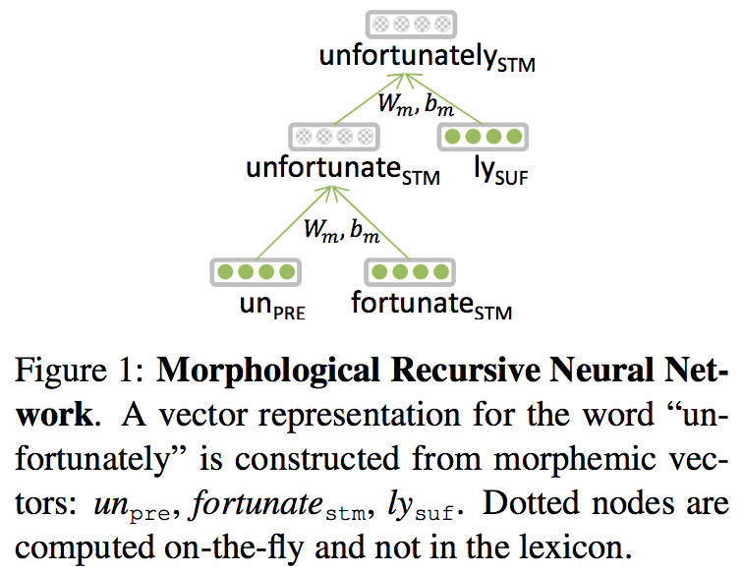
Early Neural Methods
morphological analyzer + recursive neural network:
Luong et al. (2013): Better Word Representations with Recursive Neural Networks for Morphology

Slide 9

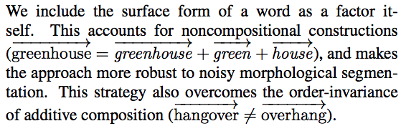
unsupervised morphological analysis & vector addition:
Botha & Blunsom (2014): Compositional Morphology for Word Representations and Language Modelling

Slide 10
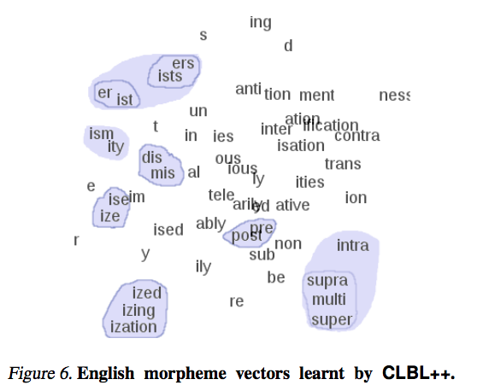
visualization of learned morpheme vectors:
Botha & Blunsom (2014): Compositional Morphology for Word Representations and Language Modelling

Slide 11
2013-2014: morphological analyzers + define composition function on morphemes + learn embeddings for morphemes
today, researchers use one of the following:
RNNs on character sequences (Ling et al., 2015; Ballesteros et al., 2015)
CNNs on character sequences (dos Santos and Zadrozny, 2014; Zhang et al., 2015; Kim et al., 2016)
represent words as bags of character n-grams, learn embeddings for character n-grams

Slide 12
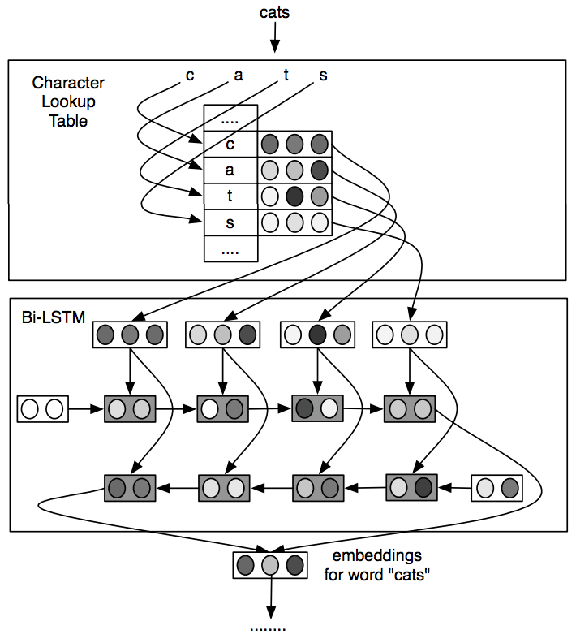
Bidirectional LSTM over Characters
Ling et al. (2015): Finding Function in Form: Compositional Character Models for Open Vocabulary Word Representation

Slide 13
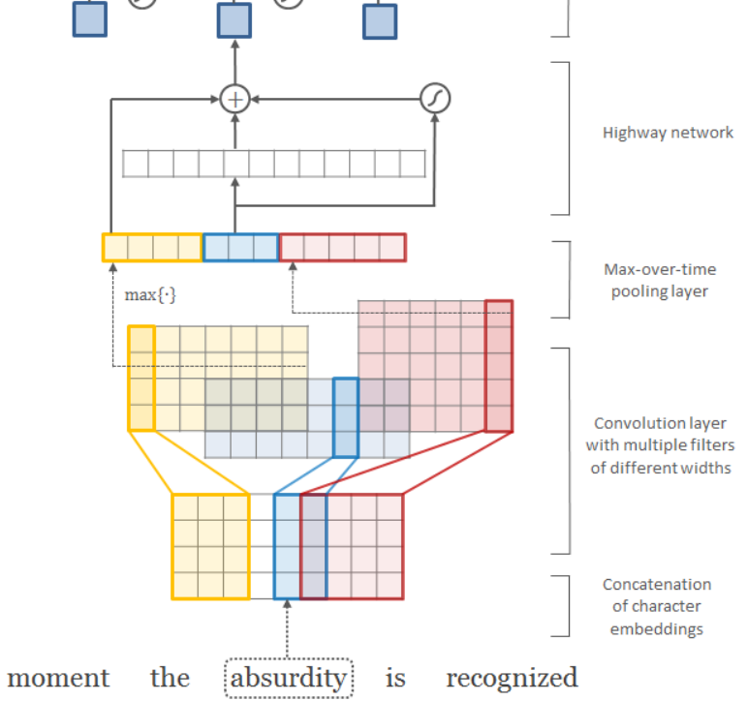
Convolutional Neural Network over Character Sequence
Kim et al. (2016): Character-Aware Neural Language Models

Slide 14
Convolutional Neural Networks
convolutional neural networks (CNNs) use filters that are “convolved with” (matched against all positions of) the input
informally, think of convolution as “perform the same operation over multiple parts of the input in some systematic order”
CNNs are often used in NLP to convert a word or sentence into a feature vector

Slide 15
Filters
for now, think of a filter as a vector in the word embedding space
the filter matches a particular region of the space
“match” = “has high dot product with”

Slide 16
Convolution
not that great
vector for not
vector for that
vector for great
consider a single convolutional filter
Notes:
%\boldsymbol{x} =
%\mathbf{x} = [0.4 \,\,... \,\, 0.9 \,\,\,\, 0.2 \,\,... \,\, 0.7 \,\,\,\, 0.3 \,\, ... \,\, 0.6]^\top
%\mathbf{w}\in\mathbb{R}^d
%\mathbf{c}
%c_1 = g\left(\mathbf{w}\cdot \mathbf{x}_{1:d} + b\right)
%c_2 = \mathbf{w}\cdot \mathbf{x}_{d+1:2d}
%c_3 = \mathbf{w}\cdot \mathbf{x}_{2d+1:3d}

Slide 17
Convolution
compute dot product of filter and each word vector:
not that great
vector for not
vector for that
vector for great
Notes:
c_1 = \mathbf{w}^\top \mathbf{x}_{1:d}

Slide 18
Convolution
compute dot product of filter and each word vector:
not that great
vector for not
vector for that
vector for great
Notes:
c_2 = \mathbf{w}^\top \mathbf{x}_{d+1:2d}

Slide 19
Convolution
compute dot product of filter and each word vector:
not that great
vector for not
vector for that
vector for great
Notes:
c_3 = \mathbf{w}^\top \mathbf{x}_{2d+1:3d}

Slide 20
Convolution
not that great
vector for not
vector for that
vector for great
Note: it’s common to add a bias b and use a nonlinearity g:
Notes:
c_1 = g\left(\mathbf{w}^\top \mathbf{x}_{1:d} + b\right)

Slide 21
Convolution
not that great
vector for not
vector for that
vector for great
= “feature map” for this filter,
has an entry for each position in input (in this case, 3 entries)

Slide 22
Pooling
not that great
how do we convert this into a fixed-length vector?
use pooling:
max-pooling: returns maximum value in
average pooling: returns average of values in
vector for not
vector for that
vector for great
= “feature map” for this filter,
has an entry for each position in input (in this case, 3 entries)

Slide 23
Pooling
not that great
how do we convert this into a fixed-length vector?
use pooling:
max-pooling: returns maximum value in
average pooling: returns average of values in
vector for not
vector for that
vector for great
then, this single filter produces a single feature
value (the output of some kind of pooling).
in practice, we use many filters of many different
lengths (e.g., n-grams rather than words).
= “feature map” for this filter,
has an entry for each position in input (in this case, 3 entries)

Slide 24
Convolutional Neural Networks
“convolutional layer” = set of filters that are convolved with the input vector (whether x or hidden vector)
could be followed by more convolutional layers, or by a type of pooling
filters of varying n-gram lengths commonly used (1- to 5-grams)
CNNs commonly used for character-level processing; filters look at character n-grams

Slide 25
Convolutional Neural Network over Characters
Kim et al. (2016): Character-Aware Neural Language Models

Slide 26
Convolutional Neural Network over Characters
1. What dimension are the character embeddings?
Kim et al. (2016): Character-Aware Neural Language Models

Slide 27
Convolutional Neural Network over Characters
1. What dimension are the character embeddings? 4
2. How many character 4-gram filters are there?
Kim et al. (2016): Character-Aware Neural Language Models

Slide 28
Convolutional Neural Network over Characters
1. What dimension are the character embeddings? 4
2. How many character 4-gram filters are there? 5
3. Why do different filter lengths lead to different lengths of feature maps?
Kim et al. (2016): Character-Aware Neural Language Models

Slide 29
what about simpler methods?
add or average vectors for character n-grams in the word:
word space (Schutze, 1993)
deep structured semantic models (Huang et al., 2013)
charagram (Wieting et al., 2016)
fastText (Bojanowski et al., 2017)

Slide 30
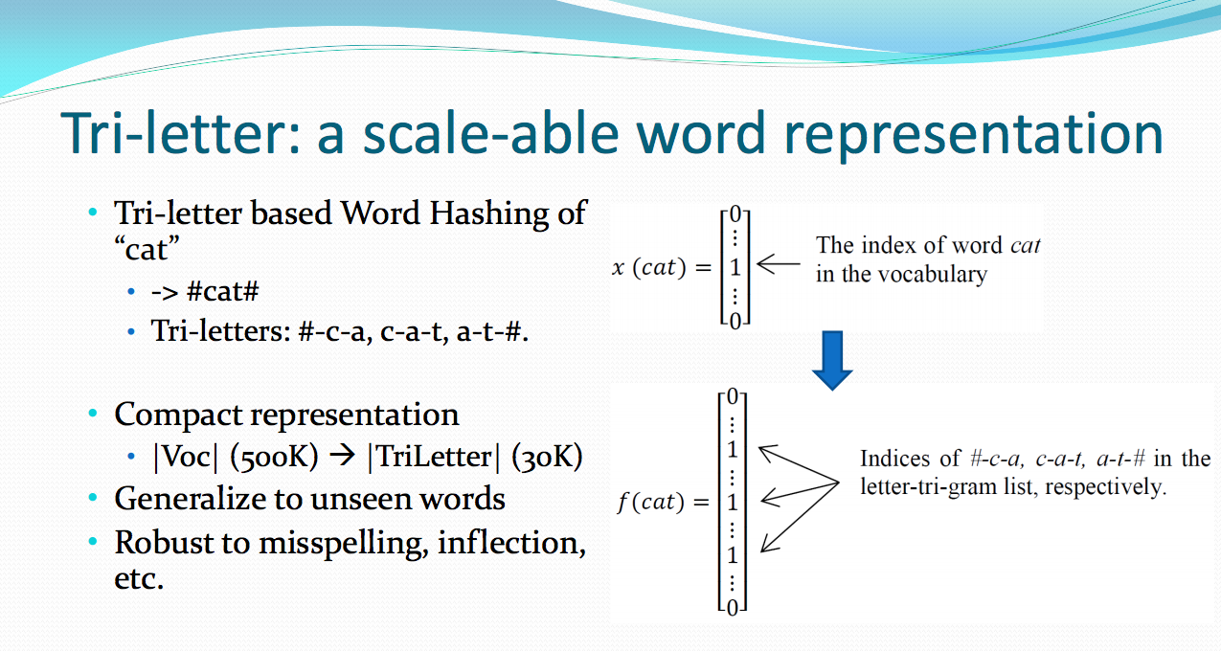
DSSM (Microsoft Research, 2013-2016)
Huang et al. (2013): Learning Deep Structured Semantic Models for Web Search using Clickthrough Data

Slide 31
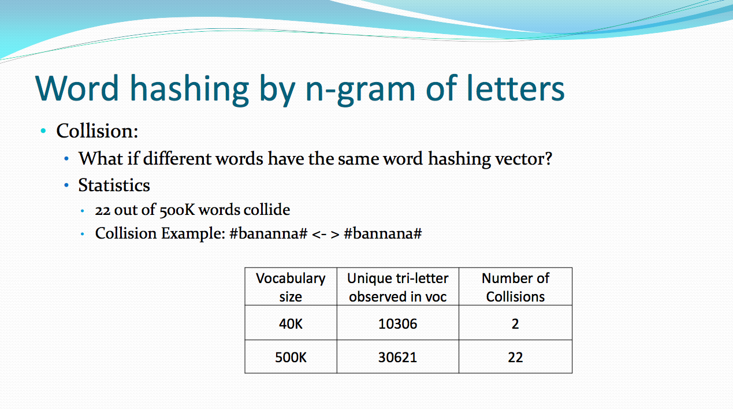
DSSM (Microsoft Research, 2013-2016)
Huang et al. (2013): Learning Deep Structured Semantic Models for Web Search using Clickthrough Data

Slide 32
“Charagram” Embeddings
to embed a character sequence (word or sentence), sum embeddings for character n-grams
only parameters to learn are embeddings for character n-grams
Wieting et al. (2016): Charagram: Embedding Words and Sentences via Character n-grams

Slide 33
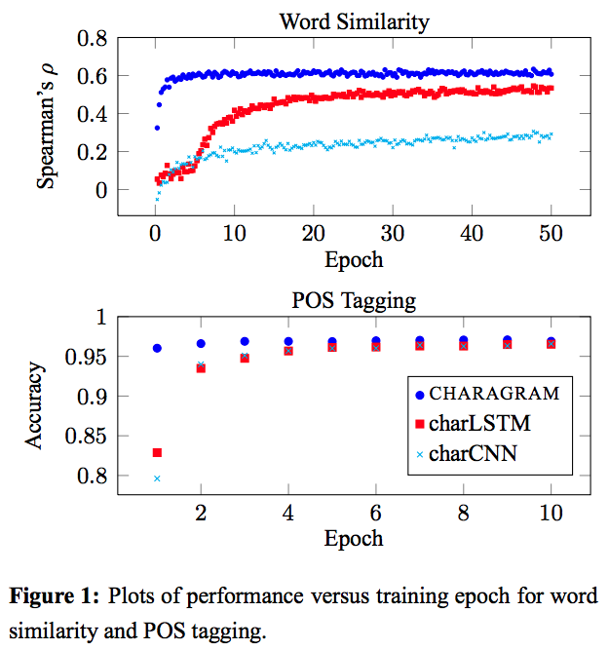
Charagram Embeddings
faster convergence to strong performance than character LSTM or CNN
Wieting et al. (2016): Charagram: Embedding Words and Sentences via Character n-grams

Slide 34
Charagram Word Embeddings
we used all 122,610 character n-grams observed in training set (2 ≤ n ≤ 4), including spaces
we trained on paraphrase pairs from the Paraphrase Database
Wieting et al. (2016): Charagram: Embedding Words and Sentences via Character n-grams

Slide 35
For words in training set:
word | nearest neighbors
refunding | refunds, refunded, refund, repayment, reimbursement, rebate, repay reimbursements, reimburse, repaying, repayments, rebates, rebating
professors | professor, professorships, professorship, teachers, professorial, teacher prof., teaches, lecturers, teachings, instructors, headteachers
huge | enormous, tremendous, large, big, vast, overwhelming, immense, giant formidable, considerable, massive, huger, large-scale, great, daunting
Wieting et al. (2016): Charagram: Embedding Words and Sentences via Character n-grams

Slide 36
For words in training set:
word | nearest neighbors
refunding | refunds, refunded, refund, repayment, reimbursement, rebate, repay reimbursements, reimburse, repaying, repayments, rebates, rebating
professors | professor, professorships, professorship, teachers, professorial, teacher prof., teaches, lecturers, teachings, instructors, headteachers
huge | enormous, tremendous, large, big, vast, overwhelming, immense, giant formidable, considerable, massive, huger, large-scale, great, daunting
For words not in training set:
word | nearest neighbors
vehicals | vehical, vehicles, vehicels, vehicular, cars, vehicle, automobiles, car
journeying | journey, journeys, voyage, trip, roadtrip, travel, tourney, voyages, road-trip
babyyyyyy | babyyyyyyy, baby, babys, babe, baby.i, babydoll, babycake, darling
Wieting et al. (2016): Charagram: Embedding Words and Sentences via Character n-grams

Slide 37
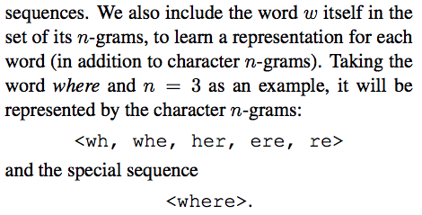
fastText
like word2vec, but represents a word as the sum of its character n-gram embeddings and an embedding for the word itself
Bojanowski et al. (2017): Enriching Word Vectors with Subword Information

Slide 38
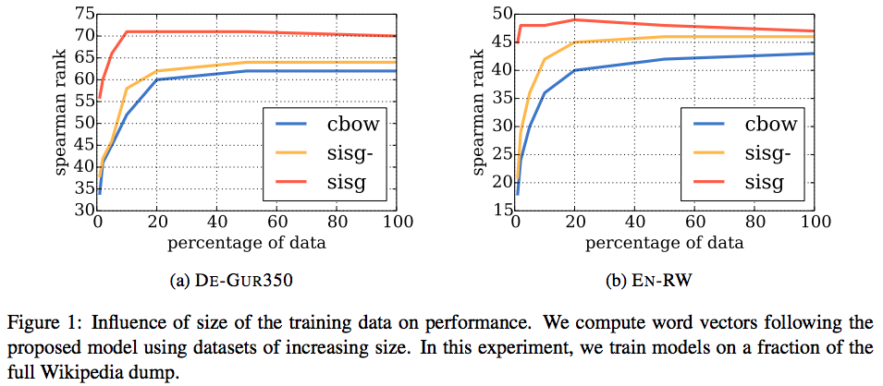
fastText
better data efficiency than word2vec:
Bojanowski et al. (2017): Enriching Word Vectors with Subword Information

Slide 39
if you’re just encoding text (rather than generating), you can use neural architectures like these to capture subword information
for generation, it’s trickier:
character RNNs are fine for generating words, but not sentences (very long sequences and long-distance dependencies)
simple, data-driven segmentation methods have emerged as the standard way to handle this

Slide 40
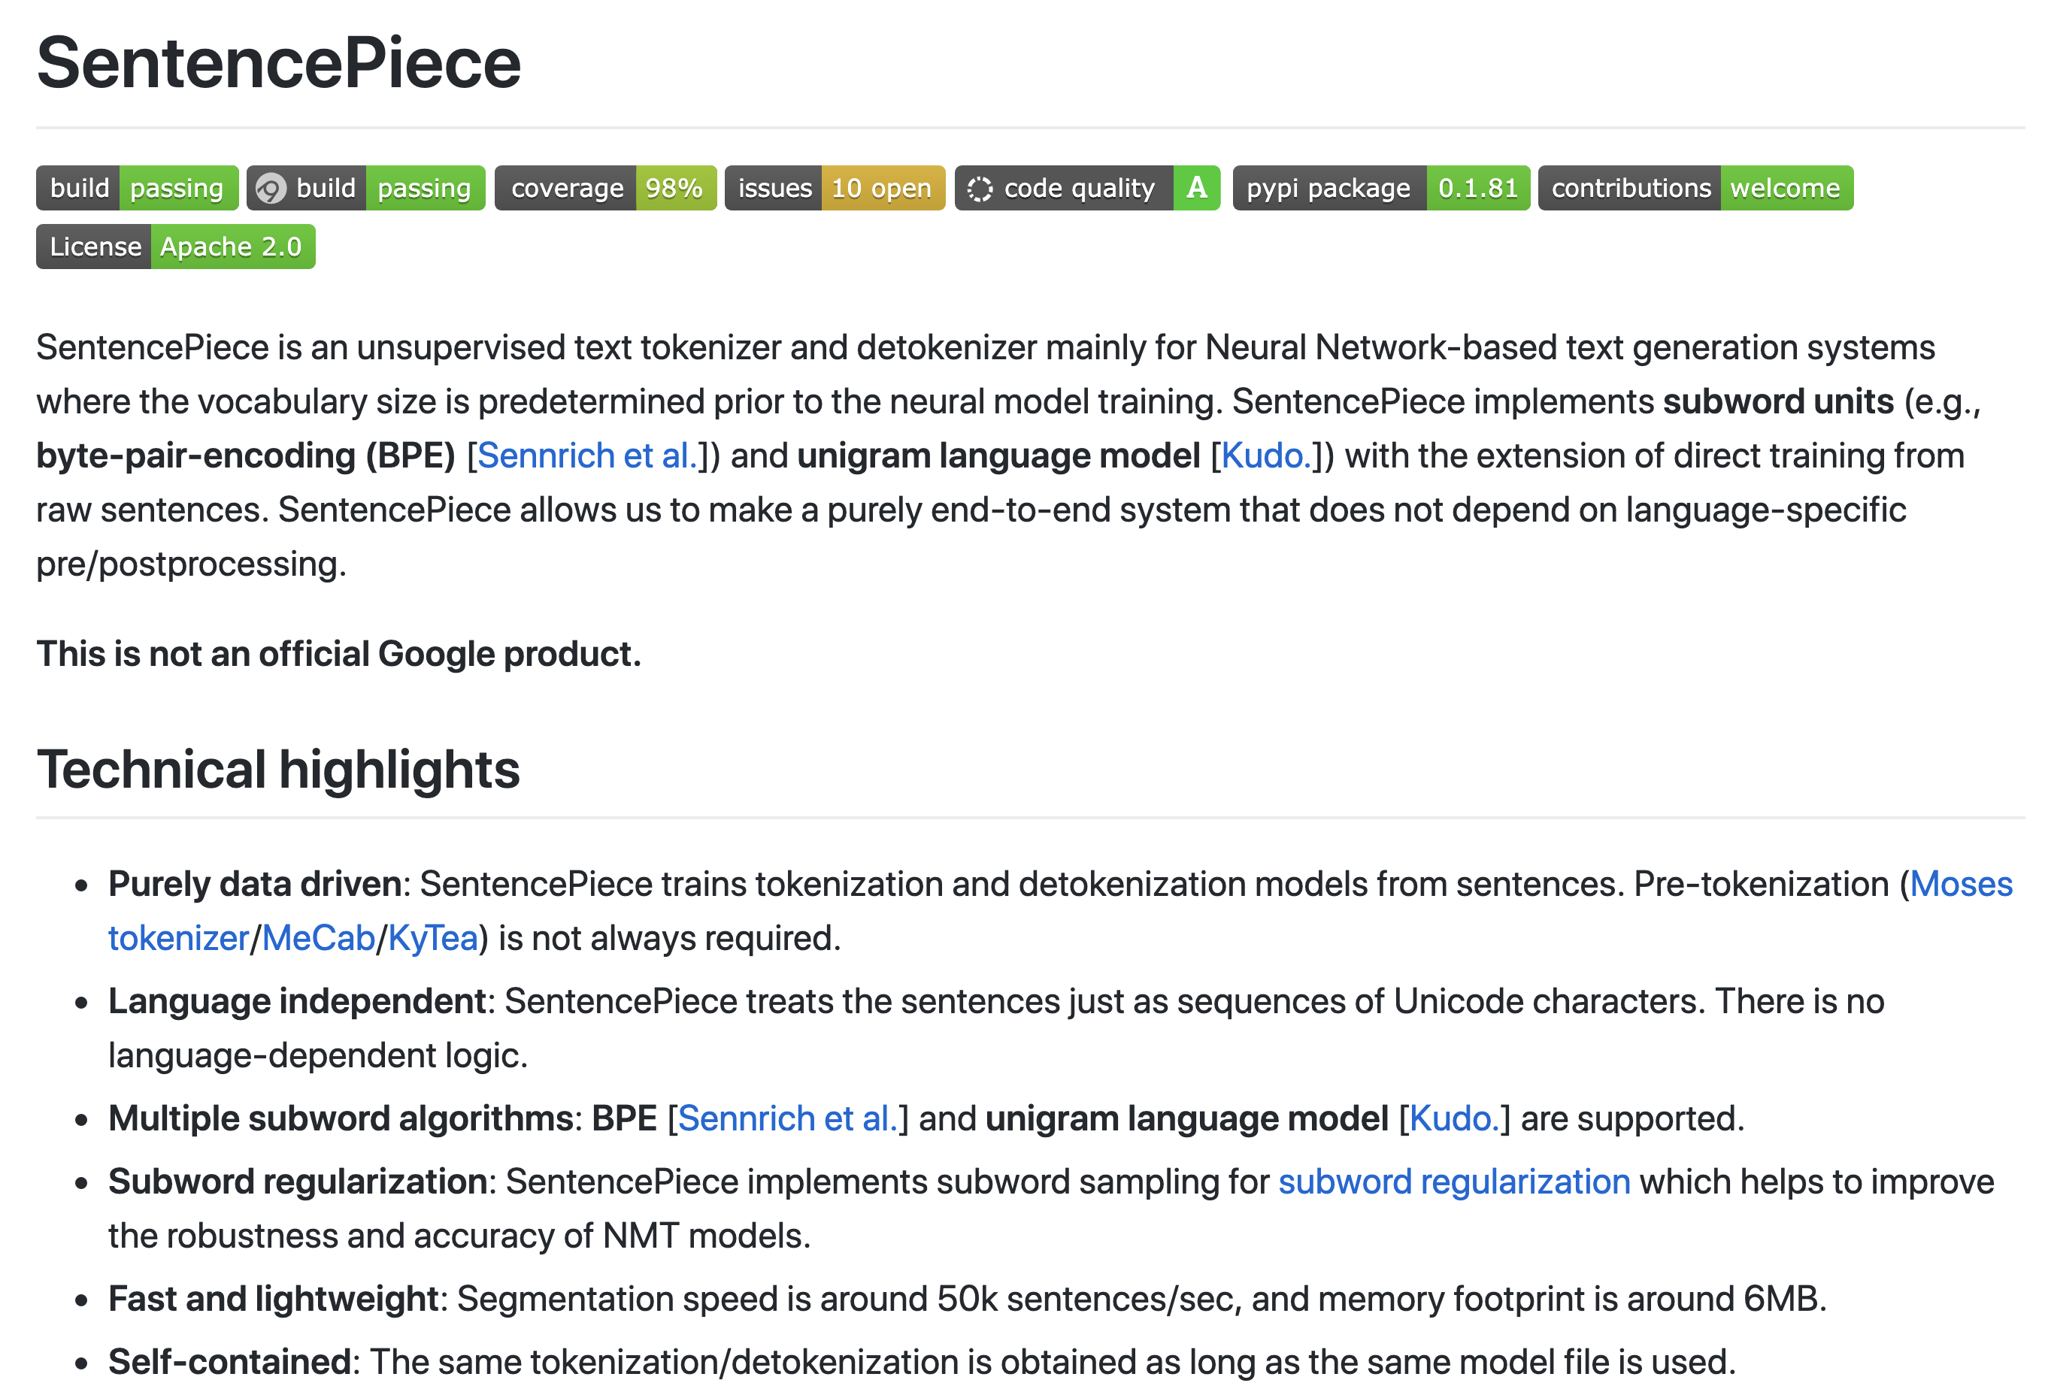
Data-Driven Segmentation
Most popular methods:
Byte pair encoding (BPE)
SentencePiece’s unigram LM

Slide 41
Data-Driven Segmentation
Most popular methods:
Byte pair encoding (BPE)
SentencePiece’s unigram LM
these are easy and fast to use & work well
they permit unbounded vocabularies with a relatively small number of parameters

Slide 42
Byte Pair Encoding (BPE) (Gage, 1994)
simple data compression technique
iteratively replaces most frequent pair of bytes in a sequence with a single, unused byte
Sennrich et al. (2016) adapted BPE for characters and character sequences

Slide 43
Byte Pair Encoding (BPE)
merge: a rule that combines two consecutive units into a single unit
initially, units are characters
after merges, units become character sequences
greedy algorithm:
merge two units with the largest unit bigram count, produce merged unit
replace all instances of that 2-unit sequence with the merged unit, recompute counts

Slide 44
Byte Pair Encoding (BPE)
Sennrich et al. use BPE based on word counts from a corpus
sentences are not used; all that’s needed are word types and their counts
special treatment for end-of-word symbol </w> (an unseen initial step merges final character in each word with </w>)
when segmenting new data, segments words individually (does not use context)

Slide 45
Corpus: Merges:
low
low
lower
lowest
high
high
higher
Sennrich et al. (2016): Neural Machine Translation of Rare Words with Subword Units

Slide 46
Corpus: Merges:
low</w>
low</w>
lower</w>
lowest</w>
high</w>
high</w>
higher</w>
actually the corpus looks like this
Sennrich et al. (2016): Neural Machine Translation of Rare Words with Subword Units

Slide 47
Corpus: Merges:
low</w>
low</w>
lower</w>
lowest</w>
high</w>
high</w>
higher</w>
w </w> (2)
r </w> (2)
h </w> (2)
t </w> (1)
the first thing we do is merge word-ending characters with </w>
Sennrich et al. (2016): Neural Machine Translation of Rare Words with Subword Units

Slide 48
Corpus: Segmentation: Merges:
low</w>
low</w>
lower</w>
lowest</w>
high</w>
high</w>
higher</w>
w </w> (2)
r </w> (2)
h </w> (2)
t </w> (1)
given this set of merges, let’s segment the corpus!
Sennrich et al. (2016): Neural Machine Translation of Rare Words with Subword Units

Slide 49
Corpus: Segmentation: Merges:
low</w>
low</w>
lower</w>
lowest</w>
high</w>
high</w>
higher</w>
l o w</w>
l o w</w>
l o w e r</w>
l o w e s t</w>
h i g h</w>
h i g h</w>
h i g h e r</w>
w </w> (2)
r </w> (2)
h </w> (2)
t </w> (1)
Sennrich et al. (2016): Neural Machine Translation of Rare Words with Subword Units

Slide 50
Corpus: Segmentation: Merges:
low</w>
low</w>
lower</w>
lowest</w>
high</w>
high</w>
higher</w>
l o w</w>
l o w</w>
l o w e r</w>
l o w e s t</w>
h i g h</w>
h i g h</w>
h i g h e r</w>
w </w> (2)
r </w> (2)
h </w> (2)
t </w> (1)
looking at the segmented corpus shows us what merge will occur next
Sennrich et al. (2016): Neural Machine Translation of Rare Words with Subword Units

Slide 51
Corpus: Segmentation: Merges:
low</w>
low</w>
lower</w>
lowest</w>
high</w>
high</w>
higher</w>
l o w</w>
l o w</w>
l o w e r</w>
l o w e s t</w>
h i g h</w>
h i g h</w>
h i g h e r</w>
w </w> (2)
r </w> (2)
h </w> (2)
t </w> (1)
what is the next merge?
(what unit bigram appears most often?)
Sennrich et al. (2016): Neural Machine Translation of Rare Words with Subword Units

Slide 52
Corpus: Segmentation: Merges:
low</w>
low</w>
lower</w>
lowest</w>
high</w>
high</w>
higher</w>
l o w</w>
l o w</w>
l o w e r</w>
l o w e s t</w>
h i g h</w>
h i g h</w>
h i g h e r</w>
w </w> (2)
r </w> (2)
h </w> (2)
t </w> (1)
l o (4)
given this new set of merges, let’s re-segment the corpus!
Sennrich et al. (2016): Neural Machine Translation of Rare Words with Subword Units

Slide 53
Corpus: Segmentation: Merges:
low</w>
low</w>
lower</w>
lowest</w>
high</w>
high</w>
higher</w>
lo w</w>
lo w</w>
lo w e r</w>
lo w e s t</w>
h i g h</w>
h i g h</w>
h i g h e r</w>
w </w> (2)
r </w> (2)
h </w> (2)
t </w> (1)
l o (4)
note: we will always “back off” to the complete segmentation
Sennrich et al. (2016): Neural Machine Translation of Rare Words with Subword Units

Slide 54
Corpus: Segmentation: Merges:
low</w>
low</w>
lower</w>
lowest</w>
high</w>
high</w>
higher</w>
lo w</w>
lo w</w>
lo w e r</w>
lo w e s t</w>
h i g h</w>
h i g h</w>
h i g h e r</w>
w </w> (2)
r </w> (2)
h </w> (2)
t </w> (1)
l o (4)
what is the next merge?
(what unit bigram appears most often?)
Sennrich et al. (2016): Neural Machine Translation of Rare Words with Subword Units

Slide 55
Corpus: Segmentation: Merges:
low</w>
low</w>
lower</w>
lowest</w>
high</w>
high</w>
higher</w>
lo w</w>
lo w</w>
lo w e r</w>
lo w e s t</w>
h i g h</w>
h i g h</w>
h i g h e r</w>
w </w> (2)
r </w> (2)
h </w> (2)
t </w> (1)
l o (4)
i g (3)

Slide 56
Corpus: Segmentation: Merges:
low</w>
low</w>
lower</w>
lowest</w>
high</w>
high</w>
higher</w>
lo w</w>
lo w</w>
lo w e r</w>
lo w e s t</w>
h ig h</w>
h ig h</w>
h ig h e r</w>
w </w> (2)
r </w> (2)
h </w> (2)
t </w> (1)
l o (4)
i g (3)

Slide 57
Corpus: Segmentation: Merges:
low</w>
low</w>
lower</w>
lowest</w>
high</w>
high</w>
higher</w>
lo w</w>
lo w</w>
lo w e r</w>
lo w e s t</w>
h ig h</w>
h ig h</w>
h ig h e r</w>
w </w> (2)
r </w> (2)
h </w> (2)
t </w> (1)
l o (4)
i g (3)
h ig (3)

Slide 58
Corpus: Segmentation: Merges:
low</w>
low</w>
lower</w>
lowest</w>
high</w>
high</w>
higher</w>
lo w</w>
lo w</w>
lo w e r</w>
lo w e s t</w>
hig h</w>
hig h</w>
hig h e r</w>
w </w> (2)
r </w> (2)
h </w> (2)
t </w> (1)
l o (4)
i g (3)
h ig (3)

Slide 59
Corpus: Segmentation: Merges:
low</w>
low</w>
lower</w>
lowest</w>
high</w>
high</w>
higher</w>
low</w>
low</w>
lowe r</w>
lowe s t</w>
high</w>
high</w>
hig h e r</w>
w </w> (2)
r </w> (2)
h </w> (2)
t </w> (1)
l o (4)
i g (3)
h ig (3)
w e (2)
lo we (2)
lo w</w>(2)
hig h</w>(2)
we’d like to merge e and r</w>, but we merged w and e already, so that messed us up

Slide 60
New Corpus: Merges for New Corpus:
low (2x)
lower
lowest
high (2x)
higher
small
smaller
smallest
l o
s m
sm a
sma l
i g
h ig
e r</w>
smal l
s t</w>
lo w</w>
lo w
hig h</w>
e st</w>

Slide 61
Merges:
Application:
l o
s m
sm a
sma l
i g
h ig
e r</w>
smal l
s t</w>
lo w</w>
lo w
hig h</w>
e st</w>
low → low
lower → low er
lowest → low est
high → high
higher → hig h er
highest → hig h est
small → smal l
smaller → small er
smallest → small est

Slide 62
we can limit the vocabulary size of the segmented data by limiting the number of merges
this can be very helpful for handling an open vocabulary of words while reducing computation (e.g., when using a softmax over the vocabulary)

Slide 63
Stanford Sentiment Treebank
BPE merging on train+dev sets
up to 20k merges (max number found: 15,417)
Example from test set:
writer/director/producer →
writ@@ er@@ /@@ direct@@ or@@ /@@ producer
(To recover original text, remove “@@ ”)

Slide 64
writ@@ er@@ /@@ direct@@ or@@ /@@ producer
Here 's a British flick gle@@ efully un@@ concerned with plau@@ sibility , yet just as determined to entertain you .
It would n't be my prefer@@ red way of sp@@ ending 100 minutes or $ 7@@ .@@ 00 .
probably good: “unconcerned” becomes “un concerned”
maybe bad: “gle efully”
probably good: “prefer” is related to “preferred”
maybe bad: “spending” is not related to “ending”

Slide 65
BPE is a useful hack, doesn’t correspond to optimizing any probabilistic objective function
other related methods have interpretations as probabilistic models
we will see methods later in the course for unsupervised segmentation using probabilistic modeling and priors related to “minimum description length”

Slide 66
Other Work on Word Embeddings
using subword information (e.g., characters) in word embeddings
multiple embeddings for a single word type corresponding to different word senses
tailoring embeddings using particular resources or for particular NLP tasks
Notes:
Ling LSTM, ballest
Yoon Kim CNN
DSSM/Charagram

Slide 67
Other Work on Word Embeddings
using subword information (e.g., characters) in word embeddings
multiple embeddings for a single word type corresponding to different word senses
tailoring embeddings using particular resources or for particular NLP tasks
Notes:
Ling LSTM, ballest
Yoon Kim CNN
DSSM/Charagram

Slide 68
Multisense Word Embeddings
one embedding for a word type is insufficient
due to different senses of a word, different meanings (polysemy, homonymy)
there has been a lot of work in learning sense-specific word embeddings:
use a word sense labeler or cluster word tokens into clusters that capture word sense
learn embeddings for each sense/cluster

Slide 69
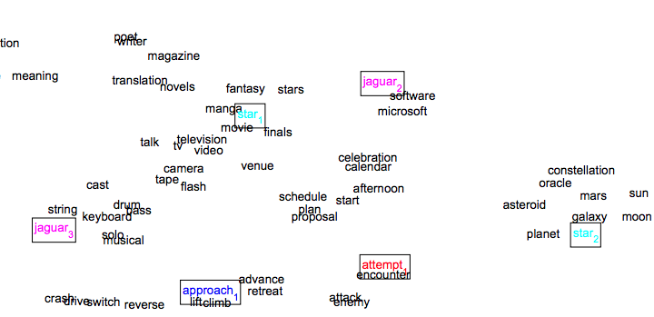
Multisense Word Embeddings
Huang et al. (2012): Improving Word Representations Via Global Context And Multiple Word Prototypes

Slide 70
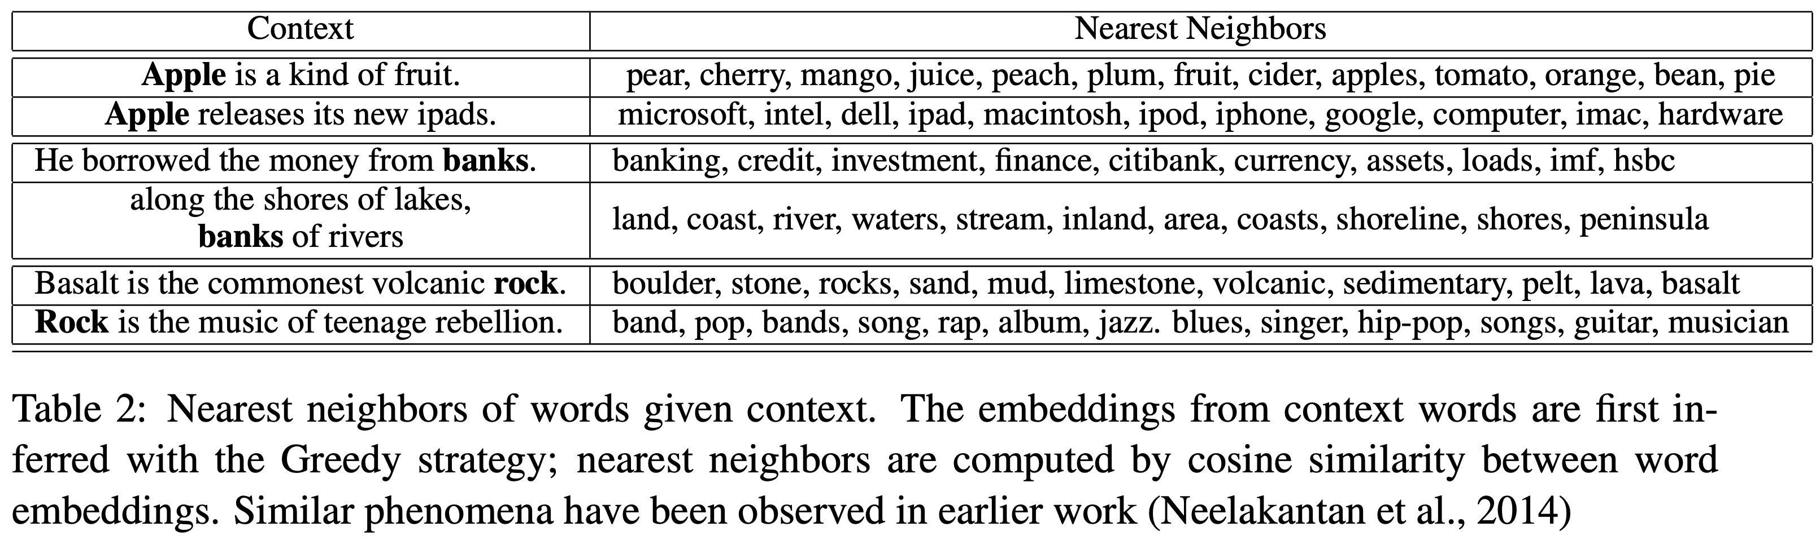
nearest neighbors given context:
Neelakantan et al. (2014): Efficient nonparametric estimation of multiple embeddings per word in vector space
Li & Jurafsky (2015): Do Multi-Sense Embeddings Improve Natural Language Understanding?

Slide 71
Multisense Word Embeddings
limitations:
need a way to label senses or cluster word tokens in training data (and for downstream tasks)
fragments training data, so more may be needed for estimating word embeddings
unlikely to get good clusters for rare word types
unable to handle new senses that only appear in test data
unclear if sense-specific embeddings are useful for downstream tasks

Slide 72
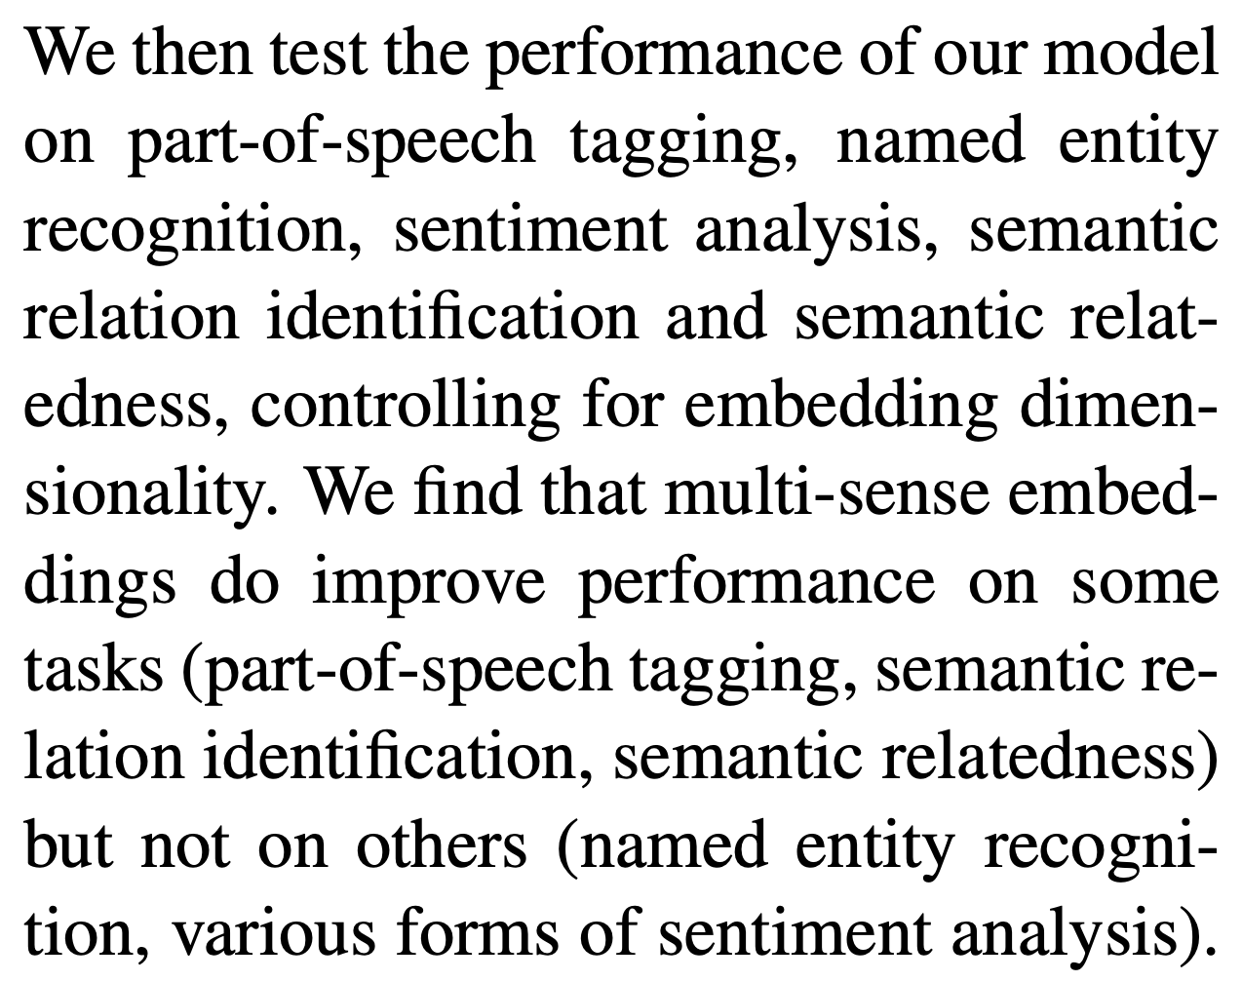
Do Multisense Embeddings Help on NLP Tasks?
yes, on some tasks
but when using powerful neural architectures, multisense embeddings may not be needed
increasing dimensionality of (single-sense) embeddings achieves some benefit of multisense embeddings
high dimensionality also may make it easier for subsequent architectures to extract relevant sense based on context
Li & Jurafsky (2015): Do Multi-Sense Embeddings Improve Natural Language Understanding?

