Slide 1
TTIC 31210: Advanced Natural Language Processing
Kevin Gimpel
Spring 2019
Lecture 8:
Structured Prediction 2

Slide 2
Roadmap
intro (1 lecture)
deep learning for NLP (5 lectures)
structured prediction (4 lectures)
introducing/formalizing structured prediction, categories of structures
inference: dynamic programming, greedy algorithms, beam search
inference with non-local features
learning in structured prediction
generative models, latent variables, unsupervised learning, variational autoencoders (2 lectures)
Bayesian methods in NLP (2 lectures)
Bayesian nonparametrics in NLP (2 lectures)
review & other topics (1 lecture)

Slide 3
Assignments
Assignment 2 due in one week
for the report, please use either pdf format or a Jupyter notebook (no plain text)

Slide 4
Modeling, Inference, Learning
inference: solve _
modeling: define score function
learning: choose _
Working definition of structured prediction:
size of output space is exponential in size of input
or is unbounded (e.g., machine translation)
(we can’t just enumerate all possible outputs)
Notes:
\mathrm{classify}(\vect{x},\vect{\theta}) = \argmax_{\vect{y}}\; \mathrm{score}(\vect{x}, \vect{y}, \vect{\theta})

Slide 5
What is Structured Prediction?
when we use a structured scoring function or structured loss function
we may be predicting a structure, but we might not necessarily be building a “structured predictor”
we will use the terms “unstructured predictor” or “local predictor” in such cases

Slide 6
Structured Prediction
a structured score/loss function does not decompose across “minimal parts” of output
to apply this definition we defined “parts” and “minimal parts”

Slide 7
Sequence Labeling (e.g., Part-of-Speech Tagging)
determiner verb (past) prep. proper proper poss. adj. noun
modal verb det. adjective noun prep. proper punc.
determiner verb (past) prep. noun noun poss. adj. noun
Some questioned if Tim Cook ’s first product
modal verb det. adjective noun prep. noun punc.
would be a breakaway hit for Apple .
Notes:
sentence -> NER labeling
sentence -> translation
Neue Umfrage: Kaufen Sie eine Apple Watch?
sentence -> parse tree
set of documents -> summary

Slide 8
parts:
minimal parts:
determiner verb (past) prep. proper proper poss. adj. noun
modal verb det. adjective noun prep. proper punc.
determiner verb (past) prep. noun noun poss. adj. noun
Some questioned if Tim Cook ’s first product
modal verb det. adjective noun prep. noun punc.
would be a breakaway hit for Apple .
determiner verb (past) prep. proper proper poss. adj. noun
modal verb det. adjective noun prep. proper punc.
determiner verb (past) prep. noun noun poss. adj. noun
Some questioned if Tim Cook ’s first product
modal verb det. adjective noun prep. noun punc.
would be a breakaway hit for Apple .

Slide 9
parts:
each “part” is a subcomponent of entire input/output pair
“parts function” = decomposition of input/output pair into a set of parts
parts functions defined for score/loss function, rather than for task (many parts functions possible for a task)
parts may overlap
minimal parts:
smallest possible parts for the task
minimal parts function defined for task (structured output space), not for structured score/loss function
minimal parts are non-overlapping

Slide 10
Parts and Score Functions
given a “parts” function
our score function is then defined:
score function decomposes additively across parts
each part is a subcomponent of input/output pair
Notes:
&\mathrm{mp}(\boldsymbol{y}) = \{y_1,...,y_N\}\\
&\mbox{where each } y_i\in\{0,1\}
\mathrm{parts}(\boldsymbol{x}, \boldsymbol{y})
\mathrm{score}(\boldsymbol{x}, \boldsymbol{y}, \boldsymbol{\theta}) = \!\!\!\sum_{\langle \boldsymbol{x}_r, \boldsymbol{y}_r\rangle\in \mathrm{parts}(\boldsymbol{x}, \boldsymbol{y})} \!\!\!\mathrm{score}_{\mathrm{part}}(\boldsymbol{x}_r, \boldsymbol{y}_r, \boldsymbol{\theta})
\mathrm{parts}(\boldsymbol{x}, \boldsymbol{y}) = \{\langle \boldsymbol{x}, y_1\rangle,\ldots,\langle \boldsymbol{x}, y_N\rangle\}

Slide 11
Structured Prediction Tasks
task | output structure | minimal parts
multi-label classification | set of N labels, each of which can be true or false | set containing individual labels in label set
Notes:
&\mathrm{mp}(\boldsymbol{y}) = \{y_1,\ldots,y_{T}\}\\
&\mbox{where each } y_t\in\{1,\ldots,N\}

Slide 12
Structured Prediction Tasks
task | output structure | minimal parts
multi-label classification | set of N labels, each of which can be true or false | set containing individual labels in label set
sequence labeling | label sequence with same length T as input sequence; each label is one of N possibilities | set containing labels at positions in output sequence
Notes:
&\mathrm{mp}(\boldsymbol{y}) = \{y_1,\ldots,y_{T}\}\\
&\mbox{where each } y_t\in\{1,\ldots,N\}

Slide 13
Feed-Forward POS Tagger
what is the parts function for this model & loss?
Notes:
% loss:
\mathrm{loss}_{\mathrm{log}} = -\log p_{\boldsymbol{\theta}}(Y = y_t \mid x_{t-1}, x_t, x_{t+1})
% output:
p_{\boldsymbol{\theta}}(Y \mid x_{t-1}, x_t, x_{t+1})
\mathit{emb}(x_t)

Slide 14
Feed-Forward POS Tagger
what is the parts function for this model & loss?
is this a structured predictor? no.
parts functions decomposes like the minimal parts (in terms of y)
Notes:
% loss:
\mathrm{loss}_{\mathrm{log}} = -\log p_{\boldsymbol{\theta}}(Y = y_t \mid x_{t-1}, x_t, x_{t+1})
% output:
p_{\boldsymbol{\theta}}(Y \mid x_{t-1}, x_t, x_{t+1})
\mathit{emb}(x_t)

Slide 15
Forward RNN for Part-of-Speech Tagging
… if the car …
… IN DT NN …
hidden vector used to compute probability distribution over tags at each position:
Notes:
p_{\boldsymbol{\theta}}(Y_t \mid \boldsymbol{x}_{1:t})
\mathrm{parts}(\boldsymbol{x}, \boldsymbol{y}) = \{\langle \boldsymbol{x}_{1:t}, y_t \rangle : 1\leq t \leq T\}

Slide 16
Forward RNN for Part-of-Speech Tagging
… if the car …
… IN DT NN …
loss:
Notes:
-\sum_t \log p_{\boldsymbol{\theta}}(Y_t = y_t \mid \boldsymbol{x}_{1:t})
p_{\boldsymbol{\theta}}(Y_t \mid \boldsymbol{x}_{1:t})
\mathrm{parts}(\boldsymbol{x}, \boldsymbol{y}) = \{\langle \boldsymbol{x}_{1:t}, y_t \rangle : 1\leq t \leq T\}

Slide 17
Forward RNN for Part-of-Speech Tagging
… if the car …
what is the parts function for this model & loss?
… IN DT NN …
is this a structured predictor? no
Notes:
-\sum_t \log p_{\boldsymbol{\theta}}(Y_t = y_t \mid \boldsymbol{x}_{1:t})
p_{\boldsymbol{\theta}}(Y_t \mid \boldsymbol{x}_{1:t})
\mathrm{parts}(\boldsymbol{x}, \boldsymbol{y}) = \{\langle \boldsymbol{x}_{1:t}, y_t \rangle : 1\leq t \leq T\}

Slide 18
Forward RNN for Part-of-Speech Tagging with Previous Label
… if the car …
… IN DT NN …
this model uses the previous y to compute a hidden vector

Slide 19
Forward RNN for Part-of-Speech Tagging with Previous Label
… if the car …
… IN DT NN …
hidden vector used to compute probability distribution over tags at each position:
Notes:
p_{\boldsymbol{\theta}}(Y_t \mid \boldsymbol{x}_{1:t}, \boldsymbol{y}_{1:{t-1}})

Slide 20
Forward RNN for Part-of-Speech Tagging with Previous Label
… if the car …
… IN DT NN …
loss:
Notes:
-\sum_t \log p_{\boldsymbol{\theta}}(Y_t = y_t \mid \boldsymbol{x}_{1:t}, \boldsymbol{y}_{1:{t-1}})

Slide 21
Forward RNN for Part-of-Speech Tagging with Previous Label
… if the car …
… IN DT NN …
what is the parts function for this model & loss?
Notes:
\mathrm{parts}(\boldsymbol{x}, \boldsymbol{y}) = \{\langle \boldsymbol{x}_{1:t}, \boldsymbol{y}_{1:t} \rangle : 1\leq t \leq T\}

Slide 22
Forward RNN for Part-of-Speech Tagging with Previous Label
… if the car …
is this a structured predictor? yes.
parts functions does not decompose like minimal parts (in terms of y)
… IN DT NN …
Notes:
\mathrm{parts}(\boldsymbol{x}, \boldsymbol{y}) = \{\langle \boldsymbol{x}_{1:t}, \boldsymbol{y}_{1:t} \rangle : 1\leq t \leq T\}

Slide 23
Structured Prediction Tasks
task | output structure | minimal parts
multi-label classification | set of N labels, each of which can be true or false | set containing individual labels in label set
sequence labeling | label sequence with same length T as input sequence; each label is one of N possibilities | set containing labels at positions in output sequence
Notes:
&\mathrm{mp}(\boldsymbol{y}) = \{y_1,\ldots,y_{T}\}\\
&\mbox{where each } y_t\in\{1,\ldots,N\}

Slide 24
Structured Prediction Tasks
task | output structure | minimal parts
multi-label classification | set of N labels, each of which can be true or false | set containing individual labels in label set
sequence labeling | label sequence with same length T as input sequence; each label is one of N possibilities | set containing labels at positions in output sequence
labeled segmentation
Notes:
&\mathrm{mp}(\boldsymbol{y}) = \{y_1,\ldots,y_{T}\}\\
&\mbox{where each } y_t\in\{1,\ldots,N\}

Slide 25
Named Entity Recognition
Some questioned if Tim Cook’s first product would be a breakaway hit for Apple.
PERSON
ORGANIZATION
Notes:
sentence -> NER labeling
sentence -> translation
Neue Umfrage: Kaufen Sie eine Apple Watch?
sentence -> parse tree
set of documents -> summary

Slide 26
Labeled Segmentation as Sequence Labeling
O O O B-PERSON I-PERSON O O O
Some questioned if Tim Cook ’s first product
O O O O O O B-ORGANIZATION O
would be a breakaway hit for Apple .
B = “begin”
I = “inside”
O = “outside”
Notes:
sentence -> NER labeling
sentence -> translation
Neue Umfrage: Kaufen Sie eine Apple Watch?
sentence -> parse tree
set of documents -> summary

Slide 27
Structured Prediction Tasks
task | output structure | minimal parts
multi-label classification | set of N labels, each of which can be true or false | set containing individual labels in label set
sequence labeling | label sequence with same length T as input sequence; each label is one of N possibilities | set containing labels at positions in output sequence
labeled segmentation
Notes:
&\mathrm{mp}(\boldsymbol{y}) = \{y_1,\ldots,y_{T}\}\\
&\mbox{where each } y_t\in\{1,\ldots,N\}

Slide 28
Structured Prediction Tasks
task | output structure | minimal parts
multi-label classification | set of N labels, each of which can be true or false | set containing individual labels in label set
sequence labeling | label sequence with same length T as input sequence; each label is one of N possibilities | set containing labels at positions in output sequence
labeled segmentation
unlabeled dependency parsing
Notes:
&\mathrm{mp}(\boldsymbol{y}) = \{y_1,\ldots,y_{T}\}\\
&\mbox{where each } y_t\in\{1,\ldots,N\}

Slide 29
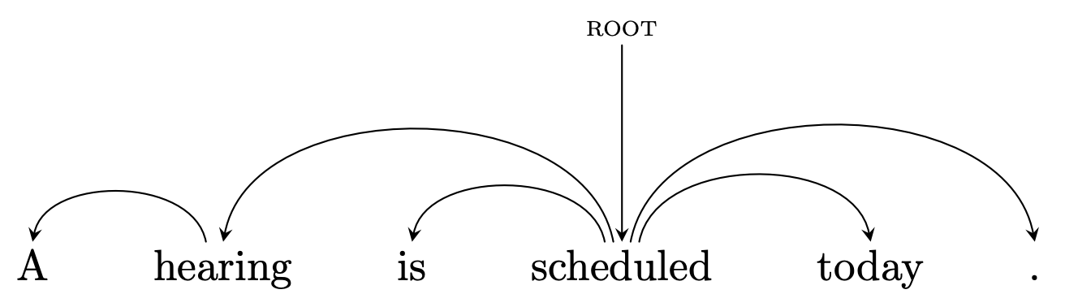
Dependency Trees
a dependency is a relation between a word (a head or parent) and its dependent (its modifier or child)
a dependency tree for a sentence contains a dependency for each word in the sentence
drawn as a directed tree with parents pointing to children
one word is the root of the tree
Notes:
https://en.wikipedia.org/wiki/Dependency_grammar

Slide 30
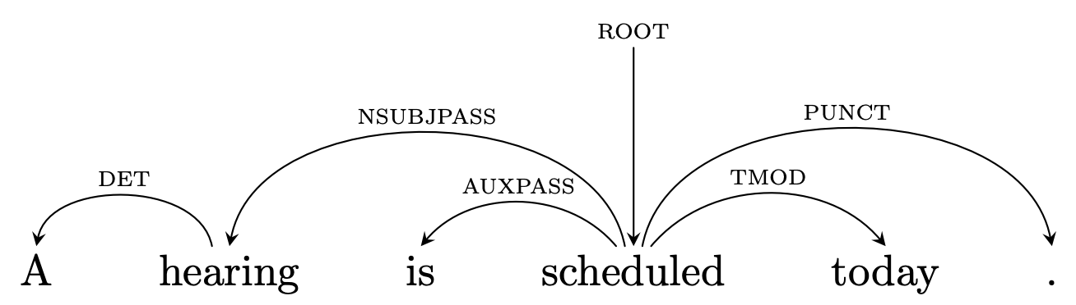
Labeled Dependency Trees
more common to use labeled dependency trees where each dependency has an associated label:
DET = determiner
NSUBJPASS = nominal subject in passive construction
AUXPASS = auxiliary verb in passive construction
TMOD = temporal modifier
PUNCT = punctuation
Notes:
https://en.wikipedia.org/wiki/Dependency_grammar

Slide 31
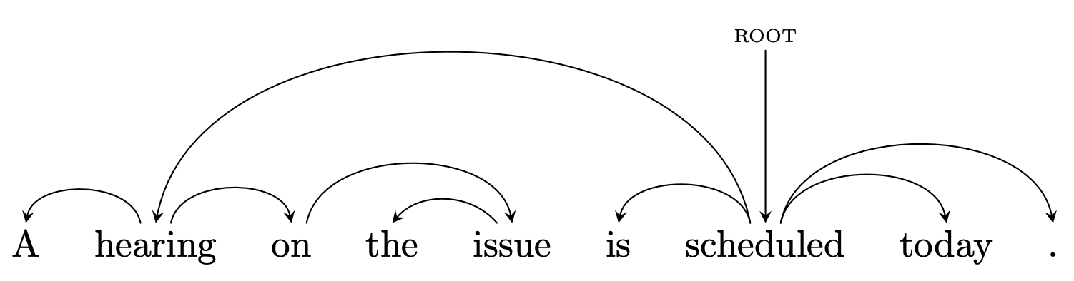
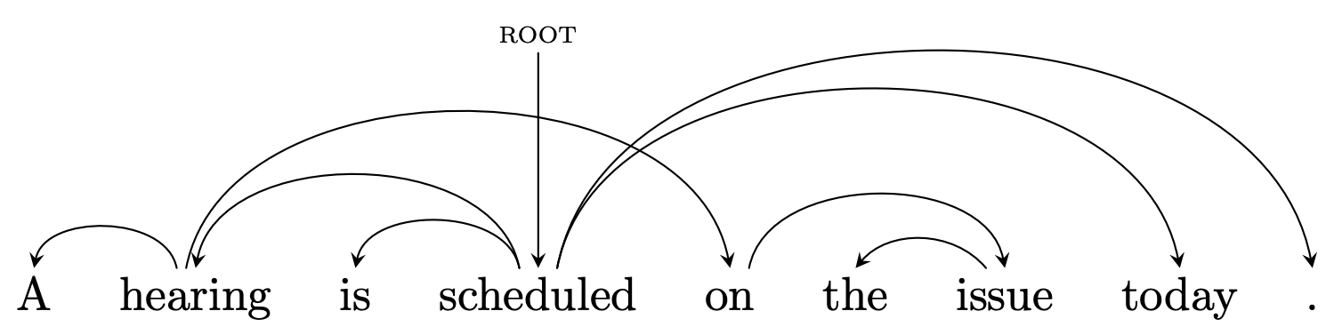
a longer sentence:
rearranging the words a bit, we now have a non-projective dependency tree (i.e., tree with crossing dependencies):
Notes:
https://en.wikipedia.org/wiki/Dependency_grammar

Slide 32
Dependency Parsing
dependency parsing is the task of predicting a dependency tree for a sentence
one of the most widely-studied structured prediction problems in NLP
used for several downstream NLP tasks

Slide 33
Applications of Dependency Parsing
widely used for NLP tasks because:
faster than constituent parsing
captures more semantic information
text classification (features on dependencies)
syntax-based machine translation
relation extraction
e.g., extract relation between Sam Smith and AITech:
Sam Smith was named new CEO of AITech.
use dependency path between Sam Smith and AITech:
Smith → named, named ← CEO, CEO ← of, of ← AITech

Slide 34
minimal parts for (unlabeled) dependency parsing:
each y_{t} holds the index in the sentence x of the parent of word x_{t}
we use 0 for the ROOT attachment
Notes:
&\mathrm{mp}(\boldsymbol{y}) = \{y_1,\ldots,y_T\}\\
&\mbox{where each } y_t\in\{0,1,\ldots,T\}

Slide 35
Unstructured Predictors for Dependency Parsing
how might you design an unstructured predictor for dependency parsing?
build a predictor that predicts the index of the head for a word
can use full sentential context, just can’t score multiple dependencies in any single scoring term
fast, simple, works ok, but doesn’t guarantee a tree structure (may have cycles, etc.)

Slide 36
Structured Prediction Tasks
task | output structure | minimal parts
multi-label classification | set of N labels, each of which can be true or false | set containing individual labels in label set
sequence labeling | label sequence with same length T as input sequence; each label is one of N possibilities | set containing labels at positions in output sequence
labeled segmentation
unlabeled dependency parsing | tree over the words in the input sentence; each word has exactly one parent | set containing indices of parent words for each word in sentence
Notes:
&\mathrm{mp}(\boldsymbol{y}) = \{y_1,\ldots,y_{T}\}\\
&\mbox{where each } y_t\in\{1,\ldots,N\}

Slide 37
Structured Prediction Tasks
task | output structure | minimal parts
multi-label classification | set of N labels, each of which can be true or false | set containing individual labels in label set
sequence labeling | label sequence with same length T as input sequence; each label is one of N possibilities | set containing labels at positions in output sequence
labeled segmentation
unlabeled dependency parsing | tree over the words in the input sentence; each word has exactly one parent | set containing indices of parent words for each word in sentence
conditional generation | sentence (or a paragraph, document, etc.)
Notes:
&\mathrm{mp}(\boldsymbol{y}) = \{y_1,\ldots,y_{T}\}\\
&\mbox{where each } y_t\in\{1,\ldots,N\}

Slide 38
Conditional Generation
for machine translation and other “conditional generation” tasks, input is a sequence and output is a sequence
minimal parts for these tasks:
each y_{t} is a word from the output vocabulary

Slide 39
Unstructured Predictors for Machine Translation
how might you design an unstructured predictor for machine translation?
assume a max length of the translation, pad to that length, build predictors that predict the word in position t in the translation
this probably won’t work very well, but if we have this model we could maximally parallelize translation across machines

Slide 40
Sequence-to-Sequence Models with Attention
most common approach for conditional generation
previously-predicted output symbol used as input for making next prediction (“auto-regressive”)
is this a structured predictor?
yes
…
Notes:
\mathbf{s}_t = \tanh\left(\mathbf{W}^{(y)}\mathit{emb}(y_{t-1}) + \mathbf{W}^{(s)}\mathbf{s}_{t-1} + \mathbf{W}^{(c)}\mathbf{c}_t + \mathbf{b}^{(s)} \right)
y_t = \argmax_{y\in\mathcal{O}} \,\,\mathrm{score}(\mathit{emb}(y), \mathbf{s}_t, \mathbf{c}_t)
% s2s encoder:
\mathbf{h}_u = \tanh\left(\mathbf{W}^{(x)}\mathbf{x}_u + \mathbf{W}^{(h)}\mathbf{h}_{u-1} + \mathbf{b}^{(h)} \right)
% s2s decoder:
\mathbf{s}_t = \tanh\left(\mathbf{W}^{(y)}\mathit{emb}(y_{t-1}) + \mathbf{W}^{(s)}\mathbf{s}_{t-1} + \mathbf{b}^{(s)} \right)
\mathbf{s}_0 = \mathbf{h}_{|\mathbf{x}|}
y_t = \argmax_{y\in\mathcal{V}} \,\,\, \mathbf{h}_t^\top \mathit{emb}(y)
\mathbf{x}_{u-1}
\mathit{emb}(y_{t-1})

Slide 41
Structured Prediction Tasks
task | output structure | minimal parts
multi-label classification | set of N labels, each of which can be true or false | set containing individual labels in label set
sequence labeling | label sequence with same length T as input sequence; each label is one of N possibilities | set containing labels at positions in output sequence
labeled segmentation
unlabeled dependency parsing | tree over the words in the input sentence; each word has exactly one parent | set containing indices of parent words for each word in sentence
conditional generation | sentence (or a paragraph, document, etc.) | set containing each word in the output
Notes:
&\mathrm{mp}(\boldsymbol{y}) = \{y_1,\ldots,y_{T}\}\\
&\mbox{where each } y_t\in\{1,\ldots,N\}

Slide 42
Other Tasks?
some tasks do not permit an easy definition of minimal parts

Slide 43
Constituency Parsing
(S (NP the man) (VP walked (PP to (NP the park))))
S
VP
Key:
S = sentence
NP = noun phrase
VP = verb phrase
PP = prepositional phrase
DT = determiner
NN = noun
VBD = verb (past tense)
IN = preposition
NP
PP
NP
DT
NN
VBD IN DT NN
the man walked to the park

Slide 44
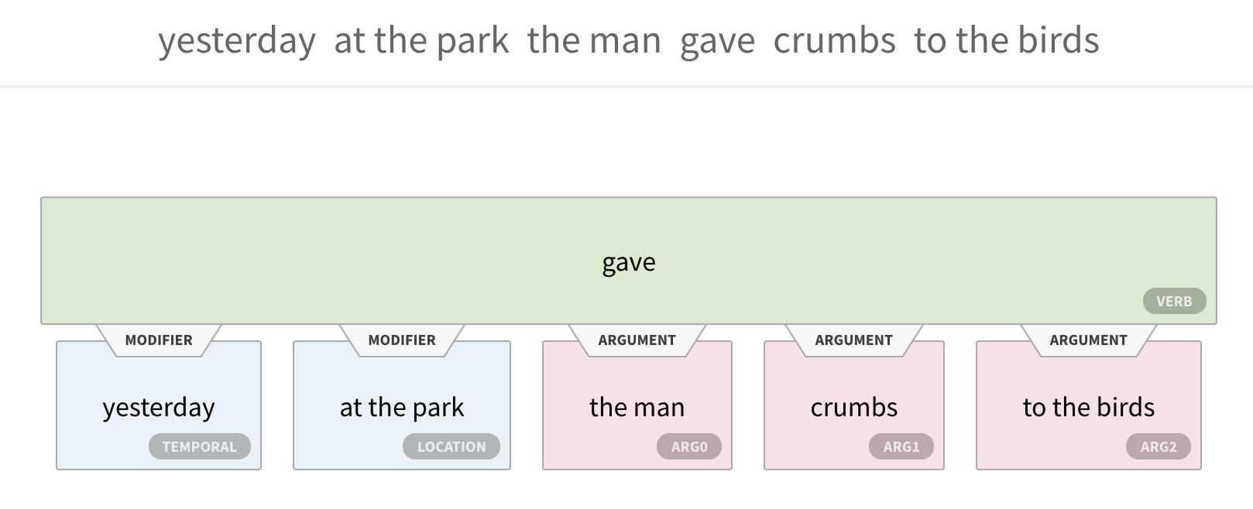

Semantic Role Labeling
ARG0 = usually agent
ARG1 = typically patient or theme
ARG2 = often beneficiary

Slide 45
Other Tasks?
some tasks do not permit an easy definition of minimal parts
constituency parsing, semantic role labeling, etc.
sometimes we can cast these as conditional generation tasks, then inherit the minimal parts definition from conditional generation

Slide 46
Sequence-to-Sequence Models with Attention
input and output sequences can have different lengths
we can frame many output structures as sequences
…
Notes:
\mathbf{s}_t = \tanh\left(\mathbf{W}^{(y)}\mathit{emb}(y_{t-1}) + \mathbf{W}^{(s)}\mathbf{s}_{t-1} + \mathbf{W}^{(c)}\mathbf{c}_t + \mathbf{b}^{(s)} \right)
y_t = \argmax_{y\in\mathcal{O}} \,\,\mathrm{score}(\mathit{emb}(y), \mathbf{s}_t, \mathbf{c}_t)
% s2s encoder:
\mathbf{h}_u = \tanh\left(\mathbf{W}^{(x)}\mathbf{x}_u + \mathbf{W}^{(h)}\mathbf{h}_{u-1} + \mathbf{b}^{(h)} \right)
% s2s decoder:
\mathbf{s}_t = \tanh\left(\mathbf{W}^{(y)}\mathit{emb}(y_{t-1}) + \mathbf{W}^{(s)}\mathbf{s}_{t-1} + \mathbf{b}^{(s)} \right)
\mathbf{s}_0 = \mathbf{h}_{|\mathbf{x}|}
y_t = \argmax_{y\in\mathcal{V}} \,\,\, \mathbf{h}_t^\top \mathit{emb}(y)
\mathbf{x}_{u-1}
\mathit{emb}(y_{t-1})

Slide 47
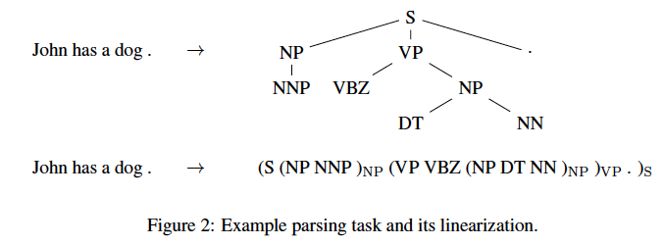
Formulating Constituency Parsing as Conditional Generation
{Vinyals, Kaiser} et al. (2015): Grammar as a Foreign Language

Slide 48
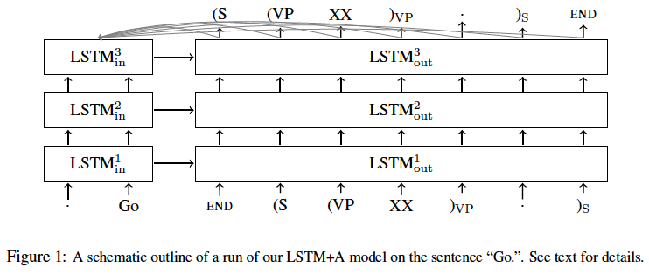
Formulating Constituency Parsing as Conditional Generation
{Vinyals, Kaiser} et al. (2015): Grammar as a Foreign Language

Slide 49
others have done this for dependency parsing, semantic role labeling, abstract meaning representation parsing, and many other tasks
sequence-to-sequence models then become a general purpose modeling framework for many structured prediction tasks

Slide 50
Modeling, Inference, Learning
inference: solve _
modeling: define score function
learning: choose _
Notes:
\mathrm{classify}(\vect{x},\vect{\theta}) = \argmax_{\vect{y}}\; \mathrm{score}(\vect{x}, \vect{y}, \vect{\theta})

Slide 51
Inference with Structured Predictors
inference: solve _
how do we efficiently search over the space of all structured outputs?
this space may have size exponential in the size of the input, or be unbounded
complexity of inference depends on parts function
Notes:
\mathrm{classify}(\vect{x},\vect{\theta}) = \argmax_{\vect{y}}\; \mathrm{score}(\vect{x}, \vect{y}, \vect{\theta})

Slide 52
Hidden Markov Models
simple, useful, well-known model for sequence labeling: Hidden Markov Model (HMM)
HMMs are used in NLP, speech processing, computational biology, and other areas

Slide 53
Hidden Markov Models
n-gram language models define a probability distribution over word sequences x
HMMs define a joint probability distribution over input sequences x and output sequences y
conditional independence assumptions (“Markov assumption”) are used to factorize this joint distribution into small terms
*for now, we are omitting stopping probabilities for clarity

Slide 54
Random Variables for Sequence Labeling
let’s define random variables for observations:
observation variable at time step t:
its possible values: words in vocabulary
and we’ll define one “hidden” variable for each observation:
hidden variable at time t:
its possible values: discrete symbols in some set
for now, think of the set of possible POS tags

Slide 55
Conditional Independence Assumptions of HMMs
two Y’s are conditionally independent given the Y’s between them:
an X at position t is conditionally independent of other Y’s given the Y at position t:
*for now, we are omitting stopping probabilities for clarity

Slide 56
HMMs
conditional independence assumptions → we only have to worry about local distributions:
transition parameters:
emission parameters:
*for now, we are omitting stopping probabilities for clarity

Slide 57
Important: Stopping Probabilities
We also assume:
special
end-of-sequence
label
special
start-of-sequence
label
why does this matter?
Notes:
%p_{\boldsymbol{w}}(\vect{x}, \vect{y}) = \prod_{i=1}^{|\boldsymbol{x}|} p_{\boldsymbol{\tau}}(y_i \mid y_{i-1}) p_{\boldsymbol{\eta}}(x_i \mid y_i)\nonumber
%p_{\boldsymbol{w}}(\vect{x},\vect{y}) = p_{\boldsymbol{\tau}}(\mbox{\texttt{</s>}} \mid y_{|\boldsymbol{x}|}) \prod_{i=1}^{|\boldsymbol{x}|} p_{\boldsymbol{\tau}}(y_i \mid y_{i-1}) p_{\boldsymbol{\eta}}(x_i \mid y_i) \nonumber

Slide 58
Parts Function for an HMM
for a bigram HMM:
each word-label pair forms a part, and each label bigram forms a part

Slide 59
Inference in HMMs
since the output is a sequence, this argmax requires iterating over an exponentially-large set
we can use dynamic programming (DP) to solve these problems exactly
for HMMs (and other sequence models), the algorithm for solving this is the Viterbi algorithm

Slide 60
Dynamic Programming (DP)
what is dynamic programming?
a family of algorithms that break problems into smaller pieces and reuse solutions for those pieces
only applicable when the problem has certain properties (optimal substructure and overlapping sub-problems)
we can often use DP to iterate over exponentially-large output spaces in polynomial time
we focus on a particular type of DP algorithm: memoization

Slide 61
Feature Locality
feature locality: how big are the parts?
for efficient exact inference with DP, we need to be mindful of this
parts can be arbitrarily big in terms of input, but not in terms of output!
HMM parts are small in both the input and output (only two pieces at a time)

Slide 62
Viterbi Algorithm for HMMs
recursive equations + memoization:
base case:
returns probability of sequence starting with label y for first word
recursive case:
computes probability of max-probability label sequence that ends with label y at position m
final value is in:

Slide 63
Viterbi Algorithm
space and time complexity?
can be read off from the recursive equations:
space complexity:
size of memoization table, which is # of unique indices of recursive equations
length of sentence
number of labels
*
so, space complexity is O(|x| |L|)

Slide 64
Viterbi Algorithm
space and time complexity?
can be read off from the recursive equations:
time complexity:
size of memoization table * complexity of computing each entry
length of sentence
number of labels
each entry requires iterating through the labels
*
*
so, time complexity is O(|x| |L| |L|) = O(|x| |L|²)

Slide 65
Viterbi Algorithm for Sequence Models (with tag bigram features)
score function for label bigram <y’, y> ending at position m in x
could be anything!
linear model, feed-forward network, LSTM, etc.
Notes:
&V(1,y) = \mathrm{score}(\vect{x}, \langle\mbox{\texttt{<s>}}, y\rangle, 1, \vect{w})\\
&V(m,y) = \max_{y'\in\mathcal{L}}\left(\mathrm{score}(\vect{x}, \langle y', y\rangle, m, \vect{w}) + V(m-1, y')\right)
%nlp18:vit-score
&V(1, y) = \mathrm{score}(\vect{x}, \langle \mbox{\texttt{<s>}}, y\rangle, 1, \vect{w}) \nonumber\\
&V(m, y) = \max_{y' \in \mathcal{L}} \left(\mathrm{score}(\vect{x}, \langle y', y\rangle, m, \vect{w})\: V(m-1, y') \right)
%&V(1, y) = p_{\boldsymbol{\eta}}(x_1 \mid y)\: p_{\boldsymbol{\tau}}(y \mid \mbox{\texttt{<s>}})\nonumber\\
%&V(m, y) = \max_{y' \in \mathcal{L}} \left(\;p_{\boldsymbol{\eta}}(x_m \mid y) \: p_{\boldsymbol{\tau}}(y \mid y')\: V(m-1, y') \right)
%f_{\boldsymbol{\eta}(y',x')}(\vect{x}, \vect{y}) = \sum_{i=1}^{|\boldsymbol{x}|} \mathbb{I}[(y_{i} = y') \wedge (x_i = x')]
%&p_{\boldsymbol{\eta}}(\mathit{for} \mid \mathrm{verb})\nonumber\\
%&p_{\boldsymbol{\eta}}(\mathit{walk} \mid \mathrm{verb})\nonumber\\
% = \log p_{\boldsymbol{\eta}}(x' \mid y')
%p_{\boldsymbol{\tau}}(y_i \mid y_{i-1}) \; p_{\boldsymbol{\eta}}(x_i \mid y_i)
%&...
\nonumber

