Slide 1
TTIC 31210: Advanced Natural Language Processing
Kevin Gimpel
Spring 2019
Lecture 9:
Inference in Structured Prediction

Slide 2
Roadmap
intro (1 lecture)
deep learning for NLP (5 lectures)
structured prediction (4 lectures)
introducing/formalizing structured prediction, categories of structures
inference: dynamic programming, greedy algorithms, beam search
inference with non-local features
learning in structured prediction
generative models, latent variables, unsupervised learning, variational autoencoders (2 lectures)
Bayesian methods in NLP (2 lectures)
Bayesian nonparametrics in NLP (2 lectures)
review & other topics (1 lecture)

Slide 3
Assignments
Assignment 2 due Wednesday
for the report, please use either pdf format or a Jupyter notebook (no plain text)

Slide 4
Modeling, Inference, Learning
inference: solve _
modeling: define score function
learning: choose _
Working definition of structured prediction:
size of output space is exponential in size of input
or is unbounded (e.g., machine translation)
(we can’t just enumerate all possible outputs)
Notes:
\mathrm{classify}(\vect{x},\vect{\theta}) = \argmax_{\vect{y}}\; \mathrm{score}(\vect{x}, \vect{y}, \vect{\theta})

Slide 5
Inference with Structured Predictors
inference: solve _
how do we efficiently search over the space of all structured outputs?
this space may have size exponential in the size of the input, or be unbounded
complexity of inference depends on parts function
Notes:
\mathrm{classify}(\vect{x},\vect{\theta}) = \argmax_{\vect{y}}\; \mathrm{score}(\vect{x}, \vect{y}, \vect{\theta})

Slide 6
Parts and Score Functions
given a “parts” function
our score function is then defined:
each part is a subcomponent of input/output pair
score function decomposes additively across parts
Notes:
&\mathrm{mp}(\boldsymbol{y}) = \{y_1,...,y_N\}\\
&\mbox{where each } y_i\in\{0,1\}
\mathrm{parts}(\boldsymbol{x}, \boldsymbol{y})
\mathrm{score}(\boldsymbol{x}, \boldsymbol{y}, \boldsymbol{\theta}) = \!\!\!\sum_{\langle \boldsymbol{x}_r, \boldsymbol{y}_r\rangle\in \mathrm{parts}(\boldsymbol{x}, \boldsymbol{y})} \!\!\!\mathrm{score}_{\mathrm{part}}(\boldsymbol{x}_r, \boldsymbol{y}_r, \boldsymbol{\theta})
\mathrm{parts}(\boldsymbol{x}, \boldsymbol{y}) = \{\langle \boldsymbol{x}, y_1\rangle,\ldots,\langle \boldsymbol{x}, y_N\rangle\}

Slide 7
Structured Prediction Tasks
task | output structure | minimal parts
multi-label classification | set of N labels, each of which can be true or false | set containing individual labels in label set
sequence labeling | label sequence with same length T as input sequence; each label is one of N possibilities | set containing labels at positions in output sequence
unlabeled dependency parsing | tree over the words in the input sentence; each word has exactly one parent | set containing indices of parent words for each word in sentence
conditional generation | sentence (or a paragraph, document, etc.) | set containing each word in the output
Notes:
&\mathrm{mp}(\boldsymbol{y}) = \{y_1,\ldots,y_{T}\}\\
&\mbox{where each } y_t\in\{1,\ldots,N\}

Slide 8
Hidden Markov Model (HMM)
transition parameters:
emission parameters:
each word-label pair forms a part, and each label bigram forms a part
note: define score as log-probability to make score function decompose additively over parts

Slide 9
Inference in HMMs
since the output is a sequence, this argmax requires iterating over an exponentially-large set
we can use dynamic programming (DP) to solve these problems exactly
for HMMs (and other sequence models), the algorithm for solving this is the Viterbi algorithm

Slide 10
Viterbi Algorithm for HMMs
recursive equations + memoization:
base case:
returns probability of sequence starting with label y for first word
recursive case:
computes probability of max-probability label sequence that ends with label y at position m
final value is in:

Slide 11
“Backpointers” in Viterbi
Viterbi only gives us the probability of the max-probability label sequence
how do we get the actual label sequence?
contains label that achieved max probability in max-prob label sequence that ends with label y at position m
Notes:
1 < m \leq |\boldsymbol{x}|: \,\,\,\, L(m, y) &= \argmax_{y' \in \mathcal{L}} \,\left(\, p_{\boldsymbol{\eta}}(x_m \mid y) \: p_{\boldsymbol{\tau}}(y \mid y')\: V(m-1, y')\right)\nonumber\\
\hat{y}_{|\boldsymbol{x}|} &= \argmax_{y' \in \mathcal{L}} \,\left(\, p_{\boldsymbol{\tau}}(\mbox{\texttt{</s>}} \mid y')\: V(|\boldsymbol{x}|, y') \right) \nonumber
%1 < t \leq T: \,\,\,\, L(t, y) &= \argmax_{y' \in \mathcal{L}} \,\, p_{\boldsymbol{\eta}}(x_t \mid y) \: p_{\boldsymbol{\tau}}(y \mid y')\: V(t-1, y')\nonumber\\
%\hat{y}_T &= \argmax_{y' \in \mathcal{L}} \,\, p_{\boldsymbol{\tau}}(\mbox{\texttt{</s>}} \mid y')\: V(T, y') \nonumber
&\hat{y}_T \nonumber \\
&\hat{y}_{T-1} = L(T, \hat{y}_T) \nonumber \\
&\hat{y}_{T-2} = L(T - 1, \hat{y}_{T-1}) \nonumber \\
&...\nonumber\\
&\hat{y}_{2} = L(3, \hat{y}_{3}) \nonumber\\
&\hat{y}_{1} = L(2, \hat{y}_{2}) \nonumber

Slide 12
“Backpointers” in Viterbi
Viterbi only gives us the probability of the max-probability label sequence
how do we get the actual label sequence?
similar modification for final label:
Notes:
1 < m \leq |\boldsymbol{x}|: \,\,\,\, L(m, y) &= \argmax_{y' \in \mathcal{L}} \,\left(\, p_{\boldsymbol{\eta}}(x_m \mid y) \: p_{\boldsymbol{\tau}}(y \mid y')\: V(m-1, y')\right)\nonumber\\
\hat{y}_{|\boldsymbol{x}|} &= \argmax_{y' \in \mathcal{L}} \,\left(\, p_{\boldsymbol{\tau}}(\mbox{\texttt{</s>}} \mid y')\: V(|\boldsymbol{x}|, y') \right) \nonumber
%1 < t \leq T: \,\,\,\, L(t, y) &= \argmax_{y' \in \mathcal{L}} \,\, p_{\boldsymbol{\eta}}(x_t \mid y) \: p_{\boldsymbol{\tau}}(y \mid y')\: V(t-1, y')\nonumber\\
%\hat{y}_T &= \argmax_{y' \in \mathcal{L}} \,\, p_{\boldsymbol{\tau}}(\mbox{\texttt{</s>}} \mid y')\: V(T, y') \nonumber
&\hat{y}_T \nonumber \\
&\hat{y}_{T-1} = L(T, \hat{y}_T) \nonumber \\
&\hat{y}_{T-2} = L(T - 1, \hat{y}_{T-1}) \nonumber \\
&...\nonumber\\
&\hat{y}_{2} = L(3, \hat{y}_{3}) \nonumber\\
&\hat{y}_{1} = L(2, \hat{y}_{2}) \nonumber

Slide 13
Following Backpointers in Viterbi
full backpointer-following procedure (after Viterbi):
Notes:
1 < m \leq |\boldsymbol{x}|: \,\,\,\, L(m, y) &= \argmax_{y' \in \mathcal{L}} \,\left(\, p_{\boldsymbol{\eta}}(x_m \mid y) \: p_{\boldsymbol{\tau}}(y \mid y')\: V(m-1, y')\right)\nonumber\\
\hat{y}_{|\boldsymbol{x}|} &= \argmax_{y' \in \mathcal{L}} \,\left(\, p_{\boldsymbol{\tau}}(\mbox{\texttt{</s>}} \mid y')\: V(|\boldsymbol{x}|, y') \right) \nonumber
%1 < t \leq T: \,\,\,\, L(t, y) &= \argmax_{y' \in \mathcal{L}} \,\, p_{\boldsymbol{\eta}}(x_t \mid y) \: p_{\boldsymbol{\tau}}(y \mid y')\: V(t-1, y')\nonumber\\
%\hat{y}_T &= \argmax_{y' \in \mathcal{L}} \,\, p_{\boldsymbol{\tau}}(\mbox{\texttt{</s>}} \mid y')\: V(T, y') \nonumber
\mbox{let } T = {|\boldsymbol{x}|}:
&\hat{y}_T \nonumber \\
&\hat{y}_{T-1} = L(T, \hat{y}_T) \nonumber \\
&\hat{y}_{T-2} = L(T - 1, \hat{y}_{T-1}) \nonumber \\
&...\nonumber\\
&\hat{y}_{2} = L(3, \hat{y}_{3}) \nonumber\\
&\hat{y}_{1} = L(2, \hat{y}_{2}) \nonumber

Slide 14
Viterbi Algorithm for Sequence Models (with tag bigram features)
score function for label bigram <y’, y> ending at position m in x
could be anything! linear model, feed-forward network, LSTM, etc.
Notes:
&V(1,y) = \mathrm{score}(\vect{x}, \langle\mbox{\texttt{<s>}}, y\rangle, 1, \vect{w})\\
&V(m,y) = \max_{y'\in\mathcal{L}}\left(\mathrm{score}(\vect{x}, \langle y', y\rangle, m, \vect{w}) + V(m-1, y')\right)
%nlp18:vit-score
&V(1, y) = \mathrm{score}(\vect{x}, \langle \mbox{\texttt{<s>}}, y\rangle, 1, \vect{w}) \nonumber\\
&V(m, y) = \max_{y' \in \mathcal{L}} \left(\mathrm{score}(\vect{x}, \langle y', y\rangle, m, \vect{w})\: V(m-1, y') \right)
%&V(1, y) = p_{\boldsymbol{\eta}}(x_1 \mid y)\: p_{\boldsymbol{\tau}}(y \mid \mbox{\texttt{<s>}})\nonumber\\
%&V(m, y) = \max_{y' \in \mathcal{L}} \left(\;p_{\boldsymbol{\eta}}(x_m \mid y) \: p_{\boldsymbol{\tau}}(y \mid y')\: V(m-1, y') \right)
%f_{\boldsymbol{\eta}(y',x')}(\vect{x}, \vect{y}) = \sum_{i=1}^{|\boldsymbol{x}|} \mathbb{I}[(y_{i} = y') \wedge (x_i = x')]
%&p_{\boldsymbol{\eta}}(\mathit{for} \mid \mathrm{verb})\nonumber\\
%&p_{\boldsymbol{\eta}}(\mathit{walk} \mid \mathrm{verb})\nonumber\\
% = \log p_{\boldsymbol{\eta}}(x' \mid y')
%p_{\boldsymbol{\tau}}(y_i \mid y_{i-1}) \; p_{\boldsymbol{\eta}}(x_i \mid y_i)
%&...
\nonumber

Slide 15
Approximate Inference
exact inference limits us to small parts functions
e.g., Viterbi requires parts with only two consecutive labels, and takes time O(|x| |L|²)
time complexity of exact DP algorithms is exponential in the size of the parts
we want to use bigger parts without exponential increase in runtime
so, we consider algorithms for approximate inference
even when using small parts, approximate inference can help us to speed up inference with little loss in accuracy

Slide 16
Example: HMM POS Tagging
tag set:
N: noun
V: verb
D: determiner
J: adjective
example sentence:
V D N
Lower the lights

Slide 17
Greedy Left-to-Right Inference
build a label sequence one word at a time from left to right
at each position, choose the tag for a word greedily to maximize a local scoring function

Slide 18
Greedy Inference
Lower the lights
<s>
starting tag
Notes:
\newcommand{\sos}{\mbox{\texttt{<s>}}}
\newcommand{\eos}{\mbox{\texttt{</s>}}}
\hat{y}_1 = \argmax_{y\in\mathcal{L}} \,\,\,p_{\boldsymbol{\eta}}(\mbox{``Lower''} \mid y)\,p_{\boldsymbol{\tau}}(y \mid \sos)

Slide 19
Greedy Inference
Lower the lights
<s>
takes O(|L|) time (iterate through labels)
Notes:
\newcommand{\sos}{\mbox{\texttt{<s>}}}
\newcommand{\eos}{\mbox{\texttt{</s>}}}
\hat{y}_1 = \argmax_{y\in\mathcal{L}} \,\,\,p_{\boldsymbol{\eta}}(\mbox{``Lower''} \mid y)\,p_{\boldsymbol{\tau}}(y \mid \sos)

Slide 20
Greedy Inference
Lower the lights
<s>
J
error here: model must choose a tag and stick with it; can’t change anything later
V D N
Lower the lights
Notes:
\newcommand{\sos}{\mbox{\texttt{<s>}}}
\newcommand{\eos}{\mbox{\texttt{</s>}}}
\hat{y}_1 = \argmax_{y\in\mathcal{L}} \,\,\,p_{\boldsymbol{\eta}}(\mbox{``Lower''} \mid y)\,p_{\boldsymbol{\tau}}(y \mid \sos)

Slide 21
Greedy Inference
Lower the lights
<s>
J
D
uses best label for previous position
V D N
Lower the lights
Notes:
\newcommand{\sos}{\mbox{\texttt{<s>}}}
\newcommand{\eos}{\mbox{\texttt{</s>}}}
\hat{y}_1 = \argmax_{y\in\mathcal{L}} \,\,\,p_{\boldsymbol{\eta}}(\mbox{``Lower''} \mid y)\,p_{\boldsymbol{\tau}}(y \mid \sos)
\hat{y}_2 = \argmax_{y\in\mathcal{L}} \,\,\,p_{\boldsymbol{\eta}}(\mbox{``the''} \mid y)\,p_{\boldsymbol{\tau}}(y \mid \mbox{\texttt{J}})

Slide 22
Greedy Inference
Lower the lights
<s>
J
D
N
</s>
for final word in input, include transition to end-of-sentence label
V D N
Lower the lights
Notes:
\newcommand{\sos}{\mbox{\texttt{<s>}}}
\newcommand{\eos}{\mbox{\texttt{</s>}}}
\hat{y}_1 = \argmax_{y\in\mathcal{L}} \,\,\,p_{\boldsymbol{\eta}}(\mbox{``Lower''} \mid y)\,p_{\boldsymbol{\tau}}(y \mid \sos)
\hat{y}_2 = \argmax_{y\in\mathcal{L}} \,\,\,p_{\boldsymbol{\eta}}(\mbox{``the''} \mid y)\,p_{\boldsymbol{\tau}}(y \mid \mbox{\texttt{J}})
\hat{y}_3 = \argmax_{y\in\mathcal{L}} \,\,\,p_{\boldsymbol{\eta}}(\mbox{``lights''} \mid y)\,p_{\boldsymbol{\tau}}(y \mid \mbox{\texttt{D}})\,p_{\boldsymbol{\tau}}(\eos\mid y)

Slide 23
Greedy Inference
Lower the lights
<s>
J
D
N
</s>
|x| positions, O(|L|) time for each position (iterate through labels)
time for greedy: O(|x| |L|)
time for Viterbi: O(|x| |L|²)
faster than Viterbi, but doesn’t work as well
can we improve it?

Slide 24
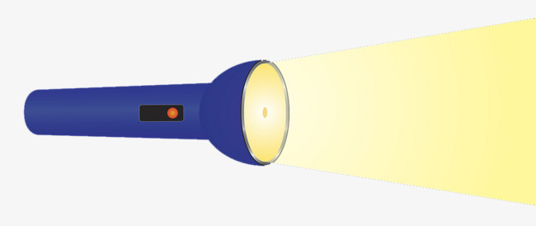
we can convert this greedy algorithm to beam search
beam search maintains multiple hypotheses at each position
two types of steps:
extend hypotheses
prune set of hypotheses
size of pruned set = size of “beam”

Slide 25
Beam Search (beam size b = 2)
Lower the lights
<s>
score of hypothesis
starting hypothesis
low score
high score
Notes:
\newcommand{\topb}{\mathop{\mbox{$\max$-$b$}}}
\newcommand{\sos}{\mbox{\texttt{<s>}}}
\newcommand{\eos}{\mbox{\texttt{</s>}}}
%\hat{y}_1 = \argmax_{y\in\mathcal{L}} \,\,\,p_{\boldsymbol{\eta}}(\mbox{``Lower''} \mid y)\,p_{\boldsymbol{\tau}}(y \mid \sos)
%\hat{y}_2 = \argmax_{y\in\mathcal{L}} \,\,\,p_{\boldsymbol{\eta}}(\mbox{``the''} \mid y)\,p_{\boldsymbol{\tau}}(y \mid \mbox{\texttt{J}})
%\hat{y}_3 = \argmax_{y\in\mathcal{L}} \,\,\,p_{\boldsymbol{\eta}}(\mbox{``lights''} \mid y)\,p_{\boldsymbol{\tau}}(y \mid \mbox{\texttt{D}})\,p_{\boldsymbol{\tau}}(\eos\mid y)
B(1) = \topb_{y\in\mathcal{L}} \,\,\,p_{\boldsymbol{\eta}}(\mbox{``Lower''} \mid y)\,p_{\boldsymbol{\tau}}(y \mid \sos)

Slide 26
Extend Hypotheses
Lower the lights
only one hypothesis here to extend
<s>
N
consider all possible ways of extending it
V
D
scores of extended hypotheses:
J
score of previous hypothesis
low score
high score
Notes:
\newcommand{\topb}{\mathop{\mbox{$\max$-$b$}}}
\newcommand{\sos}{\mbox{\texttt{<s>}}}
\newcommand{\eos}{\mbox{\texttt{</s>}}}
p_{\boldsymbol{\eta}}(\mbox{``Lower''} \mid y)\,p_{\boldsymbol{\tau}}(y \mid \sos)\,\mathrm{score}(\mathrm{hyp}_{\mathrm{prev}})
B(1) = \topb_{y\in\mathcal{L}} \,\,\,p_{\boldsymbol{\eta}}(\mbox{``Lower''} \mid y)\,p_{\boldsymbol{\tau}}(y \mid \sos)

Slide 27
Extend Hypotheses
Lower the lights
only one hypothesis here to extend
<s>
N
consider all possible ways of extending it
V
D
scores of extended hypotheses:
J
because score of starting hypothesis is fixed to 1
low score
high score
Notes:
\newcommand{\topb}{\mathop{\mbox{$\max$-$b$}}}
\newcommand{\sos}{\mbox{\texttt{<s>}}}
\newcommand{\eos}{\mbox{\texttt{</s>}}}
%\hat{y}_1 = \argmax_{y\in\mathcal{L}} \,\,\,p_{\boldsymbol{\eta}}(\mbox{``Lower''} \mid y)\,p_{\boldsymbol{\tau}}(y \mid \sos)
%\hat{y}_2 = \argmax_{y\in\mathcal{L}} \,\,\,p_{\boldsymbol{\eta}}(\mbox{``the''} \mid y)\,p_{\boldsymbol{\tau}}(y \mid \mbox{\texttt{J}})
%\hat{y}_3 = \argmax_{y\in\mathcal{L}} \,\,\,p_{\boldsymbol{\eta}}(\mbox{``lights''} \mid y)\,p_{\boldsymbol{\tau}}(y \mid \mbox{\texttt{D}})\,p_{\boldsymbol{\tau}}(\eos\mid y)
B(1) = \topb_{y\in\mathcal{L}} \,\,\,p_{\boldsymbol{\eta}}(\mbox{``Lower''} \mid y)\,p_{\boldsymbol{\tau}}(y \mid \sos)

Slide 28
Prune Hypotheses (b = 2)
Lower the lights
keep top b hypotheses
<s>
N
V
D
J
low score
high score
Notes:
\newcommand{\topb}{\mathop{\mbox{$\max$-$b$}}}
\newcommand{\sos}{\mbox{\texttt{<s>}}}
\newcommand{\eos}{\mbox{\texttt{</s>}}}
%\hat{y}_1 = \argmax_{y\in\mathcal{L}} \,\,\,p_{\boldsymbol{\eta}}(\mbox{``Lower''} \mid y)\,p_{\boldsymbol{\tau}}(y \mid \sos)
%\hat{y}_2 = \argmax_{y\in\mathcal{L}} \,\,\,p_{\boldsymbol{\eta}}(\mbox{``the''} \mid y)\,p_{\boldsymbol{\tau}}(y \mid \mbox{\texttt{J}})
%\hat{y}_3 = \argmax_{y\in\mathcal{L}} \,\,\,p_{\boldsymbol{\eta}}(\mbox{``lights''} \mid y)\,p_{\boldsymbol{\tau}}(y \mid \mbox{\texttt{D}})\,p_{\boldsymbol{\tau}}(\eos\mid y)
B(1) = \topb_{y\in\mathcal{L}} \,\,\,p_{\boldsymbol{\eta}}(\mbox{``Lower''} \mid y)\,p_{\boldsymbol{\tau}}(y \mid \sos)

Slide 29
Prune Hypotheses (b = 2)
Lower the lights
<s>
V
= set containing the top b hypotheses ending at position 1, along with their scores
J
note: this is a set; the items do not have to be sorted
low score
high score
Notes:
\newcommand{\topb}{\mathop{\mbox{$\max$-$b$}}}
\newcommand{\sos}{\mbox{\texttt{<s>}}}
\newcommand{\eos}{\mbox{\texttt{</s>}}}
%\hat{y}_1 = \argmax_{y\in\mathcal{L}} \,\,\,p_{\boldsymbol{\eta}}(\mbox{``Lower''} \mid y)\,p_{\boldsymbol{\tau}}(y \mid \sos)
%\hat{y}_2 = \argmax_{y\in\mathcal{L}} \,\,\,p_{\boldsymbol{\eta}}(\mbox{``the''} \mid y)\,p_{\boldsymbol{\tau}}(y \mid \mbox{\texttt{J}})
%\hat{y}_3 = \argmax_{y\in\mathcal{L}} \,\,\,p_{\boldsymbol{\eta}}(\mbox{``lights''} \mid y)\,p_{\boldsymbol{\tau}}(y \mid \mbox{\texttt{D}})\,p_{\boldsymbol{\tau}}(\eos\mid y)
B(1) = \topb_{y\in\mathcal{L}} \,\,\,p_{\boldsymbol{\eta}}(\mbox{``Lower''} \mid y)\,p_{\boldsymbol{\tau}}(y \mid \sos)

Slide 30
Prune Hypotheses (b = 2)
Lower the lights
<s>
V
= set containing the top b hypotheses ending at position 1, along with their scores
J
note: this is a set; the items do not have to be sorted
so, this step only takes O(N) time if there are N hypotheses to sort; cf. “unordered partial sorting”
low score
high score
Notes:
\newcommand{\topb}{\mathop{\mbox{$\max$-$b$}}}
\newcommand{\sos}{\mbox{\texttt{<s>}}}
\newcommand{\eos}{\mbox{\texttt{</s>}}}
%\hat{y}_1 = \argmax_{y\in\mathcal{L}} \,\,\,p_{\boldsymbol{\eta}}(\mbox{``Lower''} \mid y)\,p_{\boldsymbol{\tau}}(y \mid \sos)
%\hat{y}_2 = \argmax_{y\in\mathcal{L}} \,\,\,p_{\boldsymbol{\eta}}(\mbox{``the''} \mid y)\,p_{\boldsymbol{\tau}}(y \mid \mbox{\texttt{J}})
%\hat{y}_3 = \argmax_{y\in\mathcal{L}} \,\,\,p_{\boldsymbol{\eta}}(\mbox{``lights''} \mid y)\,p_{\boldsymbol{\tau}}(y \mid \mbox{\texttt{D}})\,p_{\boldsymbol{\tau}}(\eos\mid y)
B(1) = \topb_{y\in\mathcal{L}} \,\,\,p_{\boldsymbol{\eta}}(\mbox{``Lower''} \mid y)\,p_{\boldsymbol{\tau}}(y \mid \sos)

Slide 31
Extend Hypotheses
Lower the lights
scores of extended hypotheses:
<s>
V
N
J
V
b hypotheses to extend
D
J
consider all possible ways of extending them
…
last label from previous hypothesis
N
V
Notes:
\newcommand{\topb}{\mathop{\mbox{$\max$-$b$}}}
\newcommand{\sos}{\mbox{\texttt{<s>}}}
\newcommand{\eos}{\mbox{\texttt{</s>}}}
&p_{\boldsymbol{\eta}}(\mbox{``the''} \mid y)\\
&\times p_{\boldsymbol{\tau}}(y \mid y_{\mathrm{prev}})\\
&\times \mathrm{score}(\mathrm{hyp}_{\mathrm{prev}})
p_{\boldsymbol{\eta}}(\mbox{``the''} \mid y)\,p_{\boldsymbol{\tau}}(y \mid y_{\mathrm{prev}})\,\mathrm{score}(\mathrm{hyp}_{\mathrm{prev}})
%\hat{y}_1 = \argmax_{y\in\mathcal{L}} \,\,\,p_{\boldsymbol{\eta}}(\mbox{``Lower''} \mid y)\,p_{\boldsymbol{\tau}}(y \mid \sos)
%\hat{y}_2 = \argmax_{y\in\mathcal{L}} \,\,\,p_{\boldsymbol{\eta}}(\mbox{``the''} \mid y)\,p_{\boldsymbol{\tau}}(y \mid \mbox{\texttt{J}})
%\hat{y}_3 = \argmax_{y\in\mathcal{L}} \,\,\,p_{\boldsymbol{\eta}}(\mbox{``lights''} \mid y)\,p_{\boldsymbol{\tau}}(y \mid \mbox{\texttt{D}})\,p_{\boldsymbol{\tau}}(\eos\mid y)
B(1) = \topb_{y\in\mathcal{L}} \,\,\,p_{\boldsymbol{\eta}}(\mbox{``Lower''} \mid y)\,p_{\boldsymbol{\tau}}(y \mid \sos)

Slide 32
Prune Hypotheses (b = 2)
Lower the lights
<s>
V
D
= set containing the top b hypotheses ending at position 2, with their scores
J
D
note: using backpointers, we can recover the entire hypothesis
Notes:
\newcommand{\topb}{\mathop{\mbox{$\max$-$b$}}}
\newcommand{\sos}{\mbox{\texttt{<s>}}}
\newcommand{\eos}{\mbox{\texttt{</s>}}}
%\hat{y}_1 = \argmax_{y\in\mathcal{L}} \,\,\,p_{\boldsymbol{\eta}}(\mbox{``Lower''} \mid y)\,p_{\boldsymbol{\tau}}(y \mid \sos)
%\hat{y}_2 = \argmax_{y\in\mathcal{L}} \,\,\,p_{\boldsymbol{\eta}}(\mbox{``the''} \mid y)\,p_{\boldsymbol{\tau}}(y \mid \mbox{\texttt{J}})
%\hat{y}_3 = \argmax_{y\in\mathcal{L}} \,\,\,p_{\boldsymbol{\eta}}(\mbox{``lights''} \mid y)\,p_{\boldsymbol{\tau}}(y \mid \mbox{\texttt{D}})\,p_{\boldsymbol{\tau}}(\eos\mid y)
B(1) = \topb_{y\in\mathcal{L}} \,\,\,p_{\boldsymbol{\eta}}(\mbox{``Lower''} \mid y)\,p_{\boldsymbol{\tau}}(y \mid \sos)

Slide 33
Prune Hypotheses (b = 2)
Lower the lights
<s>
V
D
= set containing the top b hypotheses ending at position 2, with their scores
J
D
computational complexity of beam search?
Notes:
\newcommand{\topb}{\mathop{\mbox{$\max$-$b$}}}
\newcommand{\sos}{\mbox{\texttt{<s>}}}
\newcommand{\eos}{\mbox{\texttt{</s>}}}
%\hat{y}_1 = \argmax_{y\in\mathcal{L}} \,\,\,p_{\boldsymbol{\eta}}(\mbox{``Lower''} \mid y)\,p_{\boldsymbol{\tau}}(y \mid \sos)
%\hat{y}_2 = \argmax_{y\in\mathcal{L}} \,\,\,p_{\boldsymbol{\eta}}(\mbox{``the''} \mid y)\,p_{\boldsymbol{\tau}}(y \mid \mbox{\texttt{J}})
%\hat{y}_3 = \argmax_{y\in\mathcal{L}} \,\,\,p_{\boldsymbol{\eta}}(\mbox{``lights''} \mid y)\,p_{\boldsymbol{\tau}}(y \mid \mbox{\texttt{D}})\,p_{\boldsymbol{\tau}}(\eos\mid y)
B(1) = \topb_{y\in\mathcal{L}} \,\,\,p_{\boldsymbol{\eta}}(\mbox{``Lower''} \mid y)\,p_{\boldsymbol{\tau}}(y \mid \sos)

Slide 34
Complexity of Beam Search
|x| positions
extend hypotheses:
O(b|L|) time for each position (O(b) hypotheses, for each we have to iterate through labels)
prune set of hypotheses:
O(b|L|) time for each position (unordered partial sorting takes O(N) time for a set with N items)
time for beam: O(|x| b|L|)
time for greedy: O(|x| |L|)
time for Viterbi: O(|x| |L|²)

Slide 35
Beam Search
beam search alternates between extending hypotheses and pruning hypothesis sets
the design of these steps depends on the structure being predicted
at the end, just return the highest-scoring hypothesis
the final set of hypotheses can also be used as an approximate n-best list (where n = b)

Slide 36
Beam Search
if we set b = |L|, do we get Viterbi?
no
beam search still operates left-to-right greedily and can’t recover if the best path is pruned early
Viterbi doesn’t prune
recombination can improve the diversity of hypotheses in the beam (and therefore improve the search), but is only applicable for certain parts functions

Slide 37
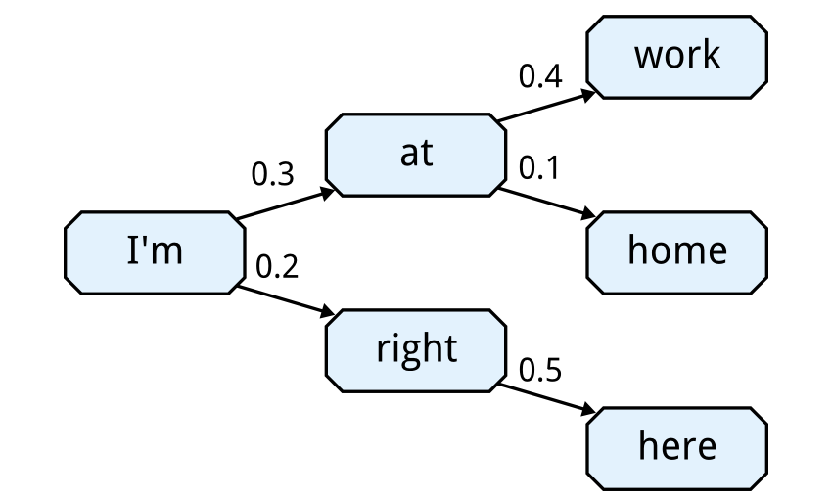
Beam Search for Generation
Let beam size = 2:
X
Pranav Khaitan, Google Research Blog: Chat Smarter with Allo

Slide 38
Beam Search in Generation
in generation tasks, using too large of a beam size may hurt performance
why?

Slide 39
Approximate Inference
greedy
beam search
coarse-to-fine
heuristic search

Slide 40
Coarse-to-Fine
use a series of models of increasing complexity
earlier models are faster than later models
each model is used to prune away potential structures for subsequent models to consider
downside is that this requires training additional models
but these additional models are usually fairly simple and efficient to train

Slide 41
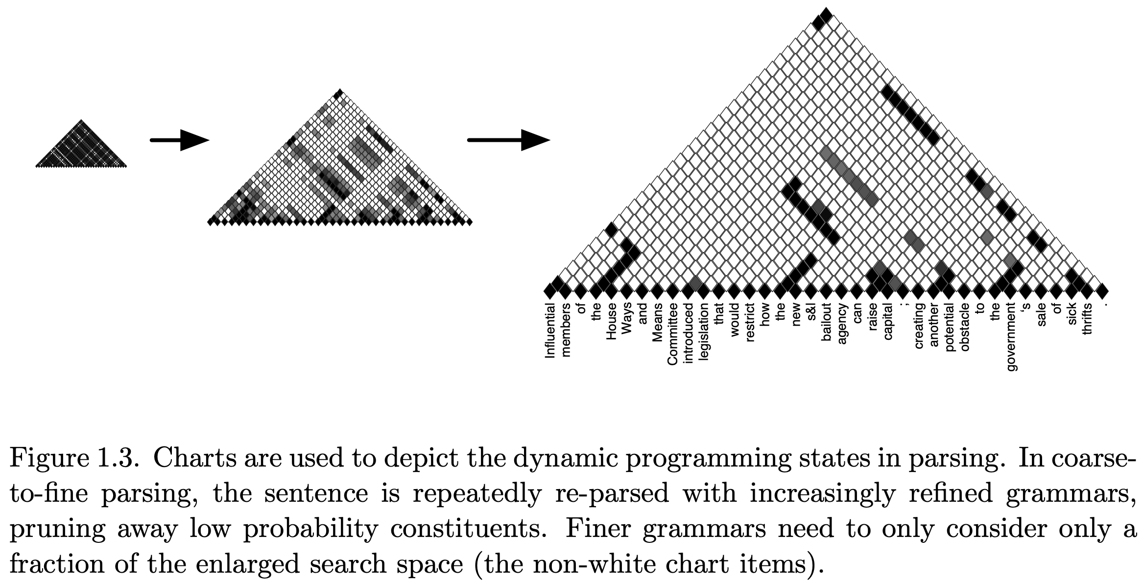
Coarse-to-Fine
this is popular for tasks like parsing
Petrov (2009): Coarse-to-Fine Natural Language Processing

Slide 42
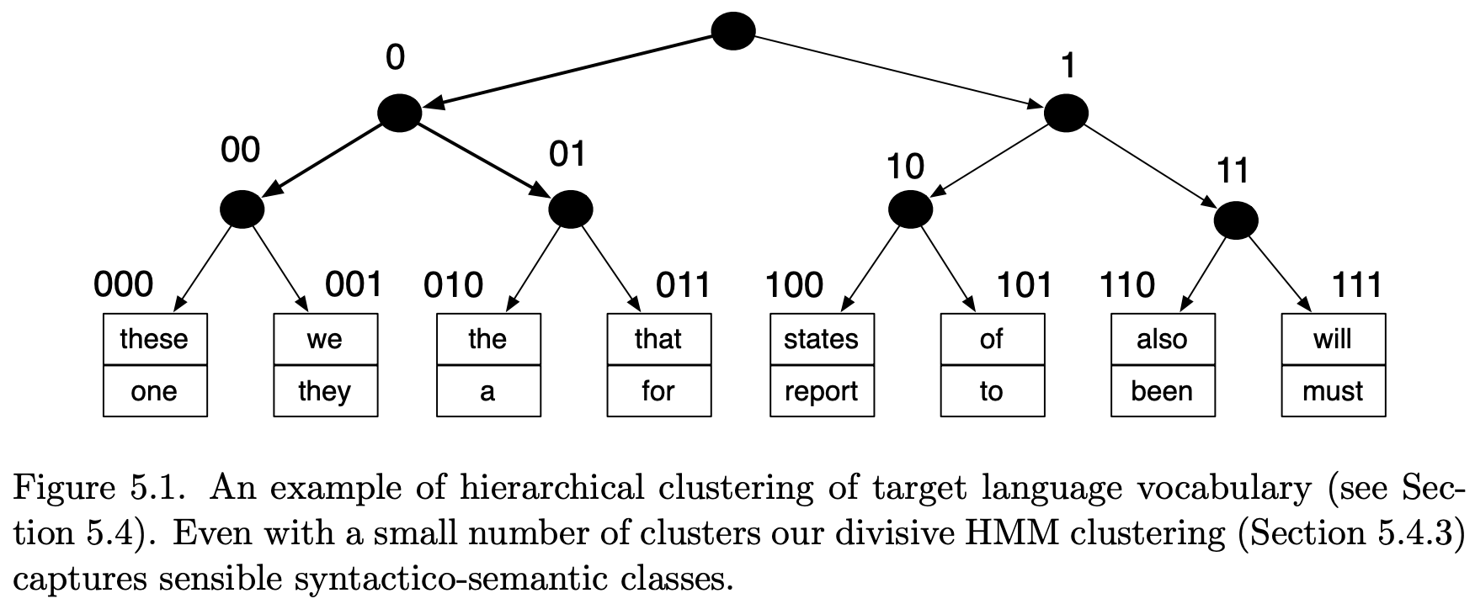
Coarse-to-Fine
also can be used for generation tasks (by clustering words and training coarse models to predict clusters)
Petrov (2009): Coarse-to-Fine Natural Language Processing

Slide 43
Coarse-to-Fine
remember the local predictors we discussed for dependency parsing and machine translation?
while they don’t work very well by themselves, they can be useful as coarse models
e.g., for dependency parsing:
train a local predictor
use it to get top k head candidates for each word
restrict next model to trees that use those candidates

Slide 44
References for Coarse-to-Fine Procedures in NLP
Petrov (2009): Coarse-to-Fine Natural Language Processing
Weiss and Taskar (2010): Structured Prediction Cascades
Rush and Petrov (2012): Vine Pruning for Efficient Multi-Pass Dependency Parsing

Slide 45
Heuristic Search Algorithms
beam search can be improved by using heuristics to favor certain hypothesis extensions over others
e.g., in phrase-based machine translation this is called “future cost estimation” (see Koehn et al. (2003): Statistical Phrase-Based Translation)
if using a particular form of beam search (cf. “agenda algorithms”) and the heuristics satisfy certain conditions, search can be exact
cf. A* search
for parsing, see Klein & Manning (2003): A* Parsing: Fast Exact Viterbi Parse Selection

Slide 46
Non-Local Features
efficient exact or even approximate inference requires relatively small parts
but intuitively, this limits modeling power
how can we combine efficiency with some long-distance or “non-local” information in the scoring function?
lots of work on this

Slide 47
Non-Local Features in Named Entity Recognition
The Chicago Bears needed a win in Sunday night’s game.… But in the end, Chicago came up short.
organization?
location?

Slide 48
Non-Local Features in Named Entity Recognition
organization
The Chicago Bears needed a win in Sunday night’s game.… But in the end, Chicago came up short.
first mention of a named entity may have more information
organization

Slide 49
Non-Local Features in Named Entity Recognition
this type of non-local feature was used in several papers focused on approximate inference for NLP

Slide 50
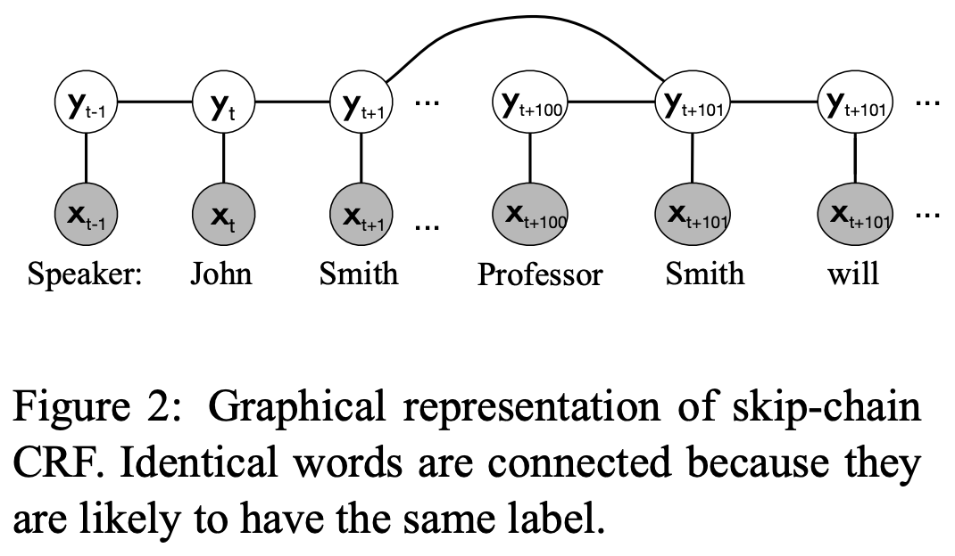
Skip-Chain CRFs with Inference via Loopy Belief Propagation
Sutton and McCallum (2004): Collective Segmentation and Labeling of Distant Entities in Information Extraction

Slide 51
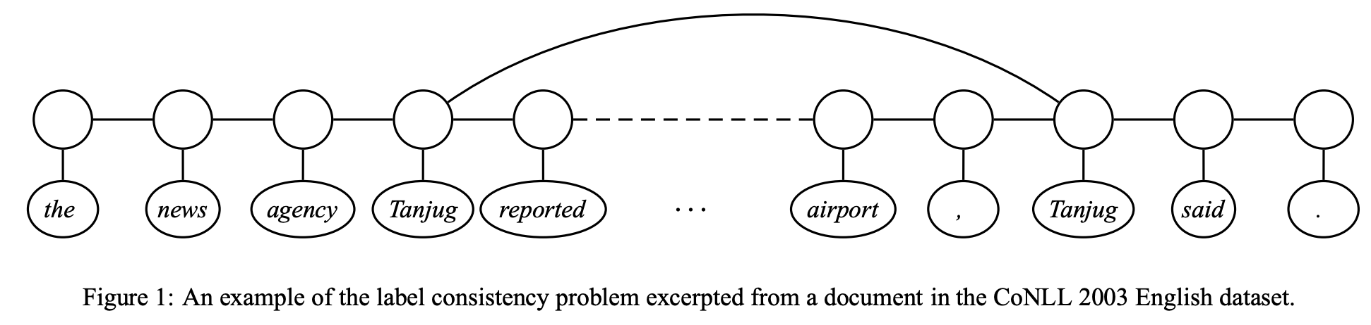
Inference via Gibbs Sampling
Finkel et al. (2005): Incorporating non-local information into information extraction systems by Gibbs sampling

Slide 52
Non-Local Features in Beam Search
Lower the lights
<s>
V
D
J
D
note: using backpointers, we can recover the entire hypothesis → we can compute any feature or scoring function using the entire hypothesis!
same idea can be applied to Viterbi and other exact DP algorithms!
Notes:
\newcommand{\topb}{\mathop{\mbox{$\max$-$b$}}}
\newcommand{\sos}{\mbox{\texttt{<s>}}}
\newcommand{\eos}{\mbox{\texttt{</s>}}}
%\hat{y}_1 = \argmax_{y\in\mathcal{L}} \,\,\,p_{\boldsymbol{\eta}}(\mbox{``Lower''} \mid y)\,p_{\boldsymbol{\tau}}(y \mid \sos)
%\hat{y}_2 = \argmax_{y\in\mathcal{L}} \,\,\,p_{\boldsymbol{\eta}}(\mbox{``the''} \mid y)\,p_{\boldsymbol{\tau}}(y \mid \mbox{\texttt{J}})
%\hat{y}_3 = \argmax_{y\in\mathcal{L}} \,\,\,p_{\boldsymbol{\eta}}(\mbox{``lights''} \mid y)\,p_{\boldsymbol{\tau}}(y \mid \mbox{\texttt{D}})\,p_{\boldsymbol{\tau}}(\eos\mid y)
B(1) = \topb_{y\in\mathcal{L}} \,\,\,p_{\boldsymbol{\eta}}(\mbox{``Lower''} \mid y)\,p_{\boldsymbol{\tau}}(y \mid \sos)

Slide 53
Inference in PCFGs
to find max-probability tree for a sentence, use dynamic programming: CKY algorithm
to find the best way to build a tree covering words i to j:
consider all possible “split points” k between i and j
for each split point k, consider all possible nonterminals for the two smaller trees created by that split

Slide 54
Notes:
Based on a treebank tree

Slide 55
CKY Algorithm
max probability
of all ways to
build a constituent
with nonterminal
Z from i to j
Notes:
Consider a single step in the CKY algorithm

Slide 56
CKY Algorithm
max over
split points
max over
nonterminals
for smaller trees
Notes:
Consider a single step in the CKY algorithm

Slide 57
detail: CKY requires the PCFG to be in Chomsky Normal Form (CNF)
basically: every rule has either 2 nonterminals or 1 terminal on the right-hand side

Slide 58
Cube Pruning (Chiang, 2007; Huang & Chiang, 2007)
modification to dynamic programming algorithms for decoding to use non-local features approximately
keeps a k-best list of derivations for each item
applies non-local feature functions on these derivations when defining new items
lets modeler decide which scoring terms to incorporate exactly and which scoring terms to incorporate approximately
Notes:
For this talk, the key ideas of cube pruning are those listed here:
We keep a k-best list of proofs or derivations for each theorem
We use these proofs to compute non-local feature functions
We’ll now go through an example of cube pruning.

Slide 59
Notes:
Based on a treebank tree

Slide 60
CKY Algorithm
Notes:
Consider a single step in the CKY algorithm

Slide 61
Local scoring functions compatible with CKY:

Slide 62
Local scoring functions compatible with CKY:

Slide 63
Local scoring functions compatible with CKY:
Notes:
Talk about NP going to NP PP

Slide 64
Local scoring functions compatible with CKY:

Slide 65
Imagine a scoring term that uses this information:
“NGramTree” feature
(Charniak & Johnson, 2005)
Notes:
Right under the S, when the NP rewrites as NP PP, this feature must look at the proofs (or derivations) of the NP and the PP, so it is non-local.

Slide 66
Imagine a scoring term that uses this information:
“NGramTree” feature
(Charniak & Johnson, 2005)
Notes:
Here’s another example, showing how the feature can look at arbitrarily long sequences of non-terminals depending on the grammar.

Slide 67
We cannot use these scoring terms in the CKY algorithm
Notes:
Here’s another example, showing how the feature can look at arbitrarily long sequences of non-terminals depending on the grammar.

Slide 68
“non-local features” like these break dynamic programming!
Notes:
But, non-local features break dynamic programming. By ‘break’ we mean that we lose our space and runtime guarantees and things become either exponential in general or must become approximate.
It’s sometimes possible to extend dynamic programming algorithms to accommodate extra information for computing these features, but it becomes exponential in general.

Slide 69
Notes:
Consider a single step in the CKY algorithm

Slide 70
Notes:
Here we see a k-best list for the NP and one for the PP, along with their values. And k equals 3 here.
The bold tags are those that differ among proofs, for clarity.
The word ‘there’ has a few different tags in the Penn Treebank. The tag ‘EX’ indicates the ‘existential there’ while the tag ‘RB’, normally used for adverbs, here indicates the ‘deictic there’ as in ‘here or there’. EX is the more common tag for there but the ‘deictic there’ is the correct ‘there’ for this sentence. In this example, we’ll show how the ngramtree feature helps us get the correct parse.

Slide 71
Notes:
The proofs of the NP are along the rows and the proofs for the PP are along the columns.
The grid will contain the values of the resulting proofs obtained through multiplication.
First, we simply multiply the values of the two proofs in each cell.

Slide 72
Notes:
Then, we need to multiply in weights for all local features. Here, the only local feature is the rule NP goes to NP PP.

Slide 73
Notes:
Next, we need to apply non-local feature functions to each cell in the grid.

Slide 74
Notes:
Shown in the upper-left is the NGramTree feature template for the first cell in the grid (which happens to be the same for the second cell).
I’ve given this feature a weight of 0.2 so this value now gets multiplied in.

Slide 75
Notes:
Unlike local features, there can now be a different weight multiplied in for each cell. Here I’ve listed the weights for all the features used here.

Slide 76
Notes:
Now we need to select the top k proofs for the result.

Slide 77
Notes:
Those are shown here in white.

Slide 78
Notes:
And the resulting k-best proof list is shown at the bottom. And we see that interpretations with the ‘deictic there’ have risen to the top of the list.

Slide 79
Clarification
Cube pruning does not actually expand all k² proofs as this example showed
It uses a fast approximation that only looks at O(k) proofs

