Slide 1
TTIC 31210: Advanced Natural Language Processing
Kevin Gimpel
Spring 2017
Lecture 10:
Introduction to Bayesian NLP

Slide 2
Assignment 2 has been posted, due May 17
Grades for Assignment 1 will be emailed to you soon
Project proposal details posted, due May 10

Slide 3
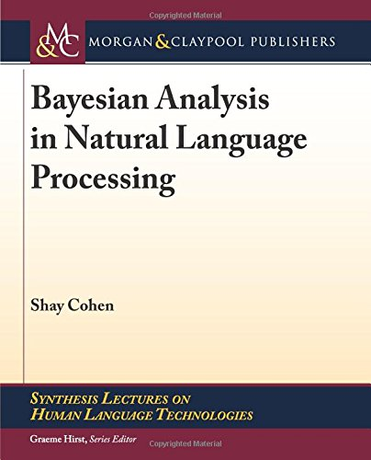
Additional Reading
For this segment of the course, the optional text is Cohen (2016)
There is a copy in the TTIC library
Readings will be drawn from this book for the next few lectures

Slide 4
Motivation
in most neural NLP, we assume parameters and architectures are fixed
consider a one-hidden-layer MLP:

Slide 5
Motivation
in most neural NLP, we assume parameters and architectures are fixed
consider a one-hidden-layer MLP:
now let’s be more explicit about what we’re conditioning on:

Slide 6
Motivation
how do we get back to ?

Slide 7
Motivation
how do we get back to ?
marginalize over new random variables:

Slide 8
Motivation
how do we get back to ?
marginalize over new random variables:

Slide 9
Going Further…
marginalize over architectures & parameters:

Slide 10
Going Further…
marginalize over architectures & parameters:
the Bayesian framework gives us a vocabulary to discuss this kind of thing and methods for approximating these computations

Slide 11
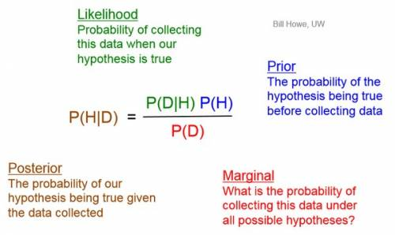
Why “Bayesian”?

Slide 12
Bayesian NLP
typically used with unsupervised learning:
we have data
we hypothesize some latent variables through which the data are generated
we define the “generative story” that describes how latent variables are generated, then how data is generated using latent variables
we parameterize the distributions & add the parameters themselves to the generative story

Slide 13
Generative Story Template

Slide 14
Multinomial Distribution
parameterized by a vector of probabilities, one for drawing each outcome
i.e., prob. of drawing outcome i for variable A:

Slide 15
Multinomial Distribution
parameterized by a vector of probabilities, one for drawing each outcome
i.e., prob. of drawing outcome i for variable A:
when we want to draw from this distribution, we will write:

Slide 16
we should more accurately call this a “categorical distribution”
a multinomial is more general (permits more than 1 instance of an event)
but multinomial is used frequently to mean categorical in this literature, so we’ll often use multinomial

Slide 17
generative model for document collections using latent variables that can be interpreted as “topics”
learns a multinomial distribution over words for each topic

Slide 18
Latent Dirichlet Allocation (Blei et al., 2003)
multinomial distributions over words for four topics:

Slide 19
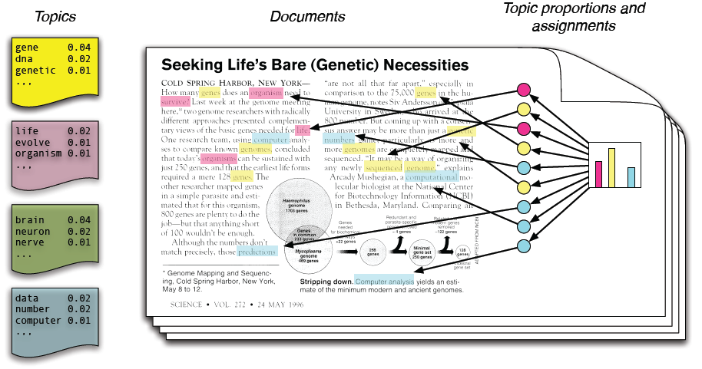

Slide 20
Generative Story for Simple LDA
simplified LDA model, and only showing generative story for a single document:

Slide 21
Generative Story for Simple LDA
simplified LDA model, and only showing generative story for a single document:
multinomial distribution over words for topic

Slide 22
Generative Story for Simple LDA
simplified LDA model, and only showing generative story for a single document:
what should we keep in mind
when choosing this distribution?

Slide 23
Dirichlet Distribution
distribution over vectors with entries that are all positive and sum to 1
so it’s kind of like a “distribution over (multinomial) distributions”
normalization term that depends on

Slide 24
Dirichlet Distribution
parameterized by a positive vector

Slide 25
[see Jupyter Notebook]

Slide 26
Generative Story for Simple LDA
simplified LDA model, and only showing generative story for a single document:

Slide 27
Generative Story for LDA
now we show explicitly the generation of the word multinomials (once for the document collection)
where should the hyperparameters (alpha and psi) come from?

Slide 28
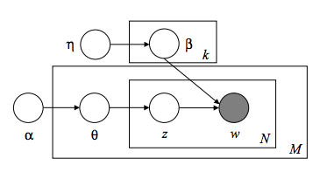
Graphical Model for LDA

