Slide 1
TTIC 31210: Advanced Natural Language Processing
Kevin Gimpel
Spring 2017
Lecture 11:
Inference in Bayesian NLP

Slide 2
Project proposals due Wednesday, May 10

Slide 3
Bayesian Modeling
this typically means:
defining parameters as random variables and giving them prior distributions
marginalizing out random variables whenever possible (like those parameter random variables)
aiming to compute posterior over all latent variables conditioned on observations (and maybe some hyperparameters)

Slide 4
Motivation
a Bayesian approach is more impactful when there are latent variables
NLP has a lot of models with latent variables
unsupervised learning in NLP: “consider the unseen output as a latent variable”

Slide 5
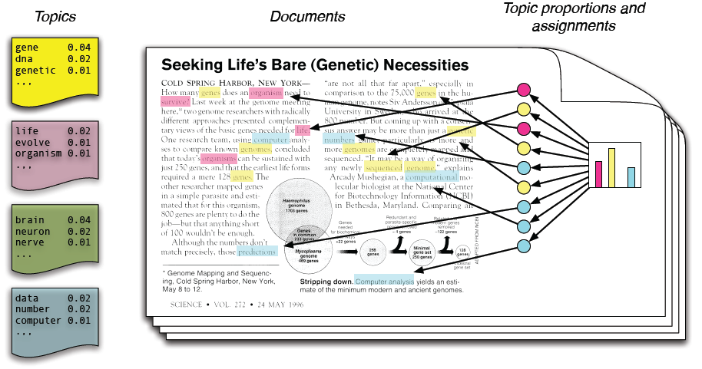
Topic Modeling
Blei et al. (2003)

Slide 6
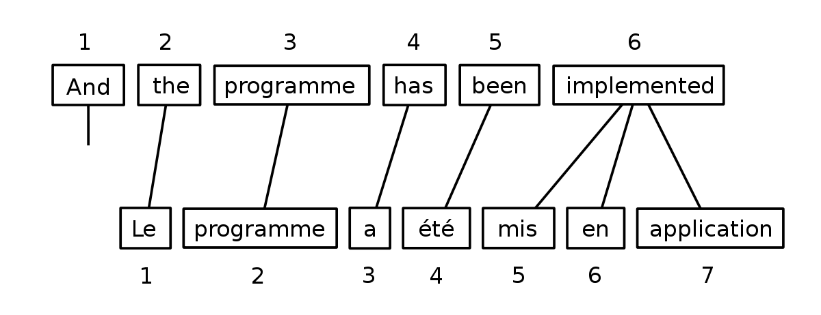
Word Alignment
parallel sentences are observed, word alignments are latent variables:
Brown et al. (1990)

Slide 7
Unsupervised Part-of-Speech Tagging
sentences are observed, part-of-speech tags are treated as latent variables:
y₁
y₂
y₃
y₄
justin bieber for president

Slide 8
Unsupervised Dependency Parsing
sentences are observed, dependency parse trees are treated as latent variables:
Klein & Manning
Smith & Eisner

Slide 9
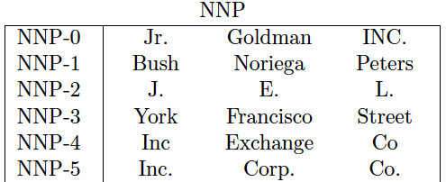
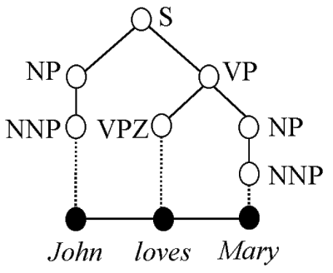
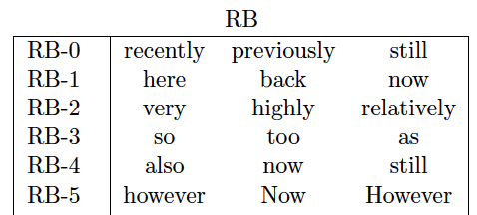
Latent Syntactic Categories for Parsing
split Penn Treebank syntactic categories into finer subcategories
Petrov (2009)

Slide 10
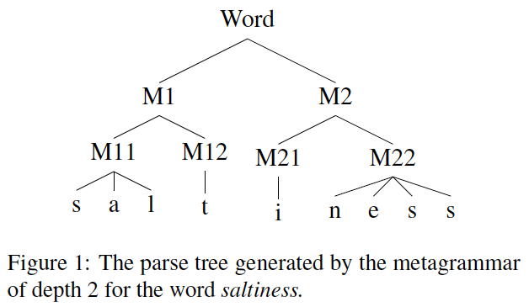
Morphological Segmentation
Sirts & Goldwater (2013)

Slide 11
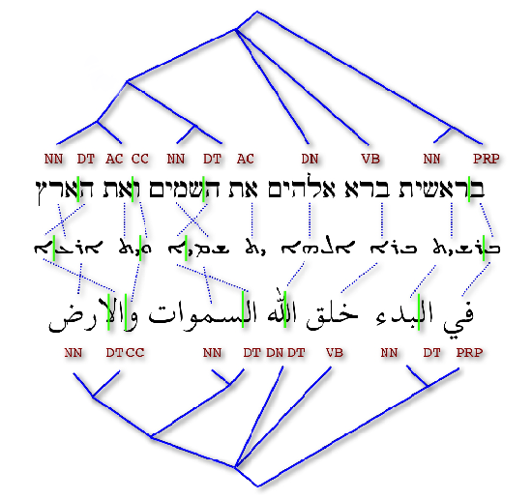
Morphological Segmentations, POS, and Syntactic Trees
Snyder & Barzilay

Slide 12
Generative Stories
we hypothesize latent variables through which data are generated
define “generative story” that describes how latent variables are generated, then how data is generated using latent variables
we parameterize the distributions & add parameter generation to generative story

Slide 13
Generative Story Template

Slide 14
Inference
in general, inference roughly means “calculate statistical quantities of interest”
examples:
compute the mode of some random variables when conditioning on some and marginalizing out others
compute marginals of some random variables (variable posteriors when marginalizing out everything else)
compute posterior distribution over some subset of random variables

Slide 15
Learning?
in Bayesian NLP, there’s often no “learning”
there is only “inference”
just define model and do inference to calculate what we want to calculate
no parameters are being estimated from data*
we are not optimizing any loss function*
there is no gradient descent*
* typically

Slide 16
Generative Story Template
Our data is a set of samples:

Slide 17
Key Quantities
Our data is a set of samples:

Slide 18
Markov Chain Monte Carlo (MCMC)
MCMC algorithms are widely used in Bayesian modeling but also useful more generally
can be used to generate samples from distributions that are hard to sample from
samples can be used to estimate quantities of interest
these estimates are unbiased

Slide 19
Gibbs Sampling
Gibbs sampling is the simplest and most widely-used MCMC algorithm (at least in NLP)

Slide 20
Gibbs Sampling Template

Slide 21
Gibbs Sampling Template
At convergence, each time we update any value of any random
variable in , we have another sample from the posterior
these samples can be used to estimate any quantity of interest
while offering some nice theoretical properties

Slide 22
Disadvantages of Gibbs Sampling?
nearby samples are not necessarily uncorrelated, so it
can take many samples for good estimates, especially
of rare events
guarantees are at convergence, “burn-in” time
can be hard to estimate & depends on initialization

Slide 23
LDA Inference Cheat Sheet

