Slide 1
TTIC 31210: Advanced Natural Language Processing
Kevin Gimpel
Spring 2017
Lecture 12:
Bayesian Inference, Unsupervised NLP

Slide 2
Generative Story Template

Slide 3
Key Quantities
Our data is a set of samples:

Slide 4
Gibbs Sampling Template

Slide 5
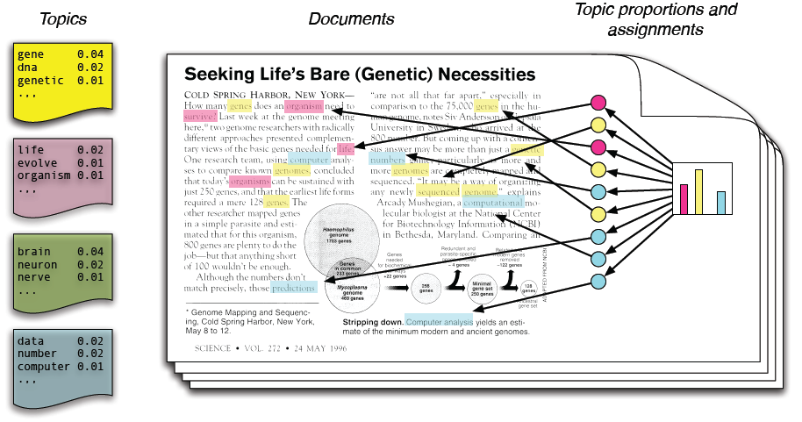
Topic Modeling
Blei et al. (2003)

Slide 6
LDA Generative Story

Slide 7
Gibbs Sampling for LDA

Slide 8
Gibbs Sampling for LDA

Slide 9
we now have a way to generate samples from the posterior for the LDA model
how should we do the following?
get topic assignments for each word in the document collection?
get topic distribution for a document?
get estimates of topic-word distributions for each topic?

Slide 10
LDA

Slide 11
Conjugate Priors
Dirichlet is (simplest) conjugate prior to multinomial
Dirichlet hyperparameters are like “pseudo-observations”
definition: “posterior obtained from a given prior in the prior family and a given likelihood function belongs to the same prior family”
direct result of “algebraic similarity” between prior family and likelihood
often leads to tractability & closed-form analytic solutions for posterior

Slide 12
Key Quantities
Our data is a set of samples:

Slide 13
Collapsed Gibbs Sampling for LDA
the collapsed posterior is tricky to work with because all latent variables become coupled
i.e., we now have fewer independence assumptions to help us simplify things
[on board]

Slide 14
Collapsed Gibbs Sampling for LDA

Slide 15
Expectation Maximization (EM)
EM is an algorithmic template that finds a local maximum of the marginal likelihood of the observed data

Slide 16
Expectation Maximization (EM)
working instead with the log-likelihood:
where q_{i} is some distribution over values for z

Slide 17
Expectation Maximization (EM)
working instead with the log-likelihood:
via Jensen’s inequality

Slide 18
Expectation Maximization (EM)
maximize lower bound of the log-likelihood:
alternate between optimizing wrt q and theta

Slide 19
EM
“E” step:
compute posteriors over latent variables:

Slide 20
EM
“E” step:
compute posteriors over latent variables:
“M” step:
update parameters given posteriors:

Slide 21
EM for LDA
“E” step:
compute posteriors over latent variables:

Slide 22
EM for LDA
“E” step:
compute posteriors over latent variables:
“M” step:
update parameters given posteriors:

