Slide 1
TTIC 31210: Advanced Natural Language Processing
Kevin Gimpel
Spring 2017
Lecture 13:
Introduction to Bayesian Nonparametrics for NLP

Slide 2
“Nonparametric”?
nonparametric does not mean “no parameters”
it means that “the number of parameters grows as the data grows”
for our purposes, think of it as “some component of the model permits an unbounded set of something”

Slide 3
Parametric or Nonparametric?
Model | Parametric or Nonparametric?
Gaussian Mixture Model (GMM) | parametric
Hidden Markov Model (with GMM emissions) | parametric
Hidden Markov Model (for part-of-speech tagging, with multinomial emissions) | nonparametric*
n-gram language models | nonparametric
LDA | nonparametric*
LSTM language model | nonparametric*
character-level LSTM language model | parametric (assuming fixed set of characters)
*parametric if vocab fixed

Slide 4
Parametric or Nonparametric?
Model | Parametric or Nonparametric?
Gaussian Mixture Model (GMM) | parametric
Hidden Markov Model (with GMM emissions) | parametric
Hidden Markov Model (for part-of-speech tagging, with multinomial emissions) | nonparametric*
n-gram language models | nonparametric
LDA | nonparametric*
LSTM language model | nonparametric*
character-level LSTM language model | parametric (assuming fixed set of characters)
*parametric if vocab fixed

Slide 5
“nonparametric modeling” in terms of vocab has a lot of engineering solutions:
use UNK for unknown words, do smoothing of high-order n-grams, etc.
in this case, unbounded part of model is mostly determined by observed data, heuristics are useful
modeling gets more interesting when unbounded part of model relates to latent variables

Slide 6
when might you want to permit an unbounded set of latent items in a model?

Slide 7
Infinite Mixture Model
number of mixture components is unbounded (grows depending on the data)
e.g., LDA with an unbounded set of topics

Slide 8
“Infinite” HMM
HMMs permit infinite sequences already
what’s new here?
infinite number of hidden states:
Beal et al. (2002), Teh et al. (2005)

Slide 9
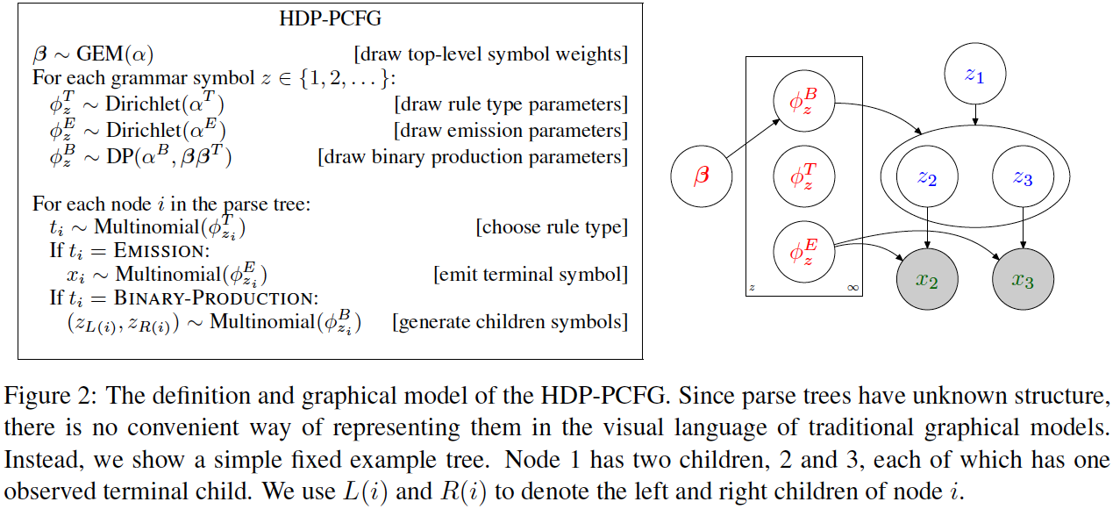
“Infinite” PCFG
PCFGs can already handle infinite-length derivations
“infinite” here means an infinite number of nonterminals:
Liang et al. (2007), Finkel et al. (2007)

Slide 10
when might you want to permit an unbounded set of latent items in a model?
number of topics in LDA
number of Gaussians in a Gaussian Mixture Model
number of hidden states in an HMM
number of nonterminals in a PCFG
morph lexicon for morphological segmentation
lexicon for Chinese word segmentation
number of coreference chains in coreference resolution
number of dimensions in an embedding (?!)

Slide 11
we need priors over distributions that permit an unbounded set of items

Slide 12
LDA Generative Story
dimensionality of alpha
must be K (the number of topics)

Slide 13
Dirichlet Process (DP)
“distribution over distributions”
unlike Dirichlet distribution, DP does not require pre-specifying number of components
we’ll now describe how a DP generates a distribution over an unbounded set of items

Slide 14
Running Example
let’s say we’re trying to segment words into morphological units without any supervision:
walking → walk + ing
restarted → re + start + ed
what is the unbounded set of latent items here?
lexicon of possible morphological units

Slide 15
Dirichlet Process (DP)
contains a “base distribution”
simple example base distribution for our morph lexicon:
e.g., probability of “ing”:

Slide 16
Dirichlet Processes
our unbounded distribution over items will choose its items by sampling from the base distribution
base distribution typically has an infinite set of items with nonzero probability, as in our example:

Slide 17
Items and Probabilities
base distribution provides the items (“atoms”), as many as we want
where do their probabilities come from?
we need an infinite set of probabilities that sum to 1
DPs have another parameter: concentration (strength) parameter s

Slide 18
Stick-Breaking Process
full stick
…
the betas form an infinite sequence that sums to 1
they provide probabilities for an infinite set of items!

Slide 19
Stick-Breaking Process
full stick
the betas form an infinite sequence that sums to 1
they provide probabilities for an infinite set of items!

Slide 20
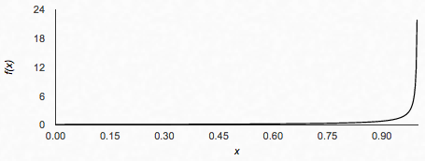
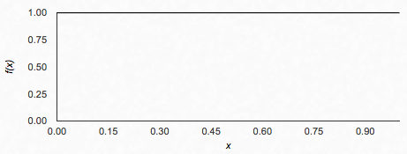
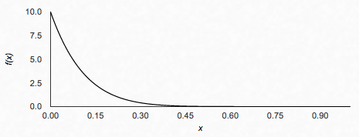
Beta Distribution

Slide 21
Stick-Breaking with High Concentration (s = 10)
full stick

Slide 22
Stick-Breaking with High Concentration (s = 10)
full stick
high concentration = more of probability mass preserved for other pieces in the stick

Slide 23
Stick-Breaking with Low Concentration (s = 0.1)
full stick

Slide 24
Stick-Breaking with Low Concentration (s = 0.1)
full stick
low concentration = stronger power law effects in resulting probabilities

Slide 25
A Draw G from a DP
draw infinite probabilities from
stick-breaking process with parameter s
draw atoms from base distribution
atoms can be repeated!

Slide 26
A Draw G from a DP
draw infinite probabilities from
stick-breaking process with parameter s
draw atoms from base distribution
atoms can be repeated!

Slide 27
the stick-breaking construction of the DP is useful for specifying models and defining inference algorithms

Slide 28
Dirichlet Process Mixture Model
generative story for dataset :
each x is generated from a single mixture component
the number of mixture components is unbounded
what should the base distribution be?

