Slide 1
TTIC 31210: Advanced Natural Language Processing
Kevin Gimpel
Spring 2017
Lecture 14:
Finish up Bayesian/Unsupervised NLP,
Start Structured Prediction

Slide 2
Today and Wednesday: structured prediction
No class Monday May 29 (Memorial Day)
Final class is Wednesday May 31

Slide 3
Assignment 3 has been posted, due Thursday June 1
Final project report due Friday, June 9

Slide 4
Key Quantities
Our data is a set of samples:

Slide 5
Gibbs Sampling Template

Slide 6
LDA

Slide 7
Expectation Maximization (EM)
EM is an algorithmic template that finds a local maximum of the marginal likelihood of the observed data

Slide 8
EM
“E” step:
compute posteriors over latent variables:
“M” step:
update parameters given posteriors:

Slide 9
Different Views of the Dirichlet Process (DP)
last time we discussed the “stick-breaking” view of the DP
today we’ll briefly discuss the “Chinese Restaurant Process” view
with both views, we still have the same DP hyperparameters
(base distribution & concentration parameter)

Slide 10
Base Distribution for DP
our unbounded distribution over items will choose them from the base distribution
base distribution usually has infinite support
simple example base distribution for our morph lexicon:

Slide 11
Concentration Parameter
in stick-breaking process, concentration parameter determines how much of the stick we break off each time
high concentration == small parts of stick
full stick

Slide 12
the stick-breaking construction of the DP is useful for specifying models and defining inference algorithms
another useful way of representing a draw from a DP is with the Chinese Restaurant Process (CRP)
CRP provides a distribution over partitions with an unbounded number of parts

Slide 13
imagine a Chinese restaurant with an infinite number of tables…
…
1
2
3
4

Slide 14
first customer sits at first table:
…
1
2
3
4

Slide 15
second customer enters, chooses a table:
…
1
2
3
4

Slide 16
second customer enters,
chooses table 1:
…
1
2
3
4

Slide 17
second customer enters,
chooses table 1:
chooses new table:
…
1
2
3
4

Slide 18
second customer enters,
chooses table 1
…
1
2
3
4

Slide 19
third customer enters,
…
1
2
3
4

Slide 20
third customer enters,
chooses table 1:
chooses new table:
…
1
2
3
4

Slide 21
third customer enters,
chooses new table
…
1
2
3
4

Slide 22
fourth customer enters,
p(choose table 1): p(choose table 2):
p(choose new table):
…
1
2
3
4

Slide 23
…
1
2
3
4

Slide 24
large value of concentration parameter:
…
1
2
3
4
full stick

Slide 25
small value of concentration parameter:
…
1
2
3
4

Slide 26
A Draw G from a DP (Stick-Breaking Representation)
draw infinite probabilities from
stick-breaking process with parameter s
draw atoms from base distribution
atoms can be repeated!

Slide 27
A Representation of G Drawn from a DP (Chinese Restaurant Process Representation)
draw table assignments for n customers
with parameter s
for each occupied table, draw atom
from base distribution
each draw from G is an atom, where its
probability comes from the number of
customers at its table
number of
tables occupied

Slide 28
When to be Bayesian?
if you’re doing unsupervised learning or learning with latent variables
if you want to marginalize out some model parameters
if you want to learn the structure/architecture of your model
if you want to learn a potentially-unbounded lexicon (Bayesian nonparametrics)

Slide 29
What is Structured Prediction?

Slide 30
Modeling, Inference, Learning

Slide 31
Modeling, Inference, Learning
modeling: define score function
Modeling: How do we assign a score to an (x,y) pair using parameters ?

Slide 32
Modeling, Inference, Learning
inference: solve _
modeling: define score function
Inference: How do we efficiently search over the space of all labels?

Slide 33
Modeling, Inference, Learning
inference: solve _
modeling: define score function
learning: choose _
Learning: How do we choose ?

Slide 34
Modeling, Inference, Learning
inference: solve _
modeling: define score function
learning: choose _
Structured Prediction:
size of output space is exponential in size of input
or is unbounded (e.g., machine translation)
(we can’t just enumerate all possible outputs)

Slide 35
Simplest kind of structured prediction: Sequence Labeling
Part-of-Speech Tagging
determiner verb (past) prep. proper proper poss. adj. noun
modal verb det. adjective noun prep. proper punc.
determiner verb (past) prep. noun noun poss. adj. noun
Some questioned if Tim Cook ’s first product
modal verb det. adjective noun prep. noun punc.
would be a breakaway hit for Apple .
Notes:
sentence -> NER labeling
sentence -> translation
Neue Umfrage: Kaufen Sie eine Apple Watch?
sentence -> parse tree
set of documents -> summary

Slide 36
Formulating segmentation tasks as sequence labeling via B-I-O labeling:
Named Entity Recognition
O O O B-PERSON I-PERSON O O O
Some questioned if Tim Cook ’s first product
O O O O O O B-ORGANIZATION O
would be a breakaway hit for Apple .
B = “begin”
I = “inside”
O = “outside”
Notes:
sentence -> NER labeling
sentence -> translation
Neue Umfrage: Kaufen Sie eine Apple Watch?
sentence -> parse tree
set of documents -> summary

Slide 37
Constituent Parsing
(S (NP the man) (VP walked (PP to (NP the park))))
S
VP
Key:
S = sentence
NP = noun phrase
VP = verb phrase
PP = prepositional phrase
DT = determiner
NN = noun
VBD = verb (past tense)
IN = preposition
NP
PP
NP
DT
NN
VBD IN DT NN
the man walked to the park

Slide 38
Dependency Parsing
“wall” symbol

Slide 39
Coreference Resolution
As we head towards training camp, the Philadelphia Eagles have finally filled most of their needs on offense.
One of the main goals for this off-season was to find weapons for the team’s franchise quarterback, Carson Wentz. The Eagles needed a wide receiver who could stretch the field and give Wentz the opportunity to throw the long ball.
They signed receiver Torrey Smith to a 3-year deal. While the signing of Smith was huge for the team, the biggest signing the Eagles made was former Chicago Bears receiver Alshon Jeffery. He had a solid 5-year stint in Chicago, but as the team started to fall apart, Jeffery was forced to explore other options.

Slide 40
Coreference Resolution
input: a document
output: a set of “mentions” (textual spans in document), and memberships of those mentions in clusters

Slide 41
Semantic Role Labeling
Agent
Predicate
Theme
Location
input: a sentence
output: one span in the sentence identified as a predicate, and a set of other spans identified as particular roles for that predicate
J&M/SLP3

Slide 42
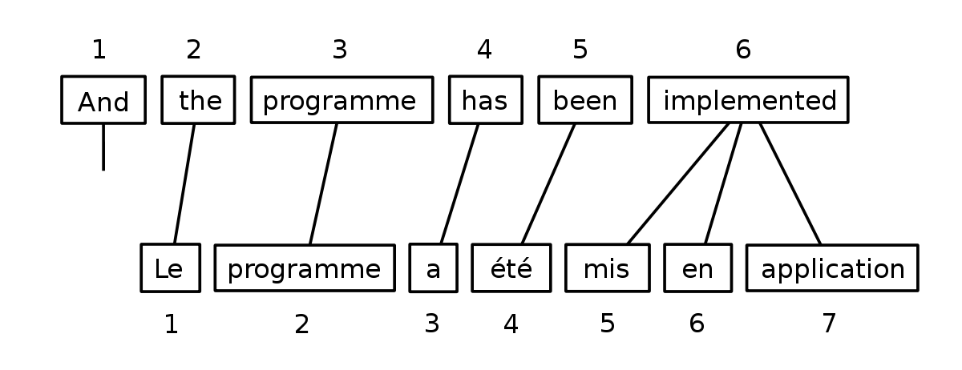
Supervised Word Alignment
given parallel sentences, predict word alignments:
Brown et al. (1990)

Slide 43
Machine Translation
phrase-based model (Koehn et al., 2003):
input: a sentence in the source language
output: a segmentation of the source sentence into segments, a translation of each segment, and an ordering of the translations

Slide 44
Key Categories of Structured Prediction
I think of structured prediction methods in two primary categories:
score-based and search-based

Slide 45
Score-Based Structured Prediction
focus on defining the score function of the structured input/output pair:
in dependency parsing, this is called “graph-based parsing” because minimum spanning tree algorithms can be used to find the globally-optimal max-scoring tree

Slide 46
Search-Based Structured Prediction
focus on the procedure for searching through the structured output space (usually involves simple greedy or beam search)
design a classifier to score a small number of decisions at each position in the search
this classifier can use information about the current state as well as the entire history of the search
in dependency parsing, this is called “transition-based parsing” because it consists of greedily, sequentially deciding what parsing decision to make

Slide 47
Structured Prediction
to make SP practical, we need to decompose the SP problem into parts
this is true whether we are going to use search-based or score-based SP
score-based: score function decomposes additively into scores of parts
search-based: search factors into a sequence of decisions, each one adding a part to the final output structure

