Slide 1
TTIC 31210: Advanced Natural Language Processing
Kevin Gimpel
Spring 2017
Lecture 3:
Word Embeddings

Slide 2
Assignment 1
Assignment 1 due tonight

Slide 3
Roadmap
review of TTIC 31190 (week 1)
deep learning for NLP (weeks 2-4)
generative models & Bayesian inference (week 5)
Bayesian nonparametrics in NLP (week 6)
EM for unsupervised NLP (week 7)
syntax/semantics and structure prediction (weeks 8-9)
applications (week 10)

Slide 4
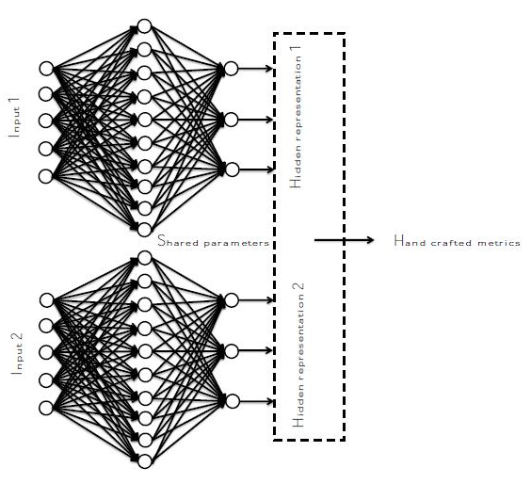
Neural Similarity Modeling
“Siamese networks” (Bromley et al., 1993)
two identical networks with shared parameters
at end, similarity computed between two representations

Slide 5
Similarity Functions
many choices for similarity functions
we talked about some during Lecture 2

Slide 6
Learning for Similarity
We want to learn input representation function as well as any parameters of similarity function
We’ll just write all these parameters as
How about this loss? (loss A on your handout)
Any potential problems with this?

Slide 7
(Better) Learning for Similarity
Contrastive hinge loss (loss B on handout):
is a “negative” example
Any potential problems with this?

Slide 8
(Better) Learning for Similarity
Large-margin contrastive hinge loss:
is the “margin”

Slide 9
(Better) Learning for Similarity
Large-margin contrastive hinge loss:
How should we choose negative examples?

Slide 10
(Better) Learning for Similarity
Large-margin contrastive hinge loss:
How should we choose negative examples?
random: just pick v randomly from the data
max:
many other ways depending on problem

Slide 11
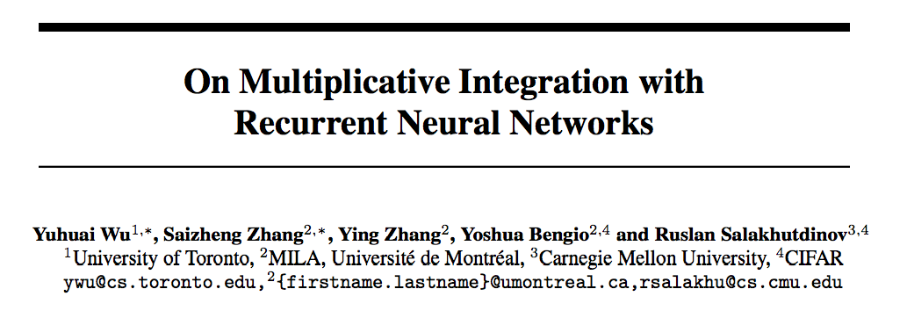
Aside:

Slide 12
Recurrent Neural Networks
“hidden vector”

Slide 13
Recurrent Neural Networks
Multiplicative Integration
Recurrent Neural Networks

Slide 14
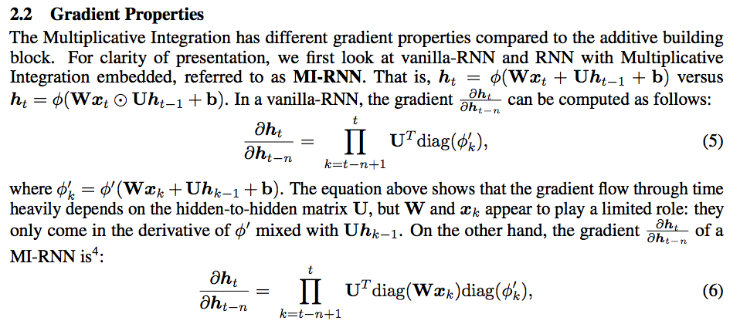

Slide 15
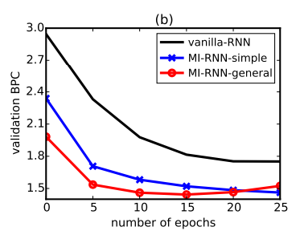

Slide 16
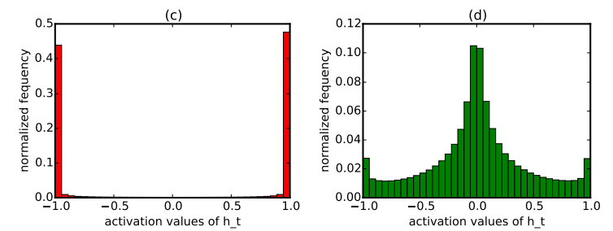
RNN
MI-RNN

Slide 17
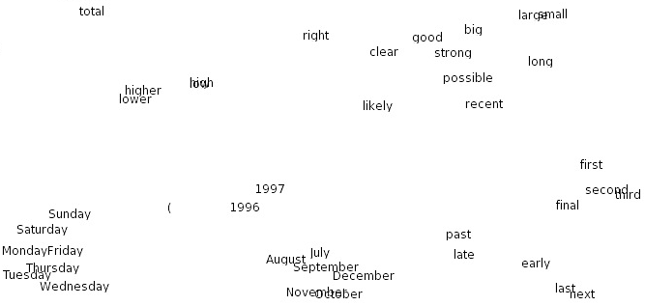
Word Embeddings
Turian et al. (2010)
Notes:
These are nice because word similarities can be computed using distance functions in these continuous spaces

Slide 18
idea: use a neural network for n-gram language modeling:

Slide 19
this is not the earliest paper on using neural networks for n-gram language models, but it’s the most well-known and first to scale up
see paper for citations of earlier work

Slide 20
Neural Probabilistic Language Models (Bengio et al., 2003)

Slide 21
Model (Bengio et al., 2003)

Slide 22
Bengio et al. (2003)
Experiments:
they minimized log loss of next word conditioned on a fixed number of previous words
no RNNs here. just a feed-forward network.
~800k training tokens, vocab size of 17k
they trained for 5 epochs, which took 3 weeks on 40 CPUs!

Slide 23
Experiments (Bengio et al., 2003)

Slide 24
Experiments (Bengio et al., 2003)
Observations:
hidden layer (h > 0) helps
interpolating with n-gram model (“mix”) helps
using higher word embedding dimensionality helps
5-gram model better than trigram

Slide 25
Experiments

Slide 26
Bengio et al. (2003)
they discuss how the word embedding space might be interesting to examine but they don’t do this
they suggest that a good way to visualize/interpret word embeddings would be to use 2 dimensions ☺
they discussed handling polysemous words, unknown words, inference speed-ups, etc.

Slide 27
Collobert et al. (2011)

Slide 29
Collobert et al. Pairwise Ranking Loss
is training set of 11-word windows
is vocabulary
What is going on here? (loss C on handout)

Slide 30
Collobert et al. Pairwise Ranking Loss
is training set of 11-word windows
is vocabulary
What is going on here?
Make actual text window have higher score than all windows with center word replaced by w

Slide 31
Collobert et al. Pairwise Ranking Loss
is training set of 11-word windows
is vocabulary
This still sums over entire vocabulary, so it should be as slow as log loss…
Why can it be faster?
when using SGD, summation → sample

