Slide 1
TTIC 31210: Advanced Natural Language Processing
Kevin Gimpel
Spring 2017
Lecture 5:
Sequence-to-Sequence Modeling
and Sentence Embeddings

Slide 2
Recurrent Neural Networks
“hidden vector”

Slide 3
“Output” Recurrent Neural Networks
“hidden vector”
“output symbol”

Slide 4
“Output” Recurrent Neural Networks
y is a symbol, not a vector
O is the “output” vocabulary
we have a new parameter vector emb(y) for each output symbol in O
emb(y) = x?
probability distribution over output symbols?

Slide 6
Example: Language Modeling
… if the car …

Slide 7
Language Modeling: Training
… if the car …

Slide 8
Language Modeling: Training
… if the car …
…

Slide 9
Language Modeling: Decoding
we’ll use the term “decoding” to mean roughly “test-time inference”
for language modeling, decoding means “output the highest-probability sentence”

Slide 10
Language Modeling: Decoding
<s>
“The”

Slide 11
Language Modeling: Decoding
<s> The
“one”

Slide 12
Language Modeling: Decoding
<s> The one

Slide 13
Concern
there’s a mismatch between training and test!
(what is it?)

Slide 14
Sequence-to-Sequence Modeling
data: <input sequence, output sequence> pairs
use one neural network to encode input sequence as a vector
use an output RNN to generate the output sequence (conditioned on the input sequence vector)
more generally called “encoder-decoder” architectures

Slide 15

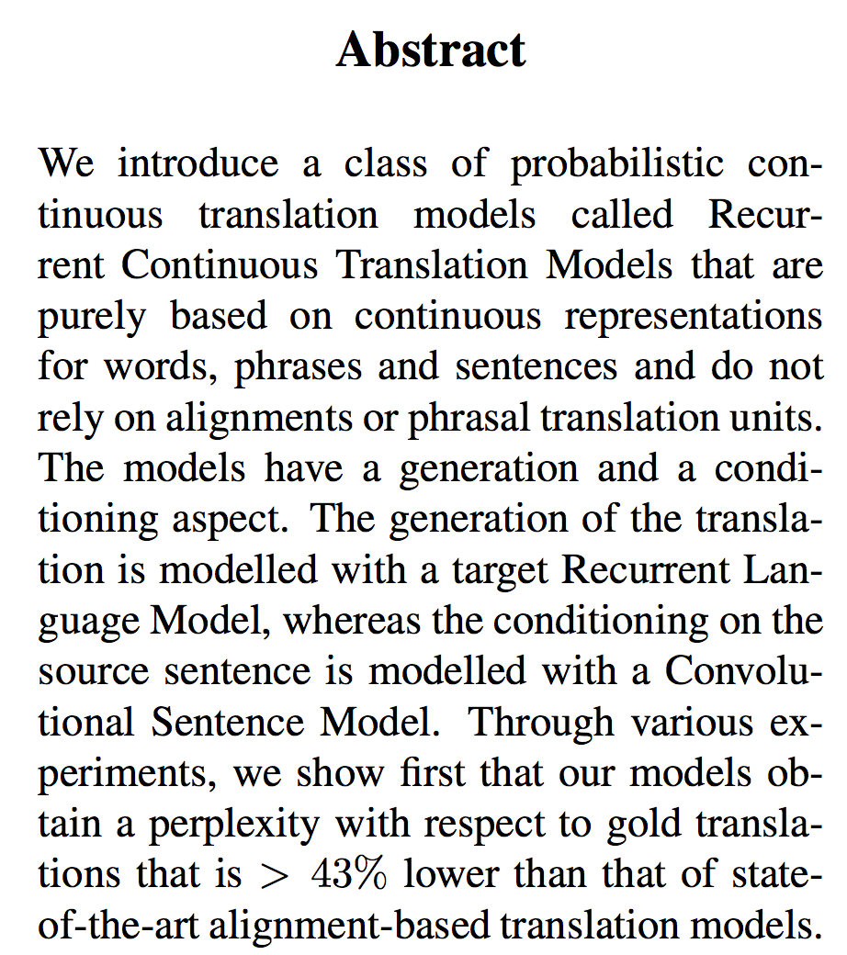
EMNLP 2013

Slide 16
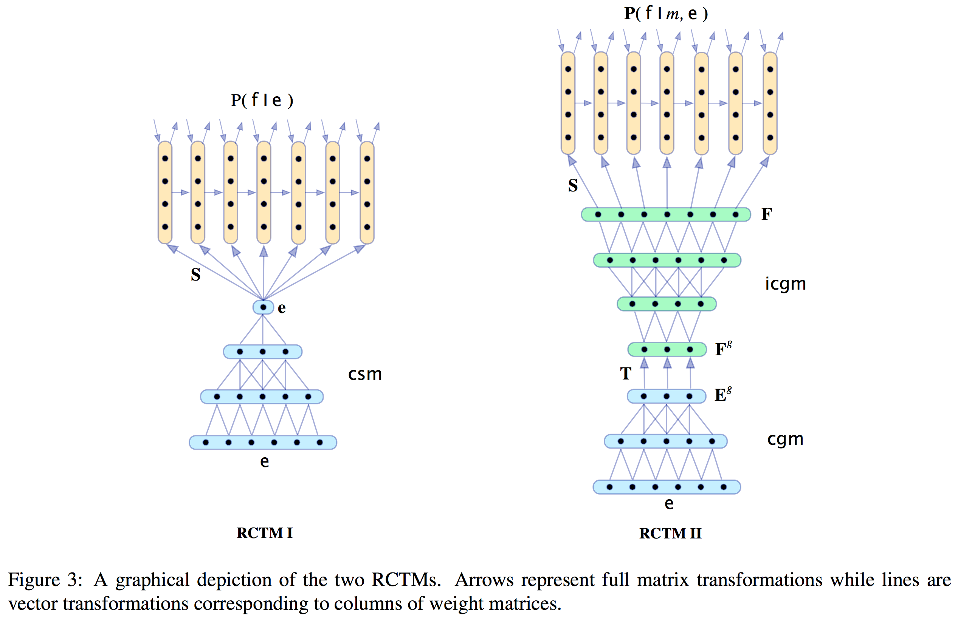
EMNLP 2013

Slide 17
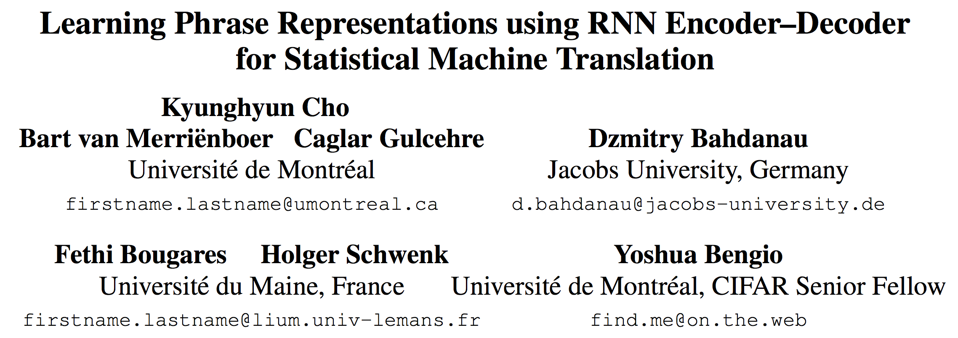
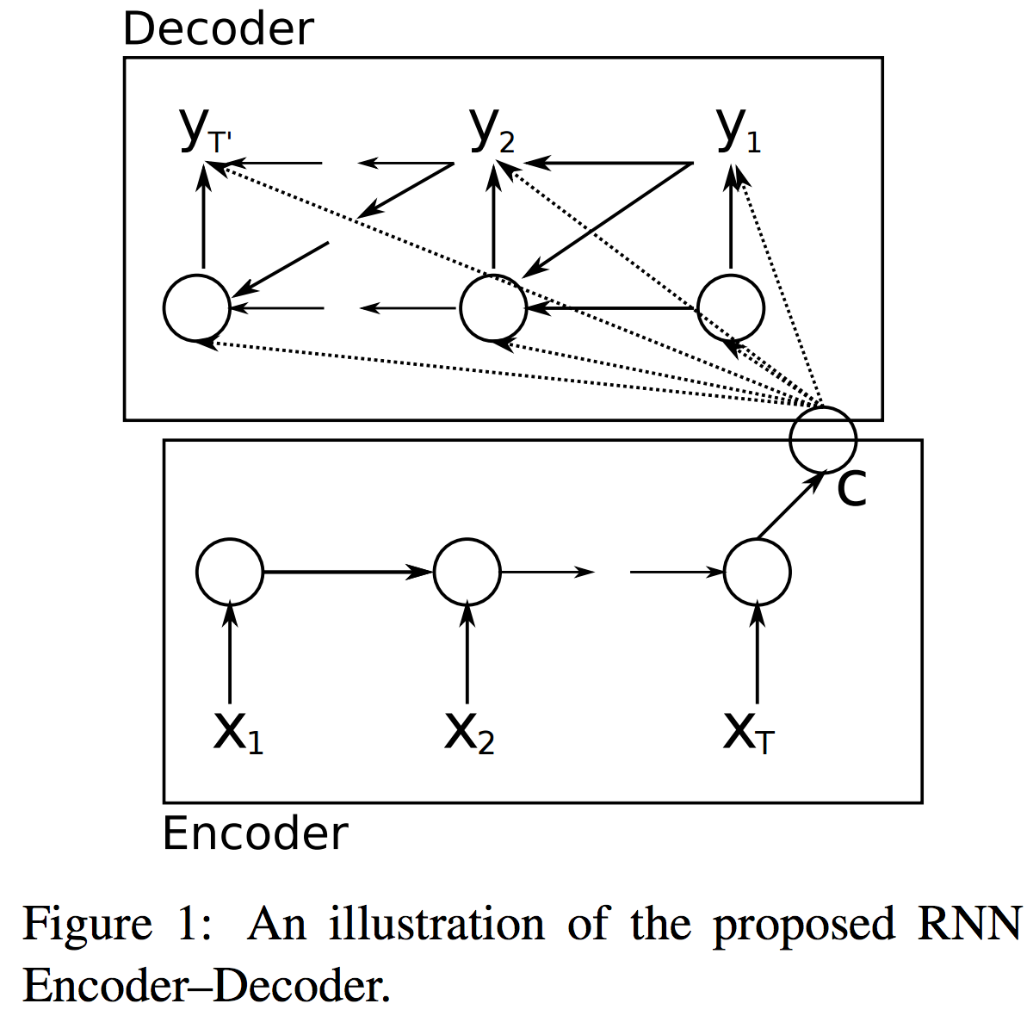
EMNLP 2014

Slide 18
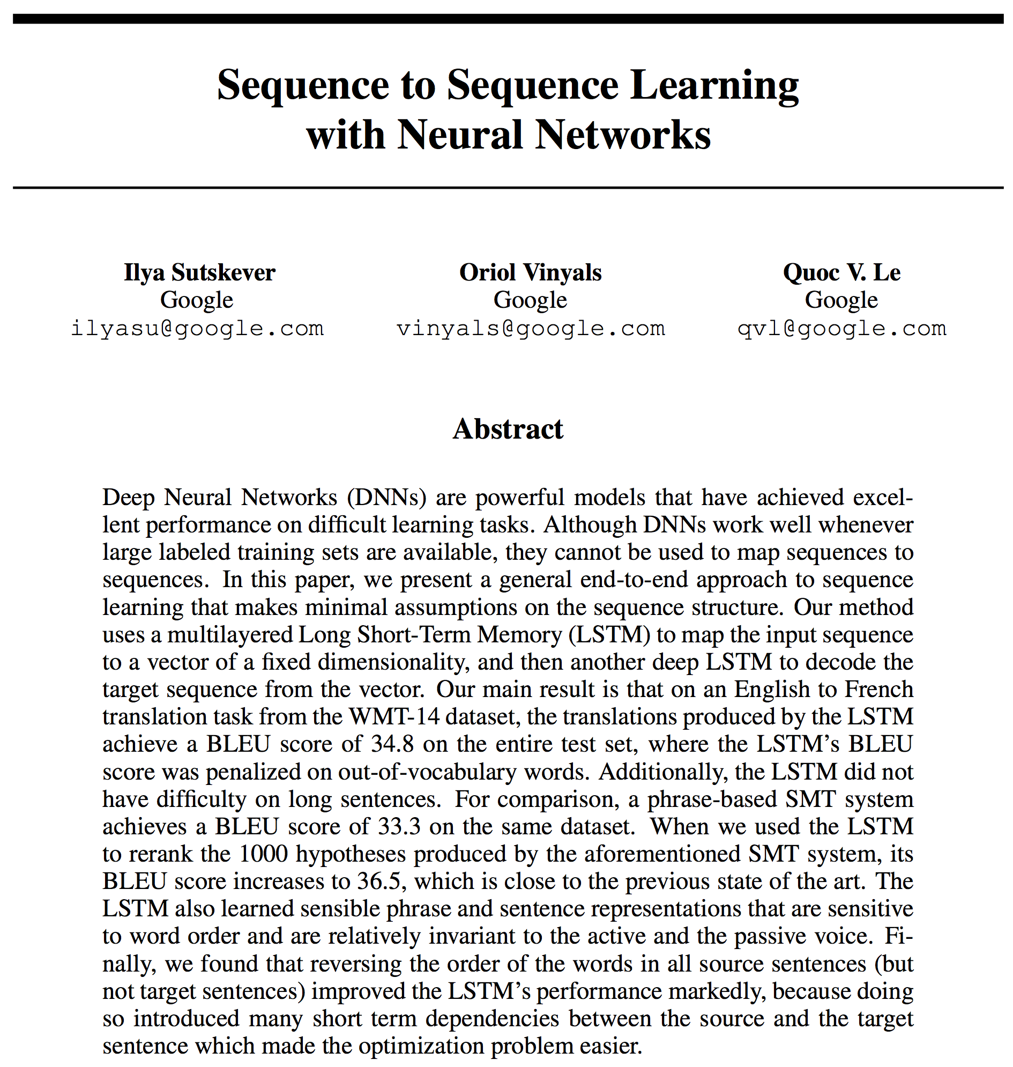
NIPS 2014

Slide 19
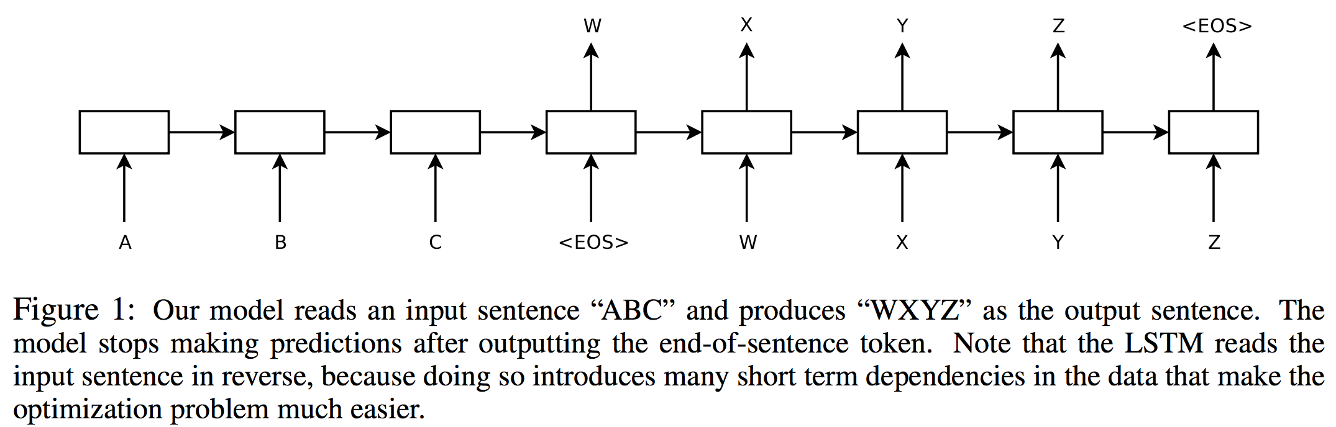
NIPS 2014

Slide 20
Unsupervised Sentence Models
how should we evaluate sentence models?
we consider two ways here:
sentence similarity:
two sentences with similar meanings should have high cosine similarities
metric: corr. between similarities & human judgments
sentence classification:
train a linear classifier using the fixed sentence representation as the input features
metric: average accuracy over 6 tasks

Slide 21
Evaluation 1: Semantic Textual Similarity (STS)
Other ways are needed.
We must find other ways.
4.4
I absolutely do believe there was an iceberg in those waters.
I don't believe there was any iceberg at all anywhere near the Titanic.
1.2
Results reported on datasets from 6 domains

Slide 22
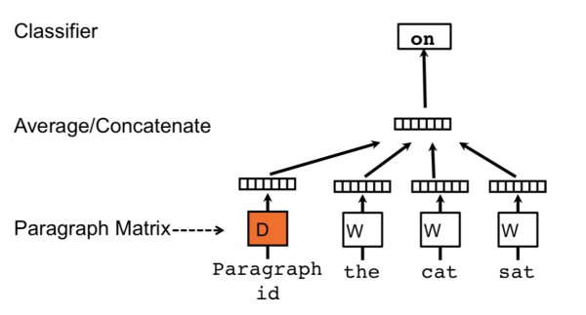
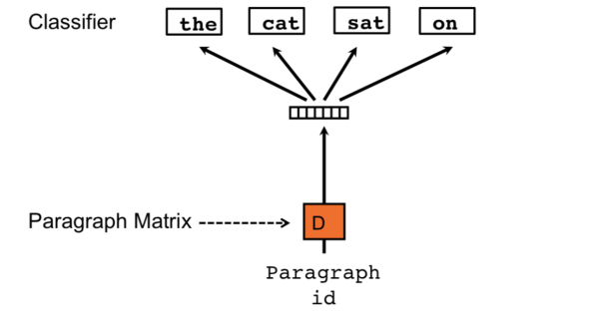
Paragraph Vectors
Represent sentence (or paragraph) by predicting its own words or context words
Le & Mikolov (2014)

Slide 23
Evaluation
Sentence Embedding Model | STS | Classification
Paragraph Vector | 44 | 70.4
Hill, Cho, Korhonen (2016)

Slide 24
Sentence Autoencoders
encode sentence as vector, then decode it
minimize reconstruction error (using squared error or cross entropy) of original words in sentence

Slide 25
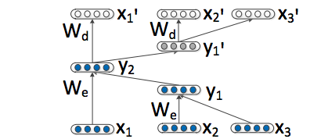
Recursive Neural Net Autoencoders
composition based on syntactic parse
Socher, Huang, Pennington, Ng, Manning (2011)

Slide 26
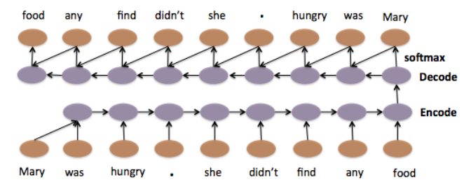
LSTM Autoencoders
Encode sentence, decode sentence
Li, Luong, Jurafsky (2015)

Slide 27
Evaluation
Sentence Embedding Model | STS | Classification
Paragraph Vector | 44 | 70.4
LSTM Autoencoder | 43 | 75.9
Hill, Cho, Korhonen (2016)

Slide 28
LSTM Denoising Autoencoders
Encode “corrupted” sentence, decode sentence
Hill, Cho, Korhonen (2016)

Slide 29
Evaluation
Sentence Embedding Model | STS | Classification
Paragraph Vector | 44 | 70.4
LSTM Autoencoder | 43 | 75.9
LSTM Denoising Autoencoder | 38 | 78.9
Hill, Cho, Korhonen (2016)

Slide 30
Other Training Criteria for Sentence Embeddings
encode sentence, decode other things from it:
decode its translation
decode neighboring sentences
predict words in the sentence and predict words in neighboring sentences

Slide 31
Neural Machine Translation
Encode source sentence, decode translation
Sutskever, Vinyals, Le (2014)
Cho, van Merrienboer, Gulcehre, Bahdanau, Bougares, Schwenk, Bengio (2014)
Notes:
These are nice because word similarities can be computed using distance functions in these continuous spaces

Slide 32
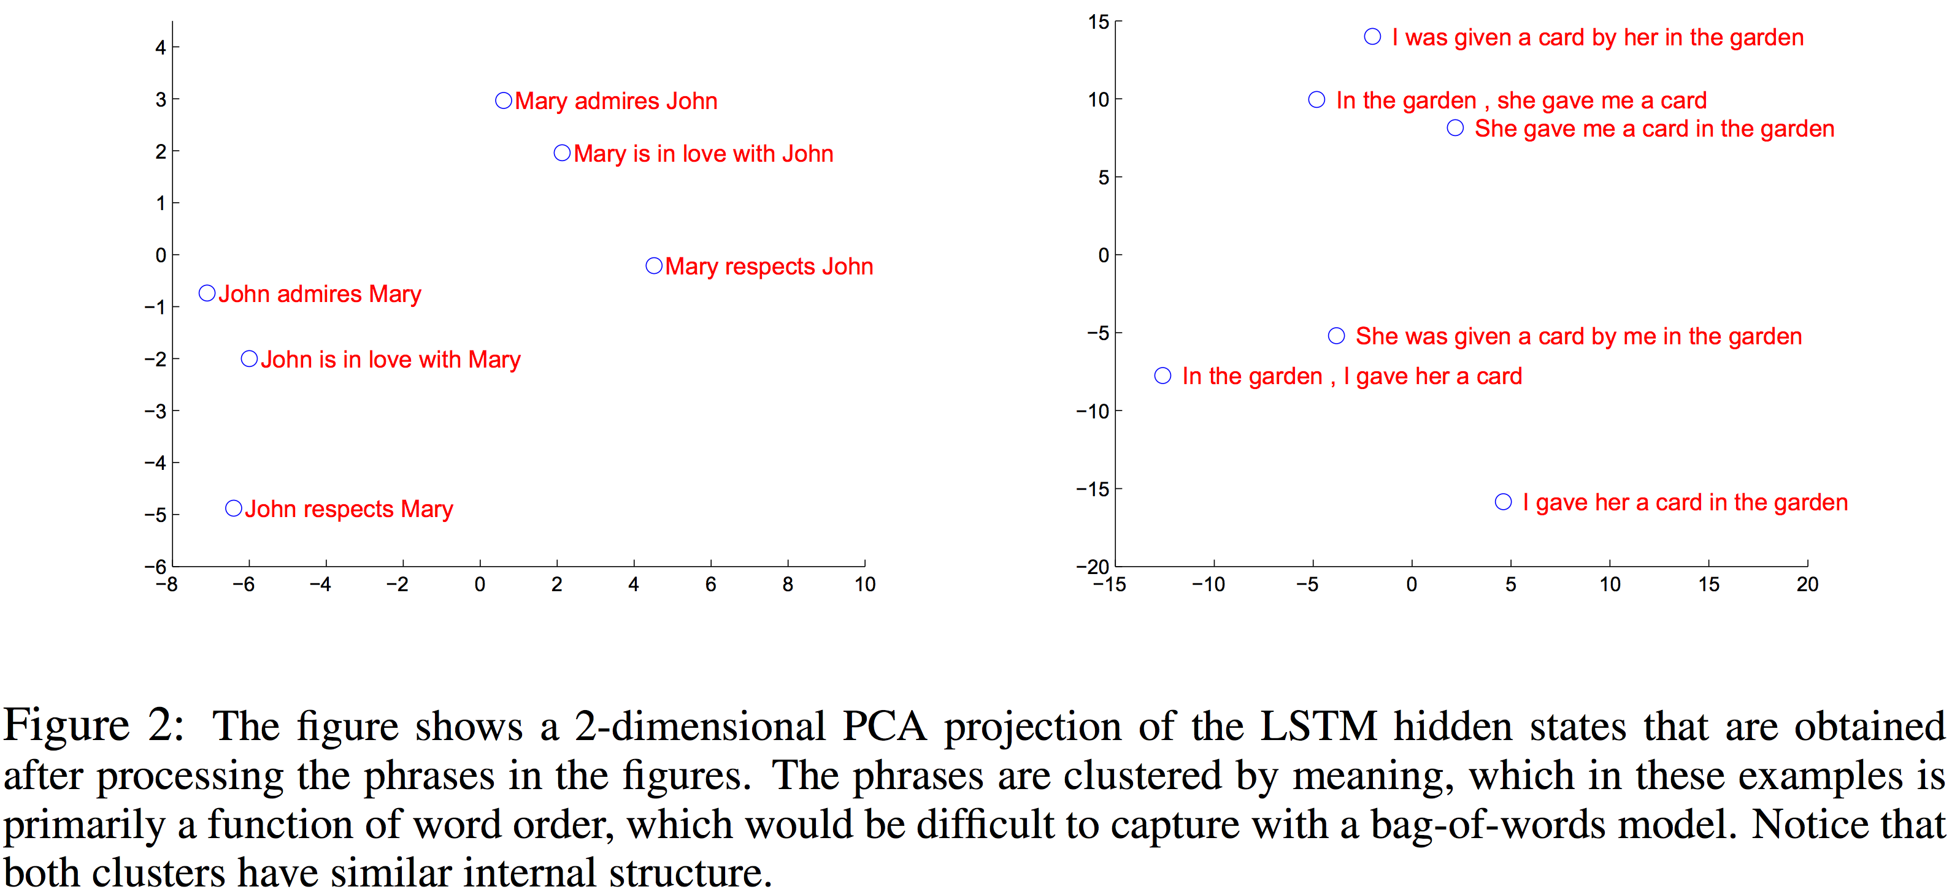
Encoder as a Sentence Embedding Model?
Sutskever, Vinyals, Le (2014)
Notes:
These are nice because word similarities can be computed using distance functions in these continuous spaces

Slide 33
Encoder as a Sentence Embedding Model?
Sutskever, Vinyals, Le (2014)
Notes:
These are nice because word similarities can be computed using distance functions in these continuous spaces

Slide 34
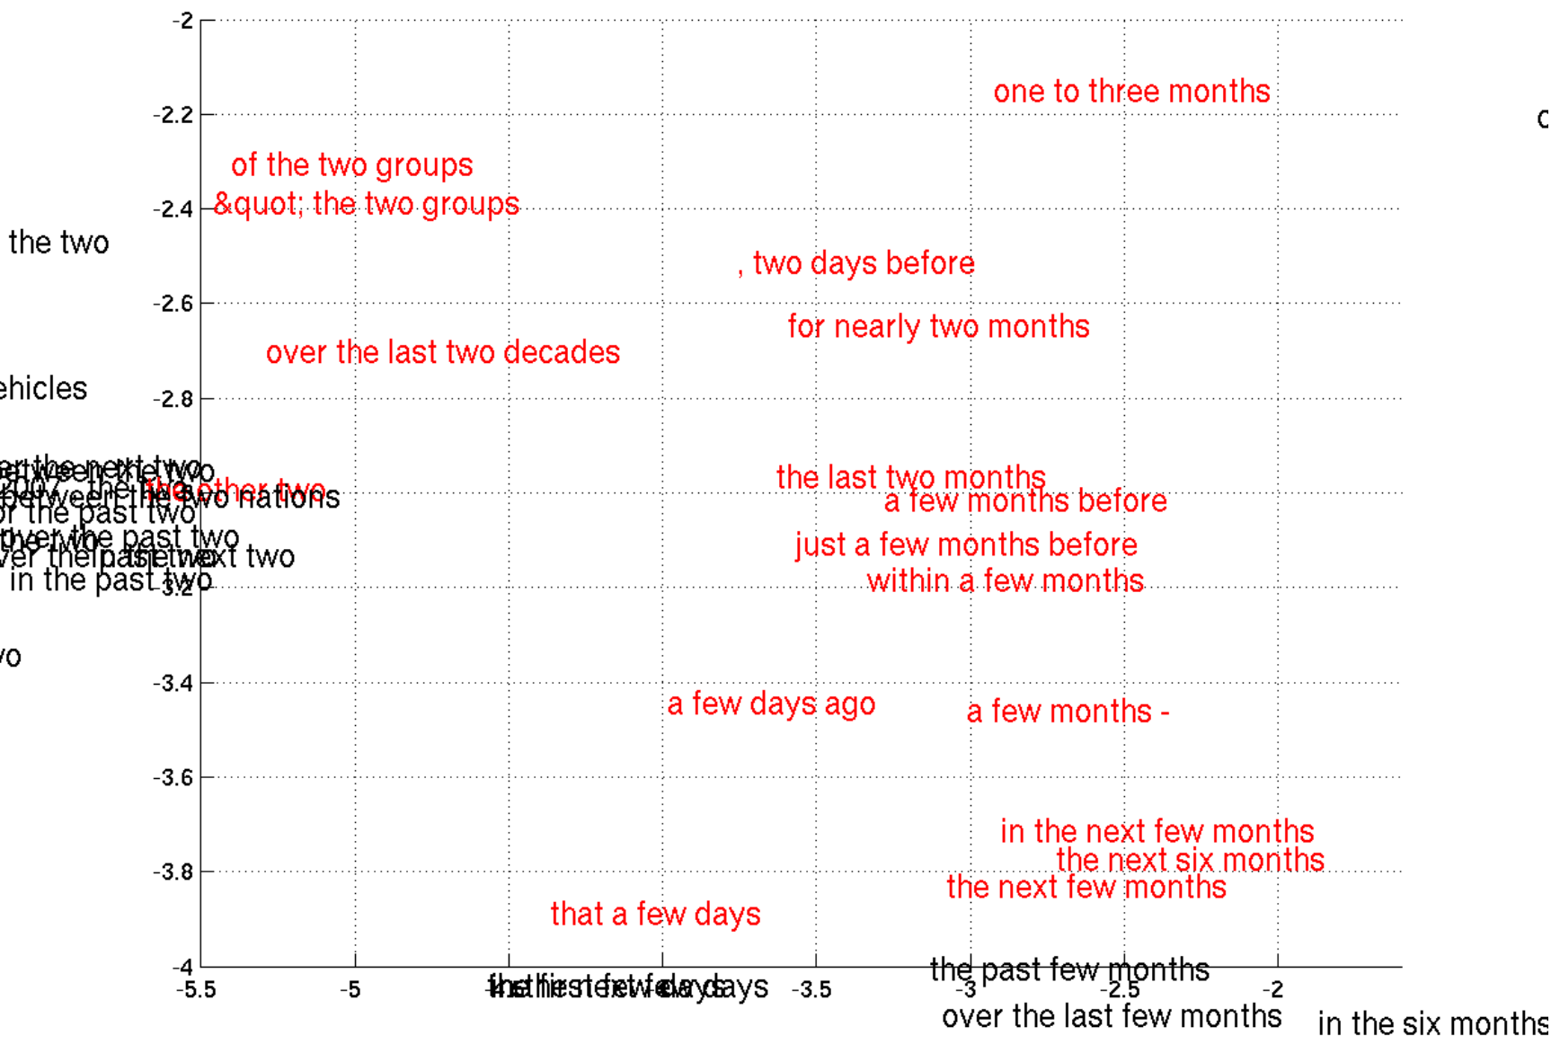
Cho, van Merrienboer, Gulcehre, Bahdanau, Bougares, Schwenk, Bengio (2014)

Slide 35
Evaluation
Sentence Embedding Model | STS | Classification
Paragraph Vector | 44 | 70.4
LSTM Autoencoder | 43 | 75.9
LSTM Denoising Autoencoder | 38 | 78.9
Neural MT Encoder | 42 | 76.9
Hill, Cho, Korhonen (2016)

Slide 36
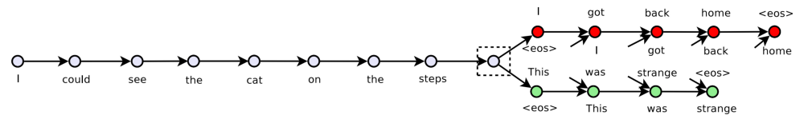
Skip-Thoughts
encode sentence using an RNN
decode two neighboring sentences
use different RNNs for previous and next sentences
also pass center sentence vector on each decoding step
…I got back home I could see the cat on the steps This was strange …
Kiros, Zhu, Salakhutdinov, Zemel, Torralba, Urtasun, Fidler (2015)

Slide 37
Skip-Thoughts
query sentence:
im sure youll have a glamorous evening , she said , giving an exaggerated wink .
nearest neighbor:
im really glad you came to the party tonight , he said , turning to her .
Kiros, Zhu, Salakhutdinov, Zemel, Torralba, Urtasun, Fidler (2015)

Slide 38
Skip-Thoughts
query sentence:
if he had a weapon , he could maybe take out their last imp , and then beat up errol and vanessa .
nearest neighbor:
if he could ram them from behind , send them sailing over the far side of the levee , he had a chance of stopping them .
Kiros, Zhu, Salakhutdinov, Zemel, Torralba, Urtasun, Fidler (2015)

Slide 39
Evaluation
Sentence Embedding Model | STS | Classification
Paragraph Vector | 44 | 70.4
LSTM Autoencoder | 43 | 75.9
LSTM Denoising Autoencoder | 38 | 78.9
Neural MT Encoder | 42 | 76.9
Skip Thought | 31 | 85.3
Hill, Cho, Korhonen (2016)
Wieting, Bansal, Gimpel, Livescu (2016)

Slide 40
FastSent
encode center sentence using sum
decode to predict words in neighboring sentences
different embedding spaces for “input” and “output” words
…I got back home I could see the cat on the steps This was strange …
home
was
strange
…
I could see the cat on the steps
Hill, Cho, Korhonen (2016)

Slide 41
FastSent + Autoencoder
encode center sentence using sum
decode to predict words in current+neighboring sentences
…I got back home I could see the cat on the steps This was strange …
cat
home
was
strange
…
I could see the cat on the steps
Hill, Cho, Korhonen (2016)

Slide 42
Evaluation
Sentence Embedding Model | STS | Classification
Paragraph Vector | 44 | 70.4
LSTM Autoencoder | 43 | 75.9
LSTM Denoising Autoencoder | 38 | 78.9
Neural MT Encoder | 42 | 76.9
Skip Thought | 31 | 85.3
FastSent | 64 | 79.3
FastSent + Autoencoder | 62 | 79.7
Hill, Cho, Korhonen (2016)
Wieting, Bansal, Gimpel, Livescu (2016)

Slide 43
Sentence Embedding Model | STS | Classification
Paragraph Vector | 44 | 70.4
LSTM Autoencoder | 43 | 75.9
LSTM Denoising Autoencoder | 38 | 78.9
Neural MT Encoder | 42 | 76.9
Skip Thought | 31 | 85.3
FastSent | 64 | 79.3
FastSent + Autoencoder | 62 | 79.7
C-PHRASE | 67 | 81.7
Hill, Cho, Korhonen (2016)
Wieting, Bansal, Gimpel, Livescu (2016)

Slide 44
Sentence Embedding Model | STS | Classification
Paragraph Vector | 44 | 70.4
LSTM Autoencoder | 43 | 75.9
LSTM Denoising Autoencoder | 38 | 78.9
Neural MT Encoder | 42 | 76.9
Skip Thought | 31 | 85.3
FastSent | 64 | 79.3
FastSent + Autoencoder | 62 | 79.7
C-PHRASE | 67 | 81.7
Avg. pretrained word embeddings | 65 | 80.6
Hill, Cho, Korhonen (2016)
Wieting, Bansal, Gimpel, Livescu (2016)

Slide 45
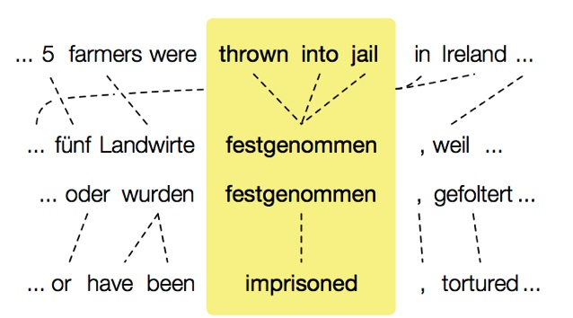
Paraphrase Database (PPDB) (Ganitkevitch, Van Durme, and Callison-Burch, 2013)
credit: Chris Callison-Burch

Slide 46
Training Data: phrase pairs from PPDB
tens of millions more!
good | great
be given the opportunity to | have the possibility of
i can hardly hear you . | you 're breaking up .
and the establishment | as well as the development
laying the foundations | pave the way
making every effort | to do its utmost
… | …
Notes:
Features!!!! and scores

Slide 47
Sentence Embedding Model | STS | Classification
Paragraph Vector | 44 | 70.4
LSTM Autoencoder | 43 | 75.9
LSTM Denoising Autoencoder | 38 | 78.9
Neural MT Encoder | 42 | 76.9
Skip Thought | 31 | 85.3
FastSent | 64 | 79.3
FastSent + Autoencoder | 62 | 79.7
C-PHRASE | 67 | 81.7
Avg. pretrained word embeddings | 65 | 80.6
Ours (avg. trained on PPDB) | 71 | N/A
Hill, Cho, Korhonen (2016)
Wieting, Bansal, Gimpel, Livescu (2016)

