Slide 1
TTIC 31210: Advanced Natural Language Processing
Kevin Gimpel
Spring 2017
Lecture 7:
Sequence-to-Sequence Modeling
and Attention

Slide 2
Sequence-to-Sequence Modeling
data: <input sequence, output sequence> pairs
use one RNN to encode input sequence
use another RNN to decode the output sequence from the input sequence vector

Slide 3
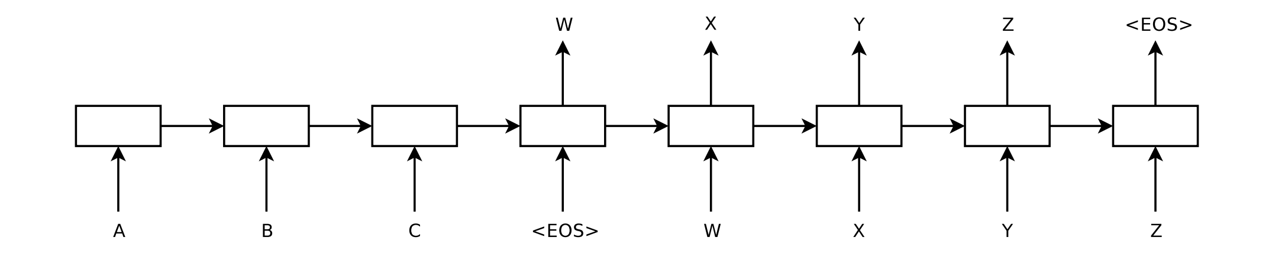
Application: Machine Translation
Encode source sentence, decode translation
Sutskever, Vinyals, Le (2014)
Cho, van Merrienboer, Gulcehre, Bahdanau, Bougares, Schwenk, Bengio (2014)
Notes:
These are nice because word similarities can be computed using distance functions in these continuous spaces

Slide 4
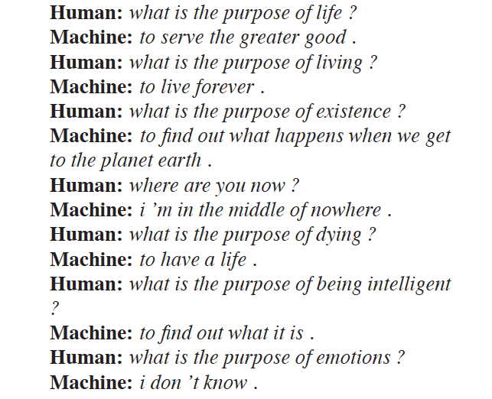
Application: Chatbots
“A Neural Conversational Model”
Vinyals & Le (2015)

Slide 5
Input RNN (“Encoder”)
“hidden vector”

Slide 6
Output RNN (“Decoder”)
“next output symbol”
“hidden vector”

Slide 7
Output RNN (“Decoder”)
“next output symbol”
“hidden vector”

Slide 8
Output RNN (“Decoder”)
“next output symbol”
“hidden vector”

Slide 9
Distribution over next symbols?
“next output symbol”
“hidden vector”

Slide 10
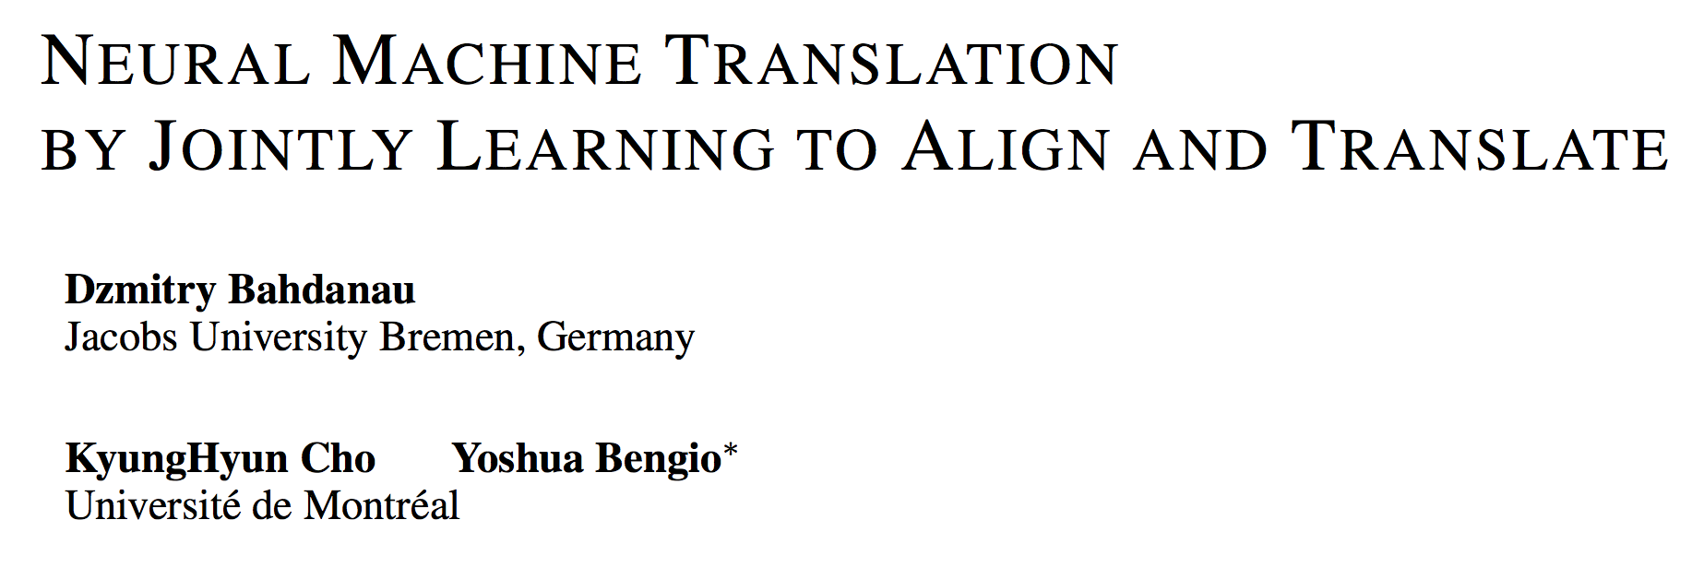
Extension: Attention

Slide 11
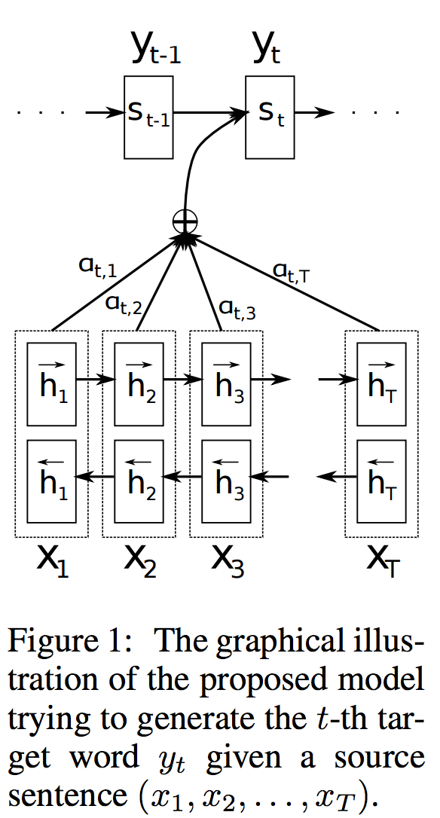
Extension: Attention
“Neural Machine Translation by Jointly Learning to Align and Translate”
Bahdanau et al. (2015)

Slide 12
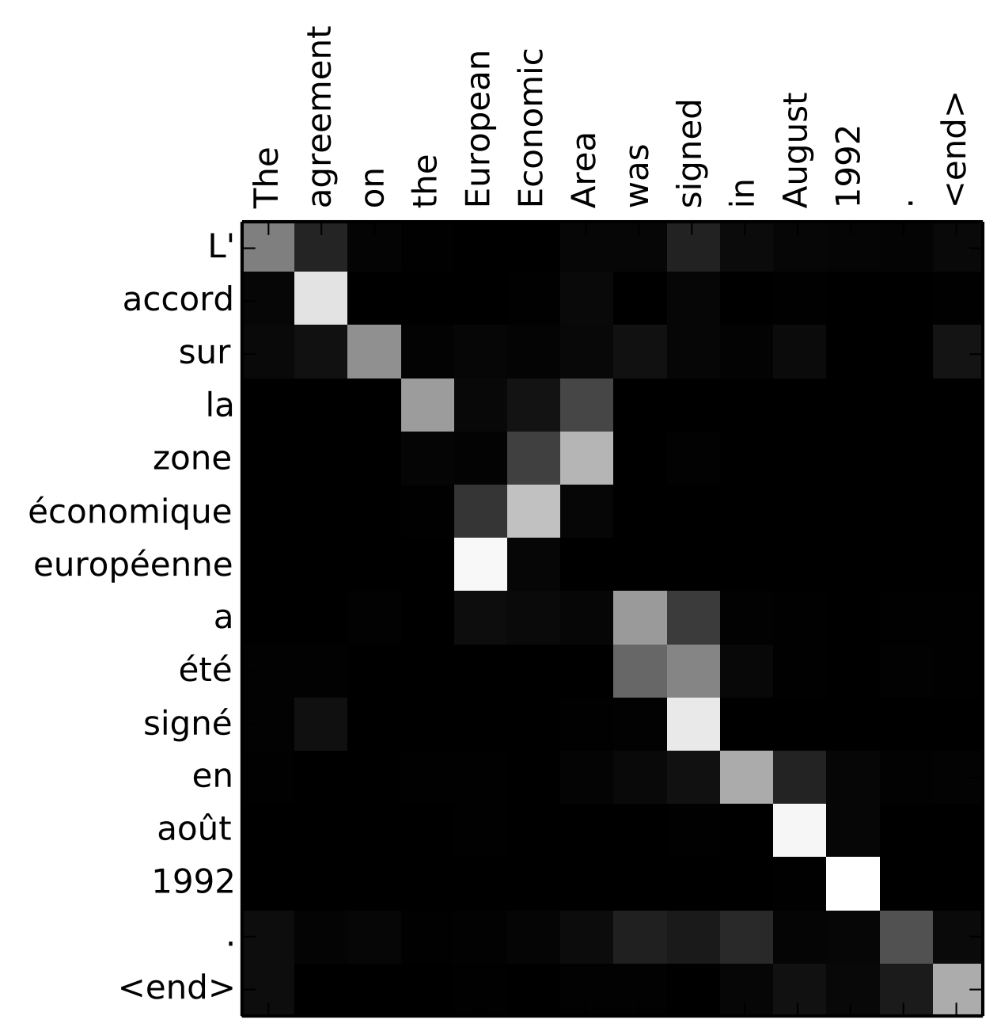
Extension: Attention
“Neural Machine Translation by Jointly Learning to Align and Translate”
Bahdanau et al. (2015)

Slide 13
Disclaimer: the version I will present is a little simpler than the Bahdanau et al version

Slide 14
Adding Attention
att function models association between all pairs of hidden vectors in encoder and decoder
…

Slide 15
Adding Attention
…

Slide 16
Adding Attention
…

Slide 17
Adding Attention
…

Slide 18
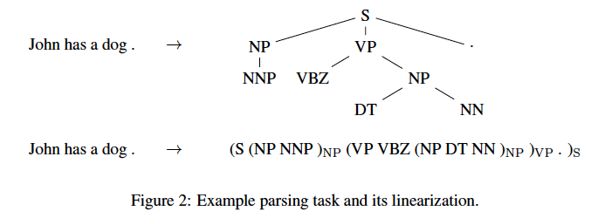
Application: Parsing
“Grammar as a Foreign Language”
{Vinyals, Kaiser} et al. (2015)

Slide 19
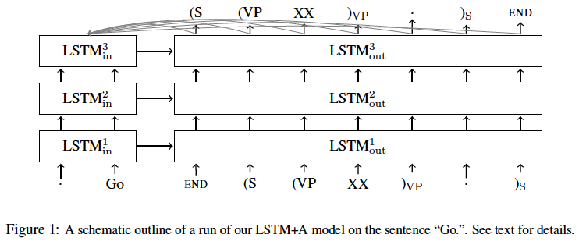
Application: Parsing
“Grammar as a Foreign Language”
{Vinyals, Kaiser} et al. (2015)

Slide 20
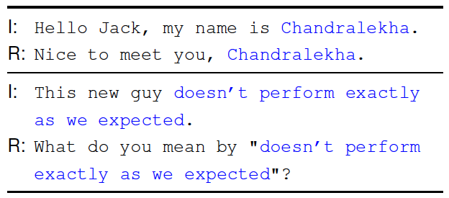
Extension: Copy Mechanism
“Incorporating Copying Mechanism in Sequence-to-Sequence Learning”
Gu et al. (2016)

Slide 21
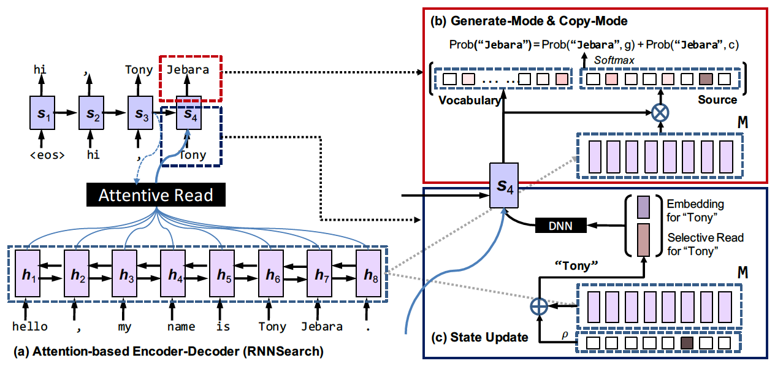
Extension: Copy Mechanism
“Incorporating Copying Mechanism in Sequence-to-Sequence Learning”
Gu et al. (2016)

Slide 22
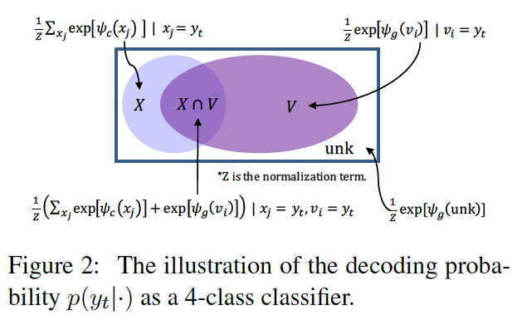
Extension: Copy Mechanism
“Incorporating Copying Mechanism in Sequence-to-Sequence Learning”
Gu et al. (2016)

Slide 23
Reading Comprehension

Slide 24
Dataset: MCTest
Once there was a boy named Fritz who loved to draw. He drew everything. In the morning, he drew a picture of his cereal with milk. His papa said, “Don’t draw your cereal. Eat it!”
After school, Fritz drew a picture of his bicycle. His uncle said, “Don't draw your bicycle. Ride it!”
…
What did Fritz draw first?
A) the toothpaste
B) his mama
C) cereal and milk
D) his bicycle
“MCTest: A Challenge Dataset for the
Open-Domain Machine Comprehension of Text”
Richardson et al. (2013)

Slide 25
Dataset: MCTest
Once there was a boy named Fritz who loved to draw. He drew everything. In the morning, he drew a picture of his cereal with milk. His papa said, “Don’t draw your cereal. Eat it!”
After school, Fritz drew a picture of his bicycle. His uncle said, “Don't draw your bicycle. Ride it!”
…
What did Fritz draw first?
A) the toothpaste
B) his mama
C) cereal and milk
D) his bicycle
“MCTest: A Challenge Dataset for the
Open-Domain Machine Comprehension of Text”
Richardson et al. (2013)

Slide 26
Dataset: MCTest
660 fictional stories, written at a 4th grade reading level
4 multiple choice questions per story
“MCTest: A Challenge Dataset for the
Open-Domain Machine Comprehension of Text”
Richardson et al. (2013)

Slide 27
Dataset: CNN/Daily Mail Comprehension Tasks
Document:
actress @entity1 has entered a rehab facility for her addictions , a spokesman said . " @entity1 has valiantly battled substance abuse over the years and whenever she has needed to seek treatment she has done so , " said spokesman @entity5 … @entity1 won an @entity15 in 1973 for her performance in " cabaret . " …
Question:
XXXXX won an @entity15 for her performance in " cabaret "
“Teaching Machines to Read and Comprehend”
Hermann et al. (2015)

Slide 28
Dataset: CNN/Daily Mail Comprehension Tasks
Document:
actress @entity1 has entered a rehab facility for her addictions , a spokesman said . " @entity1 has valiantly battled substance abuse over the years and whenever she has needed to seek treatment she has done so , " said spokesman @entity5 … @entity1 won an @entity15 in 1973 for her performance in " cabaret . " …
Question:
XXXXX won an @entity15 for her performance in " cabaret "
“Teaching Machines to Read and Comprehend”
Hermann et al. (2015)

Slide 29
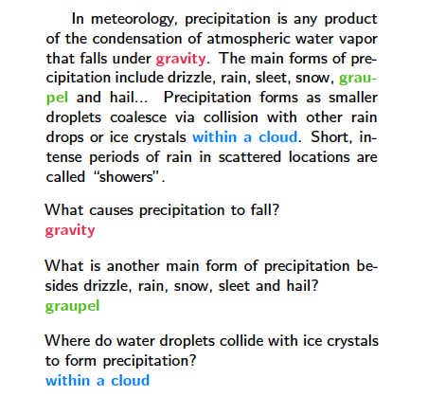
Dataset: SQuAD
“SQuAD: 100,000+ Questions for Machine Comprehension of Text”
Rajpurkar et al. (2016)

Slide 30
Neural Models for Comprehension
lots of recent activity here!
Hermann et al. (2015)
Hill et al. (2016)
Chen et al. (2016)
Kadlec et al. (2016)
Dhingra et al. (2016)
inter alia
we will describe the Attention Sum Reader (Kadlec et al., 2016) because it is simple and works well

Slide 31
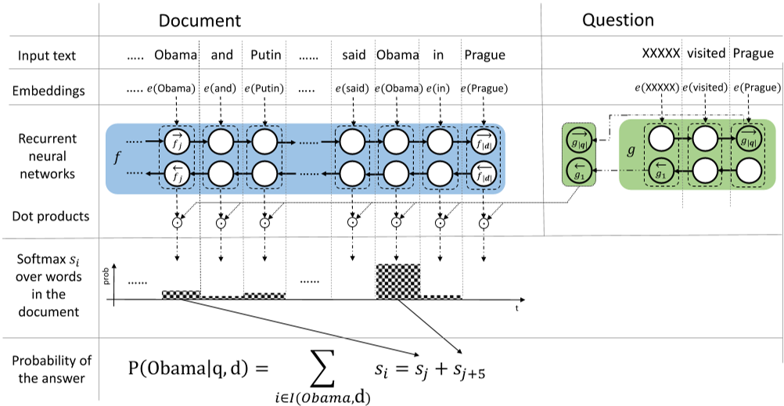
Attention Sum Reader (Kadlec et al., 2016)

Slide 32
Attention Sum Reader (Kadlec et al., 2016)
Encode document using bidirectional RNN
Encode question using another bidirectional RNN

Slide 33
Attention Sum Reader (Kadlec et al., 2016)
Compute attention over positions of document using question representation

Slide 34
Attention Sum Reader (Kadlec et al., 2016)
Normalize over positions of document

Slide 35
Attention Sum Reader (Kadlec et al., 2016)

Slide 36
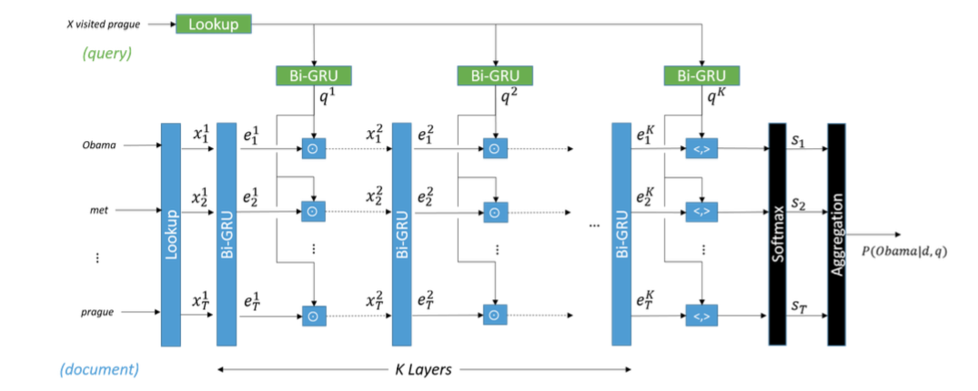
Gated Attention Reader (Dhingra et al., 2016)

