Slide 1
TTIC 31210: Advanced Natural Language Processing
Kevin Gimpel
Spring 2017
Lecture 8:
Neural Machine Translation

Slide 2
Neural methods have transformed machine translation
Neural Machine Translation (NMT) systems are typically based on sequence-to-sequence models with attention
Today we’ll describe a number of enhancements/modifications that improve translation quality

Slide 3
Input RNN (“Encoder”)

Slide 4
Output RNN (“Decoder”)

Slide 5
Output RNN (“Decoder”)

Slide 6
Output RNN (“Decoder”)

Slide 7
Attention for NMT
Luong et al. (2015) simplify & generalize the model of Bahdanau, and compare different ways of defining attention
“Effective Approaches to Attention-based Neural Machine Translation”
Luong et al. (2015)

Slide 8
Simplifying Attention for NMT
Same in both:
Bahdanau et al. (simplified a bit for clarity):
Luong et al.:
How is this simpler?
just comes from decoder RNN

Slide 9
Attention Functions
Bahdanau et al.:
Luong et al.:
…

Slide 10
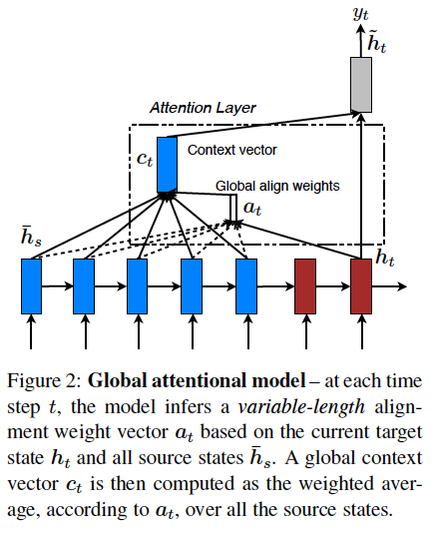
Global Attention
global = computed over all hidden vectors of input
Luong et al. (2015)

Slide 11
Global Content-Based Attention Functions
global = computed over all hidden vectors of input
content-based = attention function looks at source hidden vectors
dot product (“dot”):
bilinear (“general”):
feed-forward (“concat”):
parameter vector
Luong et al. (2015)

Slide 12
Global Location-Based Attention Function
global = computed over all hidden vectors of input
location-based = attention function does not look at source hidden vectors themselves, just positions:
parameter vector for position u in source sentence
Luong et al. (2015)

Slide 13
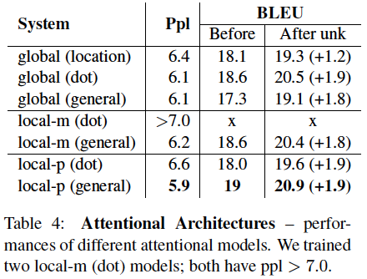
Results
BLEU
feed-forward (“concat”) did not work well!
Luong et al. (2015)

Slide 14
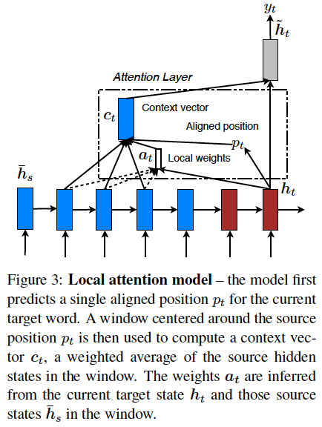
Local Attention
local = computed over a subset of input hidden vectors
at decoder step ,
find position in source sentence,
compute attention over a window centered at that position in the source sentence
Luong et al. (2015)

Slide 15
Local Attention
local-m: set , assumes roughly monotonic alignment between decoder positions and source sentence positions
local-p: predict based on decoder hidden state and some additional parameters
Luong et al. (2015)

Slide 16
Results
BLEU
“Effective Approaches to Attention-based Neural Machine Translation”
Luong et al. (2015)

Slide 17
Results
BLEU
“Effective Approaches to Attention-based Neural Machine Translation”
Luong et al. (2015)

Slide 18
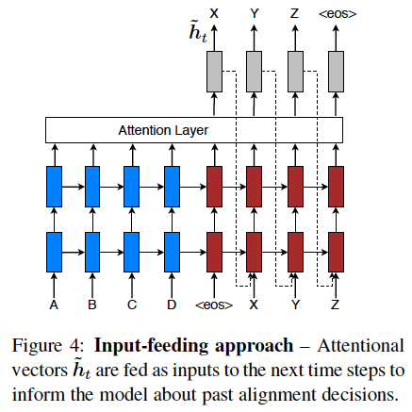
“Input Feeding” of Decoder Hidden States
Luong et al. (2015)

Slide 19
Modeling Coverage
NMT sometimes doesn’t translate all source words, or translates them multiple times
“Modeling Coverage for Neural Machine Translation”
Tu et al. (2016)

Slide 20
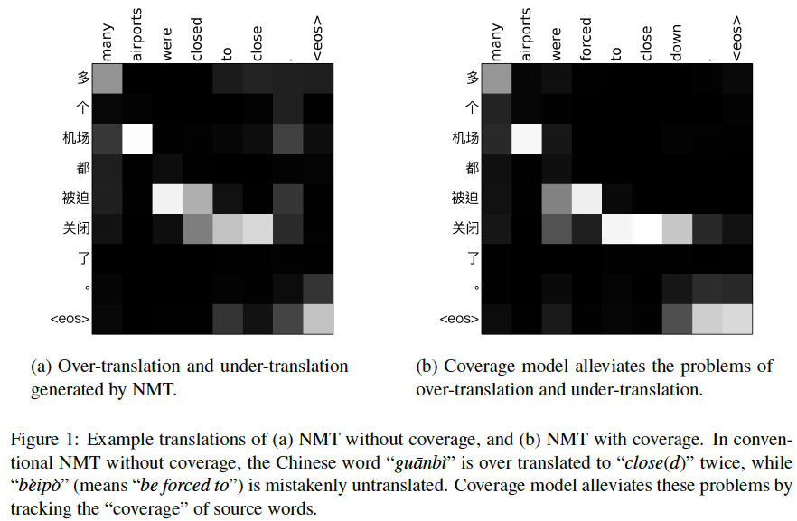
NMT sometimes doesn’t translate all source words, or translates them multiple times:
“Modeling Coverage for Neural Machine Translation” Tu et al. (2016)

Slide 21
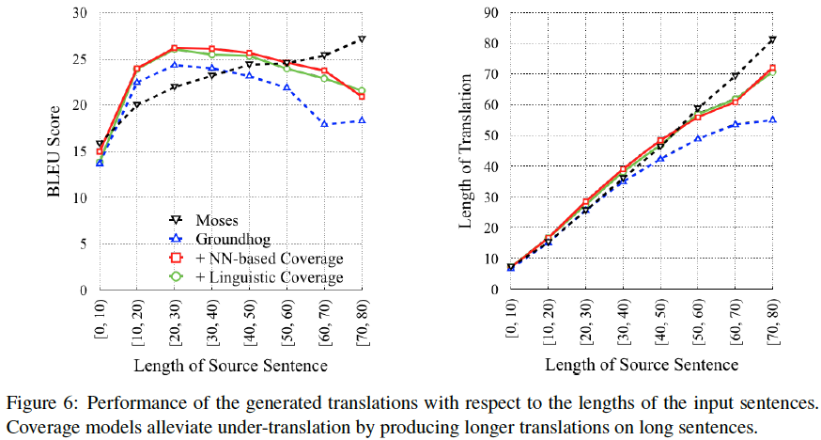
Results: Modeling Coverage
“Modeling Coverage for Neural Machine Translation”
Tu et al. (2016)

Slide 22
Inference

Slide 23
Beam Search
to find a translation, greedy search just picks most-probable word at each position
but does this give us any guarantees about the entire translation?
beam search can be used to approximately find the most-probable complete translation

Slide 24
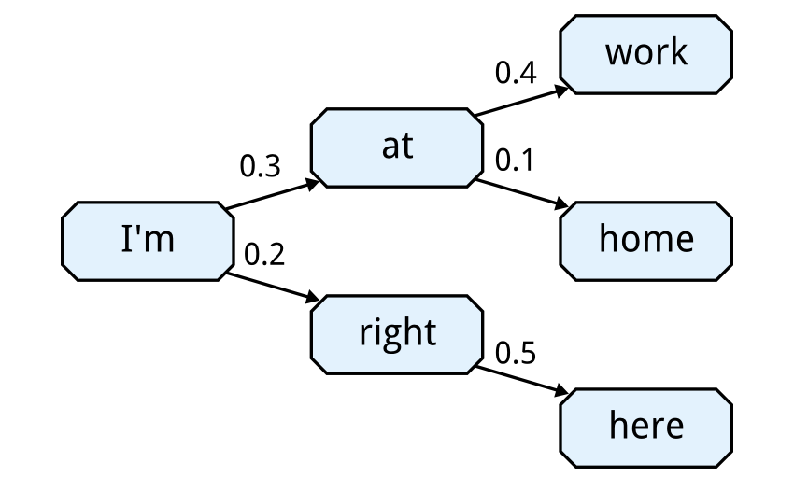
Beam Search
Let beam size = 2:
X
“Chat Smarter with Allo”
Pranav Khaitan, Google Research Blog

Slide 25
Learning

Slide 26
Concern
there’s a mismatch between training and test!
(what is it?)

Slide 27
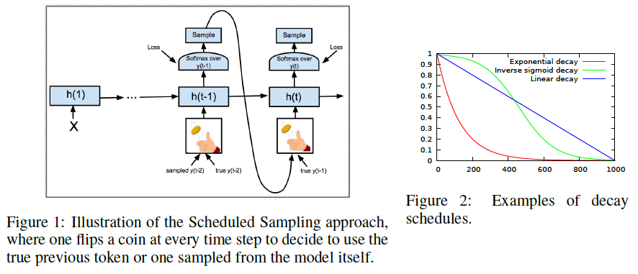
Scheduled Sampling
“Scheduled Sampling for Sequence Prediction with Recurrent Neural Networks”
Bengio et al. (2015)

Slide 28
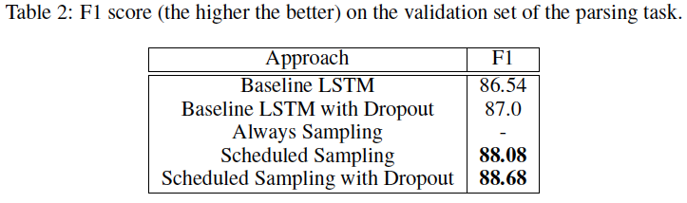
Scheduled Sampling Results
“Always Sampling” did not work well!
“Scheduled Sampling for Sequence Prediction with Recurrent Neural Networks”
Bengio et al. (2015)

