Slide 1
TTIC 31210: Advanced Natural Language Processing
Kevin Gimpel
Spring 2017
Lecture 9:
NMT, finishing up Neural NLP

Slide 2
Assignment 2 has been posted, due May 17
Grades for Assignment 1 will be emailed to you soon
Project proposal details posted, due May 10

Slide 3
Input RNN (“Encoder”)

Slide 4
Output RNN (“Decoder”)

Slide 5
Learning

Slide 6
Minimum Risk Training
“Bayes risk” is an alternative training objective that has been classically used in speech recognition and machine translation
it permits the use of nearly-arbitrary evaluation metrics in training (through the specification of a “cost function”)
[on board]
“Minimum Risk Training for Neural Machine Translation”
Shen et al. (2016)

Slide 7
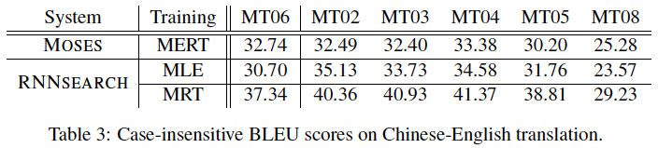
Minimum Risk Training
“Minimum Risk Training for Neural Machine Translation”
Shen et al. (2016)

Slide 8
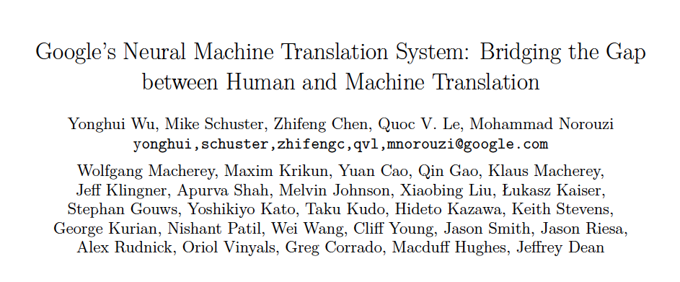

Slide 9
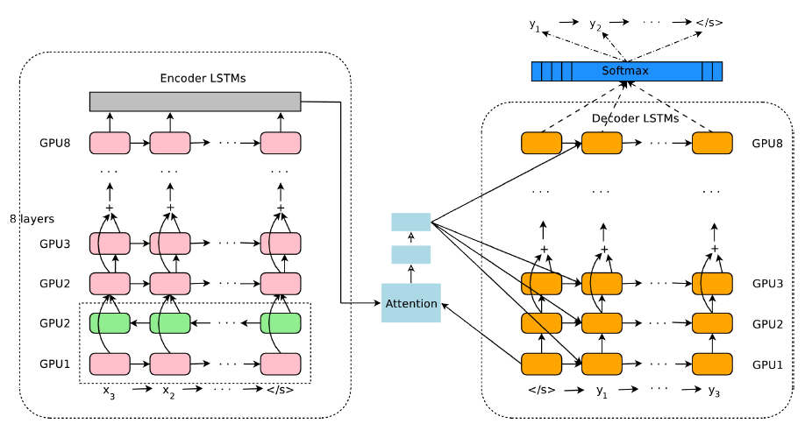
Google’s NMT System

Slide 10
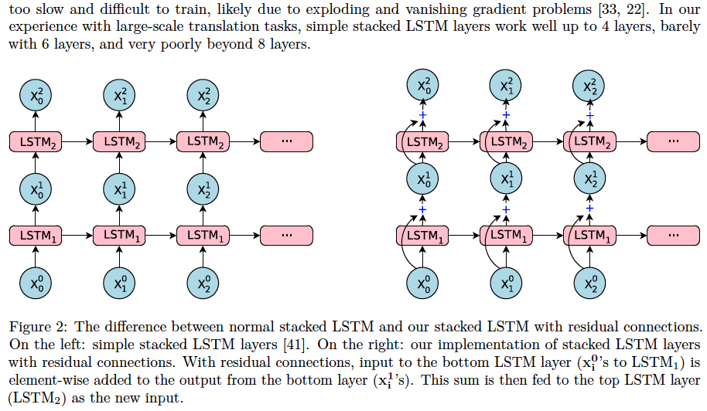
Google’s NMT System

Slide 11
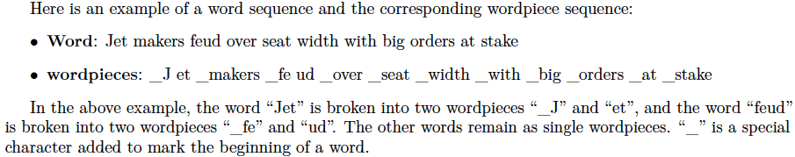
Google’s NMT System
they use a procedure that deterministically segments any character sequence into wordpieces
vocab: 8k-32k wordpieces
they first learn a “wordpiece model”
we’ll talk more about this sort of thing in the coming weeks

Slide 12
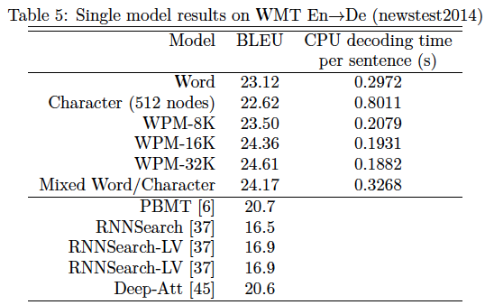
Google’s NMT System

Slide 13
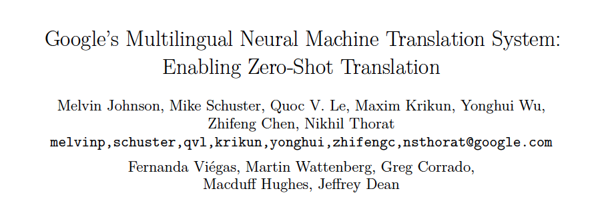

Slide 14
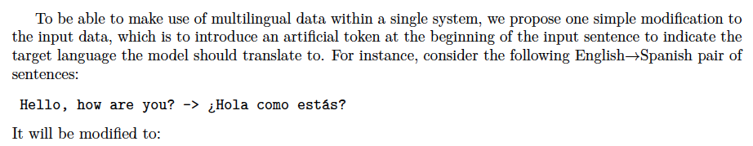
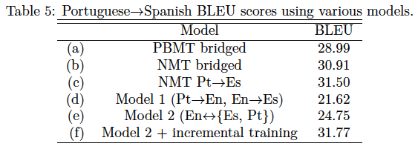

Slide 15
Understanding Neural NLP

Slide 16
How do we understand what information is captured in an embedding?
one approach is to attempt to predict different things and see what the accuracy is
e.g., from a sentence embedding, attempt to predict sentence length, words in sentence, and word order in sentence (Adi et al., 2017)
they compare word averaging (“CBOW”) and an LSTM (“ED”)

Slide 17
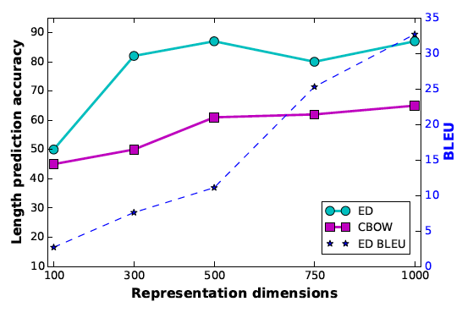
Predicting Sentence Length from Sentence Embeddings
length prediction = predict the length bin of the sentence, using 8 length bins (majority baseline gives 20% accuracy)
Adi et al. (ICLR 2017)

Slide 18
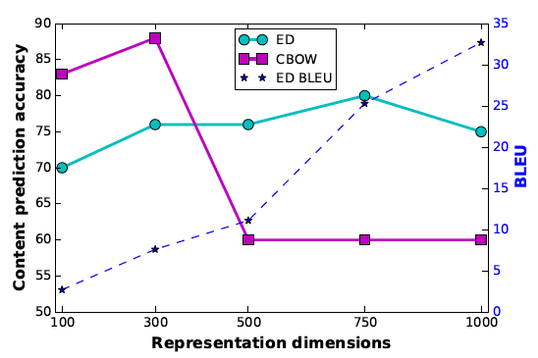
Predicting Words in Sentence (“Content”) from Sentence Embeddings
content prediction = predict whether a word is contained in the sentence (baseline is 50%)
Adi et al. (ICLR 2017)

Slide 19
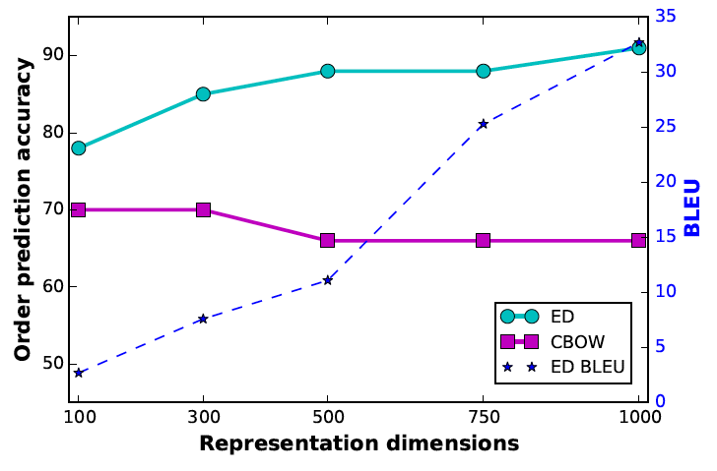
Predicting Word Order from Sentence Embeddings
order prediction = given two random words in sentence, predict which comes first (baseline is 50%)
Adi et al. (ICLR 2017)

Slide 20
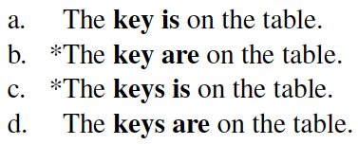
Do LSTMs capture syntactic agreement?
Linzen et al. (TACL 2016)

Slide 21
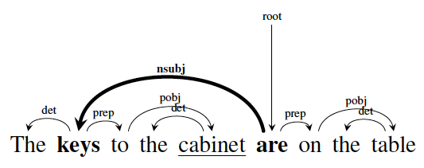
Do LSTMs capture syntactic agreement?
Linzen et al. (TACL 2016)

Slide 22
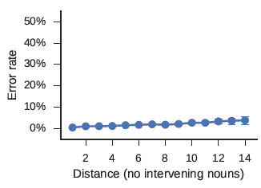
Yes, if you directly train to predict the verb form:
Linzen et al. (TACL 2016)

Slide 23
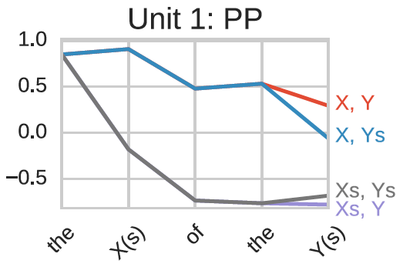
LSTM unit that remembers number (singular or plural) of earlier noun (X):
Linzen et al. (TACL 2016)

Slide 24
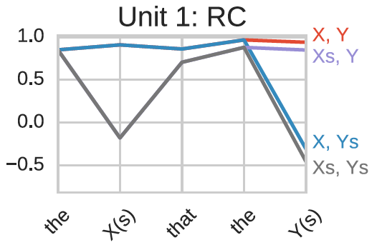
in a relative clause (RC), same LSTM unit recognizes that verb number agrees with Y:
Linzen et al. (TACL 2016)

Slide 25
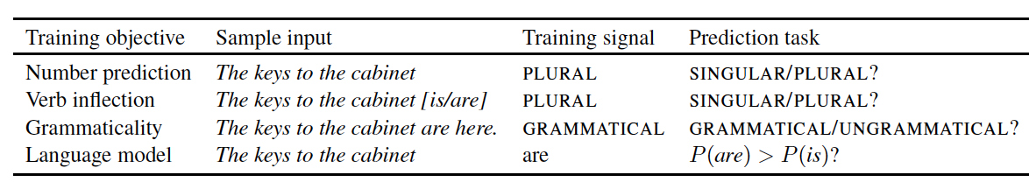
But how about if you train the LSTM as a language model?
Linzen et al. (TACL 2016)

Slide 26
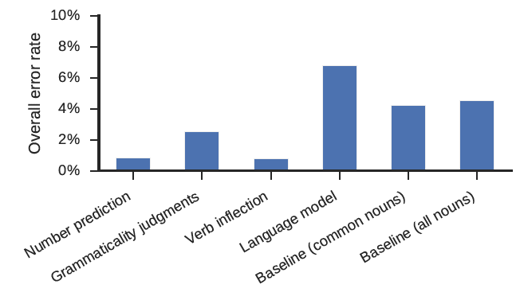
Then it doesn’t do well at predicting agreement:
Linzen et al. (TACL 2016)

