Slide 1

Angular Unit Testing
An unusually fun workshop
Kiffin Gish
Devops
April 4, 2019

Slide 2



Agenda
Part I - General
  Angular architecture
  Testing principles
  What is a good test?

Slide 3

Agenda
Part I - General
  Angular architecture
  Testing principles
  What is a good test?
Part II – Deep dive
  Complicated stuff

Slide 4

Goal
Learn unit testing with Angular
Write good unit tests
Understand Isolated vs integration tests

Slide 5
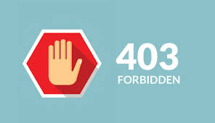
Not about
End to end testing
Testing tools
Test Driven Development (TDD)

Slide 6
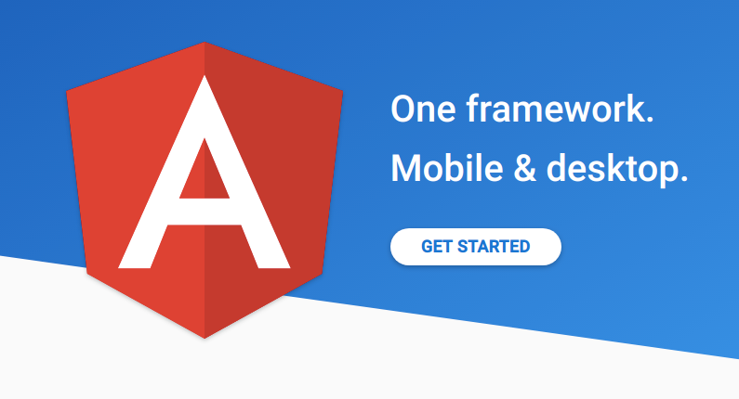
Angular framework
Single page application (SPA)
Responsive (mobile-friendly)
Theming (Material Design)
Advanced testing

Slide 7
Single page application (SPA)
Mobile-friendly
More secure (HTTPS, HMAC and JWT)
Deployment greatly simplified
Easier to test!

Slide 8
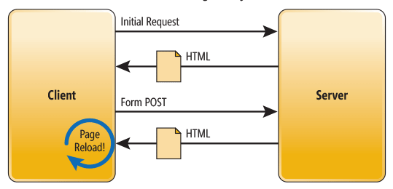
Traditional page lifecycle

Slide 9
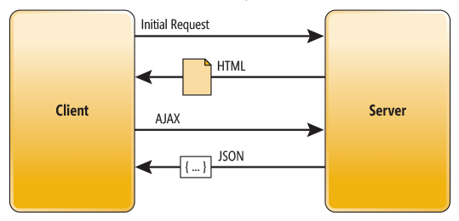
SPA lifecycle

Slide 10
Single page application (SPA)
HTML templates served statically
Client retrieves data from REST services
Views dynamically rendered
Application bootstrapped (runs) on the client
Interactive, quick and snappy

Slide 11
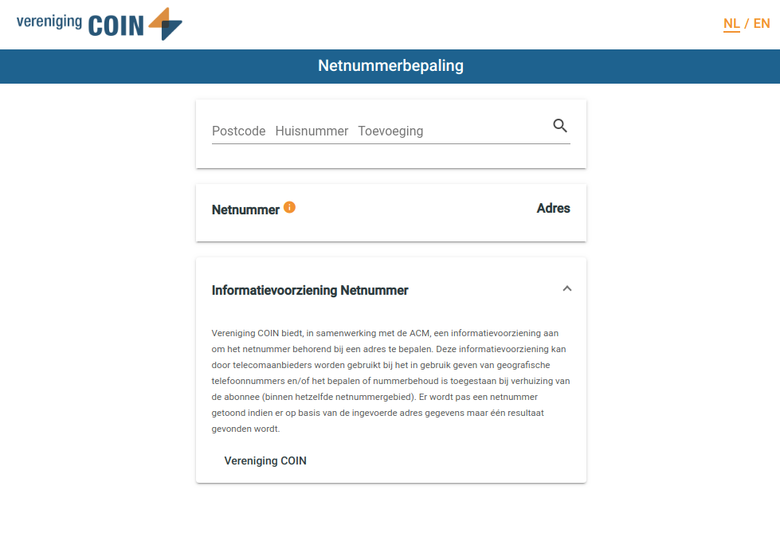
Responsive - desktop

Slide 12
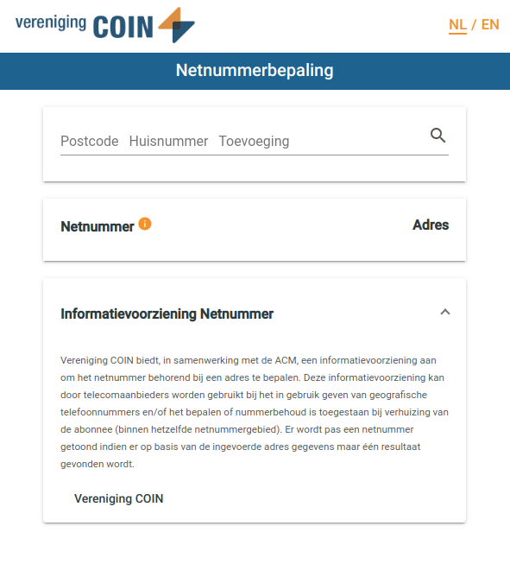
Responsive - tablet

Slide 13
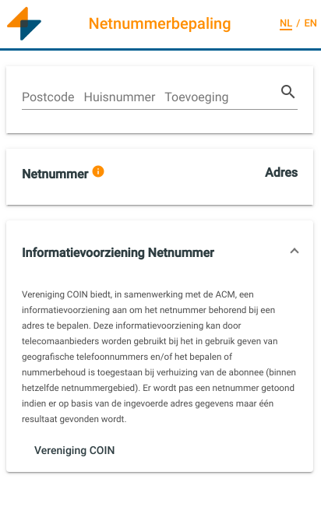
Responsive - smartphone

Slide 14
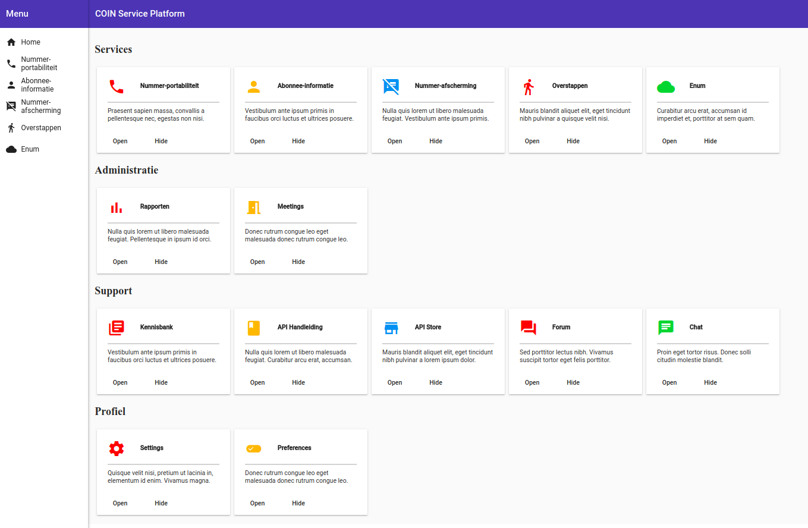
COIN Portal

Slide 15
Angular architecture
Layered (separation of concerns)
Modules and components
Web components
Templates, directives and data-binding
Data down ↓, actions up ↑
Services and Dependency Injection (DI)

Slide 16
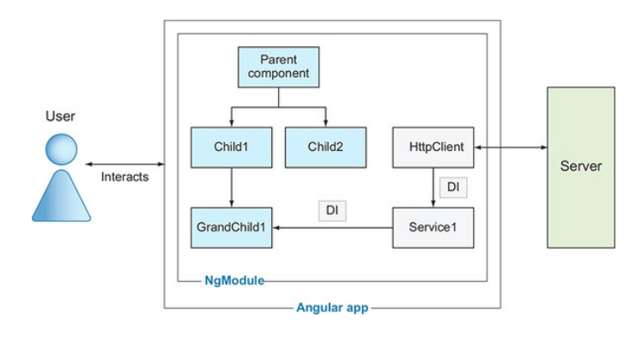
Modules and components

Slide 17
Web components
Custom elements
Shadow DOM¹
HTML Templates
Composition and slots
<html>
<my-component>
<h1><slot name="title"></slot></h1>
<p><slot name="description"></slot></p>
</my-component>
</html>
¹DOM - The Document Object Model is a programming interface for HTML and XML documents.

Slide 18
Web components
Sub-class of HTML Element
Constructor
Properties (state)
Methods
class MyComponent extends HTMLElement {
count = 0
constructor() {}
addBy(n) {
count += n
}
}

Slide 19
Data down ↓ actions up↑
Parent
Consistent interfaces
Reusable tests
data
event
class MyComponent extends HTMLElement {
@Input stock
@Output stockValueChange = new EventEmitter()
add(n) {
stock += n
StockValueChange.emit(stock)
}
}
Child
data
event
Grandchild

Slide 20
Data down ↓ actions up↑
Consistent interfaces
Reusable tests
data in
action out
class MyComponent extends HTMLElement {
@Input stock
@Output stockValueChange = new EventEmitter()
add(n) {
stock += n
StockValueChange.emit(stock)
}
}
Child
data out
action in

Slide 21


Data down ↓ actions up↑
Parent
Breaking this is like playing with fire.
You will be punished!
data
X
event
Child
data
Other
Component
Grandchild
event

Slide 22
Dependency injection (DI)
Angular has its own DI framework
Coding pattern for testing and maintainability
Service injection, where service is:
  Application state
  Storage
  Auth0 (refresh)
  Messaging
  HTTP

Slide 23

Dependency injection (DI)
Angular has its own DI framework
Coding pattern for testing and maintainability
Dependencies from external source rather than creating itself
class MyComponent extends HTMLElement {
constructor(private myService: MyService){}
doSomething() {
this.myService.getById(42)
...
}
}

Slide 24
Dependency injection (DI)
Angular has its own DI framework
Coding pattern for testing and maintainability
Dependencies from external source rather than creating itself
class MyComponent extends HTMLElement {
constructor(private mockService: MyService){}
doSomething() {
this.myService.getById(42)
...
}
}
Unit
Test

Slide 25

Testing with DI
Looks like a duck, walks like a duck and quacks like a duck ...

Slide 26
Testing with DI
Looks like a duck, walks like a duck and quacks like a duck ...
test(‘MyComponent’) {
mockService = new Object()
component = new MyComponent(mockService)
doSomething() {
this.mockService.getById(42)
...
}
}

Slide 27
Testing with DI
Looks like a duck, walks like a duck and quacks like a duck ...
test(‘MyComponent’) {
mockService = new Object()
component = new MyComponent(mockService)
doSomething() {
this.mockService.getById(42)
...
}
}

Slide 28
Automated testing
Unit testing
End to end testing
Integration or functional testing

Slide 29
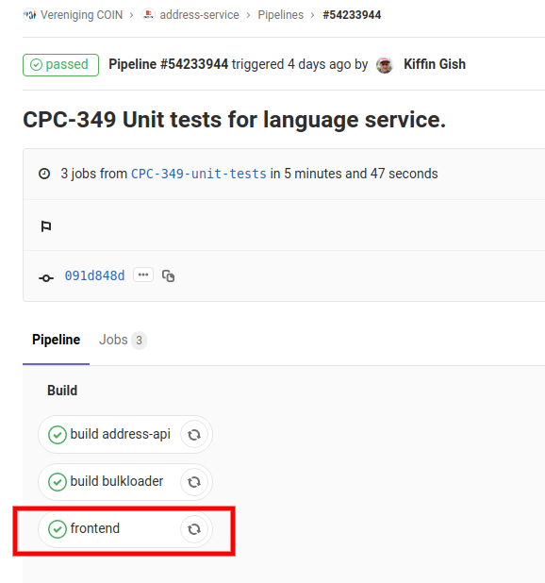
CI/CD pipeline

Slide 30
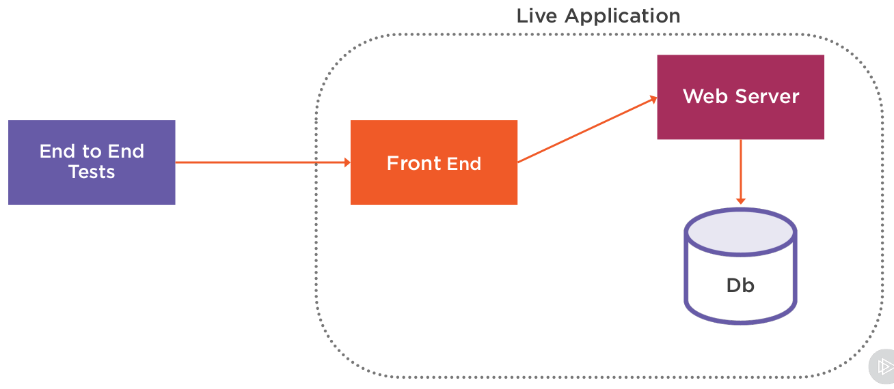
End to end testing (E2E)
Live running application
Tests exercise actual application
- SoapUI
- SeleniumHQ
- WebdriverIO
- Cypress

Slide 31
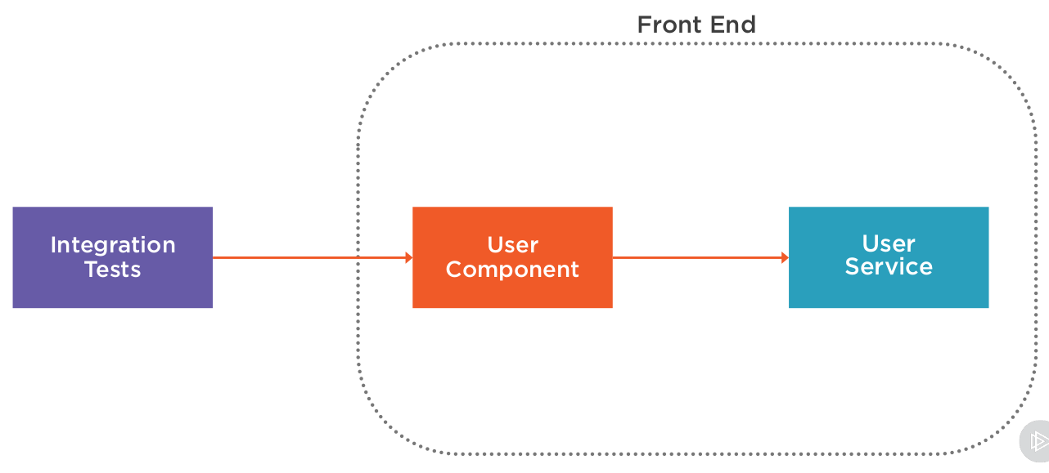
Integration and functional testing
More than a unit, less than the complete application

Slide 32
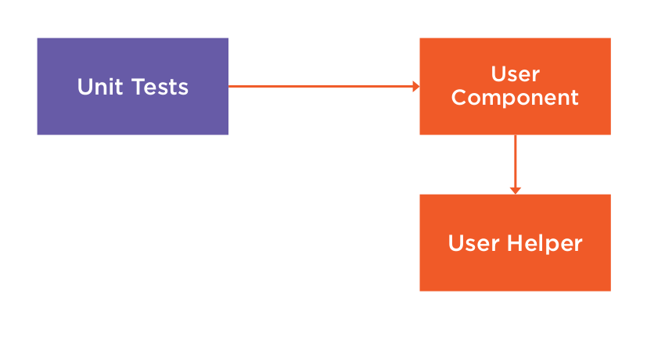
Unit testing
A single unit of code

Slide 33
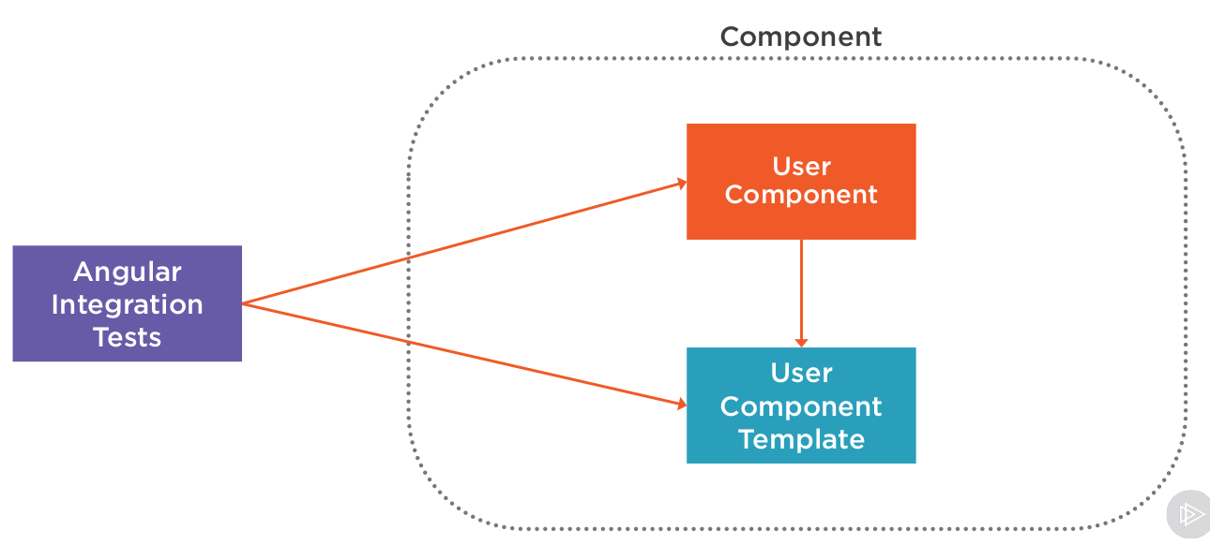
Angular integration testing
...
...

Slide 34
Mocking
Instead of using the “real” service we provide a “mock” service
A mock is a class that looks like the real class
However, we can control what it does, what its methods return, and we can ask it questions about what methods were called during a test.

Slide 35
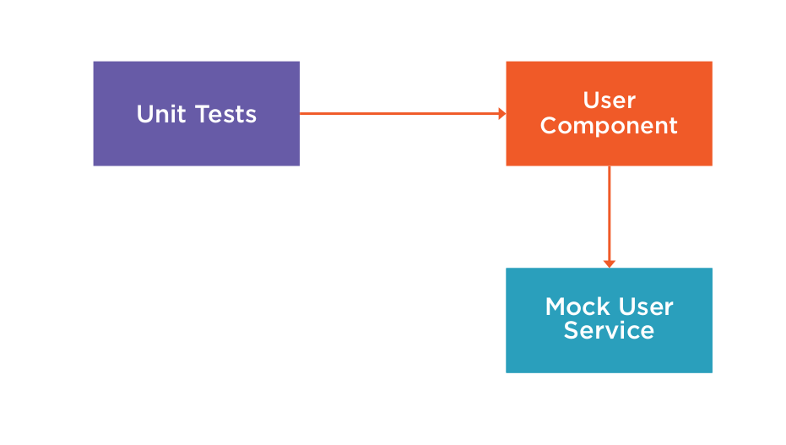
Mocking

Slide 36
Types of mocks
Dummies – just objects that do nothing
Stubs – object with controllable behavior
Spies – keeps track of methods called
True mocks – complex objects that verify being used exactly in a very specific way (HTTP).

Slide 37
Types of unit tests in Angular
Isolated – exercise a single unit of code
Integration – component in context of specific module
  Shallow – single component
  Deep – parent and child components

Slide 38
Angular tools
Karma – Test runner for browsers and devices
Jasmine – JavaScript testing framework
expect(array).toContain(member)
expect(fn).toThrow(string)
expect(fn).toThrowError(string)
expect(instance).toBe(instance)
expect(mixed).toBeDefined()
expect(mixed).toBeFalsy()
expect(mixed).toBeNull()
expect(mixed).toBeTruthy()
expect(mixed).toBeUndefined()
expect(mixed).toEqual(mixed)
expect(mixed).toMatch(pattern)
expect(number).toBeCloseTo(number, decimalPlaces)
expect(number).toBeGreaterThan(number)
expect(number).toBeLessThan(number)
expect(number).toBeNaN()
expect(spy).toHaveBeenCalled()
expect(spy).toHaveBeenCalledTimes(number)
expect(spy).toHaveBeenCalledWith(...arguments)
...

Slide 39
Other unit testing tools
Jest
Mocha, Chai
Sinon
TestDouble
Wallaby
Cypress
Ad infinitum ...

Slide 40
AAA Pattern
Arrange all necessary preconditions and inputs
Act on the object or class under tests
Assert that the expected results have occurred

Slide 41
Code example
// Arrange
let repository = Substitute.For<IClientRepository>();
let client = new Client(repository);
client.deposit(1000);
// Act
client.charge(250);
// Assert
expect(client.amount()).toEqual(750);

Slide 42
DAMP versus DRY
DRY (Don’t Repeat Yourself)
  Remove all duplication
DAMP (Descriptive And Maintainable Procedures)
  Repeat yourself if necessary

Slide 43
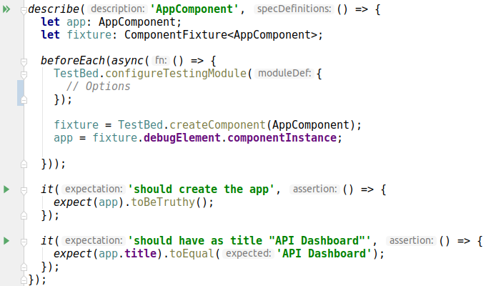
App.component.spec.ts

Slide 44
Tell the story
“First, we set up whatever we need to set up, then we make a change, and then we check that the change happened in the way that we expected...”

Slide 45
Tell the story
“Another way that we look at this is that we set an initial state, we change the state, and then we check to make sure that the new state is correct...”

Slide 46
Tell the story
A test should be a complete story within the `it()`
Shouldn’t need to look around much to understand test
Put less interesting setup within the `beforeEach()`
Keep critical setup within the `it()`
Use arrange, act and assert within the `it()`

Slide 47
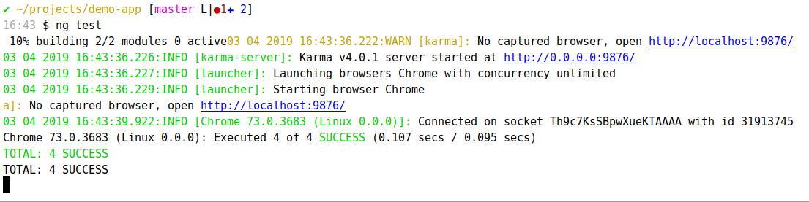
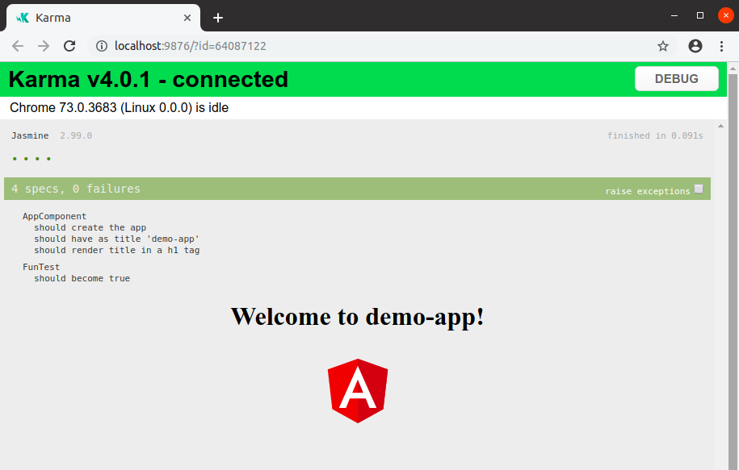
Demo

Slide 48
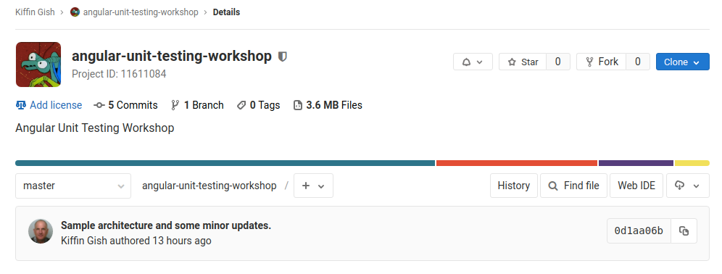
Repository
https://gitlab.com/kiffin/angular-unit-testing-workshop

Slide 49
Repository
https://gitlab.com/kiffin/angular-unit-testing-workshop

Slide 50

Repository
https://gitlab.com/kiffin/angular-unit-testing-workshop
Zorak says “Thanks and good-bye!”

