Slide 1

Embedding Rust in NodeJS applications
Rust Berlin Meetup
Rust and Tell
Kiffin Gish
26 May, 2020

Slide 2

Who am I?
Please allow me to introduce myself:
  Born and raised in sunny California.
  Survived 35+ years hacking thru life.
  Started with Assembler, Unix and C.
  Ended up a “full stack” developer.
  Got the Rust itch and can’t get enough.
Long live Rust!
@kiffin

Slide 3

https://github/kgish
Long live Rust!
@kiffin

Slide 4
Why use Rust?
We already know why Rust is such a fantastic and fun programming language:
  Safe
  Fast
  Concurrent
  No garbage collection
Long live Rust!
@kiffin

Slide 5
Why use Rust with Node.js?
More specifically using Rust means:
  High computational speed.
  Interoperability with external libraries (FFI).
  No runtime overhead.
  Predictable performance.
  Low-level hardware (device drivers).
Long live Rust!
@kiffin

Slide 6
Why use Rust with Node.js?
Foreign
Function
Interface
More specifically using Rust means:
  High computational speed.
  Interoperability with external libraries (FFI).
  No runtime overhead.
  Predictable performance.
  Low-level hardware (device drivers).
“Start by rewriting specific performance
critical modules in Rust ...”
Long live Rust!
@kiffin

Slide 7
Foreign Function Interface (FFI)
...
Long live Rust!
@kiffin

Slide 8
N-API
“... for building native Addons. It is independent from the underlying JavaScript runtime and is maintained as part of Node.js itself. This API will be Application Binary Interface (ABI) stable across versions of Node.js. It is intended to insulate Addons from changes in the underlying JavaScript engine and allow modules compiled for one major version to run on later major versions of Node.js without recompilation...”
https://nodejs.org/api/n-api.html
Long live Rust!
@kiffin

Slide 9
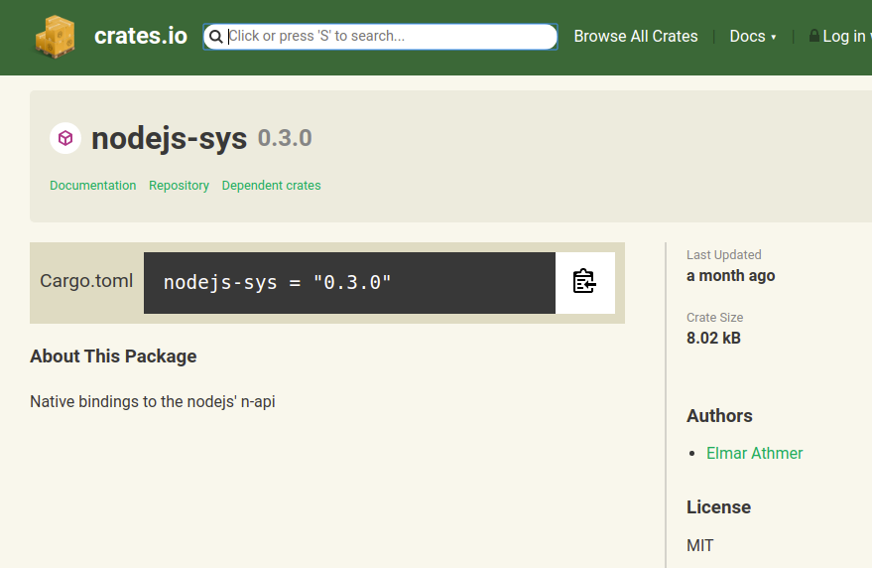
Nodejs-sys
https://crates.io/crates/nodejs-sys
Long live Rust!
@kiffin

Slide 10
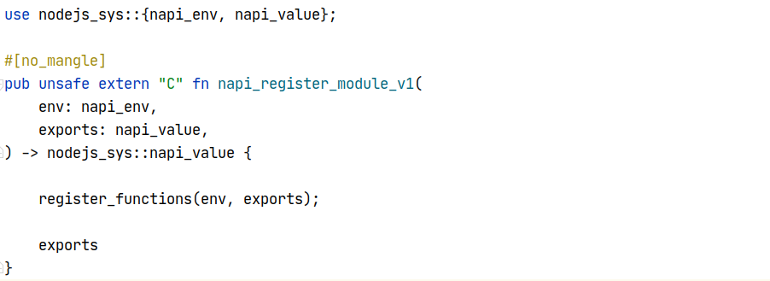
Nodejs-sys | Register module
Long live Rust!
@kiffin

Slide 11
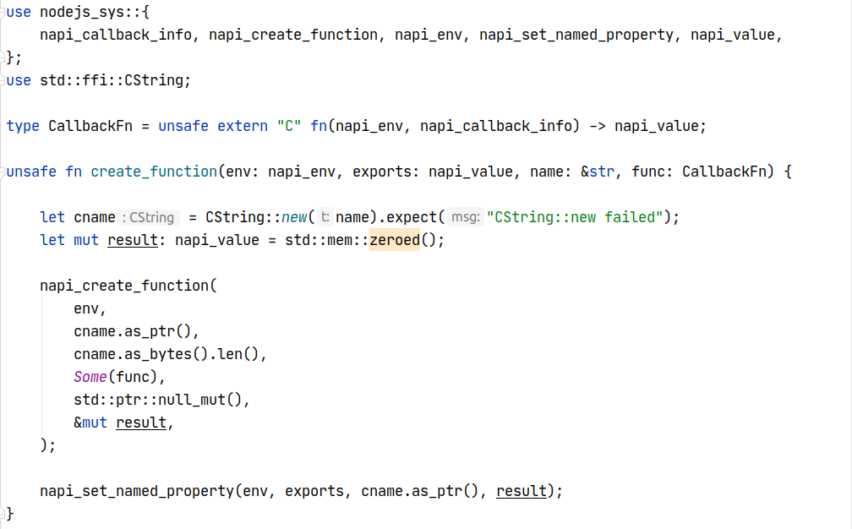
Nodejs-sys | Create a function
Long live Rust!
@kiffin

Slide 12
Some conclusions
Advantages of using Rust with Node.js:
  Computational demands.
  Performance is predictable.
  Low-level access to GPU and GPIO.
  Cheaper hardware (IoT).
There are also some disadvantages:
  Support another programming language.
  Different tool chain and deploy pipeline.
  Steep learning curve.
Long live Rust!
@kiffin

