Slide 1

Embedding Rust in NodeJS Applications
Rust Berlin Meetup
Rust and Tell
Kiffin Gish
26 May, 2020

Slide 2

Who am I?
Please allow me to introduce myself:
  Born and raised in sunny California
  Survived 35+ years hacking thru life
  Started with Assembler, Unix and C
  Ended up a “full stack” developer
  Got the Rust itch and can’t get enough
Long live Rust!
@kiffin

Slide 3
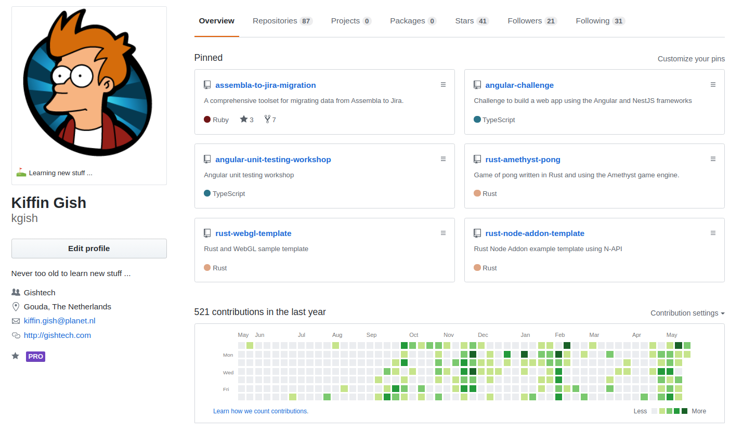
https://github/kgish
Long live Rust!
@kiffin

Slide 4
Why use Rust?
We already know why Rust is such a fantastic and fun programming language:
  Safe
  Fast
  Concurrent
  No garbage collection (GC)
Long live Rust!
@kiffin

Slide 5
Why use Rust with Node.js?
More specifically, using Rust means:
  High computational speed
  Interoperability with external libraries (FFI)
  No runtime overhead
  Predictable performance
  Low-level access to hardware (device drivers)
Long live Rust!
@kiffin

Slide 6
Why use Rust with Node.js?
Foreign
Function
Interface
More specifically, using Rust means:
  High computational speed
  Interoperability with external libraries (FFI)
  No runtime overhead
  Predictable performance
  Low-level access to hardware (device drivers)
“Start by rewriting specific performance
critical modules in Rust ...”
Long live Rust!
@kiffin

Slide 7
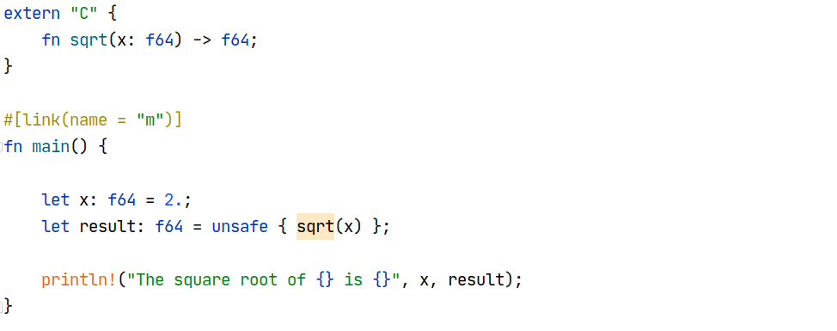
Foreign Function Interface (FFI)
Long live Rust!
@kiffin

Slide 8
Foreign Function Interface (FFI)
All FFI functions are unsafe to call because the other language can do operations the the Rust compiler cannot check.
Long live Rust!
@kiffin

Slide 9
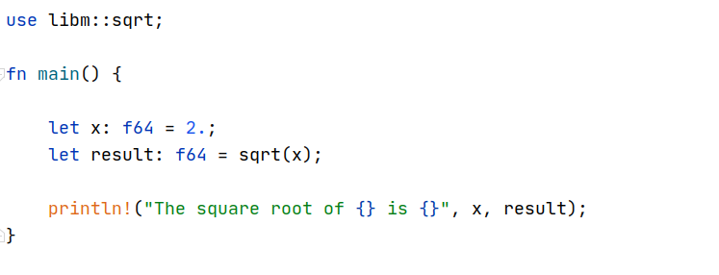
Crate libm
Long live Rust!
@kiffin

Slide 10

Rustonomicon
https://doc.rust-lang.org/nomicon/meet-safe-and-unsafe.html
https://doc.rust-lang.org/book/ch19-01-unsafe-rust.html
Long live Rust!
@kiffin

Slide 11
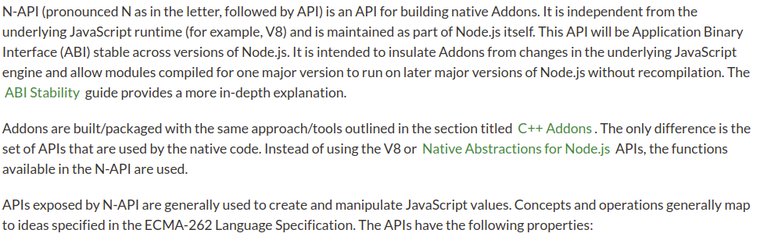
Node.js API (N-API)
https://nodejs.org/api/n-api.html#n_api_n_api
Long live Rust!
@kiffin

Slide 12
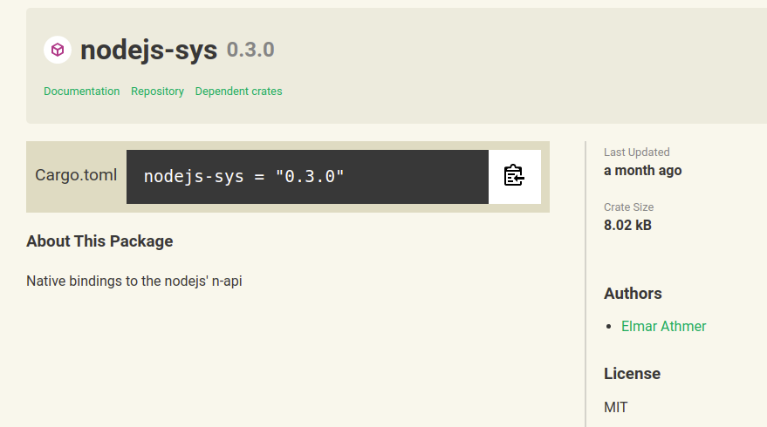
Crate | nodejs-sys
https://crates.io/crates/nodejs-sys
Long live Rust!
@kiffin

Slide 13
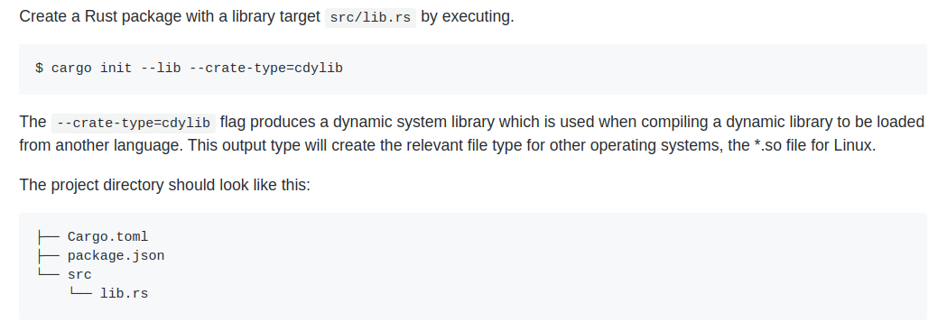
Cargo.toml
Long live Rust!
@kiffin

Slide 14
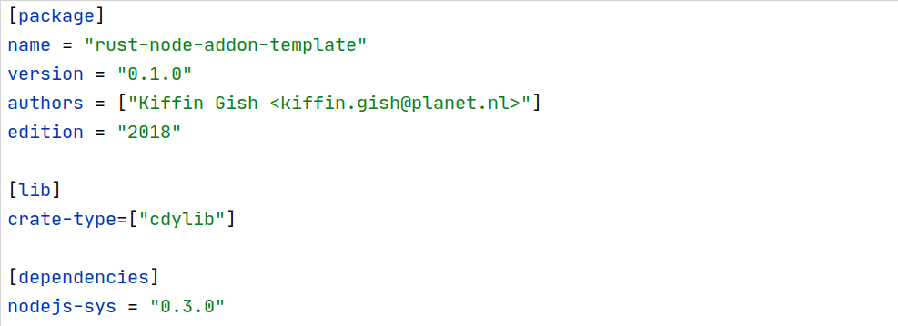
Cargo.toml
Long live Rust!
@kiffin

Slide 15
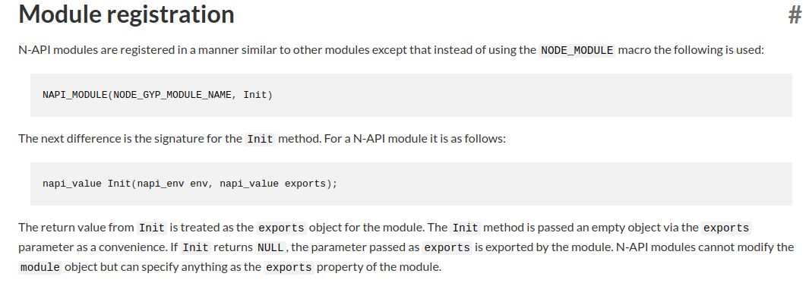
Module registration 1/2
https://nodejs.org/api/n-api.html#n_api_module_registration
Long live Rust!
@kiffin

Slide 16
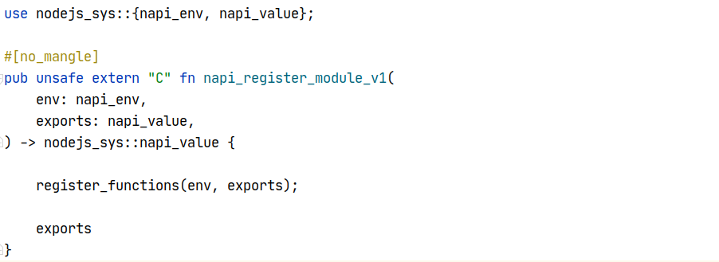
Module registration 2/2
Long live Rust!
@kiffin

Slide 17
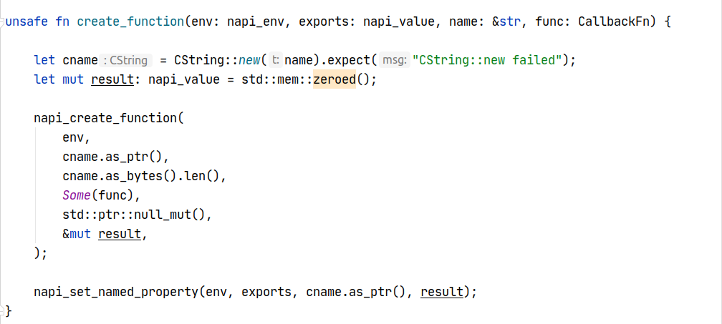
Create function
Long live Rust!
@kiffin

Slide 18
Create function
Long live Rust!
@kiffin

Slide 19
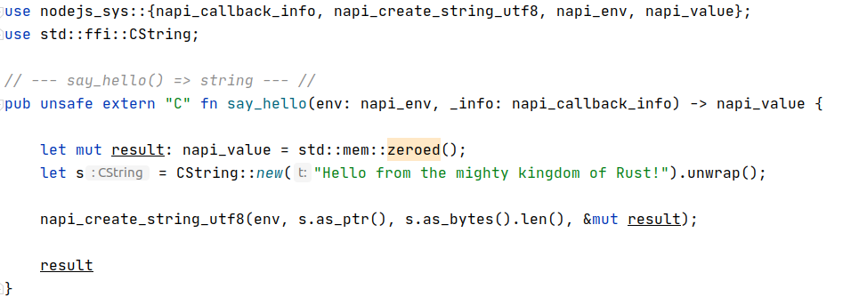
say_hello() → sayHello()
Long live Rust!
@kiffin

Slide 20
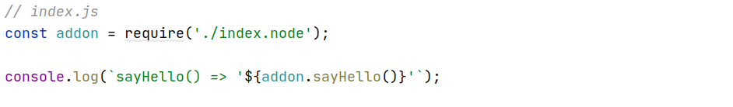
Build and run
Long live Rust!
@kiffin

Slide 21
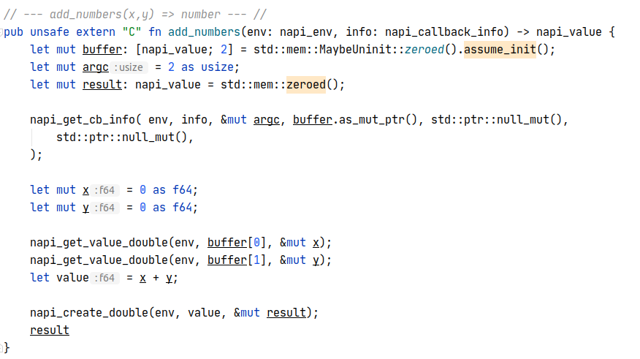
Demo
Long live Rust!
@kiffin

Slide 22
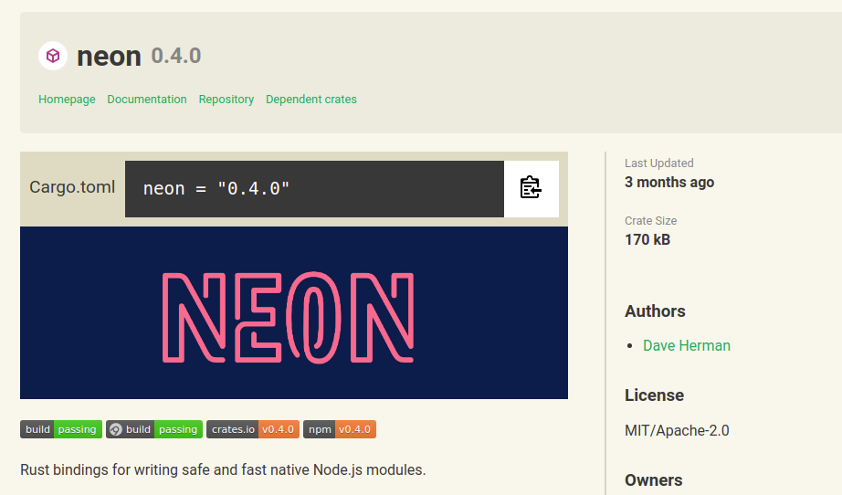
Crate | neon
https://neon-bindings.com
Long live Rust!
@kiffin

Slide 23
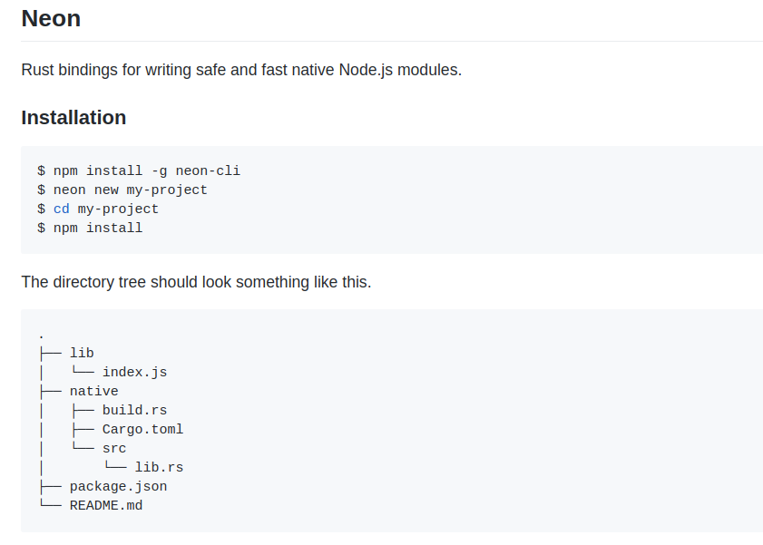
Installation
Long live Rust!
@kiffin

Slide 24
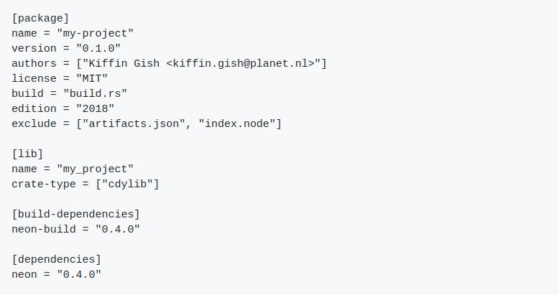
Cargo.toml
Long live Rust!
@kiffin

Slide 25
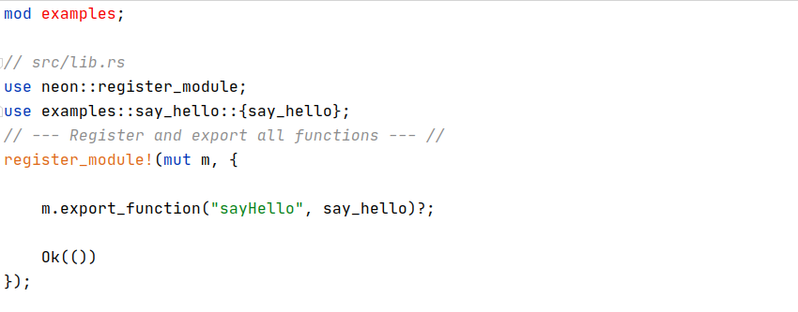
Module registration
Long live Rust!
@kiffin

Slide 26
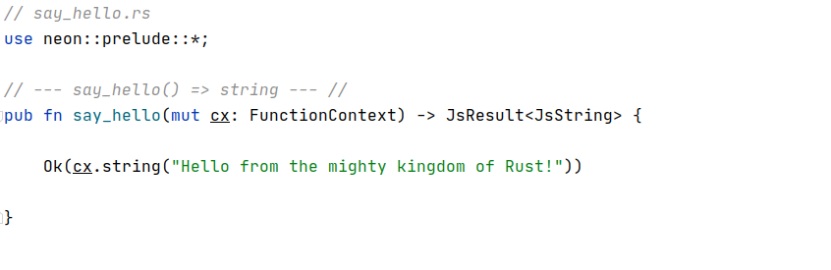
say_hello()
Long live Rust!
@kiffin

Slide 27
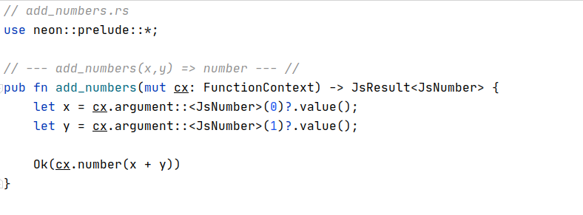
Demo
Long live Rust!
@kiffin

Slide 28
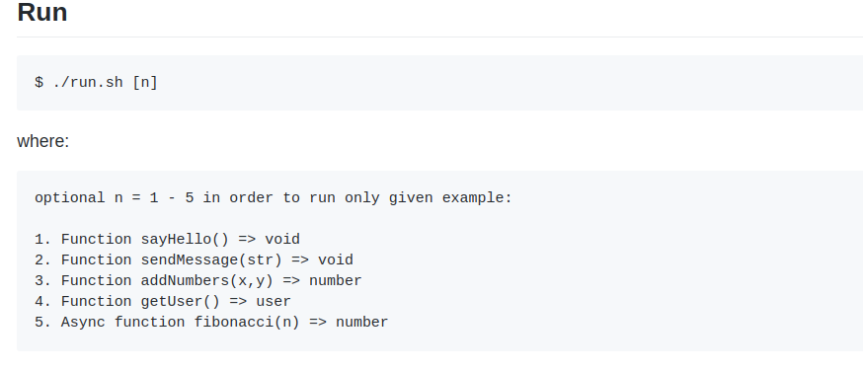
Additional examples
Long live Rust!
@kiffin

Slide 29
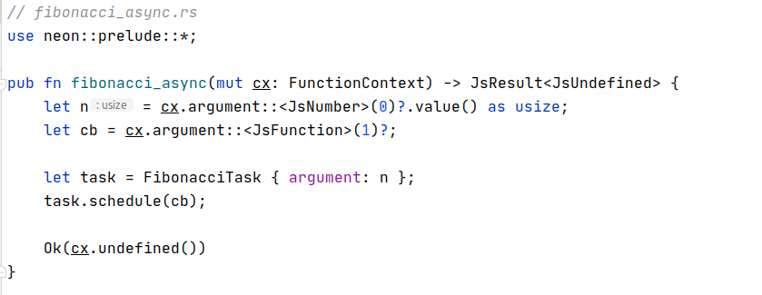
Async Fibonacci
Long live Rust!
@kiffin

Slide 30
Some conclusions 1/2
Advantages of using Rust with Node.js:
  Computational demands
  Performance is predictable
  Low-level access to GPU and GPIO
Long live Rust!
@kiffin

Slide 31
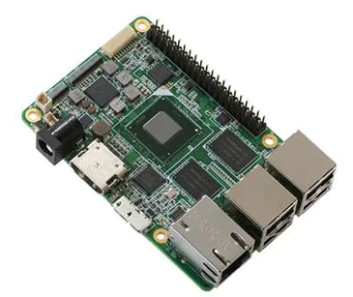

Some conclusions 1/2
Advantages of using Rust with Node.js:
  Computational demands
  Performance is predictable
  Low-level access to GPU and GPIO
  Cheaper hardware (IoT)
2 CPU cores, 1 GB RAM
1 CPU core, 512 MB RAM
Long live Rust!
@kiffin

Slide 32
Some conclusions 2/2
There are also some disadvantages:
  Support another programming language
  Different tool chain and deploy pipeline
  Steep learning curve
Long live Rust!
@kiffin

Slide 33
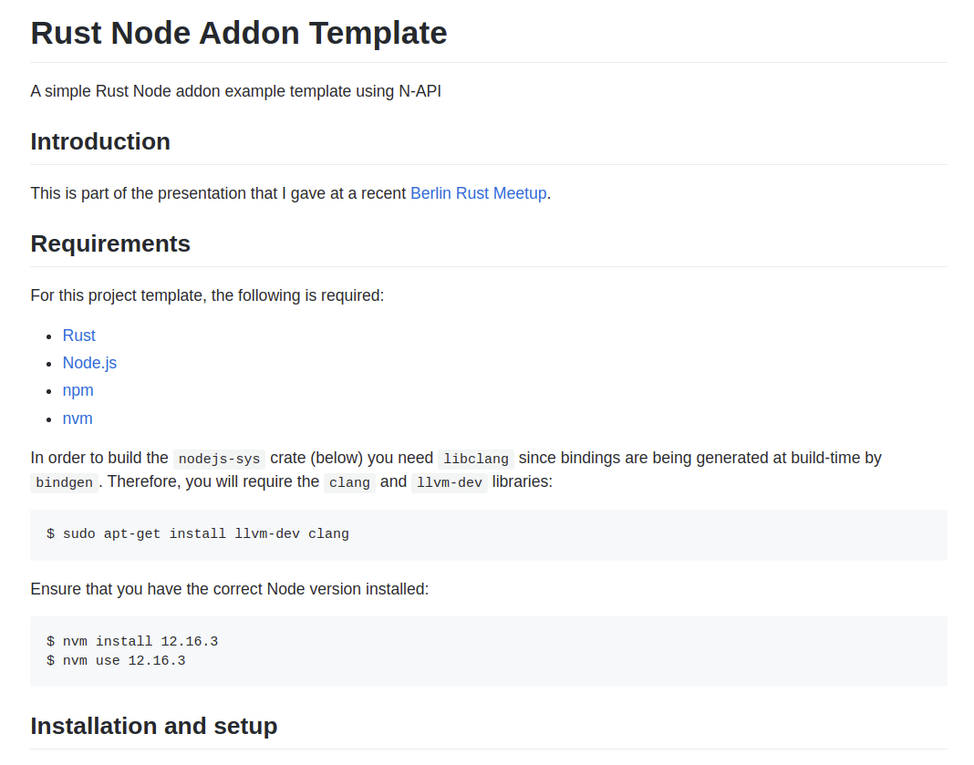
Github
https://github.com/kgish/rust-node-addon-template
Long live Rust!
@kiffin

Slide 34

End
Hope you liked it!
If you are looking for an eager and enthusiastic guy to help you out ... look me up!
kiffin.gish@planet.nl
https://github.com/kgish
https://www.linkedin.com/in/kiffin
Long live Rust!
@kiffin

