Slide 1

Viriciti export assignment
A fun and interesting code challenge.
Kiffin Gish
November 28, 2019

Slide 2

Introduction
In order to be able to better assess my technical expertise, the kind folks at Viriciti assigned me the following code challenge.

Slide 3
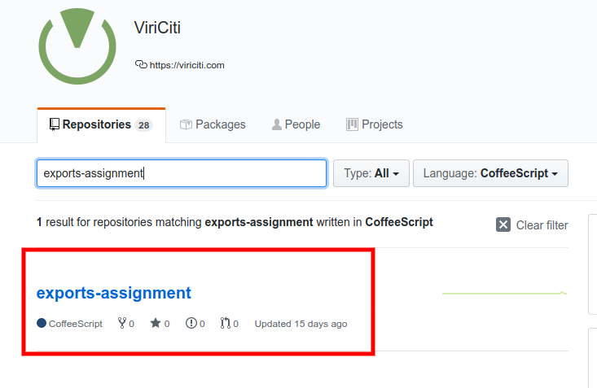
Repository

Slide 4
Code challenge
Build an CSV export system exposing an API.
For a given vehicle and range of dates, return a data set of measured attributes.
Must NOT overflow the database system when a lot of export requests are issued.
(Optional) Build a front-end that accesses a robust back-end.

Slide 5
Plan of attack 1/2
Brush up on MongoDB.
Rewrite the unwind utility and test ES6/TypeScript.
Verify that the rewritten test works with MongoDB.
Create a MongoDB docker container and import the data dump.
Tried to learn Express Gateway but time too short.
Instead used NestJS (more familiar).
Build the back-end API server.

Slide 6
Plan of attack 2/2
Check out Balena (formerly resin.io) but time limited.
Learn Redis quickly.
Create a Redis docker container as cache.
Build a responsive Angular front-end.
Dockerize everything.
Finalize the readme.
Practice this presentation in front of the mirror.

Slide 7















Open source

Slide 8
Open source
ANGULAR
JEST
REDIS
NESTJS
COCA-COLA
JASMINE
CHAI
CHARTJS
GIT
MONGODB
D3JS
NODE
POSTGRES
MATERIAL
DOCKER

Slide 9
Specifications 1/2
Ensure that the export service will remain robust during periods of high traffic.
Support intensive usage by multiple users exporting large volumes of data simultaneously.
The MongoDB will not become overloaded and that no performance hits arise for those trying to export the data.
After some thought, I came up with the following strategy...

Slide 10
Specifications 2/2
Restrict access to authorized users (JWT).
Use a rate limiter to throttle the API requests.
Cache the data set results for recurring API requests.
Slice the date ranges into common blocks (days).
Offload the actual export to the front-end client.
Allow users to interact with the data set: date ranges, filters, sorting, etc.

Slide 11
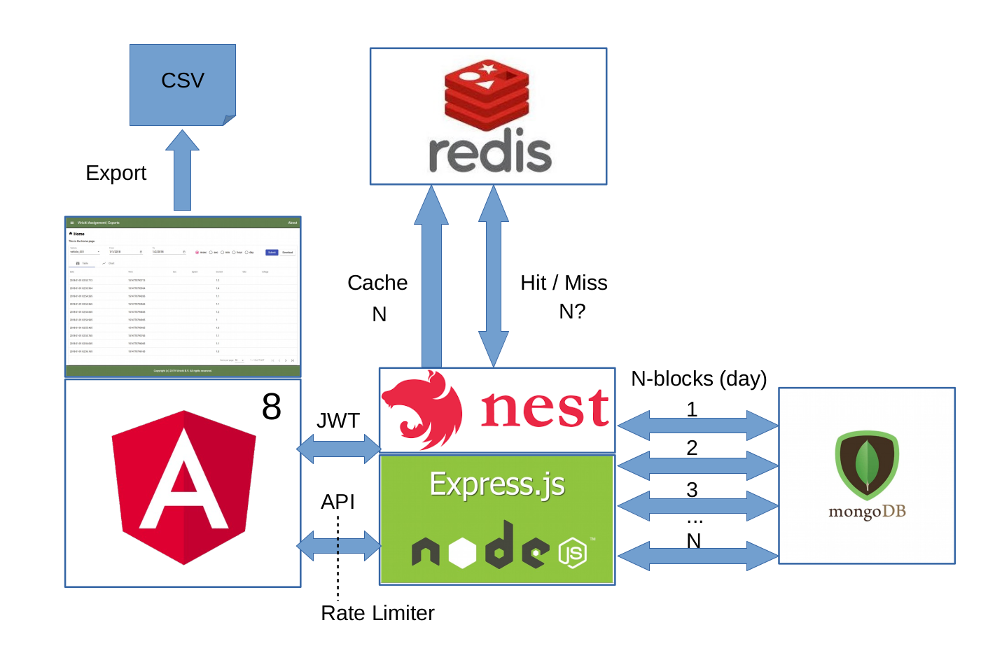
Architecture

Slide 12
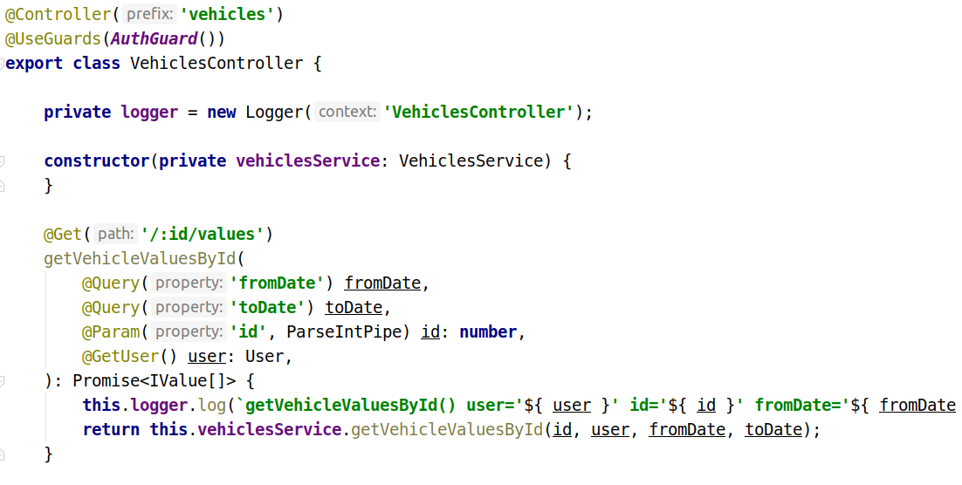
Code walk-through

Slide 13
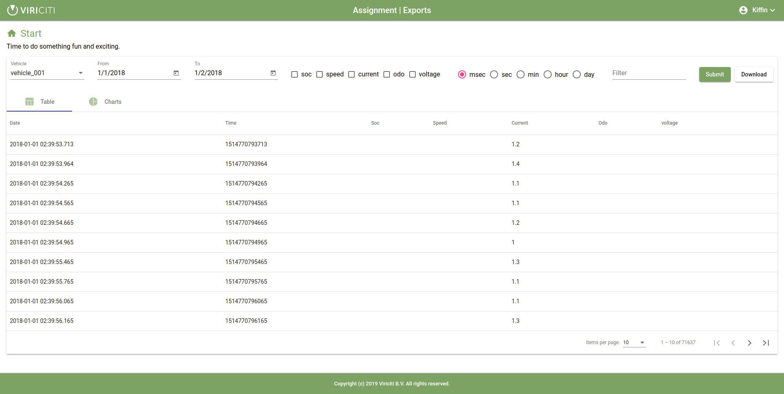
Demo

Slide 14
To do (rainy day)
Implement BSON to compress data exchange.
Create fancier graphs with D3js.
Measure performance and tweak the code accordingly.
Optimize Redis configuration options.
Optimize MongoDB configuration options.
Smaller interval slices, hours or minutes or even dynamic.
Offload to a separate microservice for Redis caching.
Aggregate time mean sequences: seconds, minutes, hours and days.

Slide 15

End
Thanks for your time and attention.

