Slide 1
Reinforcement Learning

Slide 2
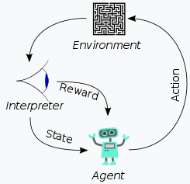
Reinforcement learning (RL)
interdisciplinary area of machine learning and optimal control concerned with how an intelligent agent ought to take actions in a dynamic environment in order to maximize the cumulative reward.

Slide 3
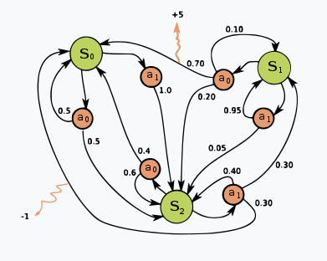
Markov decision process
Basic reinforcement learning is modeled as a Markov decision process

Slide 4



Criterion of optimality
Policy
The policy map gives the probability of taking action a a when in state s s.
state-value function
0 ≤ γ < 1 {\displaystyle 0\leq \gamma <1} is the discount rate. γ \gamma is less than 1, so rewards in the distant future are weighted less than rewards in the immediate future.
E is meaning ‘Expected’
Gain is Related in Discount rate

