Slide 1
How much do we get paid?
Story 4
Keeno Glanville

Slide 2
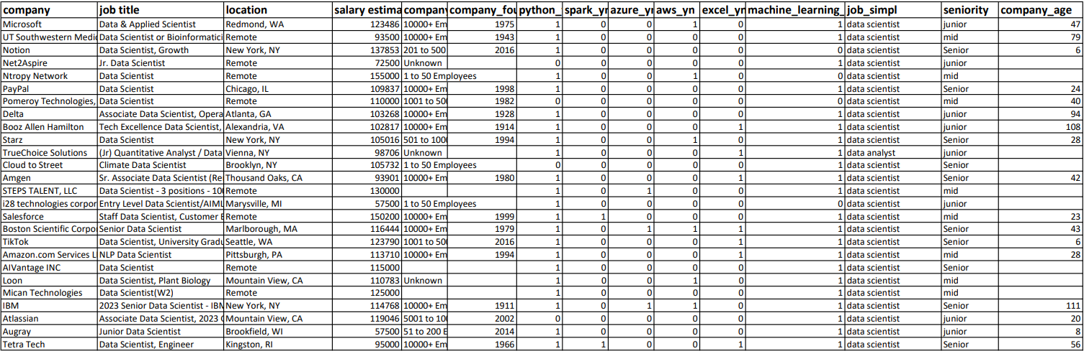
Data set
The data utilized in this story comes from the Kaggle data set Data Related Jobs in the US taken from Kaggle. The data is sourced from Glassdoor job postings as well as their salary estimates.
https://www.kaggle.com/datasets/mohamedsiika/data-related-jobs-in-us

Slide 3

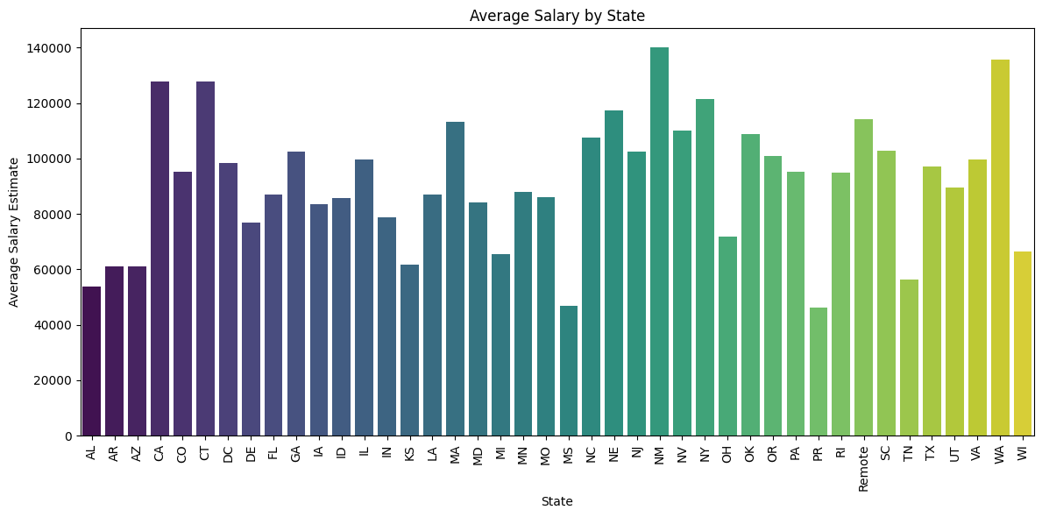
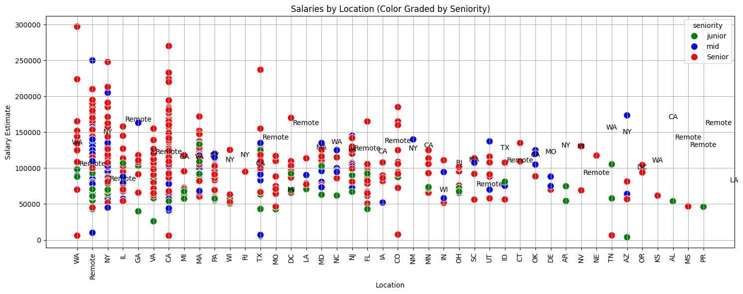
Salaries vs state
These visualization tells the story of job salaries across the states, color coded for seniority. This demonstrates the power the senior roles have on the job market

Slide 4
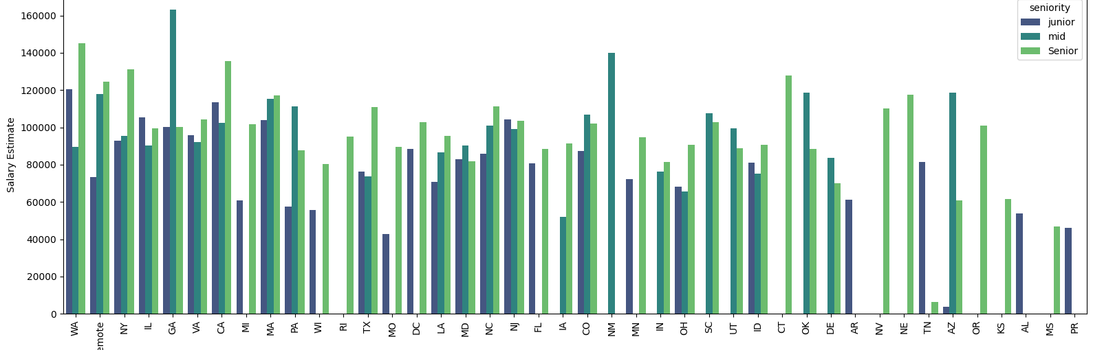

Bar graph of salaries vs state

Slide 5
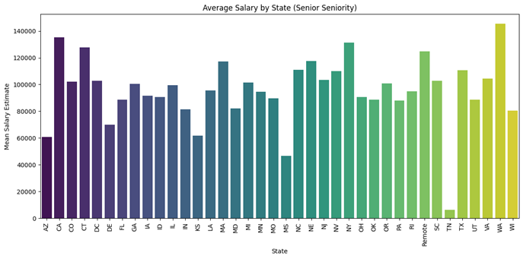
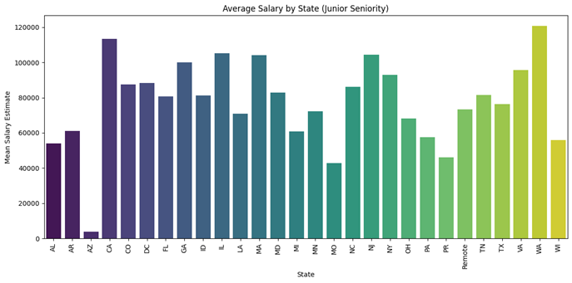
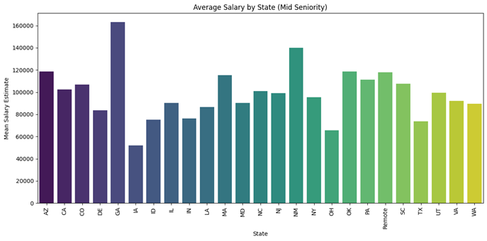
Average salary vs state separated into job level

Slide 6
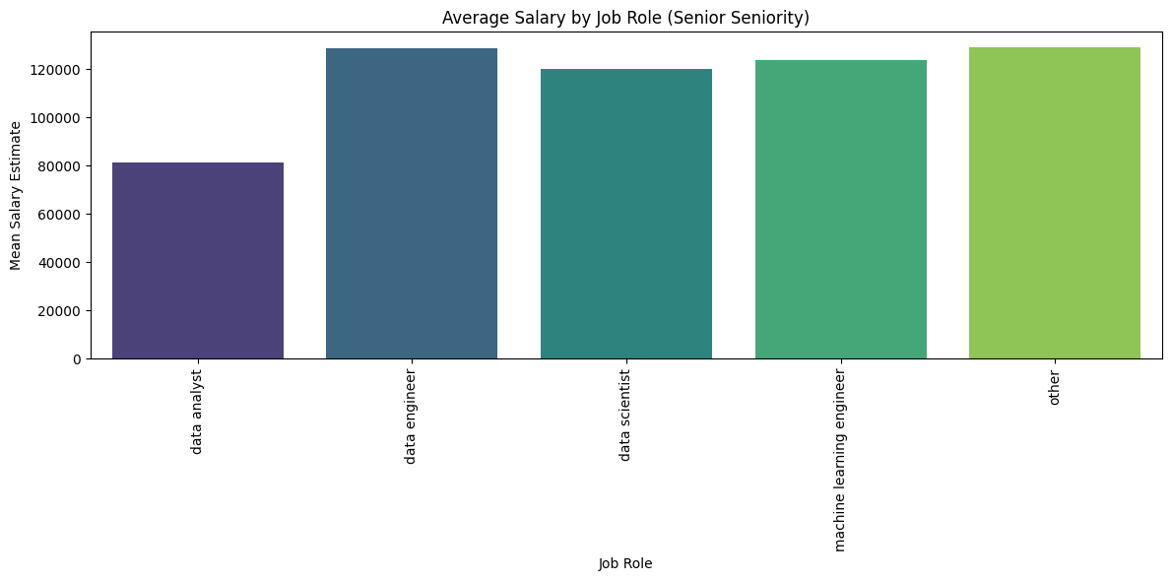
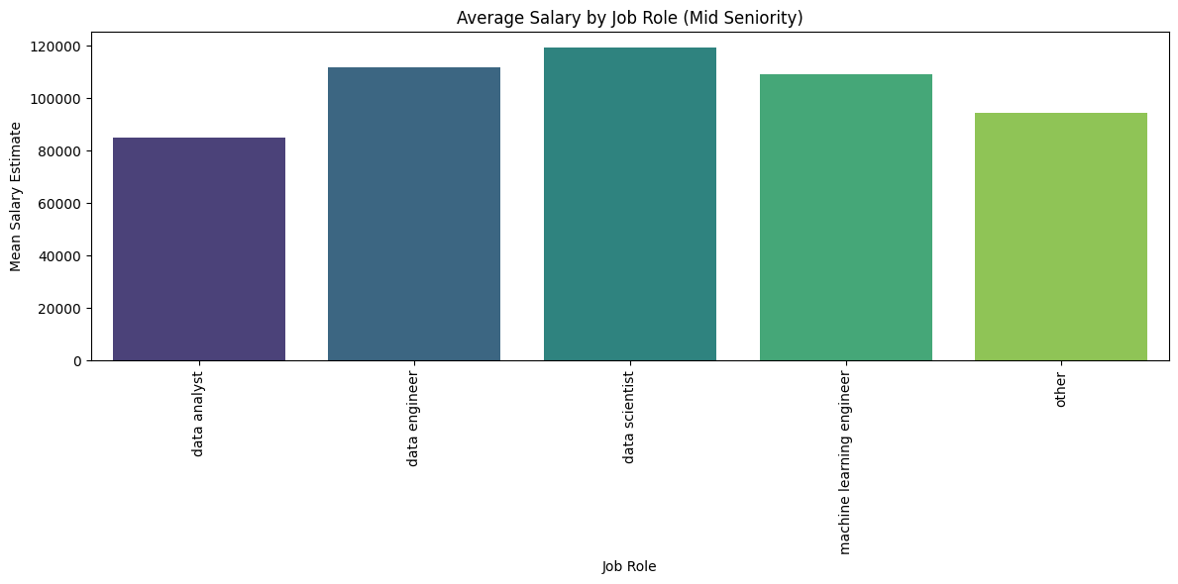
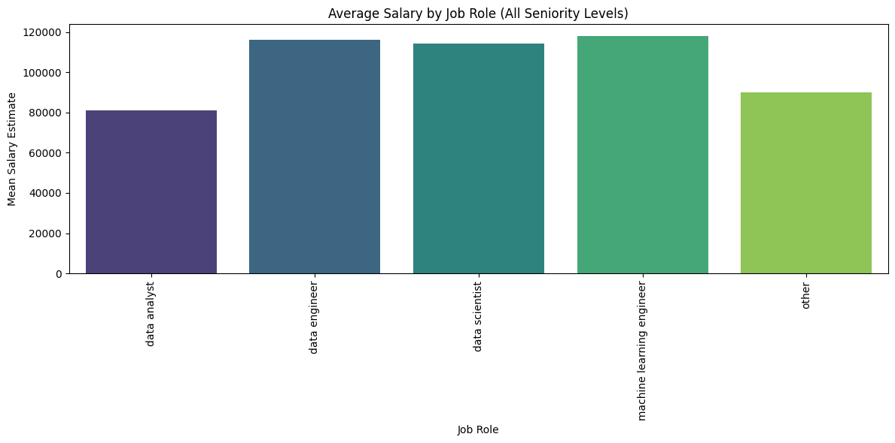
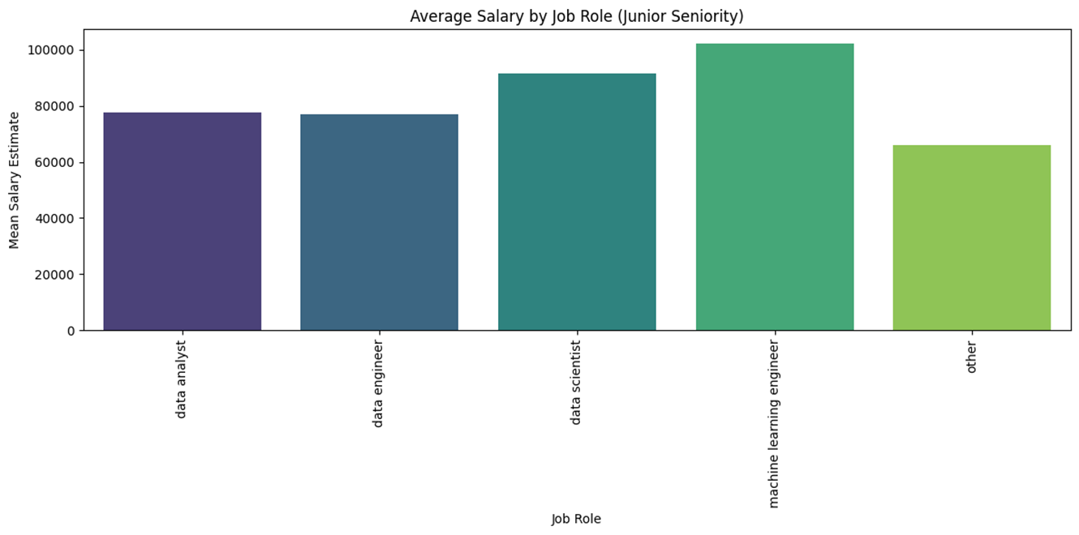
Salary vs job role
Machine Learning Engineer roles tend to have higher salaries overall

Slide 7
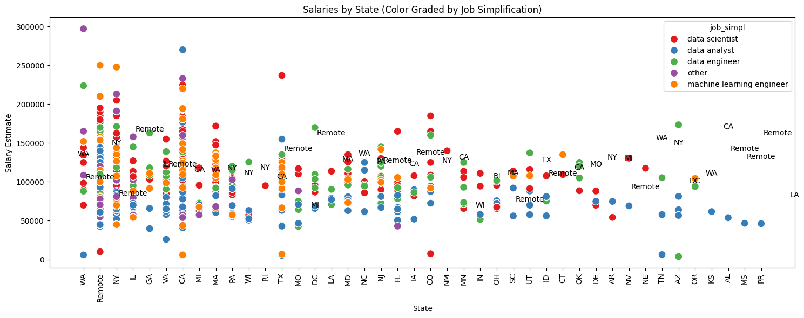
These visualization tells the story of job salaries across the states, color coded for job role. This demonstrates the power the machine learning roles have on the job market

