Slide 1


Poverty and Food Insecurity

Slide 2
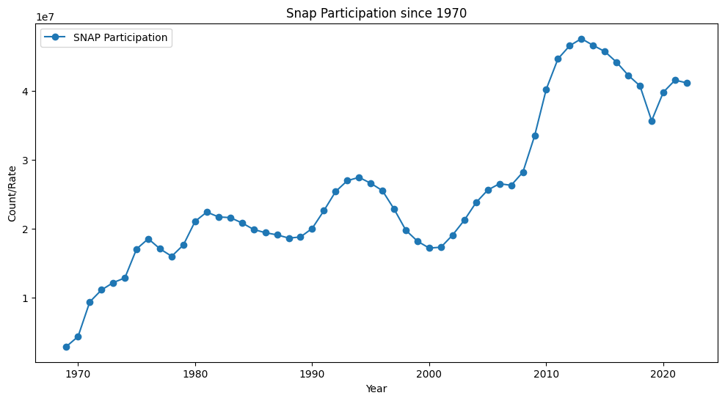
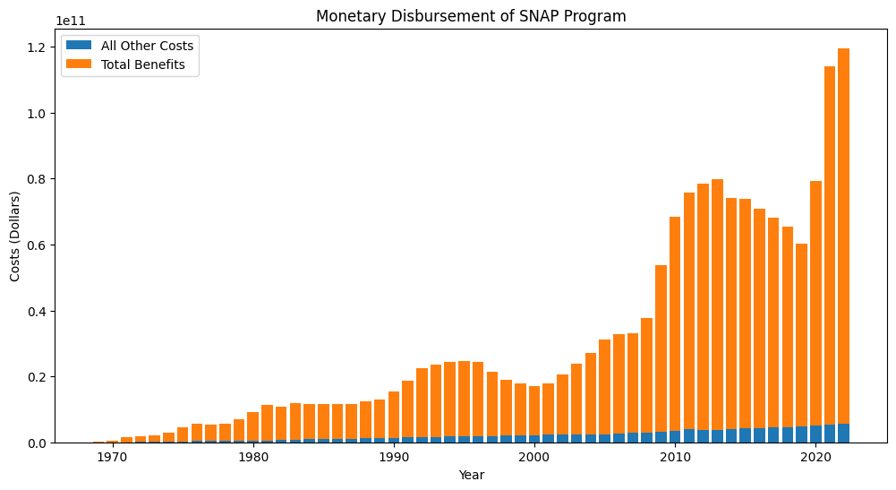
Poverty in America
Over the years we are seeing a tremendous uptick in Snap Participation as well as the amount of money the country is spending to alleviate the problem.

Slide 3
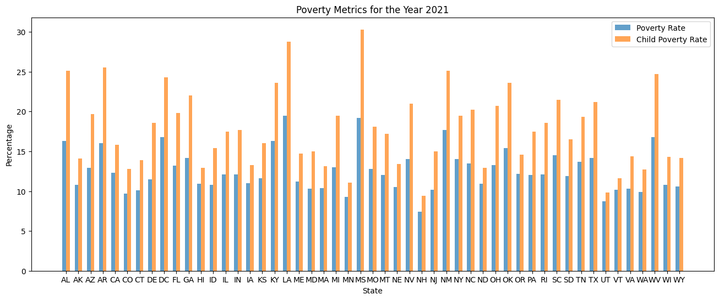
Who is impacted most? …children

Slide 4
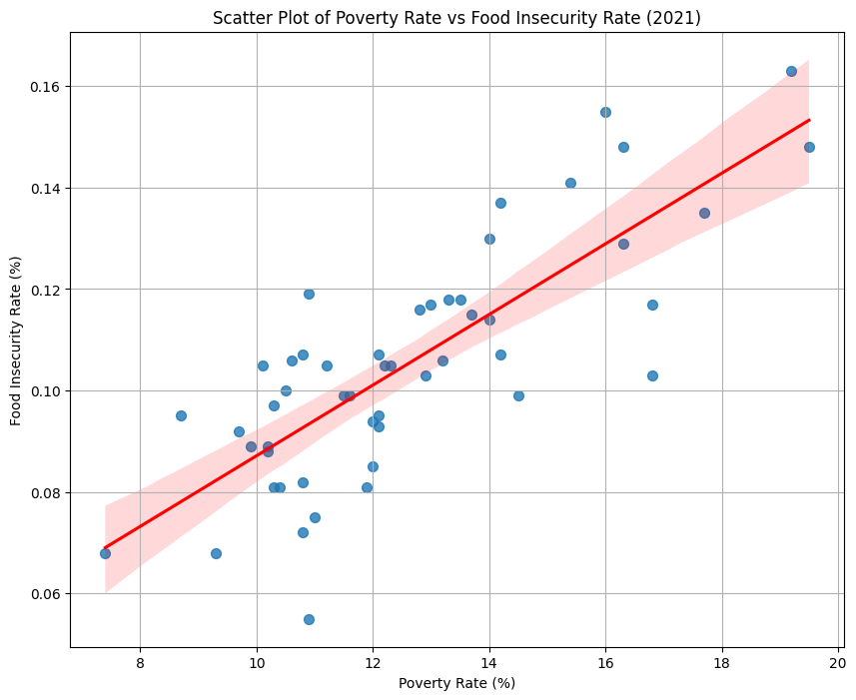
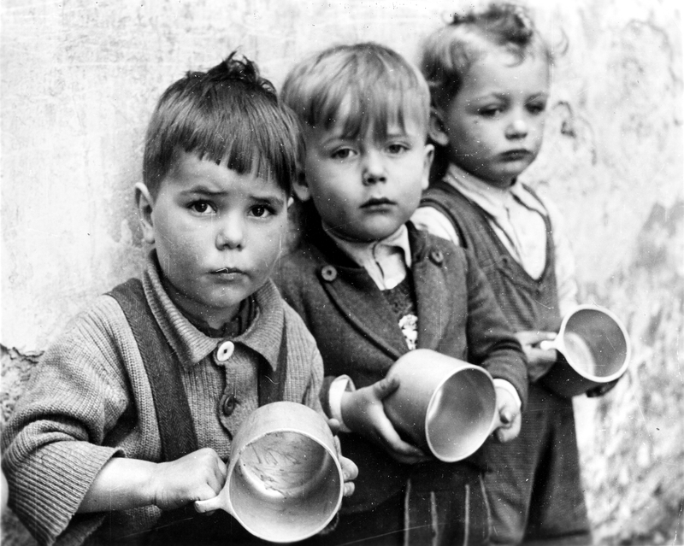
If we don’t control it now children will continue to go hungry in our country

Slide 5
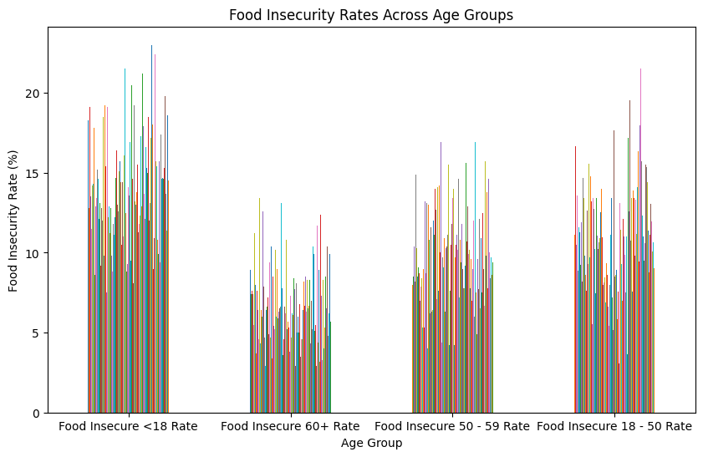
These children will eventually turn to hungry adults

Slide 6
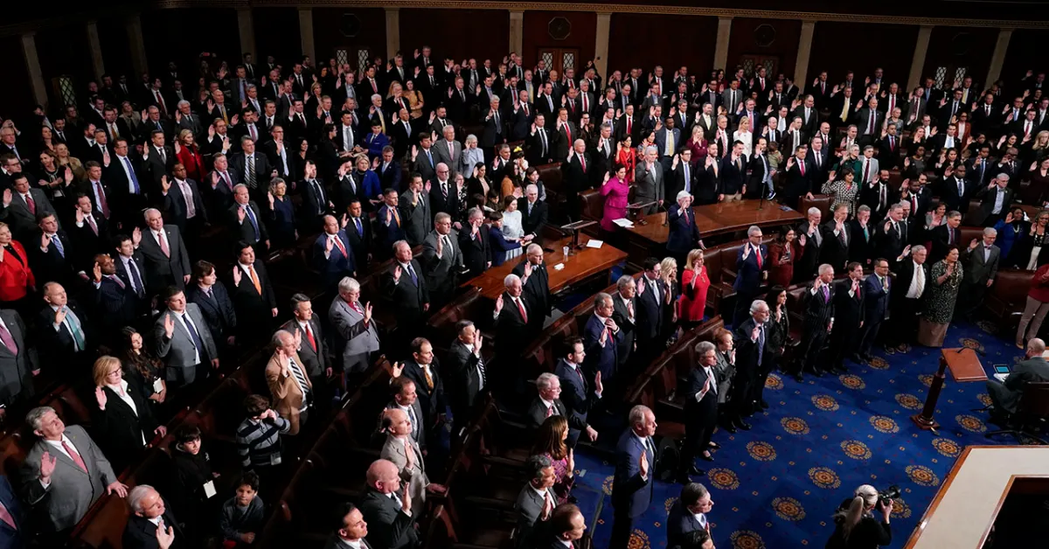
It is our duty to help

