Slide 1
HW5
Keeno Glanville

Slide 2
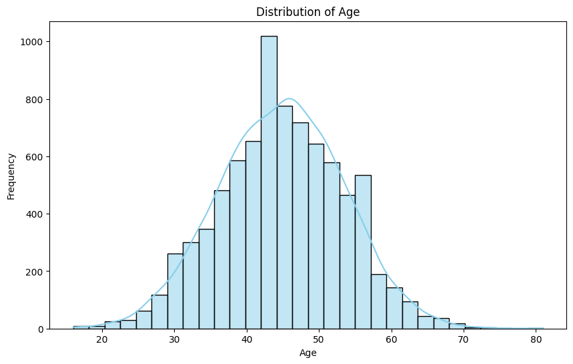
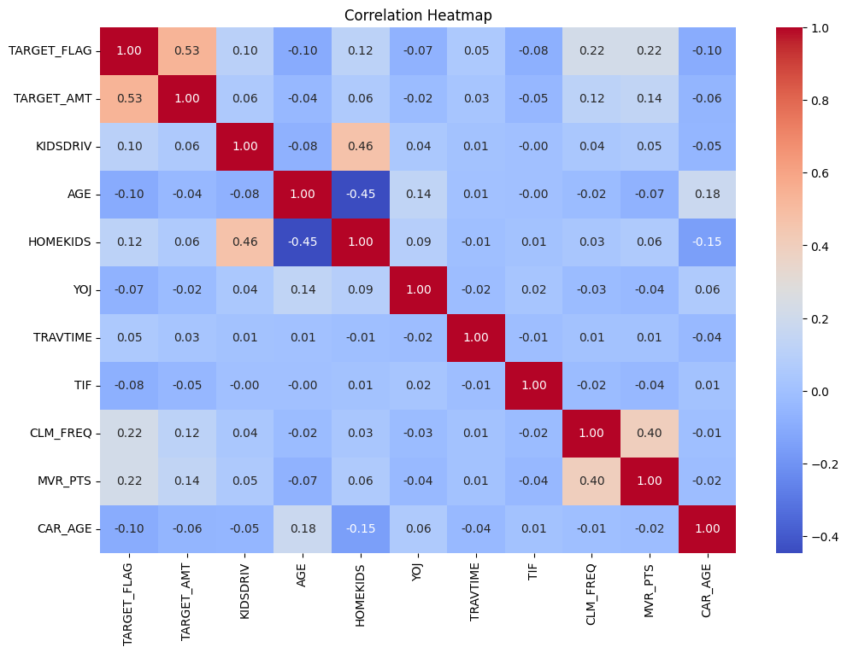
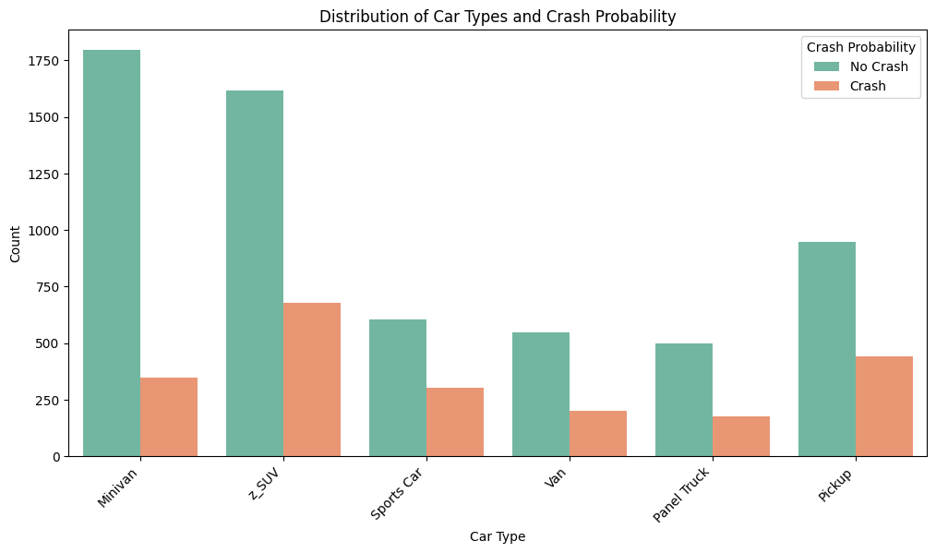
Data Exploration
The data exploration was quite telling, it was able to alleviate personal expectations about age distribution. I would assume more youth would be involved in the crashes. The data was also not strongly correlated which would be intuitive seeing as no one can really predict a crash

Slide 3
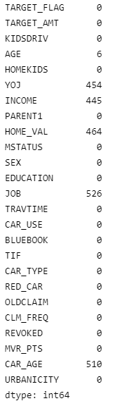
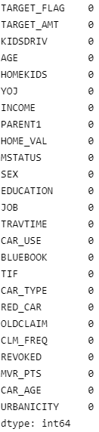
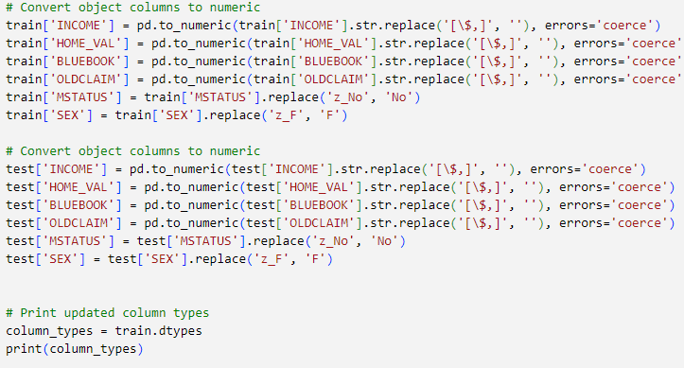
Data Preparation
The data preparation consisted of fixing typographical inconsistencies as well as imputing missing values. For the most part the dataset was easy to work with.

Slide 4
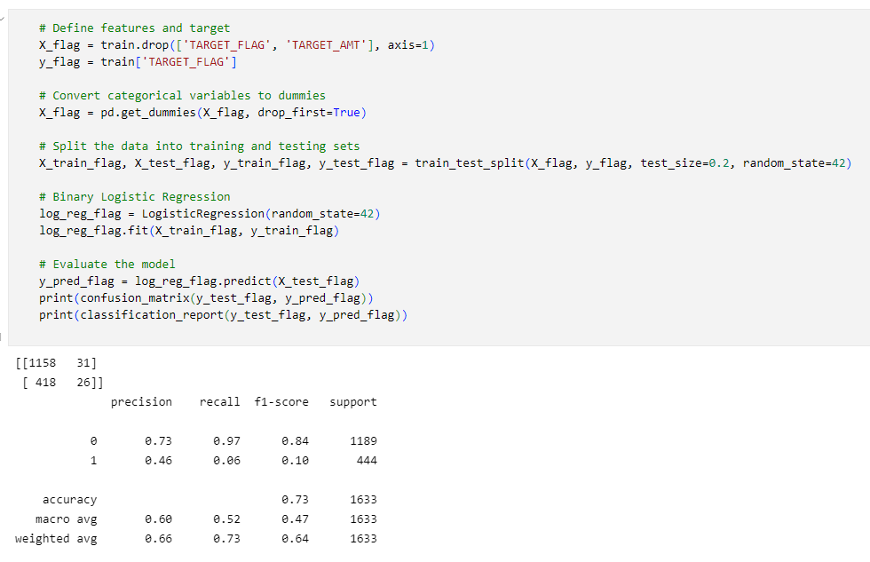
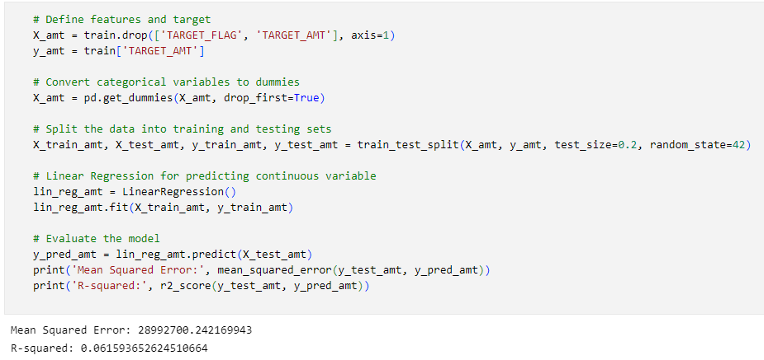
Build Models

Slide 5
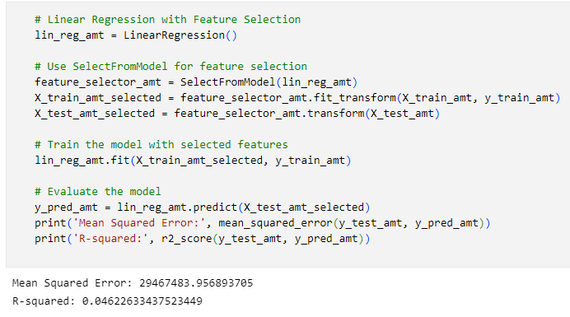
Select Models
Model was tuned to select the most optimal features to present a more accurate model, however the model had a very difficult time fitting the data

