Slide 1


Keeno Glanville
DMV Simulation

Slide 2
Introduction
In the United States, the Department of Motor Vehicles(DMV) is a government agency that administers motor vehicle registration and driver licensing. These departments are governed by state and have varying processes and applications. Within many states however, there are huge complaints that these departments tend to be overcrowded and have terrible processes. As a result, there are awful queue times that people have to wait in order to have even the simplest things done within the DMV. This is even more complicated by the fact that individuals have a plethora of options within the DMV like taking tests, getting licenses, registering for tests, paying tickets, etc. And all these processes can be disturbed by the factors of being prepared vs time of arrival.

Slide 3
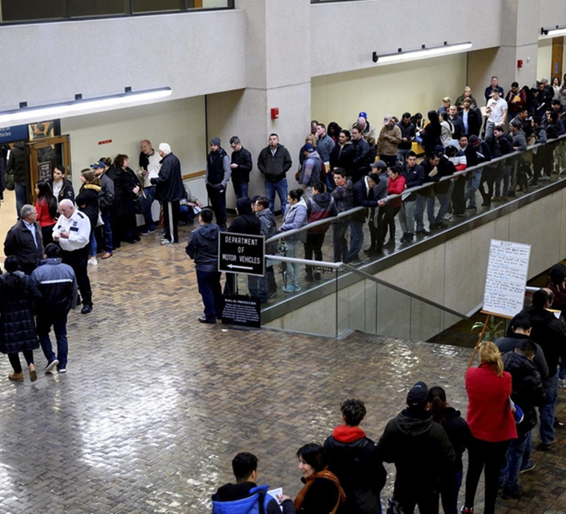
# Problem The Department of Motor Vehicles (DMV) faces significant challenges in managing customer flow, minimizing wait times, and improving overall customer satisfaction. Customers often experience long queue times and inefficient processes, resulting in frustration and delays in obtaining essential services such as driver's license applications, vehicle registrations, and license plate issuances. The problem lies in the complex nature of the DMV, where various processes and services need to be streamlined and optimized to enhance operational efficiency and provide a better experience for customers. # Significance Efficient and streamlined operations at the DMV are crucial for several reasons. First, reducing wait times and improving service delivery enhances customer satisfaction and reduces frustration. It helps individuals complete their necessary transactions promptly and with minimal disruption to their daily lives. Second, optimizing DMV operations leads to cost savings for the government and taxpayers by maximizing the utilization of resources, such as staff, counters, and equipment. Third, a well-functioning DMV contributes to safer roads and improved compliance with traffic regulations by ensuring that drivers have the necessary licenses and registrations. By simulating the DMV processes and evaluating key performance metrics such as wait times and resource utilization, we can identify areas for improvement and implement strategies to enhance the efficiency of DMV operations, ultimately benefiting both customers and the government.

Slide 4
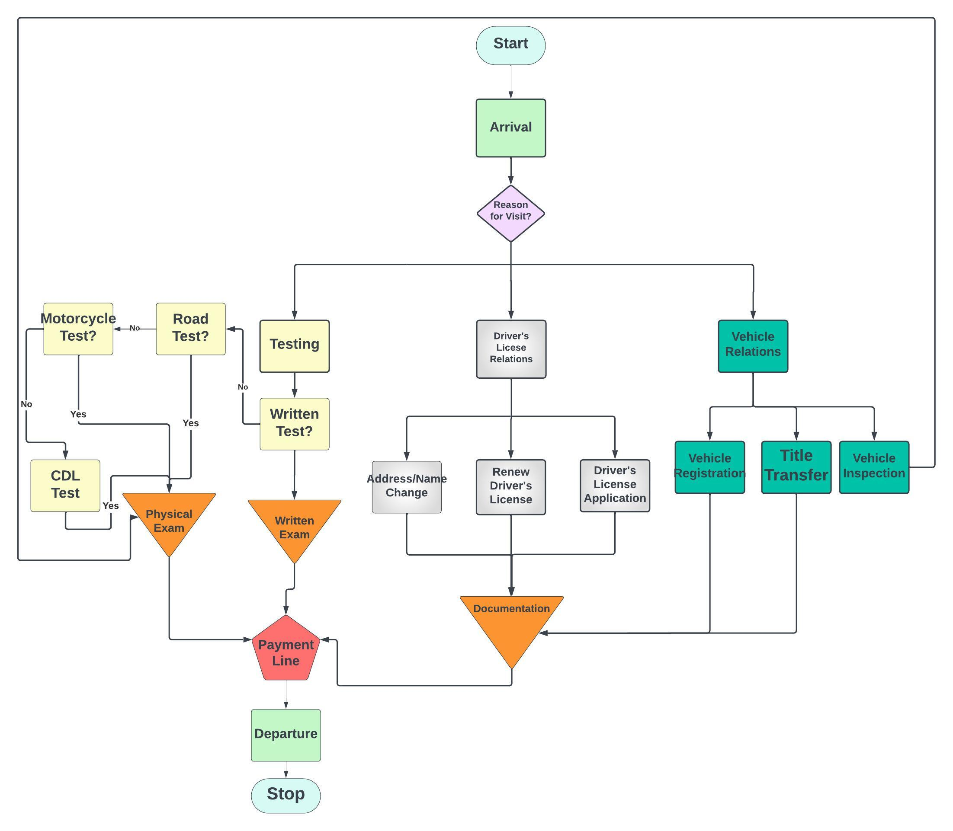
Flow Chart

Slide 5

Example Code Execution
Person 222 joined Payment Queue at 28325.65298501787
Person 218 Exited DMV at 29452.961526751795
Person 215 completed documentation at 29583.846690895076
Person 215 joined Payment Queue at 29583.846690895076
Person 212 Exited DMV at 29592.461263609002
Person 217 completed documentation at 29697.37388140803
Person 217 joined Payment Queue at 29697.37388140803
Person 219 Exited DMV at 29714.756561721235
Person 215 Exited DMV at 29883.846690895076
Person 217 Exited DMV at 29997.37388140803
Person 225 completed documentation at 30308.843097476325
Person 225 joined Payment Queue at 30308.843097476325
Person 226 completed documentation at 30605.254406823828
Person 226 joined Payment Queue at 30605.254406823828
Person 225 Exited DMV at 30608.843097476325
Person 226 Exited DMV at 30905.254406823828

Slide 6
Verification and Validation
In terms of Verification, this segment of the process was immensely daunting. In order to verify the model was working effectively, I utilized print statements during the creation of the code. The most difficult part of this operation was the fact that I wanted to incorporate the great variation in the DMV's process. This often resulted in the code running each iteration independently and running the full process as if only one person could enter the DMV at a time. This was obviously not realistic and was eventually fixed.
In terms of Validation, the Annual reports of the DMV data don't issue the various queue times or average amounts of people that enter the facilities. It was through searching through the average estimated times one can expect to be within the facilities for various activities that I was able to create the process and estimate how long someone can be expected to be in the facility. One important thing is that the model would have to be built to accommodate the 7-hour workday. And as an effect the DMV wouldn't let too many people in as it would bring them to capacity and not allow them to leave and go home in time.

Slide 7
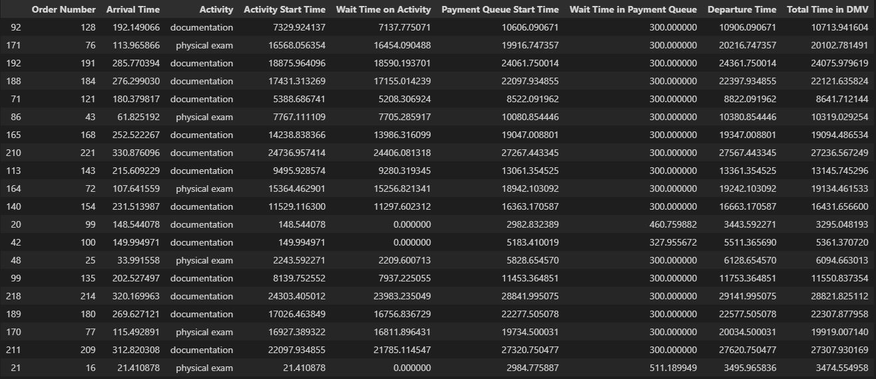
Example Dataframe results

Slide 8
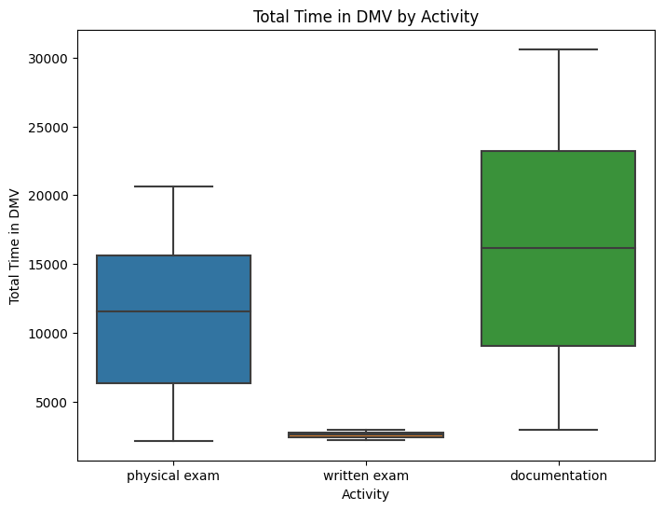
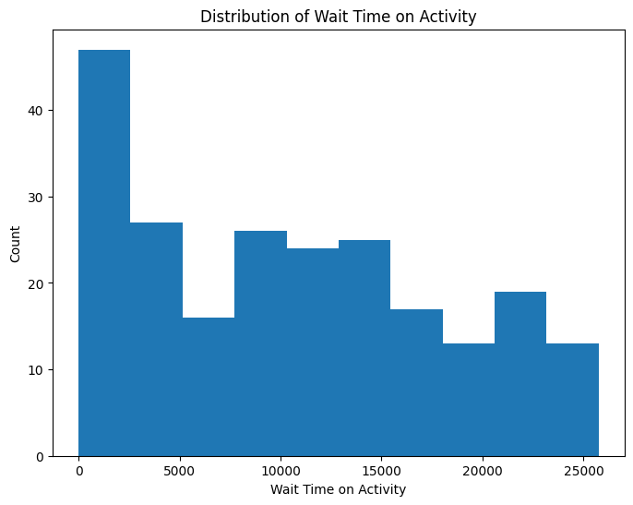
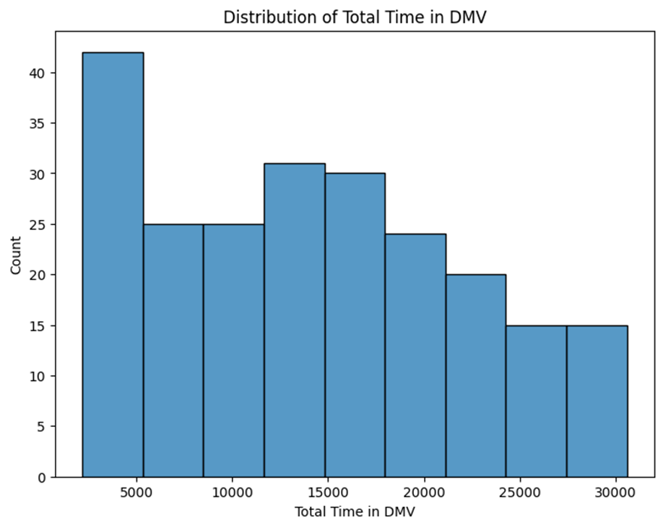
Visualization of Simulation

Slide 9

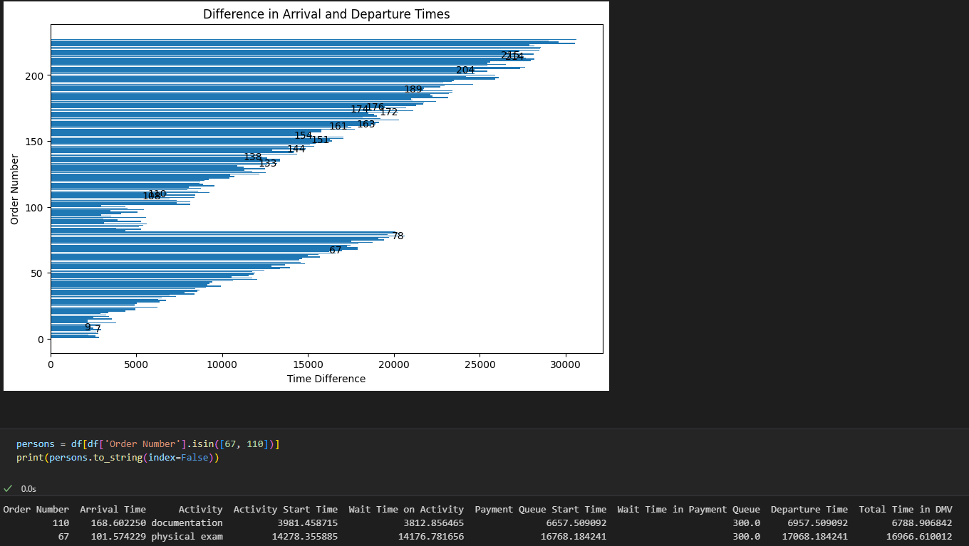



Slide 10
Conclusion
The model was quite insightful. I went into the model thinking it would be highlighting the disfunction of the DMV, but it just highlights how varied their day can be and how ill-prepared they can be for that to happen. This day was a document heavy day, and we see that the documentation team was faster than the physical exam team. This is all due to the allocated resources given. I expected since I made the model harder for documentation as those tended to be the longest wait times within the DMV, that they would always end up taking the longest time, but because the model I set up accounted for them having the manpower to deal with people, they were able to overcome that onslaught. Overall, this simulation gave me a whole new perspective on the processes of the DMV.

