Slide 1
MockLetsEat
September 10 2019

Slide 2
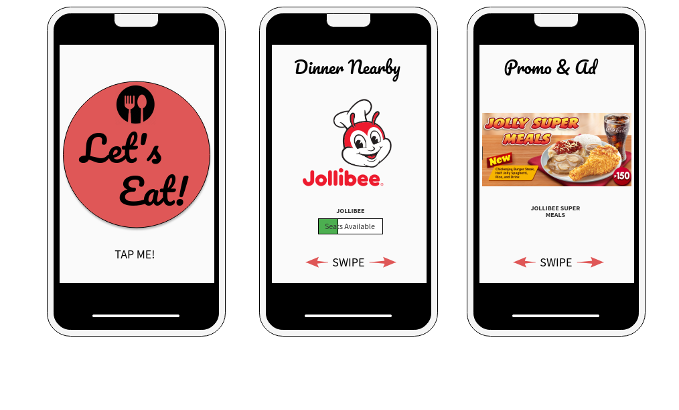

Slide 3
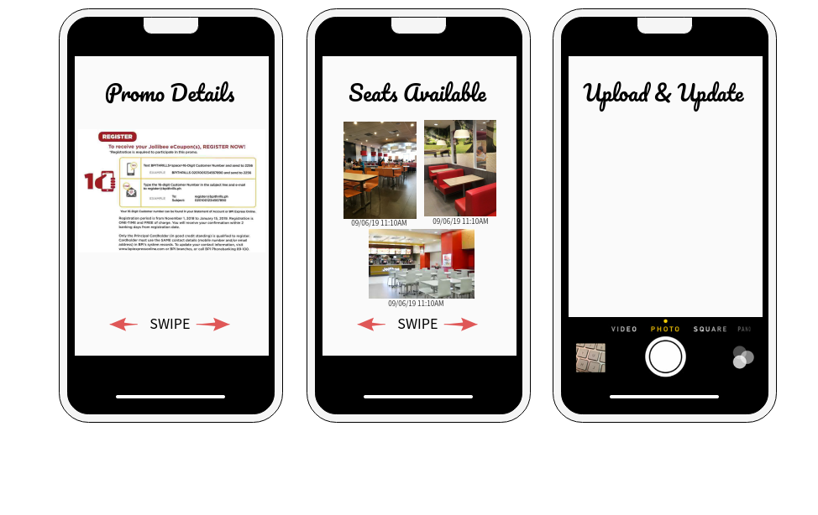

Slide 4
