Slide 1
Explains the logic in renderer/core.js __handleScroll: differential scroll How to calculate the “offset” of creative relative to its container to achieve the special effect

Slide 2
It’s a lot about ratio and proportions!
e.g. You are given a job :
7500USD for the whole thing
You are paid at the end of each day day
The job last 25 days, starting on 3rd July. i.e. morning of 3July -> evening 27July
Then you can calculate the amount of money you got:
Formula of amount of $ accumulated, at morning of a certain day in July:
Max (7500, 7500 x (date-in-july – 3) / (28 – 3))
Check: morning of 3July : 7500 x (3 – 3) / (28 – 3) = 0
Check: morning of 28July: ..7500 x ( 28-3) / (28-3) = 7500
Check: morning of 29July: …30 July … 7500

Slide 3
Case 1: creative taller than adslot
(assume viewport taller than adslot)
Terminology:
"offset" will refer to the offset of the creative we should put relative to the OSM unit to achieve the special effect.
Yellow frame: OSM unit, green line is top of the OSM unit
Let
HAD = height of creative, the pink thing
HOSM = height of OSM unit, the yellow frame.
HVP (winowHeight): height of viewport
So here it how to approach the question of how to work out the offset:
Config1
Config2

Slide 4
config1 (adcontainer just barely became fully in vp)
With this, the offset is still = 0, but as user continues to scroll down,
offset should start to be negative
config2 (adcontainer just still fully in vp)
With this the offset should be reached its most negative (i.e. HAD - HOSM) and should not decrease further as user continues to scroll down

Slide 5
User Scrolling from config1->2, relative to the viewport, the bottom of OSM (greenline) would have travelled a distance denoted by red arrow , = HVP - HOSM
since the required shift in "offset" (purple)
is supposed be take place gradually, uniformly as the greenline travels that distance
offset = THE TOTAL OFFSET CHANGE FROM CONFIG1->CONFIG2 * (A FACTOR)
And this factor is:
(actual dist moved by OSM’sBottom so far) / (total dist moved by OSM’sBottom from cfg1 -> 2)
offset = (HAD - HOSM) * ((windowHeight - osmRect.bottom)/windowHeight - HOSM)
We can check easily that it make sense:
In config1. Plug in osmRect.bottom = windowHeight. This gives offset = 0, which is what we expect
In config2. Plug in osmRect.bottom = HOSM. This gives offset = HAD - HOSM

Slide 6
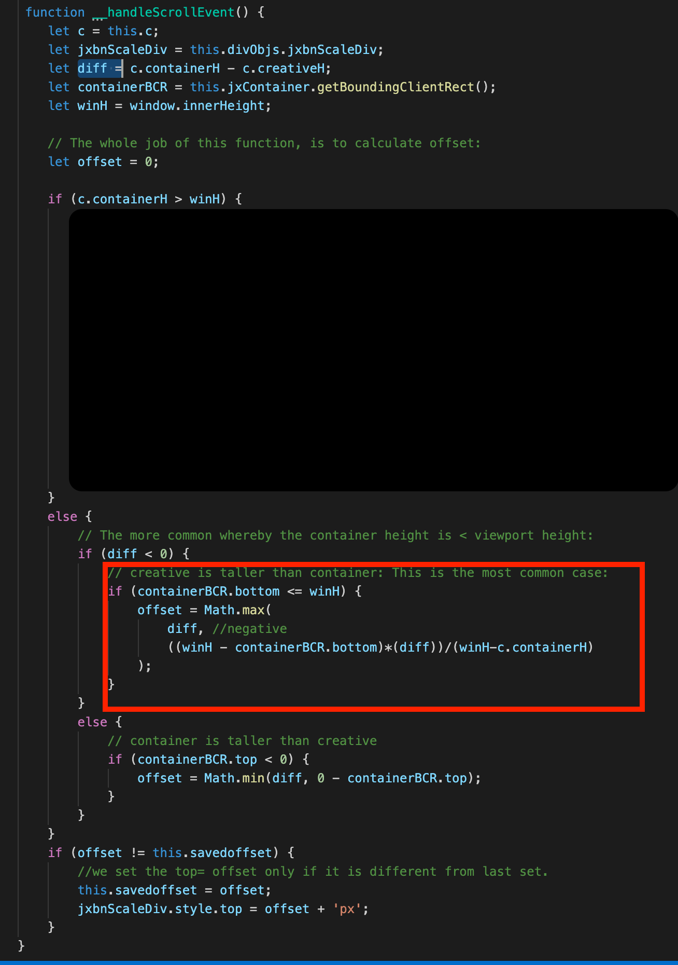
in terms of code, the above is this (red box):

Slide 7

Case 2: adslot taller than creative
(assume viewport taller than adslot)
Terminology (same as case1)
"offset" will refer to the offset of the creative we should put relative to the OSM unit to achieve the special effect.
Yellow frame: OSM unit, green line is top of the OSM unit
Let
HAD = height of creative, the pink thing
HOSM = height of OSM unit, the yellow frame.
HVP (windowHeight): height of viewport
So here it how to approach the question of how to work out the offset:
Config1’
Config2’

Slide 8
Config1’ (adcontainer just barely still fully in vp)
With this, the offset is still = 0, but as user continues to scroll down,
offset should start to be positive (to make use of the extra space to show the ad “more”)
Config2’ (the creative’s is so offset-ed that its bottom touches the bottom of the OSM unit; and that’s the most we can do)
Here offset = HOSM - HAD

Slide 9
User Scrolling from config1’->2’, relative to the viewport, the top of OSM (greenline) would have travelled a distance denoted by red arrow , = HOSM - HAD
since the required shift in "offset" (purple)
is supposed be take place gradually, uniformly as the greenline travels that (red arrow) distance:
offset = THE TOTAL OFFSET CHANGE FROM CONFIG1->CONFIG2 * (A FACTOR)
And this factor is:
(actual dist moved by OSM’Top so far) / (total dist moved by OSM’sTop from cfg1’ -> 2’)
offset = (HOSM - HAD) * ((0 - osmRect.top)/HOSM - HAD)
= 0 – osmRect.top
We can check easily that it make sense:
In config1. Plug in osmRect.top = 0. This gives offset = 0, which is what we expect
In config2. Plug in osmRect.top = HAD – HOSM (negative). This gives offset = HOSM - HAD
Notes:
HOSOSM

Slide 10
Other cases: How about the OSM unit is longer than the viewport?
This is here left as an exercise for the reader.
Always draw diagrams if we cannot produce the formula in our head!
HVP < HOSM
Hint: consider the different cases (Note: One of the 3 cases is tricky so be careful when you draw the diagrams)
1/ HOSM < HAD
2/ HOSM > HAD
a/ HAD > HVP
b/ HAD < HVP

