Slide 1
Design and Developments in UUVs
Group Members:
Kaushal Kisshor 2015A4PS0421P
Kunal Nandanwar 2015A4PS0430P
Ravindra Abhijith 2015A4PS0459P

Slide 2
INTRODUCTION
Underactuated Underwater Vehicles (UUVs) are defined as underwater moving vehicles with number of independent control actuators less than the number of independent directions of motion desired.
The kinematic and dynamic models are highly nonlinear and coupled.
The point stabilization, trajectory tracking and path following problem in 2D & 3D spaces, have been studied by various researchers..
Underwater Vehicles
Unmanned Underwater Vehicles
Autonomous Underwater Vehicles (AUVs)
Remotely Operated Underwater Vehicles (ROVs)
Manned Underwater Vehicles

Slide 3
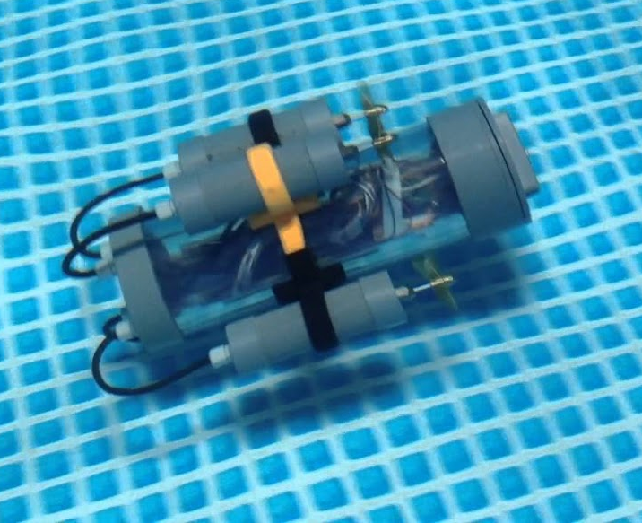
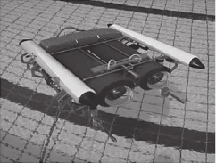
AUVs vs ROVs
AUVs are controlled automatically by onboard computer systems and can work independently without requiring to be connected to the surface.
ROVs are controlled or remotely controlled by human operator from a cable or wireless communication on ship or on the ground.

Slide 4
Factors affecting a UUV’s Design
Buoyancy
Hydrodynamic Damping
Stability
Coriolis
Added Mass
Environmental Forces
Pressure

Slide 5
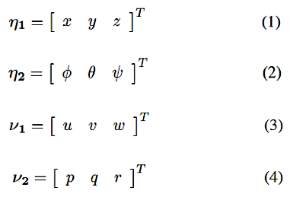
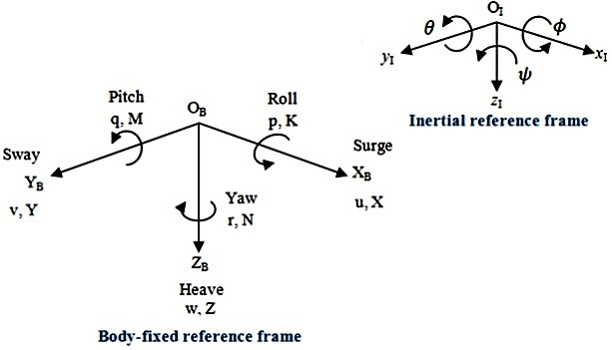

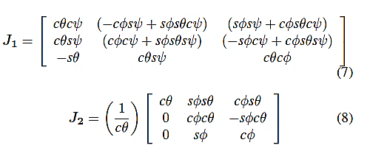
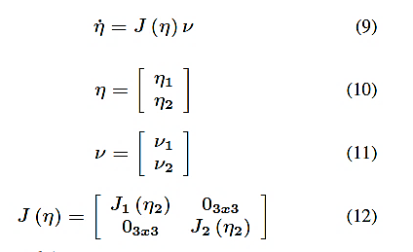
Kinematic Model

Slide 6
Dynamic Model

Slide 7
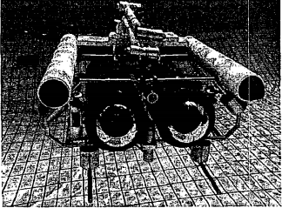
Case Study: RRC ROV
RRC ROV I:
Designed by NTU.
Used to perform underwater pipeline inspections such as locating pipe leakages or cracks.
Accomplished with the operator focusing on inspection while ROV automatically tracks the pipeline.
RRC ROV II:
Has better intelligent control and more data collection.
Slightly larger in size.
Has an immersive 3-D graphical display and control assistance subsystems which give a simulated environment for the pilot.

Slide 8
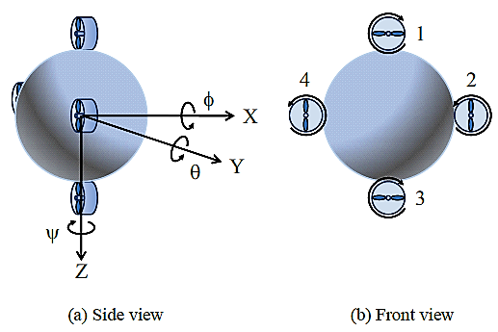
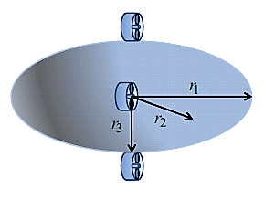
Case Study: X4 AUV
Former X4-AUV: Spherical hull in shape
Studied by Okamura
Only 4 thrusters used to control the vehicle
Has nonholonomic features
Modified X4-AUV: Ellipsoidal in shape
Known to minimize the drag forces

Slide 9
Critical Observations

Slide 10
Conclusion and Learning Outcomes

