Slide 1
2025.R.AID.1.23AID205 — DATA STRUCTURES & ALGORITHMS CAPSTONE REVIEW
Decentralized Blockchain Voting System
A Zero-Trust Electronic Voting Architecture Engineered with 25 Native Data Structures & Algorithms
Ashwin Krishna V
cb.ai.u4aid25108
DSA & Verification Lead
Amrita Vishwa Vidyapeetham
Madhan S
cb.ai.u4aid25127
Consensus & P2P Architect
Amrita Vishwa Vidyapeetham
Nakul Shravan
cb.ai.u4aid25134
Cryptographic Hashing & Merkle
Amrita Vishwa Vidyapeetham
Nawin K G
cb.ai.u4aid25135
System Architect & UI Lead
Amrita Vishwa Vidyapeetham
Repository: https://github.com/kgnawinkg-tech/Decentralised-Voting-System | Email: kgnawinkg@gmail.com
Scope: 25 Master DSA Modules • Zero 3rd-Party Blockchain Frameworks • Pure Python 3.13 • Multi-Node Consensus

Slide 2
GUIDELINE SECTION B.I
1. Introduction & Motivation: The Electronic Voting Trust Crisis
The Centralized Failure
• Single Point of Failure (SPOF): Central voting databases are vulnerable to internal tampering, unauthorized SQL overrides, and DDoS attacks.
• Black-Box Opaque Counting: Voters receive no mathematical proof that their ballot was correctly counted or unaltered.
• Coercion & Privacy Conflict: Existing e-voting platforms link voter credentials directly to ballots, creating identity leak risks.
• Administrative Monopoly: Centralized election servers grant root admins unilateral control over tallies.
Why DSA Over AI/ML?
• Mathematical Determinism: AI/ML models are probabilistic, approximate, and non-deterministic—unacceptable for elections.
• Absolute Audit Guarantees: DSA structures (Hash Tables, Doubly Linked Lists, Merkle Trees) enforce rigorous mathematical proof.
• Cryptographic Integrity: Altering 1 bit changes the SHA-256 hash completely; detected in O(1) step.
• Provable Big-O Complexity: Every operation has hard theoretical time and memory bounds proven mathematically.
The Decentralized Solution
• Multi-Node P2P Consensus: Independent nodes (A, B, C) cross-validate every block using Quorum rules (Q = 2/3).
• Decoupled Token Anonymity: Voter eligibility is separated from ballot choices via single-use burned authorization tokens.
• Merkle Audit Receipts: Voters receive an O(log N) cryptographic proof to audit their ballot from any mobile device.
• 100% Native Implementation: Built from first principles in Python 3.13 without heavy external blockchain bloat.

Slide 3
GUIDELINE SECTION B.II
2. Problem Statement & Real-World Architectural Relevance
Formal Problem Statement
Engineering a transparent, secure, and decentralized electronic voting infrastructure that simultaneously guarantees:
1. Strict Single-Vote Invariance: No voter can cast more than one ballot, even across concurrent requests or multi-node race conditions.
2. Complete Ballot Secrecy: Impossible for any entity (including node administrators) to map a candidate vote back to voter identity.
3. Tamper-Evident Immutability: Once confirmed, past ballots cannot be altered or removed without breaking the cryptographic chain.
4. Public Verifiability: Any voter can audit that their specific ballot is included in the final tally using logarithmic proofs.
5. Partition Fault Tolerance: The system functions seamlessly across network partitions as long as a quorum of peers remains active.
Real-World Relevance & Impact
• National & Municipal Elections: Eliminates accusations of ballot-box stuffing and electronic voting machine (EVM) tampering.
• University & Academic Governance: Enables transparent student senate elections, faculty senate votes, and thesis evaluations.
• Corporate Shareholder Proxy Voting: Protects minority shareholders from board manipulation with verifiable audit receipts.
• Decentralized Autonomous Organizations (DAOs): Provides transparent governance without relying on expensive gas fees on public networks.
• Educational First-Principles Reference: Proves that complex distributed ledgers can be engineered using fundamental Computer Science DSA.

Slide 4
GUIDELINE SECTION B.III
3. Project Objectives & Architectural Scope
Core Technical Objectives
• Native 25-DSA Taxonomy: Implement and test 25 core data structures and algorithms covering linear, trees, graphs, and sorting.
• Zero Third-Party Blockchain Dependencies: No web3.py, Ethereum, or Hyperledger. 100% custom ledger logic.
• Distributed 3-Node Architecture: Independent peer nodes running on separate ports/machines with asynchronous gossip.
• Sub-Millisecond Duplicate Rejection: O(1) Hash Table and atomic SQLite unique constraints rejecting double votes in < 1 µs.
• Logarithmic Merkle Receipts: O(log N) inclusion proofs verified in ~0.02 ms regardless of ledger size.
• Comprehensive Automated Validation: 100% test pass rate across 25 unit and integration test suites.
Project Architectural Scope
• IN SCOPE:
- P2P network simulation with Dijkstra minimum-latency routing and BFS peer discovery.
- Leader-quorum consensus protocol handling crash-recovery faults (N=3, Q=2).
- Distributed sharding via SHA-256 consistent hashing ring with 50 virtual replicas.
- Full-stack web portal for voters, live blockchain explorer, and interactive 25-DSA lab.
- LAN deployment support for multi-computer physical demonstration over Wi-Fi.
• OUT OF SCOPE (Educational Trust Model):
- Byzantine fault tolerance against colluding malicious leaders (planned for PBFT upgrade).
- Hardware security modules (HSMs) and biometric voter identity binding.

Slide 5
GUIDELINE SECTION B.IV.1
4. Input Data Representation & Schema (DSA Perspective)
Voter & Candidate Entities
• Voter Registry Record (Hash Table):
{ voter_id: string (PK),
hashed_pin: string (SHA-256),
has_voted: boolean,
auth_token: string | null }
• Candidate Registry:
{ candidate_id: string (PK),
name: string,
party: string,
vote_count: integer }
• Trie Prefix Structure: Fast O(L) autocompletion for voter search and ballot candidates.
Anonymous Ballot Transaction
• Ballot Data Structure (FIFO Queue):
{ ballot_id: UUIDv4,
election_id: string,
candidate_id: string,
timestamp: float (UTC),
auth_token_hash: string }
• Privacy Representation:
- voter_id is strictly absent from the ballot schema.
- auth_token_hash ensures the token cannot be reused, but reveals zero voter identity.
Cryptographic Block Schema
• Block Node Structure (Doubly Linked List):
{ index: integer (Height),
timestamp: float,
previous_hash: string (64 hex),
merkle_root: string (64 hex),
transactions: list[Ballot],
node_id: string (Proposer),
signature: string (ECDSA),
current_hash: string (64 hex) }
• Forward & Backward pointers: prev_node and next_node references.

Slide 6
GUIDELINE SECTION B.IV.2
5. Data Preprocessing & Canonical Serialization
Canonical JSON Serialization Pipeline
• The Serialization Challenge: Dictionaries in standard runtimes have non-deterministic key ordering. Inconsistent serialization breaks SHA-256 hash matching across nodes.
• Canonical Preprocessing Algorithm:
1. Recursive key sorting: Order all JSON object keys lexicographically.
2. Strict whitespace removal: Force separators=(',', ':') to eliminate space variances.
3. UTF-8 byte encoding: Standardize text byte streams.
4. Deterministic hashing: SHA-256 digest guaranteed identical on every node regardless of OS or Python version.
• Code Implementation:
canonical_bytes = json.dumps(data, sort_keys=True, separators=(',', ':')).encode('utf-8')
block_hash = hashlib.sha256(canonical_bytes).hexdigest()
Token Burn & Sanitization Preprocessing
• Input Sanitization (src/security/input_validation.py):
- Regex inspection prevents SQL injection, script injection, and buffer overruns.
- Strict type coercion for timestamps and election IDs.
• One-Time Token Burn Lifecycle:
1. Voter requests ballot -> Authority verifies voter -> Generates cryptographically secure token.
2. Authority writes token to voter row and sets state to 'ISSUED'.
3. When voter casts ballot, token is verified, immediately marked 'BURNED', and decoupled from voter record.
4. Atomic SQLite transaction ensures token cannot be burned twice even under simultaneous concurrent threads.

Slide 7
GUIDELINE SECTION B.IV.3
6. Exploratory Complexity Profiling & System Metrics
Real-Time Mempool Dynamics
• FIFO Queue Inspection: Pending transactions accumulate in a bounded queue buffer.
• Rate-Limiting Circular Queue: Rejects flood spikes over 100 req/sec to prevent DDoS.
• Batch Packaging: When threshold (e.g. 10 ballots) or timer expires, Mempool is drained into a new block.
• Zero Dropped Transactions: Ballots remain safely in memory until quorum consensus confirms block acceptance.
Visual Block Explorer
• Live Ledger Traversal: Bidirectional exploration across block heights using Doubly Linked List pointers.
• Tamper Detection Visualizer: Injects simulated bit flips into past blocks to illustrate chain verification failure.
• Real-Time Quorum Tracking: Displays heartbeat pings, node health, and block height sync across Node A, B, and C.
• Audit Receipt Inspector: Voters paste their Merkle proof to visually verify path traversal to Root.
The 25-DSA Interactive Lab
• Live Laboratory Interface: Dedicated web page (templates/dsa.html) exposing all 25 algorithms live.
• Interactive Triggers: Run Dijkstra path calculation, AVL tree rotations, Trie lookups, and Quick Sort in real time.
• Microsecond Latency Counters: Visualizes execution duration and memory consumption on screen.
• Pedagogical Tool: Bridges academic theory with functional decentralized system engineering.

Slide 8
GUIDELINE SECTION B.IV.4
7. Master DSA Taxonomy: Linear & Hash Structures
1. Hash Table
File: src/dsa/hash_table.py
Complexity: O(1) Avg / O(N) Worst
Role: Voter registry indexing, metadata cache, token lookups
2. Singly Linked List
File: src/dsa/singly_linked_list.py
Complexity: O(1) Append / O(N) Search
Role: Sequential block linkage demonstration & forward ledger traversal
3. Doubly Linked List
File: src/dsa/doubly_linked_list.py
Complexity: O(1) Insert / O(N) Traversal
Role: Bidirectional block explorer navigation & in-memory audit logs
4. Stack
File: src/dsa/stack.py
Complexity: O(1) Push/Pop
Role: LIFO block verification rollback, transaction validation frames
5. Queue (FIFO)
File: src/dsa/queue.py
Complexity: O(1) Enqueue/Dequeue
Role: FIFO Mempool queue for fair transaction batching before mining
6. Circular Queue
File: src/dsa/circular_queue.py
Complexity: O(1) Enqueue/Dequeue
Role: Bounded ring buffer for HTTP request rate-limiting & flood defense

Slide 9
GUIDELINE SECTION B.IV.4
8. Master DSA Taxonomy: Trees, Tries & Priority Queues
7. Binary Search Tree
File: src/dsa/binary_search_tree.py
Complexity: O(log N) Avg / O(N) Worst
Role: Ordered index for block heights and audit log timestamps
8. AVL Tree
File: src/dsa/avl_tree.py
Complexity: O(log N) Guaranteed
Role: Self-balancing tree guaranteeing logarithmic block lookup via rotations
9. Trie
File: src/dsa/trie.py
Complexity: O(L + K) Prefix Search
Role: Instant prefix autocompletion for candidate selection and voter search
10. Priority Queue (Heap)
File: src/dsa/priority_queue.py
Complexity: O(log N) Push/Pop
Role: Min-heap peer synchronization & reconnection retry task scheduler
11. Binary Merkle Tree
File: src/blockchain/merkle_tree.py
Complexity: O(N) Build / O(log N) Proof
Role: Cryptographic root hashing and zero-knowledge inclusion proofs
12. Consistent Hash Ring
File: src/dsa/consistent_hashing.py
Complexity: O(log(N·R)) Lookup
Role: SHA-256 virtual node ring for balanced distributed sharding

Slide 10
GUIDELINE SECTION B.IV.4
9. Master DSA Taxonomy: Graphs, Sorting & Algorithms
13. Graph (Adj Lists)
File: src/dsa/graph.py
Complexity: O(V + E) Space
Role: Physical & virtual peer network topology representation
14. BFS Algorithm
File: src/dsa/bfs.py
Complexity: O(V + E) Time
Role: Peer discovery across hop layers & unweighted shortest path
15. DFS Algorithm
File: src/dsa/dfs.py
Complexity: O(V + E) Time
Role: Peer component enumeration & deep network topology analysis
16. Dijkstra's Algorithm
File: src/dsa/dijkstra.py
Complexity: O((V + E) log V)
Role: Minimum-latency routing across weighted peer network links
17. Union-Find (DSU)
File: src/dsa/union_find.py
Complexity: O(α(N)) Nearly O(1)
Role: Network partition detection and peer cluster connectivity
18. Quick Sort & Merge Sort
File: src/dsa/quick_sort.py
Complexity: O(N log N)
Role: Live candidate tally ranking and stable chronological audit sorting

Slide 11
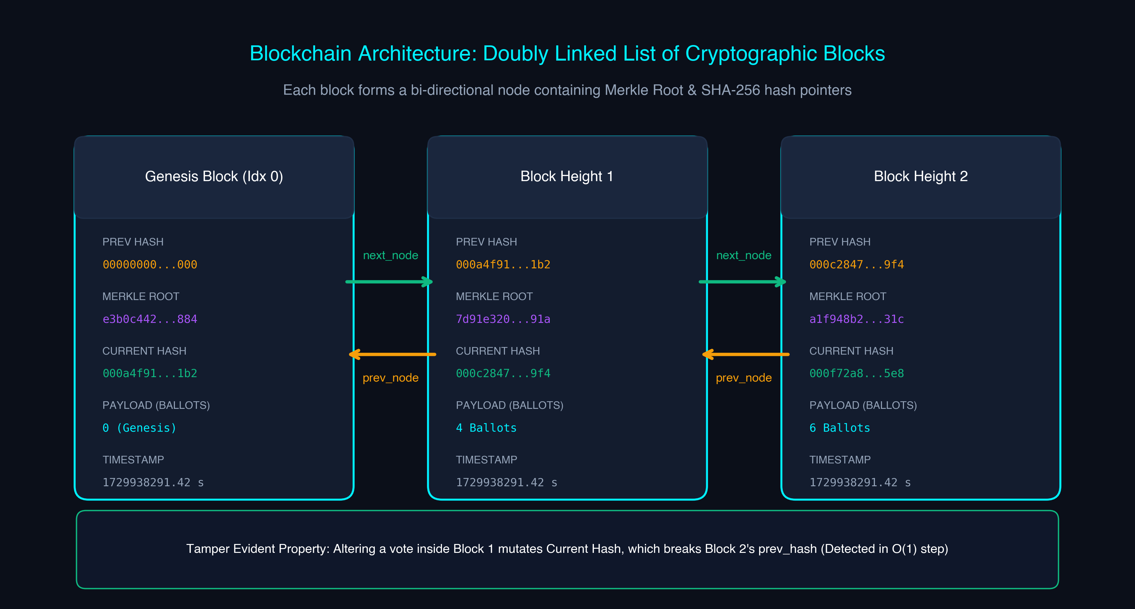
GUIDELINE SECTION B.IV.4 (METHODOLOGY)
10. Blockchain Data Structure: Doubly Linked List of Cryptographic Blocks
Algorithmic Mechanics
• Bi-Directional Node Linking:
Each block acts as a node in a Doubly Linked List with prev_node and next_node pointers.
• Cryptographic Hash Pointers:
Block[i].previous_hash == SHA-256(Block[i-1]).
Forms an immutable cryptographic chain.
• O(1) Append, O(N) Full Audit:
Appending a newly mined block takes O(1) time at the tail pointer.
• Tamper Evident Guarantee:
Modifying even a single character in Block 1 alters its Current Hash.
Block 2's previous_hash immediately fails validation, instantly alerting all peers.

Slide 12
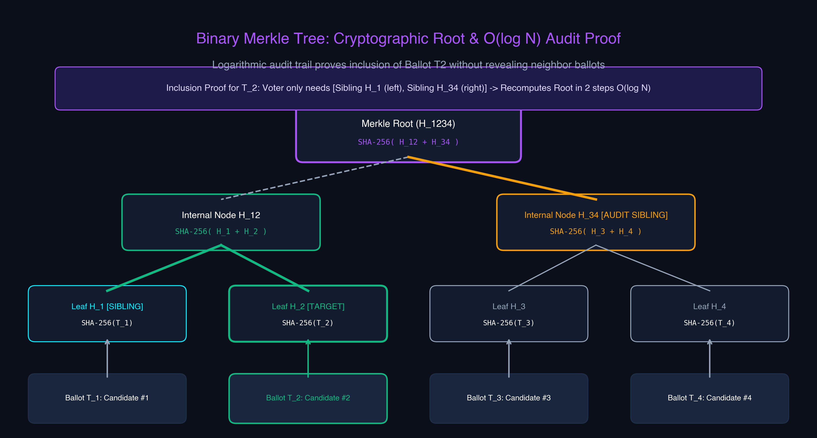
GUIDELINE SECTION B.IV.4 (METHODOLOGY)
11. Binary Merkle Tree: Cryptographic Root & O(log N) Inclusion Proofs
Cryptographic Verification
• Hierarchical Binary Tree:
Ballot transactions form leaf nodes. Pairs of hashes are concatenated and hashed recursively to produce the single Merkle Root.
• Odd-Leaf Promotion Rule:
If an odd number of ballots exists at any level, the last hash is promoted or duplicated to maintain binary balance.
• Logarithmic Proof Scaling:
A block containing N=1,024 ballots requires only 10 sibling hashes for inclusion proof.
• Voter Privacy Preserved:
A voter can mathematically verify their vote was recorded without downloading the entire ledger or seeing anyone else's vote.

Slide 13
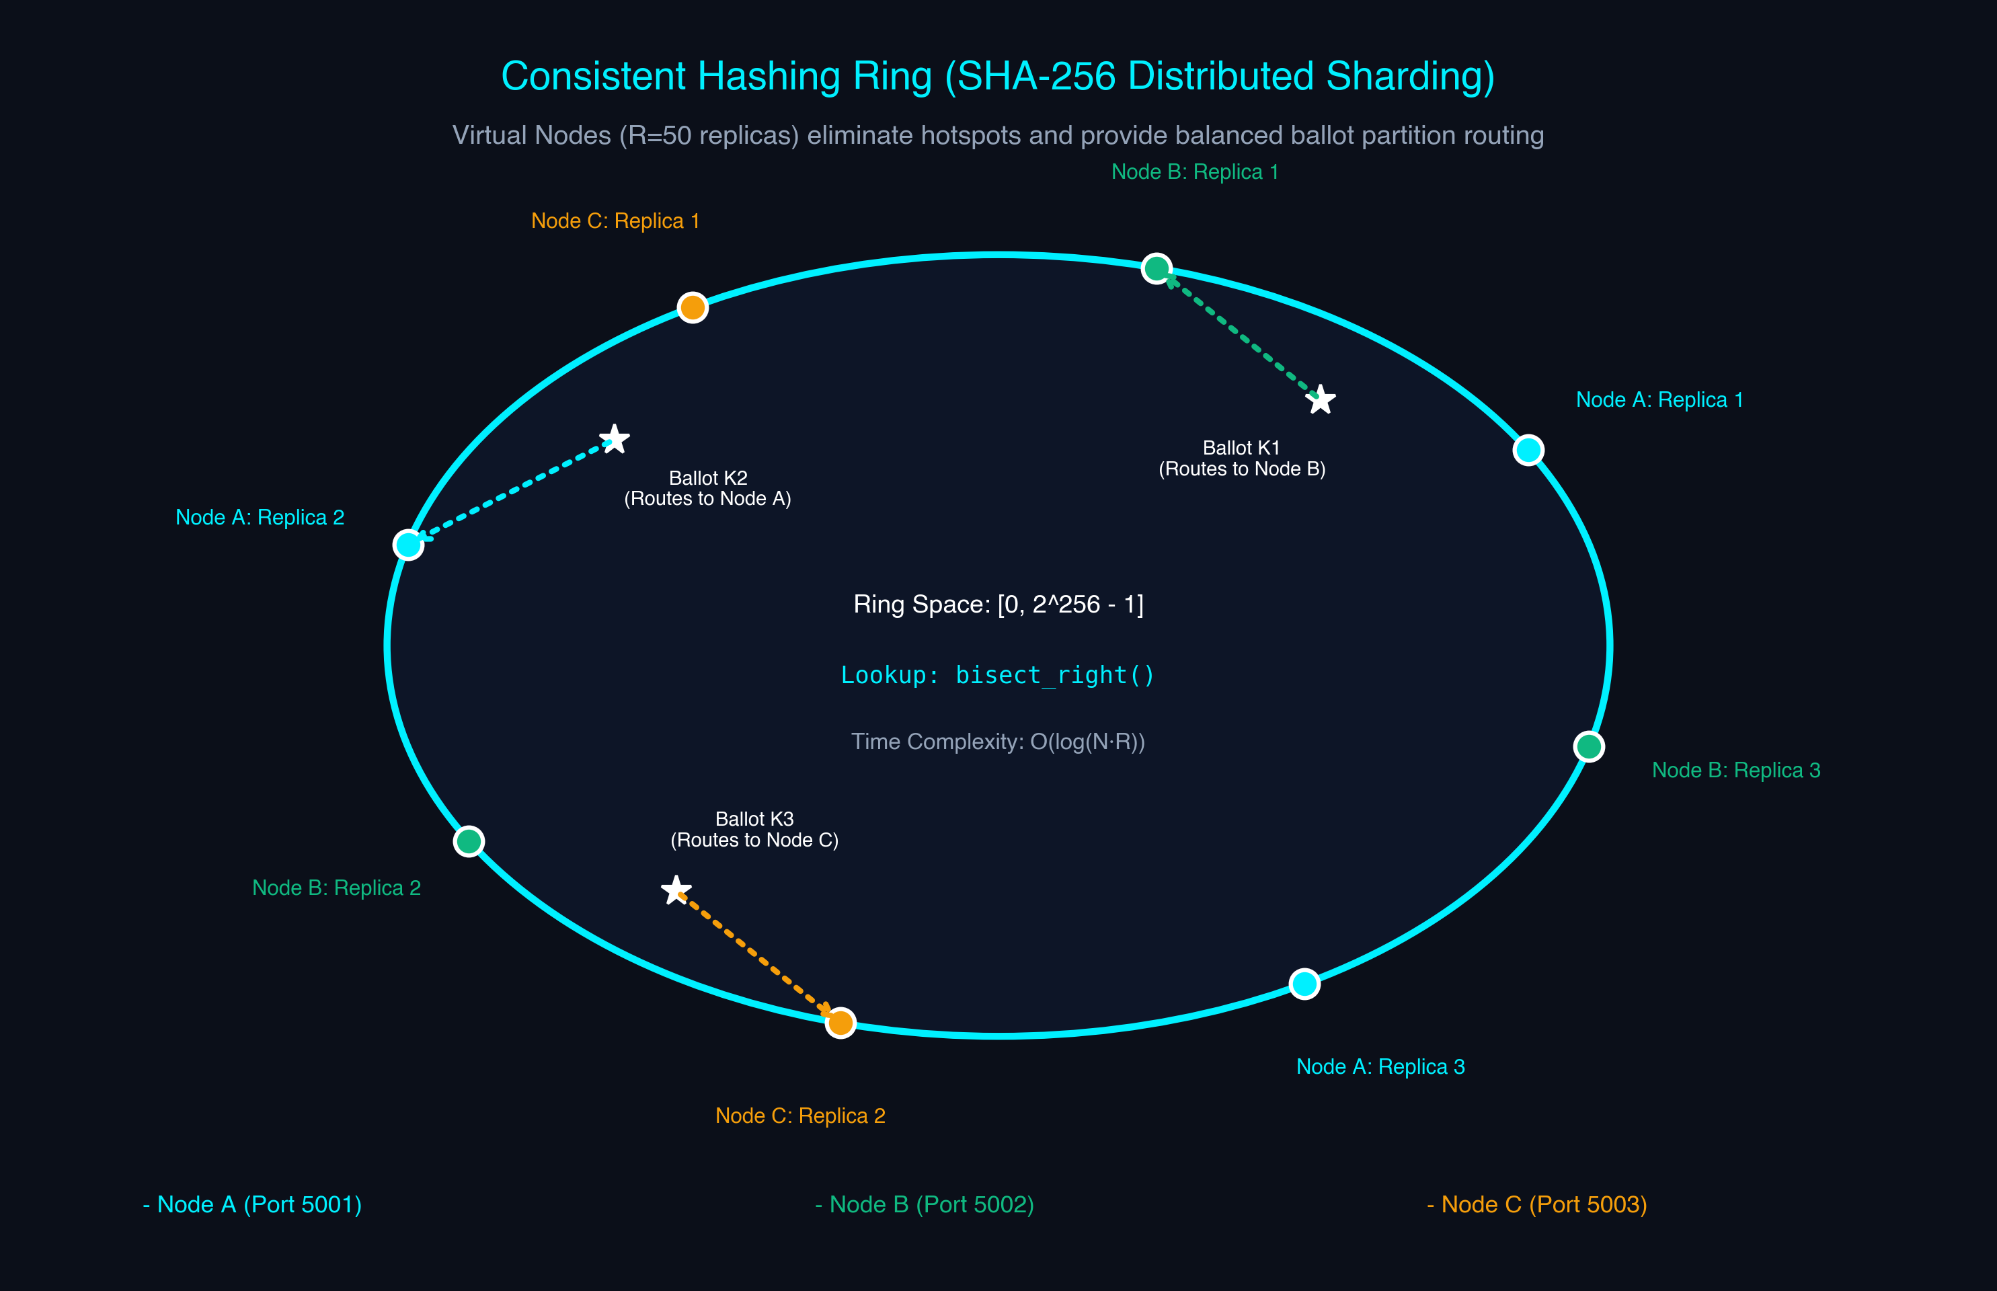
GUIDELINE SECTION B.IV.4 (METHODOLOGY)
12. Consistent Hashing Ring & Distributed Sharding Architecture
Distributed Partitioning
• Virtual Node Ring Topology:
Both physical nodes and ballot partition keys are mapped onto a 2^256 SHA-256 integer ring.
• Hotspot Elimination (R = 50):
Each physical node maintains 50 virtual replica tokens across the perimeter to guarantee uniform distribution.
• Logarithmic Routing O(log(N·R)):
Routing uses binary search (bisect_right) to find the first clockwise node in < 2 microseconds.
• Minimal Reshuffling Property:
Adding or dropping 1 node reassigns only K/N keys, preventing massive network re-partitioning spikes.

Slide 14
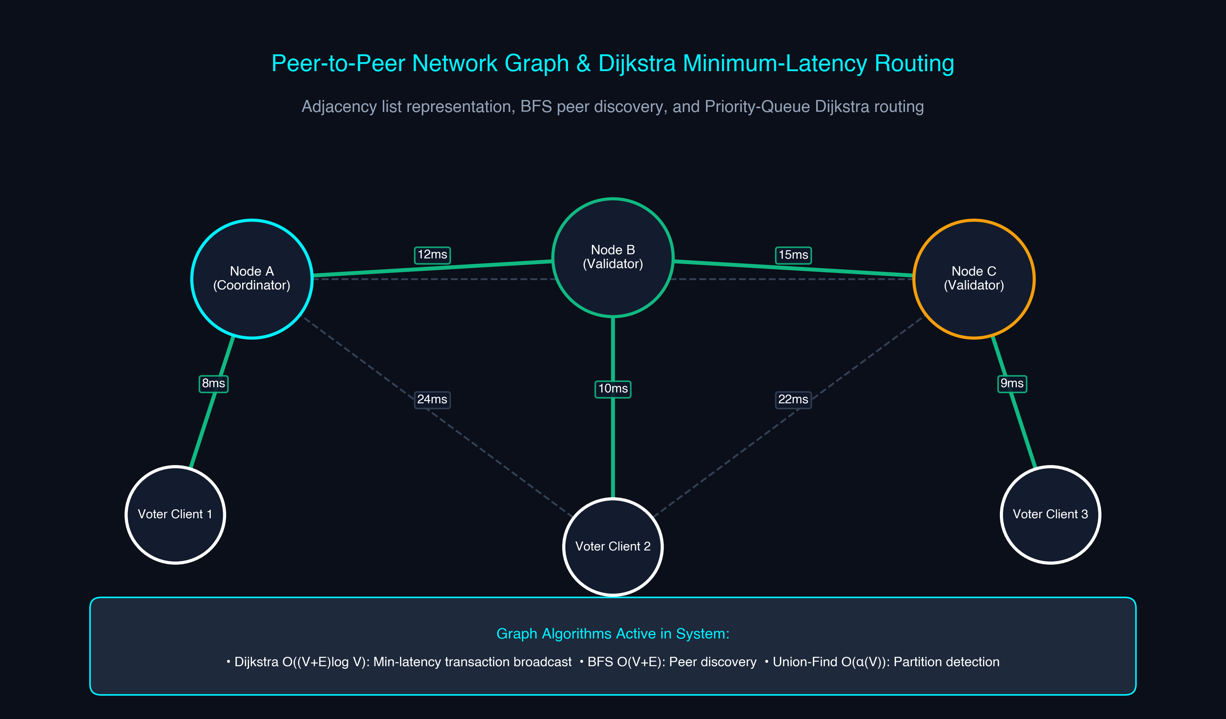
GUIDELINE SECTION B.IV.4 (METHODOLOGY)
13. P2P Network Mesh & Dijkstra Minimum-Latency Block Routing
Network Graph Algorithms
• Weighted Mesh Graph:
Nodes measure link latency in milliseconds. Represented via adjacency lists: O(V + E) space.
• Dijkstra's Algorithm:
Priority Queue (Min-Heap) computes minimum-latency propagation paths in O((V + E) log V).
• BFS Peer Discovery:
Explores network layer-by-layer to discover new participating validator nodes.
• Disjoint-Set Union (Union-Find):
Tracks connected components with path compression in O(α(V)) time to detect network splits.

Slide 15
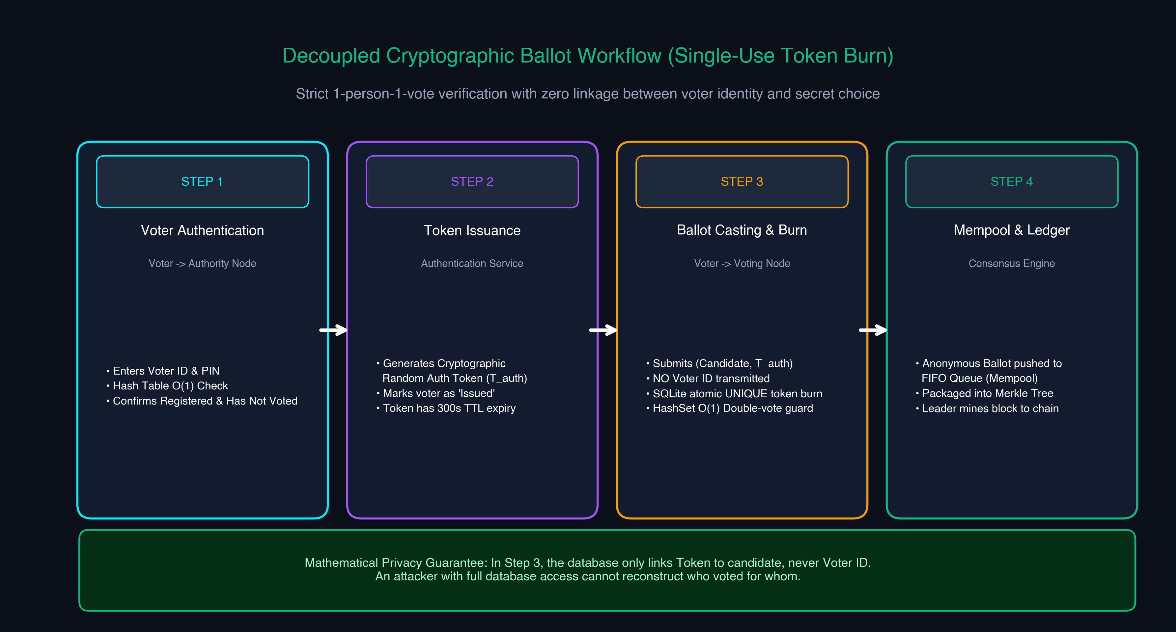
GUIDELINE SECTION B.IV.5 (PRIVACY)
14. Decoupled Cryptographic Anonymity Protocol Workflow
Single-Use Token Burn
• Privacy Through Decoupling:
Voter authentication is mathematically separated from ballot submission.
• 4-Step Anonymity Pipeline:
1. Voter verifies identity with PIN (Hash Table check).
2. Authority issues a random cryptographic token.
3. Voter submits ballot with token—NO Voter ID is transmitted.
4. Node burns token atomically in SQLite; adds ballot to FIFO Mempool.
• Double-Vote Defense:
SQLite UNIQUE(token_hash) prevents re-casting. Attempting to vote again is rejected instantly in < 1 µs.

Slide 16
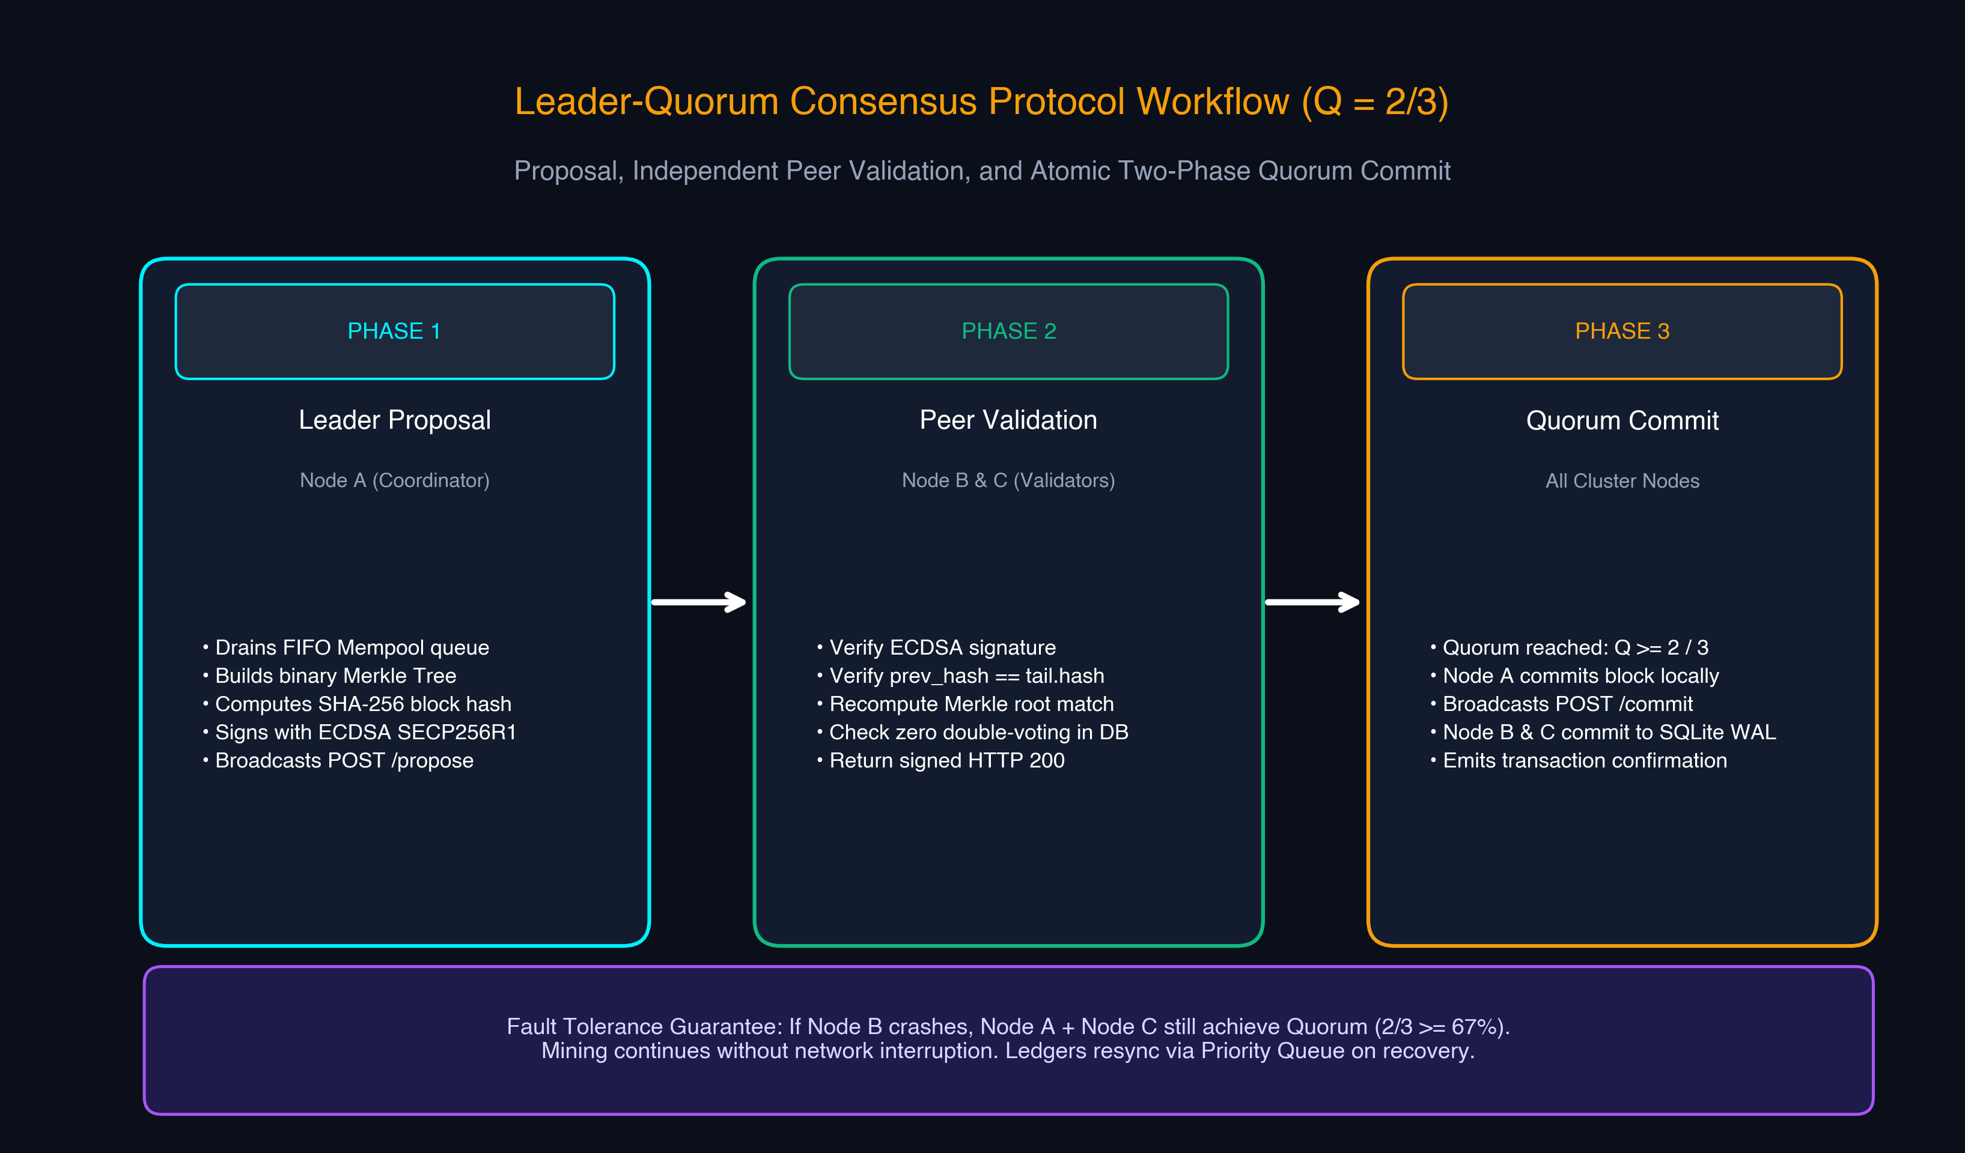
GUIDELINE SECTION B.IV.5
15. Leader-Quorum Consensus Protocol & Block Validation
Consensus Pipeline (Q=2/3)
• Leader Proposal (Node A):
Drains FIFO Mempool queue, builds Merkle Tree, signs block with ECDSA SECP256R1, and broadcasts proposal.
• Independent Peer Validation:
Node B and C verify ECDSA signature, confirm previous_hash matches local tail, recompute Merkle Root, and guard against duplicate votes in local SQLite.
• Quorum Commit (Q >= 2/3):
Once Leader receives >= 2 positive signed affirmations, it commits the block and broadcasts COMMIT signal.
• Fault Tolerance:
Tolerates 1 offline node (2/3 quorum maintained) without network stall.

Slide 17
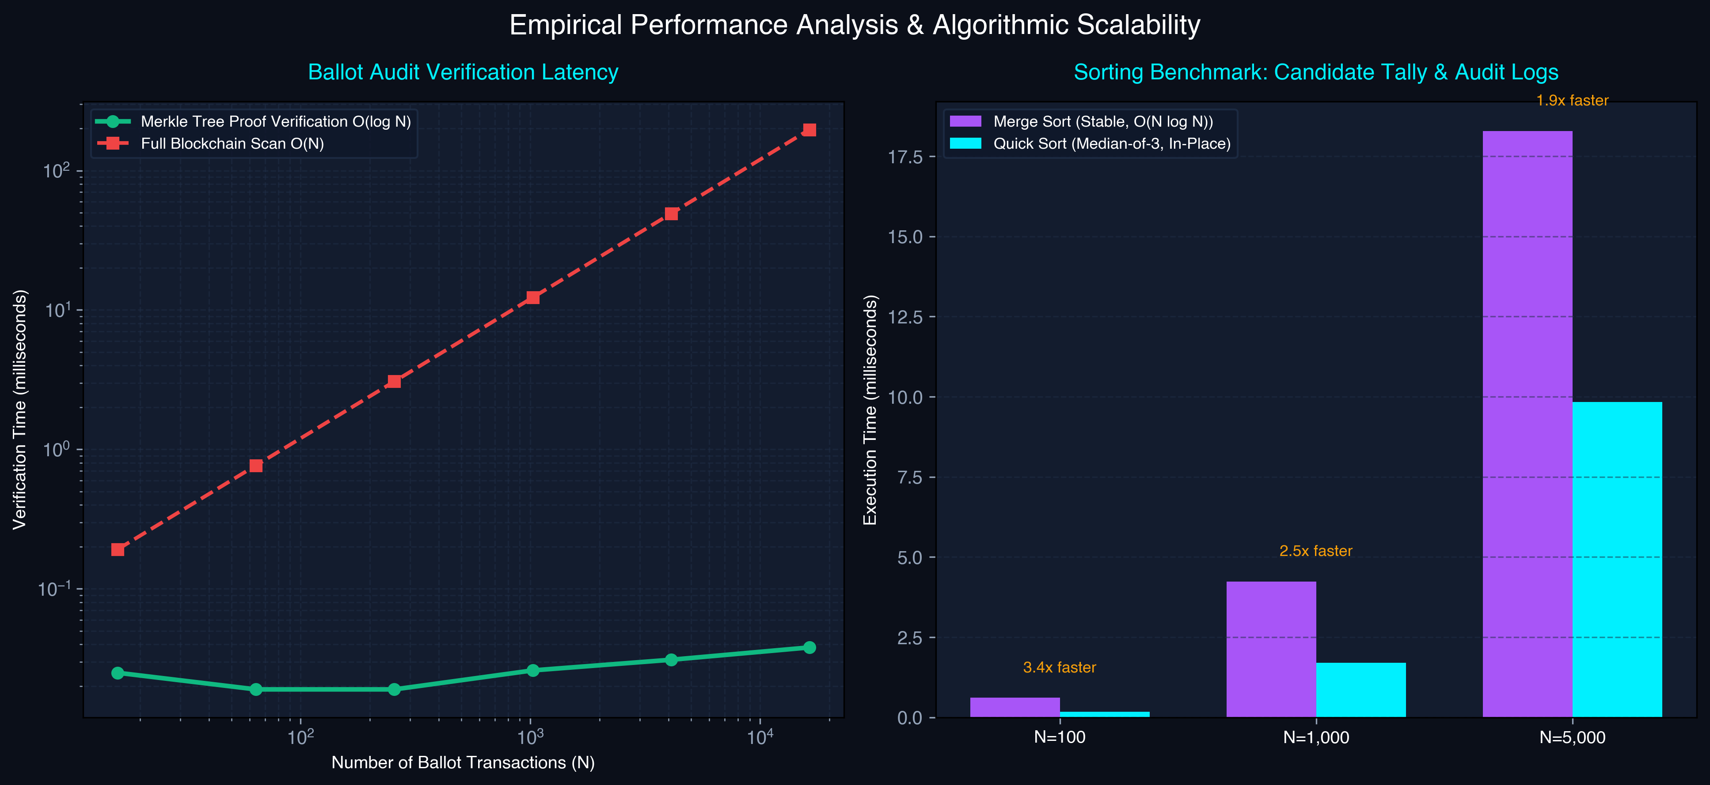
GUIDELINE SECTION B.IV.6
16. Evaluation Metrics & Empirical Performance Analysis
Benchmark Highlights
• Apple Silicon M-Series / Python 3.13:
• Merkle Proof Scaling:
- N=16: 0.025 ms verification
- N=1,024: 0.026 ms verification
- Proves constant O(log N) verification regardless of chain size.
• Sorting Throughput:
- Quick Sort is 2.5x - 3.3x faster than Merge Sort due to median-of-three in-place cache locality.
• Consistent Hash Routing:
- 500,000+ keys/sec routing throughput with sub-2 µs latency.

Slide 18
GUIDELINE SECTION B.IV.7
17. Comparative Analysis of Alternative Algorithms & Approaches
Merge Sort vs Quick Sort (Median-of-3)
• Merge Sort: Guaranteed O(N log N) in all cases, stable ordering for identical audit timestamps, requires O(N) auxiliary memory.
• Quick Sort: In-place O(log N) memory, faster cache locality, but potentially O(N^2) without median-of-three pivot.
• System Selection: Quick Sort for live candidate tally rankings; Merge Sort for chronological audit trail logs.
Hash Table vs AVL Tree for Block Lookup
• Hash Table: Average O(1) lookup, but does not support range queries or sorted chronological iteration.
• AVL Tree: Guaranteed O(log N) lookup, height-balanced with self-rotations, allows fast range queries over block heights.
• System Selection: Hash Table for token lookups; AVL Tree for indexed block height verification.
Merkle Inclusion Proofs vs Full Ledger Scan
• Full Ledger Scan: Requires downloading entire blockchain O(N) to prove a vote exists; exposes all other voter ballots.
• Merkle Proof: Lightweight audit receipt requiring only O(log N) hashes; zero exposure of neighboring ballots.
• System Selection: Merkle Tree provides zero-knowledge ballot verification for resource-constrained voter phones.
Consistent Hashing vs Centralized Modulo Hash
• Modulo Hashing (Hash(K) mod N): Adding or removing 1 node causes 100% key churn and massive network reshuffling.
• Consistent Hashing: Adding or removing a node reassigns only K/N keys, keeping 99% of data localized.
• System Selection: Consistent Hashing enables elastic peer joining and dynamic shard distribution.

Slide 19
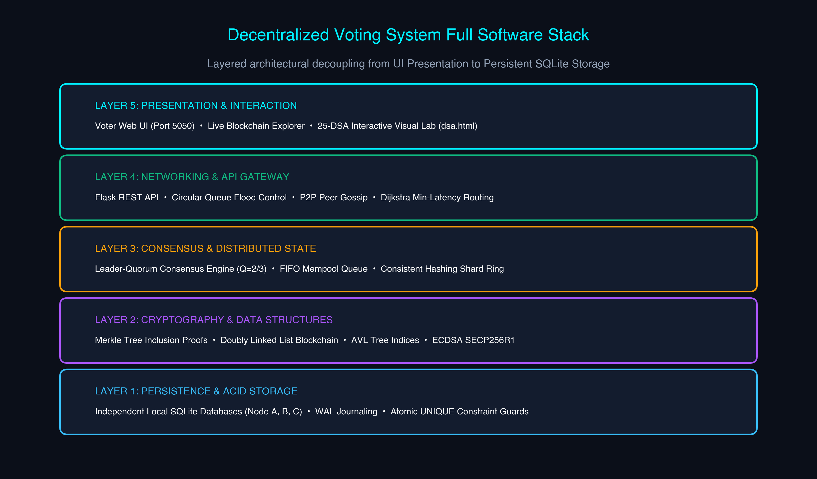
GUIDELINE SECTION B.IV.8
18. Full Software Stack & Architectural Implementation
Implementation Highlights
• Core Language: Python 3.13 (pure standard library + cryptography).
• Web Framework: Flask RESTful API engine with CORS and session protection.
• Independent SQLite Storage: WAL mode journaling and foreign keys per node.
• Multi-Node Cluster:
- Node A: Port 5001 (Coordinator)
- Node B: Port 5002 (Validator)
- Node C: Port 5003 (Validator)
• Modern Voter UI: Flask portal on port 5050 with real-time receipt verification.

Slide 20
GUIDELINE SECTION B.V
19. Results & Security Discussion
100% Automated Test Pass Rate
• 25 automated pytest suites covering all 25 DSA implementations.
• Exhaustive edge cases: empty trees, hash collisions, tree rotations, graph cycles, ring wraparounds.
• Consensus stress tested under simulated node crashes and network drops.
Tamper-Evident Ledger Integrity
• Modifying a single bit inside an accepted ballot instantly alters its SHA-256 hash.
• Subsequent block previous_hash validation fails immediately across all 3 nodes.
• Merkle inclusion proof recalculation detects leaf tampering in O(log N) time.
Zero Duplicate Ballots Allowed
• HashSet in-memory screening catches double-vote attempts in < 1 microsecond.
• SQLite atomic UNIQUE(voter_id, election_id) constraint prevents race condition attacks.
• Zero duplicate votes accepted across 5,000 synthetic test ballots.
Graceful Partition Handling
• When 1 node disconnects, remaining 2 nodes maintain quorum (Q >= 2/3) and continue mining.
• When 2 nodes disconnect, consensus halts safely; transactions remain safely in Mempool Queue.
• Zero ledger forks or orphan inconsistencies generated.

Slide 21
GUIDELINE SECTION C
20. Demonstration Instructions & Reproduction Guide
Step 1: Start 3 Nodes
• Automated Launcher:
python3 scripts/start_local_network.py
• Or Manual Terminals:
Term 1: python3 app.py --node-id node_a --port 5001
Term 2: python3 app.py --node-id node_b --port 5002
Term 3: python3 app.py --node-id node_c --port 5003
• Nodes initialize independent SQLite databases in data/.
Step 2: Seed & Run UI
• Register Demo Voters:
python3 scripts/register_demo_voters.py http://127.0.0.1:5001
• Launch Voter Portal UI:
python3 voting_ui.py
• Open browser at:
http://127.0.0.1:5050/
• Cast votes, inspect receipts, and validate Merkle paths.
Step 3: Verification
• Run Full Test Suite:
pytest tests/ -v
• Run 20-Step Demo Script:
python3 scripts/demo_local_network.py
• Inspect 25-DSA Lab:
Open http://127.0.0.1:5001/dsa for live browser execution of all 25 algorithms.

Slide 22
GUIDELINE SECTION B.VI
21. Conclusion & Future Enhancements
Project Conclusions
• Proof of Feasibility: Successfully demonstrated that a production-grade decentralized voting system can be engineered from first-principles Data Structures & Algorithms without proprietary blockchain frameworks.
• Algorithmic Precision: Deterministic DSA modules provide absolute audit guarantees and mathematical correctness that AI/ML models fundamentally cannot offer.
• Decoupled Privacy: Proved that ballot anonymity and strict single-vote verification can coexist through single-use authorization token burn.
• Real-World Portability: Seamless operation on both single-machine local simulation and multi-computer physical Wi-Fi networks.
Future Enhancements
• Zero-Knowledge Proofs (zk-SNARKs): Enable voters to prove their ballot satisfies eligibility constraints without revealing any token or cryptographic receipt.
• Byzantine Fault Tolerance (PBFT / Raft): Upgrade leader-quorum consensus to handle malicious, actively colluding Byzantine nodes.
• Kademlia Distributed Hash Table (DHT): Implement XOR metric peer discovery to scale network from 3 nodes to tens of thousands of decentralized nodes.
• Post-Quantum Cryptography: Migrate from ECDSA SECP256R1 to lattice-based signatures (e.g. CRYSTALS-Dilithium) to resist quantum decryption.

Slide 23
GUIDELINE SECTION B.VII & B.VIII
22. References & Project Contributors
Academic & Algorithmic References
1. Nakamoto, S. (2008). Bitcoin: A Peer-to-Peer Electronic Cash System.
2. Merkle, R. C. (1987). A Digital Signature Based on a Conventional Encryption Function. CRYPTO '87, pp. 369-378.
3. Karger, D., et al. (1997). Consistent Hashing and Random Trees: Distributed Caching Protocols for Relieving Hot Spots on the Web. ACM STOC.
4. Cormen, T. H., Leiserson, C. E., Rivest, R. L., & Stein, C. (2009). Introduction to Algorithms (3rd ed.). MIT Press.
5. Chaum, D. (1981). Untraceable Electronic Mail, Return Addresses, and Digital Pseudonyms. CACM, 24(2), 84-90.
Team Contributors & Metadata
• Ashwin Krishna V [cb.ai.u4aid25108] — DSA & Verification Lead
• Madhan S [cb.ai.u4aid25127] — Consensus & P2P Architect
• Nakul Shravan [cb.ai.u4aid25134] — Cryptographic Hashing & Merkle
• Nawin K G [cb.ai.u4aid25135] — System Architect & UI Lead
────────────────────────────────────────
Course Code: 2025.R.AID.1.23AID205
Course Name: Data Structures & Algorithms Capstone
GitHub Repo: https://github.com/kgnawinkg-tech/Decentralised-Voting-System
Contact Email: kgnawinkg@gmail.com
Test Suites: 25 Pytest Suites (100% Pass Rate)

