Slide 1
An introduction to Go
Kevin Golding

Slide 2
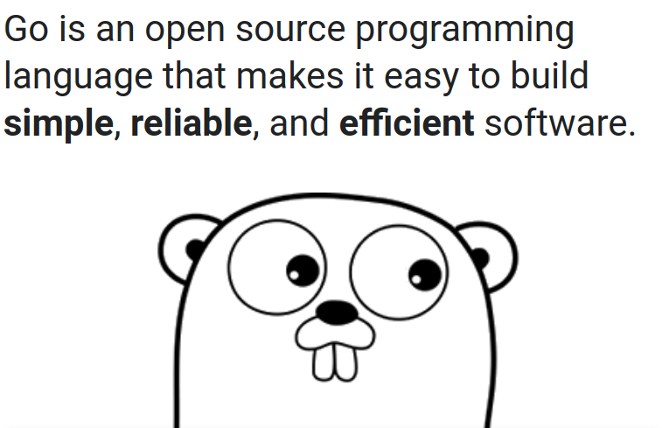
What is Go?
Notes:
Designed at Google, similar to C but with:
Memory safety
Garbage collection
Goroutines
It statically compiles binaries, so no need for libraries aka DLL’s although you can use third party libs if you want too.

Slide 3
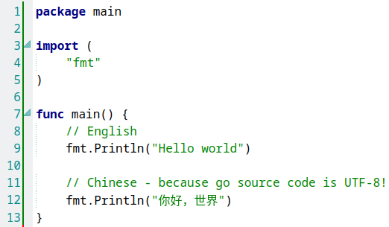
Hello World!
$ go run 01-HelloWorld.go
Hello world
你好，世界
https://github.com/kgolding/present-go-intro
01-HelloWorld.go

Slide 4
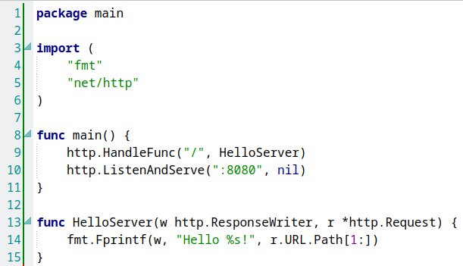
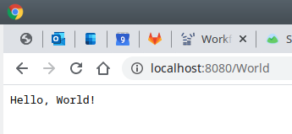
Hello World (Web server version)
02-HelloWebServer.go

Slide 5
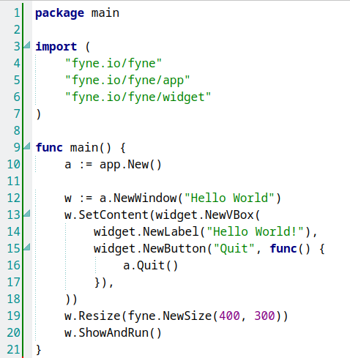
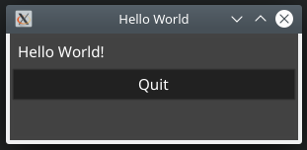
Hello World (Desktop application version)
03-HelloDesktopApp.go

Slide 6
Go Elevator pitch
Concurrency – simple, efficient & performant
Statically typed – a number is a number not a string
Single file compiled binaries - cross-platform
Powerful well documented standard libraries
Built-in testing, profiling, package management
Opinionated, clean, predicable looking code

Slide 7
Keywords
break default func interface select
case defer go map struct
chan else goto package switch
const fallthrough if range type
continue for import return var
Just 25 core language keywords!

Slide 8
Types
Numeric
  Unsigned integers
  Integers
  Floating point
  Complex
Aliases
  Byte = Uint8
  Rune = int32
String
Array
Slice
Bool
Struct
Pointer
Function
Interface
Map
Chan

Slide 9
Variables
Typed (except Interface)
Scoped global or local
Automatic garbage collection
Pointers
  Address of: &name
  Pointer: *name
Variable declarations
  var s string
  var s string = “Hello”
  s := “I’m a string”
  i := 56
  i := int(56)
  b := []byte{0x1a, 0x ff}
  m := map[string]int{
  ”key”: 999
  }

Slide 10
Constants
Typed
Scoped global or local
Autocomplete (iota)
Constant declarations
  const s = “I AM A STRING”
  const (
  MIN_AGE = 1
  MAX_AGE = 999
  )
  const (
  KEY0 = iota
  KEY1
  KEY2
  )

Slide 11
Array & Slices
Arrays are fixed length!
  var a [5]int
  a := [5]{1, 2, 3, 4, 5}
Slices are references to arrays
  Flexible wrapper on top of an array
  var s []int
  s := []int{1, 2, 3, 4, 5}
Push x onto a
  a = append(a, x)
Pop x from a
  x = a[len(a)-1]
  a = a[:len(a)-1]
Iteration
  for i, x := range a {
  // x is a[i]
  }

Slide 12
Code break...
Golang playground
  https://play.golang.org/
  Alternative with syntax highlighting: https://goplay.space/
Install on local machine (Linux, Windows or OS X)
  https://golang.org/
  Free editors
    Visual Studio Code with golang extensions
    LiteIDE https://github.com/visualfc/liteide

Slide 13
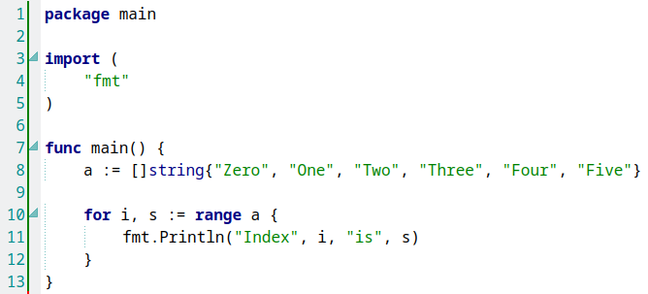
Code break… iterate over an array
04-Loop.go

Slide 14
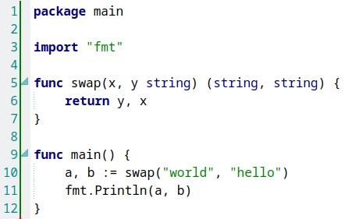
Functions
Can return multiple values
Functions can be defined and passed just like a variable
  Enables callbacks
Parameters can be either
  Passed by value
  Passed by reference using pointers
07-Functions.go

Slide 15
Go routines
“Goroutines are functions or methods that run concurrently with each other”
Lightweight aka cheap
  Goroutine !== OS Thread
“Don't communicate by sharing memory, share memory by communicating”
  Channels
  Mutex’s

Slide 16
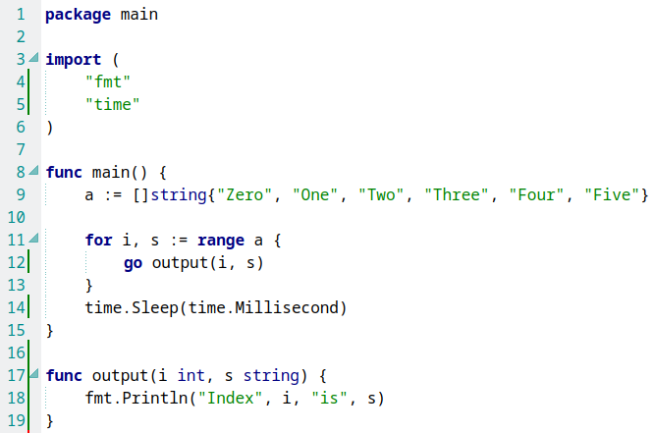
Code break… go routines
05-GoLoop.go

Slide 17
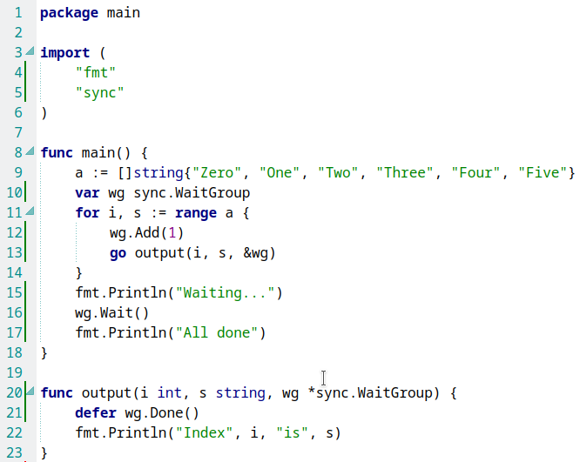
Code break… go routines - sync
06-WaitGroup.go

Slide 18
Packages
Aka libraries
Built-in package manager, versioning & vendoring
Standard library is built-in
  http, fmt, errors, log, testing, bytes, net, os, regexp, sort…
External packages use full path
  e.g. import "fyne.io/fyne/app"
“go get” will download latest imported packages

Slide 19
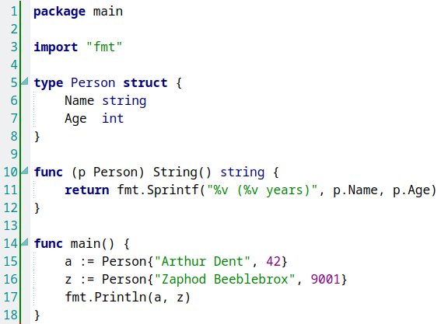
Struct
Collection of fields
Like an Object
Can have methods
Implied interfaces
  If it behaves like X
  then it is an X
Embedding
08-Structs.go

Slide 20
Public/Private
Public = Exported
  First letter must be uppercase
Private = Unexported
  First letter must be lowercase
Applies to packages and structs

Slide 21
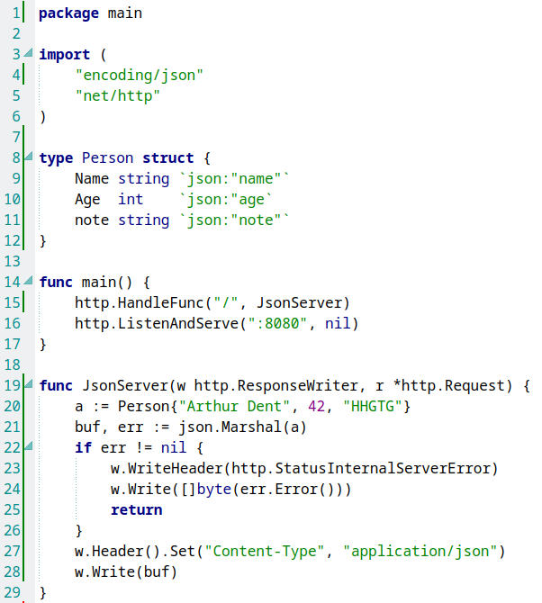
Code break… JSON
09-Json.go

Slide 22
Channels
Channels are “pipes” that let you communicate safely between goroutines
  MyChannel := make(chan string)
  Sending: MyChannel <- “Hello”
  Reading: str := <- MyChannel
Reads & Writes can block
Can be buffered using make(chan string, 100)

Slide 23
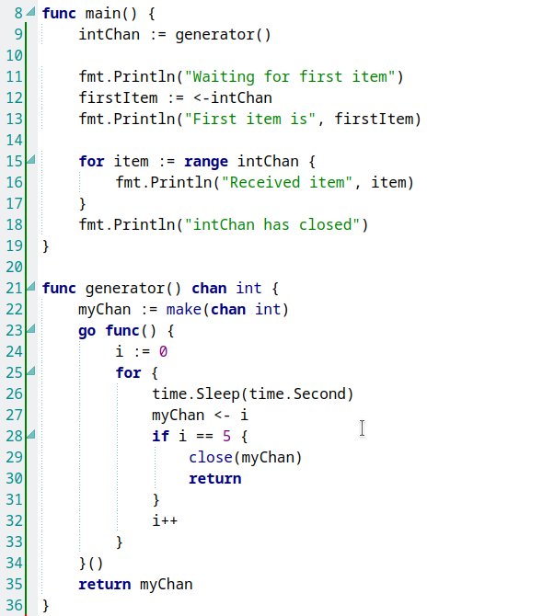
Code break… channels
10-Channels.go

Slide 24
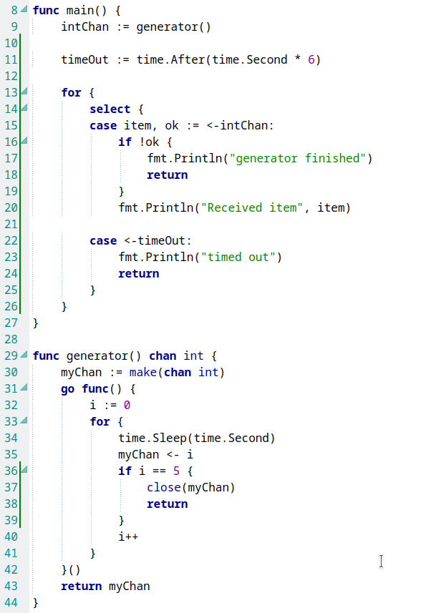
Code break… more channels
11-Channels.go

Slide 25
Resources
Go main site (excellent tutorials)
  golang.org
Editors
  github.com/visualfc/liteide
  code.visualstudio.com
Go Playgrounds
  play.golang.org
  goplay.space
Tutorials
  gobyexample.com
  github.com/golang/go/wiki
Slides and sample code
  github.com/kgolding/present-go-intro

Slide 26
Coding challenge
Level 1 challenge
Extend the network chat server to respond to a new command
  “/time” and respond with a timestamp
Level 2 challenge (no copying from the server source)
Extend the network chat client to respond to commands:
  “?time” and respond with a timestamp
  “?uptime” and respond with a duration
Level 3 challenge
Create a desktop application
network chat client!
WIFI: RedSprite_2G / redsprite
github.com/kgolding/present-go-intro
./code/go-chat-server.go
./code/go-chat-client.go

Slide 27
The end slide of an introduction to Go
Kevin Golding

