Slide 1
Recap/Big Picture
DS 574 Lecture 10

Slide 2








Econ$→$CS
Algorithmic problems
Economic concepts, arguments
Objective: Maximize buyer’s value
Objective: Maximize
[whatever]
Input:
Data
Input:
Data reported by strategic agents.
Output: Outcome
Algorithm
-who gets what
$$20$$
-who pays (gets paid) what
Allocation
$$15$$
Mechanism
$$15$$
Use game theory to reason about incentives within the algorithm so that we can guarantee (approximate) optimality.
$$10$$

Slide 3

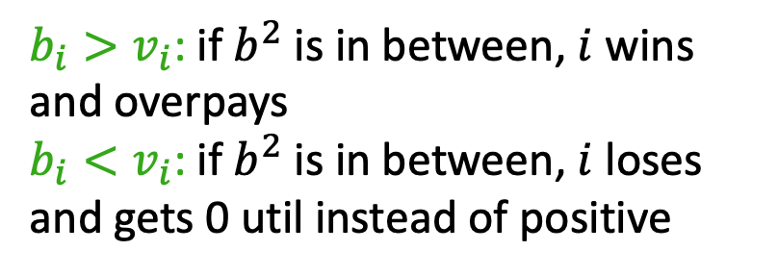


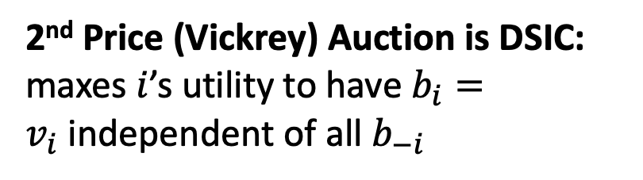


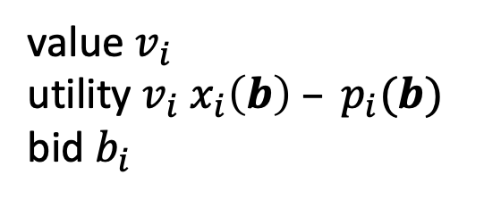


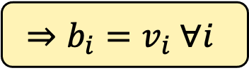
Maximize Social Welfare: 2nd Price
Objective: Maximize value of the allocation
Input: Strategic bids
Output:
allocation
payment
Mechanism
highest bidder
$$x_{1}=1$$
$$b_{1}$$
2nd highest bid
$$b^{2}$$
$$b_{2}$$
$$b_{3}$$
2nd Price (Vickrey) Auction is DSIC: maxes $i$’s utility to have $b_{i}=v_{i}$independent of all $b_{−i}$
$$b_{4}$$
$$b_{5}$$
value $v_{i}$
utility $v_{i}{ x}_{i}\left(b\right) – p_{i}(b)$
bid $b_{i}$
$b_{i}>v_{i}$: if $b^{2}$ is in between, $i$ wins and overpays
$b_{i}<v_{i}$: if $b^{2}$ is in between, $i$ loses and gets 0 util instead of positive
$$⇒b_{i}=v_{i} ∀i$$

Slide 4
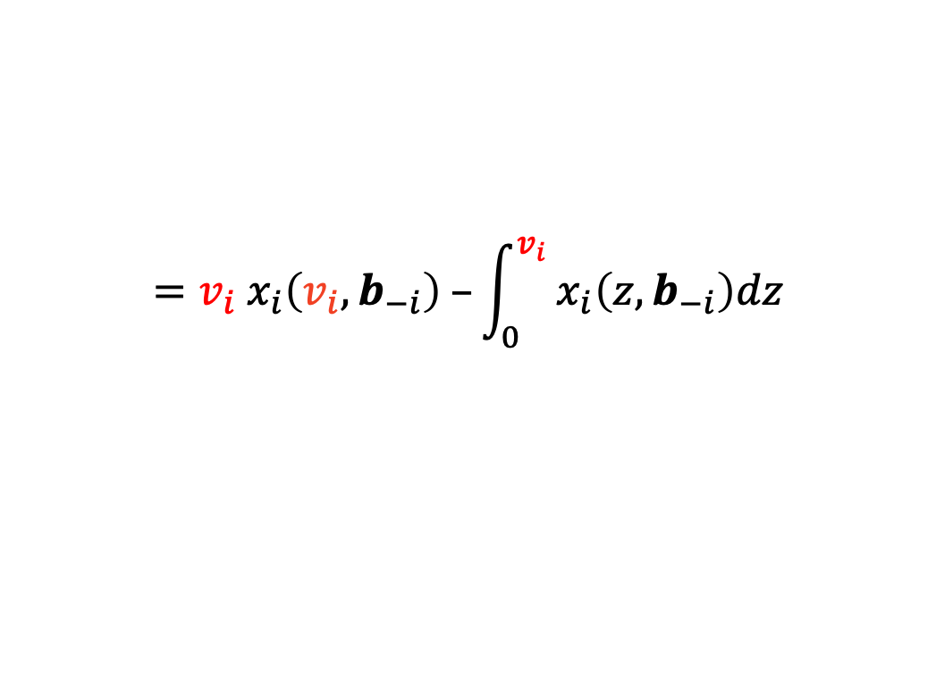



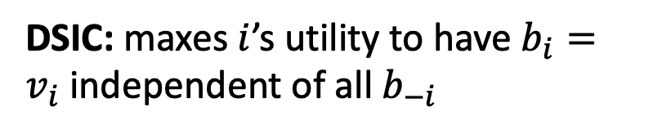

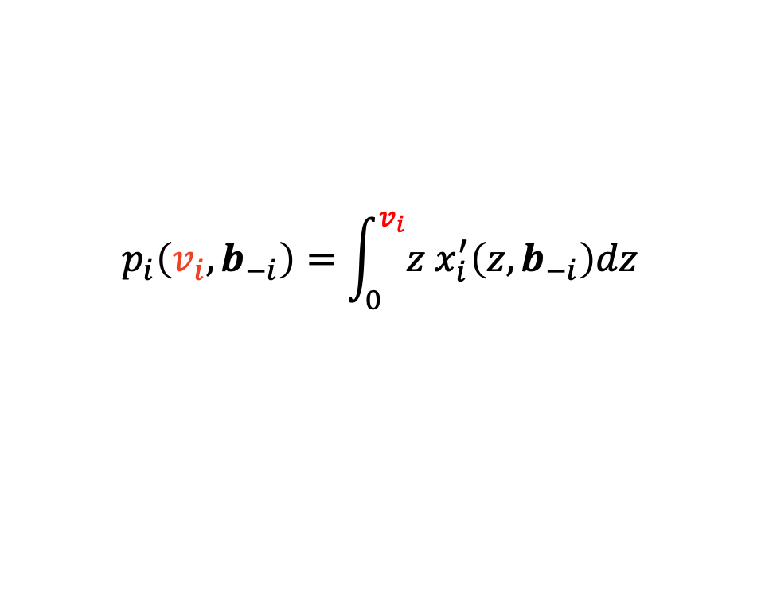

Dominant Strategy Incentive Compatibility
More utility for bidding actual value:
$v_{i}{ x}_{i}\left(v_{i}, b_{−i}\right) – p_{i}(v_{i}, b_{−i})$ $≥v_{i}{ x}_{i}\left(b_{i}, b_{−i}\right) – p_{i}\left(b_{i}, b_{−i}\right) ∀i,v_{i},b_{i},b_{−i}$
1) The allocation rule must be monotone, or this can’t hold.
implementable
Myerson’s Lemma
2) DSIC payments are completely determined by the allocation rule:
$$p_{i}\left(v_{i}, b_{−i}\right)=\int_{0}^{v_{i}}{{z x}_{i}^{′}\left(z, b_{−i}\right)dz}$$
$$={v_{i} x}_{i}\left(v_{i}, b_{−i}\right) –\int_{0}^{v_{i}}{{ x}_{i}\left(z, b_{−i}\right)dz}$$
Payment Identity
$$1$$
$$x(⋅)$$
value $v_{i}$
utility $v_{i}{ x}_{i}\left(b\right) – p_{i}(b)$
bid $b_{i}$
payment
$$□=v⋅x(v)$$
DSIC: maxes $i$’s utility to have $b_{i}=v_{i}$independent of all $b_{−i}$
allocation
$$⇒b_{i}=v_{i} ∀i$$
utility
$$0$$
$$v$$
value

Slide 5

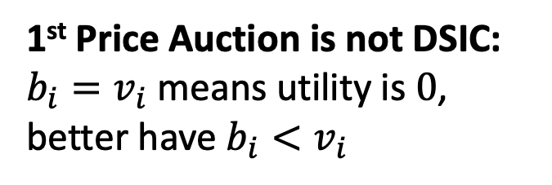
Maximize Social Welfare: 1st Price
Objective: Maximize value of the allocation
Input: Strategic bids
Output:
allocation
payment
Mechanism
highest bidder
$$x_{1}=1$$
$$b_{1}$$
own bid
$$b^{1}$$
$$b_{2}$$
$$b_{3}$$
1st Price Auction is not DSIC:
$b_{i}=v_{i}$means utility is $0$, better have $b_{i}<v_{i}$
$$b_{4}$$
$$b_{5}$$
value $v_{i}$
utility $v_{i}{ x}_{i}\left(b\right) – p_{i}(b)$
bid $b_{i}$

Slide 6


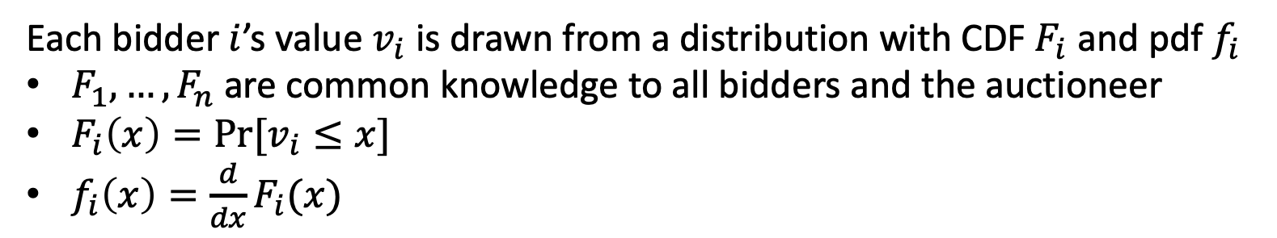




The Bayesian Setting: Stages
Each bidder $i$’s value $v_{i}$ is drawn from a distribution with CDF $F_{i}$ and pdf $f_{i}$
$F_{1},…,F_{n}$ are common knowledge to all bidders and the auctioneer
$F_{i}\left(x\right)=Pr⁡[v_{i}≤x]$
$f_{i}\left(x\right)=\frac{d}{dx}F_{i}(x)$
ex ante: no values are known. mechanism announced.
Mechanism
interim: $i$knows $v_{i}$, Bayesian updates given this
bidders submit bids
$$b_{1}$$
$$b_{2}$$
$$b_{3}$$
$$b_{4}$$
$$b_{5}$$
ex post: outcome announced. know $v_{1}, …, v_{n}$
value $v_{i}$
utility $v_{i}{ x}_{i}\left(b\right) – p_{i}(b)$
bid $b_{i}$
needed:
for bidders to reason about other bidders’ behavior (BNE)
for auctioneer to reason about objective in expectation

Slide 7





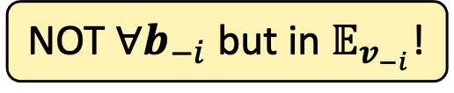


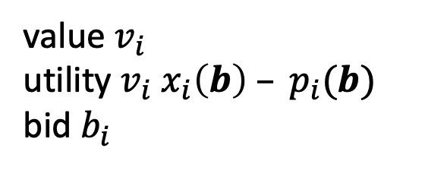



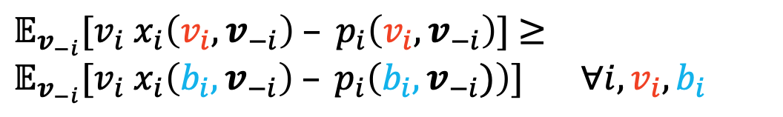
The Bayesian Setting: Incentive Compatibility
Each bidder $i$’s value $v_{i}$ is drawn from a known distribution $F_{i}$
$𝔼_{v_{−i}}[v_{i}{ x}_{i}\left(v_{i},v_{−i}\right) – p_{i}\left(v_{i},v_{−i}\right)]$ $≥𝔼_{v_{−i}}[v_{i}{ x}_{i}\left(b_{i},v_{−i}\right) – p_{i}\left(b_{i},v_{−i})\right)] ∀i,v_{i},b_{i}$
NOT $∀b_{−i}$ but in $𝔼_{v_{−i}}$!
BIC:
$v_{i}\hat{x_{i}}\left(v_{i}\right) –\hat{p_{i}}(v_{i})$ $≥v_{i}\hat{x_{i}}\left(b_{i}\right) –\hat{p_{i}}\left(b_{i}\right) ∀i,v_{i},b_{i}$
Mechanism
$$b_{1}$$
$$b_{2}$$
interim: $i$knows $v_{i}$, Bayesian updates given this
bidders submit bids
$$b_{3}$$
$$b_{4}$$
$$b_{5}$$
$$\hat{x_{i}}\left(b_{i}\right)= {𝔼_{v_{−i}}[x}_{i}\left(b_{i},v_{−i}\right)]$$
$$\hat{p_{i}}\left(b_{i}\right)= {𝔼_{v_{−i}}[p}_{i}\left(b_{i},v_{−i}\right)]$$
value $v_{i}$
utility $v_{i}{ x}_{i}\left(b\right) – p_{i}(b)$
bid $b_{i}$
ex post: outcome announced. know $v_{1}, …, v_{n}$
$$x_{i}\left(b_{i}, b_{−i}\right)$$
$$p_{i}\left(b_{i}, b_{−i}\right)$$
DSIC:
$v_{i}{ x}_{i}\left(v_{i}, b_{−i}\right) – p_{i}(v_{i}, b_{−i})$ $≥v_{i}{ x}_{i}\left(b_{i}, b_{−i}\right) – p_{i}\left(b_{i}, b_{−i}\right) ∀i,v_{i},b_{i},b_{−i}$

Slide 8
Nash Equilibrium vs. Incentive-Compatibility
A mechanism is [concept] Incentive-Compatible if in the mechanism, truthful reporting is a [concept] Nash Equilibrium. (i.e. [concept] \in Dominant Strategy, Bayes-Nash, Ex Post*)
*sincere bidding may be required instead of truthful
BNE:
Best-response strategies $σ$ form a Bayes-Nash Equilibrium (BNE) in $(x,p)$ when
$𝔼_{v_{−i}}[v_{i}{ x}_{i}\left(σ_{i}\left(v_{i}\right),σ_{−i}(v_{−i})\right) – p_{i}\left(σ_{i}\left(v_{i}\right),σ_{−i}(v_{−i})\right)]$ $≥𝔼_{v_{−i}}[v_{i}{ x}_{i}\left(b_{i},σ_{−i}(v_{−i})\right) – p_{i}\left(b_{i},σ_{−i}(v_{−i})\right)] ∀i,v_{i},b_{i}$
BIC:
A mechanism $(x,p)$ is Bayesian Incentive-Compatible (BIC) when
$𝔼_{v_{−i}}[v_{i}{ x}_{i}\left(v_{i},v_{−i}\right) – p_{i}\left(v_{i},v_{−i}\right)]$ $≥𝔼_{v_{−i}}[v_{i}{ x}_{i}\left(b_{i},v_{−i}\right) – p_{i}\left(b_{i},v_{−i})\right)] ∀i,v_{i},b_{i}$

Slide 9









Revelation Principle + Revenue Equivalence
Revelation Principle: It is without loss to focus on [DS/B/EP]IC mechanisms.
$$M′$$
$$M$$
$$v_{1}$$
$${σ_{1}(v}_{1})$$
$$v_{2}$$
$${σ_{2}(v}_{2})$$
(same)
outcome
$$⋮$$
$$⋮$$
outcome
$$v_{n}$$
$${σ_{n}(v}_{n})$$
Revenue Equivalence: Mechs w/ the same outcome have the same $𝔼$[Rev].

Slide 10
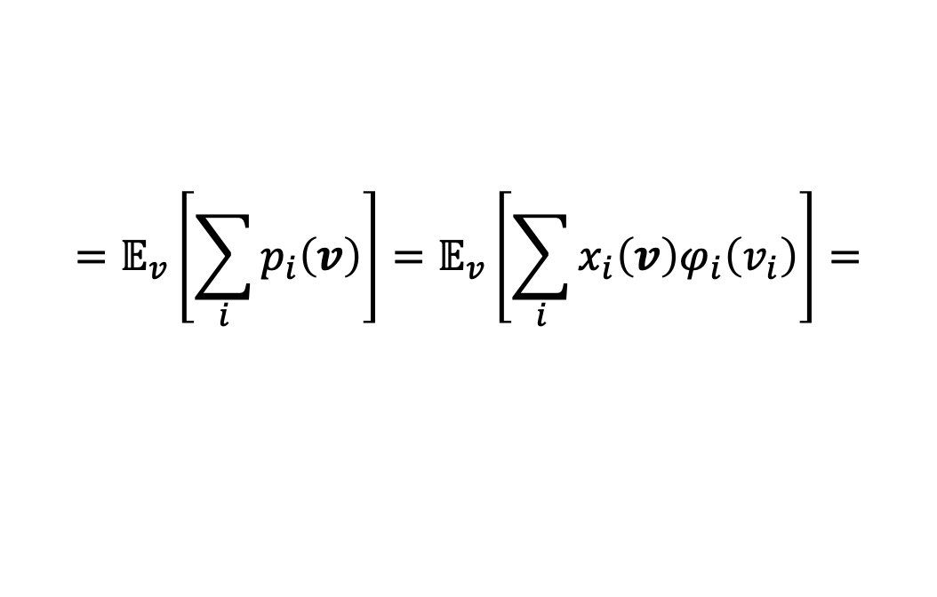

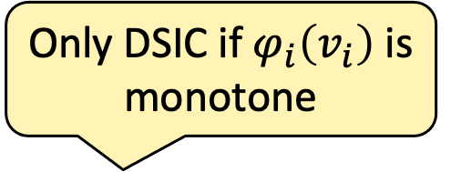
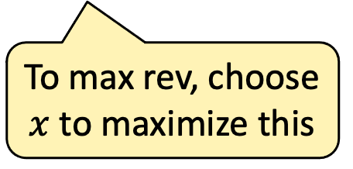

Maximizing Revenue
How can we max revenue? Can’t just charge $v_{i}$ – not IC. Still need the payment identity.
Only DSIC if $φ_{i}\left(v_{i}\right)$is monotone
Expected Revenue
$$=𝔼_{v}\left[\sum_{i}{p_{i}\left(v\right)}\right]=𝔼_{v}\left[\sum_{i}{x_{i}\left(v\right)φ_{i}\left(v_{i}\right)}\right]=$$
Expected Virtual Welfare
plug in the payment identity
To max rev, choose $x$ to maximize this
$$φ_{i}\left(v_{i}\right)=\frac{1−F_{i}(v_{i})}{f_{i}(v_{i})}$$
For virtual value functions

Slide 11
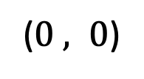



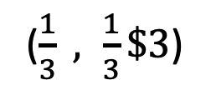



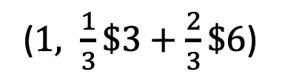





How else can we express revenue?
Any allocation rule can be expressed as a distribution of prices.
Menu
$$1$$
=
($1, \frac{1}{3}\$3+\frac{2}{3}\$6$)
prob. of service
$$\frac{2}{3}$$
($\frac{1}{3} , \frac{1}{3}\$3$)
$$\frac{1}{3}$$
$$\frac{1}{3}$$
($0 , 0$)
$$3$$
$$5$$
$$6$$
bid
$$1$$
$$1$$
$$1/3$$
$$+ 2/3$$
$$3$$
$$6$$
Notes:
Convex combination: show how this is true
Randomize over prices
Equivalent to randomize over shipment

Slide 12
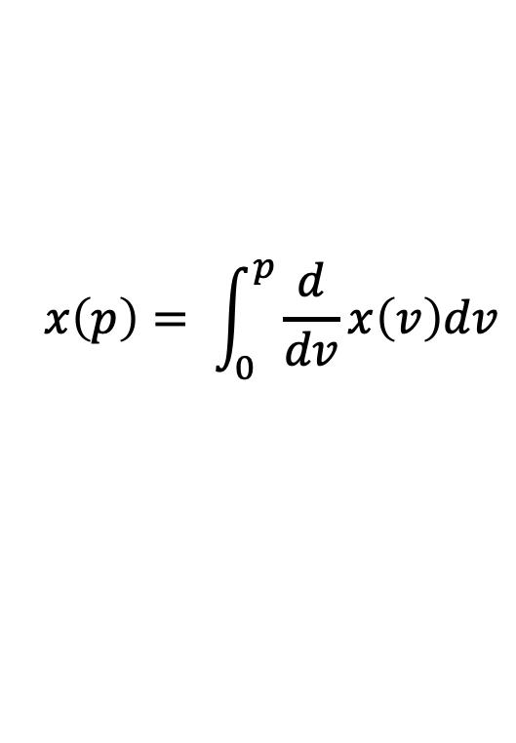


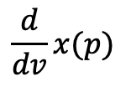



Any allocation is a distribution over prices
$$x(v)$$
$$1$$
$$\frac{d}{dv}x(p)$$
$$x\left(p\right)= \int_{0}^{p}{\frac{d}{dv}x\left(v\right)dv}$$
$$0$$
$$p$$
$$v$$

Slide 13
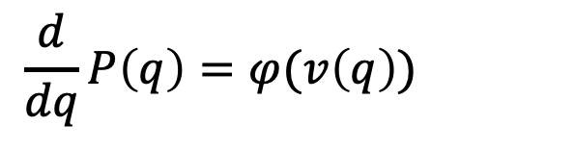










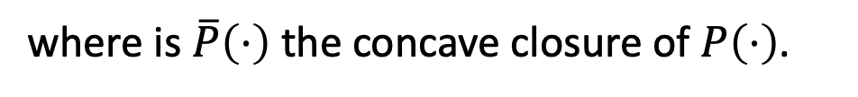

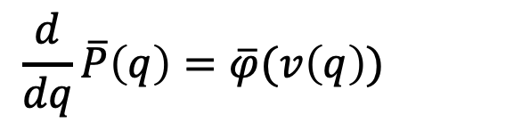

What is our revenue for a price $p$?
Single-bidder revenue curve $R\left(p\right)=p⋅\underset{v}{Pr}\left[v≥p\right]=p⋅[1−F\left(p\right)]$
Moving to quantile space:
$$𝔼[\text{rev}]$$
$$q=1−F(v)$$
$$v\left(q\right)=F^{−1}(1−q)$$
$$q∼U[0,1]$$
Single-bidder revenue curve in quantile space
$$\text{price}$$
$$v$$
$$H$$
$$0$$
$$P\left(q\right)=v\left(q\right)⋅q$$
$$𝔼[\text{rev}]$$
Happily,
$$\frac{d}{dq}P\left(q\right)=φ(v\left(q\right))$$
$$0$$
$$q_{a}$$
$$q_{c}$$
$$q_{b}$$
$$\text{quantile}$$
$$1$$
We define
$$\frac{d}{dq}\overline{P}\left(q\right)=\overline{φ}(v\left(q\right))$$
where is $\overline{P}\left(⋅\right)$ the concave closure of $P\left(⋅\right)$.

Slide 14


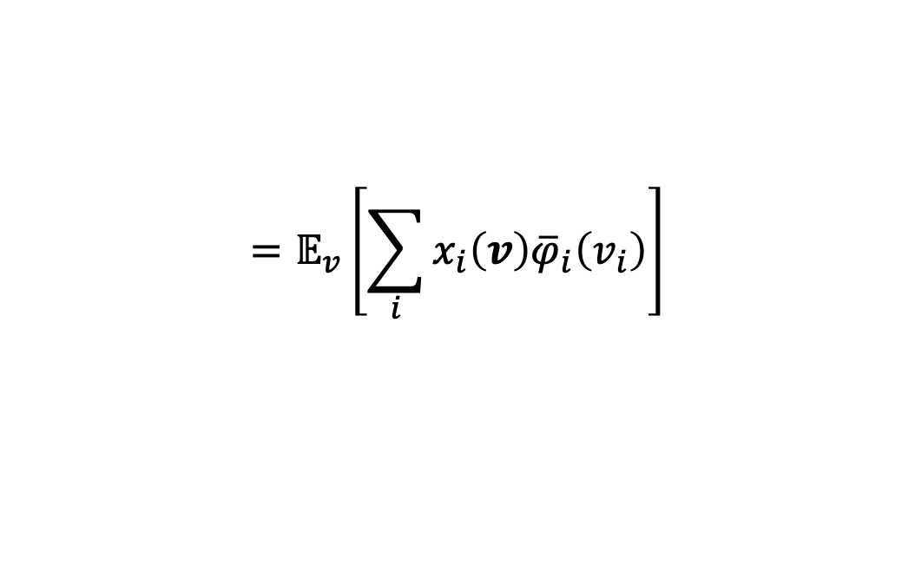
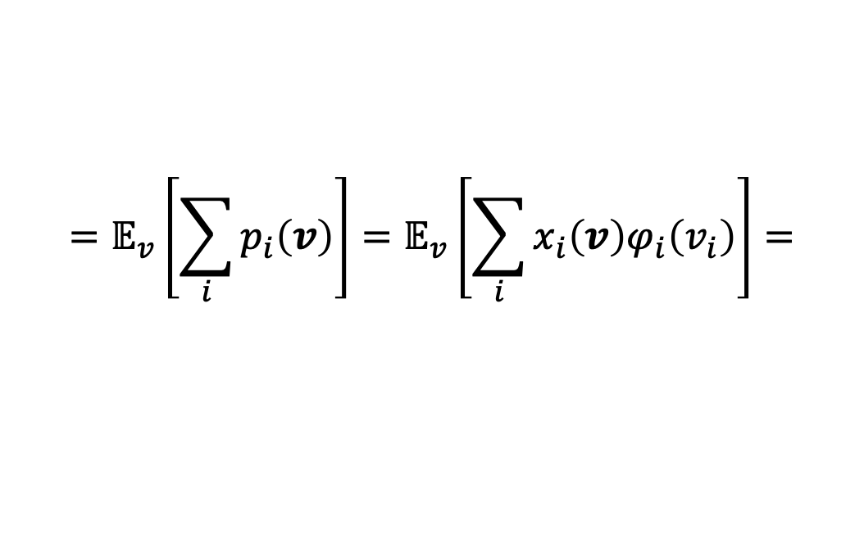
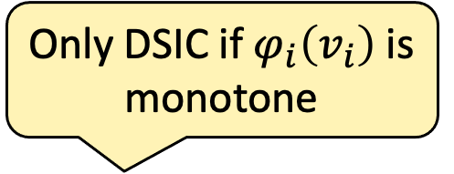
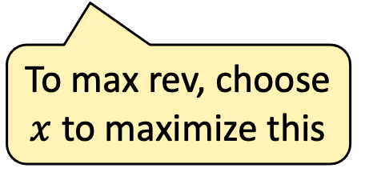
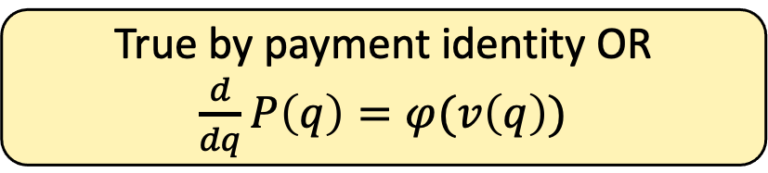
Maximizing Revenue
$$φ_{i}\left(v_{i}\right)=\frac{1−F_{i}(v_{i})}{f_{i}(v_{i})}$$
For virtual value functions
Only DSIC if $φ_{i}\left(v_{i}\right)$is monotone
Expected Revenue
$$=𝔼_{v}\left[\sum_{i}{p_{i}\left(v\right)}\right]=𝔼_{v}\left[\sum_{i}{x_{i}\left(v\right)φ_{i}\left(v_{i}\right)}\right]=$$
Expected Virtual Welfare
True by payment identity OR $\frac{d}{dq}P\left(q\right)=φ(v\left(q\right))$
To max rev, choose $x$ to maximize this
$$=𝔼_{v}\left[\sum_{i}{x_{i}\left(v\right){\overline{φ}}_{i}\left(v_{i}\right)}\right]$$
with $x=0$ when ${\overline{φ}}_{i}≠φ_{i}$

Slide 15
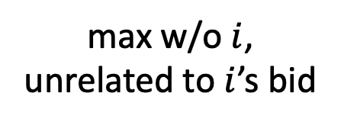
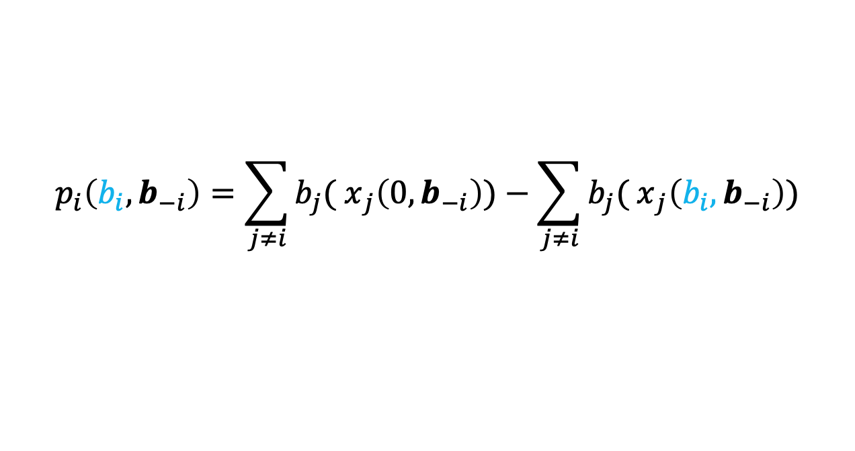
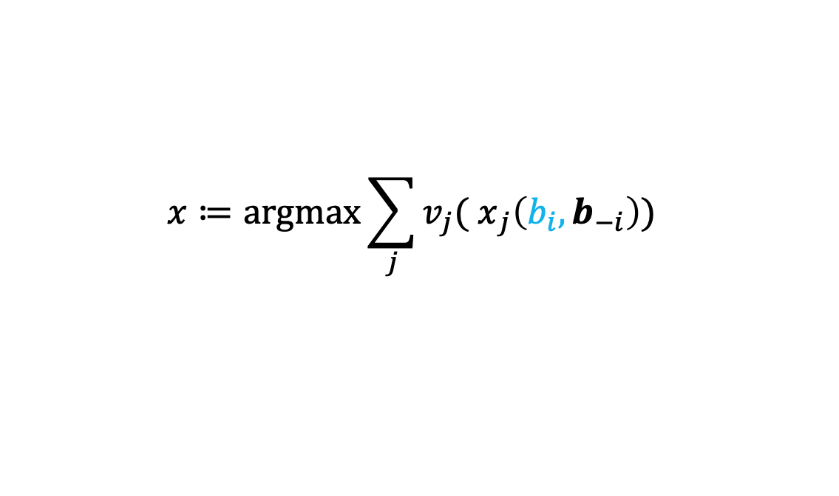
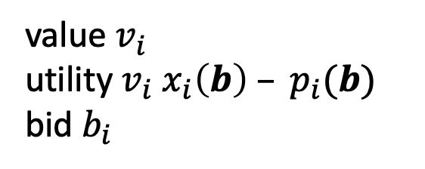
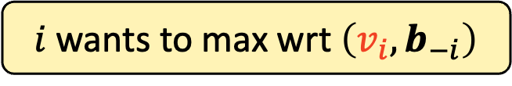
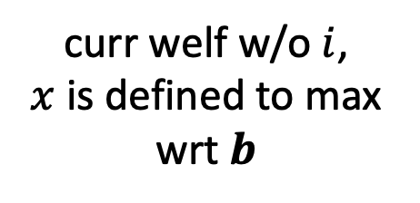
Multiparameter Social Welfare: VCG is DSIC
$$x≔\text{arg}max{\sum_{j}{v_{j}{( x}_{j}\left(b_{i}, b_{−i}\right))} }$$
More utility for bidding actual value:
$v_{i}{( x}_{i}\left(v_{i}, b_{−i}\right)) – p_{i}(v_{i}, b_{−i})$ $≥v_{i}{ (x}_{i}\left(b_{i}, b_{−i}\right)) – p_{i}\left(b_{i}, b_{−i}\right) ∀i,v_{i},b_{i},b_{−i}$
$i$ wants to max wrt $\left(v_{i}, b_{−i}\right)$
$$p_{i}\left(b_{i}, b_{−i}\right)=\sum_{j≠i}{b_{j}{( x}_{j}\left(0,b_{−i}\right))}−\sum_{j≠i}{b_{j}{( x}_{j}\left(b_{i}, b_{−i}\right))}$$
value $v_{i}$
utility $v_{i}{ x}_{i}\left(b\right) – p_{i}(b)$
bid $b_{i}$
max w/o $i$,
unrelated to $i$’s bid
curr welf w/o $i$,
$x$ is defined to max wrt $b$

Slide 16
Ascending Auctions + Walresian Eq

Slide 17
Duality Preview

