Slide 1

Encryption vs. Obfuscation
Mohammad Mahmoody
Based on joint work with Sanjam Garg (Berkeley) Ameer Mohammad

Slide 2
Two major goals in Cryptography
Secure Encryption
Secure Obfuscation
There are keys
Only hiding data
No keys
Hiding executable programs

Slide 3

Main questions always asked about crypto tasks
What assumptions are necessary and sufficient for them? (almost everything requires assuming $P≠NP$)
Closely related: what is the relationship between these tasks.

Slide 4
Main Questions
Secure Encryption
Secure Obfuscation
What is the relation between these two tasks?
Which one is harder? Do they imply each other?

Slide 5
Our results: [very informal!]
[GGHRSW13, BV16, AJ16]
Fuzzy encryption
Secure Obfuscation
Zero one encryption
There are keys
Only hiding data
No keys
Hiding executable programs
Our Result

Slide 6
Plan
Part 1: various forms of encryption
Part 2: various forms of code obfuscation
Part 3: the relation between these two camps

Slide 7
Plan
Part 1: various forms of encryption
Part 2: various forms of code obfuscation
Part 3: the relation between these two camps

Slide 8






Original Goal of Crypto: Symmetric Encryption
$c$ = Enc($m$)
Eve
Alice and Bob share same (private) key $k$
Security: Eve does not learn anything about $m$
Notes:
Let start by recalling the main question that cryptography first looked at to solve for us. For centuries nations relied on stegonagrphy and ciphers broke one after other till we learned how to do it using randomized encryption.

Slide 9
Stronger notion: Public Key Encryption
$c$ = Enc($m$)
Eve
Bob publishes the encryption key
Bob keeps the secret key for decryption
Security: Eve does not learn anything about $m$
Notes:
Let start by recalling the main question that cryptography first looked at to solve for us. For centuries nations relied on stegonagrphy and ciphers broke one after other till we learned how to do it using randomized encryption.

Slide 10





Identity-based Encryption [Sha84, BF01]
$$\left(MPK,MSK\right)$$
Company Staff
Manager
$$SK_{Bob}$$
External User
$$c=Enc\left(MPK,Bob ,m\right)$$
$$m=Dec\left(SK_{Bob},c\right)$$
Company Employee (Bob)

Slide 11



Security of Identity Based Encryption
Colluding parties
$$\left(MPK,MSK\right)$$
Manager
$$SK_{Bob}$$
$$SK_{C}$$
$$SK_{D}$$
$$SK_{E}$$
External User
$$c=Enc\left(MPK,Bob ,m\right)$$
$$m=Dec\left(SK_{Bob},c\right)$$
Security: Eve does not learn anything about $m$

Slide 12
Public Key Encryption
Identity-Based Encryption
Notes:
Notice f for ABE and IBE is fixed
BSW11 – Formal definition of FE
GGH13 – (iO + FHE) → FE
GKP13 – (2-outcome ABE + FHE + Yao’s garbling) → FE
ABE – Predicate-based Encryption with public index (can find out attributes/policy)
SW05 – Fuzzy IBE
GPSW06 – Key-Policy ABE
BSW07 – Ciphertext Policy ABE
Shamir85 – Introduced IBE
BF01 – IBE based on Weil Pairings
Cocks01 – IBE based on QR

Slide 13
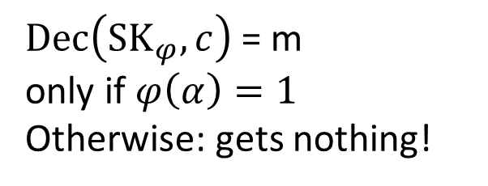



Attribute Based Encryption [SW05, GPSW06, BSW07]
$$\left(MPK,MSK\right)$$
$$SK_{φ}$$
External User
$$c=Enc\left(MPK,α ,m\right)$$
$Dec\left({SK}_{φ},c\right)$ = m only if $φ\left(α\right)=1$
Otherwise: gets nothing!

Slide 14
Symmetric key encryption
Identity-Based Encryption
Attribute-Based Encryption
Notes:
Notice f for ABE and IBE is fixed
BSW11 – Formal definition of FE
GGH13 – (iO + FHE) → FE
GKP13 – (2-outcome ABE + FHE + Yao’s garbling) → FE
ABE – Predicate-based Encryption with public index (can find out attributes/policy)
SW05 – Fuzzy IBE
GPSW06 – Key-Policy ABE
BSW07 – Ciphertext Policy ABE
Shamir85 – Introduced IBE
BF01 – IBE based on Weil Pairings
Cocks01 – IBE based on QR

Slide 15

Functional Encryption [BSW11, GKP⁺13]
$$\left(MPK,MSK\right)$$
$$SK_{φ}$$
External User
$$c=Enc\left(MPK,α ,m\right)$$
$$Dec\left({SK}_{φ},c\right)=φ(a,m)$$
Not “zero one” any more. Different keys reveal different things!

Slide 16
Identity-Based Encryption
Identity-Based Encryption
Attribute-Based Encryption
Functional Encryptoin
Notes:
Notice f for ABE and IBE is fixed
BSW11 – Formal definition of FE
GGH13 – (iO + FHE) → FE
GKP13 – (2-outcome ABE + FHE + Yao’s garbling) → FE
ABE – Predicate-based Encryption with public index (can find out attributes/policy)
SW05 – Fuzzy IBE
GPSW06 – Key-Policy ABE
BSW07 – Ciphertext Policy ABE
Shamir85 – Introduced IBE
BF01 – IBE based on Weil Pairings
Cocks01 – IBE based on QR

Slide 17
What assumptions needed?

Slide 18
Identity-Based Encryption
Trapdoor Permutations (e.g., hardness of discrete logarithm)
Identity-Based Encryption
Bilinear maps (related to hardness of discrete log)
Attribute-Based Encryption
Hardness of learning with error (related to decoding random linear codes)
Functional Encryption
???
Notes:
Notice f for ABE and IBE is fixed
BSW11 – Formal definition of FE
GGH13 – (iO + FHE) → FE
GKP13 – (2-outcome ABE + FHE + Yao’s garbling) → FE
ABE – Predicate-based Encryption with public index (can find out attributes/policy)
SW05 – Fuzzy IBE
GPSW06 – Key-Policy ABE
BSW07 – Ciphertext Policy ABE
Shamir85 – Introduced IBE
BF01 – IBE based on Weil Pairings
Cocks01 – IBE based on QR

Slide 19
Plan
Part 1: various forms of encryption
Part 2: various forms of code obfuscation
Part 3: the relation between these two camps

Slide 20


Code Obfuscation
Making a program unintelligible while preserving its functionality
VBB Obfuscation
$$M$$
$$M′$$
Notes:
Say verbally: Goal: Change a program so that it still has the same input output behavior, but while it is hard to “understand” it

Slide 21
Why Obfuscate?
Applications in software protection
Example: Prevent user from reverse-engineering
Applications in cryptography
Construct many other primitives using obfuscation
Notes:
There are 100 of applications of obfuscation. And it is studied for decades. But it is formaly defined by brack etal in 2001. obfuscation now is important in cryptography as a primitive.

Slide 22


Virtual Black-Box Obfuscation [Hada00, BGIRSVY01]
VBB Obfuscation
$$M$$
$$M′$$
[BGIRSVY01] VBB not possible in general

Slide 23


Next best thing: Indistinguishability Obfuscation?
Indistinguishability Obfuscation
$$M$$
$$M′$$
[BGIRSVY01] defined iO in appendix!

Slide 24

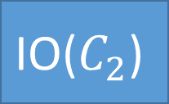


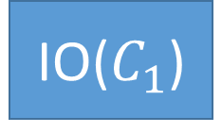
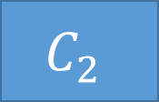

Indistinguishability Obfuscation (IO)
$$C_{1}$$
$$C_{2}$$
$$≡$$
[GGHRSW13] candidate IO
IO
IO
IO($C_{1}$)
$$?$$
$$\text{IO}\text{(}C_{2}\text{)}$$

Slide 25

What crypto task do you want to do ?
Functional Encryption: [Garg-Gentry-Halevi-Raykova-Sahai-Waters 2013]
Witness Encryption: [Garg-Gentry-Sahai-Waters 2013]
2-round MPC: [Garg-Gentry-Halevi-Raykova 2013]
Re-using garbled circuits: [Gentry–Halevi–Raykova-Wichs 2014]
Deniable Encryption, KEM, Oblivious Transfer,…: [Sahai-Waters 2014]
Random oracle instantiation: [Hohenberger-Sahai-Waters 2014]
Secret sharing: [Komargodski-Naor 2014]
2-round adaptively-secure MPC: [Garg-Polychroniadou 2015]
Multi-input Functional Encryption: [Goldwasser-Gordon-Goyal-Jain-Katz-Liu-Sahai-Shi-Zhao 2015] ………..
IO
Notes:
Attacks on MLM

Slide 26
Identity-Based Encryption
Bilinear maps (related to hardness of discrete log)
Attribute-Based Encryption
Hardness of learning with error (related to decoding random linear codes)
Functional Encryption
???
Indistinguishability Obfuscation

Slide 27
How to use Obfuscation to get Functional Enc

Slide 28
What assumptions can we base IO on?

Slide 29
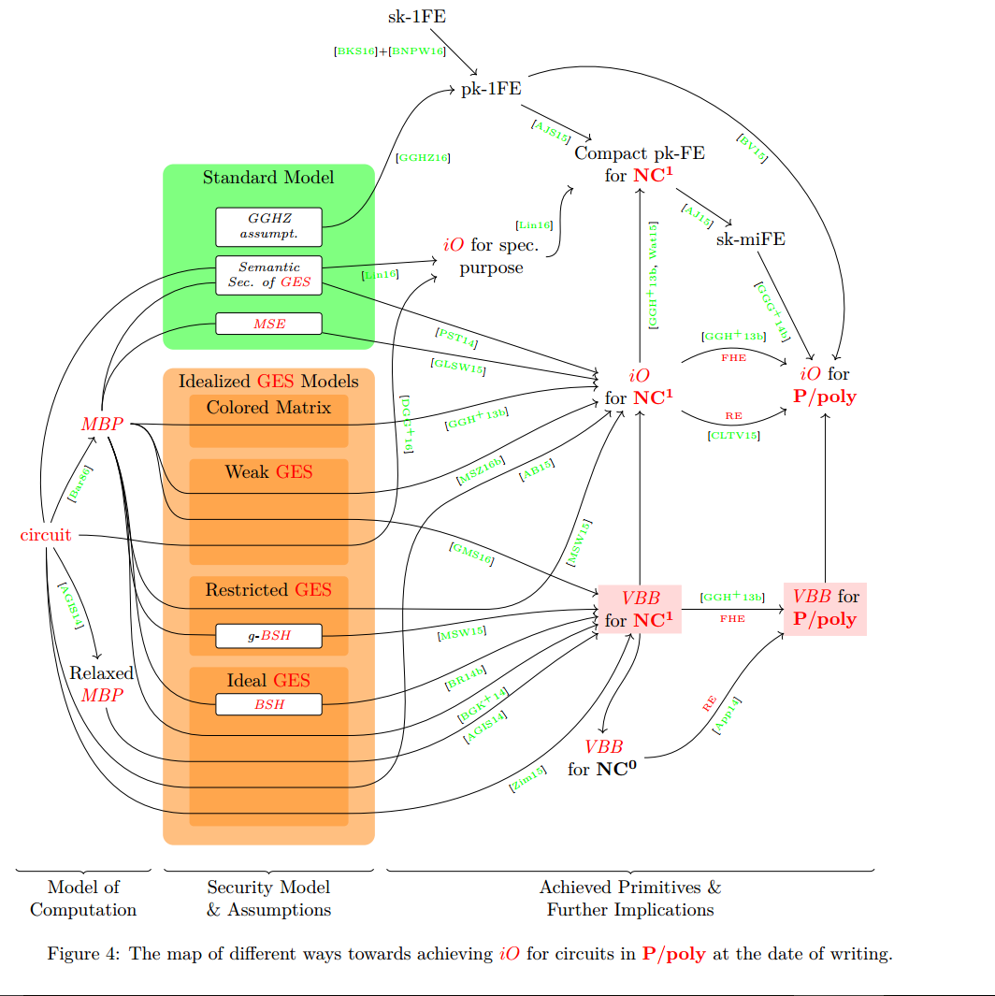
Picture by [Horváth, L Buttyán 16]

Slide 30
IO
Trapdoor permuations
[MMNPS15]
Multilinear Maps [Garg et al.]
Can we use other “standard assumptions” ?
For example Attribute Based Encryption ?
Notes:
Attacks on MLM

Slide 31
Identity-Based Encryption
Bilinear maps (related to hardness of discrete log)
Attribute-Based Encryption
Hardness of learning with error (related to decoding random linear codes)
Functional Encryption
“Multi-linear maps”
Not well understood, quite shaky!
IO

Slide 32
Plan
Part 1: various forms of encryption
Part 2: various forms of code obfuscation
Part 3: the relation between these two camps

Slide 33
Our results: [very informal!]
[GGHRSW13, BV16, AJ16]
Fuzzy encryption
Secure Obfuscation
Zero one encryption
There are keys
Only hiding data
No keys
Hiding executable programs
Our Result

Slide 34
Identity-Based Encryption
Bilinear maps (related to hardness of discrete log)
Attribute-Based Encryption
Hardness of learning with error (related to decoding random linear codes)
Our Result
Functional Encryption
“Multi-linear maps”
Not well understood, quite shaky!
IO

Slide 35


Black-Box constructions [IR’89, RTV’04]
$$P$$
$$IO$$
IO uses P as a subroutine/oracle/black-box
Notes:
If you got too many questions: say: ZK is in this model, CKP’15 in this model.

Slide 36
Main Result
Have “key” → learn all of plaintext
Not have “key” → learn nothing of plaintext
Let P be your favorite “zero one” encryption primitive
Attribute based encryption
Predicate Encryption
Witness Encryption
Fully Homomorphic Encryption
…
..
.
P
IO
Black-box
Notes:
Zvika Brakerski, Brzuska, Fleischhacker
Say it explicitly, if you are a pessimist then this gives more evidence for your belief and if you are an optimist then it tells what you need to stop trying.
"Our current understanding of cryptanalysis of known IO constructions is very closely aligned (in some sense) with the boundary of our negative result. In other words, non-all-or-nothing primitives are known only from multilinear maps. Furthermore, it is this very setting for which all cryptanalysis is known."

Slide 37
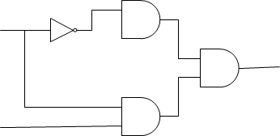


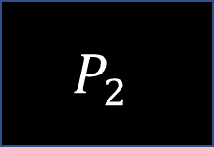

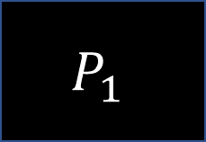

How about self-feeding $P$ ?
Special subroutine taking circuits as input
$$P_{1}$$
$$P_{2}$$
Circuit with $P_{1}$ gates
$$C$$
$$P_{1}$$
$$IO$$
Not black-box according to [IR,RTV]
But we do this all the time!
Notes:
If you got too many questions: say: ZK is in this model, CKP’15 in this model.

Slide 38



Examples of where this trick is used
IO → FE [GGHRSW13]
FE → IO [AJ’16,BV’16]
$$Obf$$
FHE-DEC
FHE-Eval
$$KGen$$
$$Enc$$

Slide 39
Identity-Based Encryption
Bilinear maps (related to hardness of discrete log)
Attribute-Based Encryption
Hardness of learning with error (related to decoding random linear codes)
Functional Encryption
“Multi-linear maps”
Not well understood, quite shaky!
IO

Slide 40







New Extended Black-Box Model
Special subroutine taking circuits as input
$$P_{1}$$
$$P_{2}$$
Inspired by [BKSY11, AS15] who allowed certain gates but not all
Extended black-box : all subroutines are allowed as oracle gates
Circuit with $all$possible gates
$$C$$
$$P_{2}$$
$$IO$$
$$P_{1}$$
Notes:
Say here, that is why there was a impossibility here htat later on was detoured…

Slide 41
Main Result
Have “key” → learn all of plaintext
Not have “key” → learn nothing of plaintext
Let P be your favorite “zero one” encryption primitive
Attribute based encryption
Predicate Encryption
Witness Encryption
Fully Hom Encryption
…
..
.
P
IO
Extended black-box
Notes:
Zvika Brakerski, Brzuska, Fleischhacker
Say it explicitly, if you are a pessimist then this gives more evidence for your belief and if you are an optimist then it tells what you need to stop trying.
"Our current understanding of cryptanalysis of known IO constructions is very closely aligned (in some sense) with the boundary of our negative result. In other words, non-all-or-nothing primitives are known only from multilinear maps. Furthermore, it is this very setting for which all cryptanalysis is known."

Slide 42
High Level of Proof for Main Theorem
Witness Encrtiption
Extended black-box
IO
Extended black-box
Extended black-box
ABE, PE, FHE, etc.

Slide 43
Ideas behind separating IO from WE
Witness Encrtiption
Extended black-box
IO
Extended black-box
Extended black-box
ABE, PE, FHE, etc.

Slide 44
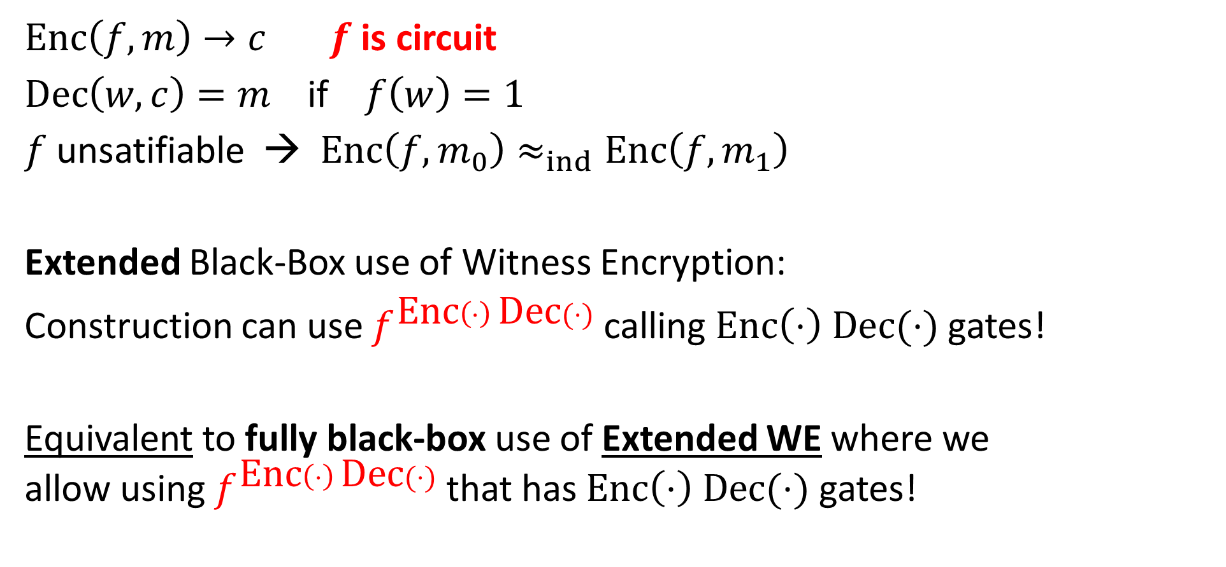
Witness Encryption
$\text{Enc}\left(f,m\right)→c$ $f$ is circuit
$\text{Dec}\left(w,c\right)=m$ if $f\left(w\right)=1$
$f$ unsatifiable → $\text{Enc}\left(f,m_{0}\right)≈_{ind}\text{Enc}\left(f,m_{1}\right)$
Extended Black-Box use of Witness Encryption:
Construction can use $f^{\text{Enc}\left(⋅\right) \text{Dec}(⋅)}$ calling $\text{Enc}\left(⋅\right) \text{Dec}(⋅)$ gates!
Equivalent to fully black-box use of Extended WE where we allow using $f^{\text{Enc}\left(⋅\right) \text{Dec}(⋅)}$ that has $\text{Enc}\left(⋅\right) \text{Dec}(⋅)$ gates!

Slide 45
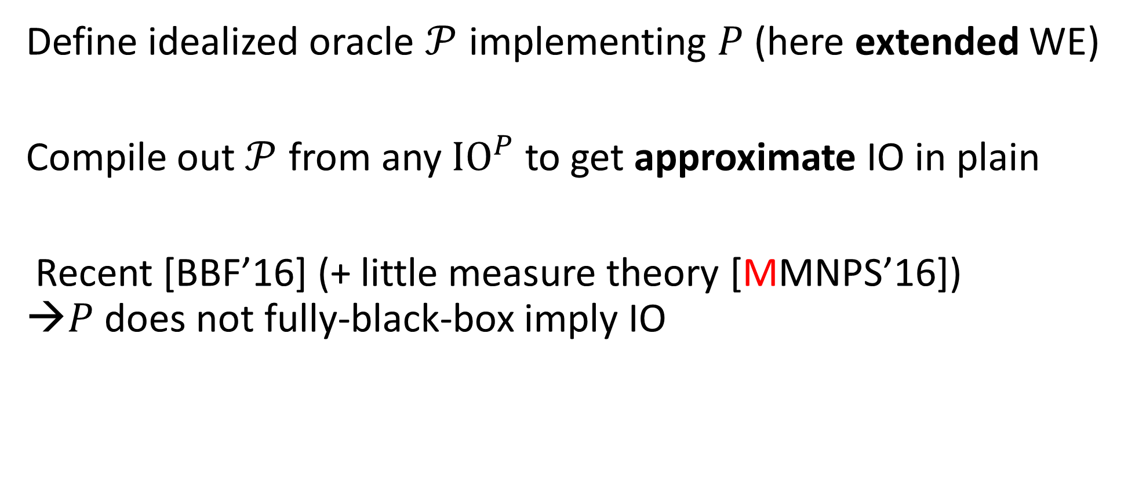
How to prove P → IO
Define idealized oracle $𝒫$ implementing $P$ (here extended WE)
Compile out $𝒫$ from any ${\text{IO}}^{P}$ to get approximate IO in plain
Recent [BBF’16] (+ little measure theory [MMNPS’16]) →$P$ does not fully-black-box imply IO
Notes:
Could work on any primitive, but we do not know how to do it for anything other tan IO!

Slide 46
Thanks!

