Slide 1
Parallel Garbage Collection in Solid State Drives (SSDs)
Narges Shahidi
PhD candidate
@ Pennsylvania State University

Slide 2
Outline
Solid State Drives
NAND Flash Chips
Update process in SSDs
Flash Translation Layer (FTL)
Garbage Collection Process
Proposed Parallel Garbage Collection
Presented in SuperComputing (SC’2016)

Slide 3

Storage Systems
SSDs replacing HDDs in Enterprise and Client applications
Increased performance ( 400 IOPS in HDD vs. >6K IOPS in SSDs)
Lower Power (6-15w in HDDs vs. 2-5w in SSDs)
Smaller form factor
Variety of device interface
No acoustic noise
Higher Price (4x HDD)
Endurance

Slide 4
What is different in NAND Flash SSDs?
NAND Flash Chip
Read/write/erase latency (100us/1000us/3~5ms)
Read 10x faster than write
Erase-before-write:
Cell value can change from 1→0, but not from 0→1.
Erase unit is block and write unit is page
Endurance: flash cells wear out
P/E cycle ( 1000 - 100000)
Results in flash capacity reduction
Block
Page-1
Page-2
...
Page-1
Page-2

Slide 5
Updating a page in SSD
Update a page is very expensive:
Read the whole block
Erase the whole block
Change one single page
Write back the whole block
Log-based update:
Write new data in any other location → need mapping table to map logical to physical addresses
Step 1: Translate LPA address to a physical page address via “Mapping Table”.
Step 2: Invalid old page and request/program a new page
Step 3: Update “Mapping table” with new physical address

Slide 6
Flash Firmware (Flash Translation Layer)
SSD needs extra space for update called over-provisioning
The capacity that is invisible to the user
SSDs have 7%-28% over-provisioned space
E.g. a 1GB SSD has 10^9 Byte (physical capacity is 2^30 =7% over-provisioning)
Need mapping of logical to physical addresses (Mapping Table)
Stale data needs to be erased to free up more space for future updates
Need Garbage Collection

Slide 7
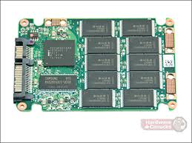
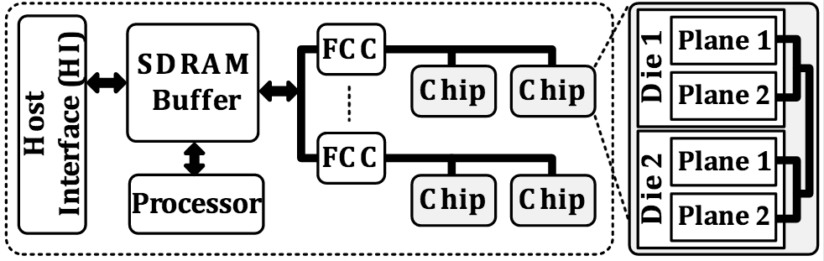
SSD Layout
Levels of parallelism:
System level parallelism: Channels and Chips
Flash level parallelism: Die and Plane
Flash-Level parallelism is not studied as much
Needs hardware supports
Flash vendors provide multi-plane/two-plane operations

Slide 8
Performance metrics in SSD
Three basic metrics:
IOPS (IO operations Per Second)
Throughput or Bandwidth (MBps)
Response Time or Latency (ms): Average and maximum response time
Access pattern of workload:
Random/Sequential - the random or sequential nature of the data address request
Block Size - the data transfer length
Read/Write ratio - the mix of read and write operation

Slide 9
Garbage Collection: Why?
Update-in-place is not possible in flash memories
Update marks pages invalid
Garbage Collection reclaims invalid pages
Garbage Collection cause high tail latency
Even a few amount of update can launch garbage collection and deny SLA
Flash chip cannot respond to IO requests during the Garbage Collection (GC) time, leads to high tail latency
Background GC is a solution, but Enterprise SSDs are 24x7

Slide 10
Garbage Collection: How?
Step 1: Select a block to erase (victim block) using GC algorithm.
Step 2: Move valid pages out of the block to another location in SSD
Step 3: Erase the block
Moving valid pages to another location in the SSD needs read and write to new location. This increase the write number to the SSD (write amplification)
More write to the SSD means more erase → reduce life time of flash cells
Moving pages occupies channels and flash chips and cause delay in servicing normal request → tail latency

Slide 11
Garbage Collection: When?
Based on the amount of free space in the SSD:
Free space < BG GC Threshold → start Background GC
Free space < GC Threshold → start on-demand GC and continue to reach BG GC Threshold
Background GC Threshold
GC Threshold

Slide 12
Performance effect of GC
Consistent and predictable performance is one of the most important metrics for storage workloads, especially in Enterprise SSDs
Tail latency penalty is harmful -- violate consistent performance
Update-in-place is not possible in flash memories
Overwrites mark old pages invalid
Garbage Collection reclaims invalid blocks result in large tail latencies
Client SSDs are 20/80 duty cycle (20 active/80 idle): higher tolerable delta between min and max response time
Enterprise SSDs use higher over-provisioned area, offer higher steady-state sustained performance

Slide 13
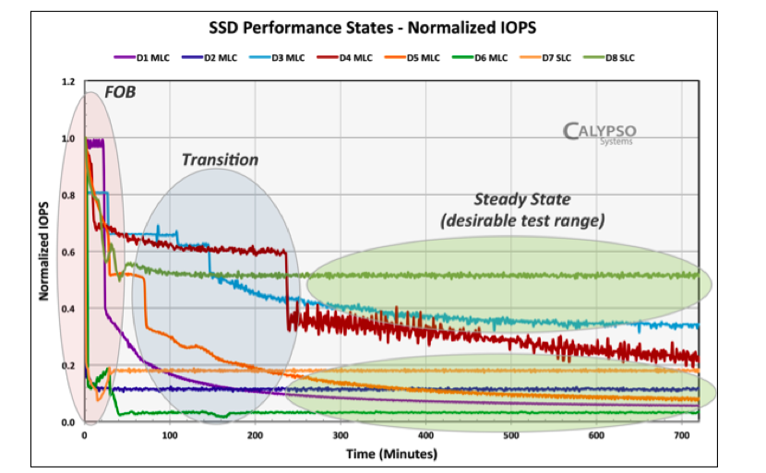
Steady State

Slide 14
“Exploiting the potential of Parallel Garbage Collection in SSDs for Enterprise Storage Systems”
Presented in: SuperComputing (SC) 2016
Salt Lake City - Utah

Slide 15
High Level of parallelism in SSDs
Levels of parallelism:
System level parallelism: Channels and Chips
Flash level parallelism: Die and Plane
Flash-Level parallelism is not studied as much
Needs hardware supports
Flash vendors provide multi-plane/two-plane operations
Multi-plane operations launches multiple reads/writes/erases at planes of the same die
Enables simultaneous operations on two pages in parallel, one in each plane
At the latency of one read/write/erase operation
Multi-plane operation can improve throughput by 100% using cache mode
Notes:
Solid state drives have four levels of parallelism, first channels,
Then channels are shared meduim and are connected to flash chips or flash packages.
A flash packages contains dies, 1, 2, or 4 dies
And within a die we have several planes
Die is the smallest independent unit, however, within a die, some flash vendors provide multi-plane operations.
Two planes of a single die cannot operate independently, but can work synchronously using multi-plane or two-plane operations.
Multi-plane operations can launch multiple read/write/erase at planes of a single die
The latency of read/write/erase operation will be the same. Channel will be the shared medium to transfer data. Using the cache mode, multi-plane operation can double the throughput
Simultaneous read and write operation to two page, and simultaneous erase operation to two block, one in each plane of a single die

Slide 16
Multi-Plane command
Restrictions on multi-plane commands:
Same physical die
Restrictions on physical address
Identical page address bits
Restrictions reduce the opportunity to leverage plane-level parallelism
Cause idle time in plane, and low plane-level utilization
The plane-level parallelism can be improved by:
Plane-first allocations improve the chance to leverage multi-plane operations
Super-page: attach pages of different planes and make a large page
Although these approach can improve flash-level parallelism, but it’s still highly depend on the workload
Notes:
Plane-first allocation strategies allocae flash-level resources rather than chip, channel in an attempt to leverage flash-level parallelism.

Slide 17
Response Time
Response time of an IO request includes waiting time and service time:
Service Time of request: Command and data transfer + operation latency
Waiting Time:
Resource Conflict: Die/Channel is busy servicing IO Request (CnGC=Conflict with non-GC operations)
Conflict with GC on the target plane (CsGC)
Conflict with GC on the other plane (CoGC)
Conflict with non-GC requests because of GC or Late Conflict (LC)
Notes:
What latency components contribute in the response time

Slide 18
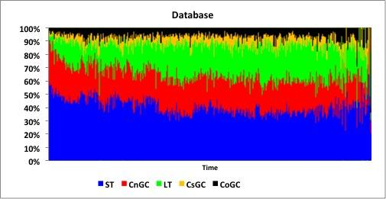
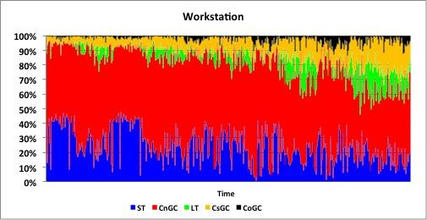
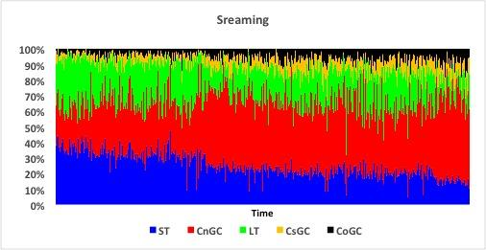
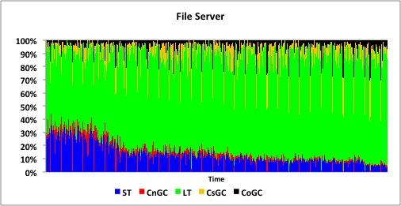
IO Request Response Time
Notes:
We considered several types of applications, and see how response time can be broken down to waiting components

Slide 19
Plane-level Parallel Garbage Collection (PaGC)
Parallel GC
IO Requests
On-demand GC
IO Requests
IDLE
Plane 1
IO Requests
IO Requests
IDLE
IO Requests
IO Requests
Plane 2
Early GC
On-demand GC
Time

Slide 20
Plane-level Parallel Garbage Collection
Why?
Leverage the idle time opportunity and improve plane-level parallelism
When?
When a plane starts On-demand GC, make it parallel GC
How?
Leverage Multi-plane operation
Garbage Collection: 1) selecting victim block 2) move valid pages 3) erasing the block
Challenges:
Multi-plane erase is straight-forward, but
Moving valid pages is more challenging

Slide 21
Parallel GC: How?
victim block
active block
Parallel Read - Parallel Write ( PR-PW)
Try to find maximum PR-PW possible moves
Can be even faster by using copy-back operations → Multi-plane Copy-Back read/write
Latency = 1 Read + 1 Write
Serial Read - Parallel Write (SR-PW)
Read is ~10x faster than Write
Read two pages in serial, write in parallel
Latency = 2 Read + 1 Write
Serial Read - Serial Write (SR-SW)
More valid pages in one of the blocks
Latency = 1 Read + 1 Write
Page-1
Plane 1
Page-2
Page-1
Page-2
victim block
active block
Page-1
Plane 2
Page-2
Page-3
Page-1
Page-3
Page-2

Slide 22
Parallel GC: How?
Plane 1
IO
On-demand GC
IO
Move Pages
Erase
Traditional GC
IO
IDLE
IO
Plane 2
IO
Parallel GC
IO
Plane 1
IO
Parallel GC
IO
Parallel GC
Plane 1
Move Pages
Erase
PR-PW / SR-PW / SR-SW
Erase
IO
IO
Plane 2
IO
Move Pages
Erase
IO
Plane 2
PR-PW / SR-PW / SR-SW
Erase

Slide 23
Parallel GC: When?
IO
Parallel GC
IO
Plane 1
PR-PW / SR-PW
IDLE
Erase
GC Th
IO
Parallel GC
IO
Plane 2
PR-PW / SR-PW
SR-SW
Erase
P1 P2
Launching Blind Parallel GC can cause very inefficient
GC and increase plane busy time
PaGC Th
GC Th
We use PaGC Th as a metric to start launching PaGC
Around 5% more than Traditional GC th in our experiments
Threshold-based Paralllel Garbage Collection (T-PaGC)
P1 P2

Slide 24
Parallel GC: When?
IO
Parallel GC
IO
Plane 1
PR-PW / SR-PW
IDLE
Erase
PaGC Th
GC Th
IO
Parallel GC
IO
Plane 2
PR-PW / SR-PW
SR-SW
Erase
P1 P2
Plane 1
IO
Parallel GC
IO
PR-PW / SR-PW
Erase
IO
Parallel GC
IO
Plane 2
PR-PW / SR-PW
SR
Erase
SW
Threshold-based Cache-aware Parallel Garbage Collection

Slide 25







Garbage Collection Efficiency
1 Block
2 Blocks

Slide 26
Experimental Results
Simulation Platform: Trace-driven simulation with SSDSim
Workloads:
UMASS Trace repository
Microsoft Research Cambridge traces
SSD Organization | Flash Organization
800GB (25% over-provisioning) | Capacity: 8GB , MLC
Host interface (PCIe 2.0) | 1 die/chip, 2 planes/die
16 channels, 8 chips/channel | Block size: 2MB Page size: 8KB
Channel rate: 333MT/s | Read/Write/Erase: 75/1500/3800 μs
Notes:
Mention that the references can be found in the paper

Slide 27
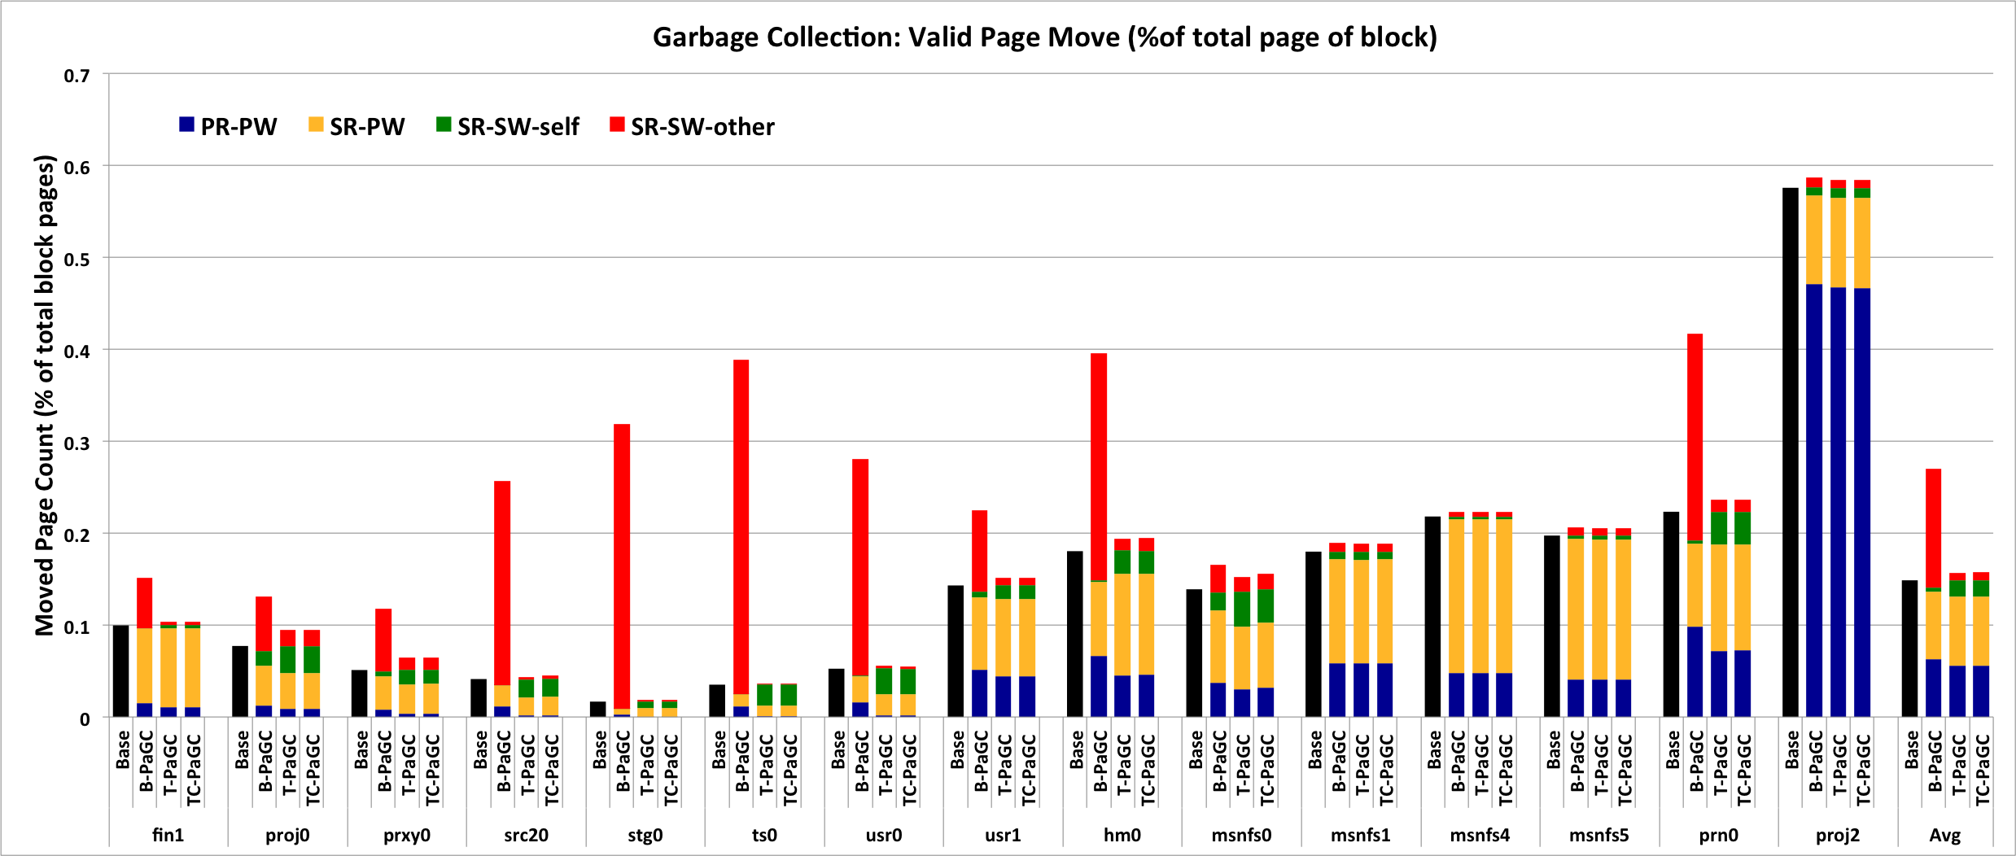
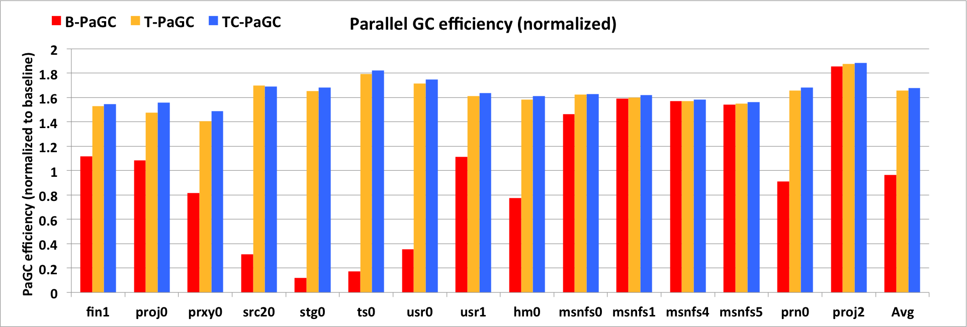
Page Move breakdown: PR-PW, SR-PW, SR-SW (self & other)
GC efficiency: PaGC normalized to baseline (Max = 2)

Slide 28
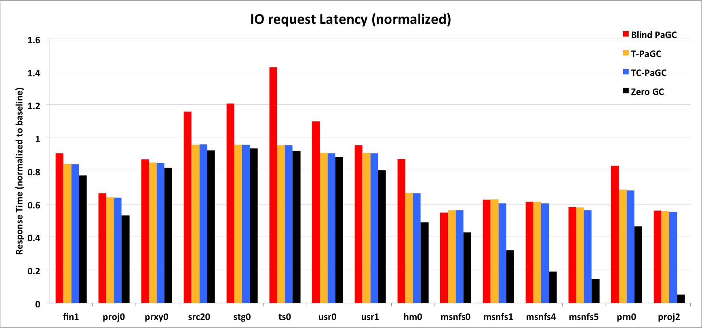
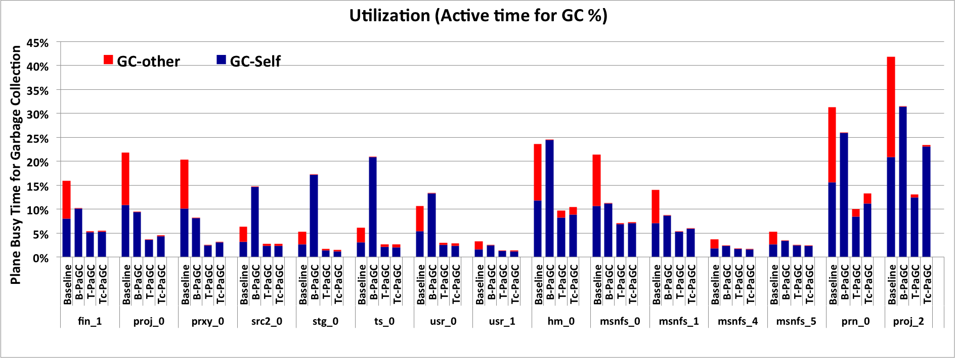
IO request Response Time
Plane GC active time (%) GC-Self: GC in plane
GC-other: GC in other plane

Slide 29
Q & A
Thanks!

Slide 30
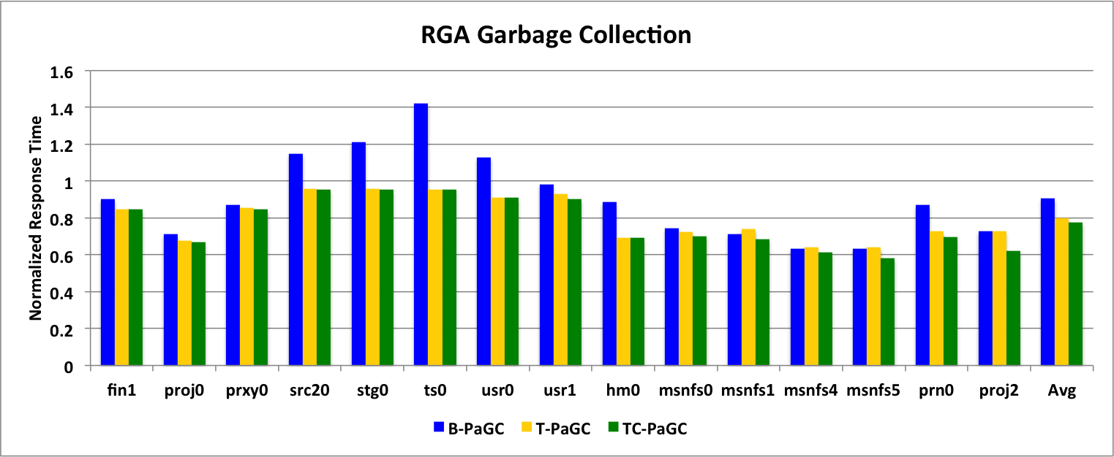
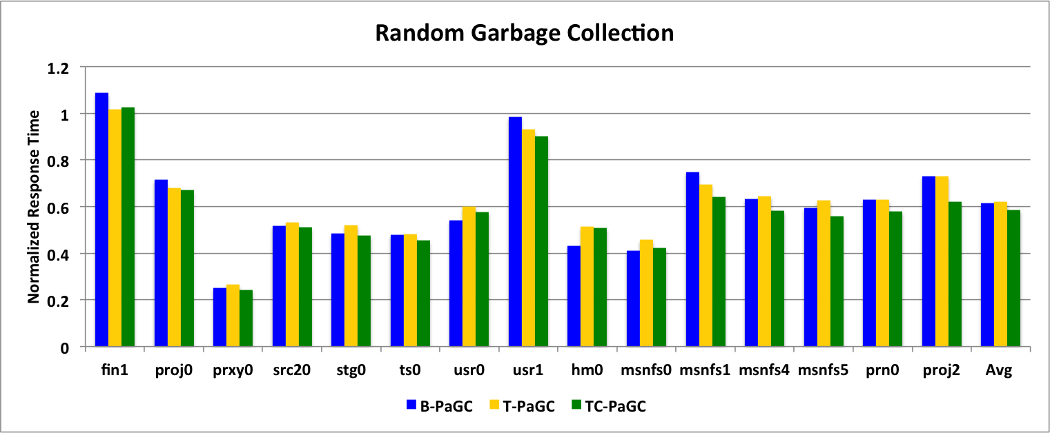
GC Selection Algorithm
Baseline: Greedy Algorithm
Select the block with minimum valid pages
RGA (Randomized Greedy Algorithm) or d-select:
select a random window of size d of pages, then use greedy algorithm within the window to select victim block
Random:
select victim block randomly

Slide 31
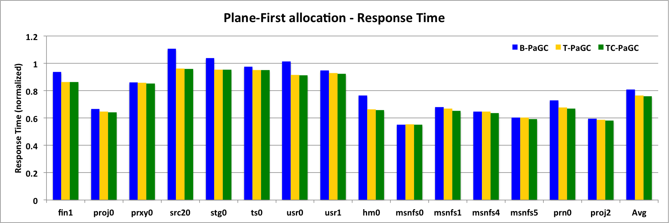
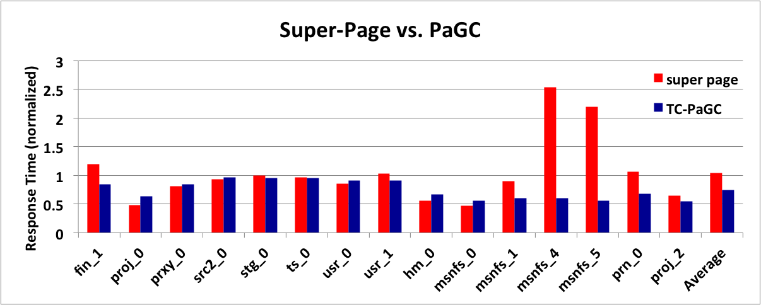
Sensitivity Analysis and Comparison
Change allocation strategy:
Plane-First allocation
Compare with Super-page

