Slide 1
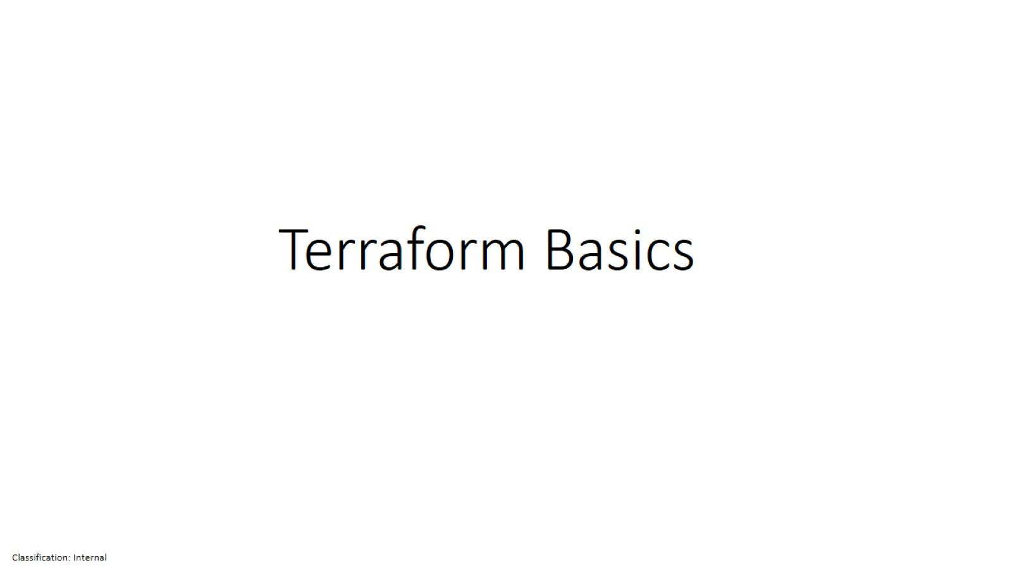
Terraform Basics

Slide 2
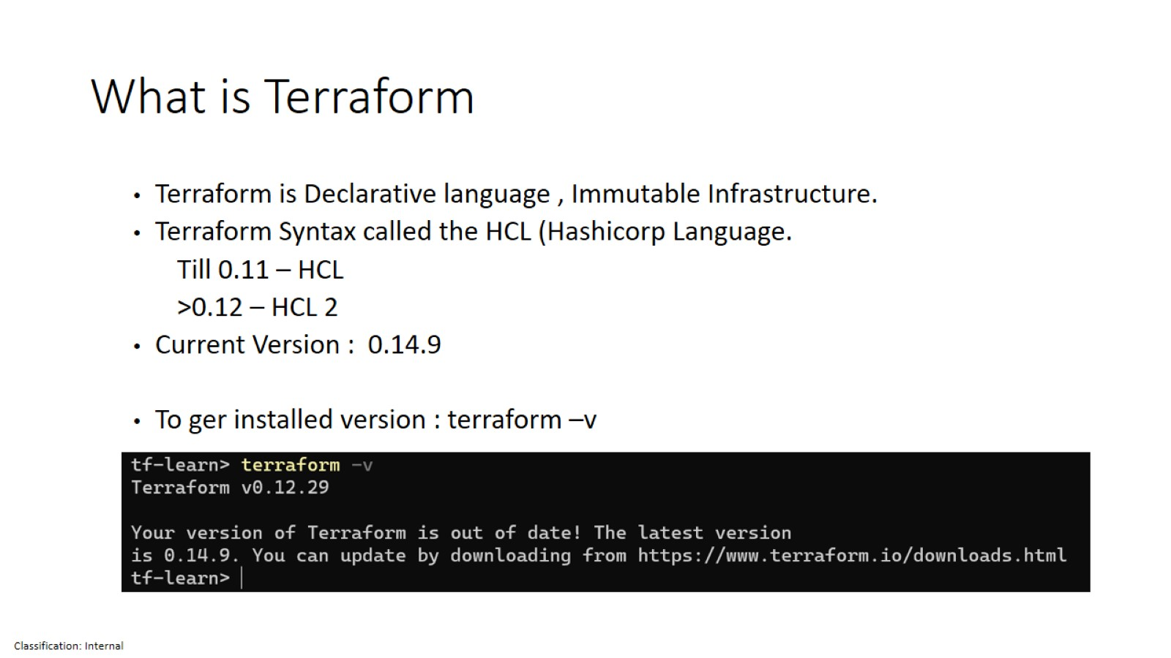
What is Terraform

Slide 3
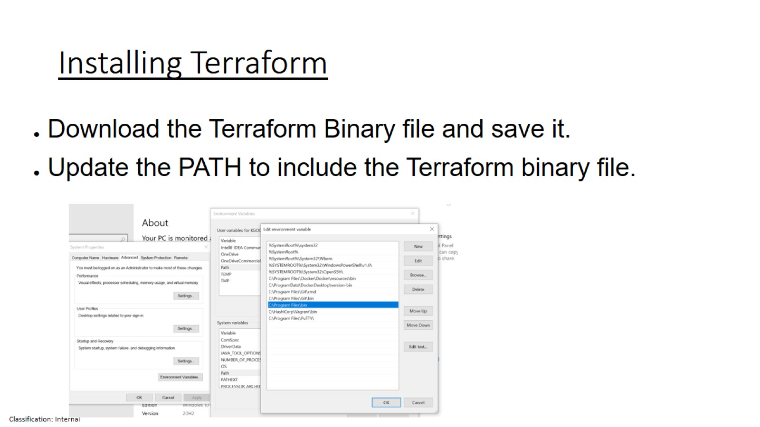
Installing Terraform

Slide 4
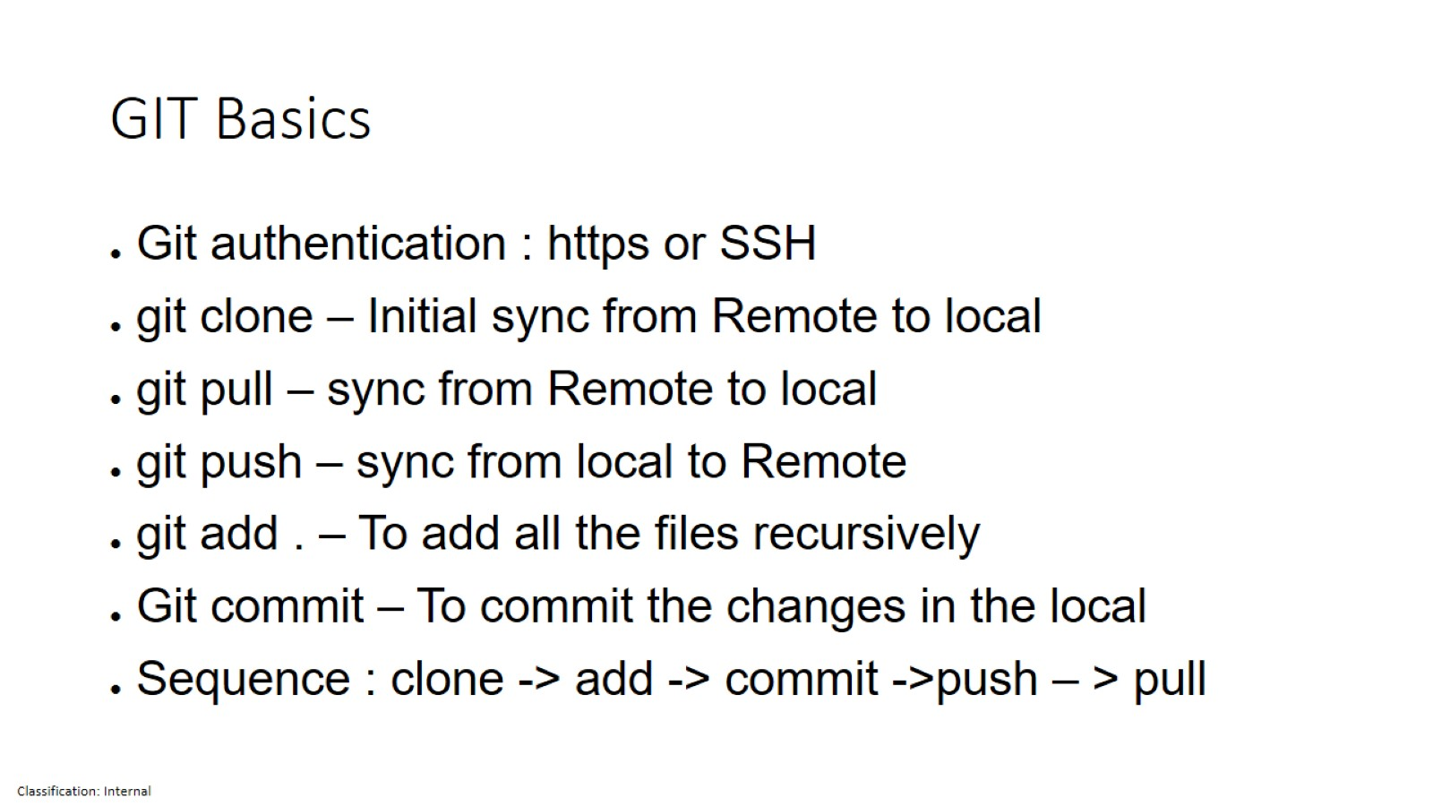
GIT Basics

Slide 5
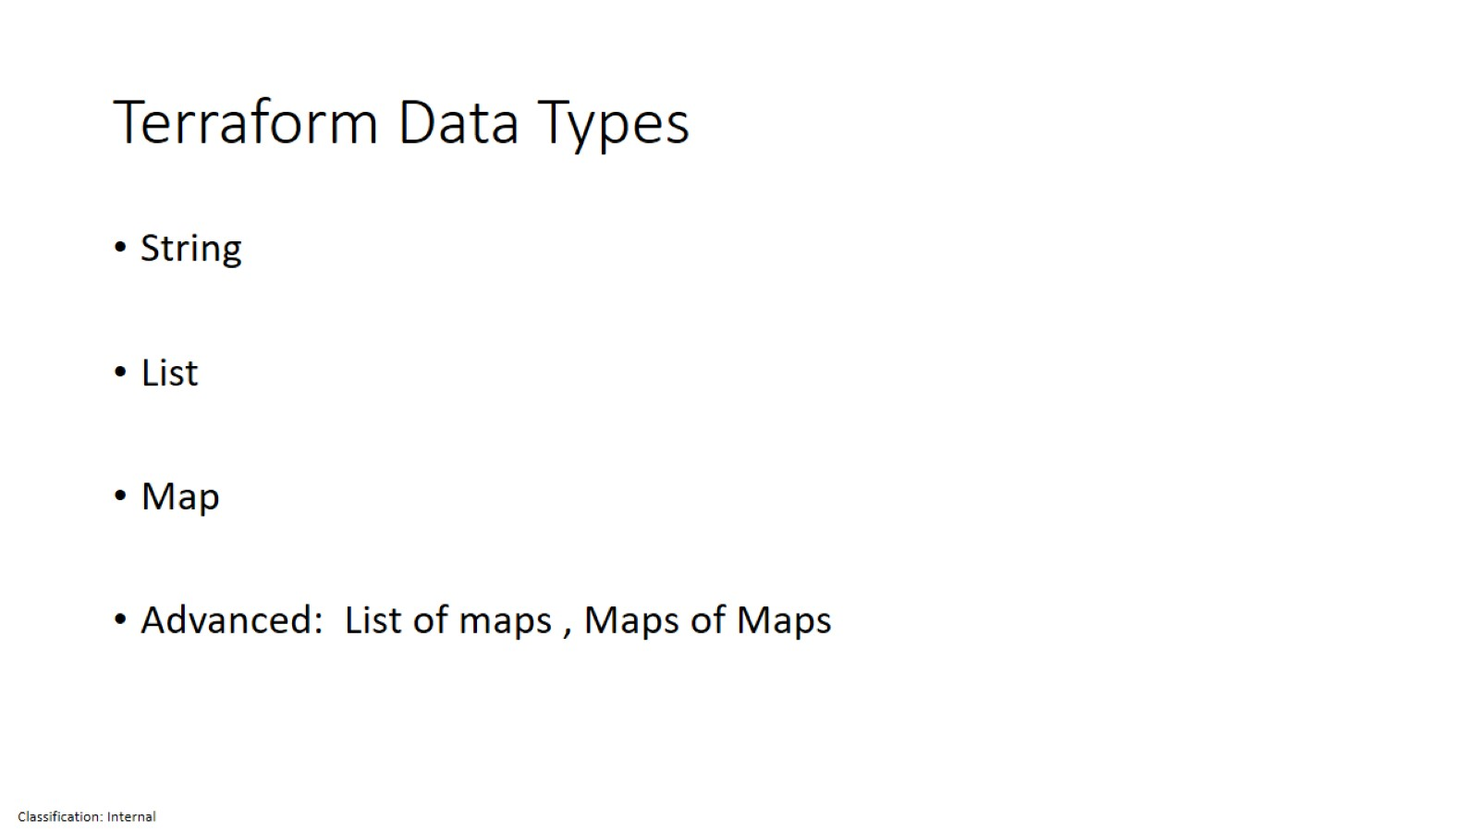
Terraform Data Types

Slide 6
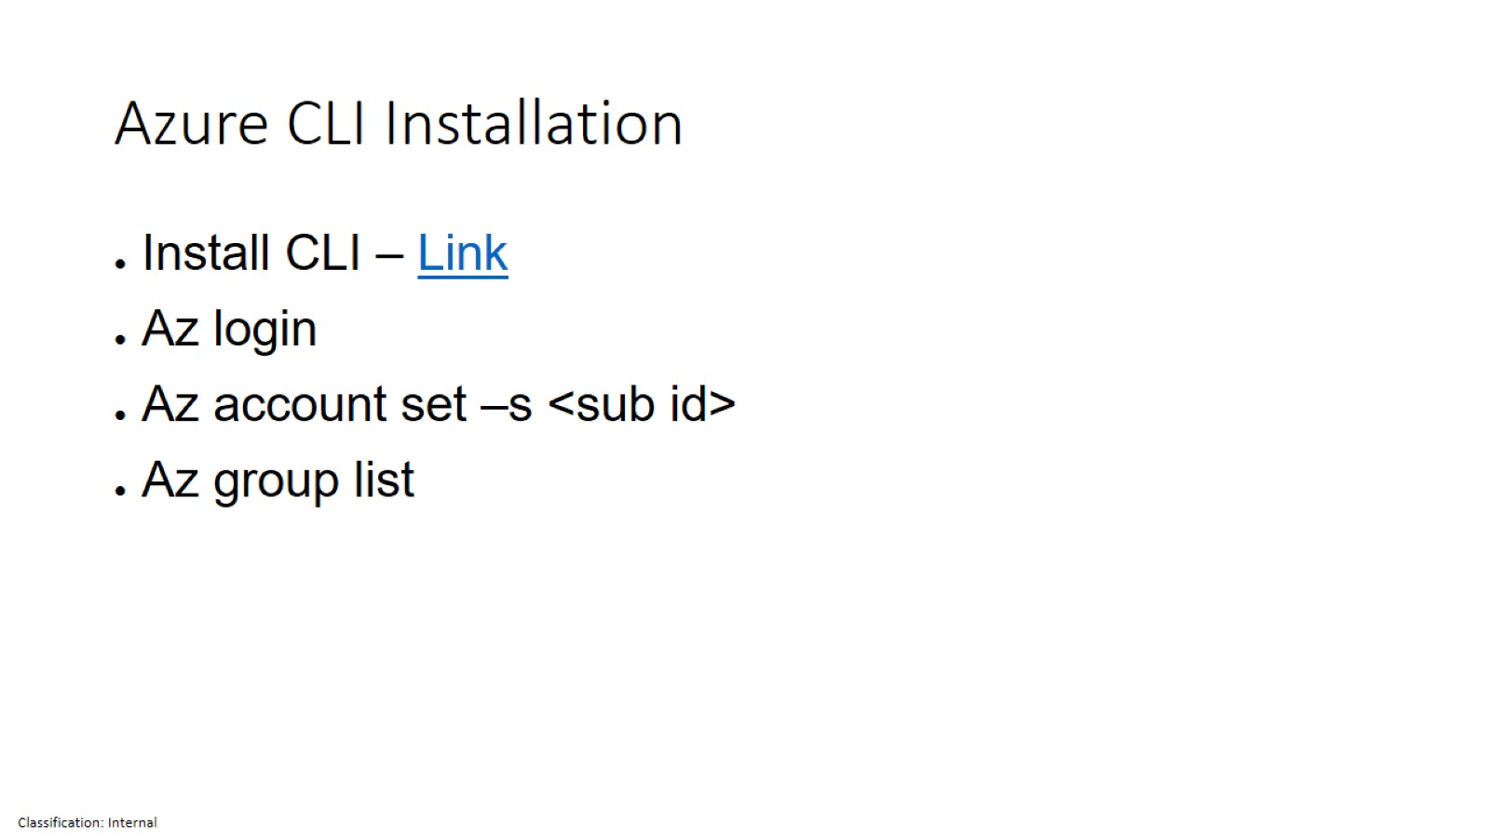
Azure CLI Installation

Slide 7
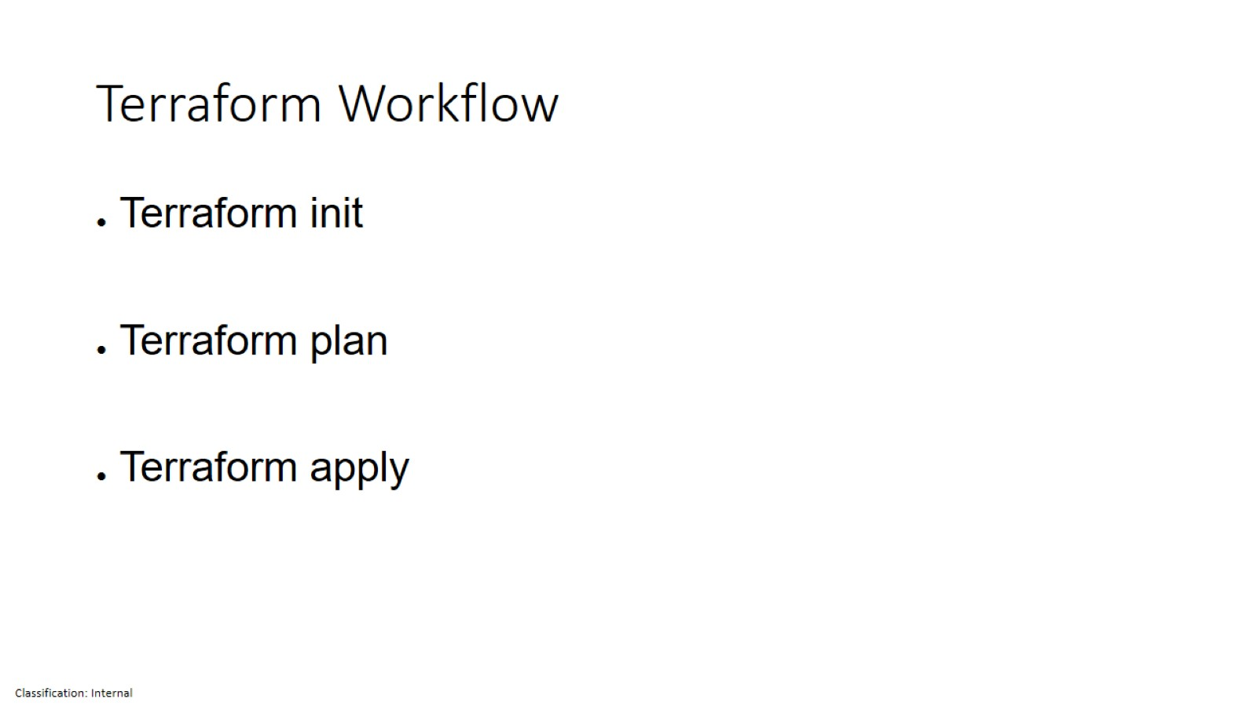
Terraform Workflow

Slide 8
Session -2

Slide 9
Topics
Review of Session 1
Terraform Variables
Different Methods of declaring variables
Var files
Tfvars
Command line passing
Terraform Modules
Use of Modules
Example of the Modules
Different type of modules
Stacks & Modules
What is Stacks and Modules
Maersk implementation of Stacks & Modules
Demo

Slide 10
Review of Session 1
Terraform Data Types
Terraform Basic provision
Git Basics

Slide 11
Different Methods of declaring variables
Environment variables
Variable files(variables.tf)
Tfvars file (variables.tfvars)
Inline variables
Environment variables

Slide 13
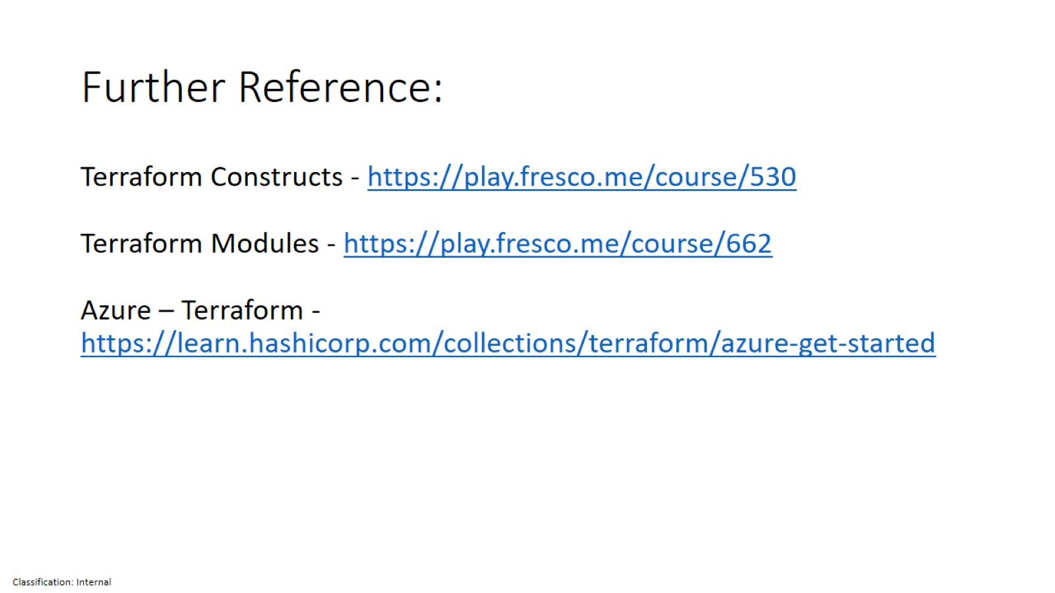
Further Reference:

