Slide 1
Imputing gene gains and losses from Ensembl Compara trees Kevin Gori
Goldman Group and Ensembl Compara meeting

Slide 2
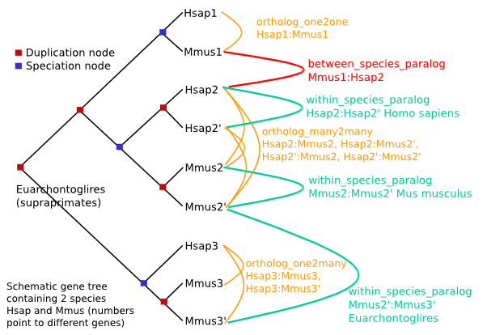
Ensembl has reconciled gene-species trees
Can we use these to estimate gene gains and losses over the species tree?

Slide 3
The website example again

Slide 4
Make it more complicated…

Slide 5
Iterate over the duplication nodes
Left:
1
1
1
1
1
Right:
1
1
1
1
1

Slide 6
Iterate over the duplication nodes
Left:
1
(1)
{0,1}
1
0
1
Right:
1
1
1
1
1

Slide 7
Iterate over the duplication nodes
Left:
1
1
1
Right:
1
1
1

Slide 8
Iterate over the duplication nodes
Left:
1
Right:
1

Slide 9
Iterate over the duplication nodes
Left:
1
Right:
1

Slide 10
The Answer (does it match?)

Slide 11
Thanks to:
Goldman Group
Ensembl Compara
Code implemented in Python using ETE2
git@github.com:kgori/ensembl_project.git

