Slide 1
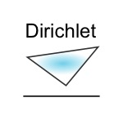
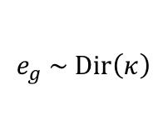
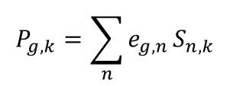
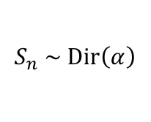
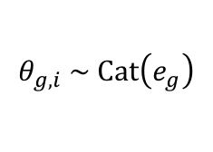
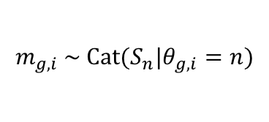
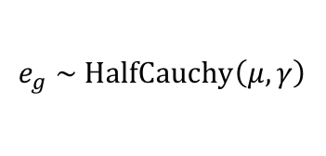
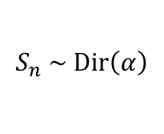
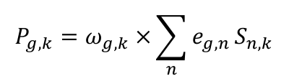
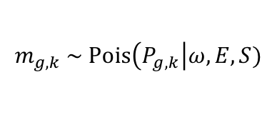
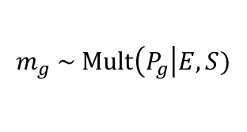
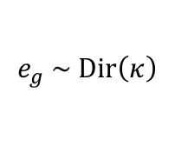
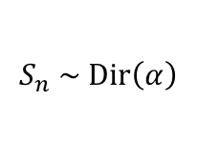
A
NMF Generative model
B
NMF Inferential model
$$e_{g} \sim \text{Dir}\left(κ\right)$$
$$e_{g} \sim \text{Dir}\left(κ\right)$$
$$S_{n} \sim \text{Dir}\left(α\right)$$
$$S_{n} \sim \text{Dir}\left(α\right)$$
$$θ_{g, i} \sim \text{Cat}\left(e_{g}\right)$$
$$P_{g,k}={\sum_{n}{e_{g, n}}S}_{n, k}$$
$$m_{g,i} \sim \text{Cat}(S_{n}|θ_{g,i}=n)$$
$$m_{g} \sim \text{Mult}\left(P_{g}\right|E,S)$$
C
EMu model
Legend
$$e_{g} \sim \text{HalfCauchy}\left(μ,γ\right)$$
Fixed value
Relationship
$$S_{n} \sim \text{Dir}\left(α\right)$$
$$P_{g,k}=ω_{g,k} ×{\sum_{n}{e_{g, n}}S}_{n, k}$$
Random variable
Probability distribution
$$m_{g,k} \sim \text{Pois}\left(P_{g,k}\right|ω,E,S)$$
Conditioning observation
Plate – indicates repeated elements within the model
Deterministic value

