Slide 1
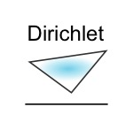
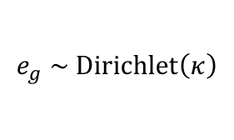
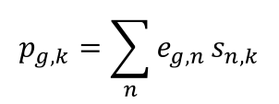
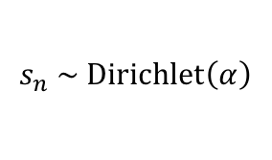
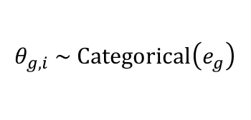
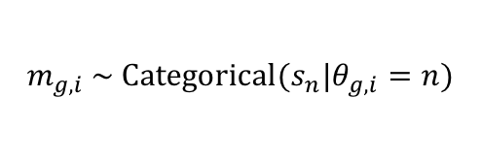
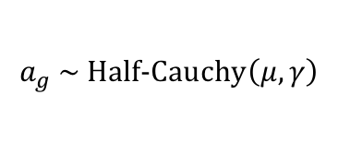
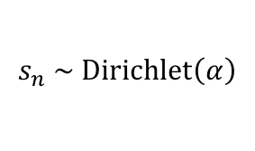
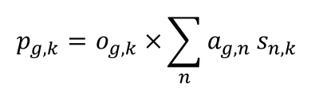
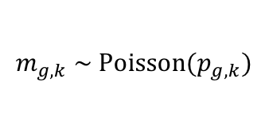
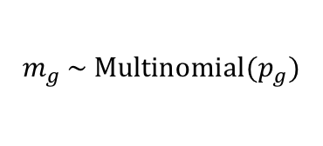
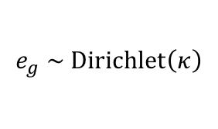
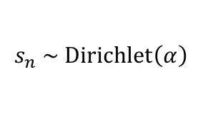
A
Generative mutational model
B
NMF model
$$e_{g} \sim \text{Dir}\text{ichlet}\left(κ\right)$$
$$e_{g} \sim \text{Dir}\text{ichlet}\left(κ\right)$$
$$s_{n} \sim \text{Dir}\text{ichlet}\left(α\right)$$
$$s_{n} \sim \text{Dir}\text{ichlet}\left(α\right)$$
$$θ_{g, i} \sim \text{Cat}\text{egorical}\left(e_{g}\right)$$
$$p_{g,k}={\sum_{n}{e_{g, n}}s}_{n, k}$$
$$m_{g,i} \sim \text{Cat}\text{egorical}(s_{n}|θ_{g,i}=n)$$
$$m_{g} \sim \text{Mult}\text{inomial}(p_{g})$$
C
EMu model
$$a_{g} \sim \text{Half}\text{-}\text{Cauchy}\left(μ,γ\right)$$
Fixed value
Dependency
$$s_{n} \sim \text{Dir}\text{ichlet}\left(α\right)$$
$$p_{g,k}=o_{g,k} ×{\sum_{n}{a_{g, n}}s}_{n, k}$$
Random variable
Probability distribution
$$m_{g,k} \sim \text{Pois}\text{son}(p_{g,k})$$
Observed data
Plate – indicates repeated elements within the model
Deterministic value
X

