Slide 1
Branch support
Molecular Phylogenetics Course 2019
Kevin Gori
kcg25@cam.ac.uk

Slide 2
Outline
Bootstrapping in general
Phylogenetic bootstrapping
Introduction
Walkthrough
Exercises
Fast approximate techniques
aLRT
aBayes
RELL
Fast bootstrapping – accelerated, not approximated
Rapid bootstrap
Ultrafast bootstrap

Slide 3
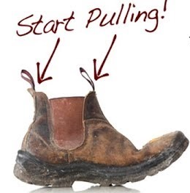
Bootstrapping
How to get something for nothing

Slide 4
Introduction to the bootstrap
Purpose
Indicates the degree of error in a statistical estimate
Why?
Generating distribution is unknown
… or difficult to work with
… or additional data sets are impossible to obtain

Slide 5
Introduction to the bootstrap
Purpose
Indicates the degree of error in a statistical estimate
How?
Gather one data set
Randomly resample, with replacement, repeatedly
Calculate statistic for each bootstrap sample
Variability indicates error

Slide 6
Phylogenetic Bootstrap
In phylogenetics the tree is our estimated statistic
Each branch is a division of taxa into groups
Bootstrapping helps us assess which groupings are statistically supported

Slide 7
Making Bootstrap Replicates
A sequence alignment is a matrix:
rows = sequences
columns = site patterns
Columns contain the information about evolutionary relationships
c
c
c
t
t
t
g
g
g
-
g
-
a
a
-
c
c
c
c
a
c
a
-
c
t
t
t
g
g
g
t
-
t
a
-
-
=
c
c
c
t
t
t
g
g
g
-
g
-
+
+
+
+ …

Slide 8
Making Bootstrap Replicates
c
c
c
t
t
t
g
g
g
-
g
-
a
a
-
c
c
c
c
a
c
a
-
c
t
t
t
g
g
g
t
-
t
a
-
-
We resample our columns – with replacement – until we have a new alignment the same size as our original

Slide 9
Making Bootstrap Replicates
c
c
c
t
t
t
g
g
g
-
g
-
a
a
-
c
c
c
c
a
c
a
-
c
t
t
t
g
g
g
t
-
t
a
-
-
We resample our columns – with replacement – until we have a new alignment the same size as our original
c
c
c

Slide 10
Making Bootstrap Replicates
c
c
c
t
t
t
g
g
g
-
g
-
a
a
-
c
c
c
c
a
c
a
-
c
t
t
t
g
g
g
t
-
t
a
-
-
We resample our columns – with replacement – until we have a new alignment the same size as our original
c
c
c
c
a
c

Slide 11
Making Bootstrap Replicates
c
c
c
t
t
t
g
g
g
-
g
-
a
a
-
c
c
c
c
a
c
a
-
c
t
t
t
g
g
g
t
-
t
a
-
-
We resample our columns – with replacement – until we have a new alignment the same size as our original
c
c
c
c
a
c
a
-
c

Slide 12
Making Bootstrap Replicates
c
c
c
t
t
t
g
g
g
-
g
-
a
a
-
c
c
c
c
a
c
a
-
c
t
t
t
g
g
g
t
-
t
a
-
-
We resample our columns – with replacement – until we have a new alignment the same size as our original
c
c
c
c
a
c
a
-
c
c
c
c

Slide 13
Making Bootstrap Replicates
c
c
c
t
t
t
g
g
g
-
g
-
a
a
-
c
c
c
c
a
c
a
-
c
t
t
t
g
g
g
t
-
t
a
-
-
We resample our columns – with replacement – until we have a new alignment the same size as our original
c
c
c
c
a
c
a
-
c
c
c
c
-
g
-

Slide 14
Making Bootstrap Replicates
c
c
c
t
t
t
g
g
g
-
g
-
a
a
-
c
c
c
c
a
c
a
-
c
t
t
t
g
g
g
t
-
t
a
-
-
We resample our columns – with replacement – until we have a new alignment the same size as our original
c
c
c
c
a
c
a
-
c
c
c
c
-
g
-
a
-
-

Slide 15
Making Bootstrap Replicates
c
c
c
t
t
t
g
g
g
-
g
-
a
a
-
c
c
c
c
a
c
a
-
c
t
t
t
g
g
g
t
-
t
a
-
-
We resample our columns – with replacement – until we have a new alignment the same size as our original
c
c
c
c
a
c
a
-
c
c
c
c
-
g
-
a
-
-
-
g
-

Slide 16
Making Bootstrap Replicates
c
c
c
t
t
t
g
g
g
-
g
-
a
a
-
c
c
c
c
a
c
a
-
c
t
t
t
g
g
g
t
-
t
a
-
-
We resample our columns – with replacement – until we have a new alignment the same size as our original
c
c
c
c
a
c
a
-
c
c
c
c
-
g
-
a
-
-
-
g
-
g
g
g

Slide 17
Making Bootstrap Replicates
c
c
c
t
t
t
g
g
g
-
g
-
a
a
-
c
c
c
c
a
c
a
-
c
t
t
t
g
g
g
t
-
t
a
-
-
We resample our columns – with replacement – until we have a new alignment the same size as our original
c
c
c
c
a
c
a
-
c
c
c
c
-
g
-
a
-
-
-
g
-
g
g
g
g
g
g

Slide 18
Making Bootstrap Replicates
c
c
c
t
t
t
g
g
g
-
g
-
a
a
-
c
c
c
c
a
c
a
-
c
t
t
t
g
g
g
t
-
t
a
-
-
We resample our columns – with replacement – until we have a new alignment the same size as our original
c
c
c
c
a
c
a
-
c
c
c
c
-
g
-
a
-
-
-
g
-
g
g
g
g
g
g
c
c
c

Slide 19
Making Bootstrap Replicates
c
c
c
t
t
t
g
g
g
-
g
-
a
a
-
c
c
c
c
a
c
a
-
c
t
t
t
g
g
g
t
-
t
a
-
-
We resample our columns – with replacement – until we have a new alignment the same size as our original
c
c
c
c
a
c
a
-
c
c
c
c
-
g
-
a
-
-
-
g
-
g
g
g
g
g
g
c
c
c
t
t
t

Slide 20
Making Bootstrap Replicates
c
c
c
t
t
t
g
g
g
-
g
-
a
a
-
c
c
c
c
a
c
a
-
c
t
t
t
g
g
g
t
-
t
a
-
-
We resample our columns – with replacement – until we have a new alignment the same size as our original
c
c
c
c
a
c
a
-
c
c
c
c
-
g
-
a
-
-
-
g
-
g
g
g
g
g
g
c
c
c
t
t
t
a
-
-

Slide 21
Making Bootstrap Replicates
c
c
c
t
t
t
g
g
g
-
g
-
a
a
-
c
c
c
c
a
c
a
-
c
t
t
t
g
g
g
t
-
t
a
-
-
We resample our columns – with replacement – until we have a new alignment the same size as our original
Some columns are sampled more than once
c
c
c
c
a
c
a
-
c
c
c
c
-
g
-
a
-
-
-
g
-
g
g
g
g
g
g
c
c
c
t
t
t
a
-
-

Slide 22
Making Bootstrap Replicates
c
c
c
t
t
t
g
g
g
-
g
-
a
a
-
c
c
c
c
a
c
a
-
c
t
t
t
g
g
g
t
-
t
a
-
-
We resample our columns – with replacement – until we have a new alignment the same size as our original
Some columns are sampled more than once
Some are not sampled at all
c
c
c
c
a
c
a
-
c
c
c
c
-
g
-
a
-
-
-
g
-
g
g
g
g
g
g
c
c
c
t
t
t
a
-
-

Slide 23
Making Bootstrap Replicates
c
c
c
t
t
t
g
g
g
-
g
-
a
a
-
c
c
c
c
a
c
a
-
c
t
t
t
g
g
g
t
-
t
a
-
-
We do this some large number of times (100-1000 is typical)
Then we calculate a new tree – exactly the same way as for our original data – for each replicate
Finally, we use the bootstrap trees to tell us something about the reliability of the original tree
c
c
c
c
a
c
a
-
c
c
c
c
-
g
-
a
-
-
-
g
-
g
g
g
g
g
g
c
c
c
t
t
t
a
-
-

Slide 24
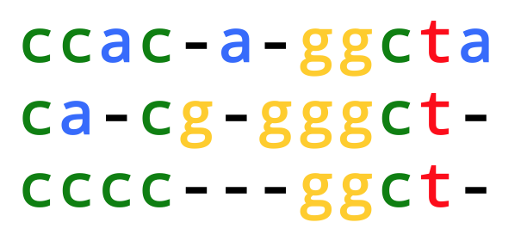
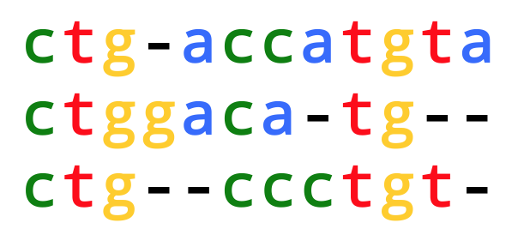
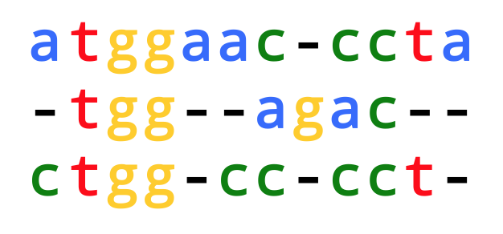
From replicates to trees
1.
2.
…
100.

Slide 25
What do bootstrap trees tell us?
a
b
Bootstrap trees show us a number of plausible relationships between species
The original tree shows us just one set of relationships
We can map the relationships – and their frequencies – in the bootstrap sample back on to the original tree
We do this using splits
c
e
d

Slide 26
Trees as splits
a
b
Every edge on a tree represents a split – deleting the edge splits the tree into two groups
Deleting the edge leading to b gives us the split b | acde
delete
c
e
d

Slide 27
Trees as splits
a
b
Every edge on a tree represents a split – deleting the edge splits the tree into two groups
Deleting the edge leading to b gives us the split b | acde
delete
c
e
d

Slide 28
Trees as splits
a
b
Every edge on a tree represents a split – deleting the edge splits the tree into two groups
Deleting the edge leading to b gives us the split b | acde
delete
c
e
d

Slide 29
Trees as splits
a
b
Every edge on a tree represents a split – deleting the edge splits the tree into two groups
Deleting the edge here gives us the split abc | de
c
delete
e
d

Slide 30
Trees as splits
a
b
Every edge on a tree represents a split – deleting the edge splits the tree into two groups
Deleting the edge here gives us the split abc | de
c
delete
e
d

Slide 31
Trees as splits
a
b
Every edge on a tree represents a split – deleting the edge splits the tree into two groups
Deleting the edge here gives us the split abc | de
And here, ab | cde
delete
c
e
d

Slide 32
Trees as splits
a
b
Every edge on a tree represents a split – deleting the edge splits the tree into two groups
Deleting the edge here gives us the split abc | de
And here, ab | cde
delete
c
e
d

Slide 33
Trees as splits
a
b
Splits leading to leaves are the same on any tree on the same taxa – they are called “trivial splits”, and are ignored
c
e
d

Slide 34
Exercise 1
What are the splits on these trees? Ignore trivial splits
1.
e
2.
e
3.
d
4.
e
f
f
f
b
f
d
d
a
c
a
c
c
e
a
d
a
b
b
b
c

Slide 35
Add bootstrap values to the original tree
Find the splits present in the original tree
Count each split’s frequency in the bootstrap sample, and divide by the size of the sample – this is the bootstrap split frequency
Map this value onto the edge in the original tree that encodes the split

Slide 36
Exercise 2
These trees appear in a bootstrap sample. The number of times they appear, out of 100, is given. The left-hand tree (n=70) is the original tree – what are its bootstrap values? (Ignore trivial splits)
e
e
d
e
n=70
f
n=15
f
n=5
f
b
f
d
d
a
n=10
c
a
c
c
e
a
d
a
b
b
b
c
ab|cdef
cd|abef
ef|abcd
ab|cdef
abc|def
ef|abcd
ac|bdef
be|acdf
df|abce
ac|bdef
acd|bef
ef|abcd
Notes:
70 85 95

Slide 37
Fast Approximate Techniques
aLRT, aBayes, RELL

Slide 38
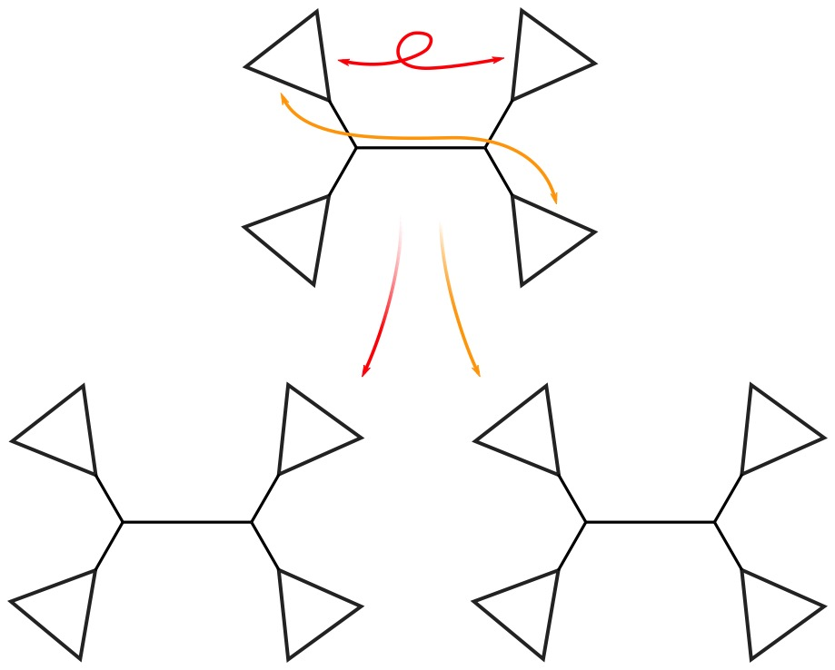
aLRT – approx. Likelihood Ratio Test
Starting with fully optimised, maximum likelihood tree,
For each internal branch:
Make two nearest neighbours by switching subtrees (NNI)
A
B
C
D
B
A
D
B
C
D
C
A

Slide 39
aLRT – approx. Likelihood Ratio Test
Starting with fully optimised, maximum likelihood tree,
For each internal branch:
Make two nearest neighbours by switching subtrees (NNI)
NNI = Nearest
neighbour
interchange
A
B
C
D
B
A
D
B
C
D
C
A

Slide 40
aLRT – approx. Likelihood Ratio Test
Starting with fully optimised, maximum likelihood tree,
For each internal branch:
Make two nearest neighbours by switching subtrees (NNI)
Optimise new branches and calculate new likelihoods
NNI = Nearest
neighbour
interchange
A
B
C
D
B
A
D
B
C
D
C
A

Slide 41
aLRT – approx. Likelihood Ratio Test
Starting with fully optimised, maximum likelihood tree,
For each internal branch:
Make two nearest neighbours by switching subtrees (NNI)
Optimise new branches and calculate new likelihoods
Compute approximate likelihood ratio test statistic
NNI = Nearest
neighbour
interchange
A
B
C
D
B
A
D
B
aLRT statistic =
= 4
C
D
C
A

Slide 42
aLRT – approx. Likelihood Ratio Test
Starting with fully optimised, maximum likelihood tree,
For each internal branch:
Make two nearest neighbours by switching subtrees (NNI)
Optimise new branches and calculate new likelihoods
Compute approximate likelihood ratio test statistic
p-value is branch support
NNI = Nearest
neighbour
interchange
A
B
C
D
B
A
D
B
Mixture of Chi-squared distributions (corrected for multiple testing)
C
D
C
A
p = 0.966

Slide 43
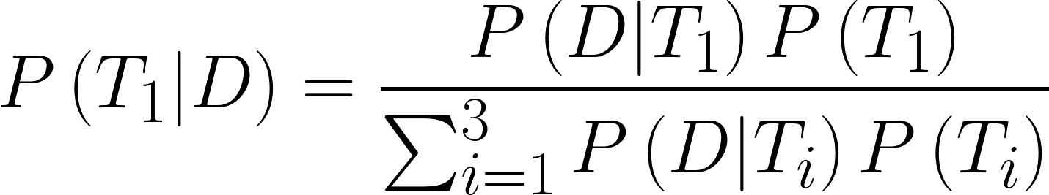
aBayes – approximate Bayes
Bayesian alternative to aLRT
Produce & optimise three NNI trees, as with aLRT
Posterior probability ∝ Likelihood × prior probability
Normalising term is simple, only three configurations
Probability of tree given data+model
Equal priors:

Slide 44
aBayes – approximate Bayes
Bayesian alternative to aLRT
Produce & optimise three NNI trees, as with aLRT
Posterior probability ∝ Likelihood × prior probability
Normalising term is simple, only three configurations
Equal priors cancel out
Probability of tree given data+model
Equal priors:

Slide 45
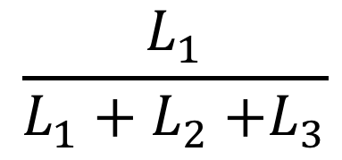
aBayes – approximate Bayes
Bayesian alternative to aLRT
Produce & optimise three NNI trees, as with aLRT
Posterior probability ∝ Likelihood × prior probability
Normalising term is simple, only three configurations
Simplifies to calculation involving three likelihoods (note: not log-likelihoods)
Probability of tree given data+model
Simplifies:
aBayes =
$$\frac{L_{1}}{L_{1}+L_{2}{+L}_{3}}$$

Slide 46
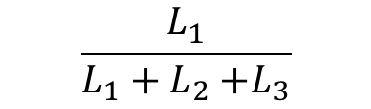
Exercise 3
We are calculating the aBayes value for a branch. If the log-likelihood of the tree is -1, and the log-likelihoods of the two NNI rearrangements are -3 and -4, what is the aBayes value?
As for question 1, but the log-likelihood of the tree is -2, and the log-likelihoods of the two NNI rearrangements are -4 and -5, what is the aBayes value?
$$\frac{L_{1}}{L_{1}+L_{2}{+L}_{3}}$$
log-Lik | -1 | -2 | -3 | -4 | -5
Lik | 0.368 | 0.135 | 0.0500 | 0.0183 | 0.00674
aBayes =
Notes:
Q1: exp(-1) / sum(exp(c(-1, -3, -4)))
Q2: exp(-2) / sum(exp(c(-2, -4, -5)))

Slide 47
Fast local bootstrap and SH-aLRT
These two methods use Resampled Estimated Log-Likelihoods (RELL)
How to RELL:
Randomly resample with replacement the sitewise likelihoods
Branch support is frequency among RELL samples that
T1 > max(T2, T3) (local bootstrap)
T1 passes modified Shimodaira-Hasegawa test (SH-aLRT)
A
B
1: Find the neighbour trees as in aLRT
C
D
2: Reoptimise branches
B
A
D
B
C
D
C
A
3: Calculate likelihoods per-site

Slide 48
Fast local bootstrap and SH-aLRT
Calculate sitewise log-likelihoods for each of the 3 trees
c
c
c
t
t
t
g
g
g
-
g
-
a
a
-
c
c
c
c
a
c
a
-
c
t
t
t
g
g
g
t
-
t
a
-
-
…
-1.2
-1.4
-1.4
-0.8
-0.9
-1.1
-1.0
-1.0
-1.0
-0.4
-0.6
-0.5
-2.1
-2.4
-2.5
-0.8
-0.7
-0.9
-0.5
-1.0
-1.0
-1.1
-1.3
-1.3
-1.3
-1.4
-1.5
-2.1
-2.0
-1.9
-0.6
-1.0
-0.9
-0.9
-0.9
-0.9
Notes:
RELL = bootstrap resampled sitewise likelihoods.
Values for 3 trees are shown – black = ML tree; red = NNI 1; orange = NNI 2
Usually ML tree has higher likelihood, but some sites are exceptions

Slide 49
Fast local bootstrap and SH-aLRT
Resample Estimated Log-Likelihoods (RELL)
c
c
c
t
t
t
g
g
g
-
g
-
a
a
-
c
c
c
c
a
c
a
-
c
t
t
t
g
g
g
t
-
t
a
-
-
…
-1.2
-1.4
-1.4
-0.8
-0.9
-1.1
-1.0
-1.0
-1.0
-0.4
-0.6
-0.5
-2.1
-2.4
-2.5
-0.8
-0.7
-0.9
-0.5
-1.0
-1.0
-1.1
-1.3
-1.3
-1.3
-1.4
-1.5
-2.1
-2.0
-1.9
-0.6
-1.0
-0.9
-0.9
-0.9
-0.9

Slide 50
Fast local bootstrap and SH-aLRT
Resample Estimated Log-Likelihoods (RELL)
c
c
c
t
t
t
g
g
g
-
g
-
a
a
-
c
c
c
c
a
c
a
-
c
t
t
t
g
g
g
t
-
t
a
-
-
…
-1.2
-1.4
-1.4
-0.8
-0.9
-1.1
-1.0
-1.0
-1.0
-0.4
-0.6
-0.5
-2.1
-2.4
-2.5
-0.8
-0.7
-0.9
-0.5
-1.0
-1.0
-1.1
-1.3
-1.3
-1.3
-1.4
-1.5
-2.1
-2.0
-1.9
-0.6
-1.0
-0.9
-0.9
-0.9
-0.9
-0.8
-0.9
-1.1

Slide 51
Fast local bootstrap and SH-aLRT
Resample Estimated Log-Likelihoods (RELL)
c
c
c
t
t
t
g
g
g
-
g
-
a
a
-
c
c
c
c
a
c
a
-
c
t
t
t
g
g
g
t
-
t
a
-
-
…
-1.2
-1.4
-1.4
-0.8
-0.9
-1.1
-1.0
-1.0
-1.0
-0.4
-0.6
-0.5
-2.1
-2.4
-2.5
-0.8
-0.7
-0.9
-0.5
-1.0
-1.0
-1.1
-1.3
-1.3
-1.3
-1.4
-1.5
-2.1
-2.0
-1.9
-0.6
-1.0
-0.9
-0.9
-0.9
-0.9
-0.8
-0.9
-1.1
-0.5
-1.0
-1.0

Slide 52
Fast local bootstrap and SH-aLRT
Resample Estimated Log-Likelihoods (RELL)
c
c
c
t
t
t
g
g
g
-
g
-
a
a
-
c
c
c
c
a
c
a
-
c
t
t
t
g
g
g
t
-
t
a
-
-
…
-1.2
-1.4
-1.4
-0.8
-0.9
-1.1
-1.0
-1.0
-1.0
-0.4
-0.6
-0.5
-2.1
-2.4
-2.5
-0.8
-0.7
-0.9
-0.5
-1.0
-1.0
-1.1
-1.3
-1.3
-1.3
-1.4
-1.5
-2.1
-2.0
-1.9
-0.6
-1.0
-0.9
-0.9
-0.9
-0.9
-0.8
-0.9
-1.1
-0.5
-1.0
-1.0
-0.8
-0.7
-0.9

Slide 53
Fast local bootstrap and SH-aLRT
Resample Estimated Log-Likelihoods (RELL)
c
c
c
t
t
t
g
g
g
-
g
-
a
a
-
c
c
c
c
a
c
a
-
c
t
t
t
g
g
g
t
-
t
a
-
-
…
-1.2
-1.4
-1.4
-0.8
-0.9
-1.1
-1.0
-1.0
-1.0
-0.4
-0.6
-0.5
-2.1
-2.4
-2.5
-0.8
-0.7
-0.9
-0.5
-1.0
-1.0
-1.1
-1.3
-1.3
-1.3
-1.4
-1.5
-2.1
-2.0
-1.9
-0.6
-1.0
-0.9
-0.9
-0.9
-0.9
-0.8
-0.9
-1.1
-0.5
-1.0
-1.0
-0.8
-0.7
-0.9
-2.1
-2.0
-1.9

Slide 54
Fast local bootstrap and SH-aLRT
Resample Estimated Log-Likelihoods (RELL)
c
c
c
t
t
t
g
g
g
-
g
-
a
a
-
c
c
c
c
a
c
a
-
c
t
t
t
g
g
g
t
-
t
a
-
-
…
-1.2
-1.4
-1.4
-0.8
-0.9
-1.1
-1.0
-1.0
-1.0
-0.4
-0.6
-0.5
-2.1
-2.4
-2.5
-0.8
-0.7
-0.9
-0.5
-1.0
-1.0
-1.1
-1.3
-1.3
-1.3
-1.4
-1.5
-2.1
-2.0
-1.9
-0.6
-1.0
-0.9
-0.9
-0.9
-0.9
-0.8
-0.9
-1.1
-0.5
-1.0
-1.0
-0.8
-0.7
-0.9
-2.1
-2.0
-1.9
-0.8
-0.9
-1.1

Slide 55
Fast local bootstrap and SH-aLRT
Resample Estimated Log-Likelihoods (RELL)
c
c
c
t
t
t
g
g
g
-
g
-
a
a
-
c
c
c
c
a
c
a
-
c
t
t
t
g
g
g
t
-
t
a
-
-
…
-1.2
-1.4
-1.4
-0.8
-0.9
-1.1
-1.0
-1.0
-1.0
-0.4
-0.6
-0.5
-2.1
-2.4
-2.5
-0.8
-0.7
-0.9
-0.5
-1.0
-1.0
-1.1
-1.3
-1.3
-1.3
-1.4
-1.5
-2.1
-2.0
-1.9
-0.6
-1.0
-0.9
-0.9
-0.9
-0.9
-0.8
-0.9
-1.1
-0.5
-1.0
-1.0
-0.8
-0.7
-0.9
-2.1
-2.0
-1.9
-0.8
-0.9
-1.1
-0.4
-0.6
-0.5

Slide 56
Fast local bootstrap and SH-aLRT
Resample Estimated Log-Likelihoods (RELL)
c
c
c
t
t
t
g
g
g
-
g
-
a
a
-
c
c
c
c
a
c
a
-
c
t
t
t
g
g
g
t
-
t
a
-
-
…
-1.2
-1.4
-1.4
-0.8
-0.9
-1.1
-1.0
-1.0
-1.0
-0.4
-0.6
-0.5
-2.1
-2.4
-2.5
-0.8
-0.7
-0.9
-0.5
-1.0
-1.0
-1.1
-1.3
-1.3
-1.3
-1.4
-1.5
-2.1
-2.0
-1.9
-0.6
-1.0
-0.9
-0.9
-0.9
-0.9
-0.8
-0.9
-1.1
-0.5
-1.0
-1.0
-0.8
-0.7
-0.9
-2.1
-2.0
-1.9
-0.8
-0.9
-1.1
-0.4
-0.6
-0.5
-2.1
-2.0
-1.9

Slide 57
Fast local bootstrap and SH-aLRT
Resample Estimated Log-Likelihoods (RELL)
c
c
c
t
t
t
g
g
g
-
g
-
a
a
-
c
c
c
c
a
c
a
-
c
t
t
t
g
g
g
t
-
t
a
-
-
…
-1.2
-1.4
-1.4
-0.8
-0.9
-1.1
-1.0
-1.0
-1.0
-0.4
-0.6
-0.5
-2.1
-2.4
-2.5
-0.8
-0.7
-0.9
-0.5
-1.0
-1.0
-1.1
-1.3
-1.3
-1.3
-1.4
-1.5
-2.1
-2.0
-1.9
-0.6
-1.0
-0.9
-0.9
-0.9
-0.9
-0.8
-0.9
-1.1
-0.5
-1.0
-1.0
-0.8
-0.7
-0.9
-2.1
-2.0
-1.9
-0.8
-0.9
-1.1
-0.4
-0.6
-0.5
-2.1
-2.0
-1.9
-2.1
-2.4
-2.5

Slide 58
Fast local bootstrap and SH-aLRT
Resample Estimated Log-Likelihoods (RELL)
c
c
c
t
t
t
g
g
g
-
g
-
a
a
-
c
c
c
c
a
c
a
-
c
t
t
t
g
g
g
t
-
t
a
-
-
…
-1.2
-1.4
-1.4
-0.8
-0.9
-1.1
-1.0
-1.0
-1.0
-0.4
-0.6
-0.5
-2.1
-2.4
-2.5
-0.8
-0.7
-0.9
-0.5
-1.0
-1.0
-1.1
-1.3
-1.3
-1.3
-1.4
-1.5
-2.1
-2.0
-1.9
-0.6
-1.0
-0.9
-0.9
-0.9
-0.9
-0.8
-0.9
-1.1
-0.5
-1.0
-1.0
-0.8
-0.7
-0.9
-2.1
-2.0
-1.9
-0.8
-0.9
-1.1
-0.4
-0.6
-0.5
-2.1
-2.0
-1.9
-2.1
-2.4
-2.5
-0.5
-1.0
-1.0
Notes:
RELL = bootstrap resampled sitewise likelihoods.
Values for 3 trees are shown – black = ML tree; red = NNI 1; orange = NNI 2
Usually ML tree has higher likelihood, but some sites are exceptions

Slide 59
Fast local bootstrap and SH-aLRT
Resample Estimated Log-Likelihoods (RELL)
c
c
c
t
t
t
g
g
g
-
g
-
a
a
-
c
c
c
c
a
c
a
-
c
t
t
t
g
g
g
t
-
t
a
-
-
…
-1.2
-1.4
-1.4
-0.8
-0.9
-1.1
-1.0
-1.0
-1.0
-0.4
-0.6
-0.5
-2.1
-2.4
-2.5
-0.8
-0.7
-0.9
-0.5
-1.0
-1.0
-1.1
-1.3
-1.3
-1.3
-1.4
-1.5
-2.1
-2.0
-1.9
-0.6
-1.0
-0.9
-0.9
-0.9
-0.9
-0.8
-0.9
-1.1
-0.5
-1.0
-1.0
-0.8
-0.7
-0.9
-2.1
-2.0
-1.9
-0.8
-0.9
-1.1
-0.4
-0.6
-0.5
-2.1
-2.0
-1.9
-2.1
-2.4
-2.5
-0.5
-1.0
-1.0
-0.6
-1.0
-0.9

Slide 60
Fast local bootstrap and SH-aLRT
Resample Estimated Log-Likelihoods (RELL)
c
c
c
t
t
t
g
g
g
-
g
-
a
a
-
c
c
c
c
a
c
a
-
c
t
t
t
g
g
g
t
-
t
a
-
-
…
-1.2
-1.4
-1.4
-0.8
-0.9
-1.1
-1.0
-1.0
-1.0
-0.4
-0.6
-0.5
-2.1
-2.4
-2.5
-0.8
-0.7
-0.9
-0.5
-1.0
-1.0
-1.1
-1.3
-1.3
-1.3
-1.4
-1.5
-2.1
-2.0
-1.9
-0.6
-1.0
-0.9
-0.9
-0.9
-0.9
-0.8
-0.9
-1.1
-0.5
-1.0
-1.0
-0.8
-0.7
-0.9
-2.1
-2.0
-1.9
-0.8
-0.9
-1.1
-0.4
-0.6
-0.5
-2.1
-2.0
-1.9
-2.1
-2.4
-2.5
-0.5
-1.0
-1.0
-0.6
-1.0
-0.9
-2.1
-2.0
-1.9

Slide 61
Fast local bootstrap and SH-aLRT
Resample Estimated Log-Likelihoods (RELL)
c
c
c
t
t
t
g
g
g
-
g
-
a
a
-
c
c
c
c
a
c
a
-
c
t
t
t
g
g
g
t
-
t
a
-
-
…
-1.2
-1.4
-1.4
-0.8
-0.9
-1.1
-1.0
-1.0
-1.0
-0.4
-0.6
-0.5
-2.1
-2.4
-2.5
-0.8
-0.7
-0.9
-0.5
-1.0
-1.0
-1.1
-1.3
-1.3
-1.3
-1.4
-1.5
-2.1
-2.0
-1.9
-0.6
-1.0
-0.9
-0.9
-0.9
-0.9
-0.8
-0.9
-1.1
-0.5
-1.0
-1.0
-0.8
-0.7
-0.9
-2.1
-2.0
-1.9
-0.8
-0.9
-1.1
-0.4
-0.6
-0.5
-2.1
-2.0
-1.9
-2.1
-2.4
-2.5
-0.5
-1.0
-1.0
-0.6
-1.0
-0.9
-2.1
-2.0
-1.9
-0.5
-1.0
-1.0

Slide 62
Fast local bootstrap and SH-aLRT
Total log-likelihoods are the row sums for the three trees
c
c
c
t
t
t
g
g
g
-
g
-
a
a
-
c
c
c
c
a
c
a
-
c
t
t
t
g
g
g
t
-
t
a
-
-
…
-1.2
-1.4
-1.4
-0.8
-0.9
-1.1
-1.0
-1.0
-1.0
-0.4
-0.6
-0.5
-2.1
-2.4
-2.5
-0.8
-0.7
-0.9
-0.5
-1.0
-1.0
-1.1
-1.3
-1.3
-1.3
-1.4
-1.5
-2.1
-2.0
-1.9
-0.6
-1.0
-0.9
-0.9
-0.9
-0.9
-0.8
-0.9
-1.1
-0.5
-1.0
-1.0
-0.8
-0.7
-0.9
-2.1
-2.0
-1.9
-0.8
-0.9
-1.1
-0.4
-0.6
-0.5
-2.1
-2.0
-1.9
-2.1
-2.4
-2.5
-0.5
-1.0
-1.0
-0.6
-1.0
-0.9
-2.1
-2.0
-1.9
-0.5
-1.0
-1.0
Notes:
orig row sums = [-12.8, -14.6, -14.9], delta = 1.8
rell row sums = [-13.3, -15.5, -15.7], delta = 2.2
centred rell row sums = [-0.5, -0.9, -0.8], delta = 0.3
SHaLRT score for 1000 Rells = 0.999

Slide 63
SH-aLRT
For each RELL:
the centred likelihood is:-
For each RELL replicate, we have 3 centred likelihoods – one for each NNI rearrangement
Calculate:
SH-aLRT_{n}, the branch support given by RELL replicate n, is:
1, if
0, otherwise
Notes:
l* is the RELL likelihood, l is the original likelihood
l^C is the centred likelihood [(E(l*) = l]

Slide 64
Faster Bootstrapping
Rapid bootstrap, Ultrafast bootstrap

Slide 65
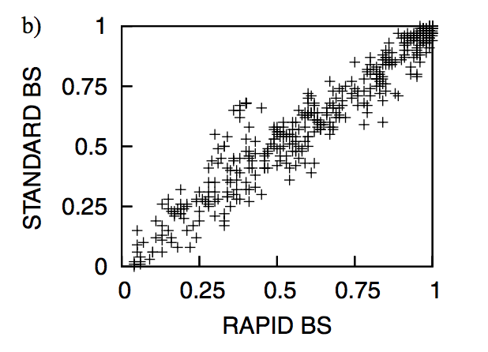
RAxML - Rapid Bootstraps
Optimisation shortcuts:
Parameters estimated once on an initial parsimony tree
Shallow tree search
CAT model of rate variation (faster than Gamma)
Uses final tree of each bootstrap run to initialise the next (resets to parsimony every 10 steps)
Correlation of standard and rapid bootstraps

Slide 66
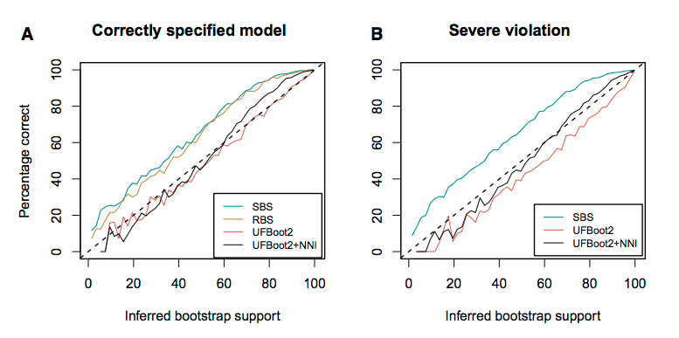
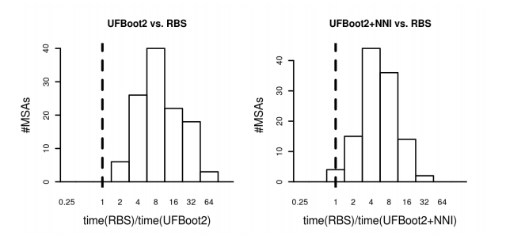
IQtree – Ultrafast Bootstraps
Bootstrapping via tree search
Create N bootstrapped alignments (BA)
Conduct tree search on original alignment
Assess each candidate tree for each BA using RELL
Assign best RELL tree to BA (never search BA directly)
+NNI: Final round of optimisation on BA at end of tree search

Slide 67
Practical
Use IQtree to run GTR+G4 on carnivores_16S.fass
Use the ultrafast bootstrap to compute 1000 bootstrap replicates
Repeat the analysis, using aLRT, SH-aLRT, aBayes and local bootstrap probabilities.
Do the different measures agree?
Can you identify poorly supported branches?
Compute 100 full bootstrap replicates (~15 minutes)
Calculate Bayesian trees using Beast, and compare posterior probabilities to bootstrap values
compare run times – which is faster, MCMC or bootstrapping?.

Slide 68
IQtree quick start guide
Run analysis using model, e.g. HKY
iqtree –s alignment.fa –m HKY -pre hky
Add gamma model of rate variation
iqtree –s alignment.fa –m HKY+G4 -pre hky_gamma
Use 100 standard bootstraps
iqtree –s alignment.fa –m HKY+G4 -b 100 -pre hky_gamma_boot
Use 1000 ultrafast bootstraps
iqtree –s alignment.fa –m HKY+G4 -bb 1000 -pre hky_gamma_ufboot
Use 100 SH-aLRT RELL replicates
iqtree –s alignment.fa –m HKY+G4 -alrt 100 -pre hky_gamma_shalrt
Use alrt
iqtree –s alignment.fa –m HKY+G4 -alrt 0 -pre hky_gamma_alrt
Use aBayes
iqtree –s alignment.fa –m HKY+G4 -abayes -pre hky_gamma_abayes
Use 1000 fast local bootstrap probabilities
iqtree –s alignment.fa –m HKY+G4 -lbp 1000 -pre hky_gamma_lbp

Slide 69
References
Invention of the bootstrap:
Efron, B (1979) Bootstrap Methods: Another Look at the Jackknife. Ann. Stat
First use of bootstrap in phylogenetics:
Felsenstein, J. (1985). Confidence Limits on Phylogenies: An Approach Using the Bootstrap. Evolution; International Journal of Organic Evolution, 39(4), 783–791.
aLRT:
Anisimova, M., & Gascuel, O. (2006). Approximate likelihood-ratio test for branches: A fast, accurate, and powerful alternative. Systematic Biology, 55(4), 539–552.
RELL:
Kishino, Miyata, and Hasegawa. (1990). “Maximum Likelihood Inference of Protein Phylogeny and the Origin of Chloroplasts.” Journal of Molecular Evolution 31 (2): 151–60.
Hasegawa, M., and H. Kishino. (1994). “Accuracies of the Simple Methods for Estimating the Bootstrap Probability of a Maximum-Likelihood Tree.” Molecular Biology and Evolution 11 (1): 142–142.
aBayes and SH-aLRT:
Anisimova, M., et al. (2011). Survey of branch support methods demonstrates accuracy, power, and robustness of fast likelihood-based approximation schemes. Systematic Biology, 60(5), 685–699.
RAxML rapid bootstrap:
Stamatakis, A, et al. (2008). A Rapid Bootstrap Algorithm for the RAxML Web Servers. Systematic Biology 57 (5)
Ultrafast bootstrap:
Minh, B. Q., et al. (2013). “Ultrafast Approximation for Phylogenetic Bootstrap.” Molecular Biology and Evolution 30 (5): 1188–95.
Hoang, et al. (2018) UFBoot2: Improving the Ultrafast Bootstrap Approximation, Molecular Biology and Evolution 35 (2): 518–522

