Slide 1
Model Selection
Molecular Phylogenetics Course 2019
Kevin Gori
kcg25@cam.ac.uk

Slide 2
Outline
Recap Likelihood vs. Probability
Recap Phylogenetic Likelihood
substitution models
pruning algorithm
rate variation among sites
ascertainment bias correction
Model selection
bias-variance trade-off
Likelihood ratio tests
Information Criteria
Practicals

Slide 3
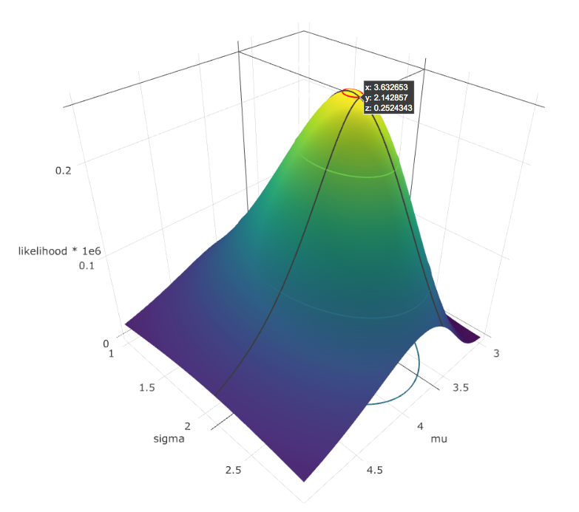
Likelihood
Recap

Slide 4
Probability and Likelihood
Probability distribution:
With what probability do we expect to see new data with a particular value (range)
Likelihood:
For given data, how likely is it that it was generated by a distribution with these parameters
probability=
0.242
likelihood=
7.74e-08
Notes:
What is likelihood in general

Slide 5
Probability and Likelihood
Probability distribution:
With what probability do we expect to see new data with a particular value (range)
Likelihood:
For given data, how likely is it that it was generated by a distribution with these parameters
likelihood=
7.74e-08
Notes:
What is likelihood in general

Slide 6
Probability and Likelihood
Probability distribution:
With what probability do we expect to see new data with a particular value (range)
Likelihood:
For given data, how likely is it that it was generated by a distribution with these parameters
likelihood=
1.358e-07
Notes:
What is likelihood in general

Slide 7
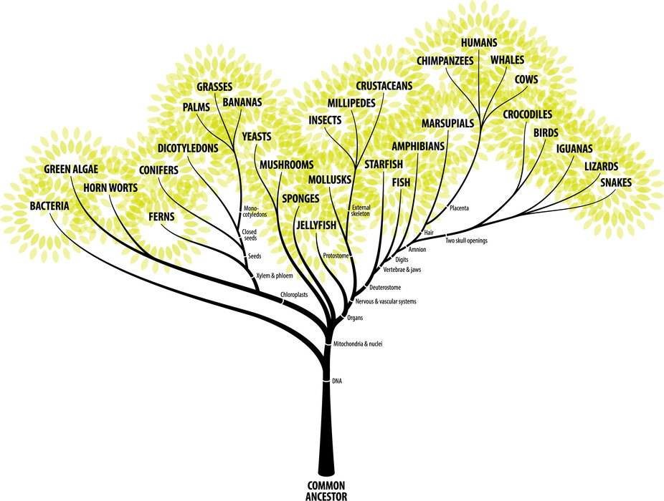
Phylogenetic Likelihood

Slide 8
Substitution Models
Model substitution process as a Continuous-time Markov Chain
Defined by [n×n] Q-matrix
n is alphabet size, i.e. DNA: n=4
Notes:
How substitution models enable calculation of probability of base substitution

Slide 9
Substitution Models
Q_{JC69} Jukes and Cantor
Model substitution process as a Continuous-time Markov Chain
Defined by [n×n] Q-matrix
n is alphabet size, i.e. DNA: n=4
Probability of substitution after time t with rate r:
P_{ij} = exp(Q×t×r)_{ij}
 | T | C | A | G
T | -3λ | λ | λ | λ
C | λ | -3λ | λ | λ
A | λ | λ | -3λ | λ
G | λ | λ | λ | -3λ
Diagonal entry ensures rows sum to 0
Notes:
How substitution models enable calculation of probability of base substitution

Slide 10
Substitution Models
Q_{K80} Kimura’s ts/tv model
Model substitution process as a Continuous-time Markov Chain
Defined by [n×n] Q-matrix
n is alphabet size, i.e. DNA: n=4
Probability of substitution after time t with rate r:
P_{ij} = exp(Q×t×r)_{ij}
 | T | C | A | G
T | - | α | β | β
C | α | - | β | β
A | β | β | - | α
G | β | β | α | -
Diagonal entry ensures rows sum to 0
Notes:
How substitution models enable calculation of probability of base substitution. Models vary in complexity (have more parameters)

Slide 11
Substitution Models
Q_{F81} Felsenstein’s unequal base frequencies
Model substitution process as a Continuous-time Markov Chain
Defined by [n×n] Q-matrix
n is alphabet size, i.e. DNA: n=4
Probability of substitution after time t with rate r:
P_{ij} = exp(Q×t×r)_{ij}
 | T | C | A | G
T | - | π_{C} | π_{A} | π_{G}
C | π_{T} | - | π_{A} | π_{G}
A | π_{T} | π_{C} | - | π_{G}
G | π_{T} | π_{C} | π_{A} | -
Diagonal entry ensures rows sum to 0
Notes:
How substitution models enable calculation of probability of base substitution. Models vary in complexity (have more parameters)

Slide 12
Substitution Models
Q_{HKY85} Hasegawa, et al.
Model substitution process as a Continuous-time Markov Chain
Defined by [n×n] Q-matrix
n is alphabet size, i.e. DNA: n=4
Probability of substitution after time t with rate r:
P_{ij} = exp(Q×t×r)_{ij}
 | T | C | A | G
T | - | π_{C}α | π_{A}β | π_{G}β
C | π_{T}α | - | π_{A}β | π_{G}β
A | π_{T}β | π_{C}β | - | π_{G}α
G | π_{T}β | π_{C}β | π_{A}α | -
Diagonal entry ensures rows sum to 0
Notes:
How substitution models enable calculation of probability of base substitution. Models vary in complexity (have more parameters)

Slide 13
Substitution Models
Q_{GTR} General time reversible model
Model substitution process as a Continuous-time Markov Chain
Defined by [n×n] Q-matrix
n is alphabet size, i.e. DNA: n=4
Probability of substitution after time t with rate r:
P_{ij} = exp(Q×t×r)_{ij}
 | T | C | A | G
T | - | π_{C}a | π_{A}b | π_{G}c
C | π_{T}a | - | π_{A}d | π_{G}e
A | π_{T}b | π_{C}d | - | π_{G}f
G | π_{T}c | π_{C}e | π_{A}f | -
Diagonal entry ensures rows sum to 0
Notes:
How substitution models enable calculation of probability of base substitution

Slide 14
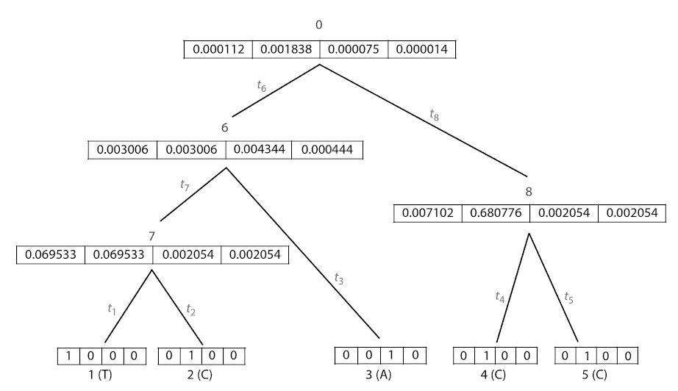
Pruning algorithm
Computes likelihood of tree + model parameters, given sequence data
Initialise conditional probabilities at leaves:
Prob_{i} = 1 if i = base
0 otherwise
0.1
0.1
0.1
0.2
0.2
0.2
0.2
0.2
Yang, 2014
Notes:
How to apply the substitution probability to the tree

Slide 15
Pruning algorithm
Postorder traversal:
Visit descendents before ancestors
Inner conditionals:
[P(t_{a}) × L(a)] ⊗ [P(t_{b}) × L(b)]
0.1
0.1
0.1
0.2
0.2
0.2
0.2
0.2
× : Matrix multiplication (dot product)
⊗: Elementwise multiplication (Hadamard product)
Yang, 2014
Notes:
How to apply the substitution probability to the tree

Slide 16
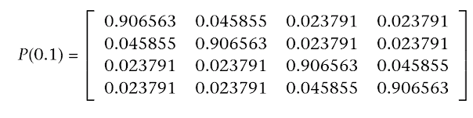
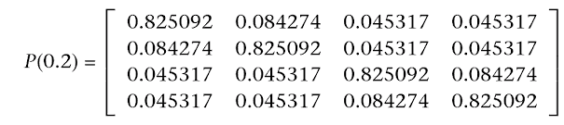
Pruning algorithm
Postorder traversal:
Visit descendents before ancestors
Inner conditionals:
[P(t_{a}) × L(a)] ⊗ [P(t_{b}) × L(b)]
0.1
0.1
0.1
Model = K80(α:2; β:1)
0.2
0.2
0.2
0.2
0.2
× : Matrix multiplication (dot product)
⊗: Elementwise multiplication (Hadamard product)
Yang, 2014
Notes:
How to apply the substitution probability to the tree

Slide 17
Pruning algorithm
Postorder traversal:
Visit descendents before ancestors
Inner conditionals:
[P(t_{a}) × L(a)] ⊗ [P(t_{b}) × L(b)]
0.1
0.1
0.1
Model = K80(α:2; β:1)
0.2
0.2
0.2
0.2
0.2
× : Matrix multiplication (dot product)
⊗: Elementwise multiplication (Hadamard product)
Yang, 2014
Notes:
How to apply the substitution probability to the tree

Slide 18
Pruning algorithm
Postorder traversal:
Visit descendents before ancestors
Inner conditionals:
[P(t_{a}) × L(a)] ⊗ [P(t_{b}) × L(b)]
0.1
0.1
0.1
Model = K80(α:2; β:1)
0.2
0.2
0.2
0.2
0.2
× : Matrix multiplication (dot product)
⊗: Elementwise multiplication (Hadamard product)
Yang, 2014
Notes:
How to apply the substitution probability to the tree

Slide 19
Pruning algorithm
Postorder traversal:
Visit descendents before ancestors
Inner conditionals:
[P(t_{a}) × L(a)] ⊗ [P(t_{b}) × L(b)]
0.1
0.1
0.1
Model = K80(α:2; β:1)
0.2
0.2
0.2
0.2
0.2
× : Matrix multiplication (dot product)
⊗: Elementwise multiplication (Hadamard product)
Yang, 2014
Notes:
How to apply the substitution probability to the tree

Slide 20
Pruning algorithm
Postorder traversal:
Visit descendents before ancestors
Inner conditionals:
[P(t_{a}) × L(a)] ⊗ [P(t_{b}) × L(b)]
0.1
0.1
0.1
Model = K80(α:2; β:1)
0.2
0.2
0.2
0.2
0.2
× : Matrix multiplication (dot product)
⊗: Elementwise multiplication (Hadamard product)
Yang, 2014
Notes:
How to apply the substitution probability to the tree

Slide 21
Pruning algorithm
logLik = log(π × L(0)) = -7.582
Postorder traversal:
Visit descendents before ancestors
Inner conditionals:
[P(t_{a}) × L(a)] ⊗ [P(t_{b}) × L(b)]
0.1
0.1
0.1
Model = K80(α:2; β:1)
0.2
0.2
0.2
0.2
0.2
× : Matrix multiplication (dot product)
⊗: Elementwise multiplication (Hadamard product)
Yang, 2014
Notes:
How to apply the substitution probability to the tree

Slide 22
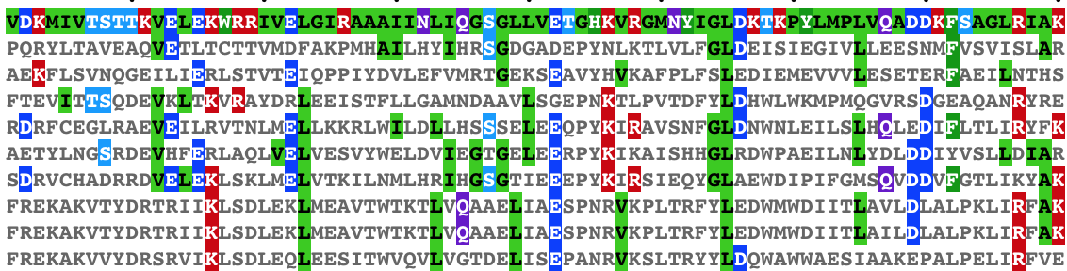
Models of Rate Heterogeneity
Sites do not all evolve at the same rate
Selective constraints
Chemical properties (e.g. CG → TG at methylated CpG)
Notes:
Invariant sites + Gamma distributed rates

Slide 23
Models of Rate Heterogeneity
Gamma Distributed Rates (+G)
Method
Compute tree likelihood for n discrete rate categories (e.g. n=4)
Use Pij = exp(Q×t×r_{n})
Likelihood at root is weighted average of n likelihoods

Slide 24
Models of Rate Heterogeneity
Gamma Distributed Rates (+G)
Method
Compute tree likelihood for n discrete rate categories (e.g. n=4)
Use Pij = exp(Q×t×r_{n})
Likelihood at root is weighted average of n likelihoods

Slide 25
Models of Rate Heterogeneity
Invariant Sites Model (+I)
Estimate proportion of invariant sites: p₀
Two rate categories: r₀ = 0, r₁ = 1 / (1 - p₀)
Site likelihoods:
(1-p₀) × L(r₁ | site) if site is variable
p₀ + (1-p₀) × L(r₁ | site) if site is invariant

Slide 26
Ascertainment Bias Correction
We threw away all our invariant sites!
Restriction enzyme digest sites
Morphological characters
SNPs called from Whole Genome Sequencing
So what?
Data appears to have unrealistically high substitution rate
Branch lengths are inflated
Might mislead tree topology estimation

Slide 27
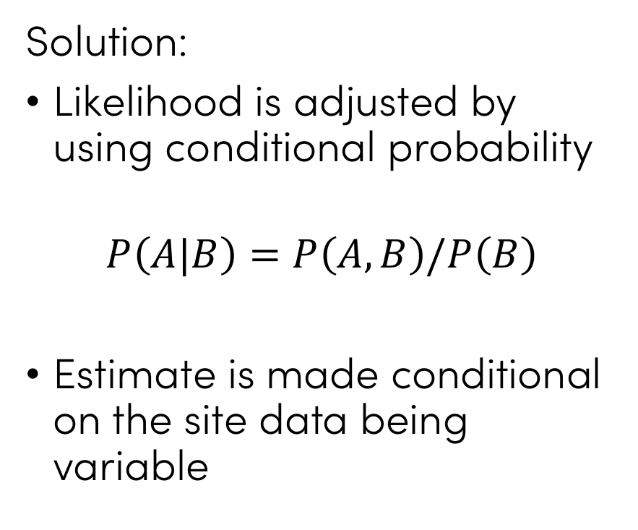
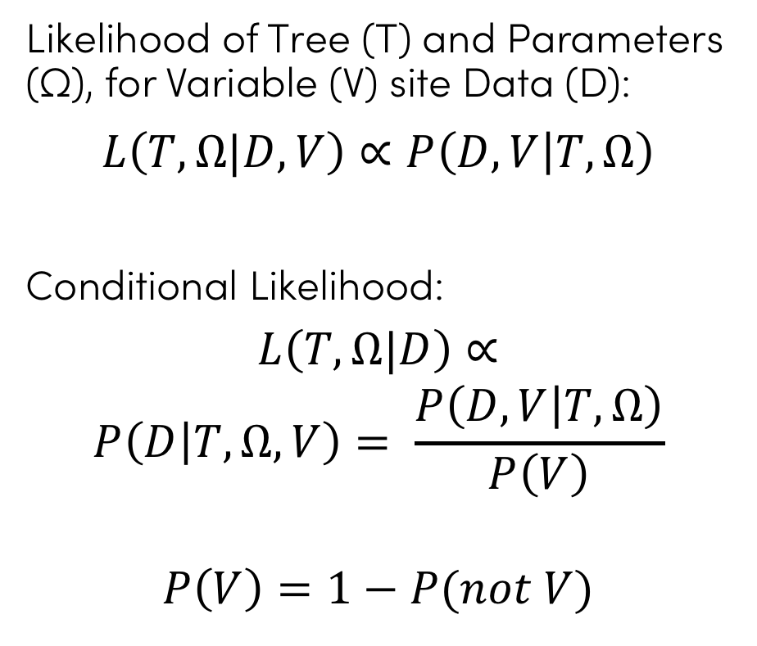
Ascertainment Bias Correction
Solution:
Likelihood is adjusted by using conditional probability
$$P\left(A|B\right)=P\left(A,B\right)/P\left(B\right)$$
Estimate is made conditional on the site data being variable
Likelihood of Tree (T) and Parameters (Ω), for Variable (V) site Data (D):
$$L\left(T,Ω|D,V\right)∝P\left(D,V | T,Ω\right)$$
Conditional Likelihood:
$L\left(T,Ω|D\right)$ $∝$
$$P\left(D | T,Ω,V\right)= \frac{P\left(D, V | T,Ω\right)}{P\left(V\right)}$$
$$P\left(V\right)=1−P(not V)$$
Lewis, 2001
Notes:
Special technique used when we know we have thrown away / not observed invariant sites

Slide 28
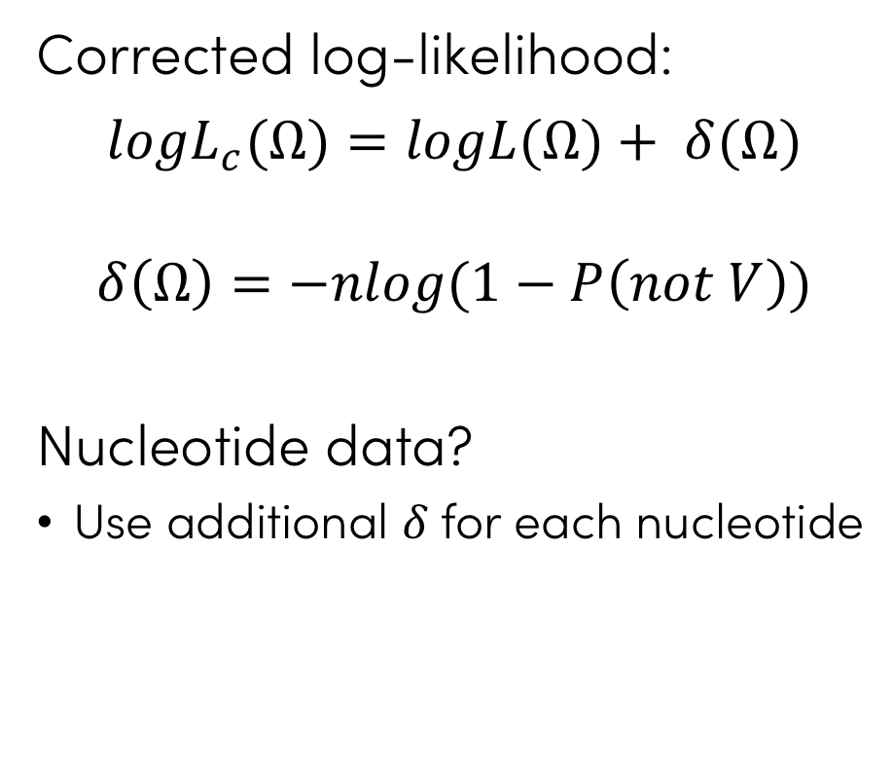
Ascertainment Bias Correction
Solution:
Likelihood is adjusted by using conditional probability
$$P\left(A|B\right)=P\left(A,B\right)/P\left(B\right)$$
Estimate is made conditional on the site data being variable
Corrected log-likelihood:
$$logL_{c}(Ω)=logL(Ω)+ δ(Ω)$$
$$δ\left(Ω\right)=−nlog(1−P\left(not V\right))$$
Nucleotide data?
Use additional 𝛿 for each nucleotide
Tamuri and Goldman, 2017
Notes:
Special technique used when we know we have thrown away / not observed invariant sites

Slide 29
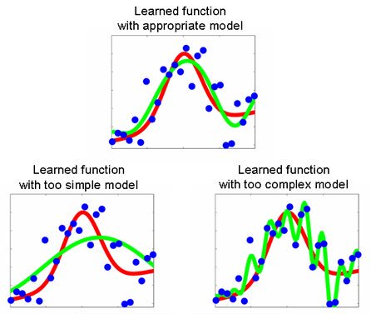
Model Selection

Slide 30
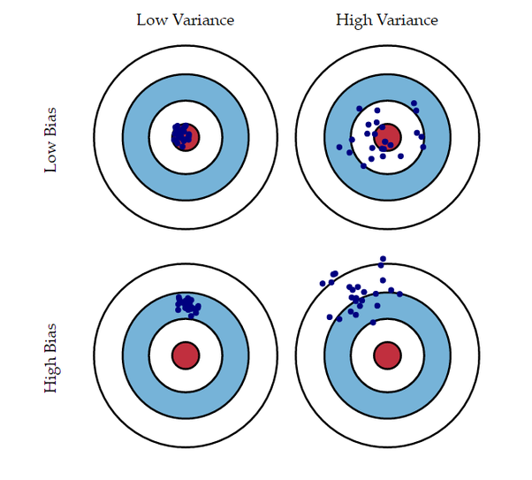
Model Selection
Why does it matter which model?
Want a model complex enough that it captures interesting features of the data
Simple enough that each parameter can be estimated with high precision
Even if not directly interested in the model
don’t want poor model choice to affect the parts of the analysis we are interested in
Bias-Variance Trade-off
Increasing model complexity

Slide 31
Techniques
Likelihood Ratio Test
Akaike Information Criterion (AIC)
Bayes Information Criterion (BIC)
All examples of the parsimony principle:
Prefer models with fewer parameters
Only introduce new parameters if there is a meaningful improvement in model fit
Notes:
LRT, AIC(c), BIC, (parametric bootstrap?)

Slide 32
LRT - Likelihood Ratio Test
Compare two models:
H₀: Null (simpler model)
H₁: Alternative (more parameters)
If models are nested:
Δ = [ logL(H₁) - logL(H₀) ]
p_{i} = number of parameters in model i
2 Δ ~ χ²(df = p₁ - p₀)
Reject H₁ if 2 Δ < critical value
Notes:
Nestedness example: K80 has 1 more parameter than JC69, but K80(kappa=1) is equivalent to JC69, so they are nested.
K80+I and K80+G are not nested.

Slide 33
AIC - Akaike Information Criterion
Penalise likelihood for each extra parameter, p
AIC = 2p - 2 × logL

Slide 34
AICc - Akaike Information Criterion
Penalise likelihood for each extra parameter, p
AICc accounts for number of data points, n
AIC = 2p - 2 × logL
AICc = AIC +
2p(p+1)
n-p-1

Slide 35
BIC - Bayes Information Criterion
Penalise likelihood for each extra parameter, p
AICc accounts for number of data points, n
BIC penalises extra parameters more strongly than AIC
AIC = 2p - 2 × logL
AICc = AIC +
BIC = log(n) × p - 2 × logL
2p(p+1)
n-p-1

Slide 36
Example
Model | sites | params | logL | LRT | AIC | AICc | BIC
JC | 2852 | 60 | -40020.222 |  | 80160.444 | 80163.066 | 80517.790
K80 | 2852 | 61 | -36393.919 | 7252.606 | 72909.838 | 72912.549 | 73273.140
HKY85 | 2852 | 64 | -36163.107 | 461.624 | 72454.213 | 72457.199 | 72835.383
χ²(1) critical value: 3.84
χ²(3) critical value: 7.81

Slide 37
Practicals

Slide 38
Model Selection by Hand
Use the alignment file primate-mtDNA.fas
Estimate a parsimony tree:
iqtree -s primate-mtDNA.fas -te PARS -m HKY -pre static
Calculate the likelihood using this tree for the following models:
iqtree -s primate-mtDNA.fas -te static.treefile -m JC -pre jc
iqtree -s primate-mtDNA.fas -te static.treefile -m JC+G4 -pre jcg
iqtree -s primate-mtDNA.fas -te static.treefile -m K80 -pre k80
iqtree -s primate-mtDNA.fas -te static.treefile -m K80+G4 -pre k80g
iqtree -s primate-mtDNA.fas -te static.treefile -m HKY -pre hky
iqtree -s primate-mtDNA.fas -te static.treefile -m HKY+G4 -pre hkyg
iqtree -s primate-mtDNA.fas -te static.treefile -m GTR -pre gtr
iqtree -s primate-mtDNA.fas -te static.treefile -m GTR+G4 -pre gtrg
Fill in a table of LRT, AIC, AICc and BIC values, and choose the best model

Slide 39
Automatic Model Selection
Use the file taz_mini.fas. This file contains 5000 SNPs found in Tasmanian Devil Facial Tumour cancers. Only variable sites are included, so ascertainment bias correction is needed.
Run IQtree’s automated model selection procedure
iqtree -s taz_mini.fas -pre model_finder
What are the features of the chosen model? Do you agree with the choice?
Description of IQtree’s models:
http://www.iqtree.org/doc/Substitution-Models
Notes:
empirical ~= [A: 0.208 C: 0.285 G: 0.291 T: 0.216]
estimated ~= [A: 0.236 C: 0.258 G: 0.261 T: 0.245]
estimated + asc ~= [A: 0.105 C: 0.363 G: 0.303 T: 0.229]

Slide 40
References
Pruning algorithm:
Felsenstein, J. (1973). Maximum-likelihood and minimum-steps methods for evolutionary trees from data on discrete characters. Syst. Zool. 22:240-249
Ascertainment Bias Correction:
Felsenstein, J. (1992). Phylogenies from restriction sites: A maximum-likelihood approach. Evolution 46:159-173
Lewis, P. O. (2001). A Likelihood Approach to Estimating Phylogeny from Discrete Morphological Character Data. Systematic Biology 50 (6): 913-25.
Tamuri, Asif, and Nick Goldman. (2017). Avoiding Ascertainment Bias in the Maximum Likelihood Inference of Phylogenies Based on Truncated Data. bioRxiv.
Everything:
Felsenstein, J. (2004) Inferring Phylogenies. Sinauer Associates Publishing.
Yang, Z. (2014). Molecular Evolution. A statistical approach. Oxford University Press

