Slide 1
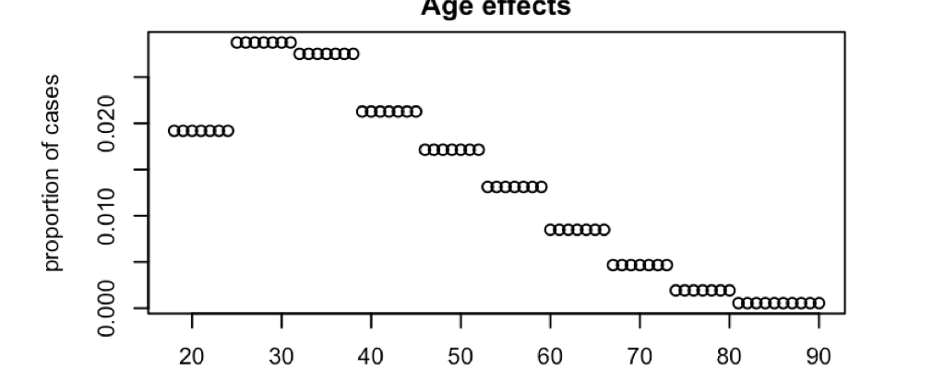
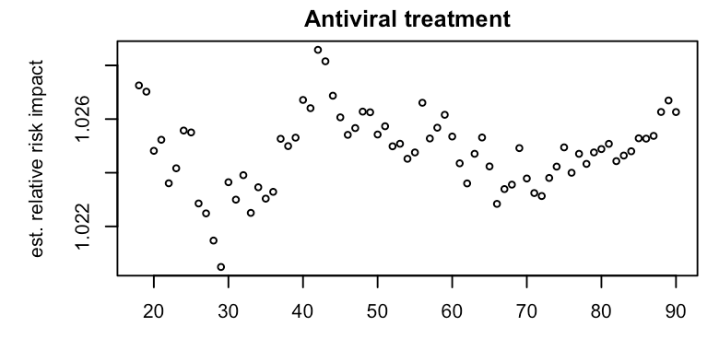
Old methods
p_{c,s} =A*T_{c,s}*U_{c,s} * 𝟙_{H1}(V_{c,s,H1} *I_{c,s,H1})* 𝟙_{H3}(I_{c,s,H3}*V_{c,s,H3})
Age-specific risk:
A = [𝟙₁₈₋₂₄*r₁₈₋₂₄*b +𝟙₂₅₋₃₁*r₂₅₋₃₁*b +𝟙₃₂₋₃₈*b +𝟙₃₉₋₄₅*r₃₉₋₄₅ +𝟙₄₆₋₅₂*r₄₆₋₅₂ +
𝟙₅₃₋₅₉*r₅₃₋₉₀+𝟙₆₀₋₆₆*r₆₀₋₆₆ +𝟙₆₇₋₇₃*r₆₇₋₇₃ +𝟙₇₄₋₈₀*r₇₄₋₈₀ +𝟙₈₁₋₉₀*r₈₁₋₉₀]
Antiviral treatment
T_{c,s} = f_{c,s,T} *r_{T}+(1-f_{c,s,T})
Underlying symptoms
U_{c,s} = f_{c,s,U} *r_{U}+(1-f_{c,s,U})
Vaccination
V_{c,s,Hx} = f_{c,s,V,Hx} *r_{V,Hx}+(1-f_{c,s,V,Hx})
Imprinting
I_{c,s,Hx} = f_{c,s,I,Hx} *r_{V,Hx}+(1-f_{c,s,I,Hx})

Slide 2
New methods
p_{c,s} =O_{c,s}*A*T_{c,s}*U_{c,s} * 𝟙_{H1}(V_{c,s,H1} *I_{c,s,H1})* 𝟙_{H3}(I_{c,s,H3}*V_{c,s,H3})
Number observed:
O_{c,s} = vector of the total number of individuals of each age tested in country c, season s
Adding this vector as the baseline prediction accounts for sampling patterns. E.g. we should expect 0 cases in age groups where 0 subjects were enrolled in the study.
I was only able to add this for the INSIGHT fits, because I don’t have denominator data from AZ
Age-specific risk:
A = [𝟙₁₈₋₂₄*r₁₈₋₂₄*b +𝟙₂₅₋₃₁*r₂₅₋₃₁*b +𝟙₃₂₋₃₈*b +𝟙₃₉₋₄₅*r₃₉₋₄₅ +𝟙₄₆₋₅₂*r₄₆₋₅₂ +
𝟙₅₃₋₅₉*r₅₃₋₉₀+𝟙₆₀₋₆₆*r₆₀₋₆₆ +𝟙₆₇₋₇₃*r₆₇₋₇₃ +𝟙₇₄₋₈₀*r₇₄₋₈₀ +𝟙₈₁₋₉₀*r₈₁₋₉₀]
Antiviral treatment
T_{c,s} = f_{c,s,T} *r_{T}+(1-f_{c,s,T})
Underlying symptoms
U_{c,s} = f_{c,s,U} *r_{U}+(1-f_{c,s,U})
Vaccination
V_{c,s,Hx} = f_{c,s,V,Hx} *r_{V,Hx}+(1-f_{c,s,V,Hx})
Imprinting
I_{c,s,Hx} = f_{c,s,I,Hx} *r_{V,Hx}+(1-f_{c,s,I,Hx})

Slide 3
NEW Results - INSIGHT
T – antiviral treatment
U – underlying symptoms
V – vaccination
S – HA subtype-level imprinting
G – HA group-level imprinting
N – NA subtype-level imprinting
Equivocal support for NA and HA-subtype imprinting. Still no clear support for group-level imprinting.

Slide 4
No change, Results - AZ
S – HA subtype-level imprinting
G – HA group-level imprinting
N – NA subtype-level imprinting

