Slide 1
Seasonal Flu Study

Slide 2
Questions
Does HA imprinting influence seasonal influenza
Birth-year specific incidence?
Severity? (Need NIH data for this)

Slide 3
Data
Arizona clinical surveillance data
18,871 lab-confirmed H1N1 and H3N2 cases
Data from NCBI sequence database
From all over the world
No samples deposited after 2009
reported age info
NCBI Data
Year | H3 | H1
1990 | 18
1991 | 16
1993 | 107
1994 | 139
1995 | 118 | 63
1996 | 155 | 6
1997 | 57
1998 | 153
1999 | 230 | 1
2000 | 249 | 134
2001 | 133 | 178
2002 | 449 | 10
2003 | 439 | 49
2004 | 409 | 9
2005 | 344 | 46
2006 | 58 | 65
2007 | 280 | 715
2008 | 393 | 402
2009 | 45 | 1058
Total | 3792 | 2736
Arizona Data
Year | H3 | H1
1993 | 105
1994 | 39 | 12
2002 | 8 | 71
2003 | 71
2004 | 140
2005 | 331 | 1
2006 | 28 | 212
2007 | 248 | 196
2008 | 382 | 2717
2009 | 1 | 6263
2010 | 1216 | 472
2011 | 350 | 595
2012 | 1587 | 80
2013 | 151 | 1475
2014 | 2114 | 5
Total | 6771 | 12099

Slide 4
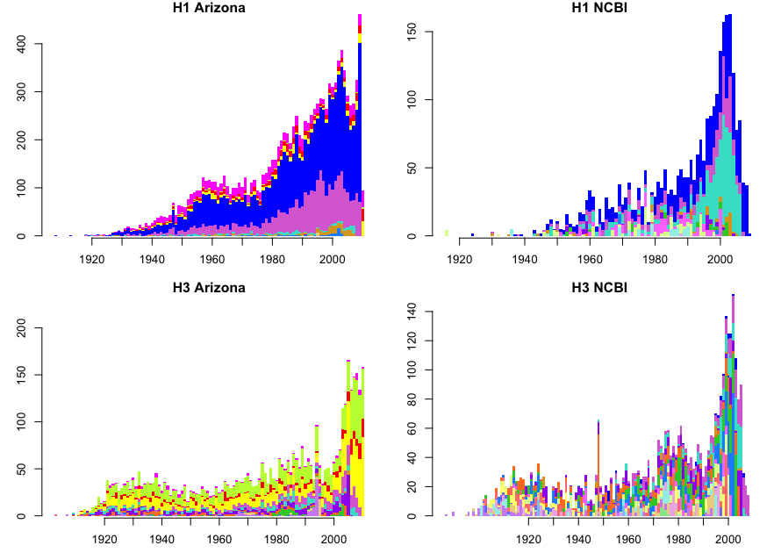
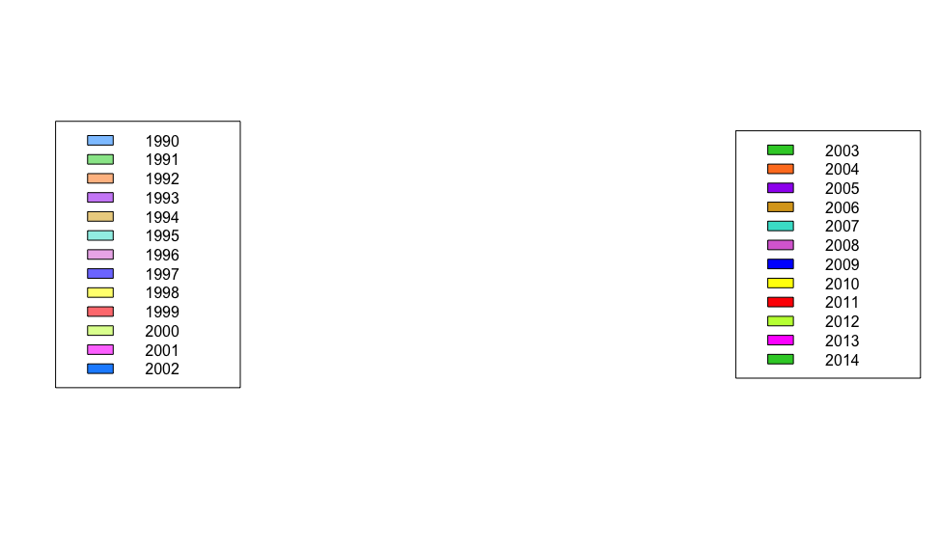
Raw data
Season
Case count
Birth year
Note, the H3 and H1 data show different patterns, and differences are consistent across data sets.

Slide 5
Raw data
Season
Case count
Birth year
Note, the H3 and H1 data show different patterns, and differences are consistent across data sets.

Slide 6
Background
Known that H3 causes more cases and kills more older people than H1
Generally, the idea seems to be that this is because older people were exposed to H1 when they were young → this has not been tested rigorously, that I know of
H3 is also known to cluster jump faster, which could have an effect (not sure how to include these effects in the models)

Slide 7
Factors that could influence age/birth-year specific incidence
Age-specific risk
Very old and very young at increased risk
Age-specific contact rates
Probability of seasonal vaccination (high for elderly, children and students)
Lifetime history of seasonal flu exposure (antigenic seniority)
Really tied to birth year, but follows roughly age-specific pattern
Need to polish this
Childhood exposure history
Group level imprinting
Subtype level imprinting

Slide 8
Factors that could influence age/birth-year specific incidence
Age-specific risk
Very old and very young at increased risk
Age-specific contact rates
Probability of seasonal vaccination (high for elderly, children and students)
Lifetime history of seasonal flu exposure (antigenic seniority)
Really tied to birth year, but follows roughly age-specific pattern
Need to polish this
Childhood exposure history
Group level imprinting
Subtype level imprinting
Same for H3/H1
Similar for H1/H3 but there may be important differences here because of differences in evolutionary rates
Can reconstruct and include in model

Slide 9
Approach
Childhood imprinting is one of the key factors that should cause age distributions of infection to differ for H1N1 vs. H3N2
To what extent can reconstructed patterns of childhood imprinting explain observed differences between age distributions of infection with H1N1 and H3N2?

Slide 10
Quantify age-specific risk
Combine H1N1 and H3N2 NCBI data.
Bootstrap to generate a null age-specific risk curve
Use a weighted sampling scheme so that you are equally likely to sample data from each observation year in the data
Calculate the fraction of sampled cases of each age
Fit a smoothing spline to the age data
Interpretation:
This baseline model captures the expected age distribution of infection if there were no difference between subtypes
Could be driven by age-specific risk of severe infection, age-specific contact patterns, and age-specific prob of vaccination
To some extent also represents antigenic seniority
Leaves out subtype-specific histories of infection

Slide 11
Models
p_{i} = multinomial prob. that a case falls in birth year i
A = age-specific risk (from smoothing spline)
H_{mg} = relative risk of infection given imprinting protection at the group level
H_{ms} = relative risk of infection given imprinting protection at the subtype level
w_{m} = fraction of the birth year protected by imprinting
w_{o} = fraction of the birth year protected by imprinting
Baseline:
p_{i} = A
Group-level imprinting:
p_{i} = A (H_{mg} w_{m} + w_{o})
Subtype-level imprinting:
p_{i} = A (H_{ms} w_{m} + w_{o})

Slide 12
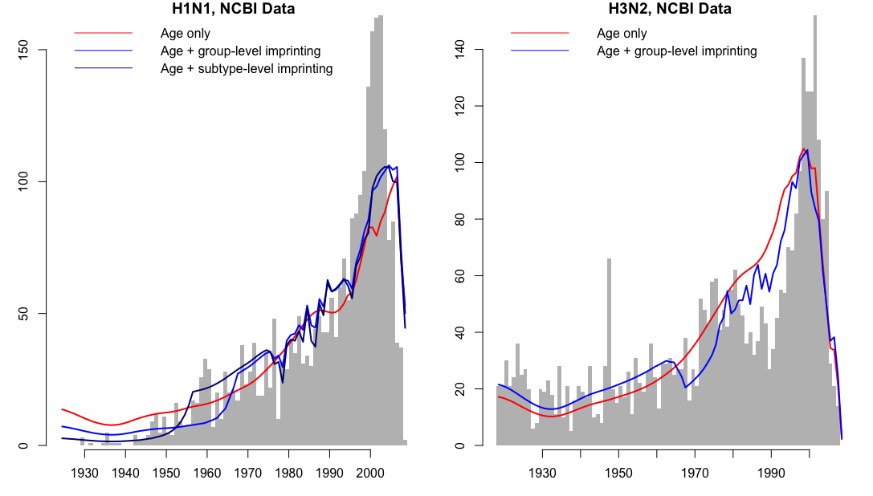
Model ΔAIC
Age + subtype 0
Age + group 175.87
Age only 332.89
Model ΔAIC
Age + subtype 0
Age only 170.40
Case count
Birth year
Birth year

