Slide 1
Discussion week 6
Parameter Intuition

Slide 2
Parameters
Which of your parameters are rates?
Which of your parameters are proportions?

Slide 3
Common sense check for rates
Say your model’s time unit is days
Which of these is a reasonable per-capita birth rate?
b = 0.005/day
b = 0.0001/day
If I know my females typically have 2 offspring/year, what is my birth rate?
If I know females in my species typically have 1 offspring in their first 4 years of reproductive maturity, what is my birth rate?

Slide 4
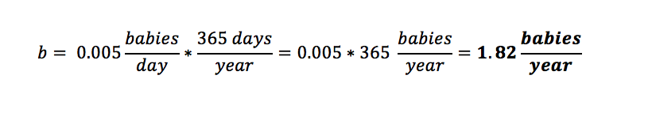
Common sense check for rates
Say your model’s time unit is days
Say your species is K-selected and reproduces annually. Which of these is a reasonable per-capita birth rate?
b = 0.005/day
b = 0.0001/day
Convert to a sensible time unit (years)

Slide 5
Common sense check for rates
Say your model’s time unit is days
If I know my females typically have 2 offspring/year, what is my birth rate?
2/year*1year/365days = 2/365 = 0.0055 babies/day
If I know females in my species typically have 1 offspring in their first 4 years of reproductive maturity, what is my birth rate?
1/4years*1year/365days = 1/(4*365) = 0.00068 babies/day

Slide 6
Relationship between rates and probabilities
I expect each female to have about 2 offspring/year, and reproduction occurs year-round. My model is in discrete time and my time step is one month. What is the probability of reproduction per time step?
Approach 1: Convert the known rate into units that line up with your time step.
2/year * 1year/12monts = 2/12 = 0.1667 offspring/month
Probability is 0.1667

Slide 7
Justification
2 offspring per year -> you expect one birth every 6 months
Binomial intuition -> If you flip a biased coin 6 times (once per time-step for 6 months), and the probability of heads is 0.1667, how many times do you expect to see heads?
E[Binom(n, p)] = np = 6*0.1667 = 1 per 6 months
Geometric intuition -> If the probability of success is 0.1667 at each time step, how long do you expect to wait for the first success?
E[Geom(p)] = 1/p = 1/0.1667 = 6 months between births on average

Slide 8
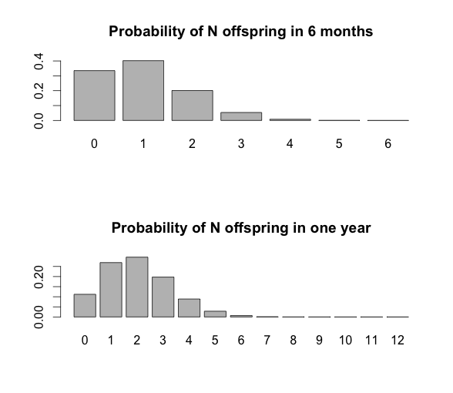
Probability distributions
barplot(dbinom(x = 0:6, size = 6, prob = 0.16667), names.arg = 0:6,
main = 'Probability of N offspring in 6 months')
barplot(dbinom(x = 0:12, size = 12, prob = 0.16667), names.arg = 0:12,
main = 'Probability of N offspring in one year')

Slide 9
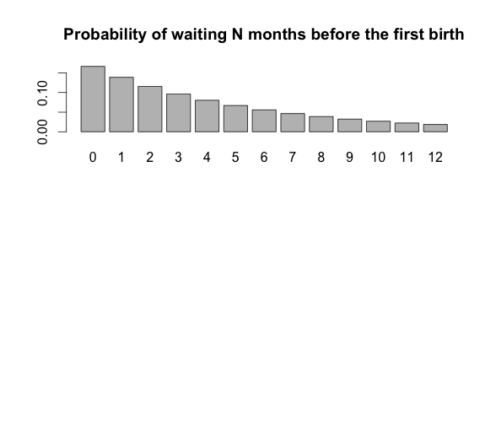
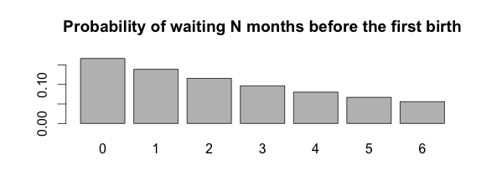
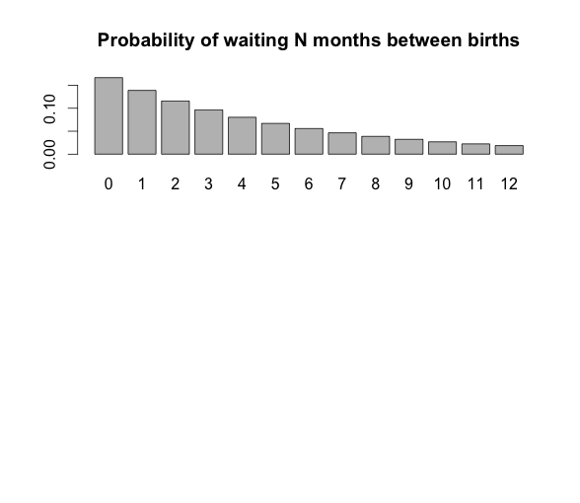
Probability distributions
barplot(dgeom(x = 0:12, prob = 0.16667), names.arg = 0:12, main = 'Probability of waiting N months before the first birth')
barplot(dbinom(x = 0:12, size = 12, prob = 0.16667), names.arg = 0:12,
main = 'Probability of N offspring in one year')

Slide 10
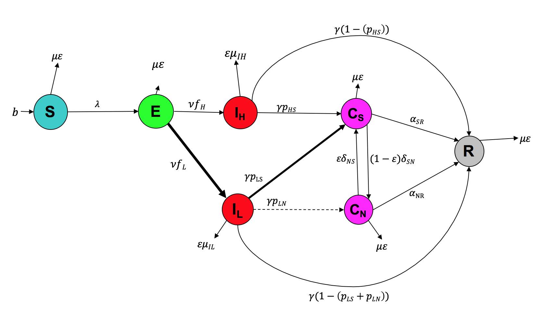
Common sense check for proportions

Slide 11
Common sense check for proportions
All green arrows represent a recovery from low-intensity, acute infection.
γ is the TOTAL rate of recovery from acute infection
coefficients on γ (the p’s) are proportions that allocate fractions of the total flow (γ) into different recovered or chronic classes

Slide 12
Common sense check for proportions
Proportions are essentially fractions and need to sum to 1
Identify which arrows are part of the same “whole”
In this case, the “whole” is all recovery from class I_{L,} at rate gamma
Make sure all relevant flows sum to the total rate
In this case, γP_{LN}+γP_{LS}+γ(1-P_{LN}-P_{LS}) = γ

Slide 13
Debugging/coding intuition
As you first write:
Break your code into sections using comments. Write yourself notes about what each section should:
Input
Do to the inputs
Output

Slide 14
Debugging/coding intuition
As you try to fix problems
Go line-by-line
Know before your run the line:
What’s going in:
Data type
Length/dimension of data
What should be coming out:
Do the arithmetic...what values do you expect?
What data type to you expect out?
What length/dimension of data do you expect out?
Print the output of each line and make sure it meets your expectations!

Slide 15
Check your data type
typeof(variableName) -> tells you the data type of the variable you input
e.g. list, factor, character, logical, numeric, etc.
For a good description of data types see http://www.cyclismo.org/tutorial/R/types.html
If your data type is wrong (e.g. character when you want numeric), it could be the root of your problems

Slide 16
Check your data type
is.numeric(variableName)
is.character()
...etc., Tell you “True” or “False” whether your variable is the data type of interest
as.numeric(), as.character(),... etc. convert to different data types.

Slide 17
Check your data dimensions
length(variableName)
tells you the length of a vector
tells you the total number of entries in a matrix
tells you the number of items in a list
dim(matrixName)
returns the (# rows, # columns) of a matrix
ls(listName)
tells you the names of all items in a named list
tells you the names of all columns in a data frame

Slide 18
Other useful commands
head(variableName)
tail(variableName)
Shows you the first, or last 10 rows or entries of a very large variable.
You can also specify the number of rows/entries you want to return (e.g. 30): head(variableName, 30)

Slide 19
Other useful commands
print()
If you use the print() command inside a for loop, it will return the value of the variable you print for every iteration of the loop (otherwise, you just get the final answer)
Careful -> this will make your code run really slowly, so don’t do it all the time.

