Slide 1
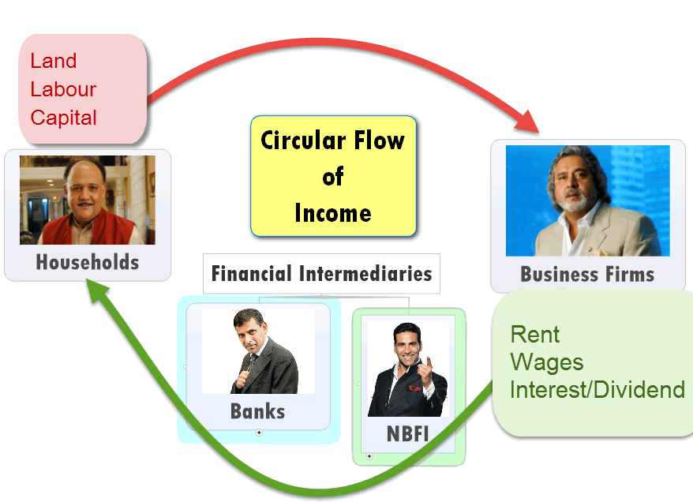
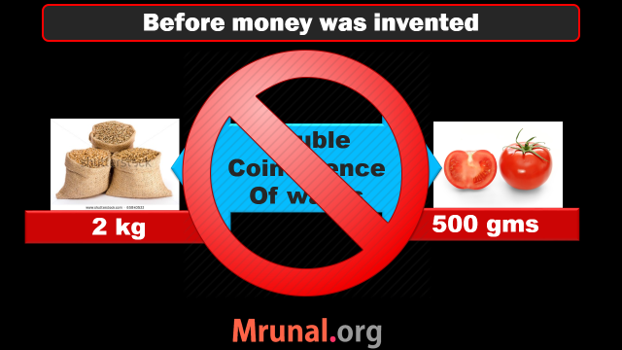
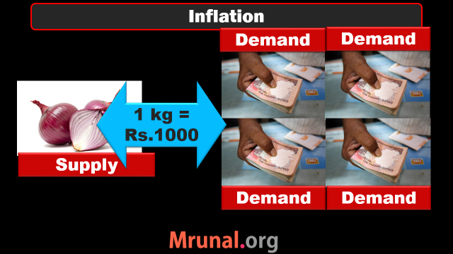

Slide 2
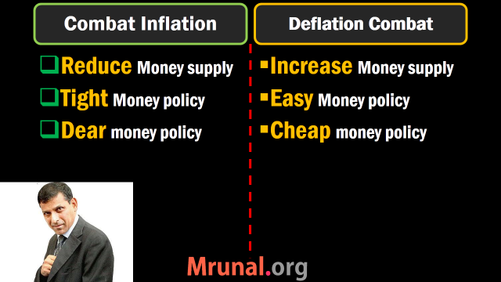

Slide 3
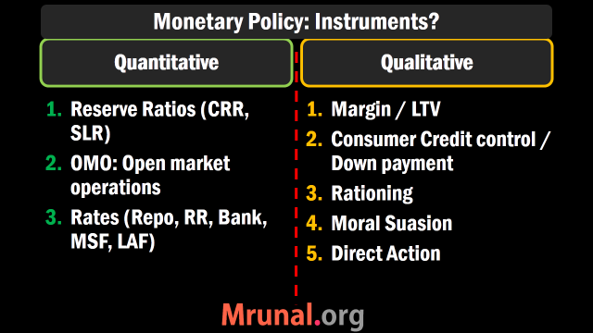

Slide 4
Monetary Policy
Quant. Tool | Inflation fight Tight/Dear | Deflation fight Easy/Cheap
CRR, SLR | Increase | Decrease
OMO | Sell | Buy
Policy RATE | Increase | Decrease

Slide 5
Quantitative Tools Measures of Money supply
Reserve money
Broad money
Narrow Money
M0, M1, M2, M3, M4..?

Slide 6
M0: reserve money, High powered money
Components | Billion Rupees in Aug'14
i) Currency in Circulation | 13610
ii) Bankers' Deposits with RBI | 3567
iii) Other' Deposits with RBI | 97
Total M0: Reserve Money | 17274

Slide 7





M2
M4
= M3+ Post office (TOTAL)
= M1+ Post office (Only Savings)
M3
Broad
Money
Currency
with Juntaa
DEMAND
DEPOSITS
TIME
DEPOSITS
M1: NARROW
Liquidity: M1 > M2 > M3 > M4

Slide 8
Monetary Policy: Instruments?
Quantitative, General, Indirect
Qualitative, Selective, Direct
Reserve Ratios (CRR, SLR)
OMO: Open market op.
Policy rate

Slide 9
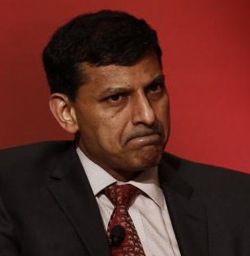

Loan to Value ratio: 60%
Loan Customer
Gold worth Rs. 1 Lakh
Lends Rs.60,000 only

Slide 10
Loan to Value ratio: 60%=> 85%
Loan Customer
Gold worth Rs. 1 Lakh
Lends Rs.85,000 only
To combat
Deflation/
Recession

Slide 11

Monetary Policy: Qualitative=> Margin
Loans against Securities (shares/bonds)
Recession=> 65%=>85%
Selective, Direct

Slide 12
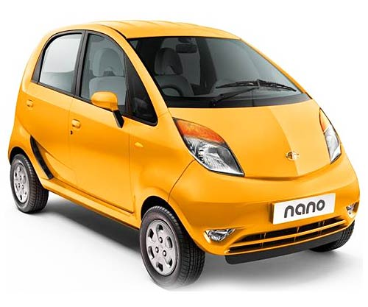
Consumer Credit controls
Qualitative
Fight Deflation, Recession
Downpayment: 30%=>10%
Reduce each installment:
10,000 x 10 => 1000 x 100
Selective, Direct
E.g.Commercial vehicle

Slide 13
Monetary Policy: Instruments?
Quantitative, General, Indirect
Qualitative, Selective, Direct
Reserve Ratios (CRR, SLR)
OMO: Open market op.
Policy rate
Margin requirement / LTV (Akshay Kumar)
Consumer credit control (Nano car)

Slide 14

Monetary Policy: Qualitative: Rationing
Ceiling on total loans in each sector.
Planned economy
PSL: 40% =>60%
Selective, Direct

Slide 15
PSL

Slide 16
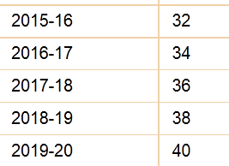
April 2015: PSL norms revised
Desi Banks | Firangi banks 20/more branches
40%
Firangi banks <20 branches
40% But in phased manner from 2015 to 2019
Adjusted net bank credit OR
Off balance sheet exposure
Whichever is high
Desi banks = domestic scheduled commercial banks

Slide 17
April 2015: PSL norms revised
Desi Banks | foreign 20/more branches
40%
Foreign banks <20 branches
40% But in phased manner from 2015 to 2019
Adjusted net bank credit OR
Off balance sheet exposure
Whichever is high

Slide 18
New PSL norms: Weaker sections target (out of 40%)
Desi Banks | foreign 20/more branches
Foreign banks <20 branches
N/A
10% to weaker sections (desi)
Foreign: by March’18

Slide 19
New PSL norms: Agro target (out of 40%)
Desi Banks | foreign 20/more branches
Foreign banks <20 branches
8% to small marginal farmers in a phased manner
Total 18% or more PSL to agro
N/A

Slide 20
New PSL norms: Micro Enterprises target (out of 40%)
Desi Banks | foreign 20/more branches
Foreign banks <20 branches
N/A
7.5% to Micro enterprises in phased manner (Desi banks)
Foreign banks sub-target later after review in 2017

Slide 21
Definitions of MSMS industry
Mfg. (plant-machine investment)
Micro: upto 25 lakh
Small: >25l-5cr.
Medium:>5-10cr
Service (equipment investment)
Micro: upto 10 lakh
Small: >10l-2cr.
Medium:>2-5cr

Slide 22
April 2015
PSL revised
Existing: housing / edu. Loans
New categories Medium enterprises, social infra and renewable energy.
Separate PSL target for small / marginal farmers, micro enterprises.
no distinction in direct / indirect lending to agro.
More details: on individual categories and quantitative limits- visit https://rbi.org.in/Scripts/NotificationUser.aspx?Id=9688&Mode=0
Notes:
recent experience of infrastructure financing. PPP-based projects have been financed either by public sector banks or through foreign currency-denominated debt (ECBs).
The former has proven tricky to say the least and the latter contributed to decline in corporate sector profitability especially in the infrastructure sector: investors borrowed in dollars and their revenues were predominantly in rupees so that when the rupee depreciated their profitability and balance sheets were adversely affected
time is therefore ripe for developing other forms of infrastructure financing, especially through a bond market. But SLRs have also stymied the development of government bond markets which in turn stifles the development of corporate bond markets.
Reducing SLRs are therefore critical to finding better sources of infrastructure financing.

Slide 23
Why Agro PSL = problem?
Eco.Survey
18/40 = 45% of PSL goes to Agro
Last decade: Agro-loans qty ▲ but Agro-GDP qty NOT ▲
▲ in large sized loans to individual farmers (=small / marginal ignored)
Lending increased in Jan-March period when farmers don’t need it but banks have ‘March rush’ =>
loan money not used for agro but social events, house repairing, vehicle /mobile purchase etc.
Loans concentrated near urban areas.
Notes:
The most important amongst them is that 45 per cent of all priority sector lending must be made to agriculture.
To be sure, the social and economic objectives that underlie PSL make it a salient feature of banking in India
But like in the case of subsidies and direct transfers, greater attention must be given to ensuring that the deployed means are the most effective to achieving desired ends.
There is hence greater need for evidence-driven policy.
summarize striking findings on agricultural credit. The main takeaway is that a much more careful approach needs to be applied to defining what constitutes priority sector and closer monitoring of how these funds are disbursed
This is especially important because a 40 per cent requirement absorbs a large fraction of the banks’ resources.
In nominal terms, agricultural credit has grown more than 8 times in the last 15 years compared to the facts that agriculture’s share in GDP has remained almost constant, and that significant urbanisation has occurred in this time.
There has been a sharp increase in the share of large-sized loans in agricultural credit
There has been a substantial increase in share of agricultural credit outstanding that emanates from urban and metropolitan areas, which is deeply puzzling.
There has been a concentration of disbursal of agricultural credit from January to March, which are generally not the normal periods of borrowing by farmers.
This shows that in order to meet priority sector lending targets banks possibly raise their lending activity in months when farmers may not necessarily need it the most.
There is a sharp decrease in the share of long-term credit in total agricultural credit. Thus, the portion of agricultural credit that was used for capital formation in agriculture has become small. The number has come down from over 70 per cent in 1991-92 to about 40 per cent in 2011-12
The implication of this evidence is that lending to agriculture may be excessive and going predominantly to large farmers. It is not being used for agricultural capital formation. Perhaps most significantly a large share of it may not be going to core agricultural activities at all.

Slide 24
Agro-PSL bottomline
Way ahead
Need to calibrate PSL norms
With “Evidence driven policy”.
End result should be (1) small-medium farmer (2) ▲ Agro GDP (absolute figure)
Notes:
The most important amongst them is that 45 per cent of all priority sector lending must be made to agriculture.
To be sure, the social and economic objectives that underlie PSL make it a salient feature of banking in India
But like in the case of subsidies and direct transfers, greater attention must be given to ensuring that the deployed means are the most effective to achieving desired ends.
There is hence greater need for evidence-driven policy.
summarize striking findings on agricultural credit. The main takeaway is that a much more careful approach needs to be applied to defining what constitutes priority sector and closer monitoring of how these funds are disbursed
This is especially important because a 40 per cent requirement absorbs a large fraction of the banks’ resources.
In nominal terms, agricultural credit has grown more than 8 times in the last 15 years compared to the facts that agriculture’s share in GDP has remained almost constant, and that significant urbanisation has occurred in this time.
There has been a sharp increase in the share of large-sized loans in agricultural credit
There has been a substantial increase in share of agricultural credit outstanding that emanates from urban and metropolitan areas, which is deeply puzzling.
There has been a concentration of disbursal of agricultural credit from January to March, which are generally not the normal periods of borrowing by farmers.
This shows that in order to meet priority sector lending targets banks possibly raise their lending activity in months when farmers may not necessarily need it the most.
There is a sharp decrease in the share of long-term credit in total agricultural credit. Thus, the portion of agricultural credit that was used for capital formation in agriculture has become small. The number has come down from over 70 per cent in 1991-92 to about 40 per cent in 2011-12
The implication of this evidence is that lending to agriculture may be excessive and going predominantly to large farmers. It is not being used for agricultural capital formation. Perhaps most significantly a large share of it may not be going to core agricultural activities at all.

Slide 25
Mock Question UPSC CSAT 2013
Priority sector lending by Banks in India Constitutes the lending to
Agriculture
Micro and small enterprises
Weaker section
All of above.
Right answer

Slide 26
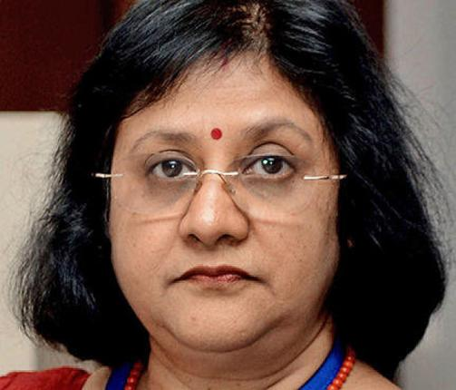
Desi + Foreign banks 20 Branches or More
PSL
If targets not met?
Remaining $$ to RIDF
Rural infra. Development fund
NABARD manages
State governments get infra. Loan
Bank earns interest + principal

Slide 27

Foreign banks <20 Branches
PSL
If targets not met?
Remaining $$ to SEDF
Small enterprises development fund
SIDBI manages
lending to state industrial fin.corp.

Slide 28
PSL: What if targets not met?
Desi (+Foreign 20) | Foreign bank <20
Remaining $$ to RIDF | To SEDF
Rural infra. Development fund | small enterprises development fund
NABARD manages | SIDBI manages
NABARD pays interest to bank | Same by SIDBI
State governments get infra. Loan | Similar case: state industrial fin.corp.

Slide 29
PSL applies to whom?

Slide 30
Banking institutions
Commercial
Urban
Coop.
Public sector
Private Banks
Foreign Banks
RRB
State
Central
PACS
NO PSL
PSL rule applies
40% | 32%
Depending on Branches

Slide 31
Monetary Policy: Instruments?
Quantitative, General, Indirect
Qualitative, Selective, Direct
Reserve Ratios (CRR, SLR)
OMO: Open market op.
Policy rate
Margin requirement / LTV (Akshay Kumar)
Consumer credit control (Nano car)
Credit Rationing (Stalin, PSL)

Slide 32
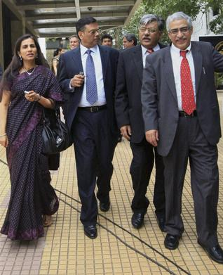

Monetary Policy: Qualitative
Moral Suasion
Direct Action

Slide 33
MCQ (UPSC-1995)
Which of the following is not an instrument of selective credit control?
Regulation of consumer credit
Rationing of credit
Margin requirements
Cash reserve ratio
Right answer
1. Skip 2. Attempt 3. Mark n Review

Slide 34
MCQ (2012)
RBI Acts as banker’s bank. This would imply which of the following?
Other banks retain their deposits with RBI
RBI lends funds to commercial banks in the times of need.
RBI advises commercial banks on monetary matters.
Correct Statement
Only 2 and 3
Only 1 and 2
Only 1 and 3
1, 2 and 3.

Slide 35
MCQ (2012)
RBI Acts as banker’s bank. This would imply which of the following?
(CRR) Other banks retain their deposits with RBI.
RBI lends funds to commercial banks in the times of need.
RBI advises commercial banks on monetary matters.
Correct Statement
Only 2 and 3
Only 1 and 2
Only 1 and 3
1, 2 and 3.

Slide 36
MCQ (2012)
RBI Acts as banker’s bank. This would imply which of the following?
(CRR) Other banks retain their deposits with RBI.
(Repo, Bank) RBI lends funds to commercial banks in the times of need.
RBI advises commercial banks on monetary matters.
Correct Statement
Only 2 and 3
Only 1 and 2
Only 1 and 3
1, 2 and 3.

Slide 37
CSAT 2012
RBI Acts as banker’s bank. This would imply which of the following?
(CRR) Other banks retain their deposits with RBI.
(Repo) RBI lends funds to commercial banks in the times of need.
(Moral Suasion) RBI advises commercial banks on monetary matters. [Ref: Money-banking E.Narayan Nadar]
Correct Statement
Only 2 and 3
Only 1 and 2
Only 1 and 3
1, 2 and 3 (Test series “A”, Q75, Ans.D)

Slide 39
NEXT
Banking evolution
Nationalization
Narsimhan Committee
New bank licenses, small-bank payment bank
Financial inclusion: PM-JDY, KVP etc.

