Slide 1
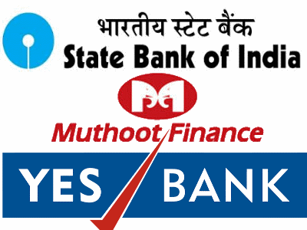
Financial intermediaries Classification: Bank vs NBFI

Slide 2
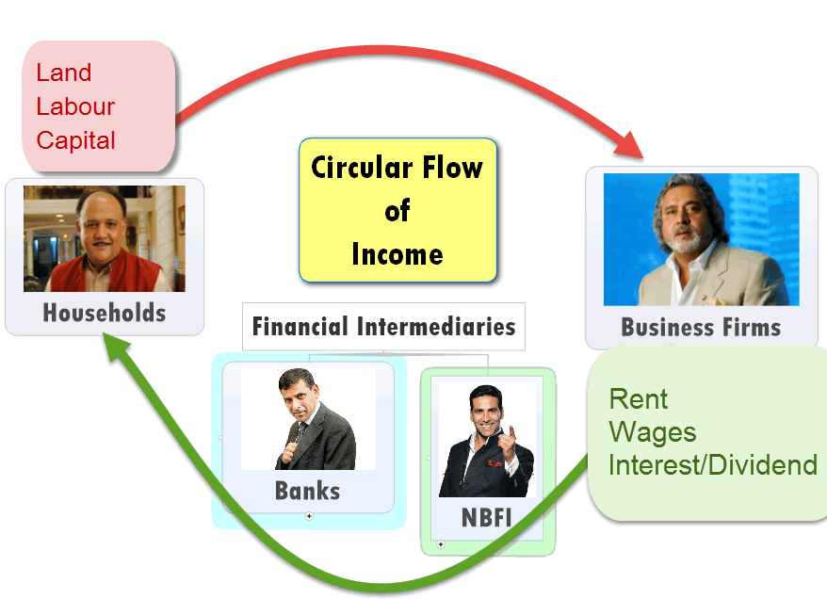

Slide 3

PSL rule applies
MSF given
NO PSL
NO PSL

Slide 4


Commercial
Cooperative
CRR, SLR: yes
yes

Slide 5
Commercial
Cooperative
PSL: yes
PSL: Nope

Slide 6
Commercial
Cooperative
Profit motive
No profit no loss motive

Slide 7
Commercial
Cooperative
Voting power as per shareholding
1 person 1 vote

Slide 8
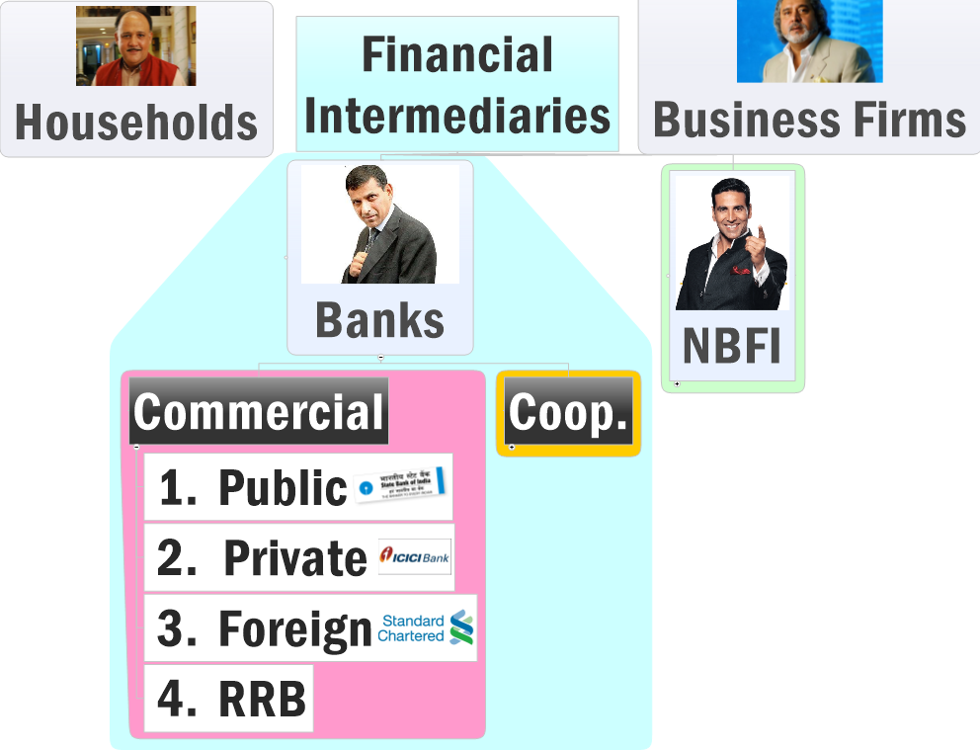

Slide 9
Commercial banks
Public sector: 22 | 27 (PJ Nayak ‘2014)
iba.org.in/viewmembanks.asp?id=1
Private sector: 23
iba.org.in/viewmembanks.asp?id=3
Foreign banks: 41
iba.org.in/viewmembanks.asp?id=4
FDI (in Indian banks)= 49% automatic | 74% FIPB approval
FDI (foreign banks)= 100% if wholly owned subsidiary

Slide 11

RRB
Comm.
Narsimhan:=Hybrid (Comm. Bank + Coop. soc.)
The Sponsor bank: HRM, Training
All India…x; few district….yes
Ownership
Union Government: 50%
State: 15%
Sponsor bank: 35%

Slide 12

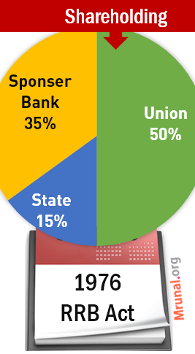
RRB
structure
This is an RRB
This is its Sponsor bank
Payment Gateway

Slide 13

RRB Problems
Comm.
Urbanization => Private banks, SCB
Deposit- low; NABARD depend.
Debt Waiver =>NPA
Solution : Amalgation [2005]

Slide 14
Amendment bill 2014
RRB
Allowed’em to raise more capital
Gave flexibility to shareholding
Imposed term limits on directors
http://mrunal.org/2014/12/banking-rrb-amendment-bill-regional-rural-banks.html

Slide 15
Banking institutions
Commercial
Urban
Coop.
Public sector
Private Banks
Foreign Banks
RRB
State
Central
PACS
PSL, MSF
NO PSL
40% | 32%
Depending on Branches

Slide 16
PSL: What if targets not met?
Desi (+Foreign 20) | Foreign bank <20
Remaining $$ to RIDF | To SEDF
Rural infra. Development fund | small enterprises development fund
NABARD manages | SIDBI manages
NABARD pays interest to bank | Same by SIDBI
State governments get infra. Loan | Similar case: state industrial fin.corp.

Slide 17

Origin
Coop-Banks
State registrar: Cooperative society.
’66: Banking regulation Act.
No-profit, no-loss;
one member one vote.
All India? No…only Guj, MH, Andhra, TN

Slide 18
Features
Coop-Banks
SLR, CRR yes.
PSL: no. (only Sch.coom.B)
Problems
politicization,
Scandals: Madhupura: Ketan Parekh, Visnagar/Kalupur: NPA.

Slide 19
Classification
Coop-Banks
Urban (women)
Rural
State Cooperative Banks
District: Central Cooperative banks
Village: PACS.
Land Development Bank:
State cooperative; Long term 20-30 years.

Slide 20
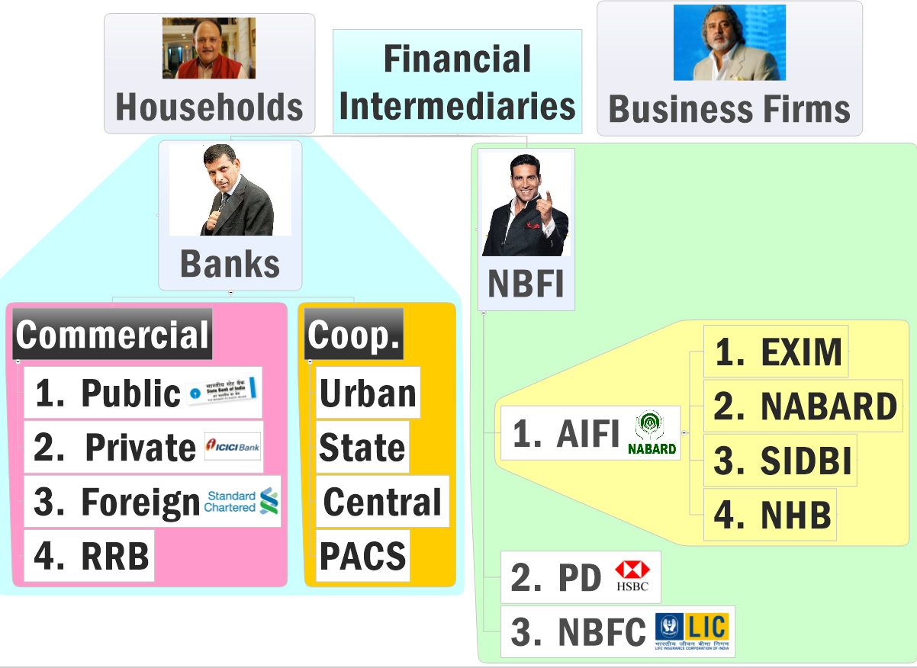
All India financial institutions

Slide 21

EXIM Bank (82)
AIFI
Export-Import Bank of India
loan/credit/finance to exporters and importers.
promotes cross border trade and investment
Boss: Government of India (100%)
Notes:
Same for Mahila bank.

Slide 22
All India financial institutions

Slide 23

NABARD (82)
AIFI
National Bank for Agriculture and Rural Development
BOSS: GoI (99.3%) + RBI (0.7%)
regulatory authority: Coop + RRB
Rural infra. Development fund (RIFD) if PSL not met
Helps State cooperative banks (SCB), (RRBs), MFI, cooperative –societies etc.
farmers, Cottage/handicraft, (SHG)

Slide 24
All India financial institutions

Slide 25

NHB(88)
AIFI
National Housing Bank
Boss: RBI (100%)
apex institution for housing finance in India
Finance to banks and NBFCs for housing projects
RESIDEX index (housing sector-inflation)

Slide 26
All India financial institutions

Slide 27

SIDBI 1990
AIFI
Small industries development bank of India
BOSS: SBI, LIC, IDBI other public sector banks, insurance companies etc.
SIDBI's SEDF= small enterprises development fund. (Foreign banks will <20 branches, PSL)
MSME sector, finance to State Industrial Development Corporation (SIDC), State finance corporations and banks

Slide 28
IIBI
AIFI
Fifth FI = Industrial Investment Bank of India (IIBI)
Closed in 2012

Slide 29
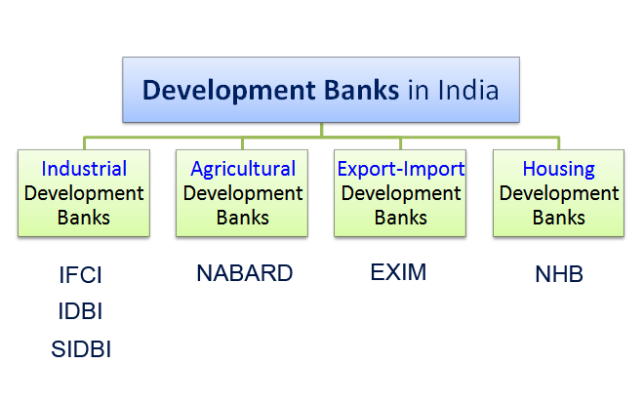
DFI/DB; Gone after Narsimhan II 1998

Slide 30
PSL rule
applies

Slide 31
Mock Question 2007 (UPSC)
The national housing bank (NHB) was setup in India as a wholly owned subsidiary of which of the following bank?
State bank of India
Reserve Bank of India
ICICI
LIC

Slide 32
Mock Question 2004- find correct
NHB, the apex institution of housing finance in India, was setup as a wholly owned subsidiary of RBI
Small industries development bank of India was established as a wholly owned subsidiary of the Industrial development bank of India
Both A and B
Neither A nor B

Slide 33
Mock Question 2004- find correct
Find Correct Statement(s)
(RIGHT) NHB, the apex institution of housing finance in India, was setup as a wholly owned subsidiary of RBI
(WRONG) Small industries development bank of India was established as a wholly owned subsidiary of the Industrial development bank of India
Both A and B
Neither A nor B

Slide 34
Mock Question
Which of the following grant(s) direct credit assistance to rural households? (2013)
RRB
NABARD
Land development Banks
Choice:
Only 1 and 2
Only 2
Only 1 and 3
1, 2 and 3.

Slide 35
Mock Question CSAT 2013
Which of the following grant(s) direct credit assistance to rural households?
RRB
NABARD
Land development Banks
Choice:
Only 1 and 2
Only 2.
Only 1 and 3
1, 2 and 3.

Slide 36
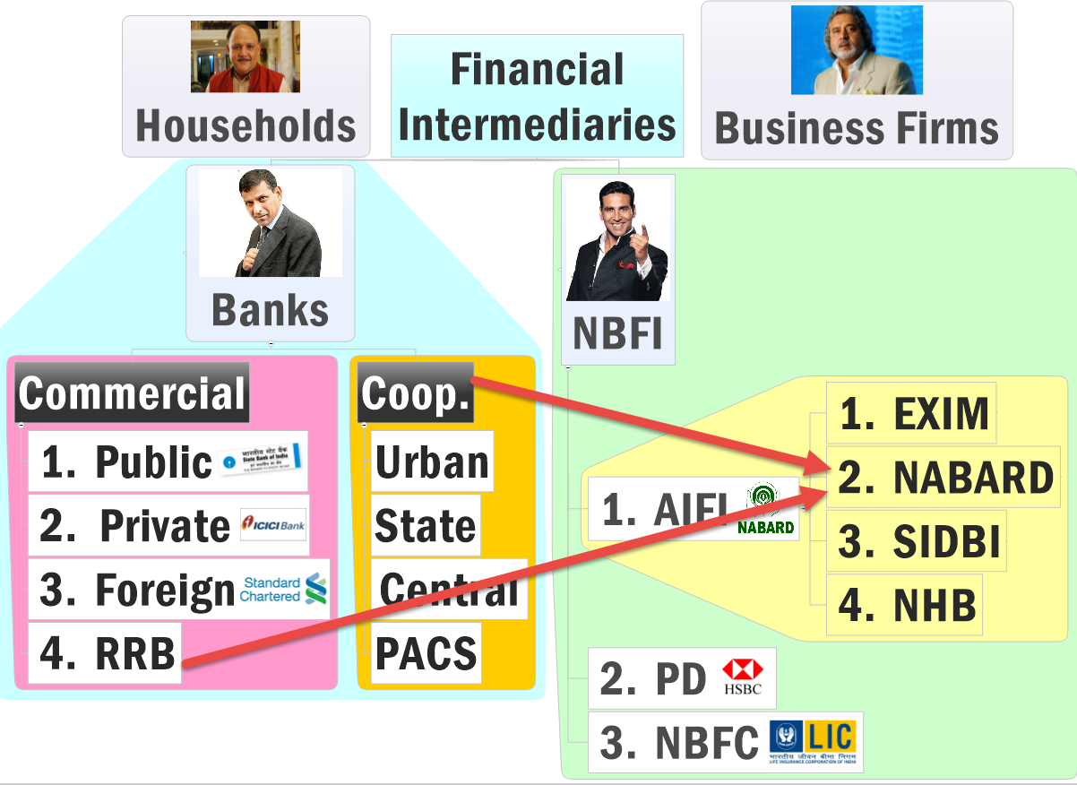

Slide 37
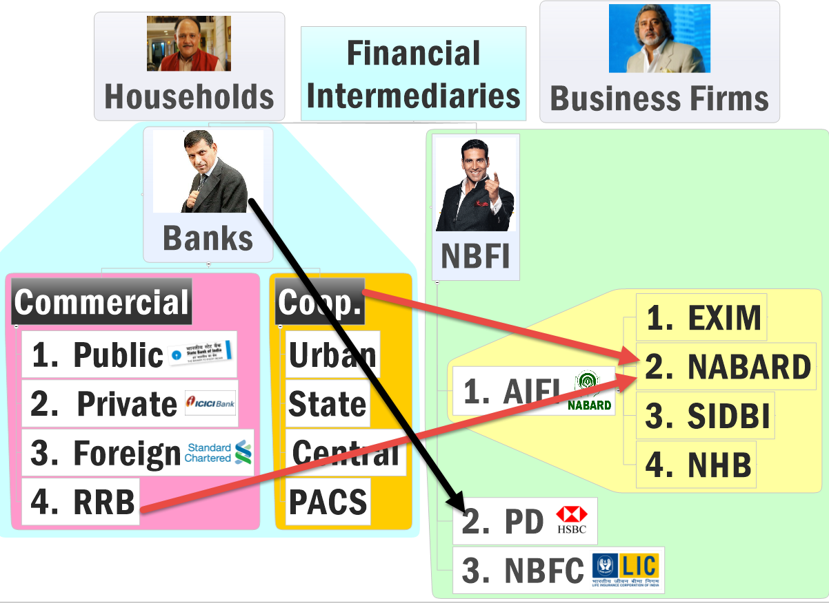

Slide 38
Financial Market
Money Market
Capital Market
Primary
Secondary
Short term
Long term
T-Bill
Fresh G-Sec
Fresh securities
Securities resold here

Slide 39

Primary Dealers
NBFI #2
deal in "primary" market. directly buy G-sec via "auction".
Can Participate in OMO
Must get license from RBI.
Morgan Stanley , Goldman Sachs, JP Morgan Chase, Standard Chartered Bank, HSBC (Hongkong and Shanghai Banking Corpn. Ltd)
Even: SBI, BoB, Kotak Mahindra etc.

Slide 41
NBFI: Type #3 NBFC
NBFC
Non Banking
Not Banks
Financial Company
Loan/finance

Slide 42
NBFI: Type #3 NBFC= Not Banks
Bank | "Non-Banking" Financial Company
RBI gave them license under Banking regulation Act. | No. They take license under Company Act.
All supervised by RBI. | NOT all. e.g. Insurance cos=IRDA; Merchant Banking Cos.=SEBI.
deposit from public time deposit (FDRD) demand deposits (CASA) | They can accept Time deposit. (such NBFC are called Deposit taking NBFC) But They cannot accept demand deposits. Not part of Payment settlement, CTS.

Slide 43

Bank
NBFC
RBI gave them license under Banking regulation Act.
Registered under Companies Act

Slide 44
Bank
NBFC
RBI supervises them all.
Depends
IRDA: Insurance
Merchant Banks: SEBI
Microfinance: State+RBI

Slide 45
Bank
NBFC
deposit from public
time deposit (FDRD)
demand deposits (CASA)
They can accept Time deposit. (such NBFC are called Deposit taking NBFC)
But They cannot accept demand deposits (CASA)
Not part of Payment settlement, CTS.

Slide 46
Bank
NBFC
4% CRR,
22% SLR
No.
Only Deposit taking NBFC. 15% SLR

Slide 47
Bank
NBFC
PSL: 40% | 32%
PSL doesn’t apply.

Slide 48
Bank
NBFC
Entry Capital requirement 500 Cr. commercial bank, small bank 100 crores.
To begin operations: 1000 cr. (Bandhan-IDFC)
5 Cr. NBFC-MF
Others 2 cr

Slide 49
Bank
NBFC
Bank lends "deposited" money to someone.
But cannot invest in sharemarket
They also lend money to someone. (="Finance" Companies)
CAN invest in sharemarket. E.g MF, PF, Insurance Cos.

Slide 50
Bank
NBFC
Loan rates linked with Base Rate system
Depends
Gold Loans= risk factor (15%, 25%)
Not all directly lend.
Shares: dividend. TCS 4, Coal India 29.
Bonds: 8/12/16%

Slide 51

Bank
NBFC
SARFAESI: loan recovery powers
SARFAESI Only for Housing finance companies
Gold loan: auction
Bonds: first
Shares: last

Slide 52
NBFI→NBFC→ Source of fund?
From clients: insurance, mutual funds.
Borrow from banks
Get finance from NABARD, National Housing bank, SIDBI etc apex institutions
Can issue of bonds
Very few permitted External Commercial Borrowing (ECB)

Slide 53
2010: Find correct statement
They cannot engage in the acquisition of securities issued by government.
They cannot accept demand deposits like savings account.
Find Correct statement(s)?
Only 1
Only 2
Both 1 and 2
Neither 1 nor 2

Slide 54
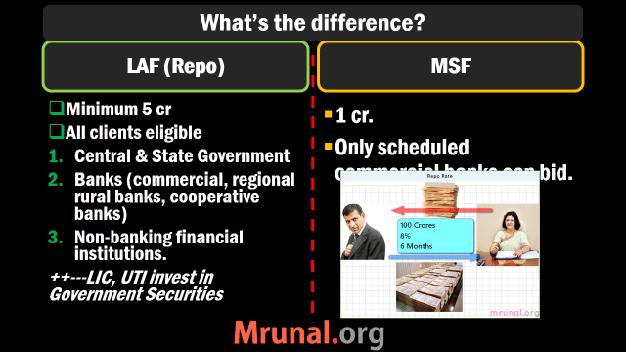

Slide 55
Mock Question (2010)
With reference to Non banking financial companies (NBFCs) in India, Consider following statements
They cannot engage in the acquisition of securities issued by government.
They cannot accept demand deposits like savings account.
Find Correct statement(s)?
Only 1
Only 2
Both 1 and 2
Neither 1 nor 2

Slide 56
Classification

Slide 57
NBFI→NBFC→Classification
Type #1 Regulated by RBI
Asset Finance Company (AFC) | loan to buy economically productive assets e.g. truck, tractor, pumpset, bulldozer, earthmover, etc. 2013: $200mn ECB, automatic window. SREI Equipment Finance (WHITE LABEL ATM)
Infrastructure Finance Company | Gives loan for infra. Projects. (IDFC got separate bank license) Rural Electrification Company (REC) Rajiv Gandhi Gramin Vidhyutikaran (Power Ministry) Rs.3,500 crore through tax-free bonds.
Infrastructure Debt Fund (IDF-NBFC) | Just like above, but they give very long term loans. Can even raise money from abroad.

Slide 58
NBFI→NBFC→RBI controlled
Investment Cos.
Core Investment Cos
Same. They too invest in securities
Investment long term (speculative, aam junta…x)
Accept public funds (NBFC-D.)
Cannot enter in insurance
E.g. Tata Capital, Birla Capital
Invest in securities
Muthoot finance
L&T finance.

Slide 59
NBFI→NBFC→RBI controlled
Loan Company | Muthoot gold loan, Mannapuram Gold LTV.
Factor Company | Factoring business HSBC
Misc. Chit Fund | RBI + Registrar of Chit fund.
Residuary | --

Slide 60
NBFI→NBFC→Classification
RBI regulated
Other than RBI
AFC
Infra. Finance
IDF
Investment Co.
Core investment
Loan Company
Factor Company
Chit Fund, Misc.

Slide 61
NBFI→NBFC→Classification (not regulated)
Insurance companies | Take "premium" from you, invest It in shares/bonds. | LIC, Bajaj Allianz | IRDA
Housing Finance Companies | They arrange money from variety of sources, lend it to home-loan seekers | DHFL, Muthoot Housing finance etc. | NHB
Stock Broker, MF | They help buying-selling of shares (of their clients).Earn commission/brokerage) in between. | Indiabulls Sherkhan Reliance Money | SEBI

Slide 62
NBFI→NBFC→Classification (not regulated RBI)
Investment Banks (US term) | Merger, acquisition, Wealth Management; Merchant Banker: Underwriting | Kotak Mahindra, Citigroup,Bank of America | SEBI
Merchant Banking Companies (UK term) | Underwriting, Corporate advising, They lend money to company via buying its "shares" | DSP Merrill Lynch, Morgan Stanley, Canara Bank, SBI capital (separate license) | SEBI
Venture Capital Fund | They finance start-up companies via equity. | IFCI, IDG | SEBI

Slide 63
NBFI→NBFC→Classification (not regulated RBI)
Nidhi | One type of 'club'. Borrow money from members, lend it among the members. mutual benefit funds | SOUTH MADRAS BENEFIT FUND ltd. | Department of Company affairs
Microfinance companies | Non-Banking Financial Company - Micro Finance Institution (NBFC-MFI) | SKS (Andhra), Cashpor (UP), Ujjivan (Karnataka) | Department of Company affairs
BANDHAN

Slide 64
NBFI→NBFC→MFI
Department of company affairs.
Entry capital 5 cr.
Individual person not given loan above Rs.50000
Focus on poor people, women clients, SHG.
Loan without collateral.
Borrower given flexibility to decide EMI and repayment
Actual interest rate: 26%
SKS (Andhra), Cashpor (UP), Ujjivan (Karnataka), Bandhan (Bengal)

Slide 65
Pending
DURING Economic Survey (Ch.5 FI)
P J Nayak Committee- reforms in public sector bank ownership
Bifurcation of CMD posts in PSB
BASEL norms
Insurance amendment
….
NEXT: Financial market

