Slide 1

Capital Gains Tax
Transfer Pricing Issue
GAAR

Slide 2
Capital Gains Tax
Direct tax
On the profit from sale of capital assets
Shares, Bonds, Gold, Real estate
Rate depends on time frame

Slide 3
Shares, Bonds and MF
Short term
15%
Long term
20%
1 year
Gold, Real estate = 3 years

Slide 4

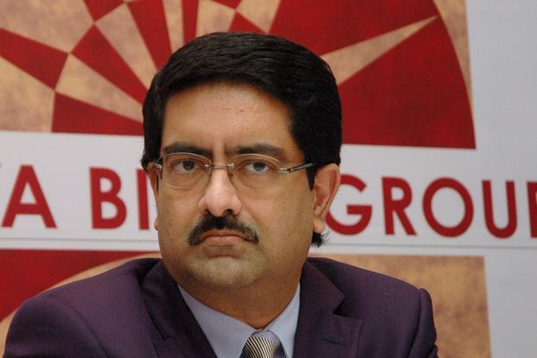

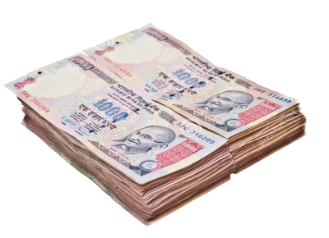
1000 Crore
Kishor Biyani
Future Group
Kumar Manglam
Birla
Pantaloon
Pantaloon
Notes:
TDS at Source; actually Pranab Mukharjee

Slide 5
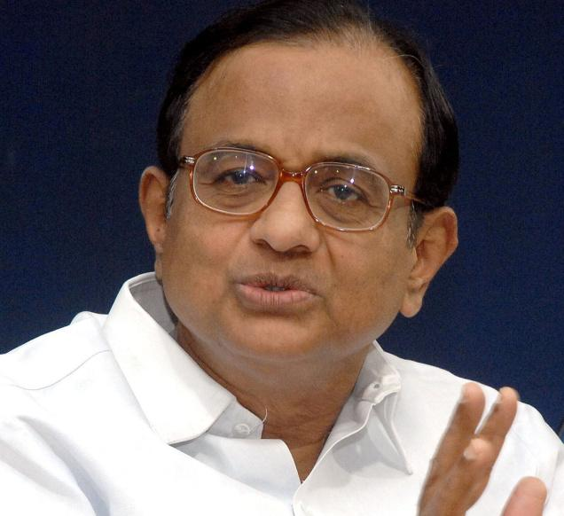
1000 Crore
Birla
Kishor Biyani
Future Group
CAPITAL GAINS TAX (100 cr.)
Pantaloon
Pantaloon
Notes:
TDS at Source; actually Pranab Mukharjee

Slide 6
900 Crore
Birla
Kishor Biyani
Future Group
CGT
100 Crore
Pantaloon
Pantaloon
Notes:
TDS at Source; actually Pranab Mukharjee

Slide 7

900 Crore
Birla
Kishor Biyani
Future Group
CGT
100 Crore
TDS
Withholding TAX
Pantaloon
Notes:
TDS at Source; actually Pranab Mukharjee

Slide 8
What happened in Hutch Deal?

Slide 9
Vodafone PLC, London
Hutchinson HongKong
$ 11 bn
Rs. 55k cr
Vodafone, Netherland
CGP investment Holding, Cayman
Hutch Essar, India
Vodafone India
Feb. 2007
Notes:
Hutch Essar’s 67% stakes held by CGP investment ltd.

Slide 10
Vodafone PLC, London
Hutchinson HongKong
55-12=43
Vodafone, Netherland
CGP investment Holding, Cayman (67%)
12k Crore
Hutch Essar, India
Vodafone Essar India
Mar. 2007
Notes:
TDS at Source; actually Pranab Mukharjee

Slide 11
Vodafone PLC, London
Hutchinson HongKong
$ 11 bn
Rs. 55k cr
Entire Deal outside India
No sale/purchase of Indian company / its shares
Vodafone, Netherland
CGP investment Holding, Cayman
CGP not in any other business
Entire Deal to acquire Hutch-Essar
Hutch Essar, India
Vodafone India
Notes:
TDS at Source; actually Pranab Mukharjee

Slide 12


2010: Bombay HC
Rs.12000 Cr.
CGT
Notes:
Bombay HC says IT Department is right. Vodafone India

Slide 13

2012: Supreme Court
Rs.12000 Cr.
CGT
Notes:
Indian authorities do not have jurisdiction on an overseas transaction.
This offshore transaction evidences participative investment in India and not a sham.
imposing capital punishment for capital investment

Slide 14
IT Act Clarification (2012)
SC – IT Dept. no power / jurisdiction (existing).
Govt. issues Clarification in IT act
Capital gains on companies outside India.
when value derived from Indian Asset
Such companies will be considered located within India.
Will apply to all deals from 1962 onwards
Notes:
Sec 5 and 9
For the removal of doubts, it is hereby clarified that an asset or a capital asset being any share or interest in a company or entity registered or incorporated outside India shall be deemed to be and shall always be deemed to have been situated in India, if the share or interest derives, directly or indirectly, its value substantially from the assets located in India,”

Slide 15
Evasion OR Avoidance?
Evasion
Avoidance
Income / transaction hidden
Black money
Jailtime
Reported, everything on file
But Legal loopholes used to avoid tax
Black money….?
Vodafone CGT

Slide 16
Budget 2012: GAAR
General Anti Avoidance Rules
WEF 1/4/2014
IT commissioner take action against tax avoidance
Indian Citizen, NRI, Foreigner
Even outside India
Even retrospective
Even if protected under any DTAA
Notes:
For more read the GAAR article on site
Parthsarthi shome
Shome (PM)
no penalty/interest in retrospective
only one rare cases
not to raise revenue for the government.

Slide 17
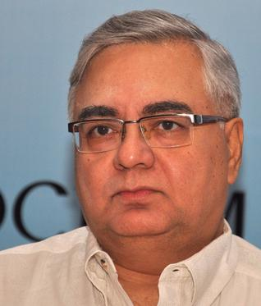
Budget 2012: GAAR
Avoidance
Shome Panel
Only in rare cases
>3 Cr. + tax benefit
Not to fill Revenue shortfalls
Defer till 2016
(2013) Chidambaram=> 1/4/2016
Notes:
For more read the GAAR article on site
Parthsarthi shome
Shome (PM)
no penalty/interest in retrospective
only one rare cases
not to raise revenue for the government.

Slide 18
Arguments: Pro-Government Pro IT-dept

Slide 19
CGT issues like Vodafone
Giant | Bought from | Indian Co.
Sanofi Aventis | French | Shantha biotech
General Electric | Luxemburg | GenPact India.
Aditya Birla, Tata | AT&T | Idea (16%)
Vedanta | Cyprus | Sesa Goa
35,000-40,000 crore tax Avoidance

Slide 20
Pro-Corporate Arguments

Slide 21
CEO
Executives
Staff
Board of Directors
Chairman/MD
IPO
SHARE-HOLDERS
Notes:
Kishor Biyani, Future group, Pantaloon

Slide 22

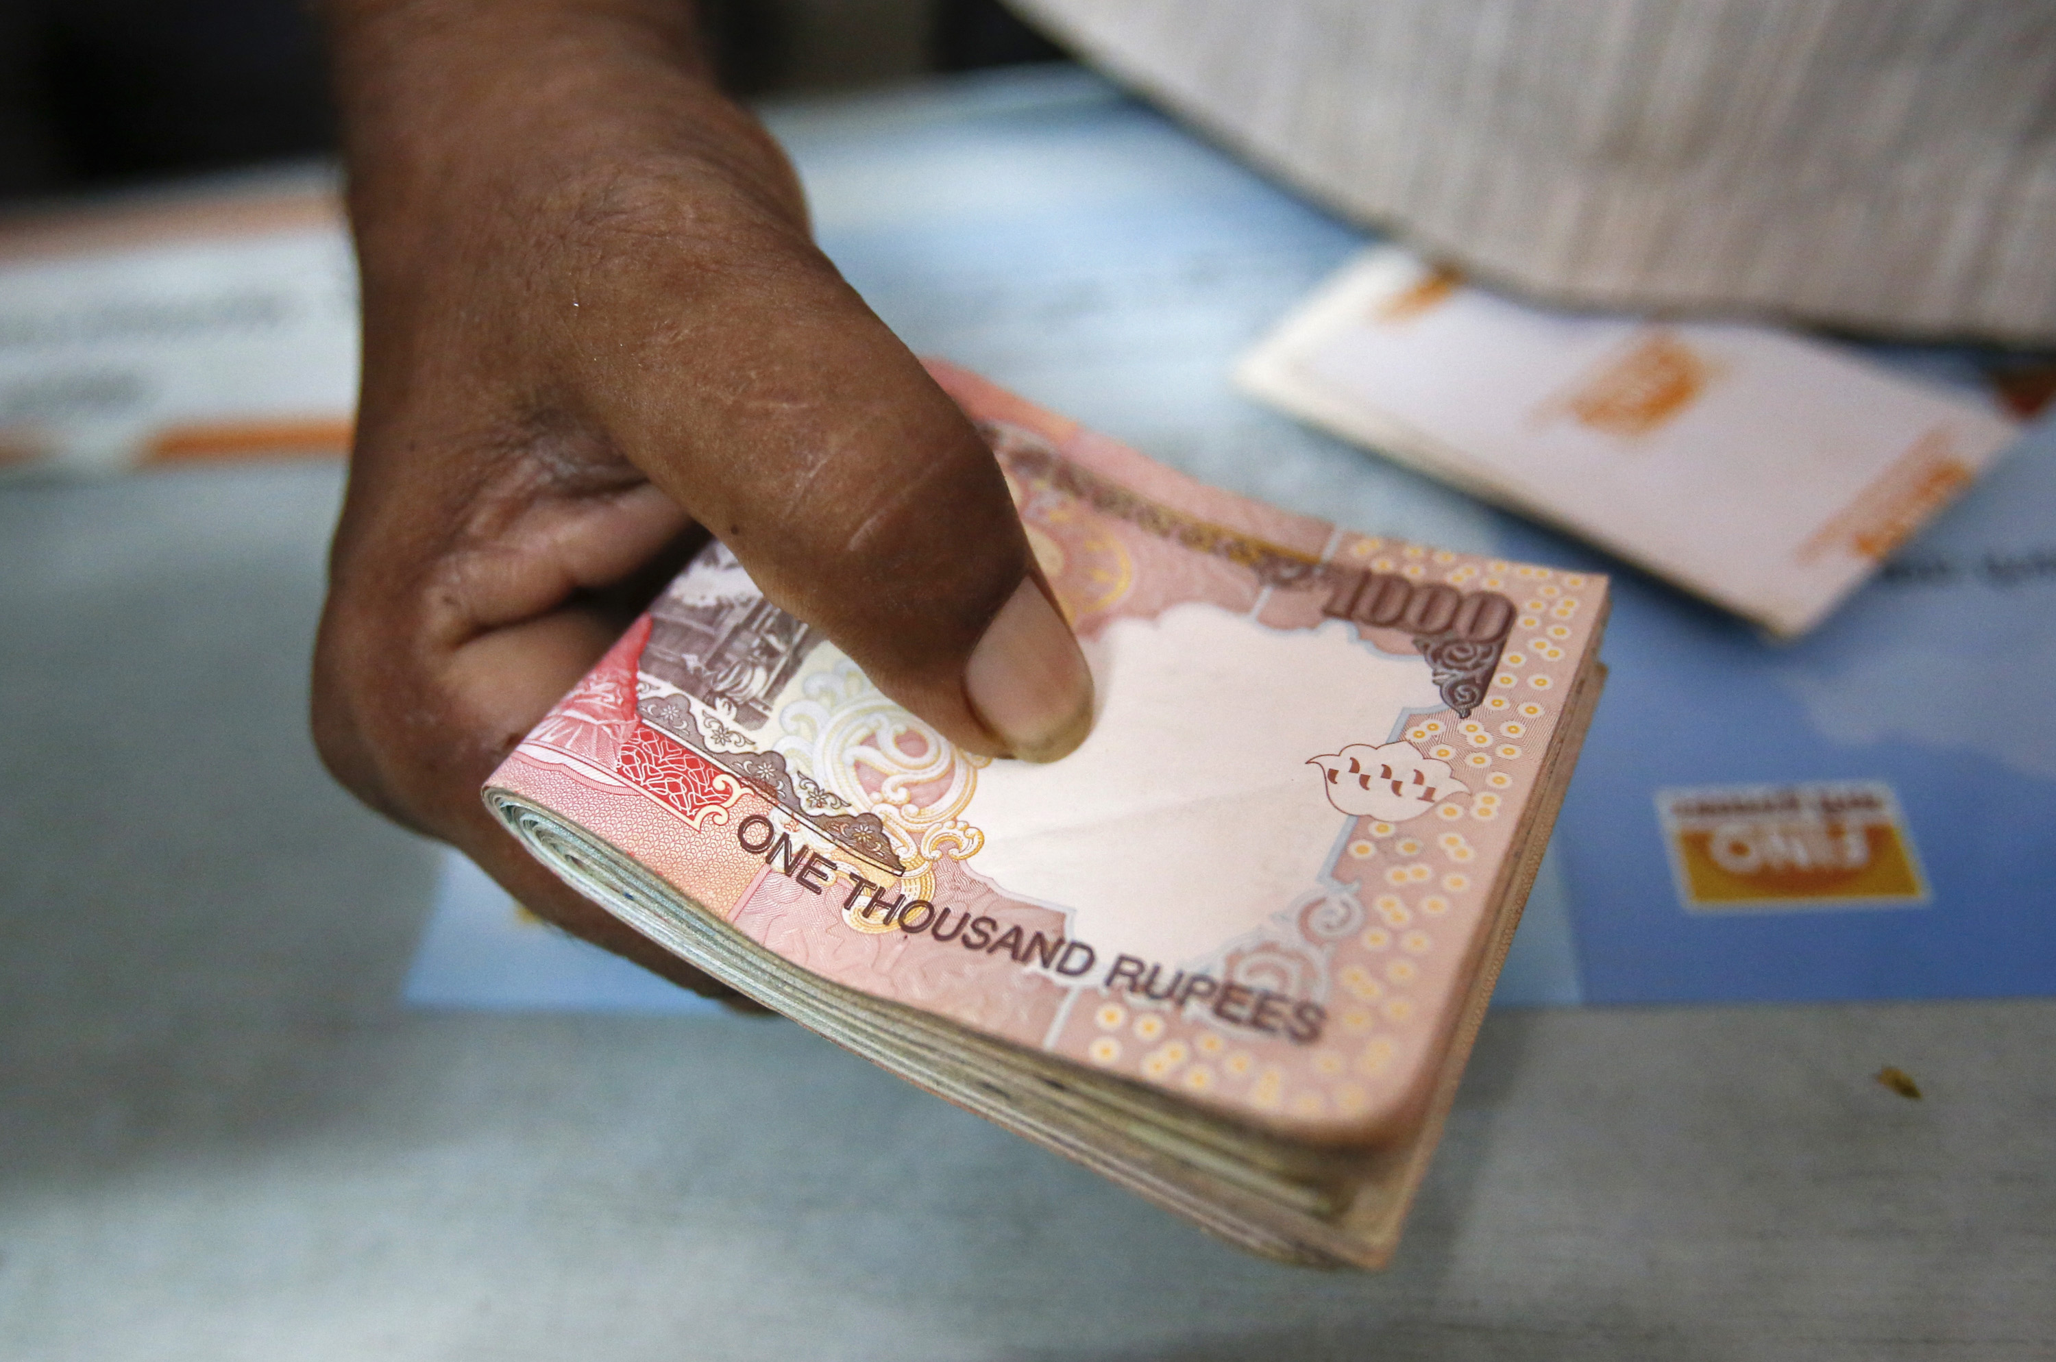
Income Tax (10|20|30%)
CEO
Executives
Staff
Excise Duty 6%
PROFIT
Corporate Tax 33%
VAT 4%
Board of Directors
Managing Director
IT
DIVIDEND
SHARE-HOLDERS
Notes:
Kishor Biyani, Future group, Pantaloon,
Ambani Rs.1 salary
Corporates luchchaa…Xm

Slide 23
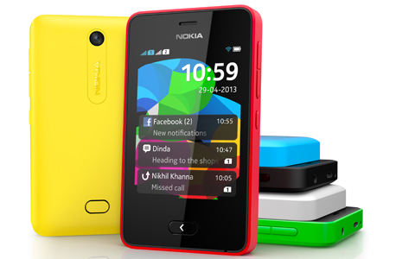
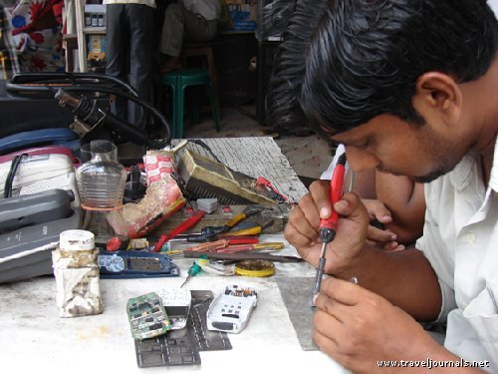
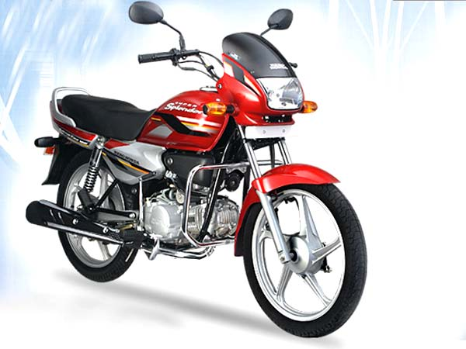

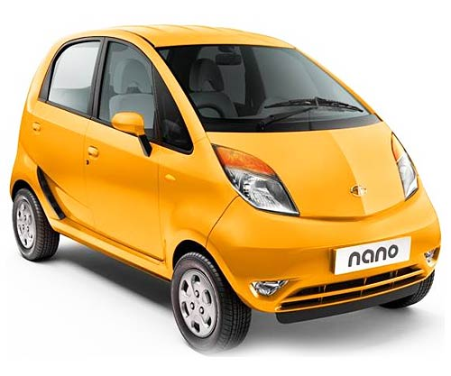
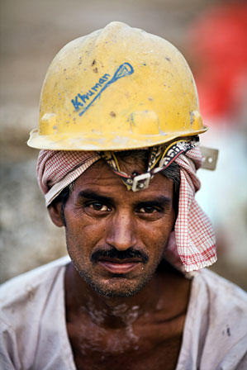

Income Tax (10|20|30%)
CEO
Executives
Staff
Excise Duty 6%
PROFIT
Corporate Tax 33%
VAT 4%
Board of Directors
Managing Director
IT
DIVIDEND
SHARE-HOLDERS
Notes:
Service sector, banking sector, insurance
Dividend-tax paid by Company

Slide 24
Vodafone:
 | Crore Rupees |  | 2013
Revenue | 35000 | 16% | 5600
Profit | 1850 | 33% | 610.5
total |  |  | +6210.5
CGT “LOST” 12,000 Cr.

Slide 25
TRANSFER PRICING (2013-14)

Slide 26
1000 Crore
Birla
Kishor Biyani
Future Group
CAPITAL GAINS TAX (100 cr.)
Pantaloon
Pantaloon
Notes:
TDS at Source; actually Pranab Mukharjee

Slide 27
Kishor Biyani
Future Group
Big Bazaar
Pantaloon
1000 Crore
Notes:
Determination of transfer price becomes imperative
Transfer price to be determined on arms length basis
Transfer pricing therefore refers to the setting of prices (arms length price) for transactions between associated enterprises the transfer of property or services
Share = individual's choice .

Slide 28
Decides the transfer price of shares
Kishor Biyani
Future Group
Big Bazaar
Pantaloon
CGT
100 Crore
900 Crore
Notes:
Honest CGT

Slide 29
Decides transfer price of shares
1000 cr. 100 Cr.
Kishor Biyani
Future Group
Big Bazaar
Pantaloon
CGT
10 Crore
90 Crore
UNDER-VALUATION
Notes:
Real life – undervaluation

Slide 30
Why Transfer?: MNC
Reduce Tax liability (Netherland => Mauritius)
Replace the Chain of command

Slide 31
2007-08
Vodafone PLC, London
Vodafone, Netherland
Vodafone BPO call center
Notes:
75%

Slide 32
Vodafone PLC, London
Vodafone Teleservices India Holding Mauritius.
Vodafone, Netherland
1300 Crore
250 Crore
Vodafone India Services (VISPL)
2009-10
Notes:
VISPL= call centre
“transfer pricing” generally refers to prices of transactions between associated enterprises (AEs). These transactions may take place under conditions differing from those taking place between independent enterprises. According to the Department, the effect of transfer pricing is that the parent company or a specific subsidiary tends to produce insufficient taxable income or excessive loss on a transaction.

Slide 33
Vodafone Teleservices India Holding Mauritius.
Vodafone PLC, London
Vodafone, Netherland
3,200 Cr.
8500 Crore
Vodafone India Services (VISPL)
FY 2013
Notes:
VISPL= call centre
“transfer pricing” generally refers to prices of transactions between associated enterprises (AEs). These transactions may take place under conditions differing from those taking place between independent enterprises. According to the Department, the effect of transfer pricing is that the parent company or a specific subsidiary tends to produce insufficient taxable income or excessive loss on a transaction.

Slide 34
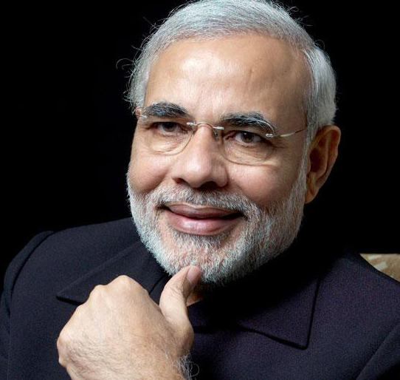
Transfer Pricing Case
Vodafone
October 2014: Bombay HC ruled in favor of Vodafone
Nov. 2014: similar case, Royal Dutch Shell co. wins (18,000 cr.)
January 2015: Modi Government decides NOT to appeal against Vodafone in Supreme court.
Improve investor confidence.

Slide 35
CGT
Transfer Pricing
Bought company from Hutch
Did not pay capital gains tax
SC says matter out of jurisdiction
But Pranab Clarification: tax demand stands
2014: Vodafone sends arbitration notice under Netherland Bilateral investment treaty
Transferred Pune-BPO shares to Mauritius company
Allegedly undervalued the shares
Bombay HC did not find fault.
Modi decides not to pursue further

Slide 36
MCQ- Find incorrect statement
CGT is an example of indirect tax levied during sale of capital assets.
During such transaction, Seller of Capital assets, is required to withhold the tax.
Both A and B
Neither A nor B
1. Skip 2. Attempt 3. Mark n Review

Slide 37
MCQ- Find Incorrect statement
CGT is an example of indirect tax levied during sale of capital assets. (WRONG)
During such transaction, Seller of Capital assets, is required to withhold the tax. (WRONG)
Both A and B
Neither A nor B
1. Skip 2. Attempt 3. Mark n Review

Slide 38
MCQ- Find Correct statement
CGT is an example of indirect tax levied during sale of capital assets. (WRONG)
During such transaction, Seller of Capital assets, is required to withhold the tax. (WRONG)
Both A and B
Neither A nor B
1. Skip 2. Attempt 3. Mark n Review

Slide 39
MCQ- Find Correct statement
State government can levy stamp duty on insurance policies, shares and debentures.
Union government can levy tax on the transfer of shares and debentures.
Both A and B
Neither A nor B
1. Skip 2. Attempt 3. Mark n Review

Slide 40
MCQ- Find Correct statement
State government can levy stamp duty on insurance policies & promissory notes. (Union List I, #91) WRONG
Union government can levy tax on the transfer of shares and debentures. (Union List I, #91) right
Both A and B
Neither A nor B
1. Skip 2. Attempt 3. Mark n Review

Slide 41
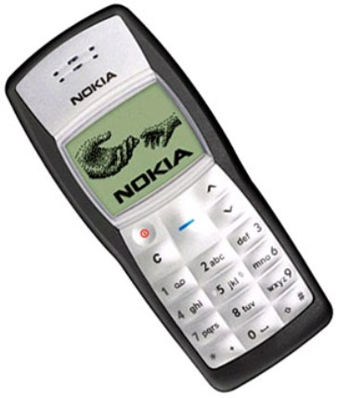

Nokia Tax Row

Slide 42
તકલીફ #૧ Royalty payment

Slide 43

CEO
Executives
Staff
PROFIT
Board of Directors
Managing Director
DIVIDEND
SHARE-HOLDERS
Notes:
Dividend has to be distributed acc. To shareholding
How can Biyani make more than his share holding? Ans. Royalties!

Slide 44
Pantaloons
Royalties
Dividend
Design Patents
Dividend
Future Group

Slide 45
Quantitative restriction on royalties
Indian Company=> Foreign Parent
Maximum 8% royalty

Slide 46
Tax on Royalty
if India has DTAA with that country (e.g Finland) | 10%
If India doesn’t have DTAA with that country | 25%

Slide 47
software
100 Cr. Royalties
Nokia
Finland
10 Cr.
Royalties Tax
India
(100% owned)
Notes:
Finland owns 100% of Nokia India, it’s a private ltd. company

Slide 48
90 Cr. Royalties
Nokia
Finland
10 Cr. tax
(on Royalties)
India
TDS
Withholding Tax
Indo-Finland DTAA

Slide 49
Rs.25,000 Cr
royalties
Nokia
Finland
Rs.6000 Cr. (Penalty, Interest)
India
Rs.2500 Cr.
2006-2013
Notes:
Royalties tax not given
Seven years

Slide 50
Timeline 2013
Jan 2013: IT raids Sriperumbudur (Tamil Nadu) plant and offices in Chennai.
Feb: Nokia’s bank accounts ceased
April 2013: Delhi HC unfreeze

Slide 51
Nokia
Arguments
India-Finland DTAA: TDS on Royalties …yes
but “Computer software” not in definition
Computer software = “RAW Material”

Slide 52
Income Tax Department
Argument
Microsoft 8 billion USD
But did not explain liability
Quick action to prevent escape

Slide 53
Current Strategy
Nokia
Chennai plant = Rs.2500 Cr
Tax =6000+ cr.
Case can go on.
Not part of Microsoft deal.
Continue production on contract : Stopped in 2014, November.
VRS + skill training offered to 7k staff
Case Defeat=> Attach factory.

Slide 54
Nokia Tax Row

Slide 55
Royalties Tax
Corporate Tax
Sriperumbudur
SEZ
Export duty 1%
Excise duty 0%
Domestic
4% VAT
Export proof not given
2009-12
Notes:
absence of proof about export of huge no. of handsets during three assessment years between 2009 and 2012

Slide 56
After thoughts
Fiscal imperialism
DTAA models
Avoidance until when?

Slide 57
Post WW1, League of nations
British Company
UK Authorities
Dividend
Royalty Payment
Interest Payment
Residual Profit
Source country..x
Indian subsidiary
Indian Authorities
Notes:
Always silent
Since ww1
Same situation in all other countries and cases, shell India vs Usa

Slide 58
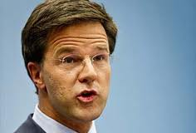
Tax agreement @Source Model
Vodafone PLC, London
Vodafone, Netherland
Vodafone India
90 Cr. Payment
10 Cr. tax
Notes:
Developed countries and MNCs don’t like it.

Slide 59
Tax agreement @Destination Model OECD
Vodafone PLC, London
90 Cr. tax
Vodafone, Netherland
Vodafone India
10 Cr. tax
Fiscal imperialism
Notes:
Developing countries don’t like it
Fiscal imperialism: money drained from colony to king

Slide 60





Foreign Parents
Intermediate Holding Company
Dividend
Capital Gain
Costa Rica
BVI
Supply Chain Transaction
Developing Countries
Cayman
Bermuda
Interest transfer payments
Luxembourg
Lease transfer payments
TAX HAVEN
Royalty transfer payments

Slide 61
After thoughts
DTAA: Legal, technical, definition loopholes will remain
Will continue until India becomes a developed country.

Slide 62
Vodafone tax issues
Nokia Tax issues
NEXT: BoP, CAD, Cap.Account convertability

