Slide 1
ECB QE

Slide 2
Why?
Low level of Inflation
Cheap Crude oil => further decline in inflation
-0.2% inflation (EU, Dec-2014)
result: purchased delayed, less demand, less biz. expansion=> recession

Slide 3
Monetary Policy
Need for backup
Quant. Tool | Inflation fight Tight/Dear | Deflation fight Easy/Cheap
CRR, SLR | Increase | Decrease
OMO | Sell | Buy
Policy RATE | Increase | Decrease
Solution
But already ~0%

Slide 4
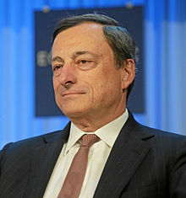



ECB Chairman
Mario Draghi
£60 billion/ month (from March)
£10: private bonds
£50: State bonds
(BBB- or above)
Till Sep 2016 (or CPI ▲)
£ 1.1 trillion injected
Notes:
In March, the ECB and national central banks of euro zone member states will start buying 60 billion euros of chiefly government debt each month. That figure includes rebundled private debt, asset-backed securities and covered bonds, typically worth about 10 billion euros, on top of the roughly 50 billion euros in state bonds. The plan is to buy until September 2016 or until there has been a "sustained" improvement in consumer price inflation, which recently turned negative. The programme could end earlier if successful, or be extended if its impact is small.
http://www.smh.com.au/business/markets/qe-explained-how-the-ecbs-quantitative-easing-plan-will-work-20150123-12wdji.html

Slide 5
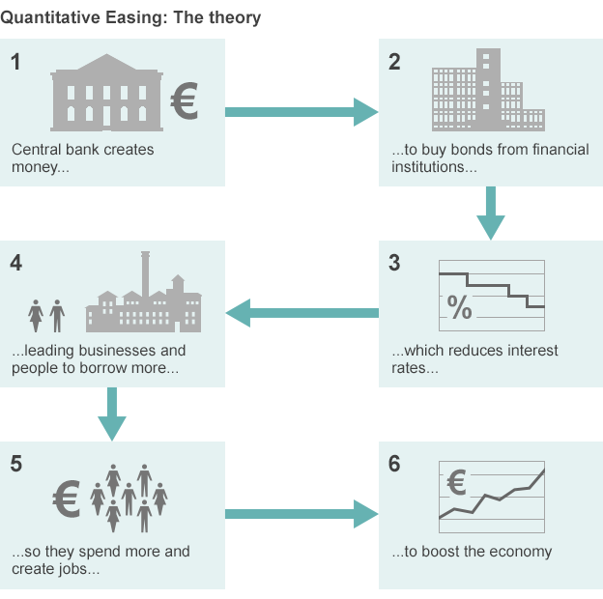
BBC chart
QE
Notes:
http://www.bbc.com/news/business-30933515

Slide 6
Good
ECB-QE
Japan, USA, England now QE / Eurozone Bond purchase (2015, March)
Increased money supply
Cheaper loan products: more cars and homes sold
Euro gets weaker than $: European Export ▲
Demand ▲: Deflation…..x

Slide 7
Good
ECB-QE
Bond purchase ▲
Bond price ▲: Bond yield ▼
8/80=10% => 8/100=8%
To earn same return, you’ve to purchase more quantity of debt.
Pension / insurance cos. sell-off G-Sec, focus on private bonds=> companies get new capital / finance
Business expansion, jobs, GDP Better (says The-Economist)
Notes:
http://www.economist.com/blogs/buttonwood/2015/01/ecb-and-qe

Slide 8
BAD
ECB-QE
Germans don’t like it: printing more money => hyperinflation as in Pre-WW2
Notes:
11th hour convinenced

Slide 9
ECB: Quantitative Easing / Bond Purchase
Good for India
Bad for India
More foreign capital incoming
Weaker euro => cheaper European imports
More demand in EU=> export boost
Stronger Rupee=> Agriculture, textile, pharma exports will decline
More money: Inflation
“tapering” => sudden weakening of Rupee (2013: 50=>68)
Hot money

Slide 10
When ECB Tapering starts
mechanical term= Continuous reduction of width.

Slide 11
BAD4India?
ECB Taper
Taper – hint that EU recovering
FIIs pull out money from Indian market =“HOT Money”.
Rupee gets weaker compared to major currencies
While good for exports but bad for imports
Rajan: 1st world’s low-interest rate policies are unleashing financial turmoil on emerging-market economies

Slide 12
Greece Anti-Austerity Measures

Slide 13
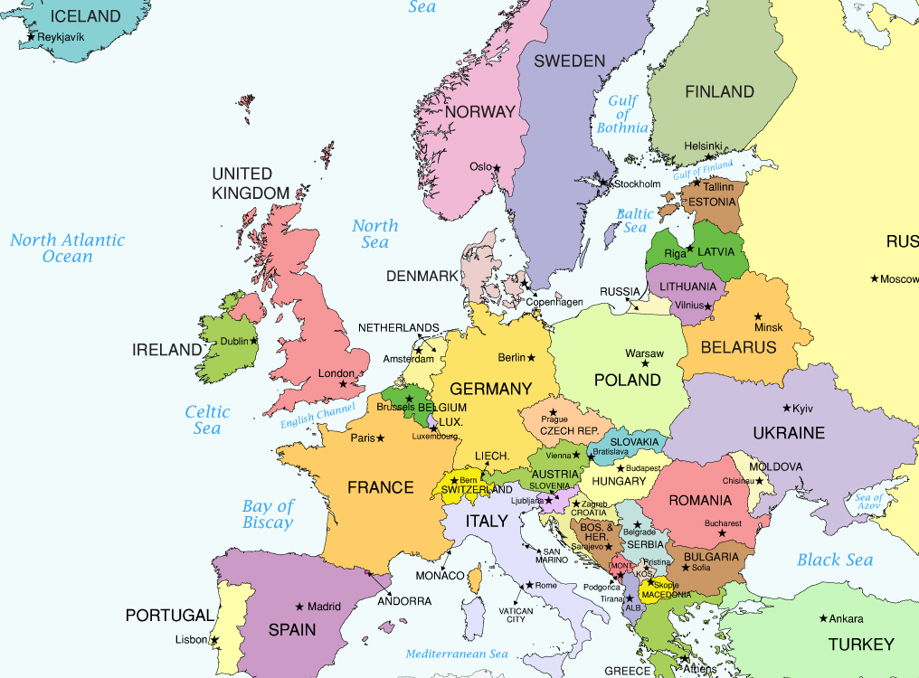
Greece
Athens

Slide 14

What’s their problem?
Greece
Excessive public welfare
Loss making PSUs not shut down to please the labour unions
Government borrowed from European banks
Mass tax evasion
Subprime crisis=> exports down, revenue down
Unable to repay loans=> “Sovereign debt crisis”

Slide 15
Why ECB not helping?
Greece
ECB will not buy Greece-bonds for 1st 6 months of 2015
(BBB-) rating….nope, yours are junk bonds
Promises not filled for even bailout money
Need Greece to follow “Austerity”

Slide 16
Austerity?
Greece
fiscal deficit ▼
Welfare schemes ▼
Shut down / privatize PSUs.
Tax rates ▲
Give progress on previous bailout money (earlier also “pledged” reforms.)
Greek Leftist party “Syriza”, leader Alexis Tsipras: “Anti-austerity”
Greece May walk out of Eurozone (Drachma currency)

Slide 17
If they leave Eurozone
Greece
Euro => Drachma
It’ll be greatly weak than other foreign currency
Exports…. ▲
Import expensive, heavy inflation
but boost domestic production for “Self-reliance” [May be?!]
How will EU powers recover loan money?

Slide 18
What Greece wants?
Include our bonds in QE program
Write off our previous debt. (no more interest /prinpal re-payment)
Give additional “Bailout” money=> public spending => create jobs => demand boost => GDP improves.

