Slide 1

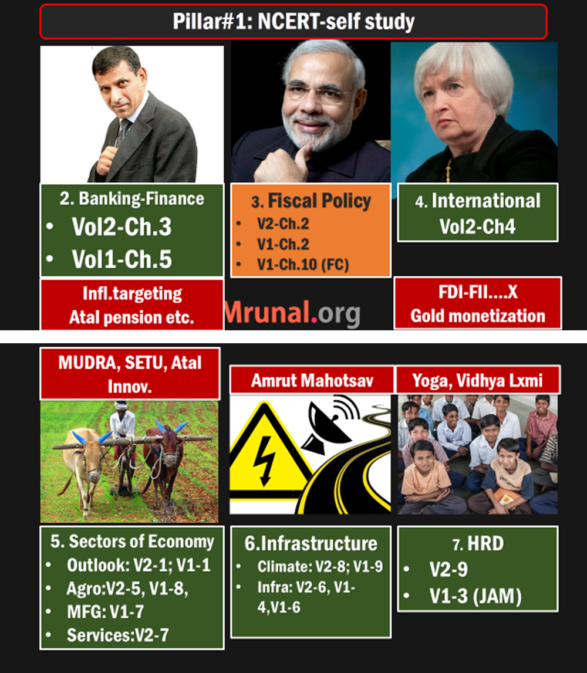
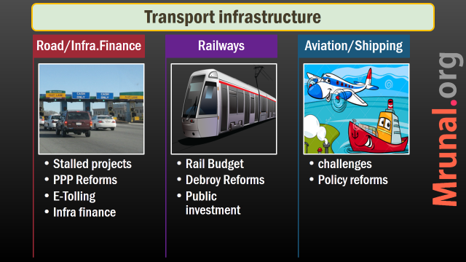
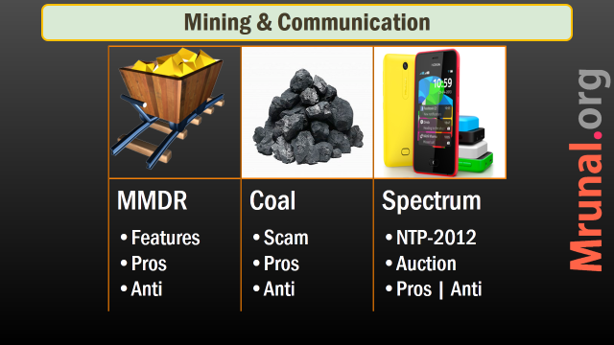

Slide 2
Mining & Communication
MMDR
Coal
Spectrum
Features
Pros
Anti
Scam
Pros
Anti
NTP-2012
Auction
Pros | Anti

Slide 3
Energy
Article link: Coal types, CBM, Basin centered gas, Syngas, NELP auction
Article link: Gas pricing, production/revenue sharing

Slide 4

India Yearbook 2015
Ball by ball
Ch.19: Industries
Page 551 onwards Mineral wealth distribution, PSUs involved
Ch.11: energy- overview of schemes, PSUs involved. UMPP location-features.

Slide 5
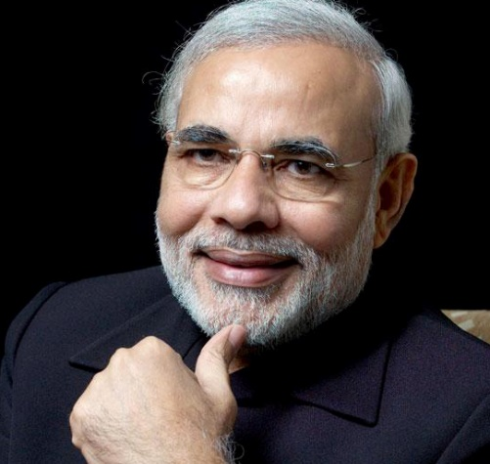

Union
states
Entry 54 in List 1
Major minerals
Entry 23 in List 2
Minor minerals

Slide 6
Union
states
Coal, manganese ore, iron ore, bauxite, limestone, kyanite, sillimanite, barites, chromite, silica sand, fluorite, quartz, sand etc
Building stones, gravel, ordinary clay, ordinary sand, limestone used for lime burning, boulders, kankar, murum, brick earth, bentonite, road metal, slate, marble, stones used for making household utensils etc

Slide 7

Mines Bill
Why?
Mines and Minerals (Development & Regulation) Act 1957
Justice Shah report on illegal mining
Many mines closed down / suspended
MMDR Bill 2015. Lok Sabha, Rajya Sabha passed in 2015,March.

Slide 8
Union
states
Decide auction procedure and technicalities
Can reserve selected mines for end users / PSUs
States to grant all leases / licenses
E-auction via competitive bidding
Winner can transfer license to another, with state’s permission

Slide 9
3rd category of license
Prospecting
Mining
Prospecting cum mining
Ease of doing Biz.
Single License

Slide 10

Time period
before
30 year
=Total 50
After
50 @ once
Renew past 20
Not for coal/nuke.
Then auction

Slide 11

Mining Area
before
Max. 10sqkm area per person
After
Union can increase lease area.
Bigger area need another license

Slide 12


Two Organizations
NMET
DMF
District mineral foundation
Solve junta’s complaints
National mineral exploration trust
Addl. Levy= 2% royalty
Addl. Levy=33% Royalty
State to frame rules

Slide 13
Benefits of MMDR Bill 2015
Transparency
E-auction = no foul play
public interest
District mineral foundation
PESA, FRA safeguarded
Ease of doing
50 years, larger area
1 license= Prospecting +Mining

Slide 14
Benefits of MMDR Bill 2015
More exploration
Less import = less trade deficit = less CAD.
Cooperative federalism
states to give all licenses, except coal / lignite
Illegal mining Curbed
Special courts for speedy trials. States too can setup
Jail: 5 years, Fine: 5 lakh/ ha.

Slide 15

MMDR 2015
Criticism
TRAI like independent regulator…X
Mechanism for dispute settlement between union and states….X
No limits on mining = Environment degradation
States given more powers: uniform policies….x, regime change policy change…YES

Slide 16
MMDR 2015
Criticism
Unlike 2011 bill
Gram sabha permission not necessary even in 5th, 6th sch. areas
Tribal cooperatives in 5th & 6th sch. Not given mining rights.
DMF= 100% of royalties. No, only 33%.
Coal companies have to give 26%.

Slide 17
Mining & Communication
MMDR
Coal
Spectrum
Features
Pros
Anti
Scam
Pros
Anti
NTP-2012
Auction
Pros | Anti

Slide 18
Who can make law?
coal
7th Sch, Union list Entry 54: mines and mineral Development
Mines and Mineral (Development and Regulation) Act, 1957…coal and lignite kept outside.
Coal Mines (Nationalization) Act, 1973

Slide 19
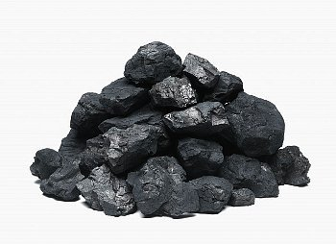
Scam HOW?
Coal
1973: private coal mining not allowed.
1993: private mining allowed for captive use- steel, cement, power etc.
Screening Committee with members of coal-rail-power ministries, state Governments.
No price discovery mechanism, procedural lapses, non-transparency, favoritism

Slide 20
Scam HOW?
Coal
Mines given to Kith and kin of ministers/MP
Cos. Without XP of iron, steel, power. They did not mine, sold rights to third parties @windfall gains.

Slide 21
Scam HOW?
Coal
2012: CAG reports losses 1.86 lakh crores. PIL filed.
2014, Sept: SC cancelled 204 /218 blocks.
Coal ordinance to continue production
Coal Mines special provision Bill 2015: for transparent auction post-SC verdict. Passed in LS.

Slide 22
Coal Mines (Special Provisions) Bill, 2015
I (Auc.+Allot)
204 Cancelled Blocks
II (Auction)
42/204
III (Auction)
32/204
End Use: Power, Steel, Cement.
Mining Infra.
Work Was About To Start
Nearly Operational
Union can classify mines from “I” to “III”
Allotment- only power
Permitted to consume /sale
Only specific end users

Slide 23
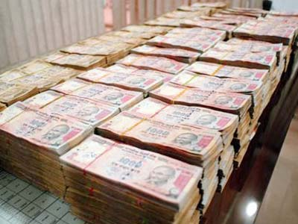
Auction
Coal bill
Jt. Secretary level officer to oversee auction, & transfer amt. to respective states.
Public, private and JV can bid
Previous owners can bid, IF Not convicted in coal scam. But have to pay addl. Levy.
Fees: 5 crore
Electronic auction
To be finished by 31st March 2015, as per SC order.

Slide 24

Compensation
Coal Bill
Previous owner to get compensation on
Land : land value + 12% simple interest. (date purchased till the date, land allotted to new person)
Mining infra: compensation as per previous financial year.

Slide 25

Rounds 2015
Auction
1st: feb
2nd: March
3rd: April
1+2 = Over 2 lakh crore revenue

Slide 26
Auction money
coal
state | Crores
Chhattisgarh | 67563
Jharkhand | 48972
Madhya Pradesh | 42689
Orissa | 33467
West Bengal | 13211
Maharashtra | 2727

Slide 27
Major coal blocks
State | Major coal blocks
Chhattisgarh | Parsa East , Kanta Basan ,Parsa, Gare Pelma, Sector I Gare Palma Sector II Gare-Pelma Sector-III, Talaipali, Gidhmuri & Paturia,Gare Palma IV-5 Gere Palma IV-4 Gare Palma IV-7
Jharkhand | Kathautia, Tokisud North ,Pachwara Central, Pachwara North ,Chatti Bariatu, Chhati-bariatu (South) Kerandari , Badam Sitanala Banhardih Rajbar E & D Saharpur Jamarpani
Maharastra | Baranj - I , Baranj-II, BaranjIII, Baranj-IV, Kiloni, Manoradeep ,Belgaum
West Bengal | Trans Damodar, Ardhagram,Barjora (North) Khagra Joydev Tara (West), Tara (East) Gangaramchak, GangaramchakBhadulia Barjora Kasta (East)
Orissa | Talabira-I,Dulanga Manoharpur, Dipside Manoharpur Mahanadi, Machhakata Chendipada, Chendipada-II Naini
Madhya Pradesh | Mara 2 Mahan, Sial Ghoghri, Mandla North ,Amelia ,North Bicharpur
Telangana | Tadicherla-1

Slide 28
Coal Auction: Pros and cos
Union
State
Companies
Consumers
Environment

Slide 29
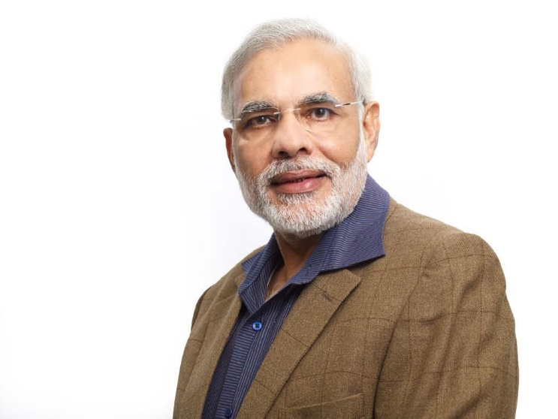
union
Coal auction
Power PSUs to get sufficient coal, through allotment from cat.1
Help in make in India.
Union got more powers to develop cat.1 mines in public interest.

Slide 30

States
Coal auction
Competitive e-bidding=> higher royalties in absolute terms.
Fiscal deficit controlled
State PSUs and electricity companies get enough coal.

Slide 31
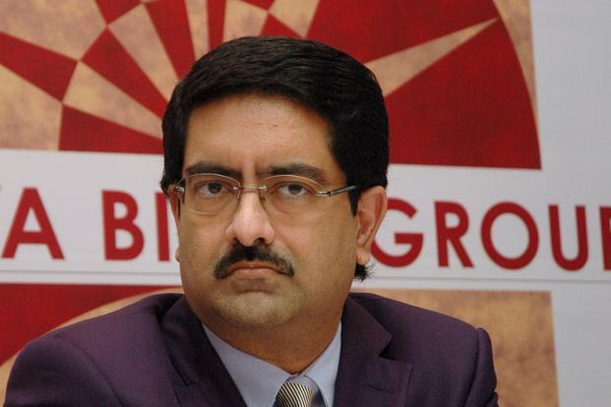
Companies
Coal auction
Transparent
No more suitcase raj of Committee system
Compensation to previous owner for (1) land (2) Mining infra.
Previous owner can participate in auction by paying addl. levy

Slide 32
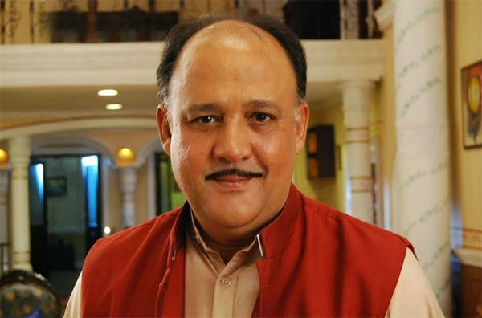
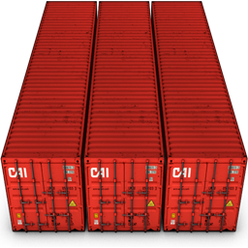
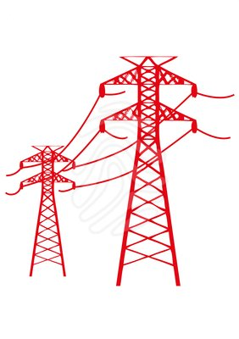
Iron, steel, cement (captive)
Electricity /power
Forward bidding
Highest bidder to get the mining rights
costs passed to consumers.
Counter: Higher coal supply = higher producn. =trickle own
Reverse bidding
@How much will you sell the electricity for? =Lowest bidder to win.
Customer to get cheap electricity.

Slide 33
power
Criticism
Power- Lowest bidder. What if bogus quality coal / shortage due to cyclone, labour unrest?
What if he has to import/procure coal from another company?
Will he be allowed to sell electricity @higher price?

Slide 34

bidding
Criticism
2 stages
(1) Technical bid (2) financial bid
Top 50% selected, to bid further.
No independent body to decide technical eligibility.
2G scam possible all over again i.e. buy mines only for purpose of selling @higher price

Slide 35

Environment
Criticism
Environment issues ignored
Land acquisition bill pending
Coal Selling allowed in sch1 mines= “De-nationalization” of coal mining = not in public interest.

Slide 36
Spectrum,Urban infra.Smart cities, REITS etc. Later

